Slide 1
Finding coefficients and the constant term
Mathematics Extension 1 – Stage 6 (Year 11)
The binomial theorem

Slide 2
Learning intentions and success criteria
Learning intentions
To be able to apply the binomial theorem to identify and interpret terms in an expansion.
Success criteria
I can expand binomial expressions to find the constant term.
I can calculate the constant term in a binomial expansion using the general term.
I can determine the coefficient of a term with a specific power within a binomial expansion.
Notes:
Notes for teachers:
Learning intentions and success criteria are best co-constructed with students. Adapt the learning intention as required and add matching success criteria.
For more information See ⁠AITSL or the NSW Department of Education explicit teaching strategies, ⁠Sharing learning intentions and ⁠Sharing success criteria
LISC is not necessarily presented at the beginning of the lesson. Teacher needs to consider most effectual time to introduce
LISC should be revisited during the lesson to support students' evaluation of their learning

Slide 3
Activating prior knowledge

Slide 4

Expanding binomials (1)
$${\left(x^{3}+1\right)}^{4} \\ =\left(\begin{matrix}4 \\ 0\end{matrix}\right){\left(x^{3}\right)}^{4}+\left(\begin{matrix}4 \\ 1\end{matrix}\right){\left(x^{3}\right)}^{3}\left(1\right)+\left(\begin{matrix}4 \\ 2\end{matrix}\right){\left(x^{3}\right)}^{2}{\left(1\right)}^{2}+\left(\begin{matrix}4 \\ 3\end{matrix}\right)\left(x^{3}\right){\left(1\right)}^{3}+\left(\begin{matrix}4 \\ 4\end{matrix}\right){\left(1\right)}^{4} \\ =x^{12}+4x^{9}+6x^{6}+4x^{3}+1$$
$${\left(x^{3}+x\right)}^{4} \\ =\left(\begin{matrix}4 \\ 0\end{matrix}\right){\left(x^{3}\right)}^{4}+\left(\begin{matrix}4 \\ 1\end{matrix}\right){\left(x^{3}\right)}^{3}\left(x\right)+\left(\begin{matrix}4 \\ 2\end{matrix}\right){\left(x^{3}\right)}^{2}{\left(x\right)}^{2}+\left(\begin{matrix}4 \\ 3\end{matrix}\right)\left(x^{3}\right){\left(x\right)}^{3}+\left(\begin{matrix}4 \\ 4\end{matrix}\right){\left(x\right)}^{4} \\ =x^{12}+4x^{10}+6x^{8}+4x^{6}+x^{4}$$

Slide 5
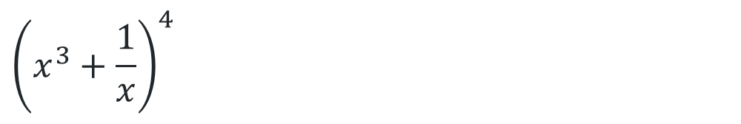
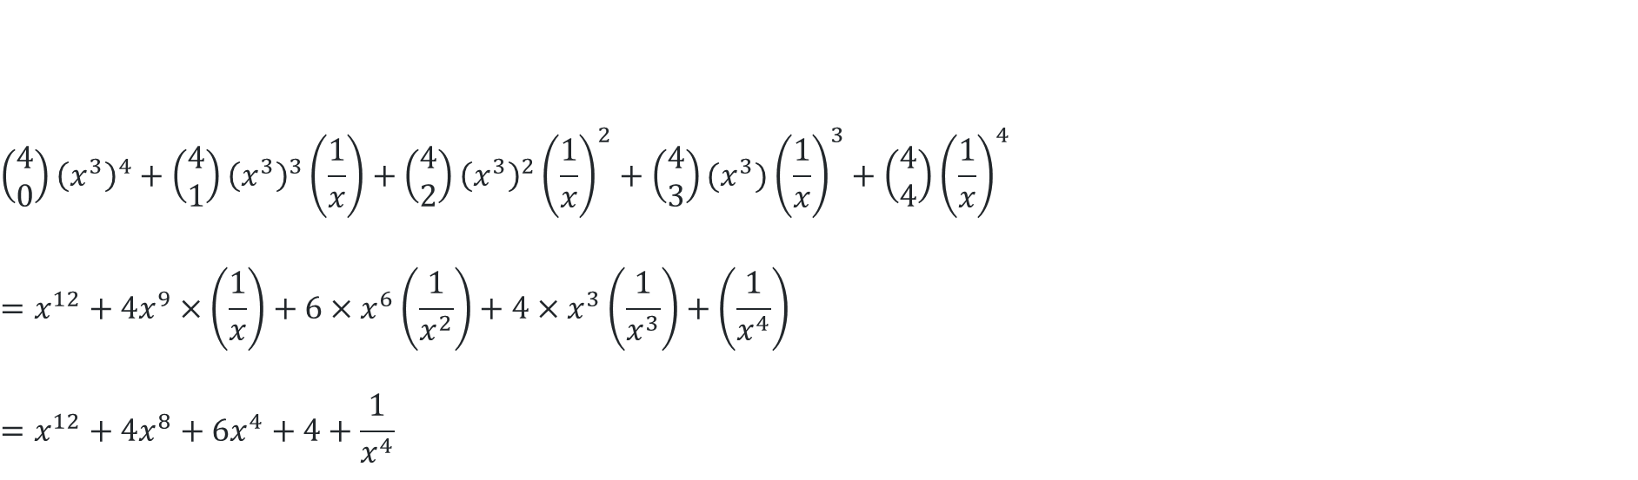
Expanding binomials (2)
$${\left(x^{3}+\frac{1}{x}\right)}^{4}$$
$$\left(\begin{matrix}4 \\ 0\end{matrix}\right){\left(x^{3}\right)}^{4}+\left(\begin{matrix}4 \\ 1\end{matrix}\right){\left(x^{3}\right)}^{3}\left(\frac{1}{x}\right)+\left(\begin{matrix}4 \\ 2\end{matrix}\right){\left(x^{3}\right)}^{2}{\left(\frac{1}{x}\right)}^{2}+\left(\begin{matrix}4 \\ 3\end{matrix}\right)(x^{3}){\left(\frac{1}{x}\right)}^{3}+\left(\begin{matrix}4 \\ 4\end{matrix}\right){\left(\frac{1}{x}\right)}^{4} \\ =x^{12}+4x^{9}×\left(\frac{1}{x}\right)+6×x^{6}\left(\frac{1}{x^{2}}\right)+4×x^{3}\left(\frac{1}{x^{3}}\right)+\left(\frac{1}{x^{4}}\right) \\ =x^{12}+4x^{8}+6x^{4}+4+\frac{1}{x^{4}}$$

Slide 6
Connecting learning

Slide 7
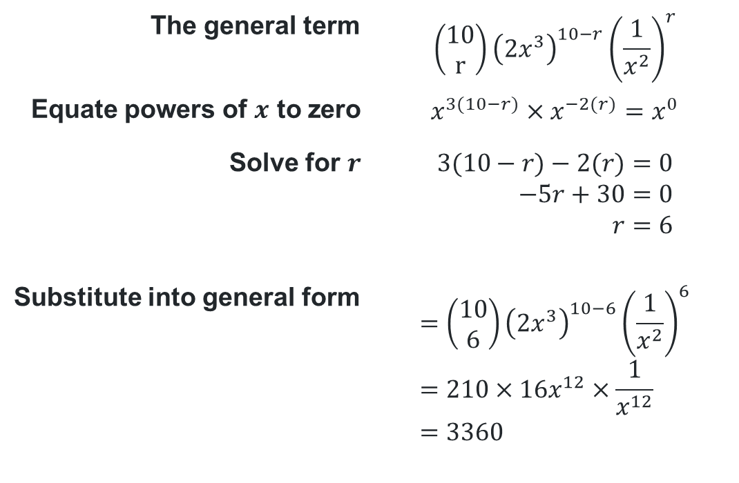
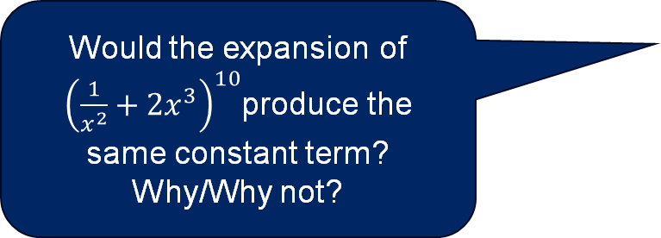
Finding the constant term using index notation (1)
Worked example 1
Find the constant term in the expansion of ${\left(2x^{3}+\frac{1}{x^{2}}\right)}^{10}$
Would the expansion of ${\left(\frac{1}{x^{2}}+2x^{3}\right)}^{10}$produce the same constant term? Why/Why not?
The general term | $$\left(\begin{matrix}10 \\ r\end{matrix}\right){\left(2x^{3}\right)}^{10−r}{\left(\frac{1}{x^{2}}\right)}^{r}$$
Equate powers of $x$ to zero | $$x^{3(10−r)}×x^{−2(r)}=x^{0}$$
Solve for $r$ | $$3(10−r)−2(r)=0 \\ −5r+30=0 \\ r=6$$
Substitute into general form | $$=\left(\begin{matrix}10 \\ 6\end{matrix}\right){\left(2x^{3}\right)}^{10−6}{\left(\frac{1}{x^{2}}\right)}^{6} \\ =210×16x^{12}×\frac{1}{x^{12}} \\ =3360$$
How would you explain where each index originated?

Slide 8
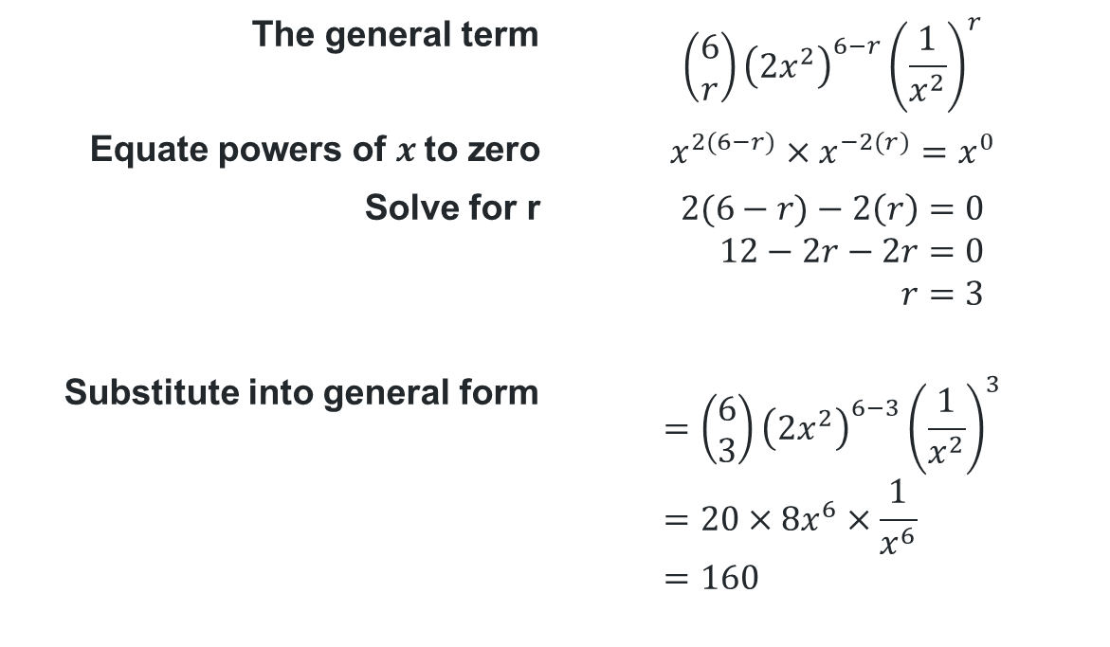
Finding the constant term using index notation (2)
Your turn – question 1
Find the constant term in the expression ${\left(2x^{2}+\frac{1}{x^{2}}\right)}^{6}$
The general term | $$\left(\begin{matrix}6 \\ r\end{matrix}\right){\left(2x^{2}\right)}^{6−r}{\left(\frac{1}{x^{2}}\right)}^{r}$$
Equate powers of $x$to zero | $$x^{2(6−r)}×x^{−2(r)}=x^{0}$$
Solve for r | $$2(6−r)−2\left(r\right)=0 \\ 12−2r−2r=0 \\ r=3$$
Substitute into general form | $$=\left(\begin{matrix}6 \\ 3\end{matrix}\right){\left(2x^{2}\right)}^{6−3}{\left(\frac{1}{x^{2}}\right)}^{3} \\ =20×8x^{6}×\frac{1}{x^{6}} \\ =160$$

Slide 9
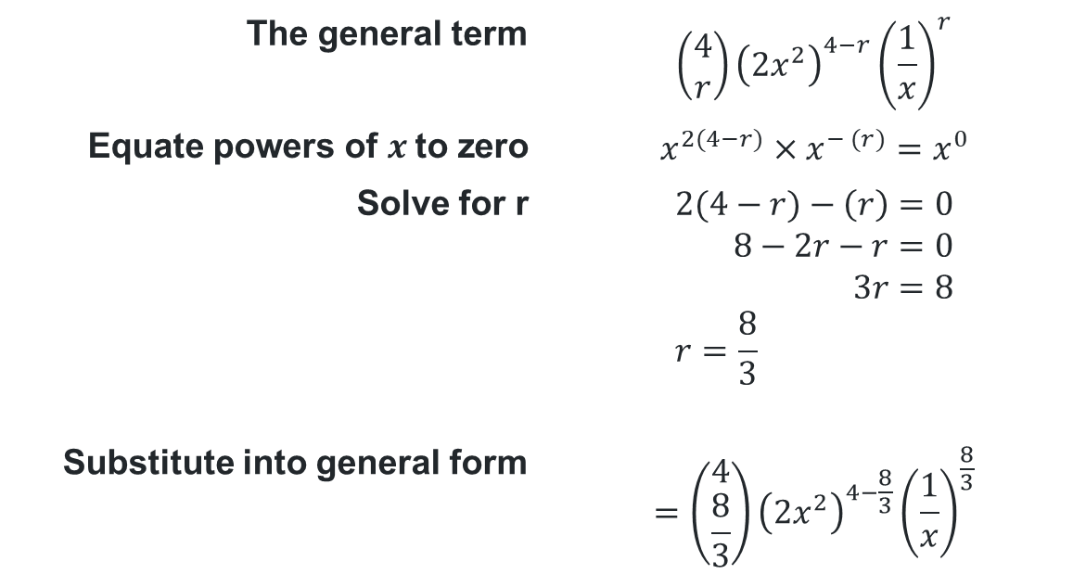
Non example
What does r represent?
Find the constant term in the expression ${\left(2x^{2}+\frac{1}{x}\right)}^{4}$
The general term | $$\left(\begin{matrix}4 \\ r\end{matrix}\right){\left(2x^{2}\right)}^{4−r}{\left(\frac{1}{x}\right)}^{r}$$
Equate powers of $x$to zero | $$x^{2(4−r)}×x^{− (r)}=x^{0}$$
Solve for r | $$2(4−r)−\left(r\right)=0 \\ 8−2r−r=0 \\ 3r=8 \\ r=\frac{8}{3}$$
Substitute into general form | $$=\left(\begin{matrix}4 \\ \frac{8}{3}\end{matrix}\right){\left(2x^{2}\right)}^{4−\frac{8}{3}}{\left(\frac{1}{x}\right)}^{\frac{8}{3}}$$
Why is this a problem?

Slide 10
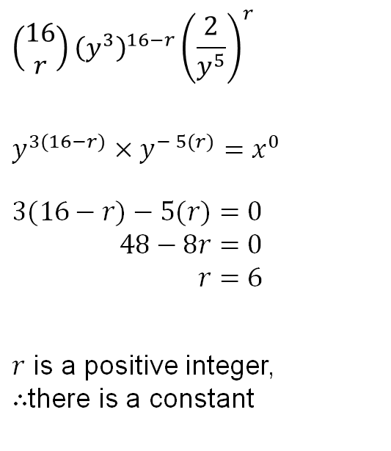
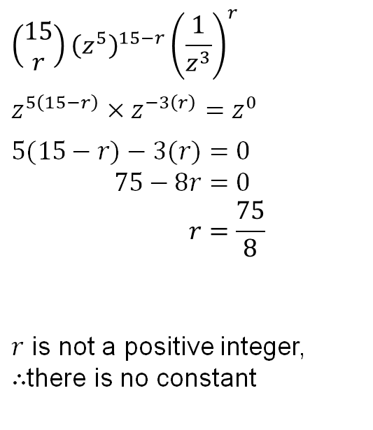
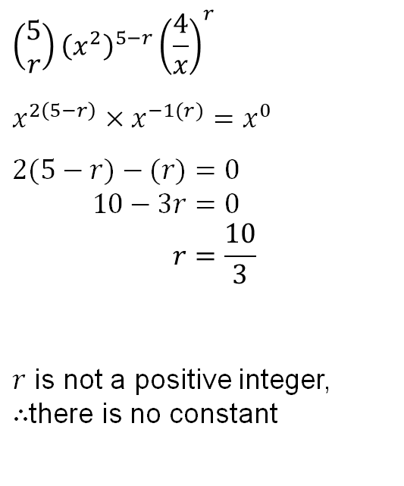
Does a constant exist?
$${\left(y^{3}+\frac{2}{y^{5}}\right)}^{16}$$ | $${\left(x^{2}+\frac{4}{x}\right)}^{5}$$ | $${\left(z^{5}+\frac{1}{z^{3}}\right)}^{15}$$
$$\left(\begin{matrix}16 \\ r\end{matrix}\right){\left(y^{3}\right)}^{16−r}{\left(\frac{2}{y^{5}}\right)}^{r}$$
$$y^{3(16−r)}×y^{− 5(r)}=x^{0}$$
$$3(16−r)−5(r)=0 \\ 48−8r=0 \\ r=6$$
$r$ is a positive integer, $∴$there is a constant
$$\left(\begin{matrix}5 \\ r\end{matrix}\right){\left(x^{2}\right)}^{5−r}{\left(\frac{4}{x}\right)}^{r}$$
$$x^{2\left(5−r\right)}×x^{−1(r)}=x^{0}$$
$$2(5−r)−(r)=0 \\ 10−3r=0 \\ r=\frac{10}{3}$$
$r$ is not a positive integer, $∴$there is no constant
$$\left(\begin{matrix}15 \\ r\end{matrix}\right){\left(z^{5}\right)}^{15−r}{\left(\frac{1}{z^{3}}\right)}^{r}$$
$$z^{5\left(15−r\right)}×z^{−3\left(r\right)}=z^{0}$$
$$5(15−r)−3(r)=0 \\ 75−8r=0 \\ r=\frac{75}{8}$$
$r$ is not a positive integer, $∴$there is no constant

Slide 11
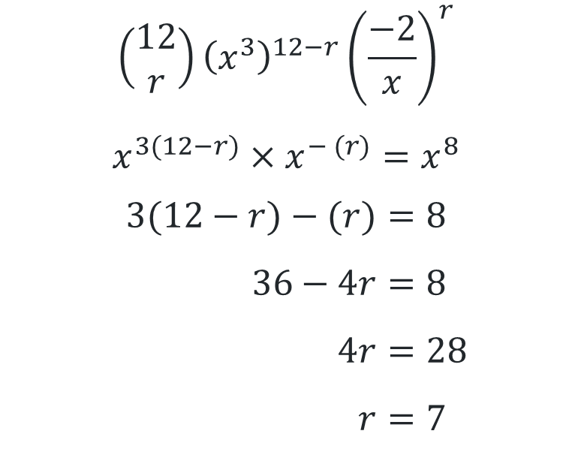
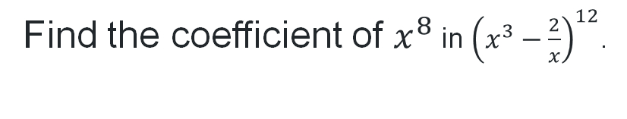
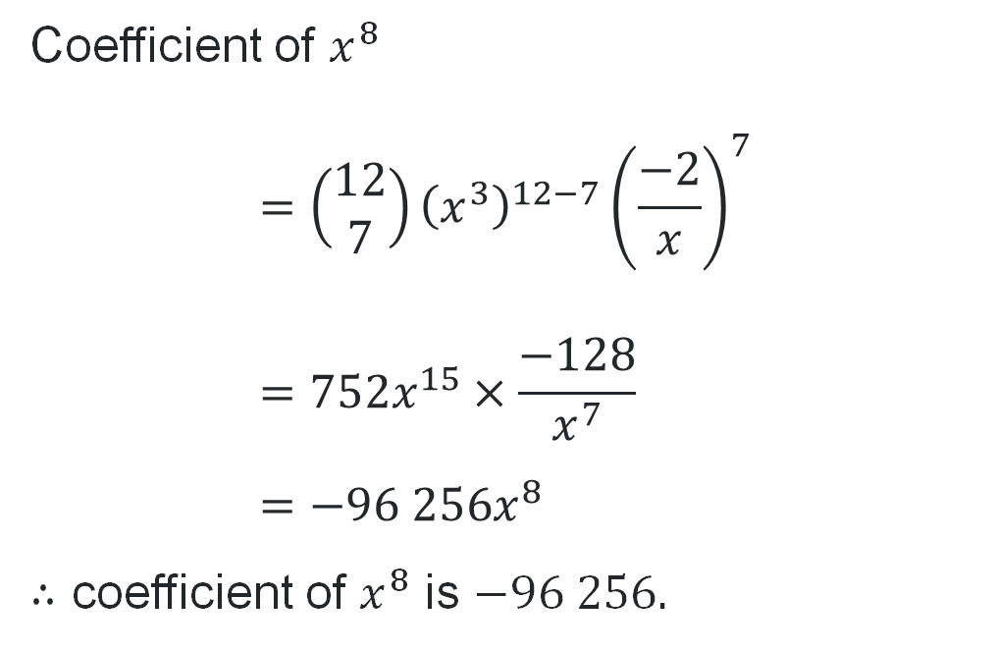
Finding any coefficient
Find the coefficient of $x^{8}$ in ${\left(x^{3}−\frac{2}{x}\right)}^{12}$.
$$\left(\begin{matrix}12 \\ r\end{matrix}\right){\left(x^{3}\right)}^{12−r}{\left(\frac{−2}{x}\right)}^{r}$$
$$x^{3(12−r)}×x^{− (r)}=x^{8}$$
$$3(12−r)−(r)=8 \\ 36−4r=8 \\ 4r=28 \\ r=7$$
Coefficient of $x^{8}$
$$=\left(\begin{matrix}12 \\ 7\end{matrix}\right){\left(x^{3}\right)}^{12−7}{\left(\frac{−2}{x}\right)}^{7} \\ =752x^{15}×\frac{−128}{x^{7}} \\ =−96 256x^{8}$$
$∴$ coefficient of $x^{8}$ is $−96 256.$

Slide 12

Finding ratios
Worked example 1
10 is the power of the binomial
$${\left(2x^{3}+\frac{1}{x^{2}}\right)}^{10}$$
3:2 is the ratio of the powers of the terms in the binomial (ignoring negatives)

Slide 13
Independent practice

Slide 14
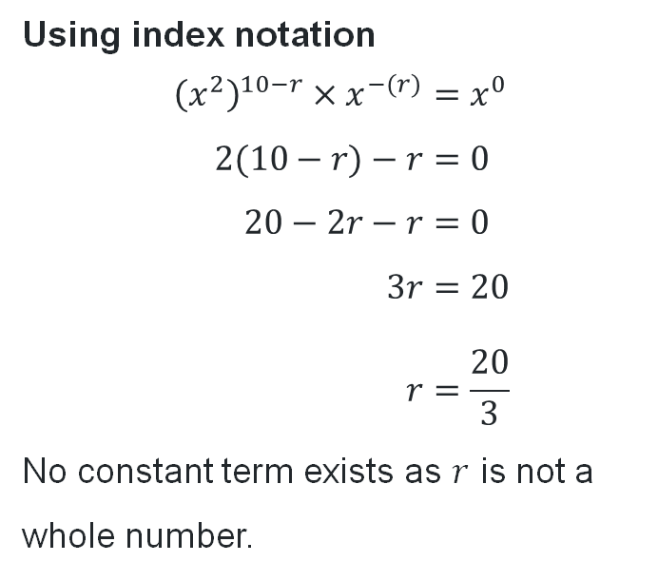
HSC-style question 1 (Using indices)
D$oes{\left(3x^{2}+\frac{2}{x}\right)}^{10}$have a constant term? Justify your answer mathematically.
Using index notation
$${\left(x^{2}\right)}^{10−r}×x^{−(r)}=x^{0} \\ 2(10−r)−r=0 \\ 20−2r−r=0 \\ 3r=20 \\ r=\frac{20}{3}$$
No constant term exists as $r$ is not a whole number.

Slide 15
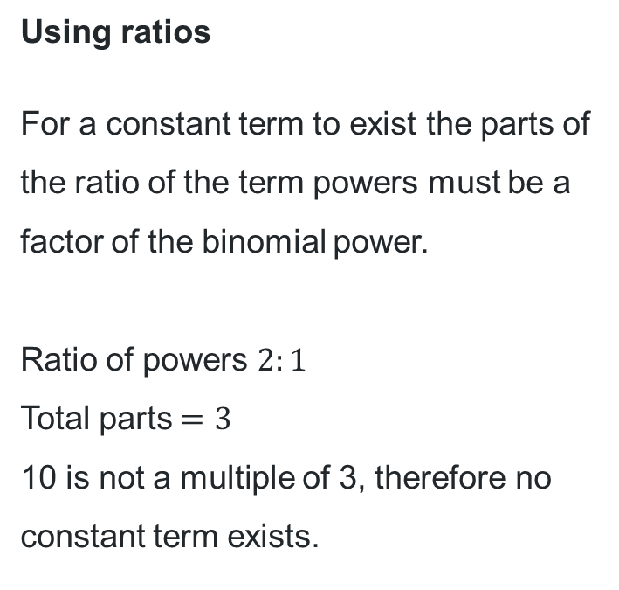
HSC-style question 1 (Using ratios)
D$oes{\left(3x^{2}+\frac{2}{x}\right)}^{10}$have a constant term? Justify your answer mathematically.
Using ratios
For a constant term to exist the parts of the ratio of the term powers must be a factor of the binomial power.
Ratio of powers $2:1$
Total parts $=3$
10 is not a multiple of 3, therefore no constant term exists.

Slide 16
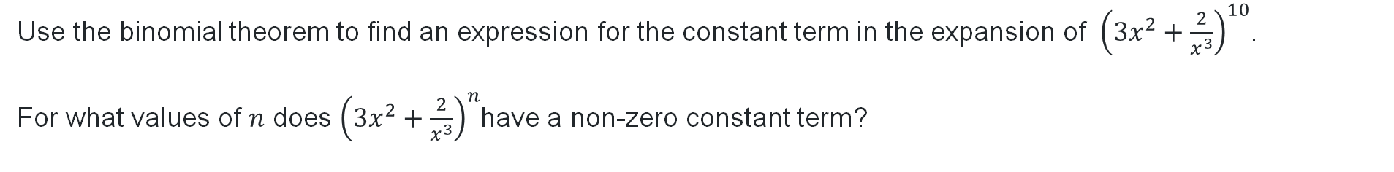
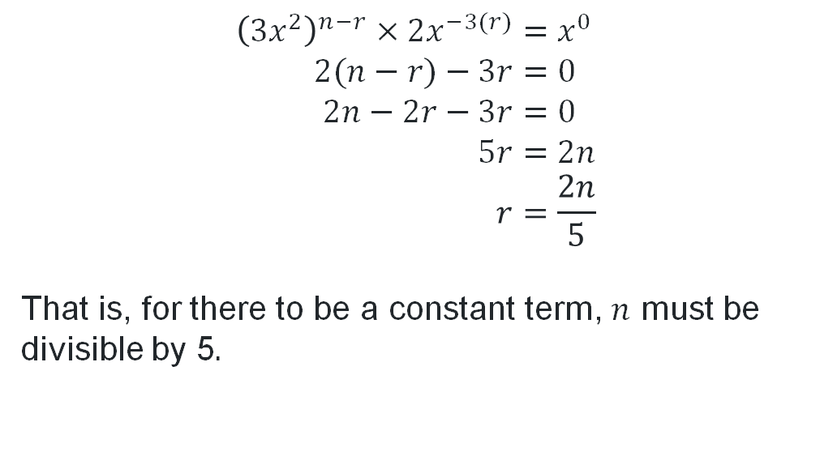
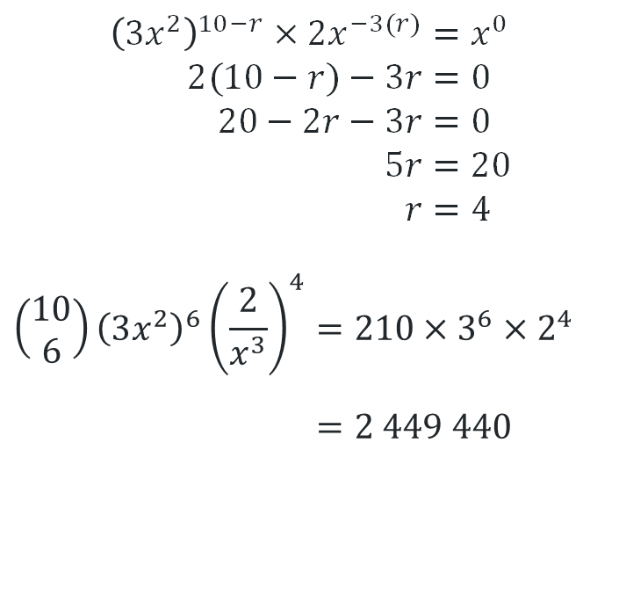
HSC-style question 2 (Using indices)
Use the binomial theorem to find an expression for the constant term in the expansion of ${\left(3x^{2}+\frac{2}{x^{3}}\right)}^{10}$.
For what values of $n$ does ${\left(3x^{2}+\frac{2}{x^{3}}\right)}^{n}$have a non-zero constant term?
$${\left(3x^{2}\right)}^{n−r}×2x^{−3(r)}=x^{0} \\ 2(n−r)−3r=0 \\ 2n−2r−3r=0 \\ 5r=2n \\ r=\frac{2n}{5}$$
That is, for there to be a constant term, $n$ must be divisible by 5.
$${\left(3x^{2}\right)}^{10−r}×2x^{−3(r)}=x^{0} \\ 2(10−r)−3r=0 \\ 20−2r−3r=0 \\ 5r=20 \\ r=4$$
$$\left(\begin{matrix}10 \\ 6\end{matrix}\right){\left(3x^{2}\right)}^{6}{\left(\frac{2}{x^{3}}\right)}^{4}=210×3^{6}×2^{4} \\ =2 449 440$$

Slide 17
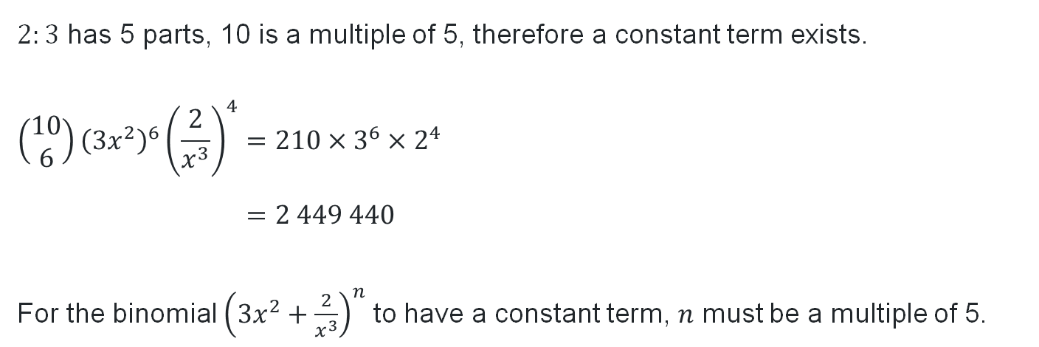
HSC-style question 2 (Using ratio)
Use the binomial theorem to find an expression for the constant term in the expansion of ${\left(3x^{2}+\frac{2}{x^{3}}\right)}^{10}$.
For what values of $n$ does ${\left(3x^{2}+\frac{2}{x^{3}}\right)}^{n}$have a non-zero constant term?
$2:3$ has 5 parts, 10 is a multiple of 5, therefore a constant term exists.
$$\left(\begin{matrix}10 \\ 6\end{matrix}\right){\left(3x^{2}\right)}^{6}{\left(\frac{2}{x^{3}}\right)}^{4}=210×3^{6}×2^{4} \\ =2 449 440$$
For the binomial ${\left(3x^{2}+\frac{2}{x^{3}}\right)}^{n}$ to have a constant term, $n$ must be a multiple of 5.

Slide 18

HSC-style question (3)
2008 HSC Extension 1 Examination (NESA 2008)
Find an expression for the coefficient of $x^{8}y^{4}$ in the expansion of ${\left(2x+3y\right)}^{12}$. (2 marks)
$$\left(\begin{matrix}12 \\ 4\end{matrix}\right){\left(2x\right)}^{12−4}{\left(3y\right)}^{4}=495×2^{8}x^{8}×3^{4}y^{4} \\ =10 264 320$$

Slide 19
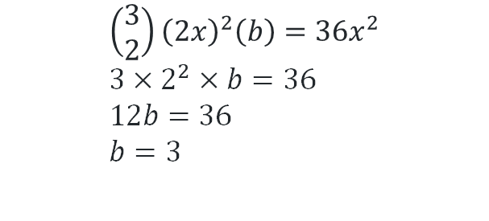
HSC-style question 4
In the expansion of ${\left(2x+b\right)}^{3}$ the coefficient of the term containing $x^{2}$ is 36. What is the value of $b$?
$$\left(\begin{matrix}3 \\ 2\end{matrix}\right){\left(2x\right)}^{2}\left(b\right)=36x^{2} \\ 3×2^{2}×b=36 \\ 12b=36 \\ b=3$$

Slide 20
References
This presentation contains NSW Curriculum and syllabus content. The NSW Curriculum is developed by the NSW Education Standards Authority. This content is prepared by NESA for and on behalf of the Crown in the right of the State of New South Wales. The material is protected by Crown copyright.
Please refer to the NESA Copyright Disclaimer for more information https://educationstandards.nsw.edu.au/wps/portal/nesa/mini-footer/copyright.
NESA holds the only official and up-to-date versions of the NSW Curriculum and syllabus documents. Please visit the NSW Education Standards Authority (NESA) website https://educationstandards.nsw.edu.au/wps/portal/nesa/home and the NSW Curriculum website https://curriculum.nsw.edu.au.
Mathematics Extension 1 Stage 6 Syllabus © NSW Education Standards Authority (NESA) for and on behalf of the Crown in right of the State of New South Wales, 2024

Slide 21
Copyright
© State of New South Wales (Department of Education), 2025
The copyright material published in this resource is subject to the Copyright Act 1968 (Cth) and is owned by the NSW Department of Education or, where indicated, by a party other than the NSW Department of Education (third-party material).
Copyright material available in this resource and owned by the NSW Department of Education is licensed under a Creative Commons Attribution 4.0 International (CC BY 4.0) license.
This license allows you to share and adapt the material for any purpose, even commercially.
Attribution should be given to © State of New South Wales (Department of Education), 2025.
Material in this resource not available under a Creative Commons license:
the NSW Department of Education logo, other logos and trademark-protected material
Material owned by a third party that has been reproduced with permission. You will need to obtain permission from the third party to reuse its material.
Links to third-party material and websites
Please note that the provided (reading/viewing material/list/links/texts) are a suggestion only and implies no endorsement, by the New South Wales Department of Education, of any author, publisher, or book title. School principals and teachers are best placed to assess the suitability of resources that would complement the curriculum and reflect the needs and interests of their students.
If you use the links provided in this document to access a third-party’s website, you acknowledge that the terms of use, including licence terms set out on the third-party’s website apply to the use which may be made of the materials on that third-party website or where permitted by the Copyright Act 1968 (Cth). The department accepts no responsibility for content on third-party websites.

