Slide 1
The binomial theorem
Mathematics Extension 1 – Stage 6 (Year 11)
The binomial theorem

Slide 2
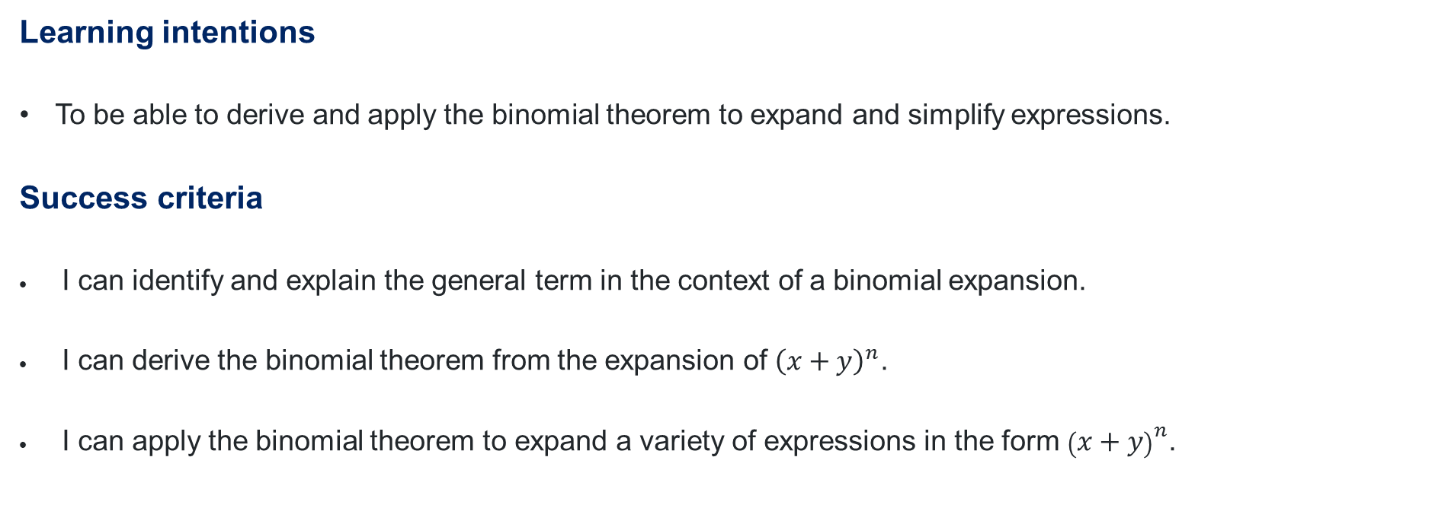
Learning intentions and success criteria
Learning intentions
To be able to derive and apply the binomial theorem to expand and simplify expressions.
Success criteria
I can identify and explain the general term in the context of a binomial expansion.
I can derive the binomial theorem from the expansion of ${\left(x+y\right)}^{n}$.
I can apply the binomial theorem to expand a variety of expressions in the form ${\left(x+y\right)}^{n}$.
Notes:
Notes for teachers:
Learning intentions and success criteria are best co-constructed with students. Adapt the learning intention as required and add matching success criteria.
For more information See ⁠AITSL or the NSW Department of Education explicit teaching strategies, ⁠Sharing learning intentions and ⁠Sharing success criteria
LISC is not necessarily presented at the beginning of the lesson. Teacher needs to consider most effectual time to introduce
LISC should be revisited during the lesson to support students' evaluation of their learning

Slide 3
Activating prior knowledge

Slide 4
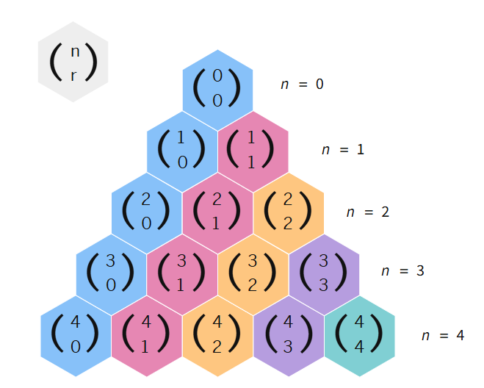
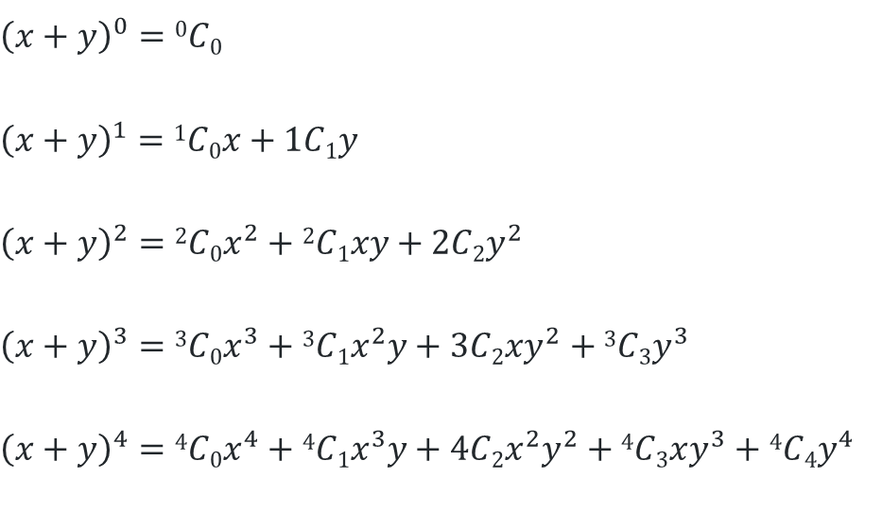
An expression for the general term
$${\left(x+y\right)}^{0}=0C0$$
$${\left(x+y\right)}^{1}=1C0x+1C1y$$
$${\left(x+y\right)}^{2}=2C0x^{2}+2C1xy+2C2y^{2}$$
$${\left(x+y\right)}^{3}={3C0x}^{3}+3C1x^{2}y+3C2xy^{2}+3C3y^{3}$$
$${\left(x+y\right)}^{4}=4C0x^{4}+4C1x^{3}y+4C2x^{2}y^{2}+4C3xy^{3}+4C4y^{4}$$
In the expansion of ${\left(x+y\right)}^{n}$ each term can be expressed as: ${\left({n \atop r}\right)x}^{n−r}y^{r}$

Slide 5
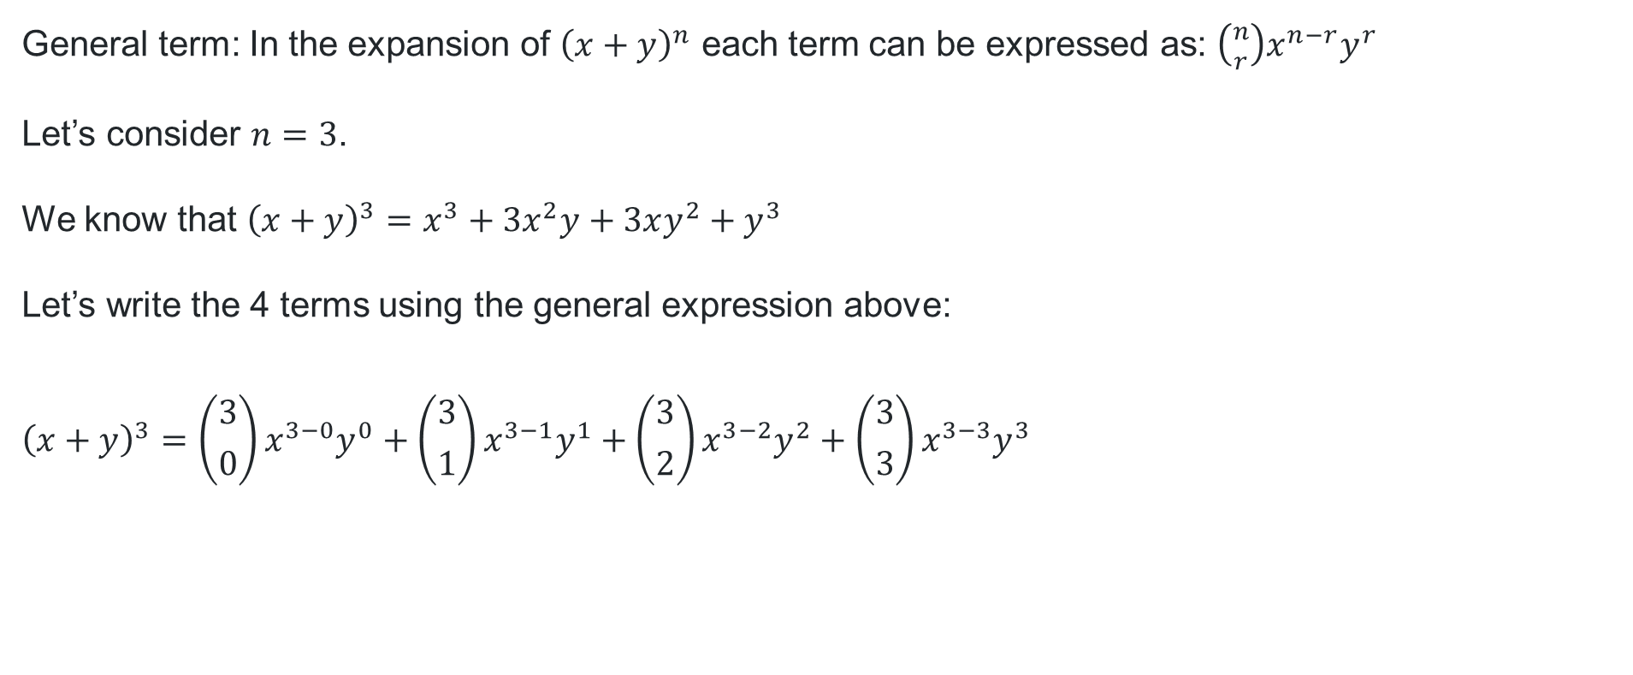
Deriving the binomial theorem (1)
General term: In the expansion of ${\left(x+y\right)}^{n}$ each term can be expressed as: ${\left({n \atop r}\right)x}^{n−r}y^{r}$
Let’s consider $n=3$.
We know that ${\left(x+y\right)}^{3}=x^{3}+3x^{2}y+3xy^{2}+y^{3}$
Let’s write the 4 terms using the general expression above:
$${\left(x+y\right)}^{3}={\left({3 \atop 0}\right)x}^{3−0}y^{0}+\left({3 \atop 1}\right)x^{3−1}y^{1}+\left({3 \atop 2}\right)x^{3−2}y^{2}+{\left({3 \atop 3}\right)x^{3−3}y}^{3}$$

Slide 6
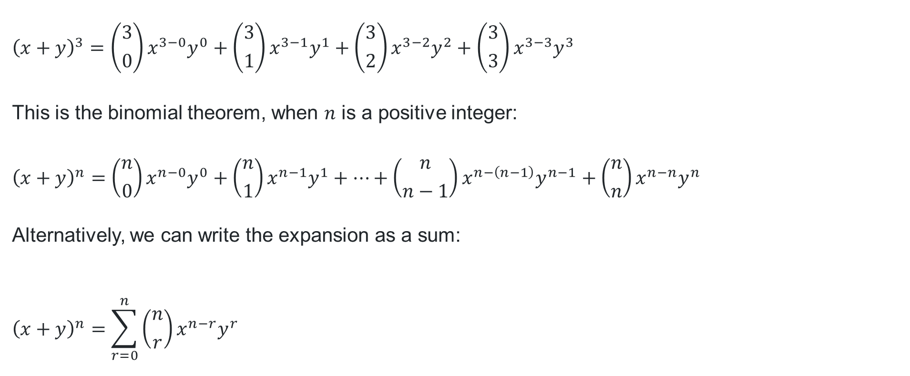
Deriving the binomial theorem (2)
$${\left(x+y\right)}^{3}={\left({3 \atop 0}\right)x}^{3−0}y^{0}+\left({3 \atop 1}\right)x^{3−1}y^{1}+\left({3 \atop 2}\right)x^{3−2}y^{2}+{\left({3 \atop 3}\right)x^{3−3}y}^{3}$$
This is the binomial theorem, when $n$ is a positive integer:
$${\left(x+y\right)}^{n}={\left({n \atop 0}\right)x}^{n−0}y^{0}+{\left({n \atop 1}\right)x}^{n−1}y^{1}+⋯+{\left({n \atop n−1}\right)x}^{n−\left(n−1\right)}y^{n−1}+{\left({n \atop n}\right)x}^{n−n}y^{n}$$
Alternatively, we can write the expansion as a sum:
$${\left(x+y\right)}^{n}=\sum_{r=0}^{n}{\left({n \atop r}\right)x^{n−r}y^{r}}$$

Slide 7

Binomial expansions
$${\left(x+y\right)}^{n}=\sum_{r=0}^{n}{\left({n \atop r}\right)x^{n−r}y^{r}}$$
$${\left(x+y\right)}^{0}=1$$
$${\left(x+y\right)}^{1}=x+y$$
$${\left(x+y\right)}^{2}=x^{2}+2xy+y^{2}$$
$${\left(x+y\right)}^{3}={ x}^{3}+3x^{2}y+3xy^{2}+y^{3}$$
$${\left(x+y\right)}^{4}=x^{4}+4x^{3}y+6x^{2}y^{2}+4xy^{3}+y^{4}$$

Slide 8
Releasing responsibility

Slide 9

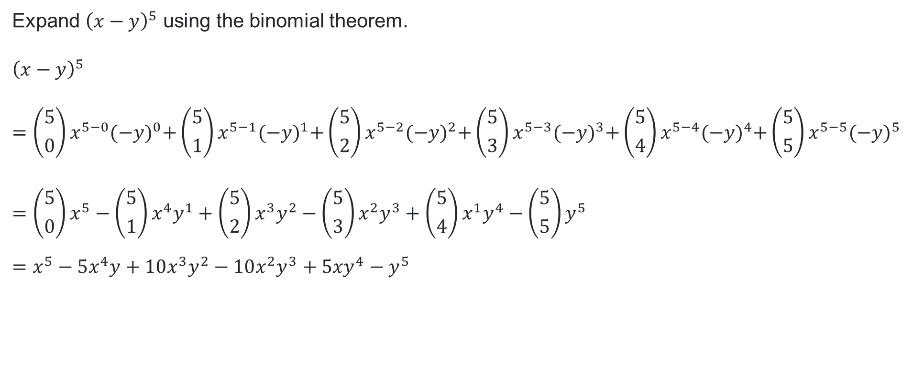
Applying the binomial theorem (1)
Worked example 1
Expand ${\left(x−y\right)}^{5}$ using the binomial theorem.
$${\left(x−y\right)}^{5} \\ ={\left({5 \atop 0}\right)x}^{5−0}{(−y)}^{0}+{\left({5 \atop 1}\right)x}^{5−1}{(−y)}^{1}+{\left({5 \atop 2}\right)x}^{5−2}{(−y)}^{2}+{\left({5 \atop 3}\right)x}^{5−3}{(−y)}^{3}+{\left({5 \atop 4}\right)x}^{5−4}{(−y)}^{4}+{\left({5 \atop 5}\right)x}^{5−5}{(−y)}^{5} \\ ={\left({5 \atop 0}\right)x}^{5}−{\left({5 \atop 1}\right)x}^{4}y^{1}+{\left({5 \atop 2}\right)x}^{3}y^{2}−\left({5 \atop 3}\right){x^{2}y}^{3}+\left({5 \atop 4}\right){x^{1}y}^{4}−{\left({5 \atop 5}\right)y}^{5} \\ =x^{5}−5x^{4}y+10x^{3}y^{2}−10x^{2}y^{3}+{5xy}^{4}−y^{5}$$
Why does this term not contain $x$?
Can we predict which terms will be negative?

Slide 10

Applying the binomial theorem (2)
Your turn question 1
Expand ${\left(a−b\right)}^{4}$ using the binomial theorem.
$${\left(a−b\right)}^{4}={\left({4 \atop 0}\right)a}^{4−0}{(−b)}^{0}+{\left({4 \atop 1}\right)a}^{4−1}{(−b)}^{1}+{\left({4 \atop 2}\right)a}^{4−2}{(−b)}^{2}+{\left({4 \atop 3}\right)a}^{4−3}{(−b)}^{3}+{\left({4 \atop 4}\right)a}^{4−4}{(−b)}^{4} \\ ={\left({4 \atop 0}\right)a}^{4}−{\left({4 \atop 1}\right)a}^{3}b^{1}+{\left({4 \atop 2}\right)a}^{2}b^{2}−\left({4 \atop 3}\right){a^{1}b}^{3}+\left({4 \atop 4}\right)b^{4} \\ =a^{4}−4a^{3}b+6a^{2}b^{2}−4ab^{3}+b^{4}$$

Slide 11

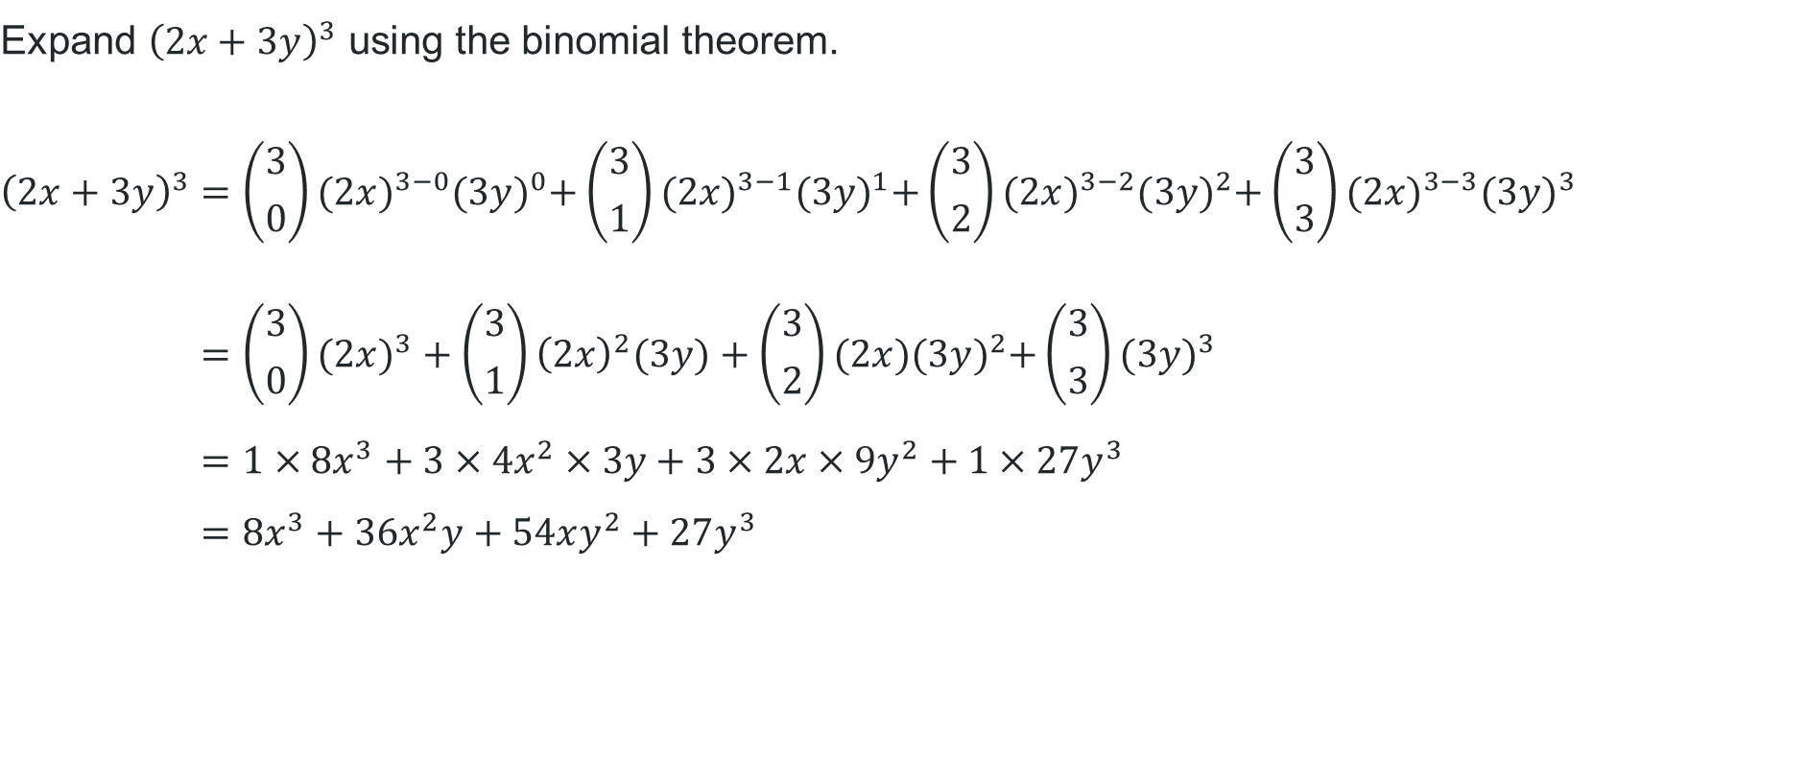

Applying the binomial theorem (3)
Worked example 2
$$\text{Expand} {\left(2x+3y\right)}^{3} \text{using} \text{the} \text{binomial} \text{theorem}\text{.}$$
$${\left(2x+3y\right)}^{3}={\left({3 \atop 0}\right)(2x)}^{3−0}{(3y)}^{0}+{\left({3 \atop 1}\right)(2x)}^{3−1}{(3y)}^{1}+{\left({3 \atop 2}\right)(2x)}^{3−2}{(3y)}^{2}+{\left({3 \atop 3}\right)(2x)}^{3−3}{(3y)}^{3} \\ ={\left({3 \atop 0}\right)(2x)}^{3}+{\left({3 \atop 1}\right)\left(2x\right)}^{2}(3y)+\left({3 \atop 2}\right){(2x)(3y)}^{2}+\left({3 \atop 3}\right){(3y)}^{3} \\ ={1×8x}^{3}+{3×4x}^{2}×3y+3×2x×9y^{2}+1×27y^{3} \\ =8x^{3}+36x^{2}y+54xy^{2}+27y^{3}$$
Why is this term $27y^{3}$?
How can we use the binomial theorem to prove $2^{3}=8$?

Slide 12
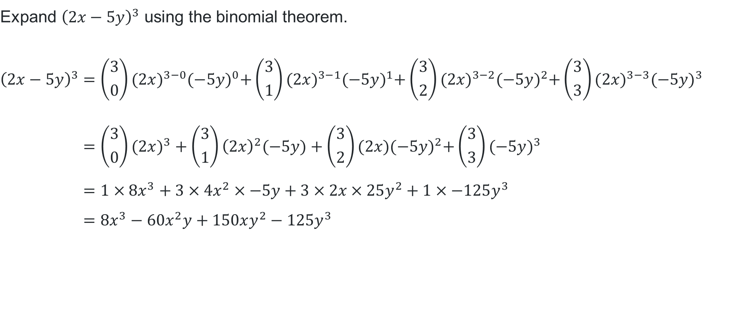
Applying the binomial theorem (4)
Your turn question 2
$$\text{Expand} {\left(2x−5y\right)}^{3} \text{using} \text{the} \text{binomial} \text{theorem}\text{.}$$
$${\left(2x−5y\right)}^{3}={\left({3 \atop 0}\right)(2x)}^{3−0}{(−5y)}^{0}+{\left({3 \atop 1}\right)(2x)}^{3−1}{(−5y)}^{1}+{\left({3 \atop 2}\right)(2x)}^{3−2}{(−5y)}^{2}+{\left({3 \atop 3}\right)(2x)}^{3−3}{(−5y)}^{3} \\ ={\left({3 \atop 0}\right)(2x)}^{3}+{\left({3 \atop 1}\right)\left(2x\right)}^{2}(−5y)+\left({3 \atop 2}\right){(2x)(−5y)}^{2}+\left({3 \atop 3}\right){(−5y)}^{3} \\ ={1×8x}^{3}+{3×4x}^{2}×−5y+3×2x×25y^{2}+1×−125y^{3} \\ =8x^{3}−60x^{2}y+150xy^{2}−125y^{3}$$

Slide 13
Independent practice

Slide 14

Binomial theorem problems
Use the binomial theorem to expand ${\left(3x−2\right)}^{6}$.
By writing $1.01$ as $(1+0.01)$, use the binomial theorem to evaluate ${1.01}^{3}$, correct to 2 decimal places.
If ${\left(1+\sqrt{2}\right)}^{4}=a+b\sqrt{2}$, use the binomial theorem to evaluate $a$ and $b$.

Slide 15
References
This presentation contains NSW Curriculum and syllabus content. The NSW Curriculum is developed by the NSW Education Standards Authority. This content is prepared by NESA for and on behalf of the Crown in the right of the State of New South Wales. The material is protected by Crown copyright.
Please refer to the NESA Copyright Disclaimer for more information https://educationstandards.nsw.edu.au/wps/portal/nesa/mini-footer/copyright.
NESA holds the only official and up-to-date versions of the NSW Curriculum and syllabus documents. Please visit the NSW Education Standards Authority (NESA) website https://educationstandards.nsw.edu.au/wps/portal/nesa/home and the NSW Curriculum website https://curriculum.nsw.edu.au.
Mathematics Extension 1 11–12 Syllabus © NSW Education Standards Authority (NESA) for and on behalf of the Crown in right of the State of New South Wales, 2024.

Slide 16
Copyright
© State of New South Wales (Department of Education), 2025
The copyright material published in this resource is subject to the Copyright Act 1968 (Cth) and is owned by the NSW Department of Education or, where indicated, by a party other than the NSW Department of Education (third-party material).
Copyright material available in this resource and owned by the NSW Department of Education is licensed under a Creative Commons Attribution 4.0 International (CC BY 4.0) license.
This license allows you to share and adapt the material for any purpose, even commercially.
Attribution should be given to © State of New South Wales (Department of Education), 2025.
Material in this resource not available under a Creative Commons license:
the NSW Department of Education logo, other logos and trademark-protected material
Material owned by a third party that has been reproduced with permission. You will need to obtain permission from the third party to reuse its material.
Links to third-party material and websites
Please note that the provided (reading/viewing material/list/links/texts) are a suggestion only and implies no endorsement, by the New South Wales Department of Education, of any author, publisher, or book title. School principals and teachers are best placed to assess the suitability of resources that would complement the curriculum and reflect the needs and interests of their students.
If you use the links provided in this document to access a third-party’s website, you acknowledge that the terms of use, including licence terms set out on the third-party’s website apply to the use which may be made of the materials on that third-party website or where permitted by the Copyright Act 1968 (Cth). The department accepts no responsibility for content on third-party websites.

