Slide 1
Combinatorial patterns
Mathematics Extension 1 – Stage 6 (Year 11)
The binomial theorem

Slide 2
Activating prior knowledge

Slide 3
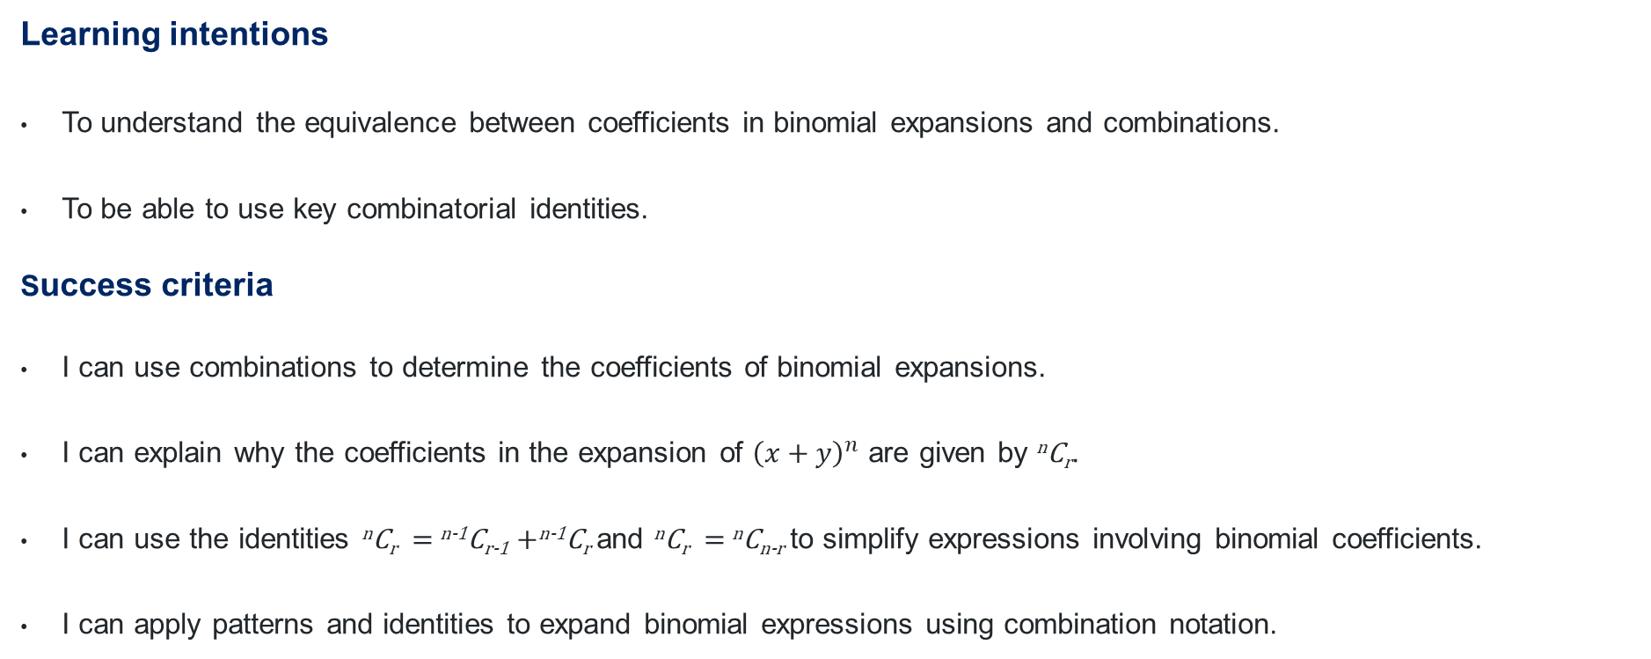
Learning intentions and success criteria
Learning intentions
To understand the equivalence between coefficients in binomial expansions and combinations.
To be able to use key combinatorial identities.
Success criteria
I can use combinations to determine the coefficients of binomial expansions.
I can explain why the coefficients in the expansion of ${\left(x+y\right)}^{n}$ are given by ^{n}C_{r}.
I can use the identities ^{n}C_{r} $=$ ^{n-1}C_{r-1} +^{n-1}C_{r} and ^{n}C_{r} $=$ ^{n}C_{n-r} to simplify expressions involving binomial coefficients.
I can apply patterns and identities to expand binomial expressions using combination notation.
Notes:
Notes for teachers:
Learning intentions and success criteria are best co-constructed with students. Adapt the learning intention as required and add matching success criteria.
For more information See ⁠AITSL or the NSW Department of Education explicit teaching strategies, ⁠Sharing learning intentions and ⁠Sharing success criteria
LISC is not necessarily presented at the beginning of the lesson. Teacher needs to consider most effectual time to introduce
LISC should be revisited during the lesson to support students' evaluation of their learning

Slide 4
Connecting learning

Slide 5
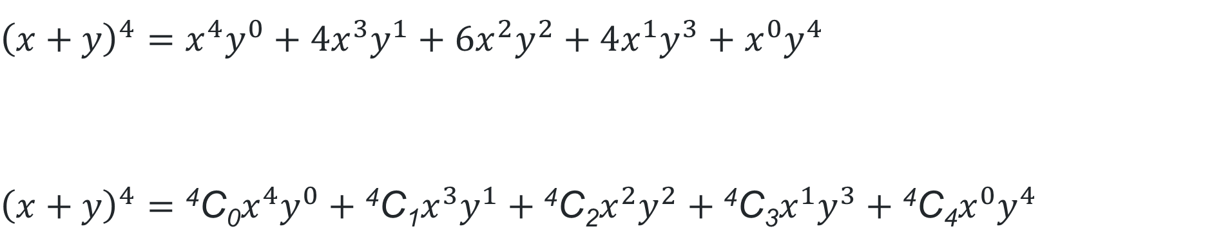
Binomial coefficients (1)
Expansion of ${\left(x+y\right)}^{4}$
$${\left(x+y\right)}^{4}=x^{4}y^{0}+\text{4}x^{3}y^{1}+\text{6}x^{2}y^{2}+\text{4}x^{1}y^{3}+{x^{0}y}^{4}$$
$${\left(x+y\right)}^{4}={\text{4}\text{C}\text{0}x}^{4}y^{0}+\text{4}\text{C}\text{1}x^{3}y^{1}+\text{4}\text{C}\text{2}x^{2}y^{2}+\text{4}\text{C}\text{3}x^{1}y^{3}+\text{4}\text{C}\text{4}{x^{0}y}^{4}$$

Slide 6
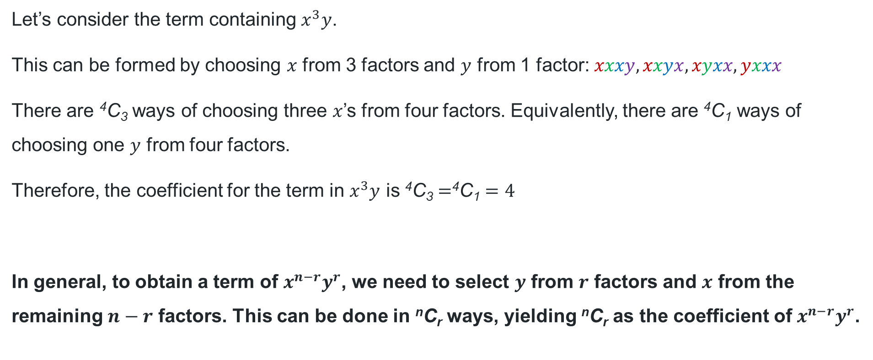
Binomial coefficients (2)
$${\left(x+y\right)}^{4}=\left(x+y\right)\left(x+y\right)\left(x+y\right)\left(x+y\right)$$
Let’s consider the term containing $x^{3}y$.
This can be formed by choosing $x$ from 3 factors and $y$ from 1 factor: $xxxy, xxyx, xyxx, yxxx$
There are ⁴C₃ ways of choosing three $x$’s from four factors. Equivalently, there are ⁴C₁ ways of choosing one $y$ from four factors.
Therefore, the coefficient for the term in $x^{3}y$ is ⁴C₃ $=$⁴C₁ $=4$
In general, to obtain a term of $x^{n−r}y^{r}$, we need to select $y$ from $r$ factors and $x$ from the remaining $n−r$ factors. This can be done in ^{n}C_{r} ways, yielding ^{n}C_{r} as the coefficient of $x^{n−r}y^{r}$.

Slide 7
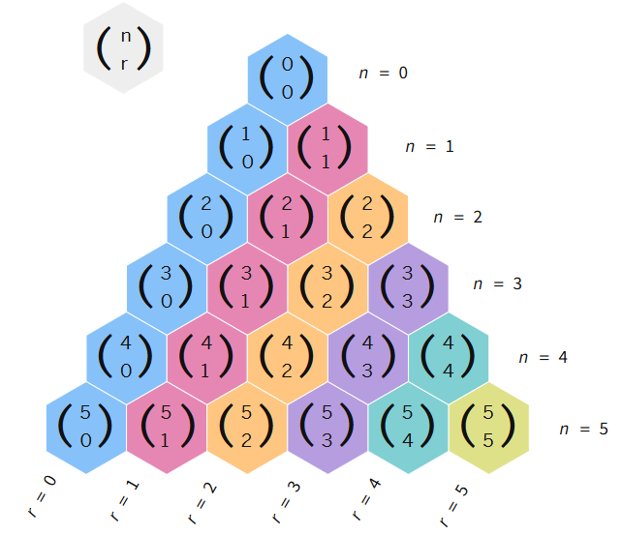

Pascal’s triangle (1)
Combination notation
$${\left(x+y\right)}^{0}=0C0$$
$${\left(x+y\right)}^{1}=1C0x+1C1y$$
$${\left(x+y\right)}^{2}=2C0x^{2}+2C1xy+2C2y^{2}$$
$${\left(x+y\right)}^{3}={3C0x}^{3}+3C1x^{2}y+3C2xy^{2}+3C3y^{3}$$
$${\left(x+y\right)}^{4}=4C0x^{4}+4C1x^{3}y+4C2x^{2}y^{2}+4C3xy^{3}+4C4y^{4}$$

Slide 8

Patterns in Pascal’s triangle (1)
Confirming identities
^{n}C₀ $=$ ^{n}C_{n} $=1$
^{n}C_{r} $=$ ^{n}C_{n-r}
^{n}C_{r} $=$ ^{n-1}C_{r-1} $+$ ^{n-1}C_{r}

Slide 9
Releasing responsibility

Slide 10

Patterns in Pascal’s triangle (2)
Key takeaways
Each row starts and ends with 1: ^{n}C₀ $=$ ^{n}C_{n} $=1$
Each row is symmetrical: ^{n}C_{r} $=$ ^{n}C_{n-r}
Each entry is the sum of the two entries directly above it from the previous row: ^{n}C_{r} $=$ ^{n-1}C_{r-1} $+$ ^{n-1}C_{r}

Slide 11
Independent practice

Slide 12

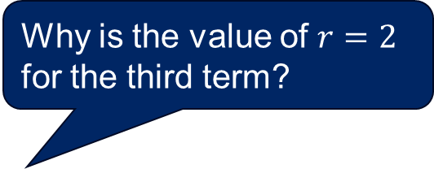
Equivalent coefficients
Expansion of ${\left(x+y\right)}^{5}$
Why is the value of $r=2$ for the third term?
$${\left(x+y\right)}^{5}={\text{5}\text{C}\text{0}x}^{5}+\text{5}\text{C}\text{1}x^{4}y+\text{5}\text{C}\text{2}x^{3}y^{2}+\text{5}\text{C}\text{3}x^{2}y^{3}+\text{5}\text{C}\text{4}{xy}^{4}+\text{5}\text{C}\text{5}y^{5}$$
$${\left(x+y\right)}^{5}=x^{5}+{5x}^{4}y+{10x}^{3}y^{2}+10x^{2}y^{3}+5{xy}^{4}+y^{5}$$
What is the value of the coefficient of this term and why?
Why are both coefficients equal to 10?

Slide 13
References
This presentation contains NSW Curriculum and syllabus content. The NSW Curriculum is developed by the NSW Education Standards Authority. This content is prepared by NESA for and on behalf of the Crown in the right of the State of New South Wales. The material is protected by Crown copyright.
Please refer to the NESA Copyright Disclaimer for more information https://educationstandards.nsw.edu.au/wps/portal/nesa/mini-footer/copyright.
NESA holds the only official and up-to-date versions of the NSW Curriculum and syllabus documents. Please visit the NSW Education Standards Authority (NESA) website https://educationstandards.nsw.edu.au/wps/portal/nesa/home and the NSW Curriculum website https://curriculum.nsw.edu.au.
Mathematics Extension 1 11–12 Syllabus © NSW Education Standards Authority (NESA) for and on behalf of the Crown in right of the State of New South Wales, 2024.

Slide 14
Copyright
© State of New South Wales (Department of Education), 2025
The copyright material published in this resource is subject to the Copyright Act 1968 (Cth) and is owned by the NSW Department of Education or, where indicated, by a party other than the NSW Department of Education (third-party material).
Copyright material available in this resource and owned by the NSW Department of Education is licensed under a Creative Commons Attribution 4.0 International (CC BY 4.0) license.
This license allows you to share and adapt the material for any purpose, even commercially.
Attribution should be given to © State of New South Wales (Department of Education), 2025.
Material in this resource not available under a Creative Commons license:
the NSW Department of Education logo, other logos and trademark-protected material
Material owned by a third party that has been reproduced with permission. You will need to obtain permission from the third party to reuse its material.
Links to third-party material and websites
Please note that the provided (reading/viewing material/list/links/texts) are a suggestion only and implies no endorsement, by the New South Wales Department of Education, of any author, publisher, or book title. School principals and teachers are best placed to assess the suitability of resources that would complement the curriculum and reflect the needs and interests of their students.
If you use the links provided in this document to access a third-party’s website, you acknowledge that the terms of use, including licence terms set out on the third-party’s website apply to the use which may be made of the materials on that third-party website or where permitted by the Copyright Act 1968 (Cth). The department accepts no responsibility for content on third-party websites.

