Slide 1
Rational inequalities
Mathematics Extension 1 – Stage 6 (Year 11)
The binomial theorem

Slide 2
Learning intentions and success criteria
Learning intentions
To be able to solve inequalities involving rational expressions with variables in the denominator.
Success criteria
I can identify values that make a rational expression zero or undefined.
I can explain where a rational expression is positive or negative.
I can identify and justify critical values of an inequality involving a rational expression.
I can solve inequalities involving rational expressions with variables in the denominator and justify the reasoning behind my method and solution.
Notes:
Notes for teachers:
Learning intentions and success criteria are best co-constructed with students. Adapt the learning intention as required and add matching success criteria.
For more information See ⁠AITSL or the NSW Department of Education explicit teaching strategies, ⁠Sharing learning intentions and ⁠Sharing success criteria
LISC is not necessarily presented at the beginning of the lesson. Teacher needs to consider most effectual time to introduce
LISC should be revisited during the lesson to support students' evaluation of their learning

Slide 3
Activating prior knowledge

Slide 4
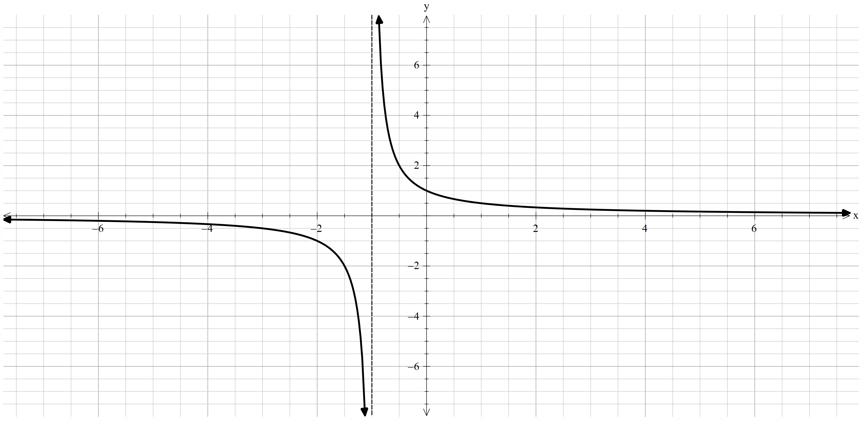
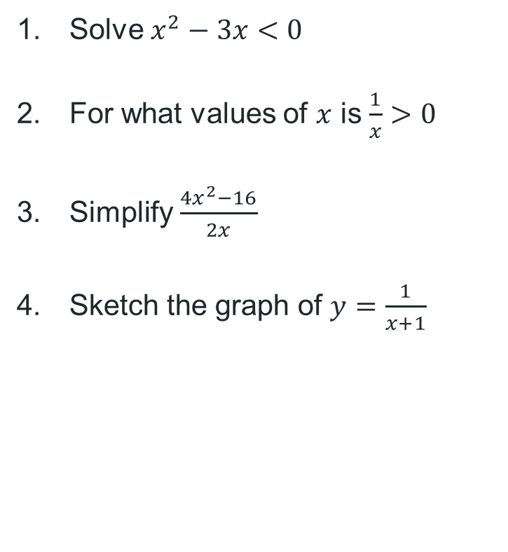
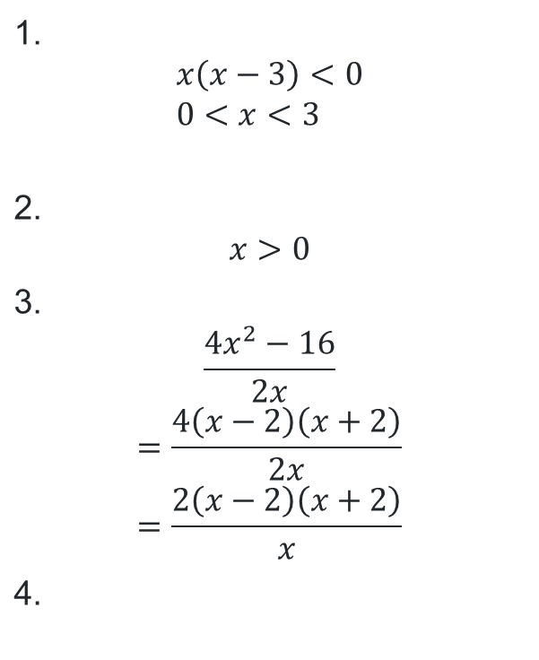
Starter questions
1. $$x\left(x−3\right)<0 \\ 0<x<3$$
2. $$x>0$$
3. $$\frac{4x^{2}−16}{2x}$$ $$=\frac{4\left(x−2\right)\left(x+2\right)}{2x} \\ =\frac{2\left(x−2\right)\left(x+2\right)}{x}$$
4.
Activating prior knowledge
Solve $x^{2}−3x<0$
For what values of $x$ is $\frac{1}{x}>0$
Simplify $\frac{4x^{2}−16}{2x}$
Sketch the graph of $y=\frac{1}{x+1}$

Slide 5
Connecting learning

Slide 6
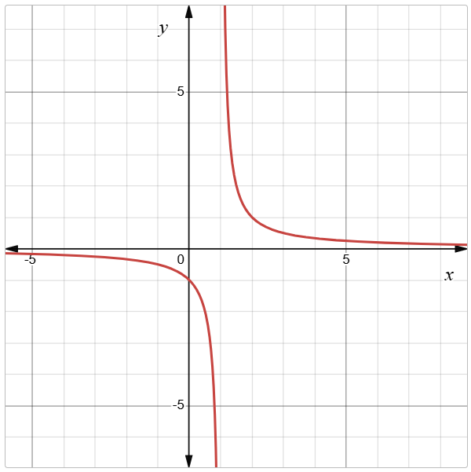
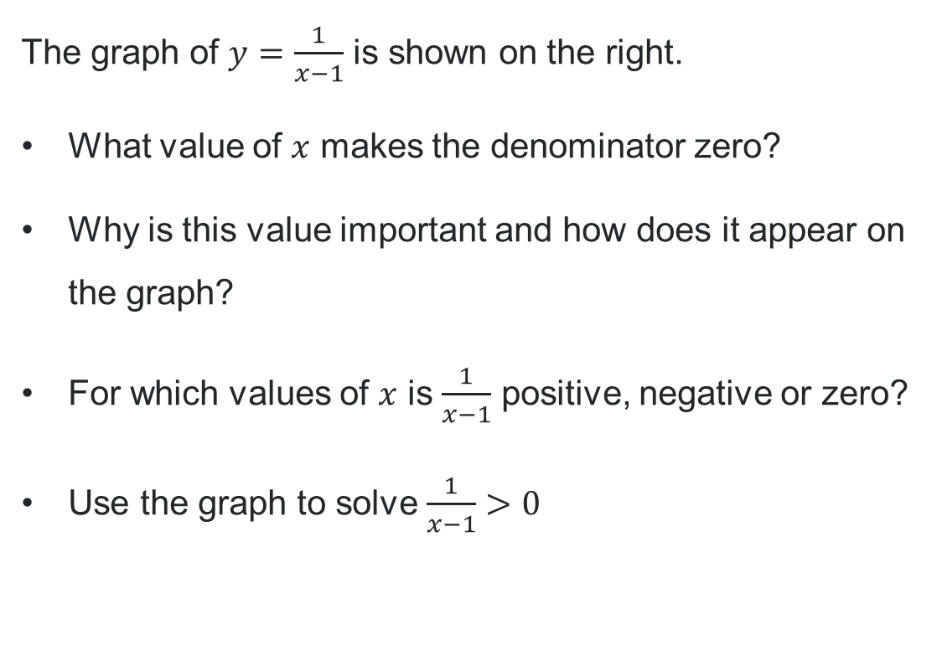
Solving inequalities using graphical methods (1)
The graph of $y=\frac{1}{x−1}$ is shown on the right.
What value of $x$ makes the denominator zero?
Why is this value important and how does it appear on the graph?
For which values of $x$ is $\frac{1}{x−1}$ positive, negative or zero?
Use the graph to solve $\frac{1}{x−1}>0$

Slide 7
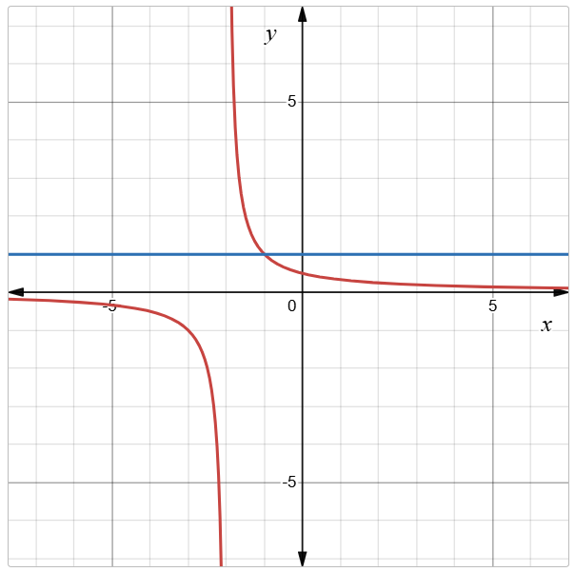
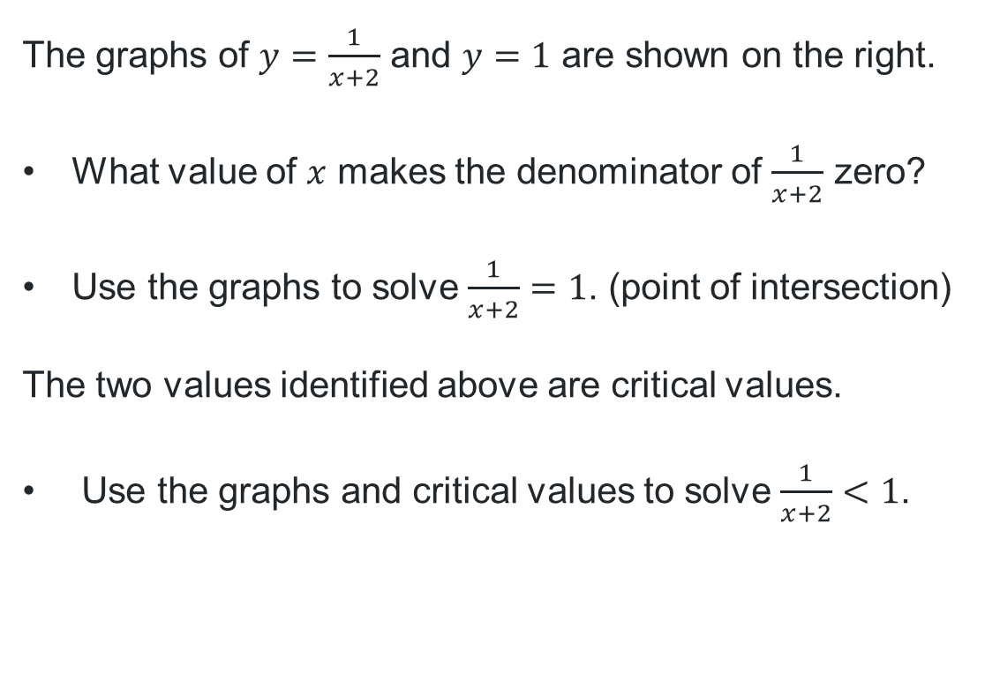
Solving inequalities using graphical methods (2)
The graphs of $y=\frac{1}{x+2}$ and $y=1$ are shown on the right.
What value of $x$ makes the denominator of $\frac{1}{x+2}$ zero?
Use the graphs to solve $\frac{1}{x+2}=1$. (point of intersection)
The two values identified above are critical values.
Use the graphs and critical values to solve $\frac{1}{x+2}<1$.

Slide 8
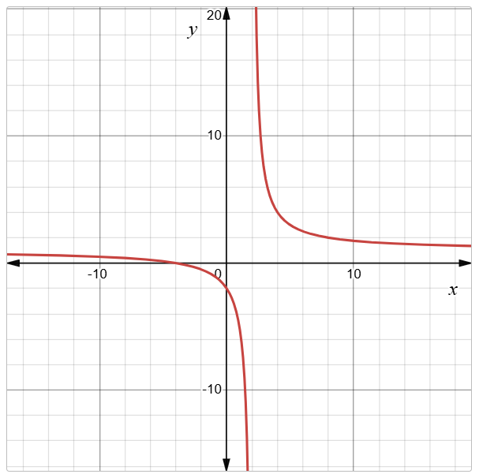
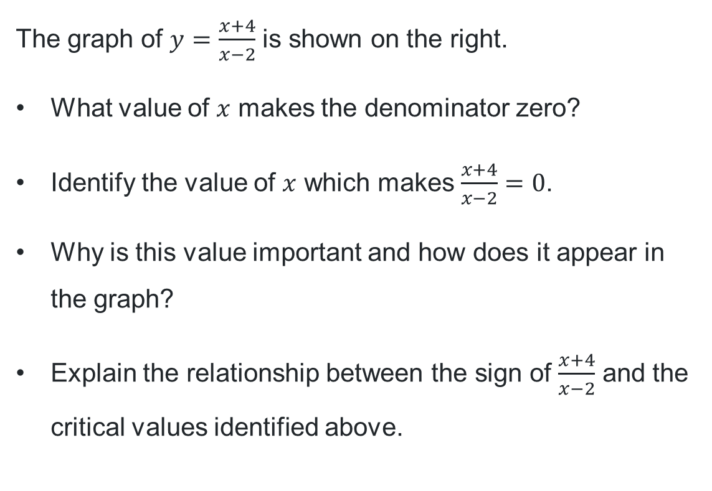
Solving inequalities using graphical methods (3)
The graph of $y=\frac{x+4}{x−2}$ is shown on the right.
What value of $x$ makes the denominator zero?
Identify the value of $x$ which makes $\frac{x+4}{x−2}=0$.
Why is this value important and how does it appear in the graph?
Explain the relationship between the sign of $\frac{x+4}{x−2}$ and the critical values identified above.

Slide 9
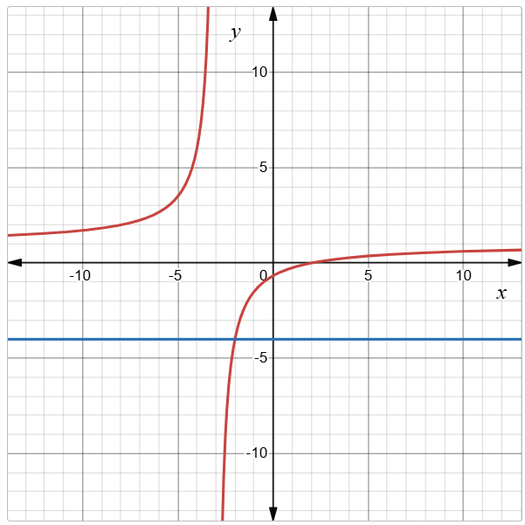
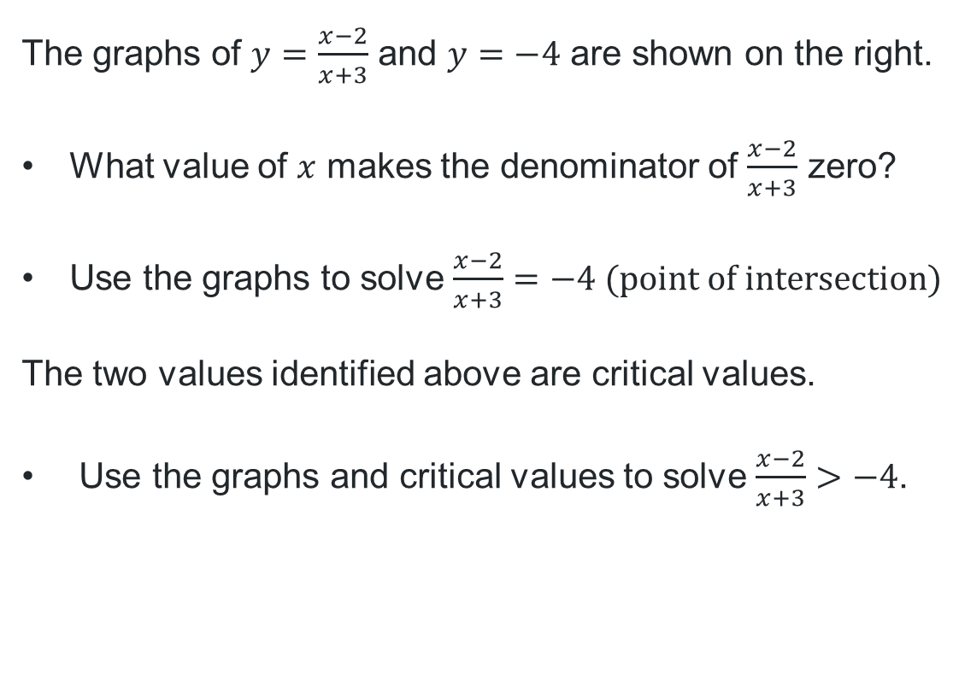
Solving inequalities using graphical methods (4)
The graphs of $y=\frac{x−2}{x+3}$ and $y=−4$ are shown on the right.
What value of $x$ makes the denominator of $\frac{x−2}{x+3}$ zero?
Use the graphs to solve $\frac{x−2}{x+3}=−4 (point of intersection)$
The two values identified above are critical values.
Use the graphs and critical values to solve $\frac{x−2}{x+3}>−4$.

Slide 10
Releasing responsibility

Slide 11
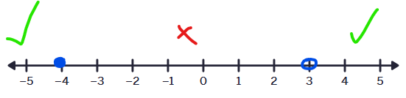

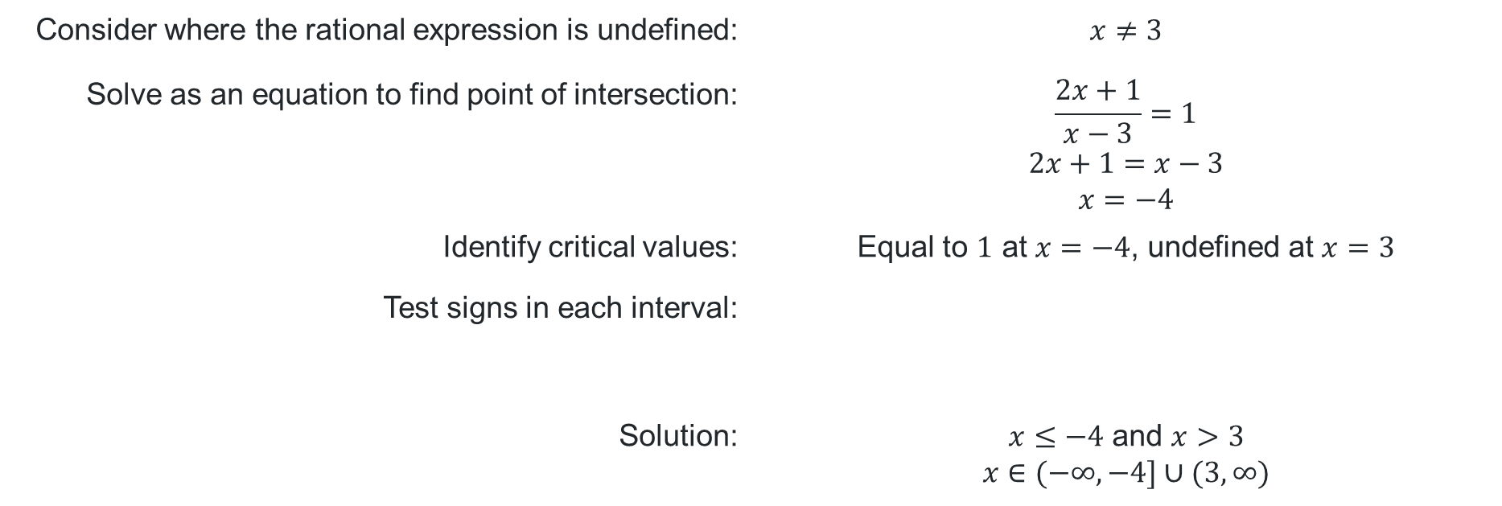
Solving rational inequalities (1)
Worked example 1
Solve $\frac{2x+1}{x−3}≥1$
Why do we solve as an equation?
Consider where the rational expression is undefined: | $$x≠3$$
Solve as an equation to find point of intersection: | $$\frac{2x+1}{x−3}=1 \\ 2x+1=x−3 \\ x=−4$$
Identify critical values: | Equal to $1$ at $x=−4$, undefined at $x=3$
Test signs in each interval:
Solution: | $x≤−4$ and $x>3$ $$x∈(−∞,−4]∪(3,∞)$$
What calculations have occurred here?
Why is $x=3$ not included as part of the solution?

Slide 12
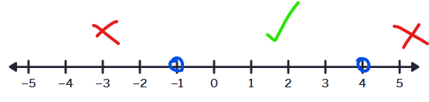
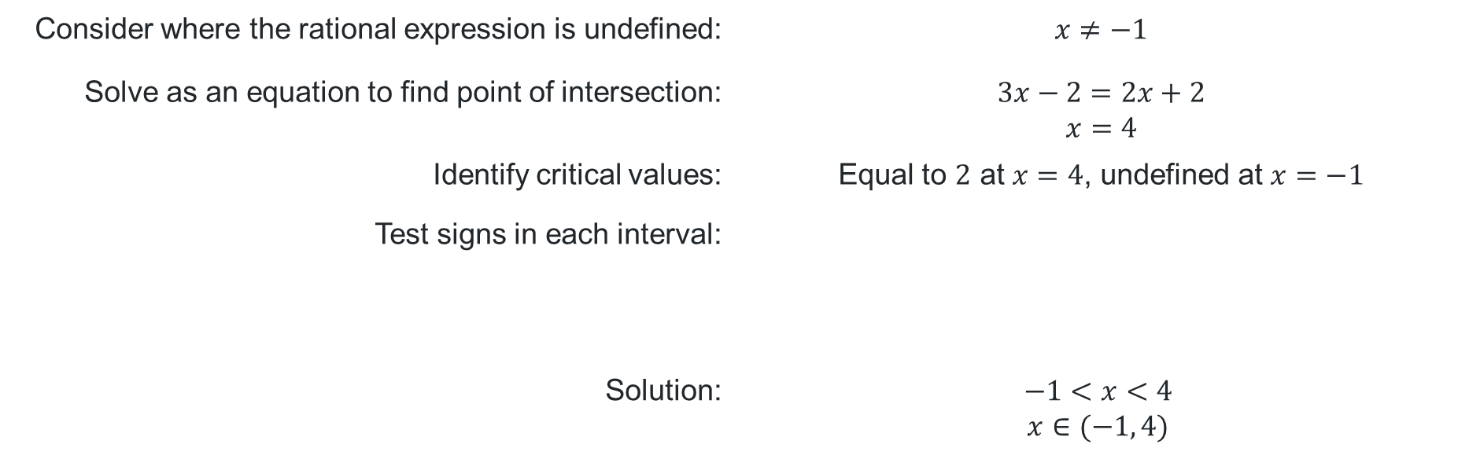
Solving rational inequalities (2)
Your turn 1
Solve $\frac{3x−2}{x+1}<2$
Consider where the rational expression is undefined: | $$x≠−1$$
Solve as an equation to find point of intersection: | $$3x−2=2x+2 \\ x=4$$
Identify critical values: | Equal to $2$ at $x=4$, undefined at $x=−1$
Test signs in each interval:
Solution: | $$−1<x<4$$ $$x∈(−1, 4)$$

Slide 13


Solving rational inequalities (3)
Incorrect worked example
Angelo attempted another method to solve the inequality $\frac{3x−2}{x+1}<2$.
He has made a mistake. Below is his working out.
$$\frac{3x−2}{x+1}×\left(x+1\right)<2×(x+1) \\ 3x−2<2x+2 \\ x<4$$
What was Angelo’s first step?
Why is this solution incorrect?
What important information has not been considered?

Slide 14
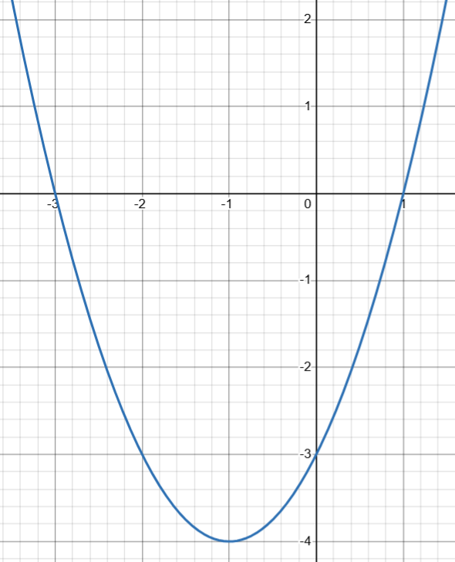

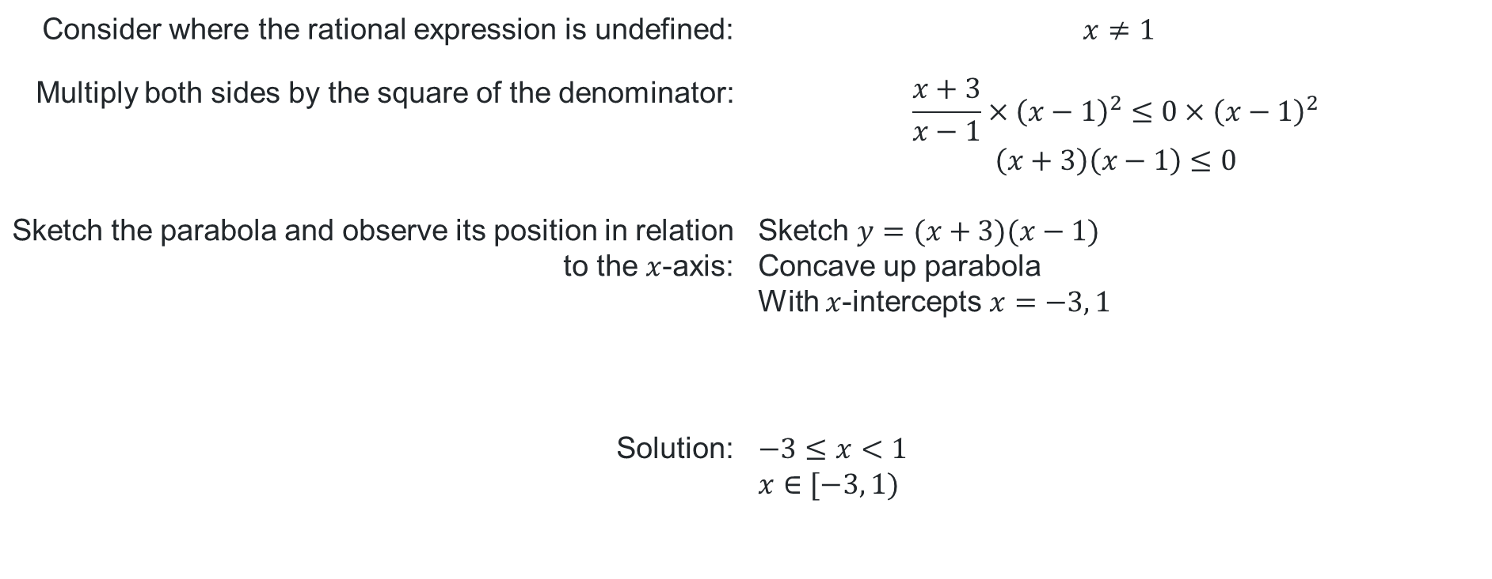
Solving rational inequalities (4)
Worked example 2
Why do we multiply by the square of the denominator?
How else could we solve this without sketching a parabola?
Solve $\frac{x+3}{x−1}≤0$
Consider where the rational expression is undefined: | $$x≠1$$
Multiply both sides by the square of the denominator: | $$\frac{x+3}{x−1}×{\left(x−1\right)}^{2}≤0×{\left(x−1\right)}^{2} \\ \left(x+3\right)\left(x−1\right)≤0$$
Sketch the parabola and observe its position in relation to the $x$-axis: | Sketch $y=(x+3)(x−1)$ Concave up parabola With $x$-intercepts $x=−3, 1$
Solution: | $−3≤x<1$ $$x∈[−3, 1)$$
How do we read the solution from the graph of the parabola?

Slide 15
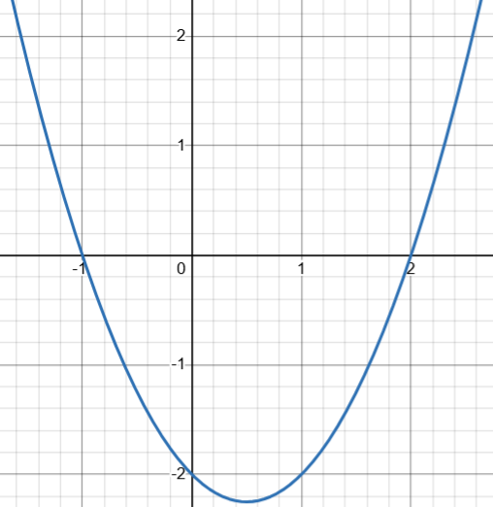
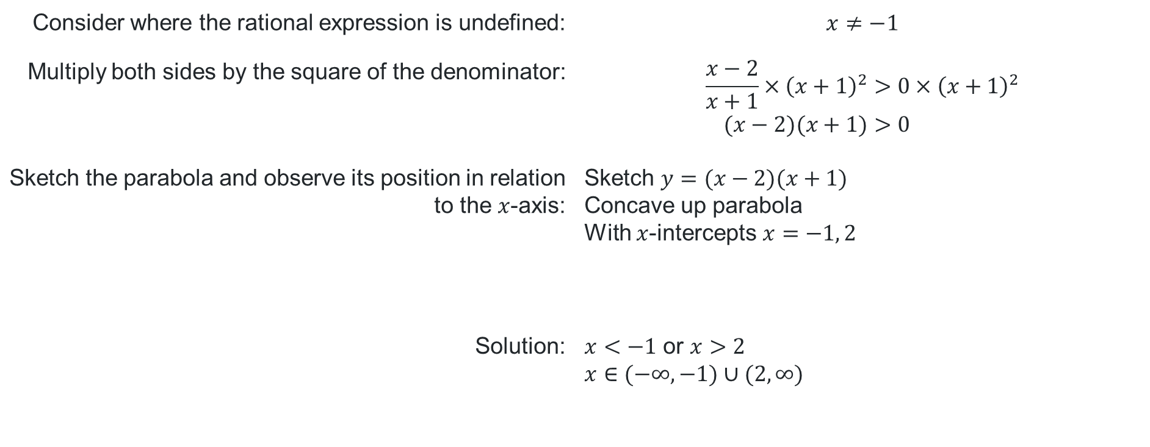
Solving rational inequalities (5)
Your turn 2
Solve $\frac{x−2}{x+1}>0$
Consider where the rational expression is undefined: | $$x≠−1$$
Multiply both sides by the square of the denominator: | $$\frac{x−2}{x+1}×{\left(x+1\right)}^{2}>0×{\left(x+1\right)}^{2} \\ (x−2)(x+1)>0$$
Sketch the parabola and observe its position in relation to the $x$-axis: | Sketch $y=(x−2)(x+1)$ Concave up parabola With $x$-intercepts $x=−1, 2$
Solution: | $x<−1$ or $x>2$ $$x∈(−∞,−1)∪(2,∞)$$

Slide 16
References
This presentation contains NSW Curriculum and syllabus content. The NSW Curriculum is developed by the NSW Education Standards Authority. This content is prepared by NESA for and on behalf of the Crown in the right of the State of New South Wales. The material is protected by Crown copyright.
Please refer to the NESA Copyright Disclaimer for more information https://educationstandards.nsw.edu.au/wps/portal/nesa/mini-footer/copyright.
NESA holds the only official and up-to-date versions of the NSW Curriculum and syllabus documents. Please visit the NSW Education Standards Authority (NESA) website https://educationstandards.nsw.edu.au/wps/portal/nesa/home and the NSW Curriculum website https://curriculum.nsw.edu.au.
Mathematics Extension 1 11–12 Syllabus © NSW Education Standards Authority (NESA) for and on behalf of the Crown in right of the State of New South Wales, 2024.

Slide 17
Copyright
© State of New South Wales (Department of Education), 2025
The copyright material published in this resource is subject to the Copyright Act 1968 (Cth) and is owned by the NSW Department of Education or, where indicated, by a party other than the NSW Department of Education (third-party material).
Copyright material available in this resource and owned by the NSW Department of Education is licensed under a Creative Commons Attribution 4.0 International (CC BY 4.0) license.
This license allows you to share and adapt the material for any purpose, even commercially.
Attribution should be given to © State of New South Wales (Department of Education), 2025.
Material in this resource not available under a Creative Commons license:
the NSW Department of Education logo, other logos and trademark-protected material
Material owned by a third party that has been reproduced with permission. You will need to obtain permission from the third party to reuse its material.
Links to third-party material and websites
Please note that the provided (reading/viewing material/list/links/texts) are a suggestion only and implies no endorsement, by the New South Wales Department of Education, of any author, publisher, or book title. School principals and teachers are best placed to assess the suitability of resources that would complement the curriculum and reflect the needs and interests of their students.
If you use the links provided in this document to access a third-party’s website, you acknowledge that the terms of use, including licence terms set out on the third-party’s website apply to the use which may be made of the materials on that third-party website or where permitted by the Copyright Act 1968 (Cth). The department accepts no responsibility for content on third-party websites.

