Slide 1
Combinations with restrictions
Mathematics Extension 1 – Year 11
Permutations and combinations

Slide 2
Activating prior knowledge

Slide 3


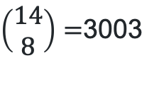
Combinations (1)
Choose 8 people
$\left(\begin{matrix}14 \\ 8\end{matrix}\right)=$3003

Slide 4
Learning intention and success criteria
Learning intention
To understand how to solve problems involving combinations with restrictions.
Success criteria
I can identify the restrictions placed on combinations.
I can separate combinations into groups based on specific restrictions.
I can solve probability problems based on combinations with restrictions.
Notes:
Notes for teachers:
Learning intentions and success criteria are best co-constructed with students. Adapt the learning intention as required and add matching success criteria.
For more information See ⁠AITSL or the NSW Department of Education explicit teaching strategies, ⁠Sharing learning intentions and ⁠Sharing success criteria
LISC is not necessarily presented at the beginning of the lesson. Teacher needs to consider most effectual time to introduce
LISC should be revisited during the lesson to support students' evaluation of their learning

Slide 5
Connecting learning

Slide 6


Combinations (2)
Choose 4 women and 4 men
How many ways are there of choosing 4 women from the group of 6 women?
How many ways are there of choosing 4 men from the group of 8 men?
How might we use these answers to calculate the number of different groups of 8 players?

Slide 7
Combinations (3)
Choose 4 women and 4 men
Women | Men | Total
$\left(\begin{matrix}6 \\ 4\end{matrix}\right)=$15 | $$\left(\begin{matrix}8 \\ 4\end{matrix}\right)=70$$ | $$15×70=1050$$

Slide 8
Releasing responsibility

Slide 9
Combinations with restrictions (1)
Example 1
A five-person team is to be chosen at random from 9 women and 6 men.
What is the probability that the team will consist of 3 women and 2 men?
Why do we consider the men separately to the women?
Total number of teams possible | $$=\left(\begin{matrix}15 \\ 5\end{matrix}\right) \\ =3003$$
Arrangements with 3 women and 2 men | $$=\left(\begin{matrix}9 \\ 3\end{matrix}\right)×\left(\begin{matrix}6 \\ 2\end{matrix}\right) \\ =84×15 \\ =1260$$
Probability | $$=\frac{1260}{3003} \\ =\frac{60}{143}$$
Why do we multiply the two combinations?
What would change if we wanted 2 women and 3 men on the team?

Slide 10
Combinations with restrictions (2)
Your turn
A five-person team is to be chosen at random from eight women and six men.
What is the probability that the team will consist of 2 women and 3 men?
Total number of teams possible | $$=\left(\begin{matrix}14 \\ 5\end{matrix}\right) \\ =2002$$
Arrangements with 2 women and 3 men | $$=\left(\begin{matrix}8 \\ 2\end{matrix}\right)×\left(\begin{matrix}6 \\ 3\end{matrix}\right) \\ =28×20 \\ =560$$
Probability | $$=\frac{560}{2002} \\ =\frac{40}{143}$$

Slide 11
Independent practice

Slide 12

Approaching questions scaffold

Slide 13
HSC style question (1)
A team of 11 students is to be chosen from a group of 18 students to form a cricket team. Four students are left-handed. What is the probability that at least one student chosen is left-handed?

Slide 14
HSC style question (2)
Combinations including left-handed players
Teams with 4 left-handed players $$=\left(\begin{matrix}4 \\ 4\end{matrix}\right)×\left(\begin{matrix}14 \\ 7\end{matrix}\right) \\ =3 432$$
Teams with 3 left-handed players $$=\left(\begin{matrix}4 \\ 3\end{matrix}\right)×\left(\begin{matrix}14 \\ 8\end{matrix}\right) \\ =12 012$$
Teams with 2 left-handed players $$=\left(\begin{matrix}4 \\ 2\end{matrix}\right)×\left(\begin{matrix}14 \\ 9\end{matrix}\right) \\ =12 012$$
Teams with 1 left-handed player $$=\left(\begin{matrix}4 \\ 1\end{matrix}\right)×\left(\begin{matrix}14 \\ 10\end{matrix}\right) \\ =4 004$$
Total number of teams with at least 1 left-handed player $$=3 432+12 012+12012+4004 \\ =31 460$$

Slide 15
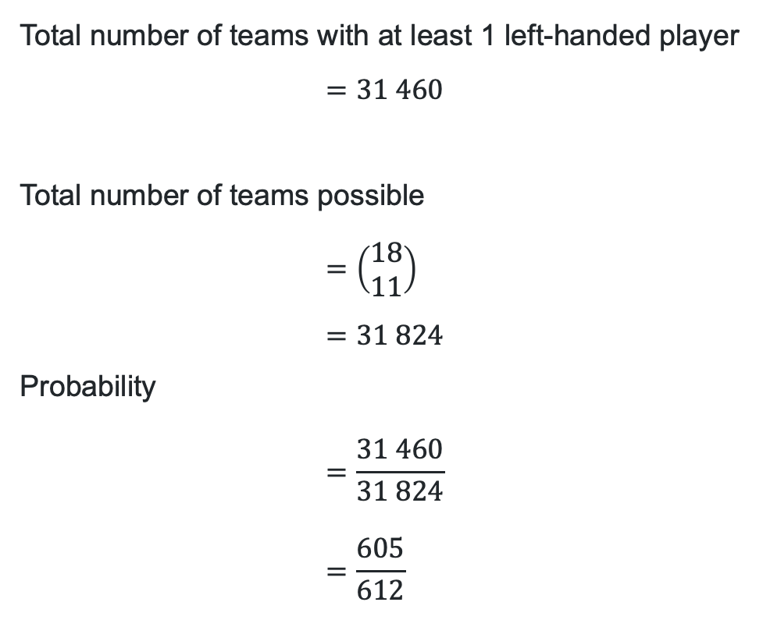
HSC style question (3)
Finding probability
Total number of teams with at least 1 left-handed player
$$=31 460$$
Total number of teams possible
$$=\left(\begin{matrix}18 \\ 11\end{matrix}\right) \\ =31 824$$
Probability
$$=\frac{31 460}{31 824} \\ =\frac{605}{612}$$

Slide 16
HSC style question (4)
Alternate solution
Total number of teams possible
$$=\left(\begin{matrix}18 \\ 11\end{matrix}\right) \\ =31 824$$
Teams with 0 left-handed players
$$=\left(\begin{matrix}4 \\ 0\end{matrix}\right)×\left(\begin{matrix}14 \\ 11\end{matrix}\right) \\ =1×364$$
Total number with at least 1 left-handed player
$$=31 824−364 \\ =31 460$$
Probability
$$=\frac{31 460}{31 824}$$
$$=\frac{605}{612}$$

Slide 17
References
This presentation contains NSW Curriculum and syllabus content. The NSW Curriculum is developed by the NSW Education Standards Authority. This content is prepared by NESA for and on behalf of the Crown in the right of the State of New South Wales. The material is protected by Crown copyright.
Please refer to the NESA Copyright Disclaimer for more information https://educationstandards.nsw.edu.au/wps/portal/nesa/mini-footer/copyright.
NESA holds the only official and up-to-date versions of the NSW Curriculum and syllabus documents. Please visit the NSW Education Standards Authority (NESA) website https://educationstandards.nsw.edu.au/wps/portal/nesa/home and the NSW Curriculum website https://curriculum.nsw.edu.au.
Mathematics Extension 1 11–12 Syllabus © NSW Education Standards Authority (NESA) for and on behalf of the Crown in right of the State of New South Wales, 2025

Slide 18
Copyright
© State of New South Wales (Department of Education), 2025
The copyright material published in this resource is subject to the Copyright Act 1968 (Cth) and is owned by the NSW Department of Education or, where indicated, by a party other than the NSW Department of Education (third-party material).
Copyright material available in this resource and owned by the NSW Department of Education is licensed under a Creative Commons Attribution 4.0 International (CC BY 4.0) license.
This license allows you to share and adapt the material for any purpose, even commercially.
Attribution should be given to © State of New South Wales (Department of Education), 2025.
Material in this resource not available under a Creative Commons license:
the NSW Department of Education logo, other logos and trademark-protected material
Material owned by a third party that has been reproduced with permission. You will need to obtain permission from the third party to reuse its material.
Links to third-party material and websites
Please note that the provided (reading/viewing material/list/links/texts) are a suggestion only and implies no endorsement, by the New South Wales Department of Education, of any author, publisher, or book title. School principals and teachers are best placed to assess the suitability of resources that would complement the curriculum and reflect the needs and interests of their students.
If you use the links provided in this document to access a third-party’s website, you acknowledge that the terms of use, including licence terms set out on the third-party’s website apply to the use which may be made of the materials on that third-party website or where permitted by the Copyright Act 1968 (Cth). The department accepts no responsibility for content on third-party websites.

