Slide 1
Circular permutations
Mathematics Extension 1 – Year 11
Permutations and combinations

Slide 2
Learning intentions and success criteria
Learning intentions
To understand why calculating arrangements in a circle is different than in a straight line.
To apply methods to calculate the number of possible arrangements of items in circular permutations.
Success criteria
I can explain why the number of ways to arrange $n$ distinct objects in a circle is $\left(n−1\right)!$.
I can calculate the number of arrangements in a circle.
I can calculate the probability of an event occurring if items are arranged in a circle.
Notes:
Notes for teachers:
Learning intentions and success criteria are best co-constructed with students. Adapt the learning intention as required and add matching success criteria.
For more information See ⁠AITSL or the NSW Department of Education explicit teaching strategies, ⁠Sharing learning intentions and ⁠Sharing success criteria
LISC is not necessarily presented at the beginning of the lesson. Teacher needs to consider most effectual time to introduce
LISC should be revisited during the lesson to support students' evaluation of their learning

Slide 3
Activating prior knowledge

Slide 4




Problem 1
Activating prior knowledge
5 friends go to the movies and want to sit together in the same row. How many arrangements are possible if:
there are no restrictions on where they sit
2 friends want to sit together
2 friends can’t sit together
Bob, one of the friends, must sit on the left end.
$$5!=120$$
$$4!×2!=48$$
$$120−48=72$$
$$4!=24$$

Slide 5
Connecting learning

Slide 6
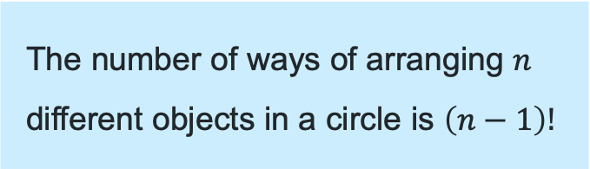
Permutations in a circle
Formalising the rule
The number of ways of arranging $n$
different objects in a circle is $\left(n−1\right)!$
Fix one and arrange as if in a straight line

Slide 7
Releasing responsibility

Slide 8

Arrangements at a circular table (1)
Example and self explanation prompts – part a
7 people are seated around a circular table.
How many arrangements are possible?
Can you explain why the answer is not 7!?
$$6!=720$$

Slide 9
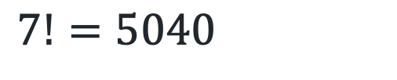
Arrangements at a circular table (2)
Question 1a – your turn
8 people are seated around a circular table.
How many arrangements are possible?
$7!=5040$

Slide 10

Arrangements at a circular table (3)
Example and self explanation prompts – part b
7 people are seated around a circular table.
How many arrangements are possible if 2 friends must sit together?
Why does the solution include a 2!?
$$=5!×2! \\ =240$$
Why does the solution include a 5!?

Slide 11

Arrangements at a circular table (4)
Question 1b – your turn
8 people are seated around a circular table
How many arrangements are possible if 3 friends must sit together?
$$=5!×3! \\ =720$$

Slide 12

Arrangements at a circular table (5)
Example and self explanation prompts – part c
7 people are seated around a circular table
What is the probability that the 2 friends sit together?
Why have we selected these numbers to represent the probability?
Answers from previous parts
Total arrangements $6!=720$
Arrangements with 2 together
$$=5!×2! \\ =240$$
P(2 friends together)
$$=\frac{240}{720} \\ =\frac{1}{3}$$

Slide 13
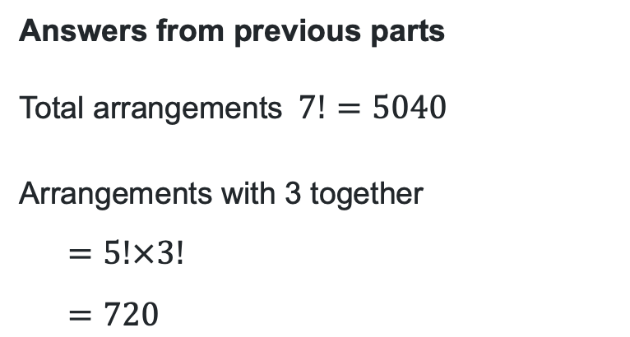
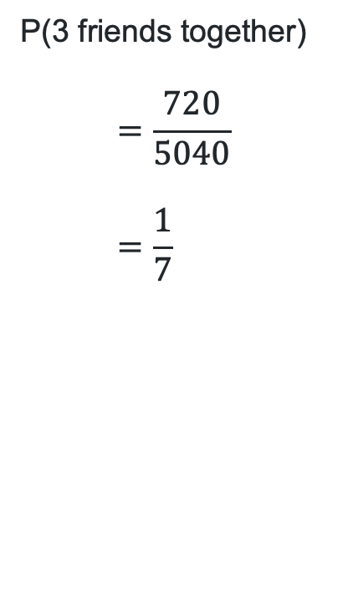
Arrangements at a circular table (6)
Question 1c – your turn
8 people are seated around a circular table
What is the probability that the 3 friends sit together?
Answers from previous parts
Total arrangements$7!=5040$
Arrangements with 3 together
$$=5!×3! \\ =720$$
P(3 friends together)
$$=\frac{720}{5040} \\ =\frac{1}{7}$$

Slide 14
Independent practice

Slide 15
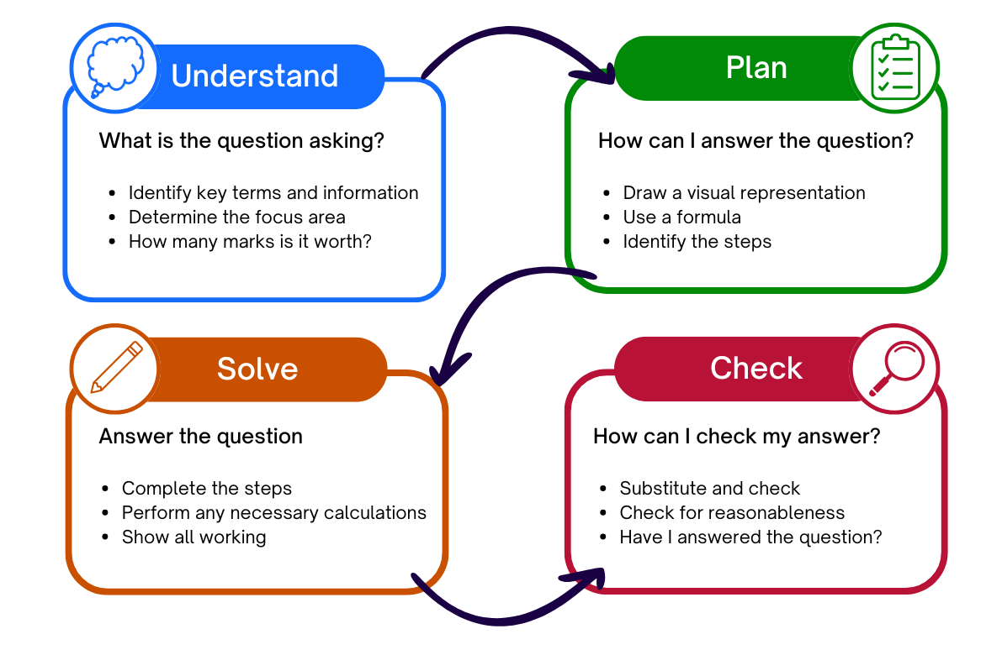
Approaching questions scaffold

Slide 16
Problem 2
Independent practice
5 boys and 5 girls are seated alternately around a circular table. Jack hopes he will be sitting next to Mary.
What is the probability that Jack will get to sit next to Mary?

Slide 17
Problem 2 - total arrangements
5 boys, 5 girls, alternately, circular table, probability that Jack will sit next to Mary
Place Jack and arrange the boys
$$4!=24$$
Arranging the girls
$$5!=120$$
Total arrangements
$$24×120=2880$$

Slide 18
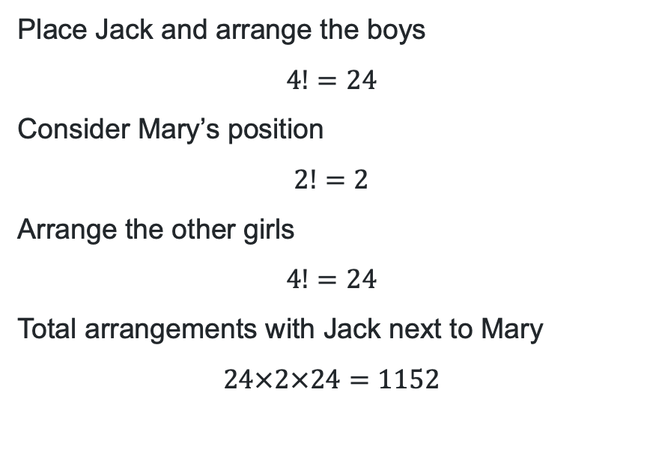
Problem 2 – arrangements with restrictions
5 boys, 5 girls, alternately, circular table, probability that Jack will sit next to Mary
Place Jack and arrange the boys
$$4!=24$$
Consider Mary’s position
$$2!=2$$
Arrange the other girls
$$4!=24$$
Total arrangements with Jack next to Mary
$$24×2×24=1152$$
M J M

Slide 19
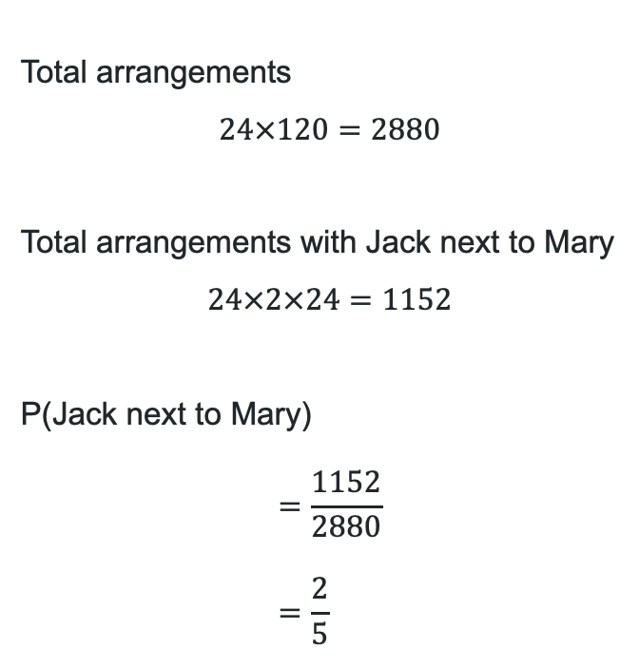
Problem 2 – calculating probability
5 boys, 5 girls, alternately, circular table, probability that Jack will sit next to Mary
Total arrangements
$$24×120=2880$$
Total arrangements with Jack next to Mary
$$24×2×24=1152$$
P(Jack next to Mary)
$$=\frac{1152}{2880} \\ =\frac{2}{5}$$

Slide 20
References
This presentation contains NSW Curriculum and syllabus content. The NSW Curriculum is developed by the NSW Education Standards Authority. This content is prepared by NESA for and on behalf of the Crown in the right of the State of New South Wales. The material is protected by Crown copyright.
Please refer to the NESA Copyright Disclaimer for more information https://educationstandards.nsw.edu.au/wps/portal/nesa/mini-footer/copyright.
NESA holds the only official and up-to-date versions of the NSW Curriculum and syllabus documents. Please visit the NSW Education Standards Authority (NESA) website https://educationstandards.nsw.edu.au/wps/portal/nesa/home and the NSW Curriculum website https://curriculum.nsw.edu.au.
Mathematics Extension 1 11–12 Syllabus (2025) © NSW Education Standards Authority (NESA) for and on behalf of the Crown in right of the State of New South Wales, 2025

Slide 21
Copyright
© State of New South Wales (Department of Education), 2025
The copyright material published in this resource is subject to the Copyright Act 1968 (Cth) and is owned by the NSW Department of Education or, where indicated, by a party other than the NSW Department of Education (third-party material).
Copyright material available in this resource and owned by the NSW Department of Education is licensed under a Creative Commons Attribution 4.0 International (CC BY 4.0) license.
This license allows you to share and adapt the material for any purpose, even commercially.
Attribution should be given to © State of New South Wales (Department of Education), 2025.
Material in this resource not available under a Creative Commons license:
the NSW Department of Education logo, other logos and trademark-protected material
Material owned by a third party that has been reproduced with permission. You will need to obtain permission from the third party to reuse its material.
Links to third-party material and websites
Please note that the provided (reading/viewing material/list/links/texts) are a suggestion only and implies no endorsement, by the New South Wales Department of Education, of any author, publisher, or book title. School principals and teachers are best placed to assess the suitability of resources that would complement the curriculum and reflect the needs and interests of their students.
If you use the links provided in this document to access a third-party’s website, you acknowledge that the terms of use, including licence terms set out on the third-party’s website apply to the use which may be made of the materials on that third-party website or where permitted by the Copyright Act 1968 (Cth). The department accepts no responsibility for content on third-party websites.

