Slide 1
Permutations with repetition
Mathematics Extension 1 – Year 11
Permutations and combinations

Slide 2
Activating prior knowledge

Slide 3
DNA strand
10 base pairs
G
T
T
C
A
G
G
C
C
A
C
A
A
G
T
C
C
G
G
T

Slide 4
Learning intention and success criteria
Learning intention
To be able to solve problems with permutations involving the repetition of objects.
Success criteria
I can identify repetition in an arrangement.
I can explain how to modify permutation calculations to account for repetition.
I can solve permutation problems where objects are not distinct.
Notes:
Notes for teachers:
Learning intentions and success criteria are best co-constructed with students. Adapt the learning intention as required and add matching success criteria.
For more information See ⁠AITSL or the NSW Department of Education explicit teaching strategies, ⁠Sharing learning intentions and ⁠Sharing success criteria
LISC is not necessarily presented at the beginning of the lesson. Teacher needs to consider most effectual time to introduce
LISC should be revisited during the lesson to support students' evaluation of their learning

Slide 5
Connecting learning

Slide 6
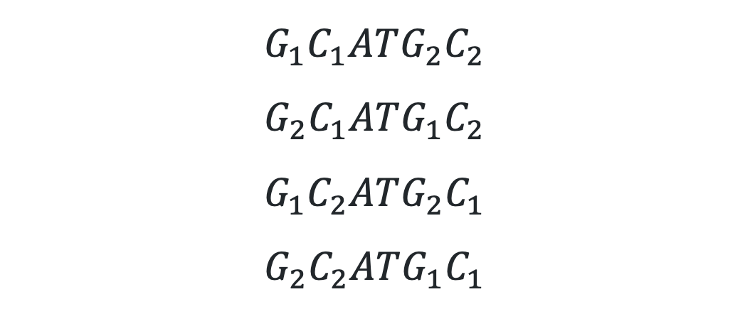
DNA arrangements (1)
Consider the arrangement GCATGC
$$G_{1}C_{1}ATG_{2}C_{2}$$
$$G_{2}C_{1}ATG_{1}C_{2}$$
$$G_{1}C_{2}ATG_{2}C_{1}$$
$$G_{2}C_{2}ATG_{1}C_{1}$$

Slide 7
DNA arrangements (2)
Consider the arrangement CAGATA
C
A
G
A
T
A
3
x
2
x
1
= 6

Slide 8
Releasing responsibility

Slide 9
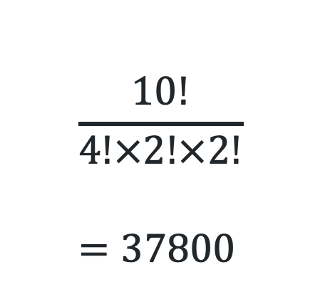
Arrangements with repetition (1)
Example 1
How many ways can the letters in the word PARRAMATTA be arranged?
P A R R A M A T T A
1 x P
4 x A
2 x R
1 x M
2 x T
Where does the 10! come from?
Can you explain where the numbers in the denominator come from?
$$\frac{10!}{4!×2!×2!} \\ =37800$$
Can you unroll the factorial notation to calculate the result?

Slide 10
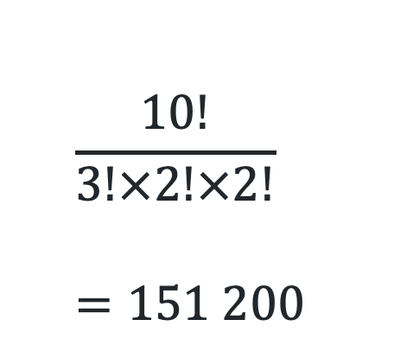
Arrangements with repetition (2)
Your turn - Question 1
How many ways can the letters in the word APPEARANCE be arranged?
A P P E A R A N C E
3 x A 1 x R
2 x P 1 x N
2 x E 1 x C
$$\frac{10!}{3!×2!×2!} \\ =151 200$$

Slide 11
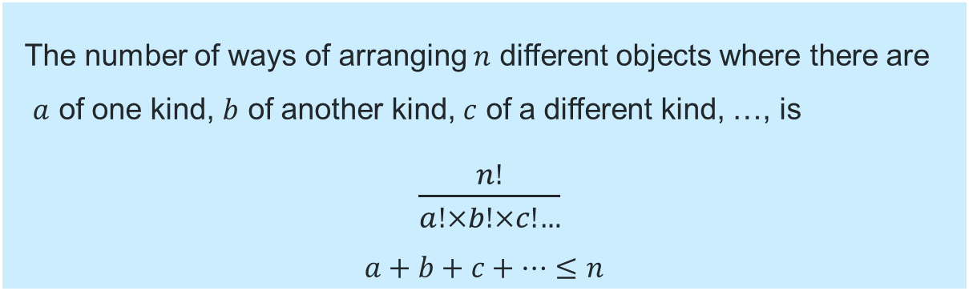
Arrangements with repetition (3)
Formalising the rule
The number of ways of arranging $n$ different objects where there are
$a$ of one kind, $b$ of another kind, $c$ of a different kind, …, is
$\frac{n!}{a!×b!×c!…}$
$$a+b+c+…≤n$$

Slide 12
Independent practice

Slide 13

Approaching question scaffold

Slide 14
Problem 1
Independent practice
Using the letters from the word COMBINATORICS, find the number of possible arrangements if the vowels can only move to where there is currently a vowel.

Slide 15
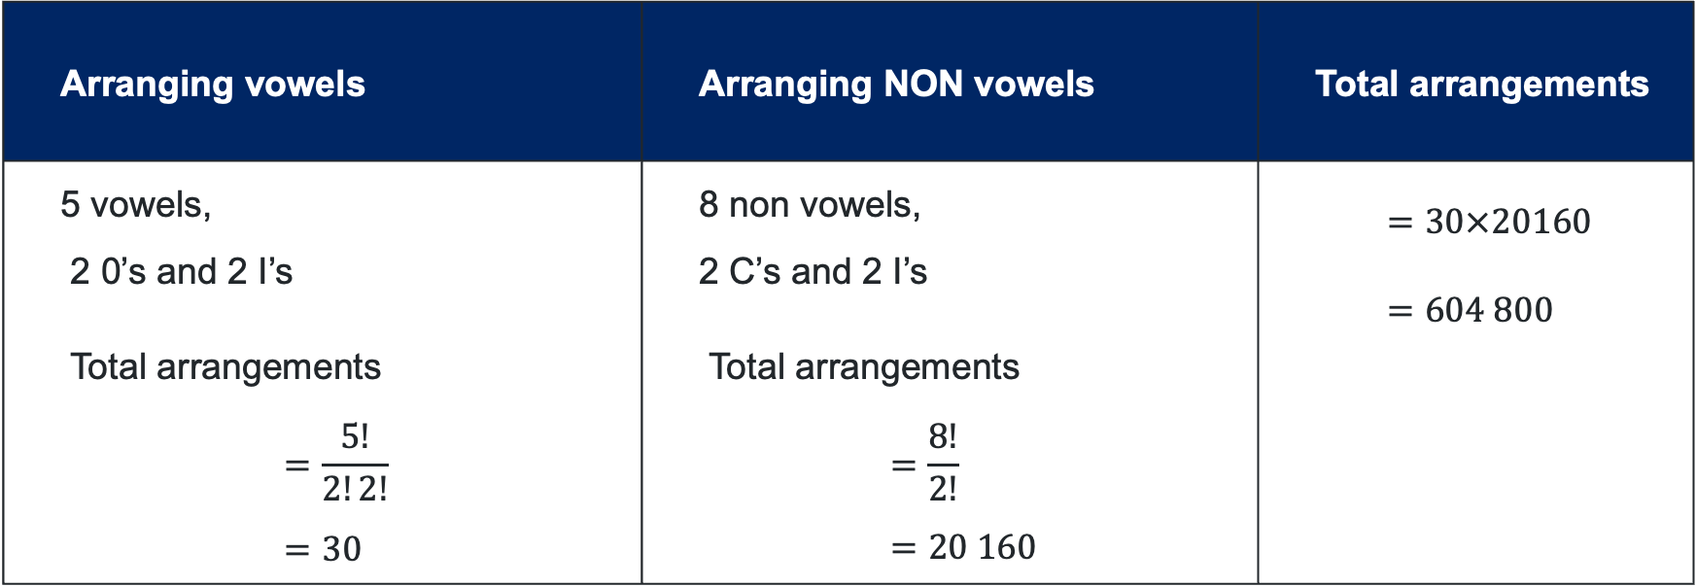
Solution – Problem 1
C
O
M
B
I
N
A
T
O
R
I
C
S
Arranging vowels | Arranging NON vowels | Total arrangements
5 vowels, 2 0’s and 2 I’s Total arrangements $$=\frac{5!}{2!2!} \\ =30$$ | 8 non vowels, 2 C’s and 2 I’s Total arrangements $$=\frac{8!}{2!} \\ =20 160$$ | $$=30×20160 \\ =604 800$$

Slide 16
Problem 2
You do
There is a test with 10 multiple-choice questions, with options A, B, C and D for each. The teacher wants to help her students and tells them there are 3 C’s 3 A’s, 2 B’s and 2 D’s. Is this helpful, why or why not? Find the probability that a student will get the answers correct.

Slide 17
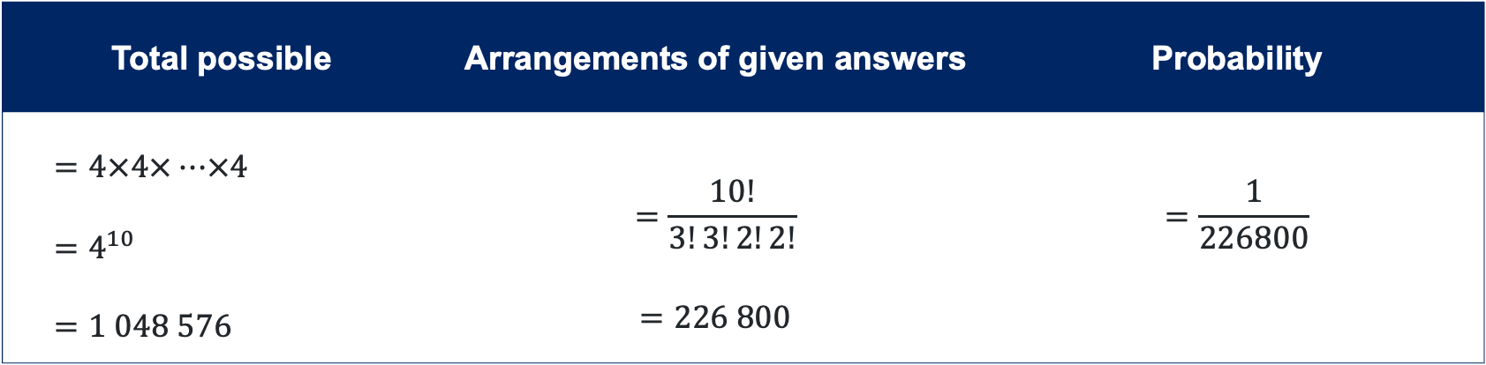
Solution - Problem 2
10 MC questions, 3 C’s 3 A’s, 2 B’s and 2 D’s. Is this helpful? Find the probability.
Total possible | Arrangements of given answers | Probability
$$=4×4×…×4 \\ =4^{10} \\ =1 048 576$$ | $$=\frac{10!}{3!3!2!2!} \\ =226 800$$ | $$=\frac{1}{226800}$$
The teacher’s tip is helpful as it reduces the number of arrangements. There is still an impossible number of arrangements for the students to rely on this hint to achieve full marks in the test.

Slide 18
References
This presentation contains NSW Curriculum and syllabus content. The NSW Curriculum is developed by the NSW Education Standards Authority. This content is prepared by NESA for and on behalf of the Crown in the right of the State of New South Wales. The material is protected by Crown copyright.
Please refer to the NESA Copyright Disclaimer for more information https://educationstandards.nsw.edu.au/wps/portal/nesa/mini-footer/copyright.
NESA holds the only official and up-to-date versions of the NSW Curriculum and syllabus documents. Please visit the NSW Education Standards Authority (NESA) website https://educationstandards.nsw.edu.au/wps/portal/nesa/home and the NSW Curriculum website https://curriculum.nsw.edu.au.
Mathematics Extension 1 11–12 Syllabus © NSW Education Standards Authority (NESA) for and on behalf of the Crown in right of the State of New South Wales, 2025

Slide 19
Copyright
© State of New South Wales (Department of Education), 2025
The copyright material published in this resource is subject to the Copyright Act 1968 (Cth) and is owned by the NSW Department of Education or, where indicated, by a party other than the NSW Department of Education (third-party material).
Copyright material available in this resource and owned by the NSW Department of Education is licensed under a Creative Commons Attribution 4.0 International (CC BY 4.0) license.
This license allows you to share and adapt the material for any purpose, even commercially.
Attribution should be given to © State of New South Wales (Department of Education), 2025.
Material in this resource not available under a Creative Commons license:
the NSW Department of Education logo, other logos and trademark-protected material
Material owned by a third party that has been reproduced with permission. You will need to obtain permission from the third party to reuse its material.
Links to third-party material and websites
Please note that the provided (reading/viewing material/list/links/texts) are a suggestion only and implies no endorsement, by the New South Wales Department of Education, of any author, publisher, or book title. School principals and teachers are best placed to assess the suitability of resources that would complement the curriculum and reflect the needs and interests of their students.
If you use the links provided in this document to access a third-party’s website, you acknowledge that the terms of use, including licence terms set out on the third-party’s website apply to the use which may be made of the materials on that third-party website or where permitted by the Copyright Act 1968 (Cth). The department accepts no responsibility for content on third-party websites.

