Slide 1
Multiplication principle
Mathematics Extension 1 – Year 11
Permutations and combinations

Slide 2
Learning intention and success criteria
Learning intention
To understand and use the multiplication principle.
Success criteria
I can identify how many outcomes there are for an event.
I can explain what it means when events are independent of each other.
I can use the multiplication principle to find the total number of outcomes of multistage events.
I can use the multiplication principle to calculate a probability.
Notes:
Notes for teachers:
Learning intentions and success criteria are best co-constructed with students. Adapt the learning intention as required and add matching success criteria.
For more information See ⁠AITSL or the NSW Department of Education explicit teaching strategies, ⁠Sharing learning intentions and ⁠Sharing success criteria
LISC is not necessarily presented at the beginning of the lesson. Teacher needs to consider most effectual time to introduce
LISC should be revisited during the lesson to support students' evaluation of their learning

Slide 3
Connecting learning

Slide 4
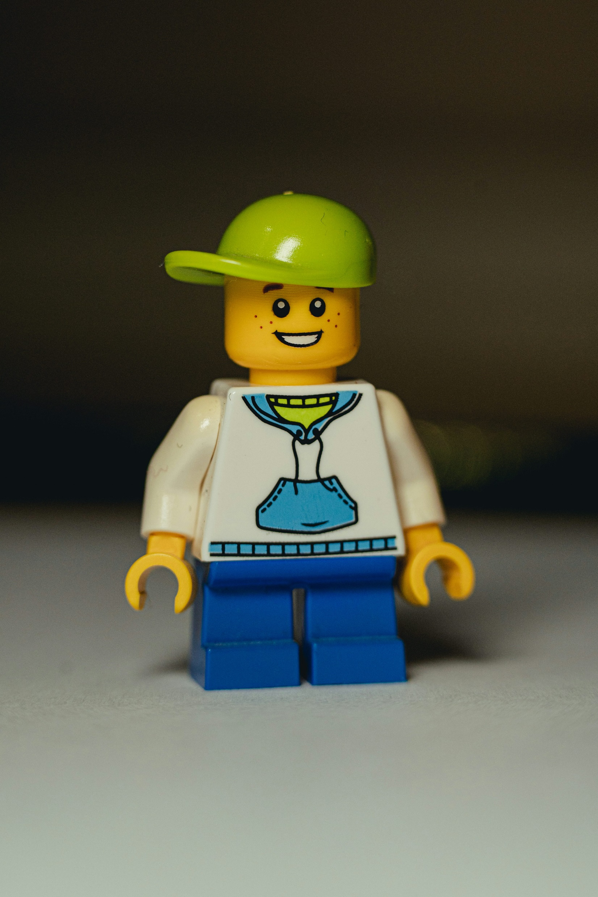
Minifigure problem
In a minifigure factory, you can build your own character. How many people can be made from a variety of
3 faces, 2 bodies and 4 legs?
Draw a tree diagram to demonstrate the choices.
Images licensed under Unsplash License

Slide 5




Multiplication principle (1)
Character
Face 1
Body 1
Face 2
Body 1
Face 3
Body 2
Body 1
Body 2
Legs 1
Legs 2
Legs 3
Legs 4
Body 2
Legs 1
Legs 2
Legs 3
Legs 4
Legs 1
Legs 2
Legs 3
Legs 4
Legs 1
Legs 2
Legs 3
Legs 4
Legs 1
Legs 2
Legs 3
Legs 4
Legs 1
Legs 2
Legs 3
Legs 4
Tree diagram
Faces
Bodies
Legs
3
2
4
$$×$$
$$×$$
$$=$$
$$24$$

Slide 6
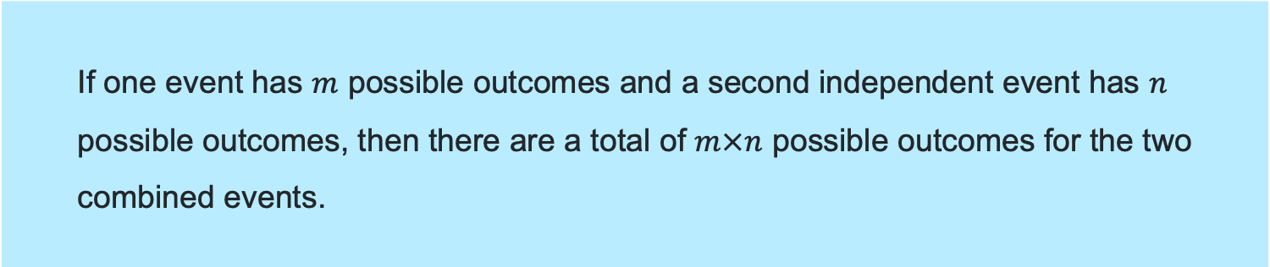
Multiplication principle (2)
Definition
If one event has $m$ possible outcomes and a second independent event has $n$ possible outcomes, then there are a total of $m×n$ possible outcomes for the two combined events.

Slide 7
Releasing responsibility

Slide 8

Multiplication principle (3)
Worked example
What is the probability of creating a minifigure with a red body?
Where do these numbers come from?
Faces | Body | Legs
😊 Happy | 🟥 Red | ⚫ Black
😐 Neutral | 🟨 Yellow | ⚪ White
😡 Angry | 🟩 Green
 | 🟦 Blue
How many figures in total?
Why do we multiply?
$$3×4×2=24$$
How many figures have a red body?
Why has the 4 turned into a 1?
$$3×1×2=6$$
What is the probability?
Why is the answer a fraction?
$$\frac{6}{24}$$

Slide 9

Multiplication principle (4)
Your turn
What is the probability that you create a minifigure with a happy face?
How many figures in total?
Faces | Body | Legs
😊 Happy | 🟥 Red | ⚫ Black
😐 Neutral | 🟨 Yellow | ⚪ White
😡 Angry | 🟩 Green
 | 🟦 Blue
$$3×4×2=24$$
How many figures have happy faces?
$$1×4×2=8$$
What is the probability?
$$\frac{8}{24}=\frac{1}{3}$$

Slide 10
Independent practice

Slide 11

Approaching questions scaffold

Slide 12
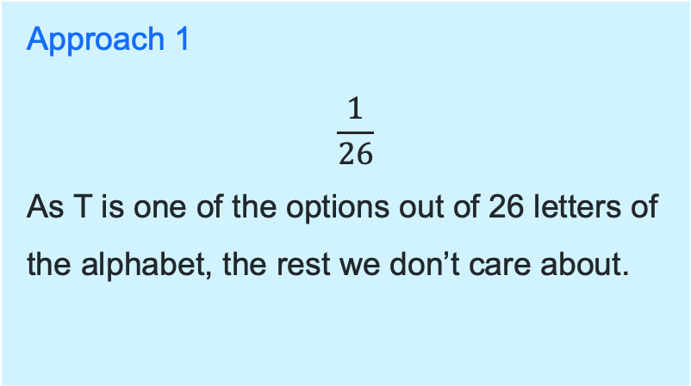
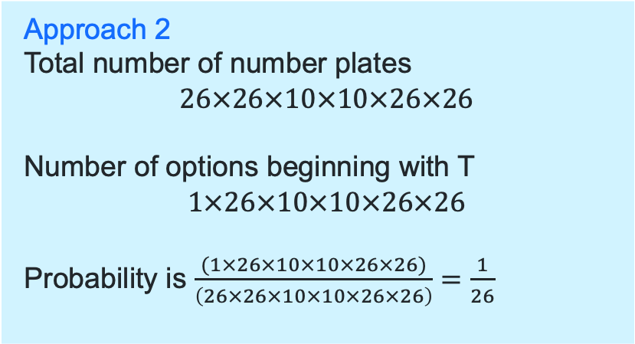
Multiplication principle (5)
HSC style question
Some car registration plates contain two letters followed by two numerals followed by two more letters, e.g., WT 01 GT. Letters and numerals may be repeated.
What is the probability of buying a new car with a number plate beginning with the letter T?
Find two ways to calculate the probability. Explain each approach.
Approach 1
$$\frac{1}{26}$$
As T is one of the options out of 26 letters of the alphabet, the rest we don’t care about.
Approach 2
Total number of number plates
$$26×26×10×10×26×26$$
Number of options beginning with T
$$1×26×10×10×26×26$$
Probability is $\frac{(1×26×10×10×26×26)}{\left(26×26×10×10×26×26\right)}$ $=\frac{1}{26}$

Slide 13
References
This presentation contains NSW Curriculum and syllabus content. The NSW Curriculum is developed by the NSW Education Standards Authority. This content is prepared by NESA for and on behalf of the Crown in the right of the State of New South Wales. The material is protected by Crown copyright.
Please refer to the NESA Copyright Disclaimer for more information https://educationstandards.nsw.edu.au/wps/portal/nesa/mini-footer/copyright.
NESA holds the only official and up-to-date versions of the NSW Curriculum and syllabus documents. Please visit the NSW Education Standards Authority (NESA) website https://educationstandards.nsw.edu.au/wps/portal/nesa/home and the NSW Curriculum website https://curriculum.nsw.edu.au.
Mathematics Extension 1 11–12 Syllabus © NSW Education Standards Authority (NESA) for and on behalf of the Crown in right of the State of New South Wales, 2024

Slide 14
Copyright
© State of New South Wales (Department of Education), 2025
The copyright material published in this resource is subject to the Copyright Act 1968 (Cth) and is owned by the NSW Department of Education or, where indicated, by a party other than the NSW Department of Education (third-party material).
Copyright material available in this resource and owned by the NSW Department of Education is licensed under a Creative Commons Attribution 4.0 International (CC BY 4.0) license.
This license allows you to share and adapt the material for any purpose, even commercially.
Attribution should be given to © State of New South Wales (Department of Education), 2025.
Material in this resource not available under a Creative Commons license:
the NSW Department of Education logo, other logos and trademark-protected material
Material owned by a third party that has been reproduced with permission. You will need to obtain permission from the third party to reuse its material.
Links to third-party material and websites
Please note that the provided (reading/viewing material/list/links/texts) are a suggestion only and implies no endorsement, by the New South Wales Department of Education, of any author, publisher, or book title. School principals and teachers are best placed to assess the suitability of resources that would complement the curriculum and reflect the needs and interests of their students.
If you use the links provided in this document to access a third-party’s website, you acknowledge that the terms of use, including licence terms set out on the third-party’s website apply to the use which may be made of the materials on that third-party website or where permitted by the Copyright Act 1968 (Cth). The department accepts no responsibility for content on third-party websites.

