Slide 1
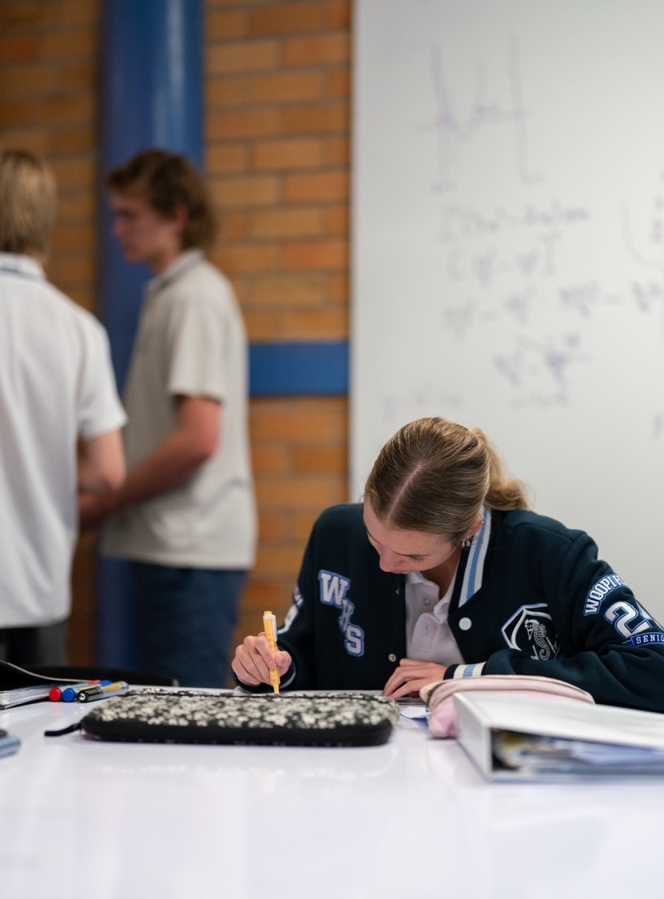
Change of base
Mathematics Advanced – Stage 6 (Year 11)
Exponential and logarithmic functions

Slide 2
Learning intentions and success criteria
Learning intention
To be able to solve problems involving logarithms with different bases.
Success criteria
I can change the base of a logarithm.
I can use a calculator to find the value of a logarithm involving different bases.
I can apply the logarithmic laws, including change of base, to solve problems.

Slide 3
Activating prior knowledge

Slide 4
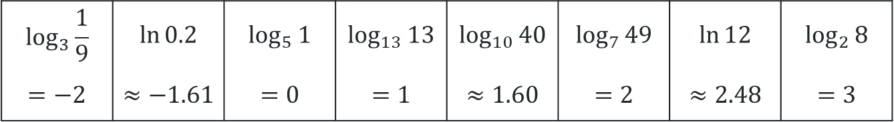
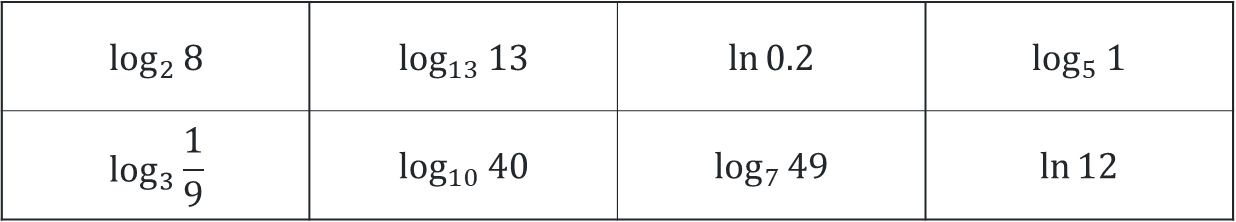

Sorting logarithms (1)
Sort the following logarithms from smallest to largest.
$$\log_{2}{8}$$ | $$\log_{13}{13}$$ | $$\ln{0.2}$$ | $$\log_{5}{1}$$
$$\log_{3}{\frac{1}{9}}$$ | $$\log_{10}{40}$$ | $$\log_{7}{49}$$ | $$\ln{12}$$
$$\log_{3}{\frac{1}{9}}$$ | $$\ln{0.2}$$ | $$\log_{5}{1}$$ | $$\log_{13}{13}$$ | $$\log_{10}{40}$$ | $$\log_{7}{49}$$ | $$\ln{12}$$ | $$\log_{2}{8}$$
$$=−2$$ | $$≈−1.61$$ | $$=0$$ | $$=1$$ | $$≈1.60$$ | $$=2$$ | $$≈2.48$$ | $$=3$$
Now consider, where $\log_{2}{2.8}$ would fit in this list?
How can we tell?

Slide 5
Connecting learning

Slide 6
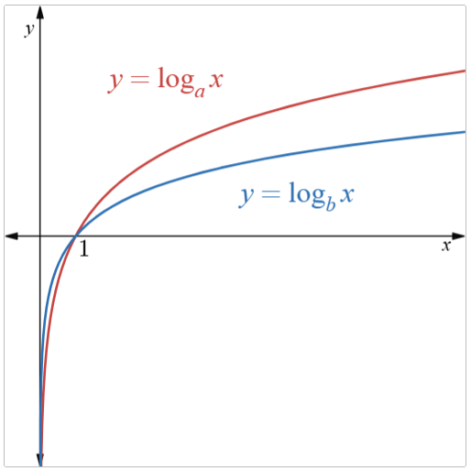
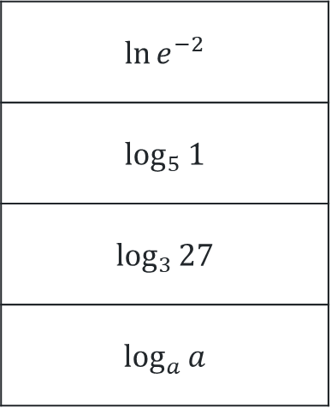
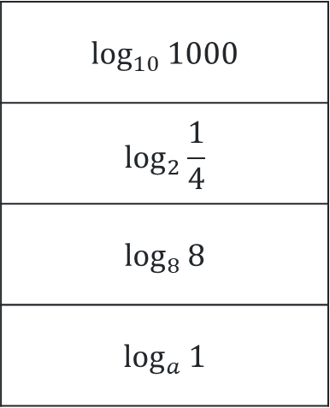
Equivalent logs
Match up the equivalent logarithms.
$$\log_{10}{1000}$$
$$\log_{2}{\frac{1}{4}}$$
$$\log_{8}{8}$$
$$\log_{a}{1}$$
$$\ln{e^{−2}}$$
$$\log_{5}{1}$$
$$\log_{3}{27}$$
$$\log_{a}{a}$$
Will there always be an equivalent logarithm in another base? Why or why not?

Slide 7

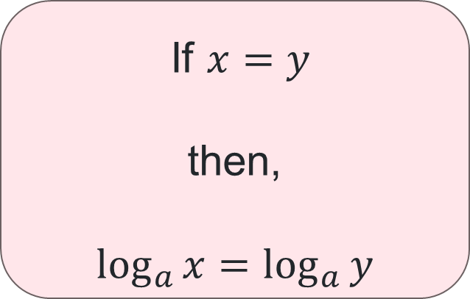
Taking the logarithm of both sides (1)
If $x=y$
then,
$$\log_{a}{x}=\log_{a}{y}$$
What are the restrictions on $x$ and $y$?
If we take the logarithm of both sides of an equation, have we changed the solution?
What do you notice about the bases?

Slide 8

Taking the logarithm of both sides (2)
Solve $2^{x}={10}^{x+1}$ for $x$, correct to 2 decimal places.
    $$2^{x}={10}^{x+1} \\ \log_{10}{2^{x}}=\log_{10}{{10}^{x+1} } (taking the logarithm of both sides, base 10) \\ \log_{10}{2^{x}}=x+1 \\ x\log_{10}{2}=x+1 \\ x\log_{10}\left(2\right)−x=1 \\ x\left(\log_{10}\left(2\right)−1\right)=1 \\ x=\frac{1}{\log_{10}\left(2\right)−1} \\ x≈−1.43$$
Why did we choose base 10?
Why might we use brackets around the number 2?

Slide 9
Releasing responsibility

Slide 10

Change of base proof (1)
Let $x=a^{m}$ then $m=$
$$\log_{a}{x }$$
Definition of a logarithm

Slide 11

Change of base proof (2)
Let $x=a^{m}$ then $m=\log_{a}{x }$
Consider $x=a^{m}$
Take the logarithm to base $b$ on both sides
$\log_{b}{x}=\log_{b}{a^{m}}$
How do I write this?

Slide 12


Change of base proof (3)
Let $x=a^{m}$ then $m=\log_{a}{x }$
Consider $x=a^{m}$
Take the logarithm to base $b$ on both sides
$\log_{b}{x}=\log_{b}{a^{m}}$
$\log_{b}{x}=m\log_{b}{a}$
$∴m=\frac{\log_{b}{x}}{\log_{b}{a }}$
How can I make $m$ the subject?

Slide 13

Change of base proof (4)
Let $x=a^{m}$ then $m=\log_{a}{x }$
Consider $x=a^{m}$
Take the logarithm to base $b$ on both sides
$\log_{b}{x}=\log_{b}{a^{m}}$
$\log_{b}{x}=m\log_{b}{a}$
$∴m=\frac{\log_{b}{x}}{\log_{b}{a }}$ but, $m=\log_{a}{x}$
$∴\log_{a}{x}=\frac{\log_{b}{x}}{\log_{b}{a}}$
How do I conclude a proof?

Slide 14

Change of base (1)
Worked example 1
Change $\log_{2}{3}$ to an expression with logarithms in base $e$ and evaluate correct to 3 decimal places.
$$\log_{2}{3=\frac{\ln{3}}{\ln{2}}} \\ =1.58496… \\ =1.585$$
How do I decide which base to use on my calculator?

Slide 15

Change of base (2)
Your turn 1
Change $\log_{5}{7}$ to an expression with logarithms in base $10$ and evaluate correct to 3 decimal places.
$$\log_{5}{7}=\frac{\log_{10}{7}}{\log_{10}{5}} \\ =1.20906… \\ =1.209$$

Slide 16

Change of base (3)
Worked example 2
If $\log_{a}{x=0.67}$ and $\log_{a}{y=}−3.20$, find the value of $\log_{x}{y^{2}}$.
$$\log_{x}{y^{2}}=2\log_{x}{y} \\ =2\frac{\log_{a}{y}}{\log_{a}{x }} \\ =2×\frac{−3.20}{0.67} \\ =9.55223…$$
$=−9.55$ (2 decimal places)
Is this the only base we could have used?
How many decimal places should we give? Why?

Slide 17

Change of base (4)
Your turn 2
If $\log_{a}{x=4.799}$ and $\log_{a}{y=}5.419$, find the value of $\log_{x}{xy}$.
$$\log_{x}{xy}=\log_{x}{x}+\log_{x}{y} \\ =1+\log_{x}{y} \\ =1+\frac{\log_{a}{y}}{\log_{a}{x }} \\ =1+\frac{5.419}{4.799} \\ =2.12919… \\ =2.129 \text{(3 }\text{decimal} \text{places}\text{)}$$

Slide 18
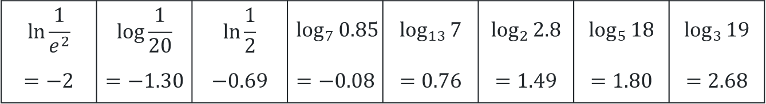
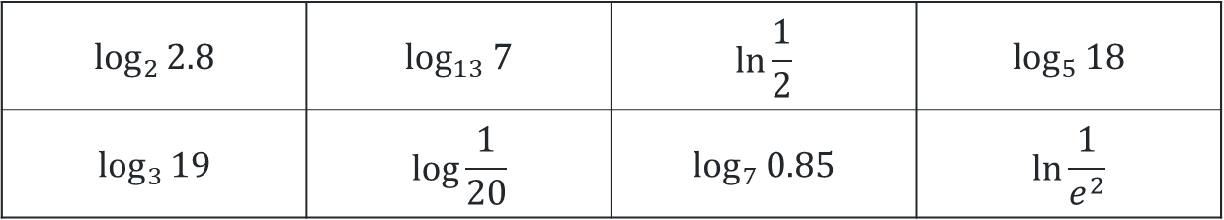
Sorting logarithms (2)
Evaluate correct to 2 decimal places and sort the following logarithms from smallest to largest.
$$\log_{2}{2.8}$$ | $$\log_{13}{7}$$ | $$\ln{\frac{1}{2}}$$ | $$\log_{5}{18}$$
$$\log_{3}{19}$$ | $$\log{\frac{1}{20}}$$ | $$\log_{7}{0.85}$$ | $$\ln{\frac{1}{e^{2}}}$$
$$\ln{\frac{1}{e^{2}}}$$ | $$\log{\frac{1}{20}}$$ | $$\ln{\frac{1}{2}}$$ | $$\log_{7}{0.85}$$ | $$\log_{13}{7}$$ | $$\log_{2}{2.8}$$ | $$\log_{5}{18}$$ | $$\log_{3}{19}$$
$$=−2$$ | $$=−1.30$$ | $$−0.69$$ | $$=−0.08$$ | $$=0.76$$ | $$=1.49$$ | $$=1.80$$ | $$=2.68$$

Slide 19
Independent practice

Slide 20

Problem-solving questions
Given that $\log_{2}{x}+\log_{4}{x}=6$, find the value of $x.$
Given that$\log_{3}{x}=\log_{x}{3}$, find the value of $x.$
Given that $\log_{x}{81}=\log_{3}{x}$, find the value of $x.$

Slide 21


Solution 1
Given that $\log_{2}{x}+\log_{4}{x}=6$, find the value of $x.$
$$\log_{2}{x}+\log_{4}{x}=6$$
$$\log_{2}{x}+\frac{\log_{2}{x}}{\log_{2}{4}}=6 \\ \log_{2}{x}+\frac{\log_{2}{x}}{2}=6 \\ \frac{3}{2}\log_{2}{x}=6$$
$$\log_{2}{x}=\frac{2}{3}×6 \\ \log_{2}{x}=4 \\ x=2^{4} \\ x=16$$

Slide 22

Solution 2
Given that$\log_{3}{x}=\log_{x}{3}$, find the value of $x.$
$$\log_{3}{x}=\log_{x}{3}$$
$$\log_{3}{x}=\frac{\log_{3}{3}}{\log_{3}{x}} \\ \log_{3}{x}=\frac{1}{\log_{3}{x}} \\ {\left(\log_{3}{x}\right)}^{2}=1 \\ \log_{3}{x}=1 (\log_{a}{x>0}) \\ ∴x=3$$

Slide 23

Solution 3
Given that $\log_{x}{81}=\log_{3}{x}$, find the value of $x.$
$$\log_{x}{81}=\log_{3}{x}\frac{\log_{3}{81}}{\log_{3}{x}}=\log_{3}{x} \\ \frac{4}{\log_{3}{x}}=\log_{3}{x} \\ 4={\left(\log_{3}{x}\right)}^{2} \\ 2=\log_{3}{x} \left(\log_{a}{x>0}\right) \\ ∴x=3^{2} \\ x=9$$

Slide 24
References
This presentation contains NSW Curriculum and syllabus content. The NSW Curriculum is developed by the NSW Education Standards Authority. This content is prepared by NESA for and on behalf of the Crown in the right of the State of New South Wales. The material is protected by Crown copyright.
Please refer to the NESA Copyright Disclaimer for more information https://educationstandards.nsw.edu.au/wps/portal/nesa/mini-footer/copyright.
NESA holds the only official and up-to-date versions of the NSW Curriculum and syllabus documents. Please visit the NSW Education Standards Authority (NESA) website https://educationstandards.nsw.edu.au/wps/portal/nesa/home and the NSW Curriculum website https://curriculum.nsw.edu.au.
Mathematics Advanced 11-12 Syllabus © NSW Education Standards Authority (NESA) for and on behalf of the Crown in right of the State of New South Wales, 2024.

Slide 25
Copyright
© State of New South Wales (Department of Education), 2026
The copyright material published in this resource is subject to the Copyright Act 1968 (Cth) and is owned by the NSW Department of Education or, where indicated, by a party other than the NSW Department of Education (third-party material).
Copyright material available in this resource and owned by the NSW Department of Education is licensed under a Creative Commons Attribution 4.0 International (CC BY 4.0) license.
This license allows you to share and adapt the material for any purpose, even commercially.
Attribution should be given to © State of New South Wales (Department of Education), 2026.
Material in this resource not available under a Creative Commons license:
the NSW Department of Education logo, other logos and trademark-protected material
Material owned by a third party that has been reproduced with permission. You will need to obtain permission from the third party to reuse its material.
Links to third-party material and websites
Please note that the provided (reading/viewing material/list/links/texts) are a suggestion only and implies no endorsement, by the New South Wales Department of Education, of any author, publisher, or book title. School principals and teachers are best placed to assess the suitability of resources that would complement the curriculum and reflect the needs and interests of their students.
If you use the links provided in this document to access a third-party’s website, you acknowledge that the terms of use, including licence terms set out on the third-party’s website apply to the use which may be made of the materials on that third-party website or where permitted by the Copyright Act 1968 (Cth). The department accepts no responsibility for content on third-party websites.

