Slide 1
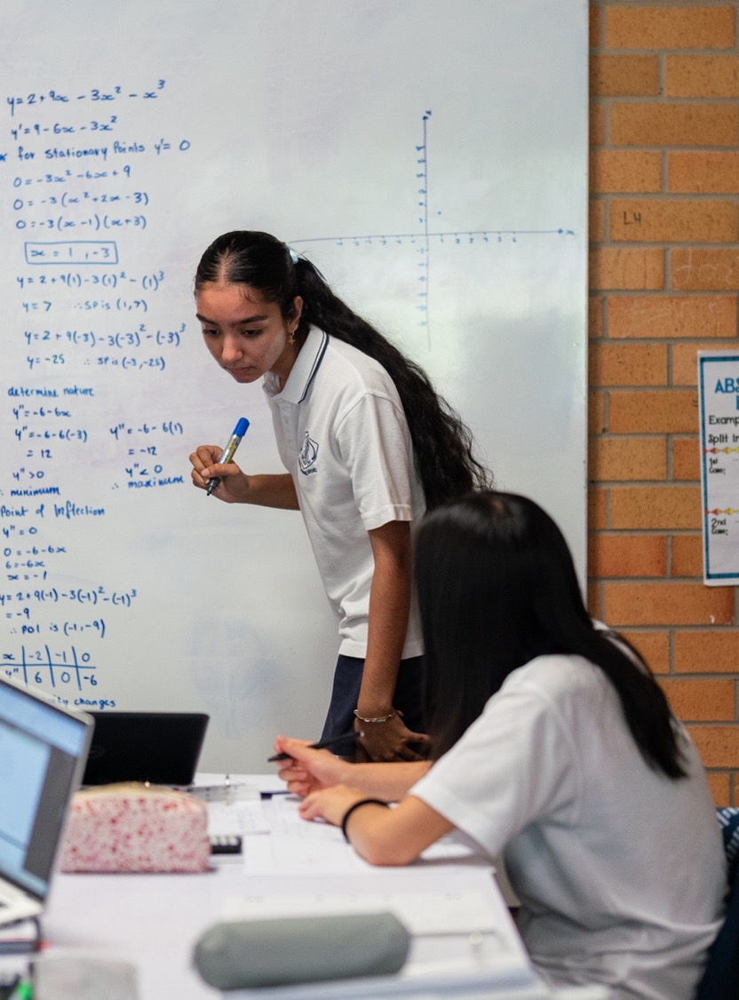
The logarithmic laws – proofs and equations
Mathematics Advanced – Stage 6 (Year 11)
Exponential and logarithmic functions

Slide 2
Learning intentions and success criteria
Learning intention
To be able to apply the logarithmic laws to prove results and solve problems
Success criteria
I can use the logarithmic laws to solve equations
I can verify logarithmic results using the logarithmic laws
I can derive the laws of logarithms

Slide 3
Activating prior knowledge

Slide 4

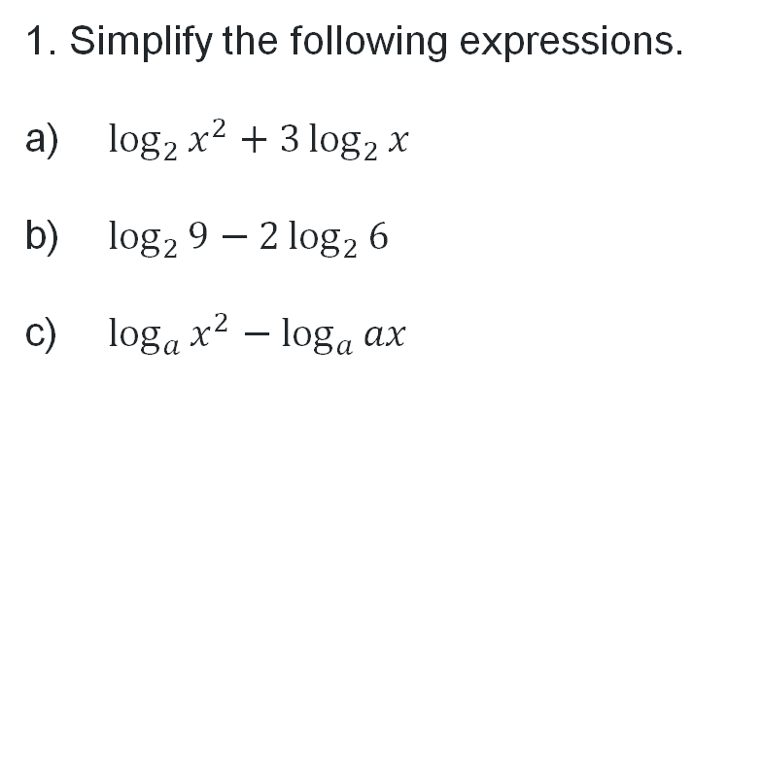


Simplifying and evaluating expressions
1. Simplify the following expressions.
$\log_{2}{x^{2}}+3\log_{2}{x}$
$\log_{2}{9}−2\log_{2}{6}$
$\log_{a}{x^{2}}−\log_{a}{ax}$
2. If $\log_{a}{x}=2.3$ and $\log_{a}{y}=4.5,$evaluate the following expressions.
$\log_{a}{xy}$
$\log_{a}{x^{y}}$
$\log_{a}\left(\frac{x^{2}}{y^{3}}\right)$
$=\log_{2}{x^{5}}$ or $5\log_{2}{x}$
$=−2$
$=\log_{a}{x}−1$
$=6.$8
$=10.35$
$=−8.9$

Slide 5

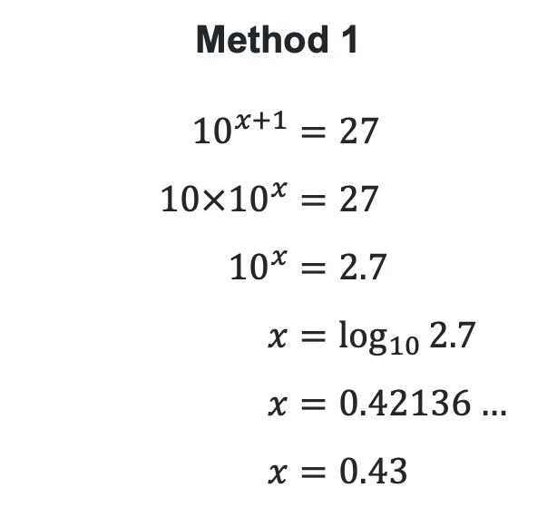
Solving exponential equations
Solve ${10}^{x+1}=27$ for $x$, correct to 2 decimal places.
Which method do you prefer and why?
Method 1
$${10}^{x+1}=27 \\ 10×{10}^{x}=27 \\ {10}^{x}=2.7 \\ x=\log_{10}{2.7} \\ x=0.42136… \\ x=0.43$$
Method 2
$${10}^{x+1}=27 \\ ∴x+1=\log_{10}{27} \\ x=\log_{10}{27}−1 \\ x=0.42136… \\ x=0.43$$
Why is the first line written this way?

Slide 6
Connecting learning

Slide 7


Logarithm of a reciprocal
Why do we show small changes from one line to the next when writing a proof?
Compare the 2 solutions
Method 1
$LHS=\log_{a}{\frac{1}{x}}$
$=\log_{a}{1}−\log_{a}{x}$
(since $\log_{b}\left(\frac{m}{n}\right)=\log_{b}{m}−\log_{b}{n}$)
$=0−\log_{a}{x}$ (since $\log_{a}{1}=0$)
$=−\log_{a}{x}$
$=RHS$
$$∴\log_{a}{\frac{1}{x}}=−\log_{a}{x}$$
Method 2
$LHS=\log_{a}{\frac{1}{x}}$
$=\log_{a}{x^{−1}}$
$=−\log_{a}{x}$ ($\log_{b}\left(m^{n}\right)=n\log_{b}{m}$)
$=RHS$
$$∴\log_{a}{\frac{1}{x}}=−\log_{a}{x}$$
What are these statements on the side and why are they here?

Slide 8
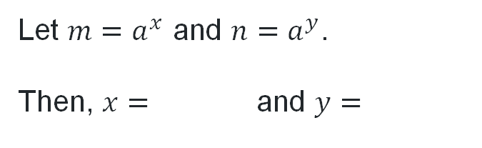
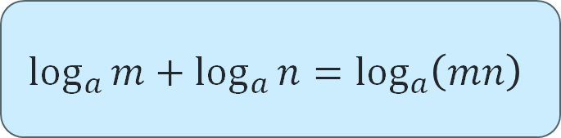
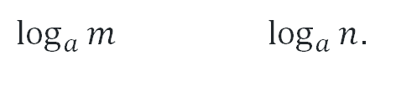
Product logarithmic law (1)
Proof
How can we rewrite these as logarithms?
$$\log_{a}{m}+\log_{a}{n}=\log_{a}\left(mn\right)$$
Let $m=a^{x}$ and $n=a^{y}$.
Then, $x=$ and $y=$
$\log_{a}{m}$ $\log_{a}{n}$.
Use the definition of a logarithm

Slide 9


Product logarithmic law (2)
Proof
$$\log_{a}{m}+\log_{a}{n}=\log_{a}\left(mn\right)$$
Let $m=a^{x}$ and $n=a^{y}$
Then, $x=\log_{a}{m}$ and $y=\log_{a}{n}$
$$\log_{a}{(mn)}=\log_{a}{(a^{x}×a^{y})} \\ = \\ = \\ =$$
Apply index laws
$$\log_{a}{(a^{x+y})}$$

Slide 10



Product logarithmic law (3)
Proof
$$\log_{a}{m}+\log_{a}{n}=\log_{a}\left(mn\right)$$
Let $m=a^{x}$ and $n=a^{y}$
Then, $x=\log_{a}{m}$ and $y=\log_{a}{n}$
$$\log_{a}{(mn)}=\log_{a}{(a^{x}×a^{y})} \\ =\log_{a}\left(a^{x+y}\right) \\ = \\ =$$
Apply the property $\log_{a}{a^{x}}=x$
$$x+y$$

Slide 11

Product logarithmic law (4)
Proof
$$\log_{a}{m}+\log_{a}{n}=\log_{a}\left(mn\right)$$
Let $m=a^{x}$ and $n=a^{y}$
Then, $x=\log_{a}{m}$ and $y=\log_{a}{n}$
$$\log_{a}{(mn)}=\log_{a}{(a^{x}×a^{y})} \\ =\log_{a}\left(a^{x+y}\right) \\ =x+y \\ =$$
What happened to the logarithm?

Slide 12


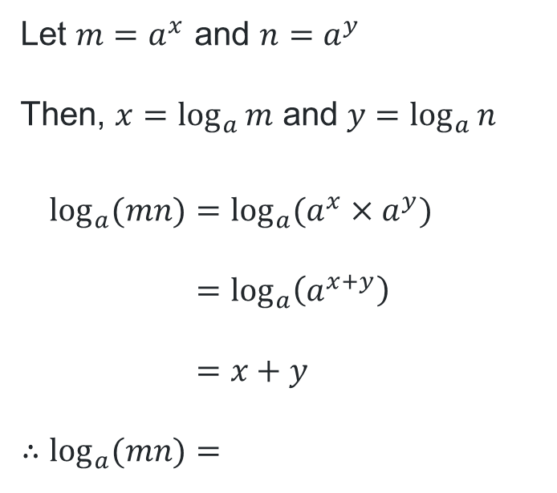
Product logarithmic law (5)
Proof
$$\log_{a}{m}+\log_{a}{n}=\log_{a}\left(mn\right)$$
Let $m=a^{x}$ and $n=a^{y}$
Then, $x=\log_{a}{m}$ and $y=\log_{a}{n}$
$$\log_{a}{(mn)}=\log_{a}{(a^{x}×a^{y})} \\ =\log_{a}\left(a^{x+y}\right) \\ =x+y \\ {∴log}_{a}{(mn)}=$$
Substitute for $x$ and $y$
$$\log_{a}{m}+\log_{a}{n}$$
Logarithm of a product

Slide 13
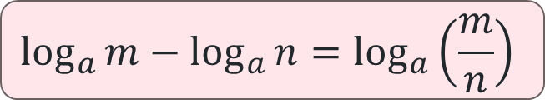
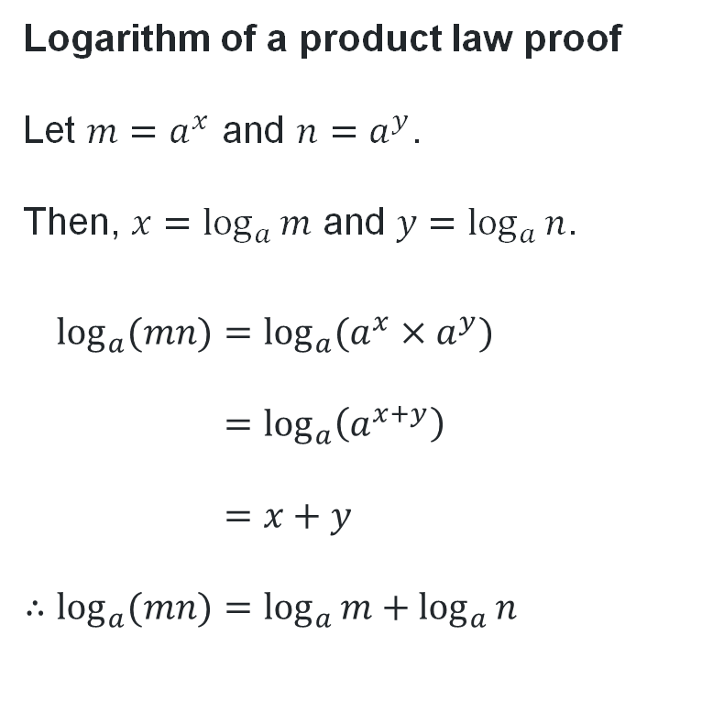
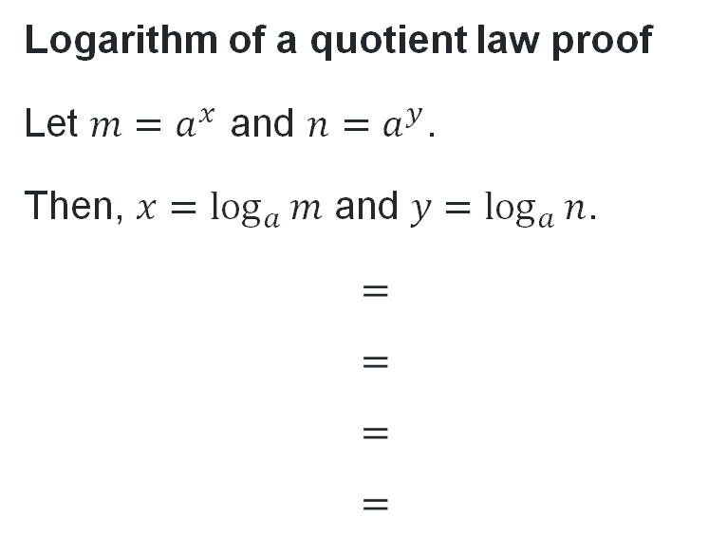
Quotient and power logarithmic laws (1)
Proving the quotient law
Use a similar process to prove the quotient law for logarithms. The proof for the product rule is displayed.
Logarithm of a product law proof
Let $m=a^{x}$ and $n=a^{y}$.
Then, $x=\log_{a}{m}$ and $y=\log_{a}{n}$.
$$\log_{a}{(mn)}=\log_{a}{(a^{x}×a^{y})} \\ =\log_{a}\left(a^{x+y}\right) \\ =x+y \\ {∴log}_{a}{(mn)}=\log_{a}{m}+\log_{a}{n}$$
$$\log_{a}{m}−\log_{a}{n}=\log_{a}\left(\frac{m}{n}\right)$$
Logarithm of a quotient law proof
Let $m=a^{x}$ and $n=a^{y}$.
Then, $x=\log_{a}{m}$ and $y=\log_{a}{n}$.
$$= \\ = \\ = \\ =$$

Slide 14
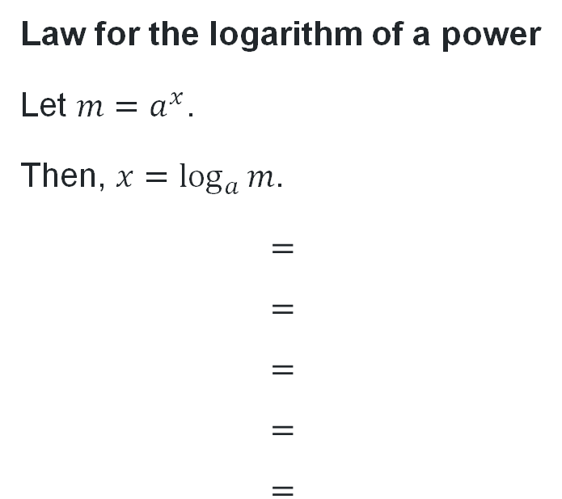
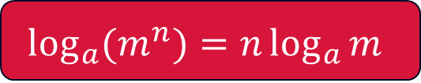

Quotient and power logarithmic laws (2)
Proving the law for the logarithm of a power
Use a similar process to prove the law for logarithm of a power.
Logarithm of a product law proof
Let $m=a^{x}$ and $n=a^{y}$.
Then, $x=\log_{a}{m}$ and $y=\log_{a}{n}$.
$$\log_{a}{(mn)}=\log_{a}{(a^{x}×a^{y})} \\ =\log_{a}\left(a^{x+y}\right) \\ =x+y \\ {∴log}_{a}{(mn)}=\log_{a}{m}+\log_{a}{n}$$
$$\log_{a}{(m^{n})}=n\log_{a}{m}$$
Law for the logarithm of a power
Let $m=a^{x}$.
Then, $x=\log_{a}{m}$.
$$= \\ = \\ = \\ = \\ =$$

Slide 15

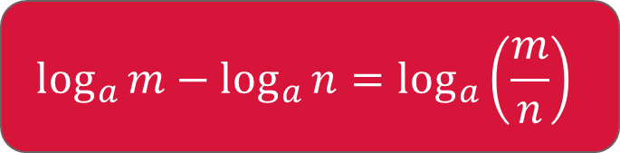
Logarithm of a quotient law
Proof
$$\log_{a}{m}−\log_{a}{n}=\log_{a}\left(\frac{m}{n}\right)$$
Let $m=a^{x}$ and $n=a^{y}$.
Then, $x=\log_{a}{m}$ and $y=\log_{a}{n}$.
$$\log_{a}\left(\frac{m}{n}\right)=\log_{a}{(a^{x}÷a^{y})} \\ =\log_{a}\left(a^{x−y}\right) \\ =x−y \\ {∴log}_{a}\left(\frac{m}{n}\right)=\log_{a}{m}−\log_{a}{n}$$
Why is the first line written this way?
Why can this be written this way?
Why was the logarithm removed?

Slide 16

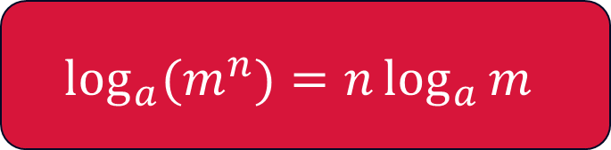
Logarithm of a power law
Proof
$$\log_{a}{(m^{n})}=n\log_{a}{m}$$
Let $m=a^{x}$.
Then, $x=\log_{a}{m}$.
$$\log_{a}{(m^{n})}=\log_{a}\left({\left(a^{x}\right)}^{n}\right) \\ =\log_{a}\left(a^{xn}\right) \\ =xn \\ =\left(\log_{a}{m}\right)×n \\ {∴log}_{a}{(xy)}=n\log_{a}{m}$$
Why can this be written this way?
Why was the logarithm notation removed?
Why isn’t the rule written this way?

Slide 17
Releasing responsibility

Slide 18
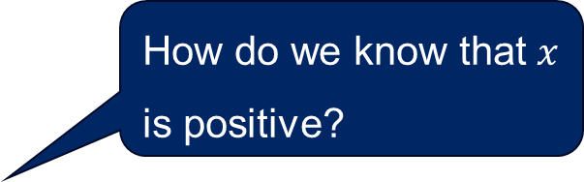


Solving logarithmic equations (1)
Worked example
Solve $\log_{2}\left(x\right)+\log_{2}\left(x−6\right)=4$, for $x$.
$$\log_{2}\left(x\right)+\log_{2}\left(x−6\right)=4 \\ \log_{2}\left(x\left(x−6\right)\right)=4 \\ ∴x\left(x−6\right)=2^{4} \\ x^{2}−6x=16 \\ x^{2}−6x−16=0 \\ \left(x−8\right)\left(x+2\right)=0 \\ x=8, −2 \\ ∴x=8, as x>0$$
What happened on this step?
How do we know that $x$ is positive?
What is the minimum value $x$ could be?

Slide 19

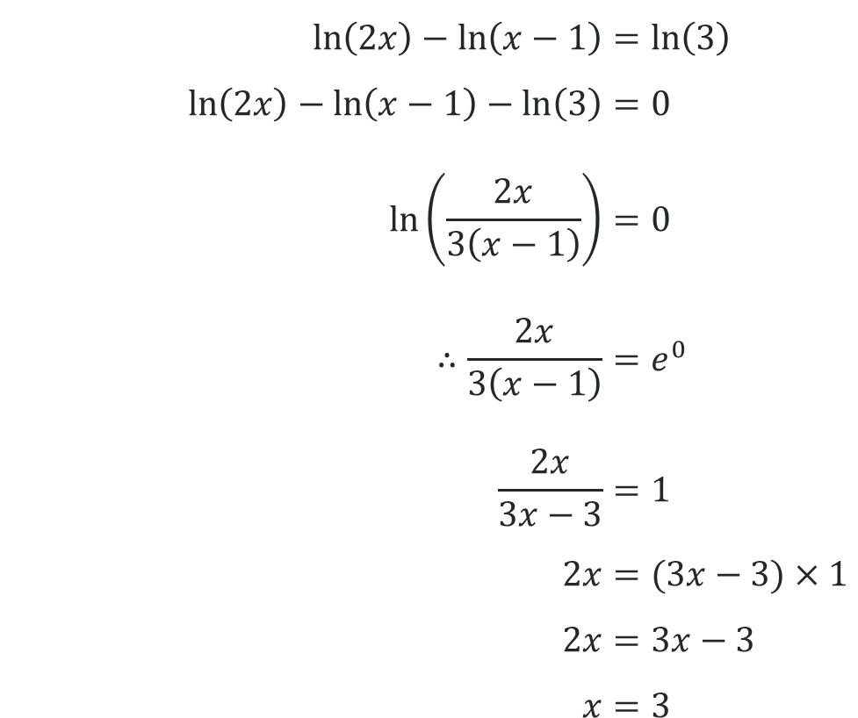
Solving logarithmic equations (2)
Your turn
Solve $\ln\left(2x\right)−\ln\left(x−1\right)=\ln\left(3\right)$ for $x.$
$$\ln\left(2x\right)−\ln\left(x−1\right)=\ln\left(3\right) \\ \ln\left(2x\right)−\ln\left(x−1\right)−\ln\left(3\right)=0 \\ \ln\left(\frac{2x}{3\left(x−1\right)}\right)=0 \\ ∴\frac{2x}{3\left(x−1\right)}=e^{0} \\ \frac{2x}{3x−3}=1 \\ 2x=(3x−3)×1 \\ 2x=3x−3 \\ x=3$$

Slide 20
Independent practice

Slide 21

Approaching questions scaffold

Slide 22
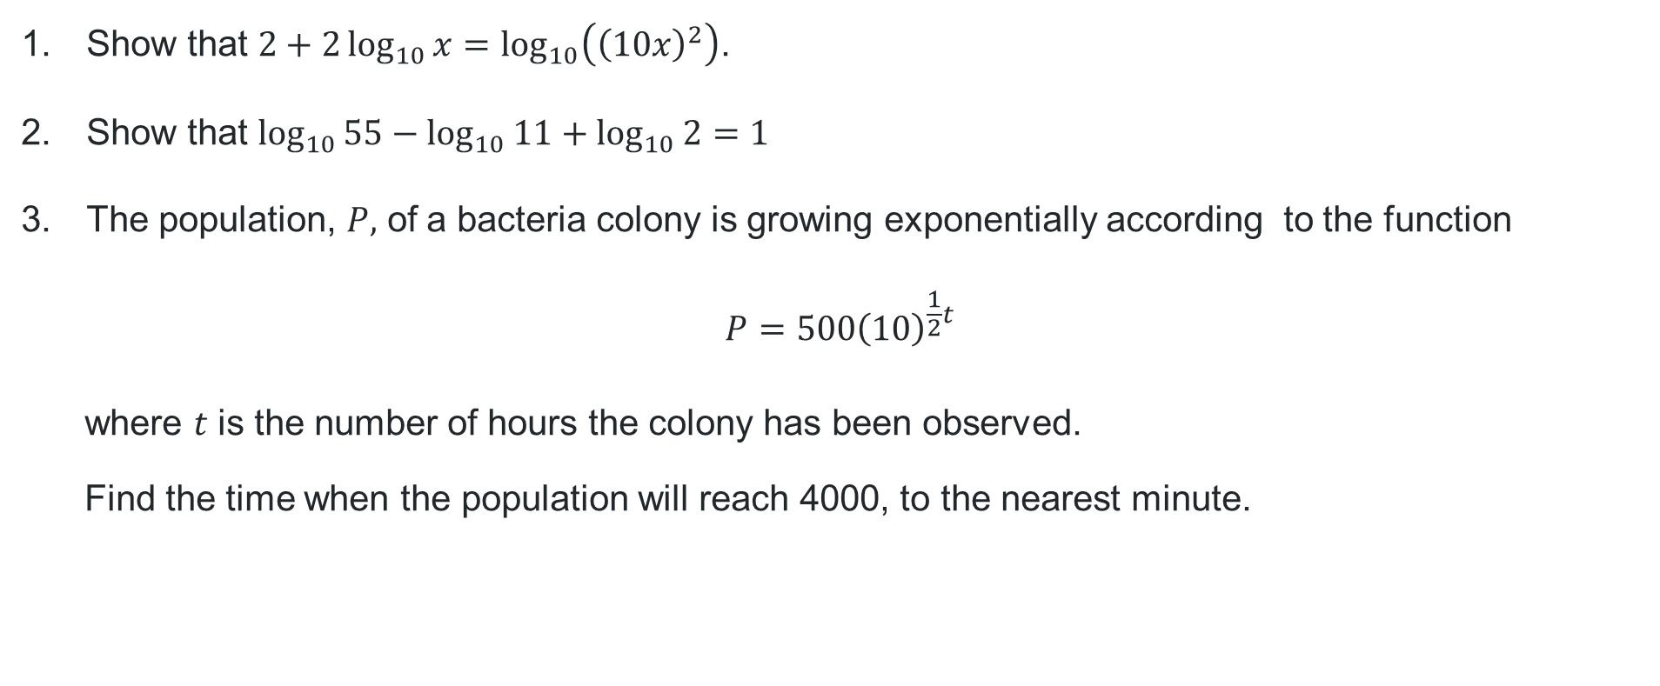
HSC-style questions (1)
Show that $2+2\log_{10}{x}=\log_{10}\left({\left(10x\right)}^{2}\right)$.
Show that $\log_{10}{55}−\log_{10}{11}+\log_{10}{2}=1$
The population, $P,$ of a bacteria colony is growing exponentially according to the function
$$P=500{\left(10\right)}^{\frac{1}{2}t}$$
        where $t$ is the number of hours the colony has been observed.
Find the time when the population will reach 4000, to the nearest minute.

Slide 23

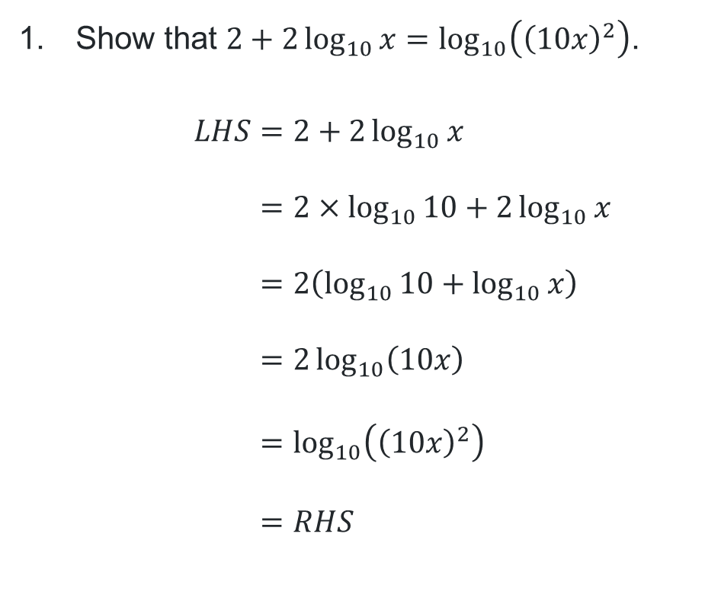
HSC-style questions (3)
Solutions
Show that $2+2\log_{10}{x}=\log_{10}\left({\left(10x\right)}^{2}\right)$.
$$LHS=2+2\log_{10}{x} \\ =2×\log_{10}{10}+2\log_{10}{x} \\ =2\left(\log_{10}{10}+\log_{10}{x}\right) \\ =2\log_{10}\left(10x\right) \\ =\log_{10}\left({\left(10x\right)}^{2}\right) \\ =RHS$$
Show that $\log_{10}{55}−\log_{10}{11}+\log_{10}{2}=1$
$$LHS=\log_{10}{55}−\log_{10}{11}+\log_{10}{2} \\ =\log_{10}\left(\frac{55×2}{11}\right) \\ =\log_{10}{10} \\ =1 \\ =RHS$$

Slide 24
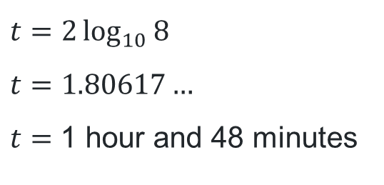
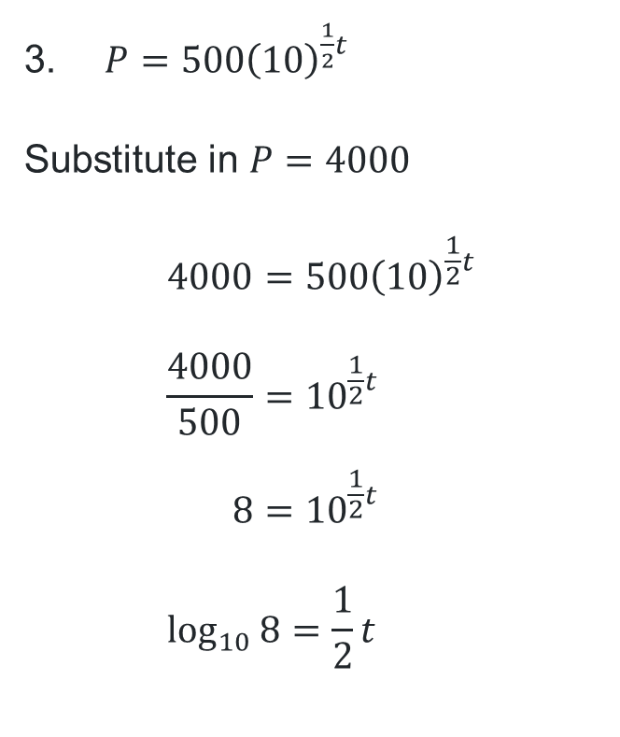
HSC-style questions (4)
Solution
$P=500{\left(10\right)}^{\frac{1}{2}t}$
Substitute in $P=4000$
$$4000=500{\left(10\right)}^{\frac{1}{2}t} \\ \frac{4000}{500}={10}^{\frac{1}{2}t} \\ 8={10}^{\frac{1}{2}t} \\ \log_{10}{8}=\frac{1}{2}t$$
$$t=2\log_{10}{8} \\ t=1.80617…$$
$t=$ 1 hour and 48 minutes

Slide 25
References
This presentation contains NSW Curriculum and syllabus content. The NSW Curriculum is developed by the NSW Education Standards Authority. This content is prepared by NESA for and on behalf of the Crown in the right of the State of New South Wales. The material is protected by Crown copyright.
Please refer to the NESA Copyright Disclaimer for more information https://educationstandards.nsw.edu.au/wps/portal/nesa/mini-footer/copyright.
NESA holds the only official and up-to-date versions of the NSW Curriculum and syllabus documents. Please visit the NSW Education Standards Authority (NESA) website https://educationstandards.nsw.edu.au/wps/portal/nesa/home and the NSW Curriculum website https://curriculum.nsw.edu.au.
Mathematics Advanced 11-12 Syllabus © NSW Education Standards Authority (NESA) for and on behalf of the Crown in right of the State of New South Wales, 2024.

Slide 26
Copyright
© State of New South Wales (Department of Education), 2025
The copyright material published in this resource is subject to the Copyright Act 1968 (Cth) and is owned by the NSW Department of Education or, where indicated, by a party other than the NSW Department of Education (third-party material).
Copyright material available in this resource and owned by the NSW Department of Education is licensed under a Creative Commons Attribution 4.0 International (CC BY 4.0) license.
This license allows you to share and adapt the material for any purpose, even commercially.
Attribution should be given to © State of New South Wales (Department of Education), 2025.
Material in this resource not available under a Creative Commons license:
the NSW Department of Education logo, other logos and trademark-protected material
Material owned by a third party that has been reproduced with permission. You will need to obtain permission from the third party to reuse its material.
Links to third-party material and websites
Please note that the provided (reading/viewing material/list/links/texts) are a suggestion only and implies no endorsement, by the New South Wales Department of Education, of any author, publisher, or book title. School principals and teachers are best placed to assess the suitability of resources that would complement the curriculum and reflect the needs and interests of their students.
If you use the links provided in this document to access a third-party’s website, you acknowledge that the terms of use, including licence terms set out on the third-party’s website apply to the use which may be made of the materials on that third-party website or where permitted by the Copyright Act 1968 (Cth). The department accepts no responsibility for content on third-party websites.

