Slide 1

The logarithmic laws
Mathematics Advanced – Stage 6 (Year 11)
Exponential and logarithmic functions

Slide 2
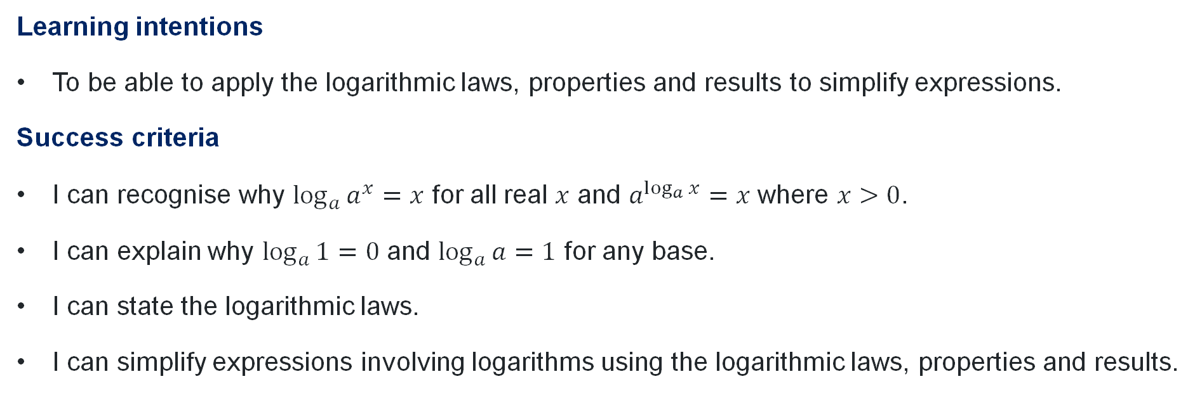
Learning intentions and success criteria
Learning intentions
To be able to apply the logarithmic laws, properties and results to simplify expressions.
Success criteria
I can recognise why $\log_{a}{a^{x}}=x$ for all real $x$ and $a^{\log_{a}{x}}=x$ where $x>0$.
I can explain why $\log_{a}{1}=0$ and $\log_{a}{a}=1$ for any base.
I can state the logarithmic laws.
I can simplify expressions involving logarithms using the logarithmic laws, properties and results.

Slide 3
Activating prior knowledge

Slide 4

Index laws
$x^{0}=1$
$x^{m}×x^{n}=x^{m+n}$
$x^{m}÷x^{n}=x^{m−n}$
${\left(x^{m}\right)}^{n}=x^{mn}$
$x^{−n}=\frac{1}{x^{n}}$
$x^{\frac{m}{n}}=\sqrt[n]{x^{m}}$
$x^{1}=x$

Slide 5
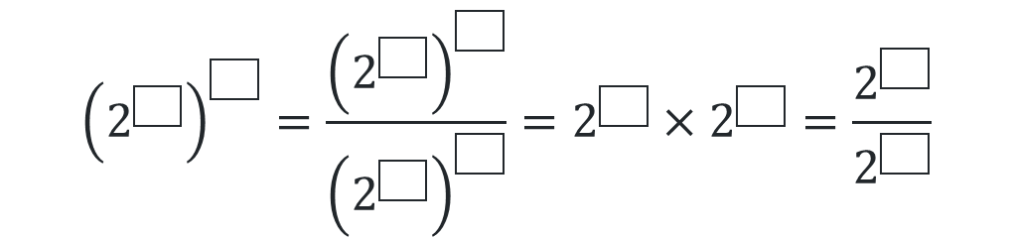
Open middle
Laws of exponents
Using the integers 1 to 20, at most one time each, place an integer in each box to create equivalent expressions.
$${\left(2^{\boxed{}}\right)}^{\boxed{}}=\frac{{\left(2^{\boxed{}}\right)}^{\boxed{}}}{{\left(2^{\boxed{}}\right)}^{\boxed{}}}=2^{\boxed{}}×2^{\boxed{}}=\frac{2^{\boxed{}}}{2^{\boxed{}}}$$
www.openmiddle.com/laws-of-exponents/

Slide 6
Connecting learning

Slide 7
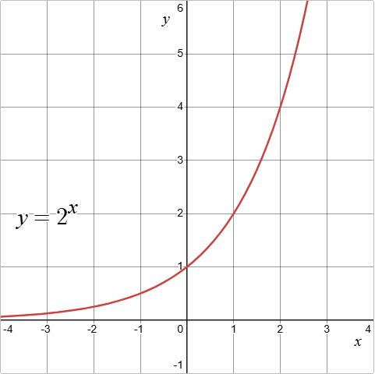
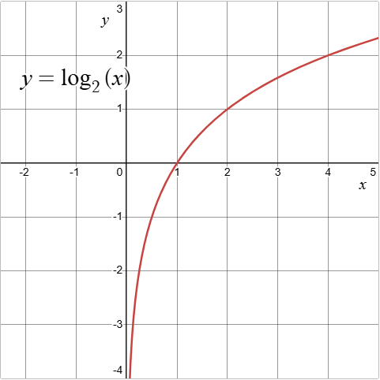
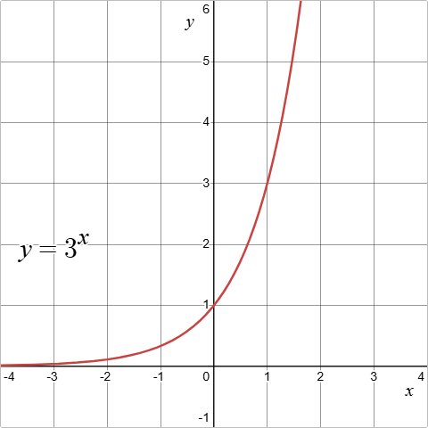
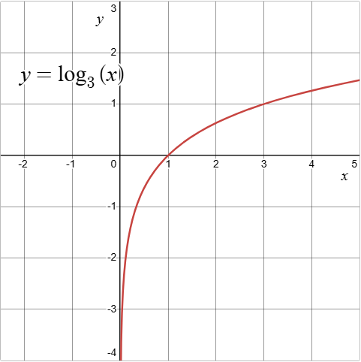
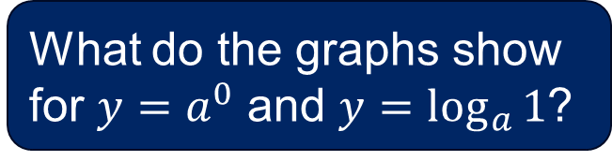
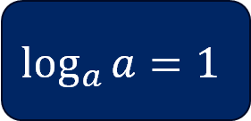
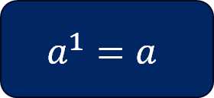
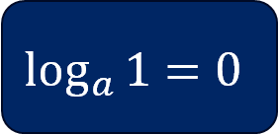
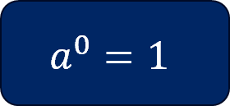
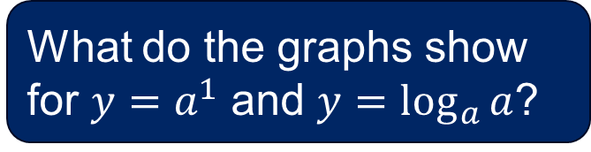
Logarithm results
${y=a}^{x}$ and $y=\log_{a}{(x)}$
What do the graphs show for ${y=a}^{0}$ and $y=\log_{a}{1}$?
What do the graphs show for ${y=a}^{1}$ and $y=\log_{a}{a}$?
$$a^{0}=1$$
$$a^{1}=a$$
$$\log_{a}{1}=0$$
$$\log_{a}{a}=1$$

Slide 8
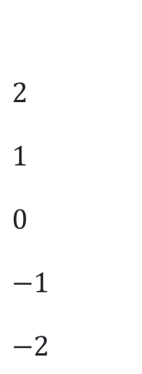
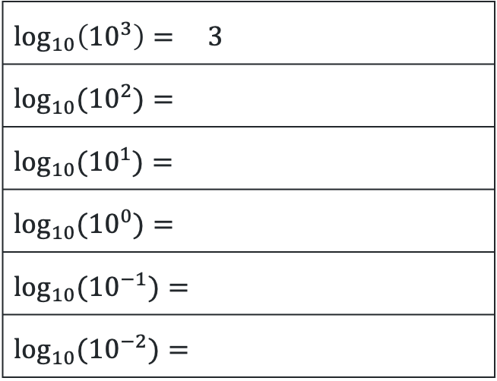

The logarithm of an exponential
Complete the table using your calculator:
$$\log_{10}\left({10}^{3}\right)= 3$$
$$\log_{10}{({10}^{2})}=$$
$$\log_{10}{({10}^{1})}=$$
$$\log_{10}{({10}^{0})}=$$
$$\log_{10}{({10}^{−1})}=$$
$$\log_{10}{({10}^{−2})}=$$
What do you notice about the pattern?
$$2$$
$$1$$
$$0$$
$$−1$$
$$−2$$
What do you notice about the base of the logarithm and the base of the exponential?
Does the pattern hold for other bases?
Try $\ln\left(e^{3}\right)$.

Slide 9

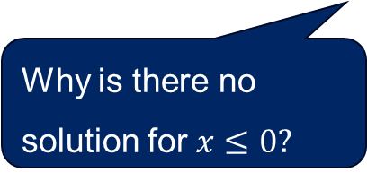
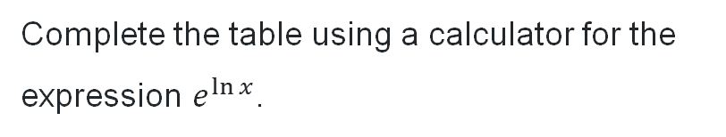


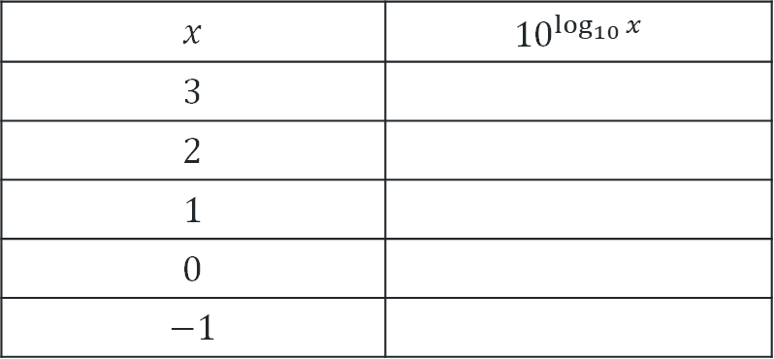

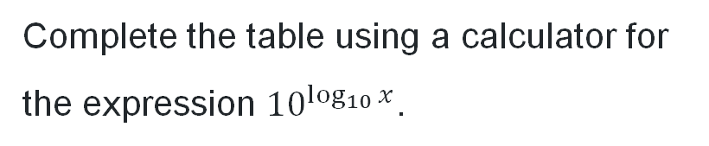

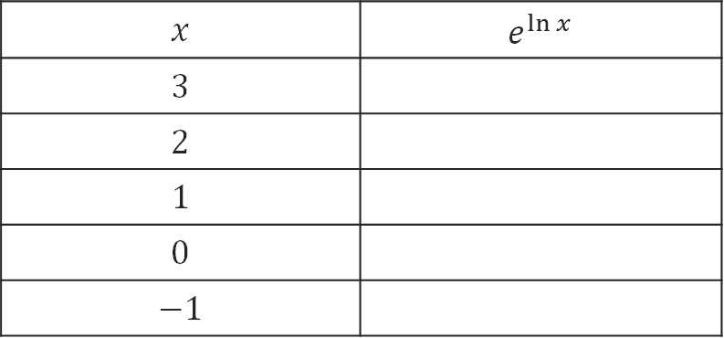

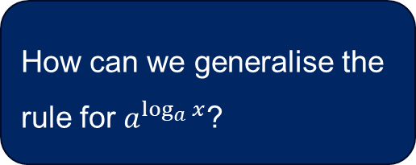
Logarithm properties (1)
What do you notice about the base of the logarithm and the base of the exponential?
$${y=a}^{\ln{x}}$$
Complete the table using a calculator for the expression $e^{\ln{x}}$.
Complete the table using a calculator for the expression ${10}^{\log_{10}{x}}$.
$$x$$ | $$e^{\ln{x}}$$
$$3$$
$$2$$
$$1$$
$$0$$
$$−1$$
$$x$$ | $${10}^{\log_{10}{x}}$$
$$3$$
$$2$$
$$1$$
$$0$$
$$−1$$
$$3$$
$$3$$
$$2$$
$$2$$
$$1$$
$$1$$
No solution
No solution
No solution
No solution
Why is there no solution for $x≤0?$
How can we generalise the rule for $a^{\log_{a}{x}}$?

Slide 10
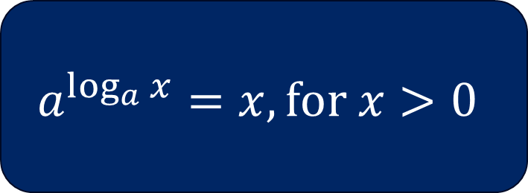
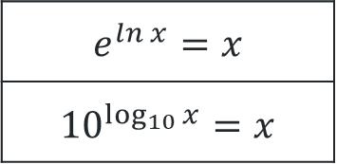
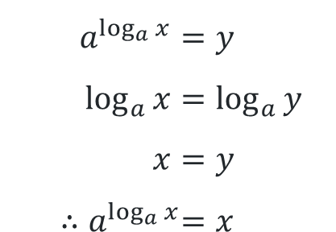
Logarithm properties (2)
$$a^{\log_{a}{x}}=x$$
$$a^{\log_{a}{x}}=y \\ \log_{a}{x}=\log_{a}{y} \\ x=y \\ {∴a}^{\log_{a}{x}}=x$$
From the definition of a logarithm
$$a^{\log_{a}{x}}=x, \text{for} x>0$$
$$e^{\ln{x}}=x$$
$${10}^{\log_{10}{x}}=x$$

Slide 11
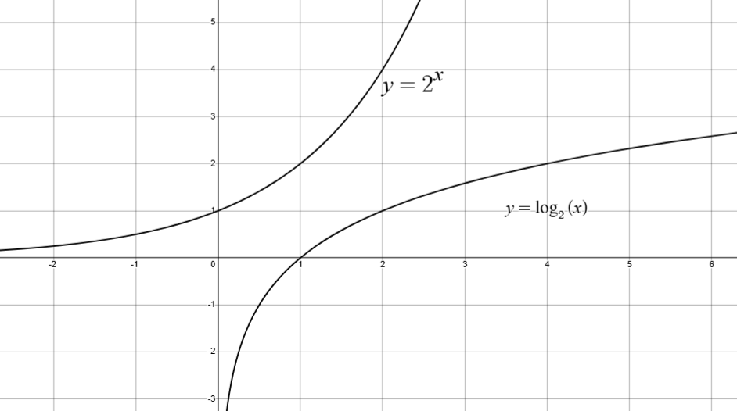
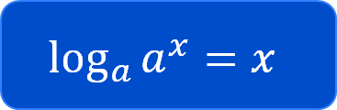
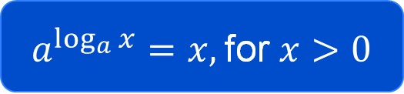
Logarithm properties (3)
Why is there no domain restriction here?
$$\log_{a}{a^{x}}=x$$
$a^{\log_{a}{x}}=x,$for$x>0$
Locate these properties on your reference sheet.
What information is not included?

Slide 12




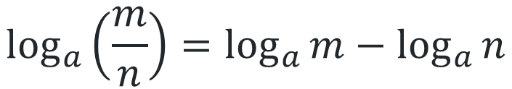

Logarithm laws (1)
$$a^{x}×a^{y}=a^{x+y}$$
$$\log_{a}\left(mn\right)=\log_{a}{m}+\log_{a}{n}$$
How would you describe what happens to the indices?
$$a^{x}÷a^{y}=a^{x−y}$$
$$\log_{a}\left(\frac{m}{n}\right)=\log_{a}{m}−\log_{a}{n}$$
$${(a^{x})}^{n}=a^{xn}$$
$$\log_{a}{m^{n}=n\log_{a}{m}}$$

Slide 13
Releasing responsibility

Slide 14
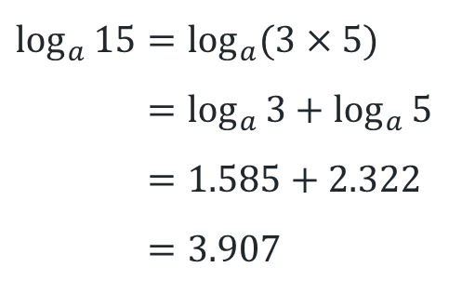
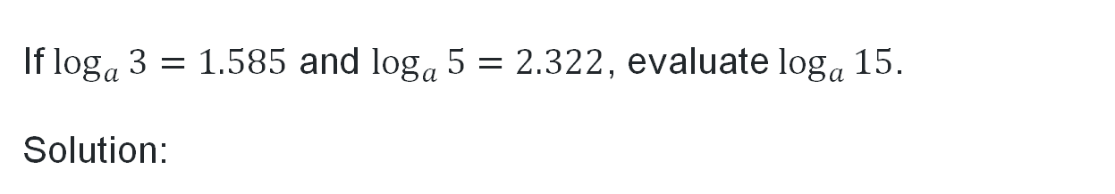

Using logarithm laws (1)
Worked example 1
If $\log_{a}{3=1.585}$ and $\log_{a}{5=2.322}$, evaluate $\log_{a}{15}$.
Solution:
Why was 15 rewritten as $3×5$?
$$\log_{a}{15}=\log_{a}{(3×5)} \\ =\log_{a}{3+\log_{a}{5}}+\log_{a}{5} \\ =1.585+2.322 \\ =3.907$$
Why is this addition here?

Slide 15
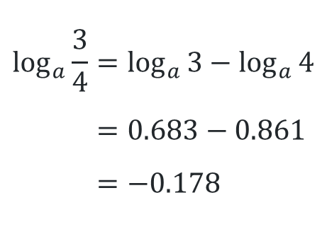
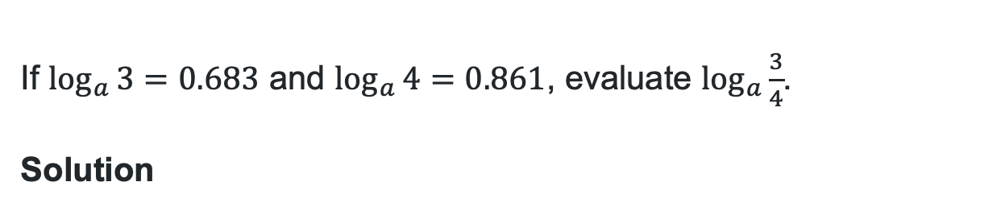
Using logarithm laws (2)
Your turn 1
If $\log_{a}{3=0.683}$ and $\log_{a}{4=0.861}$, evaluate $\log_{a}{\frac{3}{4}}$.
Solution
$$\log_{a}{\frac{3}{4}=\log_{a}{3}−\log_{a}{4}} \\ =0.683−0.861 \\ =−0.178$$

Slide 16
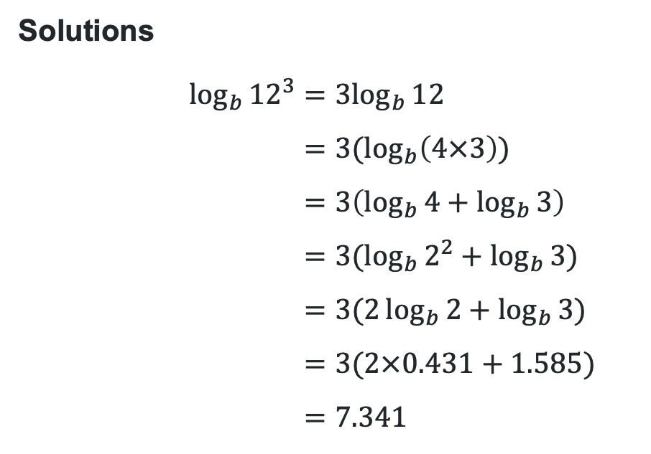
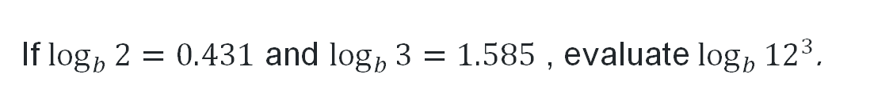

Using logarithm laws (3)
Worked example 2
If $\log_{b}{2=0.431}$ and $\log_{b}{3=1.585}$ , evaluate $\log_{b}{{12}^{3}}$.
Solutions
$$\log_{b}{{12}^{3}}=3\log_{b}{12} \\ =3(\log_{b}\left(4×3\right)) \\ =3\left(\log_{b}{4}+\log_{b}{3}\right) \\ =3(\log_{b}{2^{2}}+\log_{b}{3}) \\ =3(2\log_{b}{2}+\log_{b}{3}) \\ =3(2×0.431+1.585) \\ =7.341$$
Why do we split the 12 this way?
Why do we rewrite the 4 as $2^{2}$?
How would we explain this line of working?

Slide 17
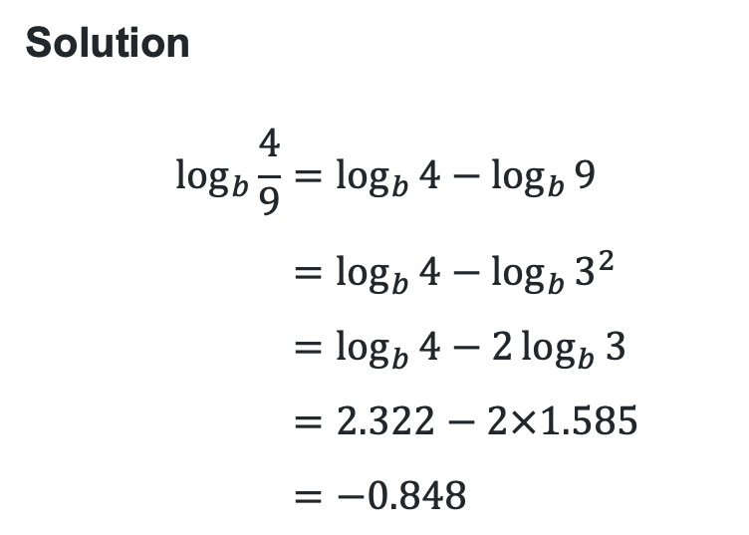
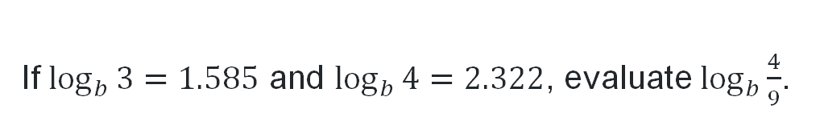
Using logarithm laws (4)
Your turn 2
If $\log_{b}{3=1.585}$ and $\log_{b}{4=2.322}$, evaluate $\log_{b}{\frac{4}{9}}$.
Solution
$$\log_{b}{\frac{4}{9}}=\log_{b}{4−\log_{b}{9}} \\ =\log_{b}{4−\log_{b}{3^{2}}} \\ =\log_{b}{4−2\log_{b}{3}} \\ =2.322−2×1.585 \\ =−0.848$$

Slide 18
References
This presentation contains NSW Curriculum and syllabus content. The NSW Curriculum is developed by the NSW Education Standards Authority. This content is prepared by NESA for and on behalf of the Crown in the right of the State of New South Wales. The material is protected by Crown copyright.
Please refer to the NESA Copyright Disclaimer for more information https://educationstandards.nsw.edu.au/wps/portal/nesa/mini-footer/copyright.
NESA holds the only official and up-to-date versions of the NSW Curriculum and syllabus documents. Please visit the NSW Education Standards Authority (NESA) website https://educationstandards.nsw.edu.au/wps/portal/nesa/home and the NSW Curriculum website https://curriculum.nsw.edu.au.
Mathematics Advanced 11-12 Syllabus © NSW Education Standards Authority (NESA) for and on behalf of the Crown in right of the State of New South Wales, 2024.

Slide 19
Copyright
© State of New South Wales (Department of Education), 2026
The copyright material published in this resource is subject to the Copyright Act 1968 (Cth) and is owned by the NSW Department of Education or, where indicated, by a party other than the NSW Department of Education (third-party material).
Copyright material available in this resource and owned by the NSW Department of Education is licensed under a Creative Commons Attribution 4.0 International (CC BY 4.0) license.
This license allows you to share and adapt the material for any purpose, even commercially.
Attribution should be given to © State of New South Wales (Department of Education), 2026.
Material in this resource not available under a Creative Commons license:
the NSW Department of Education logo, other logos and trademark-protected material
Material owned by a third party that has been reproduced with permission. You will need to obtain permission from the third party to reuse its material.
Links to third-party material and websites
Please note that the provided (reading/viewing material/list/links/texts) are a suggestion only and implies no endorsement, by the New South Wales Department of Education, of any author, publisher, or book title. School principals and teachers are best placed to assess the suitability of resources that would complement the curriculum and reflect the needs and interests of their students.
If you use the links provided in this document to access a third-party’s website, you acknowledge that the terms of use, including licence terms set out on the third-party’s website apply to the use which may be made of the materials on that third-party website or where permitted by the Copyright Act 1968 (Cth). The department accepts no responsibility for content on third-party websites.

