Slide 1
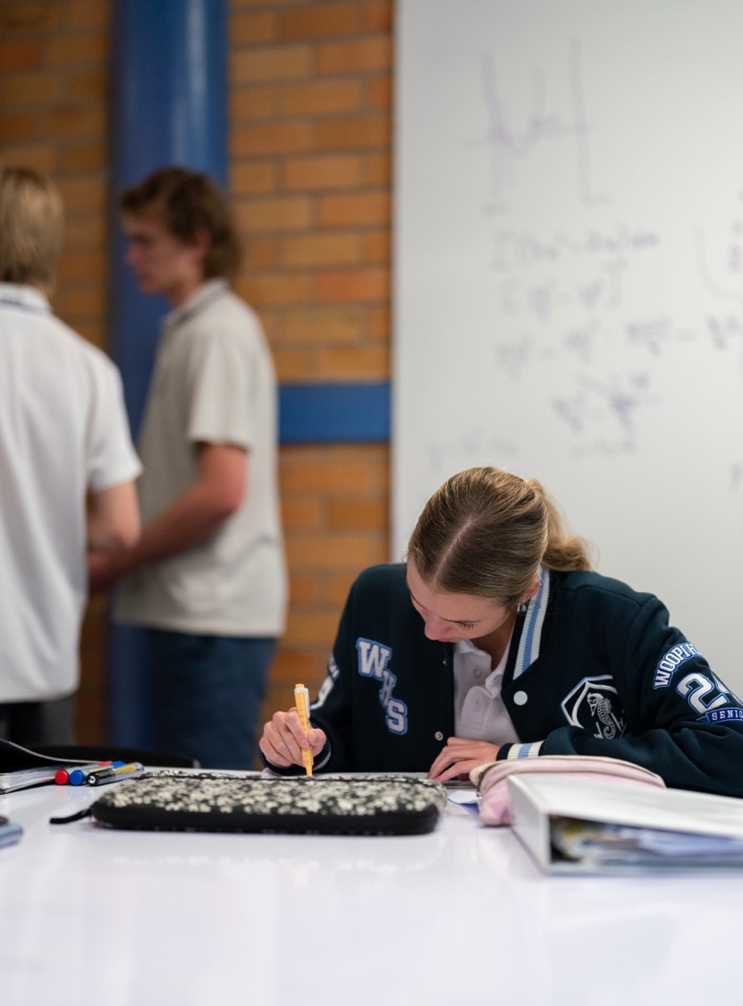
The logarithmic function
Mathematics Advanced – Stage 6 (Year 11)
Exponential and logarithmic functions

Slide 2
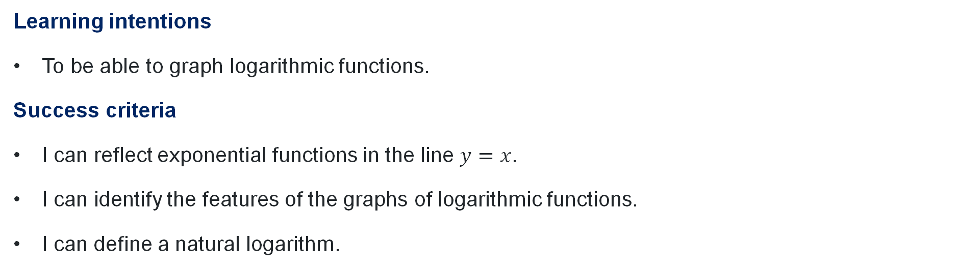
Learning intentions and success criteria
Learning intentions
To be able to graph logarithmic functions.
Success criteria
I can reflect exponential functions in the line $y=x$.
I can identify the features of the graphs of logarithmic functions.
I can define a natural logarithm.

Slide 3
Activating prior knowledge

Slide 4
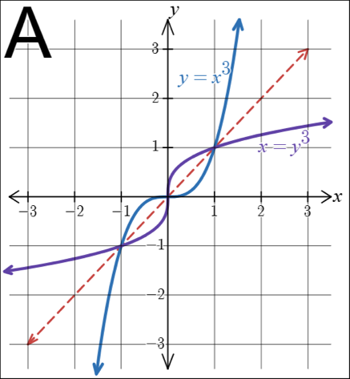
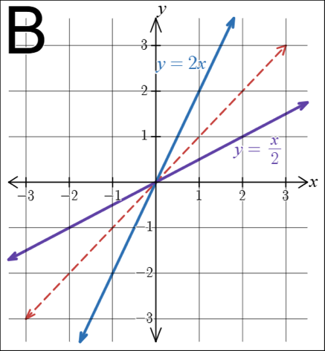
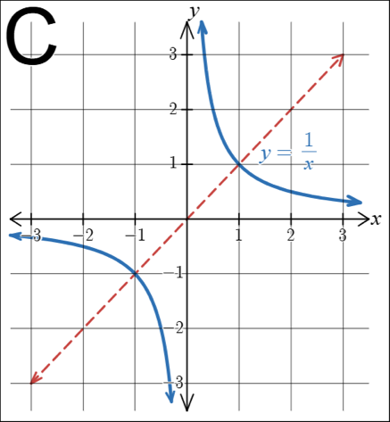
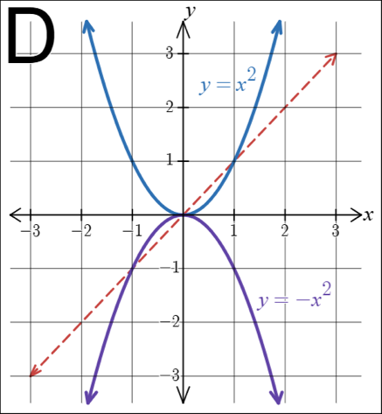
Which one doesn’t belong

Slide 5
Connecting learning

Slide 6
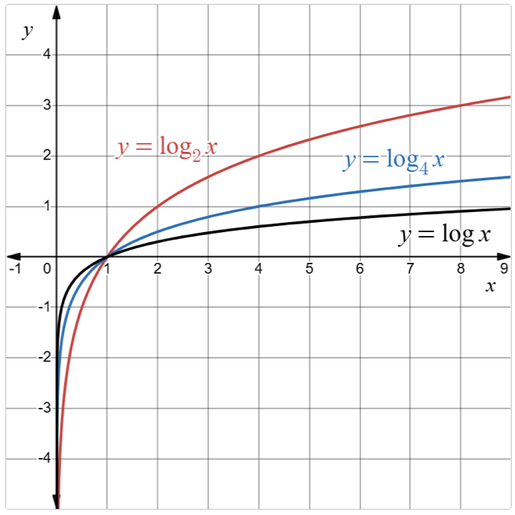
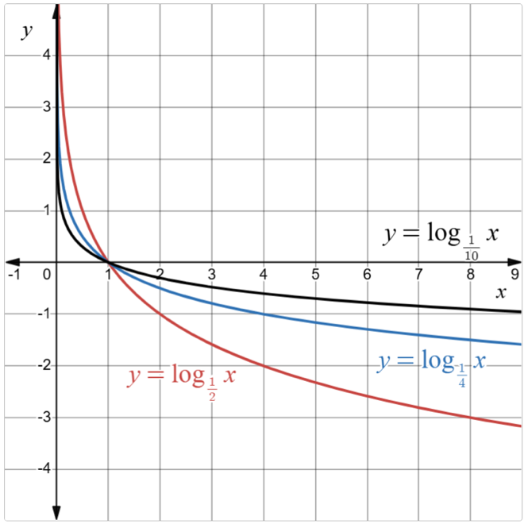
Features of logarithmic graphs (2)
How does the value of $a$ affect the graph of $y=\log_{a}{x}$?

Slide 7
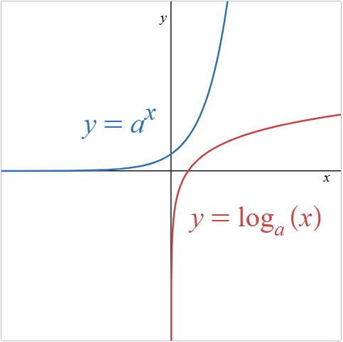
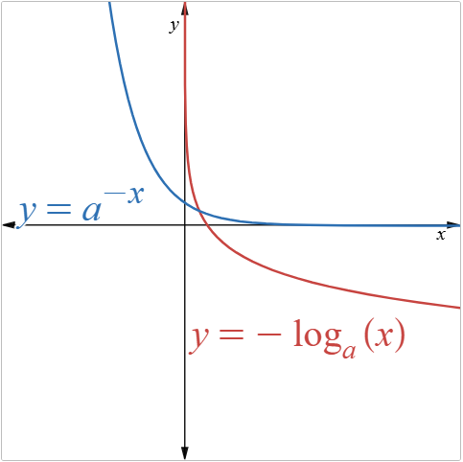
Compare the graphs (1)
What is the domain and range of the functions?
How would you compare the behaviour of the graphs?

Slide 8
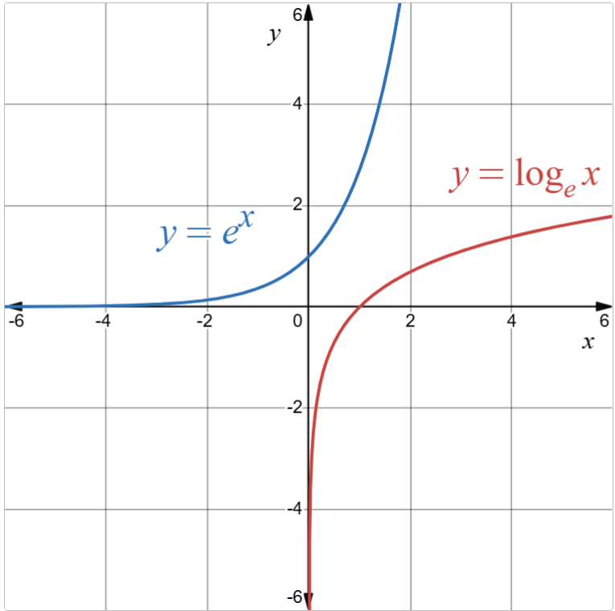
Compare the graphs (2)
How are these graphs the same as the previous graphs?
How are these graphs different to the previous graphs?

Slide 9
Releasing responsibility

Slide 10


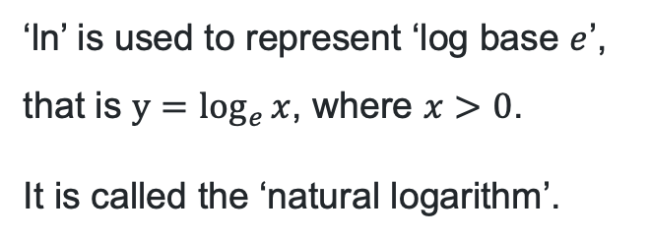
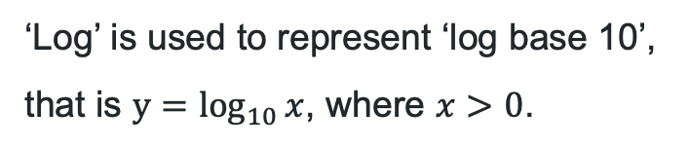
Using a calculator
$$log$$
$$ln$$
‘Log’ is used to represent ‘log base 10’, that is $y=\log_{10}{x}$, where $x>0$.
‘ln’ is used to represent ‘log base $e$’, that is $y=\log_{e}{x}$, where $x>0$.
It is called the ‘natural logarithm’.

Slide 11
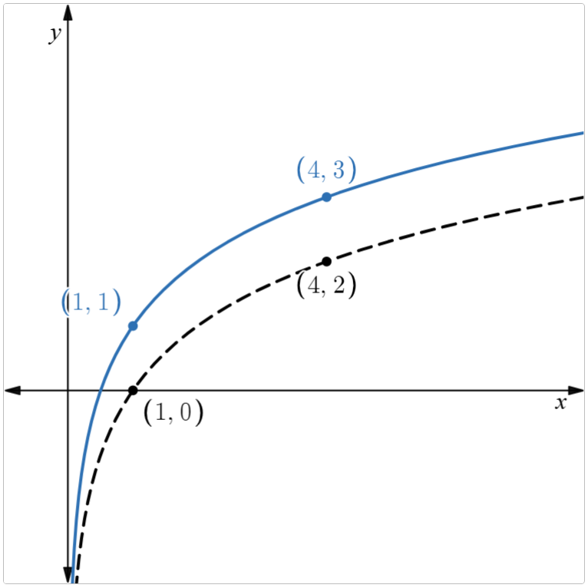
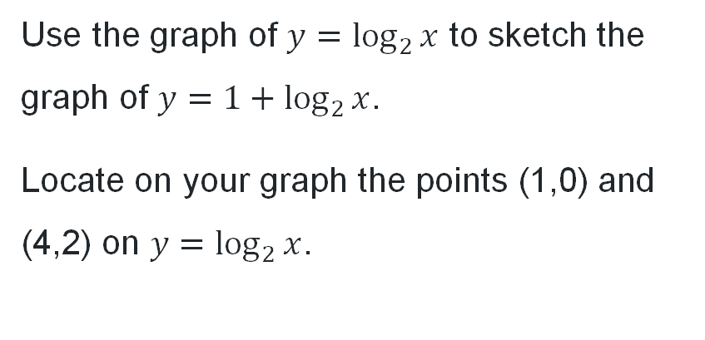
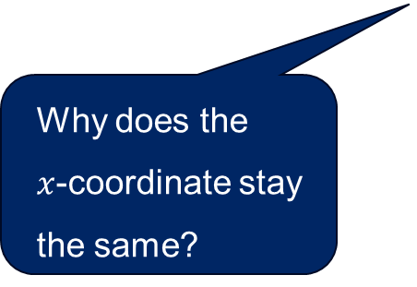
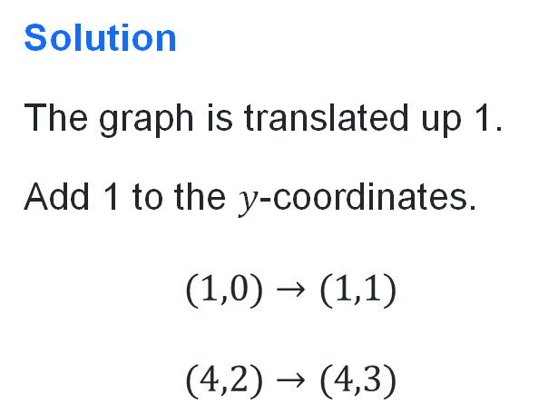
Graph transformations (1)
How were the coordinates of the corresponding point determined?
What do we know about the domain of the graph?
Worked example 1
Use the graph of $y=\log_{2}{x}$ to sketch the graph of $y=1+\log_{2}{x}$.
Locate on your graph the points (1,0) and (4,2) on $y=\log_{2}{x}$.
Solution
The graph is translated up 1.
Add 1 to the $y$-coordinates.
$$(1,0)→(1,1)$$
$$(4,2)→(4,3)$$
Why does the
$x$-coordinate stay the same?

Slide 12
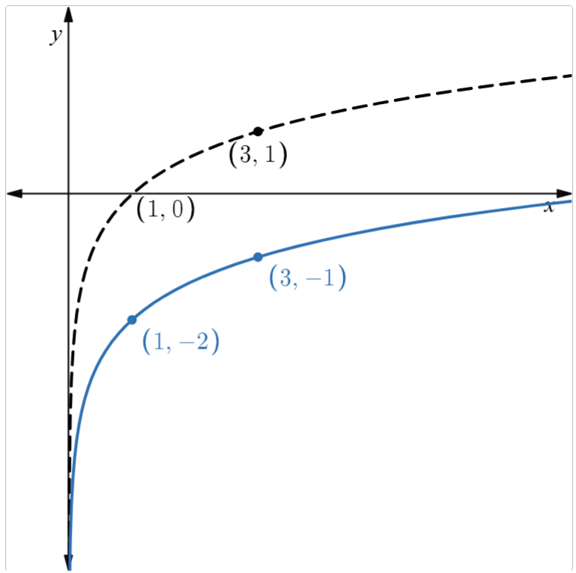
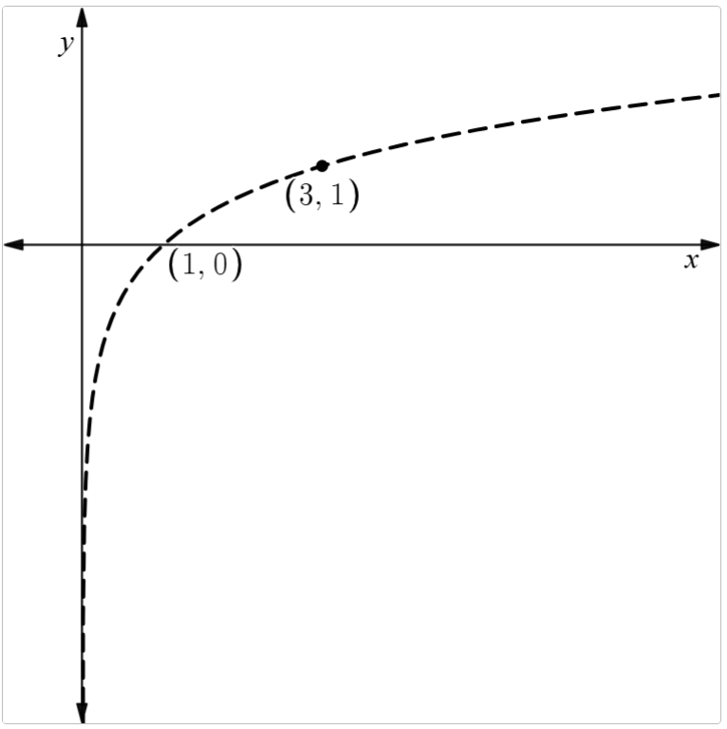
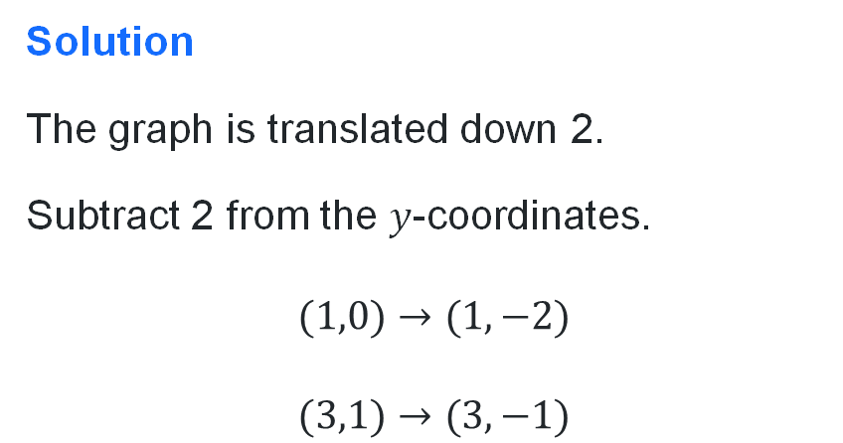
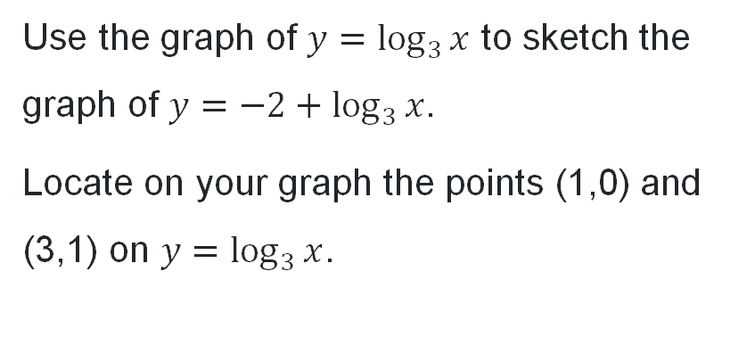
Graph transformations (2)
Your turn – Question 1
Use the graph of $y=\log_{3}{x}$ to sketch the graph of $y=−2+\log_{3}{x}$.
Locate on your graph the points (1,0) and (3,1) on $y=\log_{3}{x}$.
Solution
The graph is translated down 2.
Subtract 2 from the $y$-coordinates.
$$(1,0)→(1,−2)$$
$$(3,1)→(3,−1)$$

Slide 13
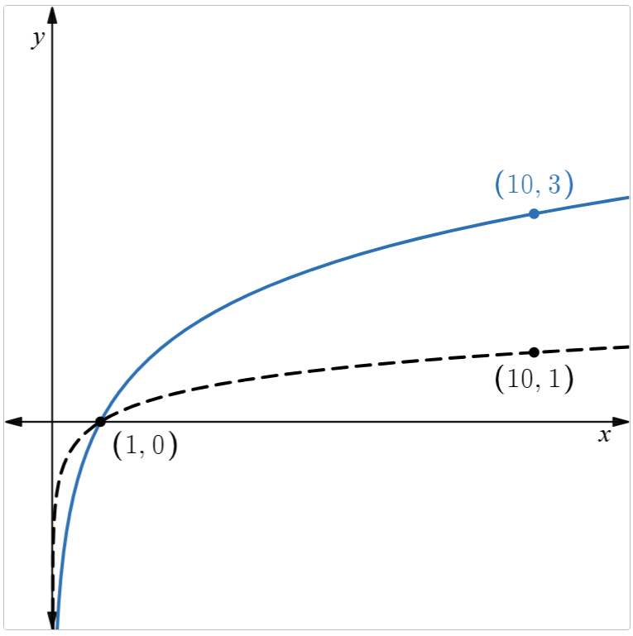
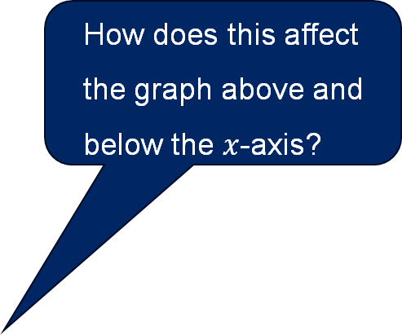
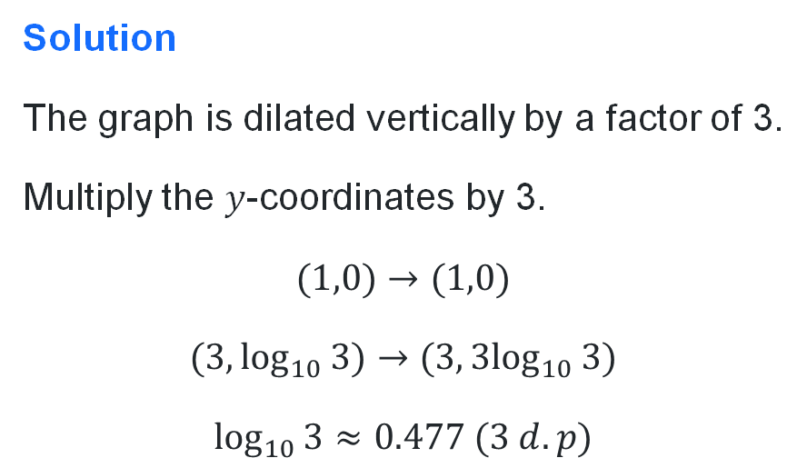

Graph transformations (3)
How could we use this point to graph the function?
Worked example 2
Use the graph of $y=\log_{10}{x}$ to sketch the graph of $y=3\log_{10}{x}$.
Locate on your graph the points $(1,0)$and $(3,\log_{10}{3})$ on $y=\log_{10}{3}$.
How does this affect the graph above and below the $x$-axis?
Solution
The graph is dilated vertically by a factor of 3.
Multiply the $y$-coordinates by 3.
$$(1,0)→(1,0)$$
$$(3,\log_{10}{3})→(3,3\log_{10}{3})$$
$$\log_{10}{3}≈0.477 (3 d.p)$$
Why does this point stay the same?

Slide 14
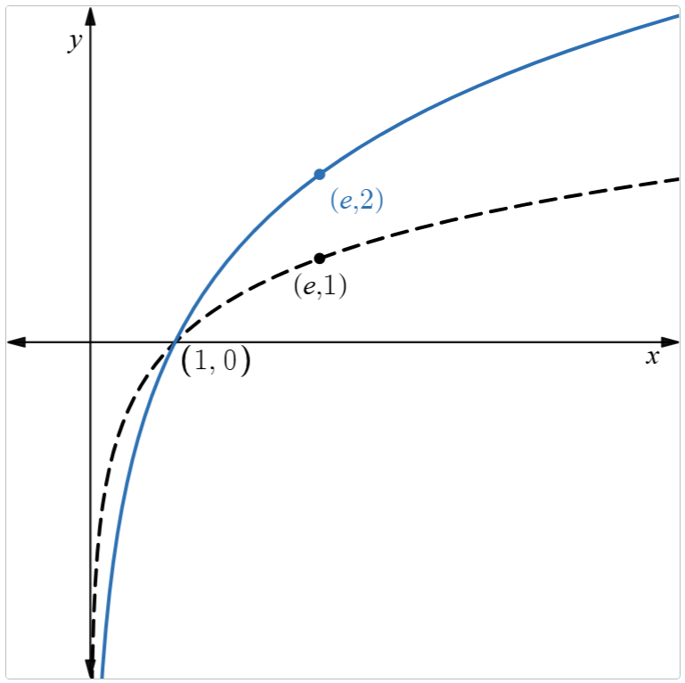
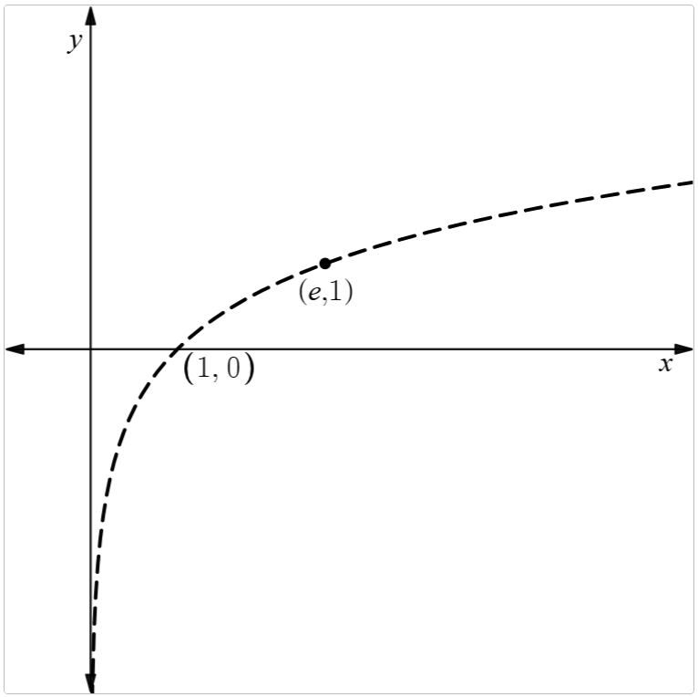
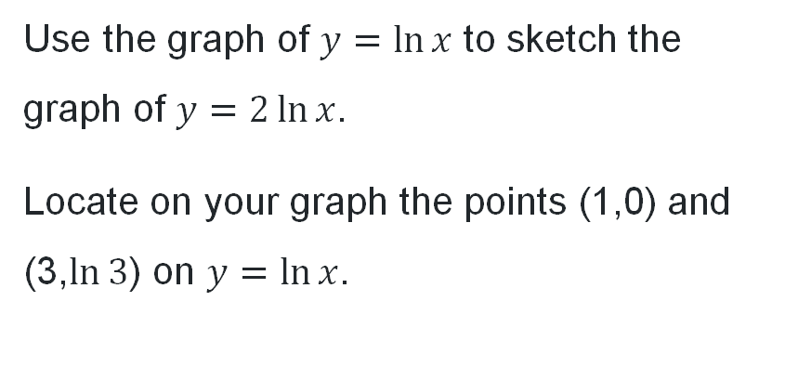
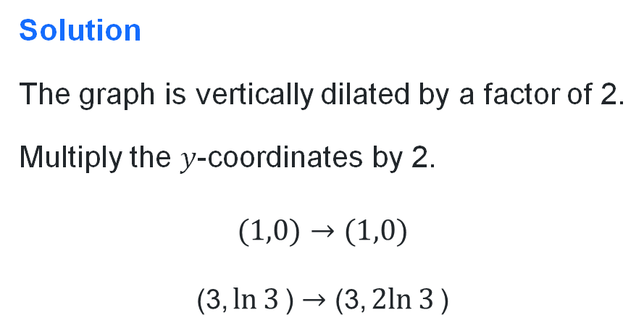
Graph transformations (4)
Your turn – Question 2
Use the graph of $y=\ln{x}$ to sketch the graph of $y=2\ln{x}$.
Locate on your graph the points (1,0) and (3,$\ln{3}$) on $y=\ln{x}$.
Solution
The graph is vertically dilated by a factor of 2.
Multiply the $y$-coordinates by 2.
$$(1,0)→(1,0)$$
$$\text{(3,}\ln{3}\text{)}→\text{(3,}2ln{3}\text{)}$$

Slide 15
Independent practice

Slide 16
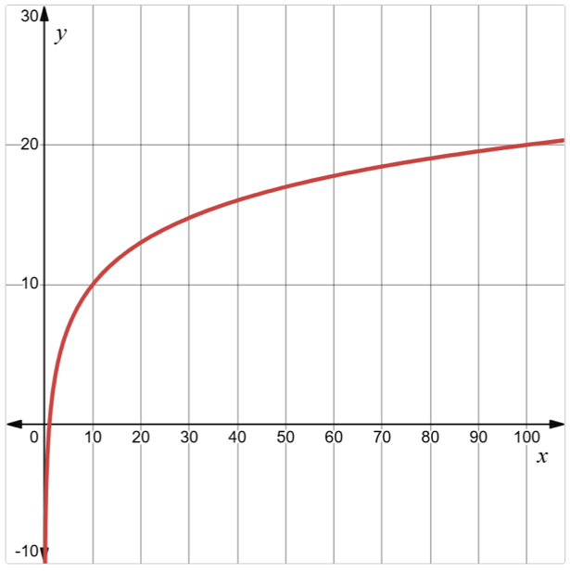
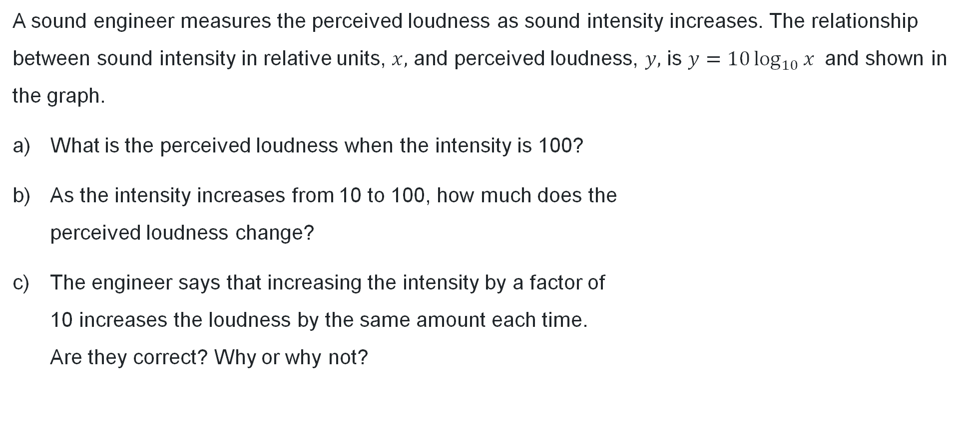
Perceived loudness (1)
A sound engineer measures the perceived loudness as sound intensity increases. The relationship between sound intensity in relative units, $x,$ and perceived loudness, $y,$ is $y=10\log_{10}{x}$ and shown in the graph.
What is the perceived loudness when the intensity is 100?
As the intensity increases from 10 to 100, how much does the
perceived loudness change?
The engineer says that increasing the intensity by a factor of
10 increases the loudness by the same amount each time.
Are they correct? Why or why not?

Slide 17

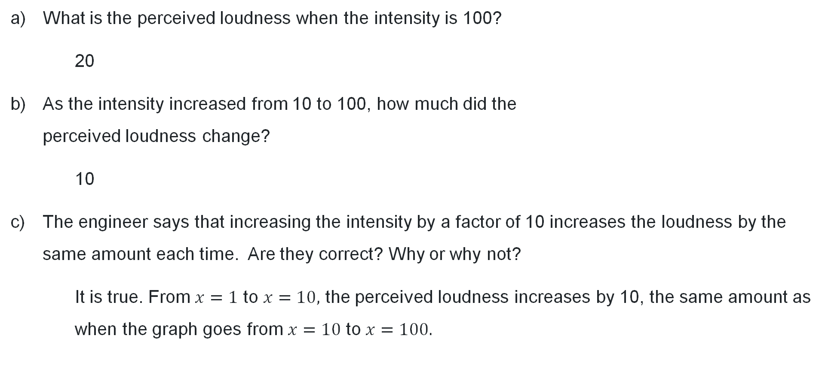
Perceived loudness (2)
What is the perceived loudness when the intensity is 100?
20
As the intensity increased from 10 to 100, how much did the
perceived loudness change?
10
The engineer says that increasing the intensity by a factor of 10 increases the loudness by the same amount each time. Are they correct? Why or why not?
It is true. From $x=1$ to $x=10,$ the perceived loudness increases by 10, the same amount as
when the graph goes from $x=10$ to $x=100.$

Slide 18
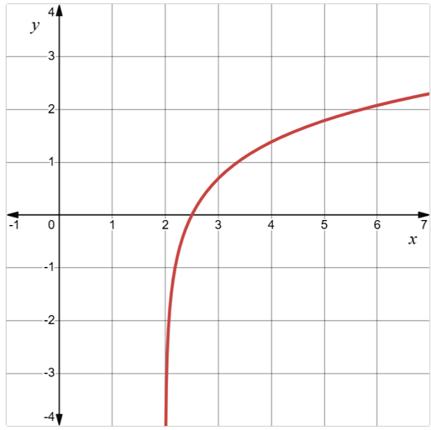
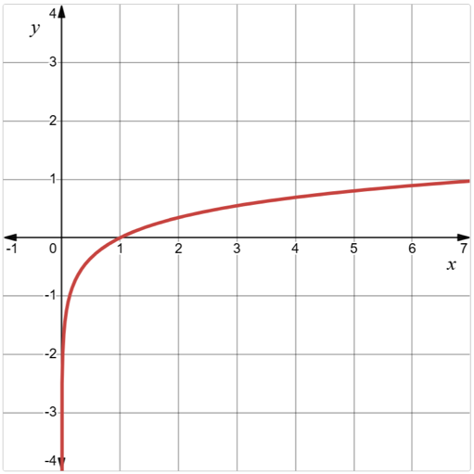
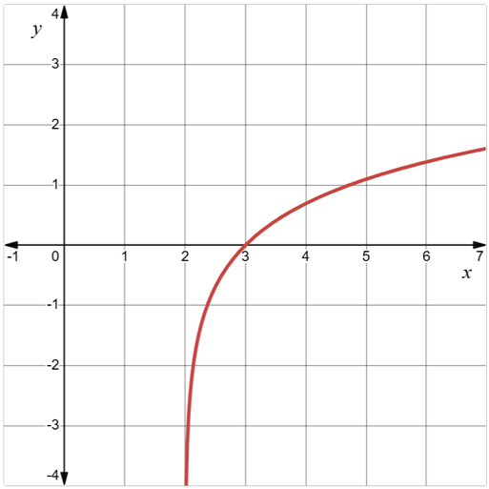
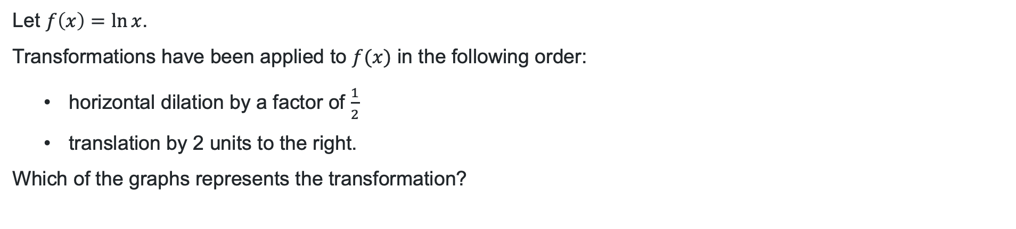
Exit ticket
Let $f\left(x\right)=\ln{x}$.
Transformations have been applied to $f(x)$ in the following order:
        horizontal dilation by a factor of $\frac{1}{2}$
        translation by 2 units to the right.
      Which of the graphs represents the transformation?
Graph 1
Graph 2
Graph 3

Slide 19
References
This presentation contains NSW Curriculum and syllabus content. The NSW Curriculum is developed by the NSW Education Standards Authority. This content is prepared by NESA for and on behalf of the Crown in the right of the State of New South Wales. The material is protected by Crown copyright.
Please refer to the NESA Copyright Disclaimer for more information https://educationstandards.nsw.edu.au/wps/portal/nesa/mini-footer/copyright.
NESA holds the only official and up-to-date versions of the NSW Curriculum and syllabus documents. Please visit the NSW Education Standards Authority (NESA) website https://educationstandards.nsw.edu.au/wps/portal/nesa/home and the NSW Curriculum website https://curriculum.nsw.edu.au.
Mathematics Advanced 11-12 Syllabus © NSW Education Standards Authority (NESA) for and on behalf of the Crown in right of the State of New South Wales, 2024.

Slide 20
Copyright
© State of New South Wales (Department of Education), 2026
The copyright material published in this resource is subject to the Copyright Act 1968 (Cth) and is owned by the NSW Department of Education or, where indicated, by a party other than the NSW Department of Education (third-party material).
Copyright material available in this resource and owned by the NSW Department of Education is licensed under a Creative Commons Attribution 4.0 International (CC BY 4.0) license.
This license allows you to share and adapt the material for any purpose, even commercially.
Attribution should be given to © State of New South Wales (Department of Education), 2026.
Material in this resource not available under a Creative Commons license:
the NSW Department of Education logo, other logos and trademark-protected material
Material owned by a third party that has been reproduced with permission. You will need to obtain permission from the third party to reuse its material.
Links to third-party material and websites
Please note that the provided (reading/viewing material/list/links/texts) are a suggestion only and implies no endorsement, by the New South Wales Department of Education, of any author, publisher, or book title. School principals and teachers are best placed to assess the suitability of resources that would complement the curriculum and reflect the needs and interests of their students.
If you use the links provided in this document to access a third-party’s website, you acknowledge that the terms of use, including licence terms set out on the third-party’s website apply to the use which may be made of the materials on that third-party website or where permitted by the Copyright Act 1968 (Cth). The department accepts no responsibility for content on third-party websites.

