Slide 1

Euler’s number
Mathematics Advanced – Stage 6 (Year 11)
Exponential and logarithmic functions

Slide 2
Activating prior knowledge

Slide 3

Derivatives and functions
Questions
Find the derivative of the function $y=x^{2}$.
Find the points where the value of the derivative is equal to the value of the function.
Find the equations of the tangents at those points.
Sketch the function and its tangents.

Slide 4
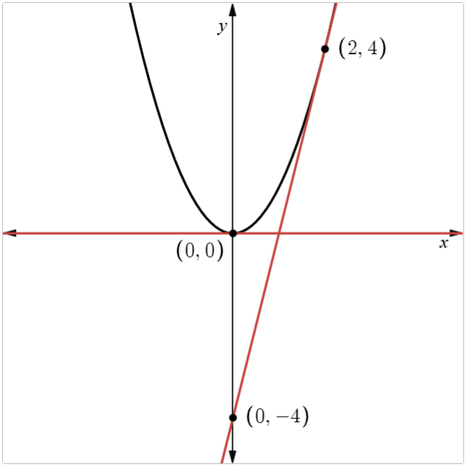
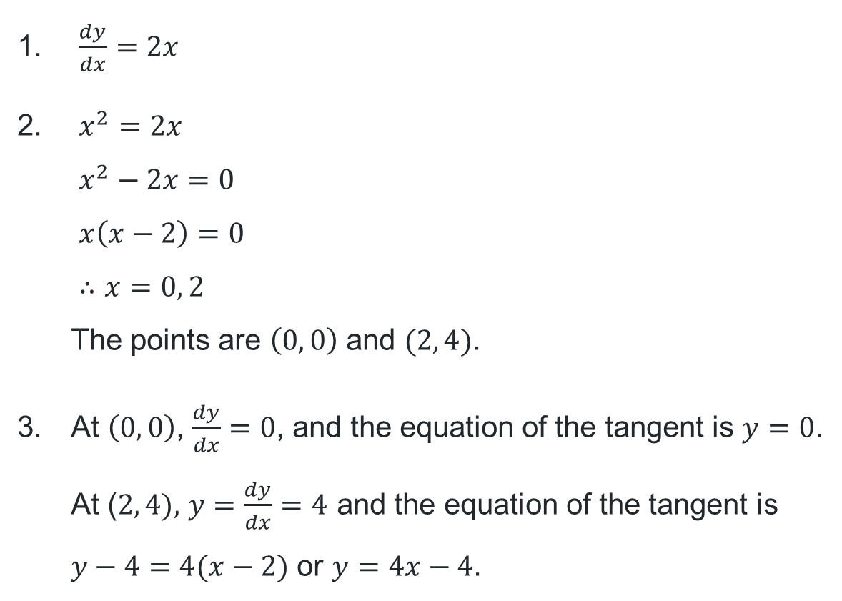
Solutions
$\frac{dy}{dx}=2x$
$x^{2}=2x$
$x^{2}−2x=0$
$x\left(x−2\right)=0$
$∴x=0, 2$
The points are $\left(0, 0\right)$ and $(2, 4)$.
At $\left(0, 0\right)$, $\frac{dy}{dx}=0$, and the equation of the tangent is $y=0$.
At ($2, 4),$ $y=\frac{dy}{dx}=4$ and the equation of the tangent is
$y−4=4(x−2)$ or $y=4x−4$.

Slide 5
Connecting learning

Slide 6
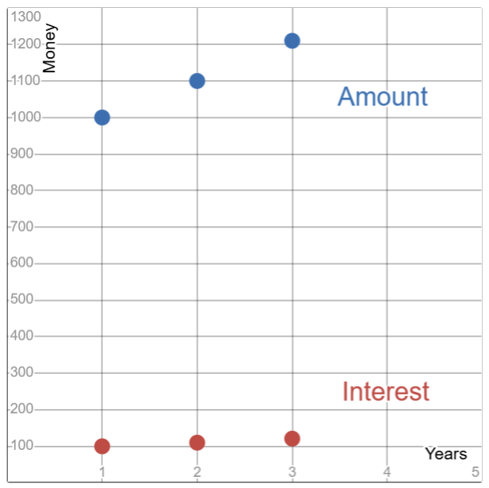
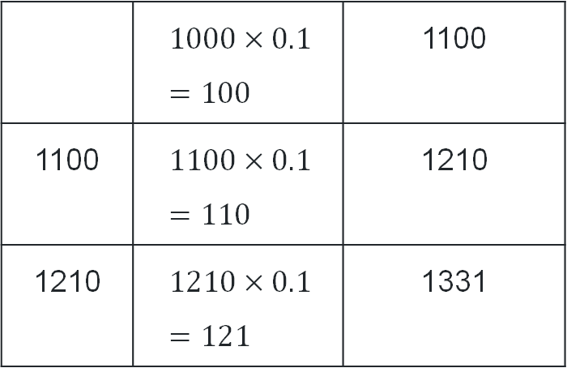
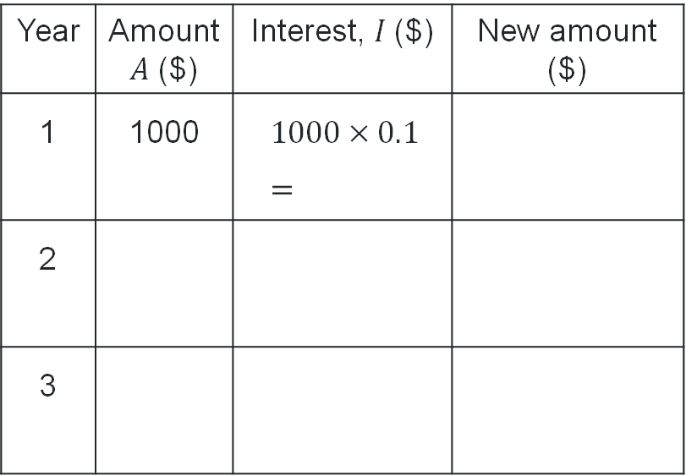
Compound interest (1)
Why can we say that the interest paid at each step is proportional to the amount?
Consider $1000 invested at 10% p.a. compounding yearly for 3 years and complete the table.
Year | Amount$A$ ($) | Interest, $I$($) | New amount ($)
1 | 1000 | $1000×0.1$ $$=$$
2
3
 | $1000×0.1$ $=100$ | 1100
1100 | $1100×0.1$ $=110$ | 1210
1210 | $1210×0.1$ $=121$ | 1331
What does the change between each step represent?

Slide 7
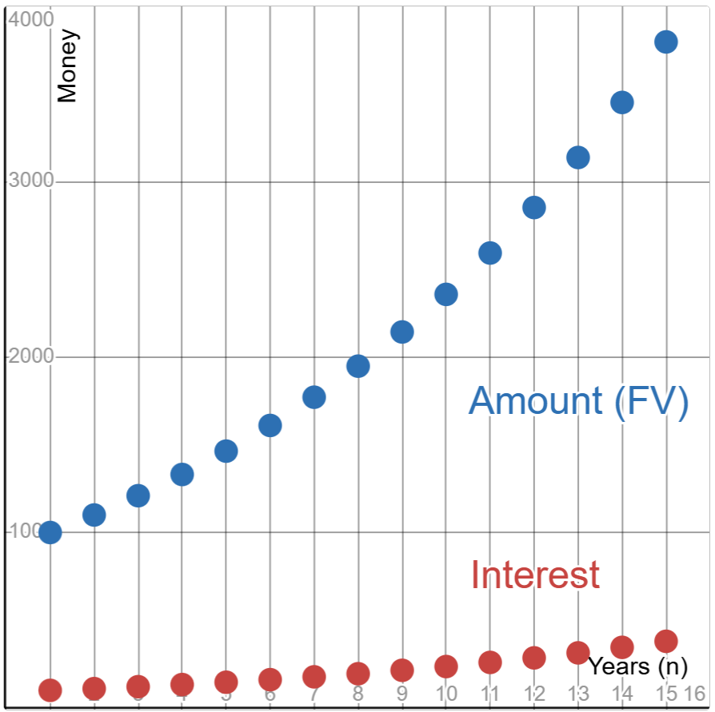
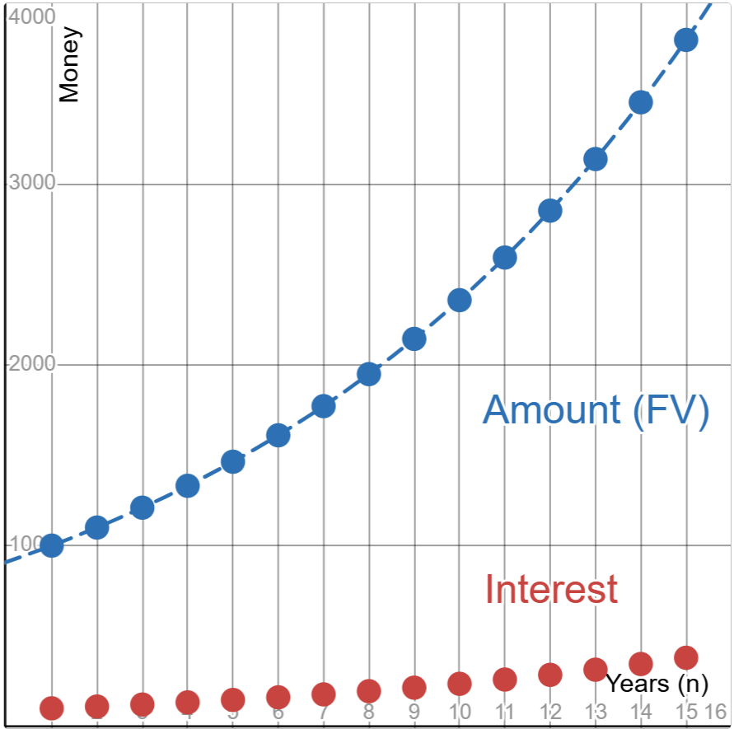
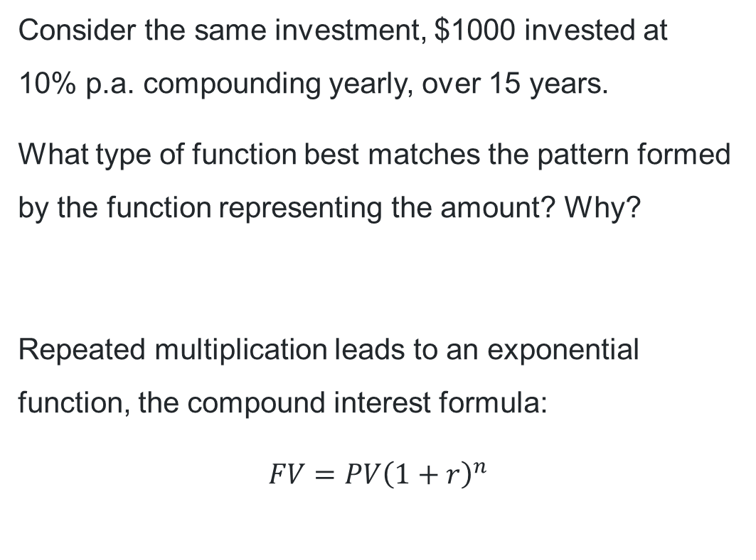
Compound interest (2)
Consider the same investment, $1000 invested at
10% p.a. compounding yearly, over 15 years.
What type of function best matches the pattern formed by the function representing the amount? Why?
Repeated multiplication leads to an exponential function, the compound interest formula:
$$FV=PV{\left(1+r\right)}^{n}$$

Slide 8
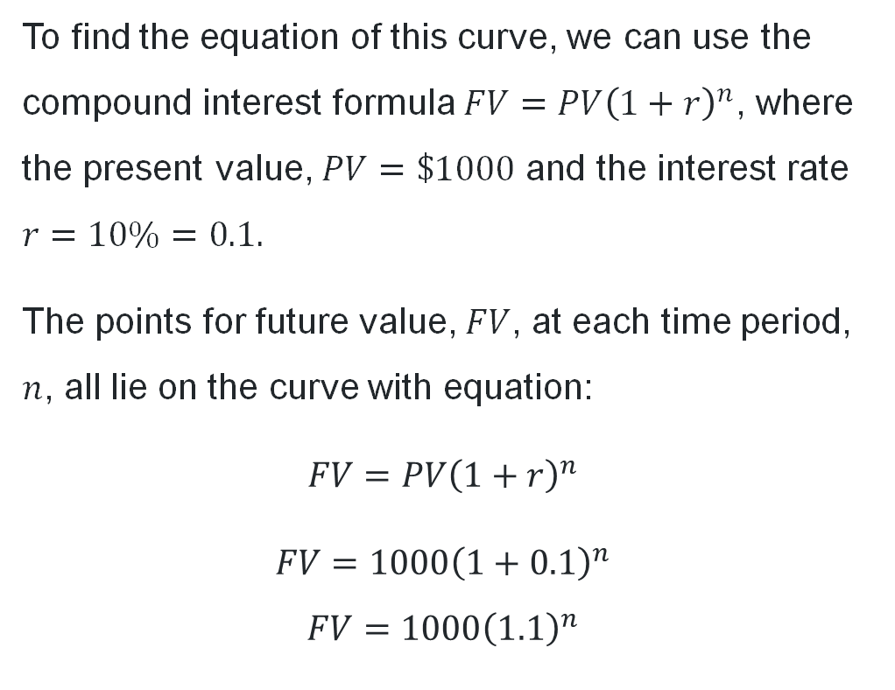
Compound interest (3)
To find the equation of this curve, we can use the compound interest formula $FV=PV{\left(1+r\right)}^{n}$, where the present value, $PV=\$1000$ and the interest rate $r=10\%=0.1.$
The points for future value, $FV$, at each time period, $n$, all lie on the curve with equation:
$$FV=PV{\left(1+r\right)}^{n}$$
$$FV=1000{\left(1+0.1\right)}^{n}$$
$$FV=1000{\left(1.1\right)}^{n}$$

Slide 9

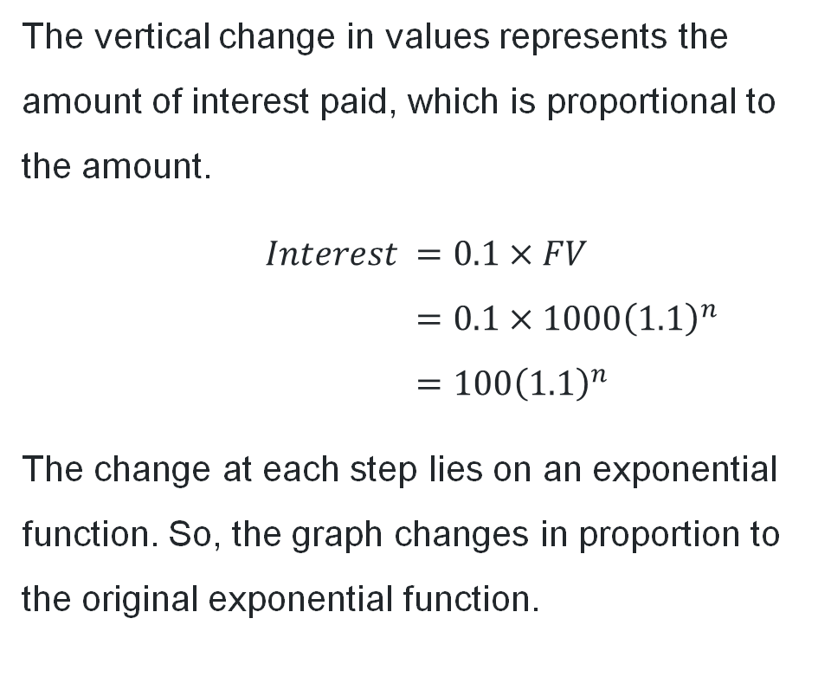
Compound interest (4)
The vertical change in values represents the amount of interest paid, which is proportional to the amount.
$$Interest =0.1×FV \\ =0.1×1000{\left(1.1\right)}^{n} \\ =100{\left(1.1\right)}^{n}$$
The change at each step lies on an exponential function. So, the graph changes in proportion to the original exponential function.

Slide 10
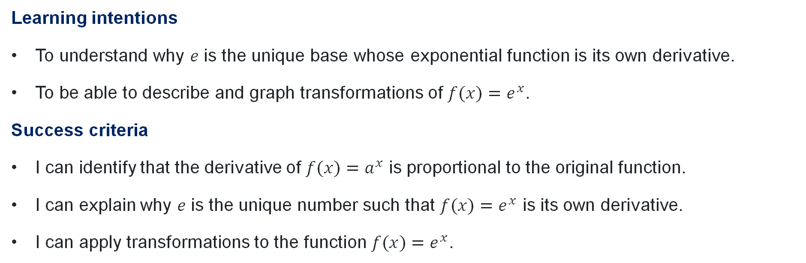
Learning intentions and success criteria
Learning intentions
To understand why $e$ is the unique base whose exponential function is its own derivative.
To be able to describe and graph transformations of $f(x)=e^{x}$.
Success criteria
I can identify that the derivative of $f(x)=a^{x}$ is proportional to the original function.
I can explain why $e$ is the unique number such that $f(x)=e^{x}$ is its own derivative.
I can apply transformations to the function $f(x)=e^{x}$.

Slide 11
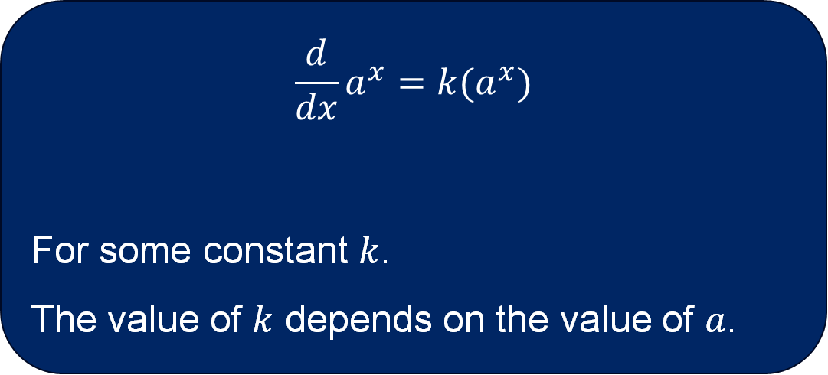
Derivative of an exponential function
$$\frac{d}{dx}a^{x}=k(a^{x})$$
For some constant $k$.
The value of $k$ depends on the value of $a$.

Slide 12
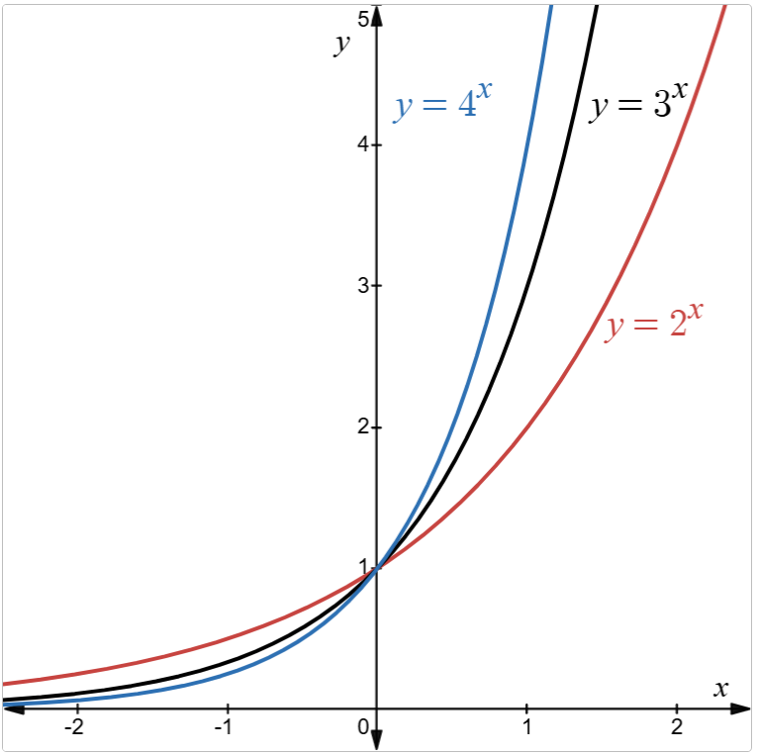
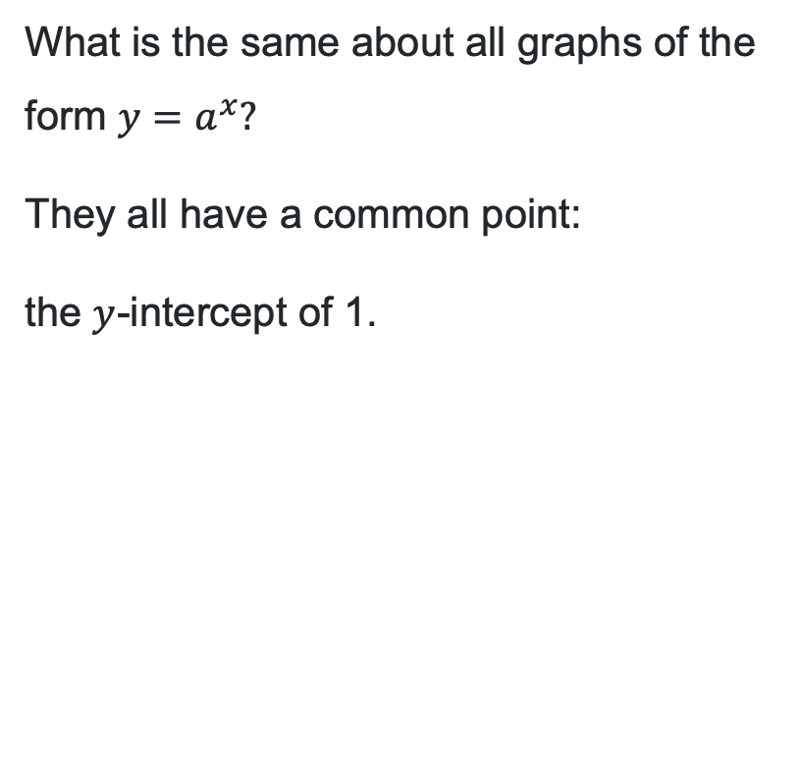
A common point
What is the same about all graphs of the form $y=a^{x}?$
They all have a common point:
the $y$-intercept of 1.

Slide 13
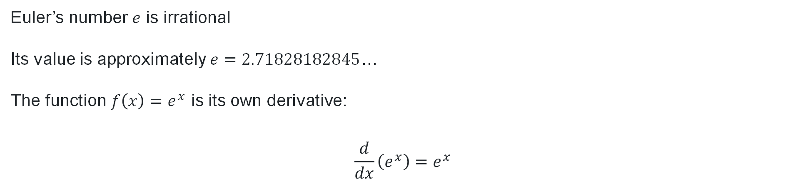
The properties of Euler’s number
Properties
Euler’s number $e$ is irrational
Its value is approximately $e=2.71828182845$…
The function $f\left(x\right)=e^{x}$ is its own derivative:
$$\frac{d}{dx}\left(e^{x}\right)=e^{x}$$

Slide 14
Releasing responsibility

Slide 15
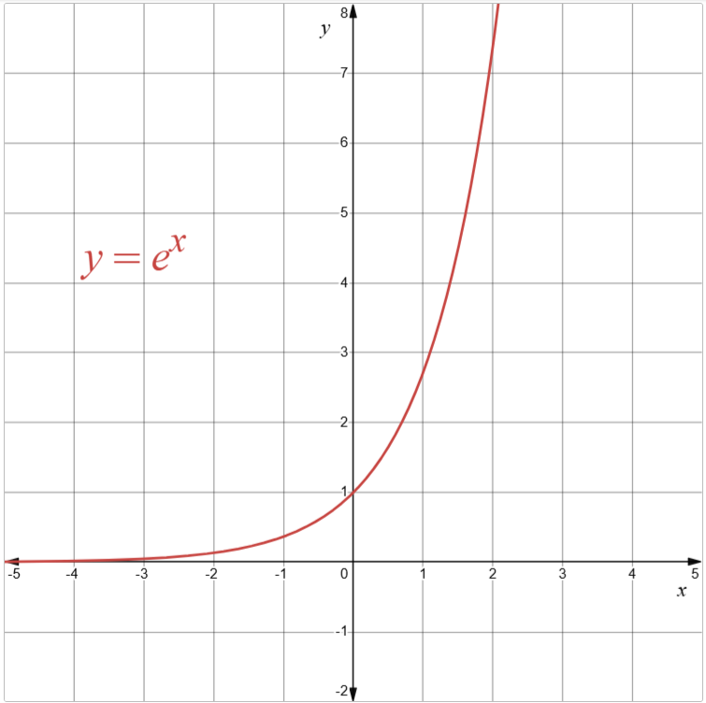

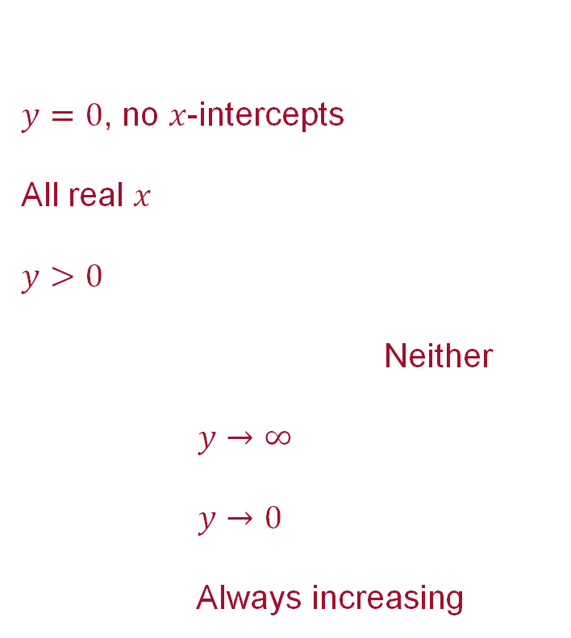
$$f(x)=e^{x}$$
What do we know about $f\left(x\right)=e^{x}$?
Intercepts:
Domain:
Range:
Symmetry (odd or even function?):
Behaviour as $x→∞:$
Behaviour as $x→−∞:$
Any other information:
$y=0$, no $x$-intercepts
All real $x$
$y>0$
Neither
$y→∞$
$y→0$
Always increasing

Slide 16
Independent practice

Slide 17
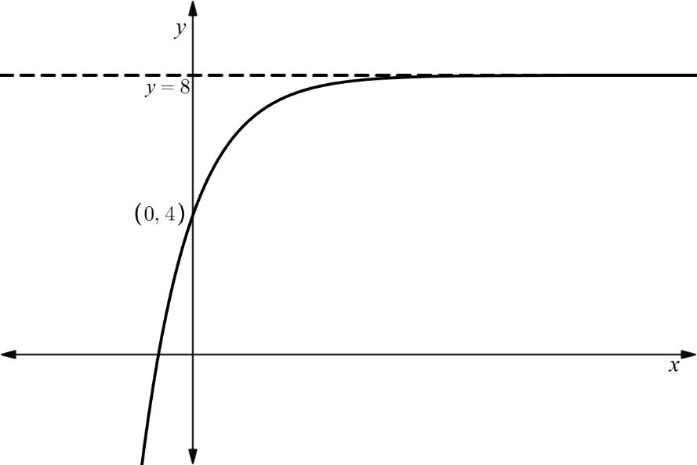


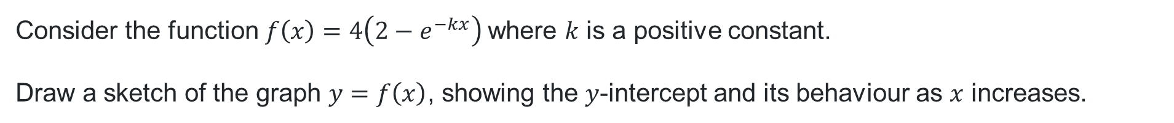
HSC-style question
Consider the function$f\left(x\right)=4\left(2−e^{−kx}\right)$ where $k$ is a positive constant.
Draw a sketch of the graph $y=f\left(x\right)$, showing the $y$-intercept and its behaviour as $x$ increases.
Expanding the equation: $f\left(x\right)=8−4e^{−kx}$
Vertical dilation by a factor of 4
$y$-intercept: $f\left(0\right)=8−4e^{0}=4$
As $x→∞$, $y→8−4\left(0\right)=8$.
Horizontal asymptote at $y=8$.
As $x→−∞,$ $y→−∞$
Expanding the equation:
Vertical dilation by a factor of
$y$-intercept:
As $x→∞$, $y→$
Horizontal asymptote at
As $x→−∞,$ $y→$

Slide 18
References
This presentation contains NSW Curriculum and syllabus content. The NSW Curriculum is developed by the NSW Education Standards Authority. This content is prepared by NESA for and on behalf of the Crown in the right of the State of New South Wales. The material is protected by Crown copyright.
Please refer to the NESA Copyright Disclaimer for more information https://educationstandards.nsw.edu.au/wps/portal/nesa/mini-footer/copyright.
NESA holds the only official and up-to-date versions of the NSW Curriculum and syllabus documents. Please visit the NSW Education Standards Authority (NESA) website https://educationstandards.nsw.edu.au/wps/portal/nesa/home and the NSW Curriculum website https://curriculum.nsw.edu.au.
Mathematics Advanced 11-12 Syllabus © NSW Education Standards Authority (NESA) for and on behalf of the Crown in right of the State of New South Wales, 2024.

Slide 19
Copyright
© State of New South Wales (Department of Education), 2026
The copyright material published in this resource is subject to the Copyright Act 1968 (Cth) and is owned by the NSW Department of Education or, where indicated, by a party other than the NSW Department of Education (third-party material).
Copyright material available in this resource and owned by the NSW Department of Education is licensed under a Creative Commons Attribution 4.0 International (CC BY 4.0) license.
This license allows you to share and adapt the material for any purpose, even commercially.
Attribution should be given to © State of New South Wales (Department of Education), 2026.
Material in this resource not available under a Creative Commons license:
the NSW Department of Education logo, other logos and trademark-protected material
Material owned by a third party that has been reproduced with permission. You will need to obtain permission from the third party to reuse its material.
Links to third-party material and websites
Please note that the provided (reading/viewing material/list/links/texts) are a suggestion only and implies no endorsement, by the New South Wales Department of Education, of any author, publisher, or book title. School principals and teachers are best placed to assess the suitability of resources that would complement the curriculum and reflect the needs and interests of their students.
If you use the links provided in this document to access a third-party’s website, you acknowledge that the terms of use, including licence terms set out on the third-party’s website apply to the use which may be made of the materials on that third-party website or where permitted by the Copyright Act 1968 (Cth). The department accepts no responsibility for content on third-party websites.

