Slide 1
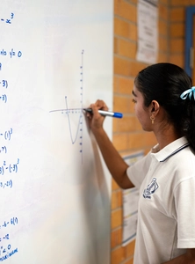
Transformations of exponential functions
Mathematics Advanced – Stage 6 (Year 11)
Exponential and logarithmic functions

Slide 2
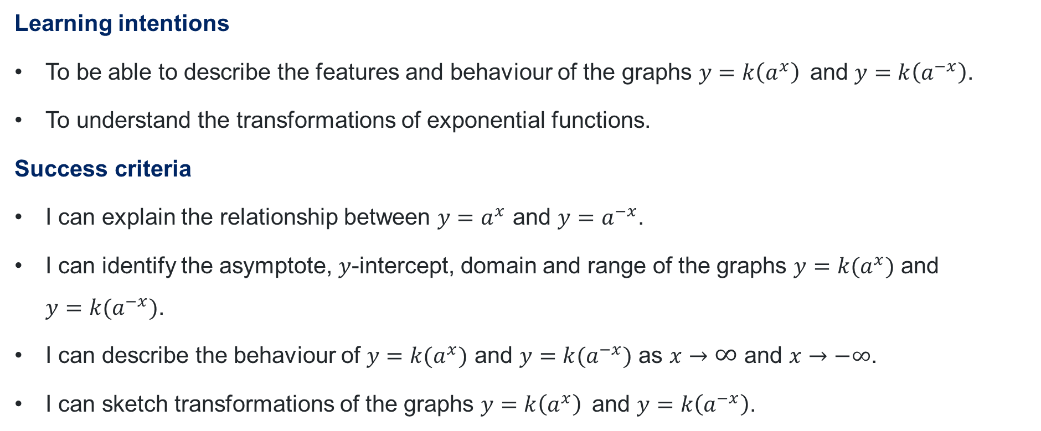
Learning intentions and success criteria
Learning intentions
To be able to describe the features and behaviour of the graphs $y=k\left(a^{x}\right)$and $y=k\left(a^{−x}\right)$.
To understand the transformations of exponential functions.
Success criteria
I can explain the relationship between $y=a^{x}$ and $y=a^{−x}$.
I can identify the asymptote, $y$-intercept, domain and range of the graphs $y=k(a^{x})$ and
$y=k(a^{−x})$.
I can describe the behaviour of $y=k(a^{x})$ and $y=k(a^{−x})$ as $x→∞$ and $x→−∞$.
I can sketch transformations of the graphs $y=k\left(a^{x}\right)$and $y=k\left(a^{−x}\right)$.

Slide 3
Retrieval practice

Slide 4



Incorrect worked examples
Linda’s solutions
Scott’s solutions
$$2x^{−3} = \frac{1}{2x^{3}}$$
$$2x^{−3} =\frac{8}{x^{3}}$$
What mistake did Linda make?
What mistake did Scott make?
Correct solution: $2x^{−3} =\frac{2}{x^{3}}$

Slide 5
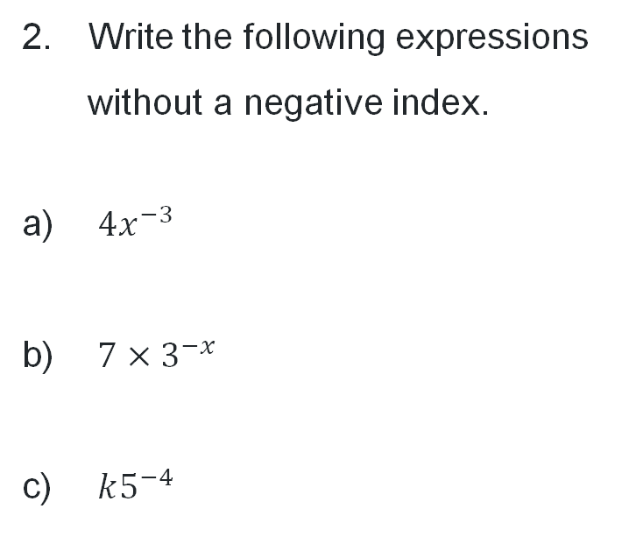
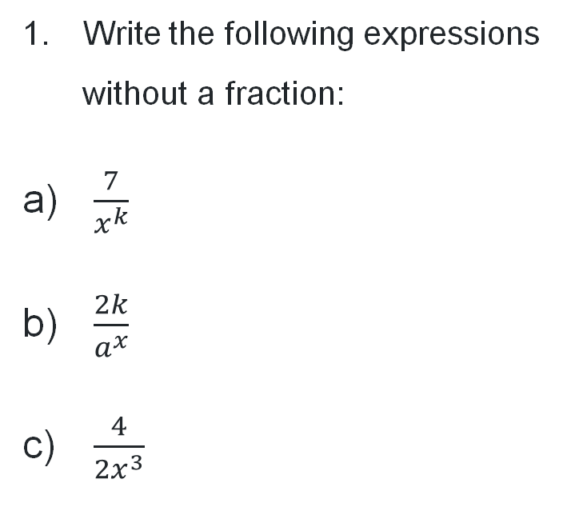


Questions
Write the following expressions
without a fraction:
$\frac{7}{x^{k}}$
$\frac{2k}{a^{x}}$
$\frac{4}{2x^{3}}$
Write the following expressions
without a negative index.
$4x^{−3}$
$7×3^{−x}$
$k5^{−4}$
$$=7x^{−k}$$
$$=2ka^{−x}$$
$$=2x^{−3}$$
$$=\frac{4}{x^{3}}$$
$$=\frac{7}{3^{x}}$$
$$=\frac{k}{5^{4}}$$

Slide 6
Connecting learning

Slide 7
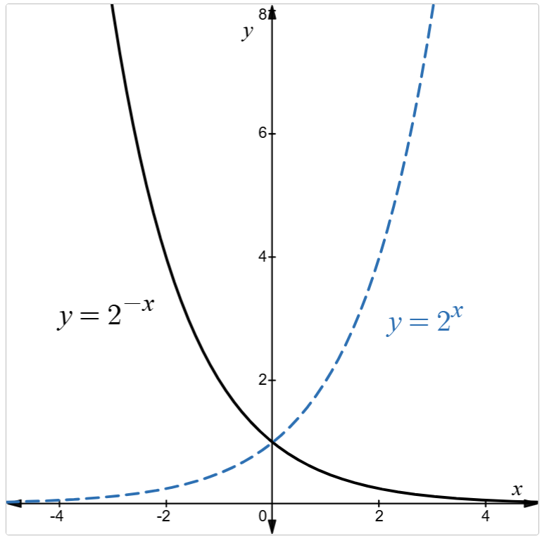
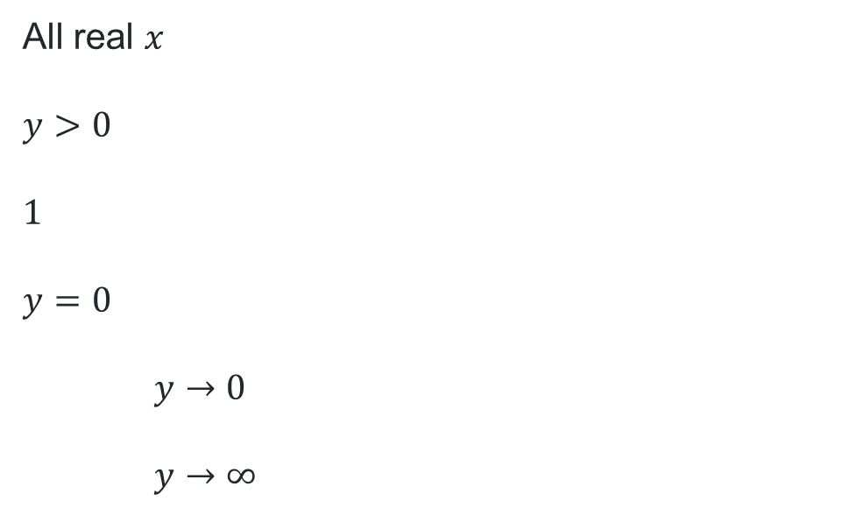
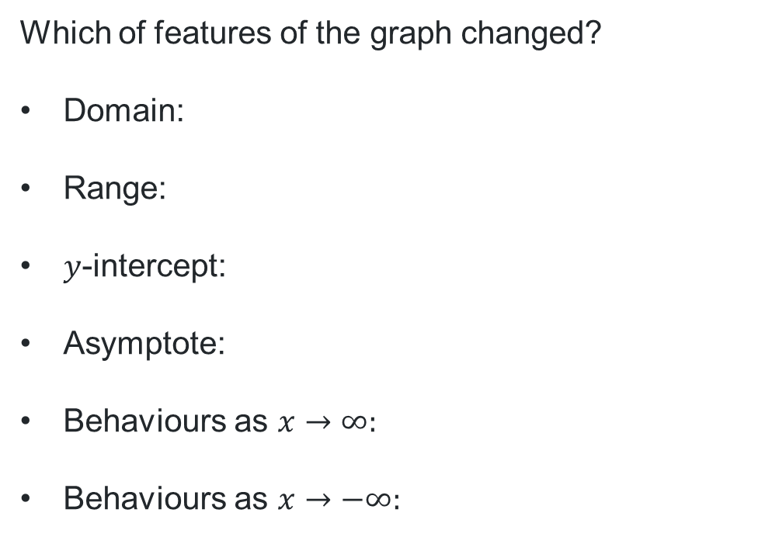
Reflection in the $y$-axis
What do you notice?
Which of features of the graph changed?
Domain:
Range:
$y$-intercept:
Asymptote:
Behaviours as $x→∞:$
Behaviours as $x→−∞:$
All real $x$
$y>0$
$1$
$y=0$
$y→0$
$y→∞$

Slide 8
Releasing responsibility

Slide 9
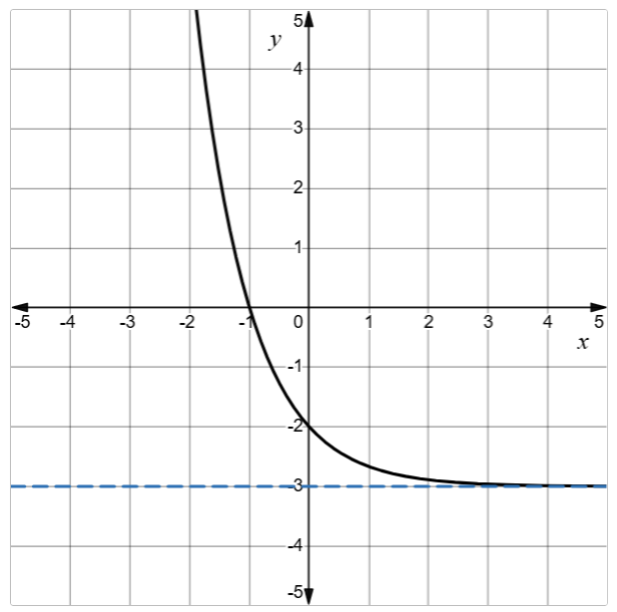

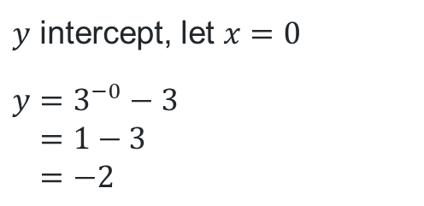
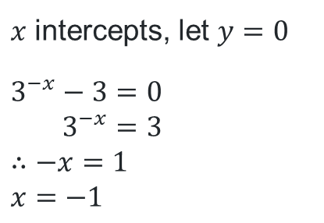
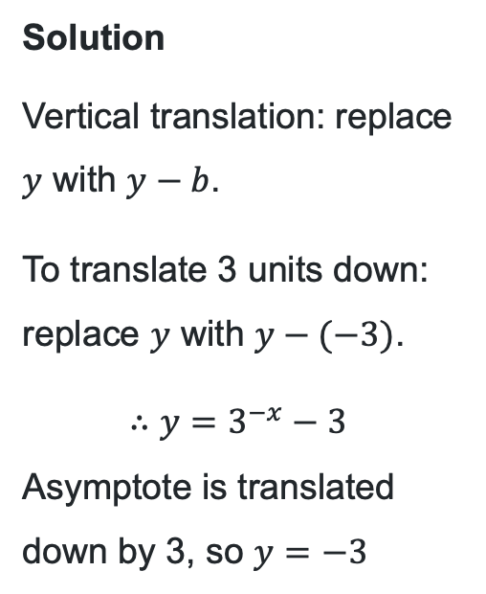
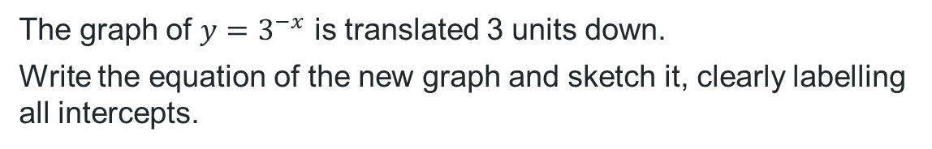
Vertical translations (1)
Worked example 1
Graph of $y=3^{−x}−3$
The graph of $y=3^{−x}$ is translated 3 units down.
Write the equation of the new graph and sketch it, clearly labelling all intercepts.
How could we show this algebraically?
Solution
Vertical translation: replace $y$ with $y−b$.
To translate 3 units down: replace $y$ with $y−(−3)$.
$$∴y=3^{−x}−3$$
Asymptote is translated down by 3, so $y=−3$
$x$ intercepts, let $y=0$
$$3^{−x}−3=0 \\ 3^{−x}=3$$
$$∴−x=1$$
$$x=−1$$
Why is this true?
$y$ intercept, let $x=0$
$$y=3^{−0}−3 \\ =1−3 \\ =−2$$
How could we have predicted this result?

Slide 10
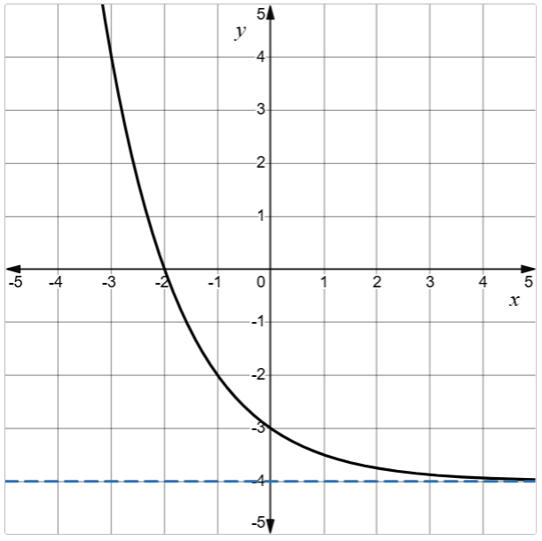
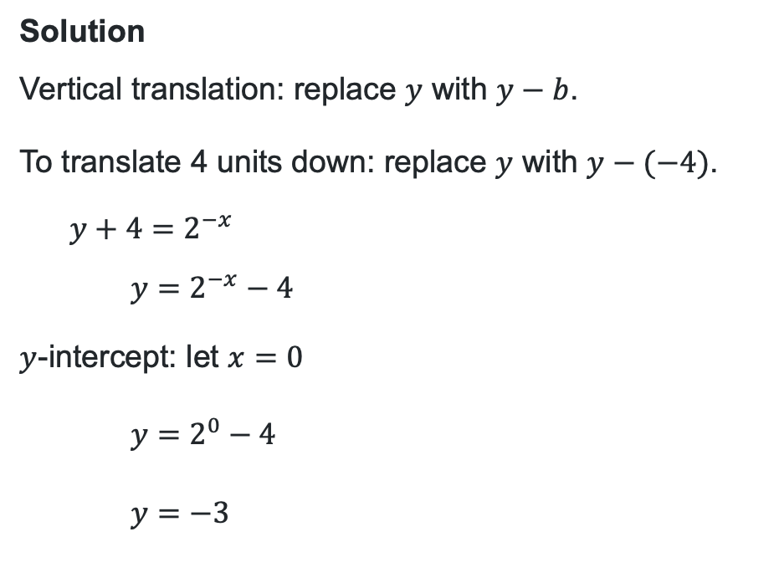
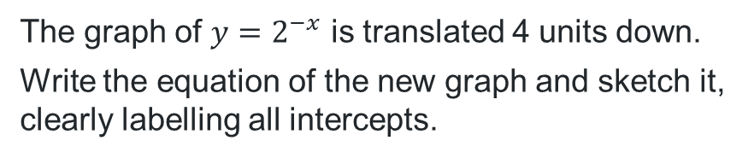

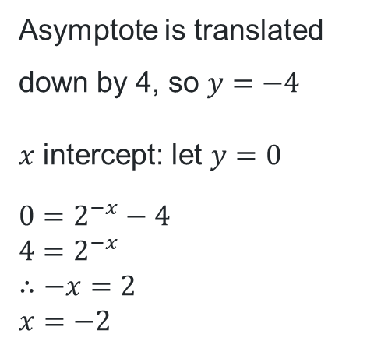
Vertical translations (2)
Graph of the new function$y=2^{−x}−4$.
Your turn – Question 1
The graph of $y=2^{−x}$ is translated 4 units down.
Write the equation of the new graph and sketch it, clearly labelling all intercepts.
Solution
Vertical translation: replace $y$ with $y−b$.
To translate 4 units down: replace $y$ with $y−(−4)$.
$$y+4=2^{−x}$$
$$y=2^{−x}−4$$
$y$-intercept: let $x=0$
$$y=2^{0}−4$$
$y=−3$
Asymptote is translated down by 4, so $y=−4$
$x$ intercept: let $y=0$
$$0=2^{−x}−4$$
$$4=2^{−x}$$
$$∴−x=2$$
$$x=−2$$

Slide 11
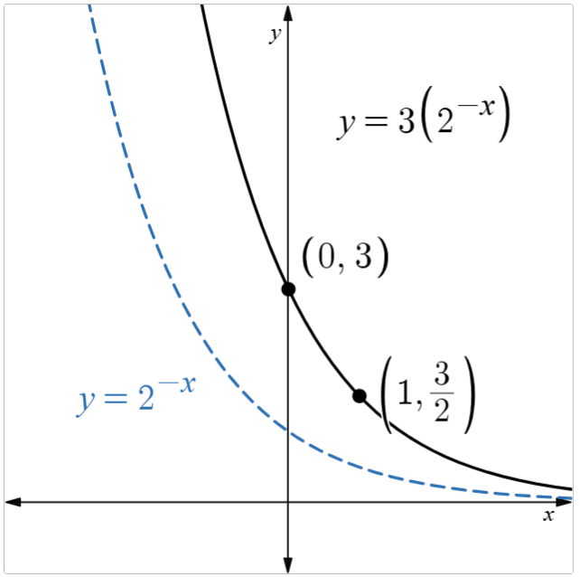
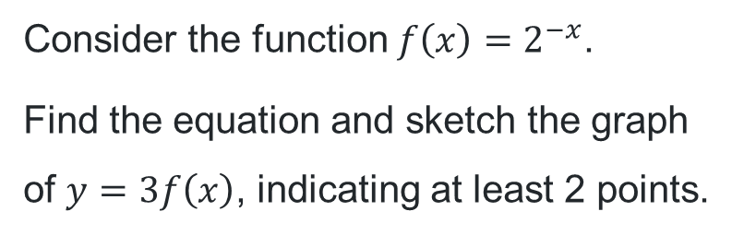
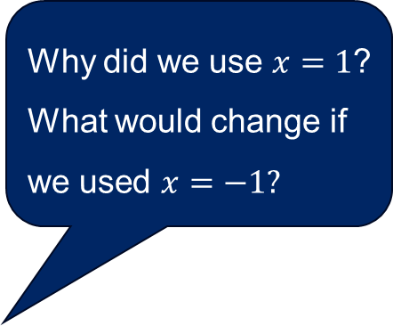
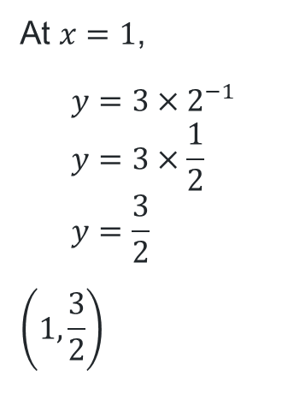
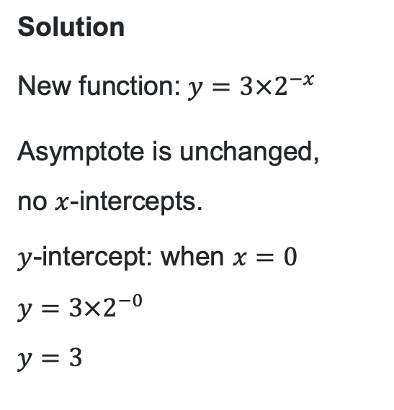
Applying dilations (1)
Why is the new graph steeper than the original function?
Worked example 2
Why did we use $x=1$?
What would change if we used $x=−1?$
Consider the function $f\left(x\right)=2^{−x}$.
Find the equation and sketch the graph of $y=3f\left(x\right)$, indicating at least 2 points.
Solution
New function: $y=3×2^{−x}$
Asymptote is unchanged,
no $x$-intercepts.
$y$-intercept: when $x=0$
$$y=3×2^{−0}$$
$$y=3$$
At $x=1$,
$$y=3×2^{−1} \\ y=3×\frac{1}{2} \\ y=\frac{3}{2}$$
$$\left(1,\frac{3}{2}\right)$$

Slide 12
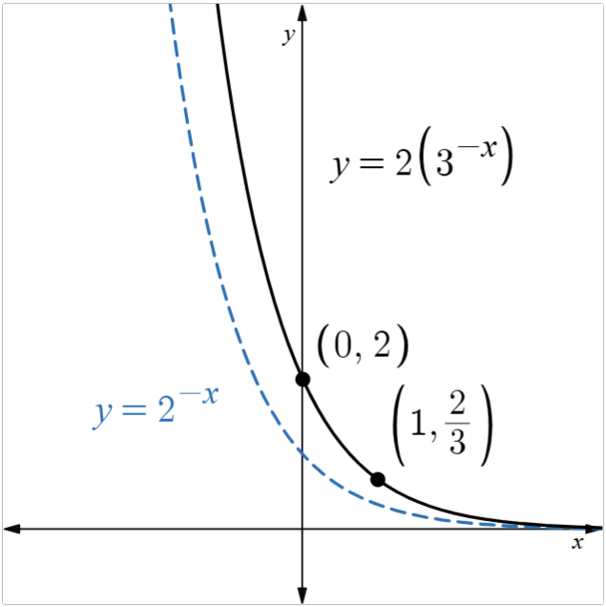
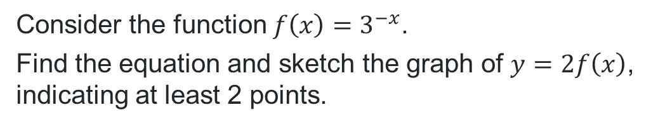
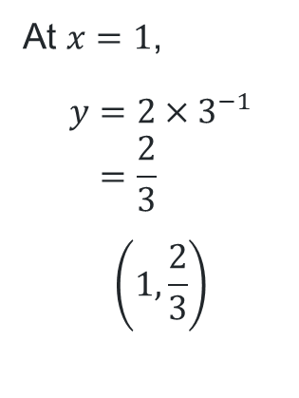
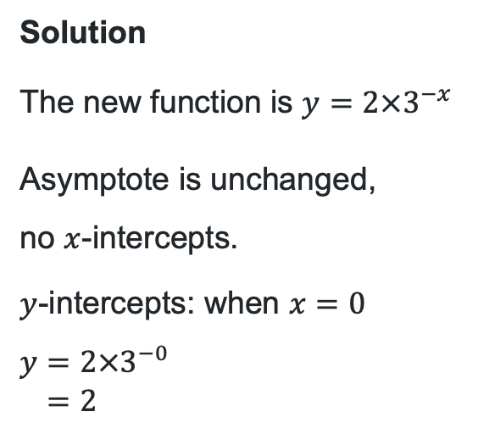
Applying dilations (2)
Your turn – Question 2
Consider the function $f\left(x\right)=3^{−x}$.
Find the equation and sketch the graph of $y=2f\left(x\right)$, indicating at least 2 points.
Solution
The new function is $y=2×3^{−x}$
Asymptote is unchanged,
no $x$-intercepts.
$y$-intercepts: when $x=0$
$$y=2×3^{−0} \\ =2$$
At $x=1$,
$$y=2×3^{−1} \\ =\frac{2}{3}$$
$$\left(1,\frac{2}{3}\right)$$

Slide 13
References
This presentation contains NSW Curriculum and syllabus content. The NSW Curriculum is developed by the NSW Education Standards Authority. This content is prepared by NESA for and on behalf of the Crown in the right of the State of New South Wales. The material is protected by Crown copyright.
Please refer to the NESA Copyright Disclaimer for more information https://educationstandards.nsw.edu.au/wps/portal/nesa/mini-footer/copyright.
NESA holds the only official and up-to-date versions of the NSW Curriculum and syllabus documents. Please visit the NSW Education Standards Authority (NESA) website https://educationstandards.nsw.edu.au/wps/portal/nesa/home and the NSW Curriculum website https://curriculum.nsw.edu.au.
Mathematics Advanced 11-12 Syllabus © NSW Education Standards Authority (NESA) for and on behalf of the Crown in right of the State of New South Wales, 2024.

Slide 14
Copyright
© State of New South Wales (Department of Education), 2026
The copyright material published in this resource is subject to the Copyright Act 1968 (Cth) and is owned by the NSW Department of Education or, where indicated, by a party other than the NSW Department of Education (third-party material).
Copyright material available in this resource and owned by the NSW Department of Education is licensed under a Creative Commons Attribution 4.0 International (CC BY 4.0) license.
This license allows you to share and adapt the material for any purpose, even commercially.
Attribution should be given to © State of New South Wales (Department of Education), 2026.
Material in this resource not available under a Creative Commons license:
the NSW Department of Education logo, other logos and trademark-protected material
Material owned by a third party that has been reproduced with permission. You will need to obtain permission from the third party to reuse its material.
Links to third-party material and websites
Please note that the provided (reading/viewing material/list/links/texts) are a suggestion only and implies no endorsement, by the New South Wales Department of Education, of any author, publisher, or book title. School principals and teachers are best placed to assess the suitability of resources that would complement the curriculum and reflect the needs and interests of their students.
If you use the links provided in this document to access a third-party’s website, you acknowledge that the terms of use, including licence terms set out on the third-party’s website apply to the use which may be made of the materials on that third-party website or where permitted by the Copyright Act 1968 (Cth). The department accepts no responsibility for content on third-party websites.

