Slide 1
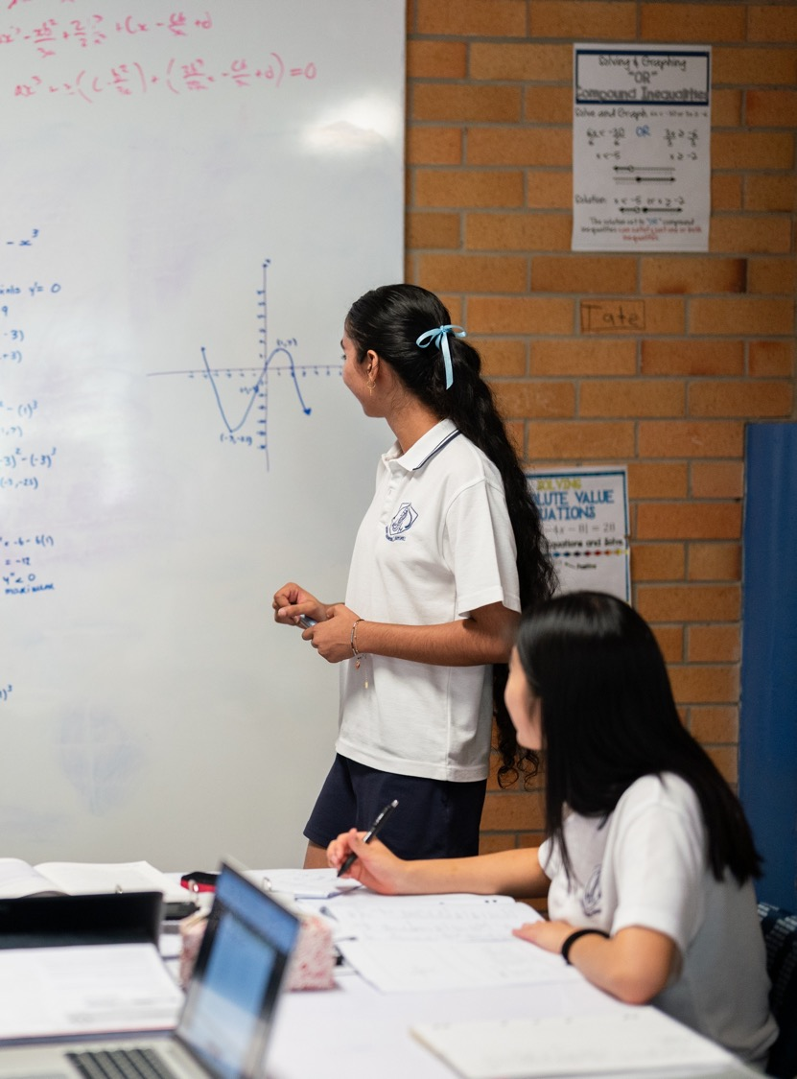
Velocity and displacement
Mathematics Advanced – Stage 6 (Year 11)
Unit 6 – Differentiation techniques and applications

Slide 2
Learning intentions and success criteria
Learning intentions
To be able to explain the difference between distance and displacement as well as velocity and speed.
To be able to calculate the displacement and velocity of a moving object.
Success criteria
I can define displacement and velocity as having both size and direction.
I can find the velocity equation from the displacement equation.
I can find when velocity and displacement are zero and interpret the value.
I can interpret displacement and velocity graphs with respect to time.
Notes:
Notes for teachers:
Learning intentions and success criteria are best co-constructed with students. Adapt the learning intention as required and add matching success criteria.
For more information See ⁠AITSL or the NSW Department of Education explicit teaching strategies, ⁠Sharing learning intentions and ⁠Sharing success criteria
LISC is not necessarily presented at the beginning of the lesson. Teacher needs to consider most effectual time to introduce
LISC should be revisited during the lesson to support students' evaluation of their learning

Slide 3
Connecting learning

Slide 4
Definitions (1)
Glossary
Distance – The length between two points, magnitude (size) only.
Displacement – The change in position of an object, after a period of time, from its original position. It has both magnitude and direction.

Slide 5
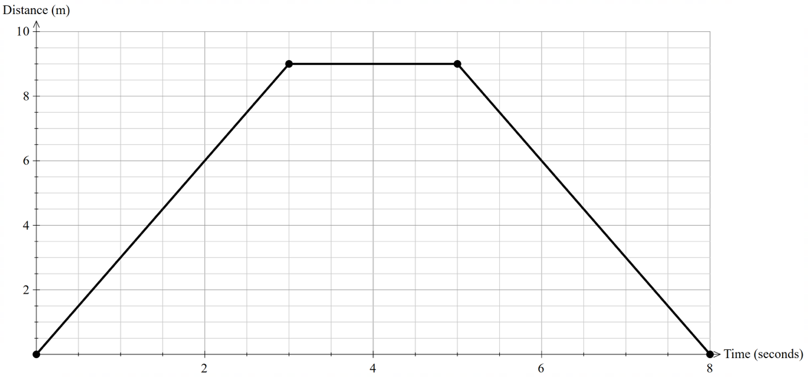
Graph 1
Distance = 18 m
Displacement = 0 m

Slide 6
Definitions (2)
Speed – The absolute value of an object’s velocity. It represents how fast the object is moving.
Velocity – The rate of change of an object's position with respect to time. meaning it has both magnitude and direction.

Slide 7
Releasing responsibility

Slide 8
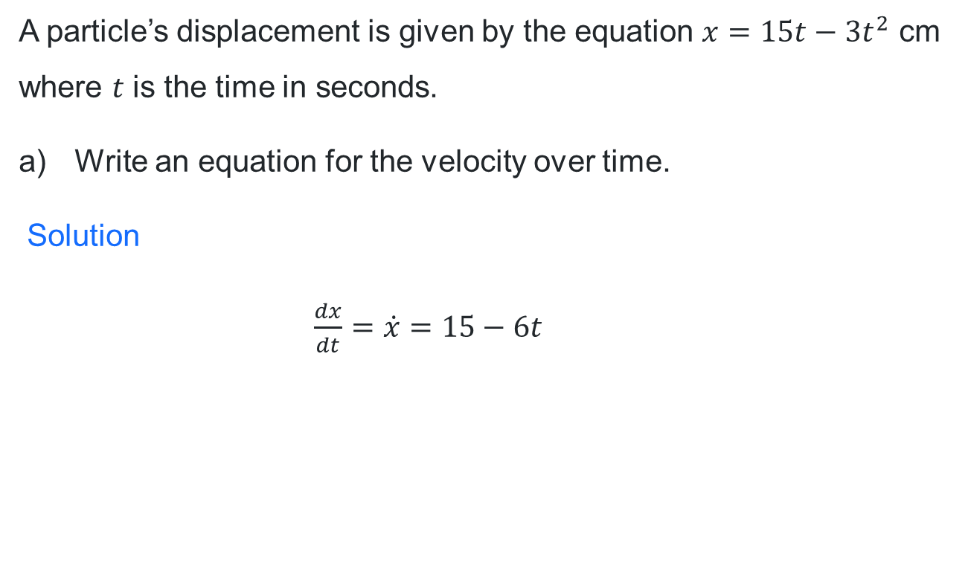
Worked example (1)
Example 1
A particle’s displacement is given by the equation $x=15t−3t^{2}$ cm where $t$ is the time in seconds.
Write an equation for the velocity over time.
Solution
$\frac{dx}{dt}=\dot{x}=15−6t$
Why have we calculated the derivative?

Slide 9

Your turn (1)
Example 1
A rocket’s height above the ground is given by the equation $x=7+6t−t^{2}$ cm where t is the time in seconds.
Write an equation for the velocity over time.
Solution
$\frac{dx}{dt}=\dot{x}=6−2$

Slide 10

Worked example (2)
Example 1
A particle’s displacement is given by the equation $x=15t−3t^{2}$ cm where $t$ is the time in seconds.
Find when the particle is at rest.
Solution
$\frac{dx}{dt}=\dot{x}=15−6t$ (from part a)
$$0=15−6t \\ 6t=15 \\ t=2.5 seconds$$
What is the velocity when the particle is at rest?

Slide 11

Your turn (2)
Example 1
A rocket’s height above the ground is given by the equation $x=7+6t−t^{2}$ cm where t is the time in seconds.
Find when the rocket is at rest.
Solution
$\frac{dx}{dt}=\dot{x}=6−2t$
$$0=6−2t \\ 2t=6 \\ t=3 seconds$$

Slide 12
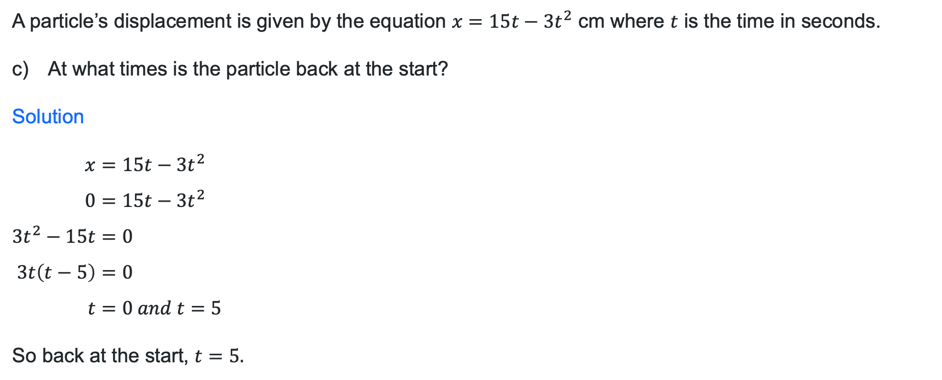
Worked example (3)
Example 1
A particle’s displacement is given by the equation $x=15t−3t^{2}$ cm where $t$ is the time in seconds.
At what times is the particle back at the start?
Solution
$$x=15t−3t^{2} \\ 0=15t−3t^{2} \\ 3t^{2}−15t=0 \\ 3t\left(t−5\right)=0 \\ t=0 and t=5$$
So back at the start, $t=5.$
Why are there 2 times?

Slide 13
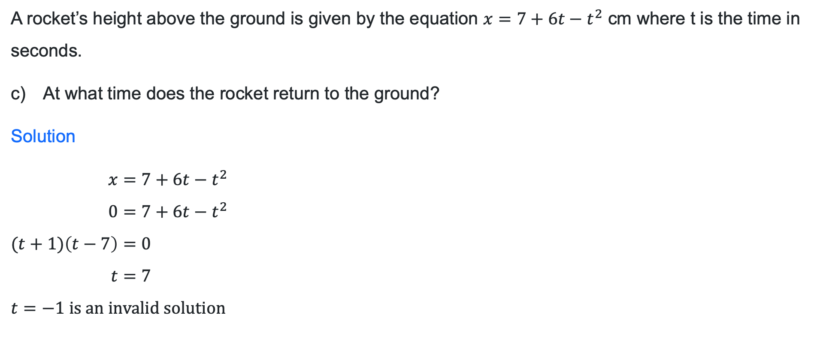
Your turn (3)
Example 1
A rocket’s height above the ground is given by the equation $x=7+6t−t^{2}$ cm where t is the time in seconds.
At what time does the rocket return to the ground?
Solution
$$x=7+6t−t^{2} \\ 0=7+6t−t^{2} \\ (t+1)\left(t−7\right)=0 \\ t=7$$
$t=−1 is an invalid solution$

Slide 14

Newtonian notation
$$\frac{dx}{dt}=\dot{x}$$

Slide 15
Banner task questions
Determine the expression for the velocity of a particle at time $t$ $seconds$ given the straight-line displacement $x metres$and find the displacement and velocity at the given times.
Determine the expression for the velocity of a particle at time $t$ $seconds$ given the displacement $x$ $metres$ and find the times when the particle is at rest.

Slide 16
Independent practice

Slide 17
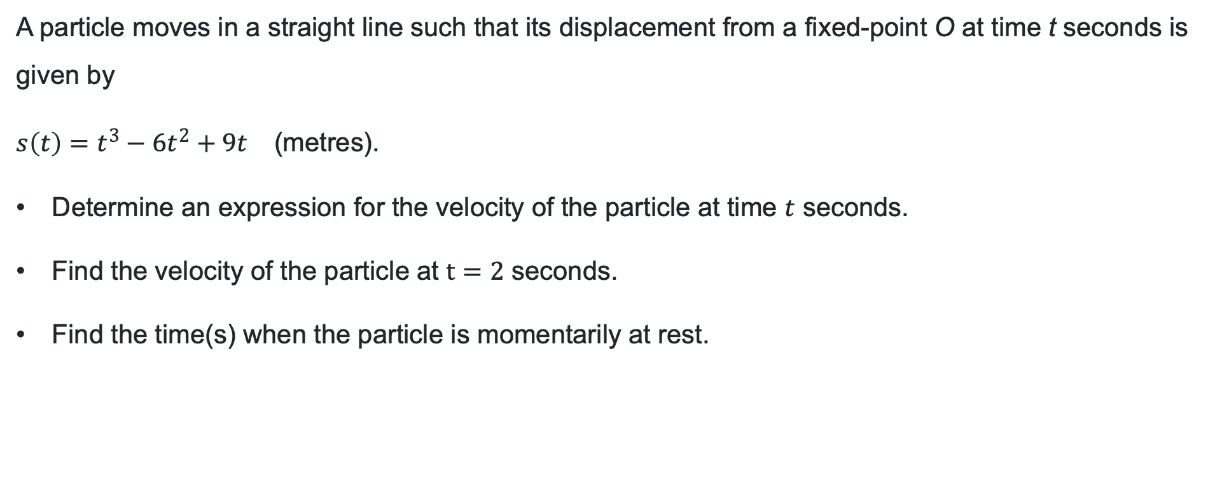
Exit ticket
A particle moves in a straight line such that its displacement from a fixed-point O at time t seconds is given by
$s\left(t\right)=t^{3}−6t^{2}+9t\text{ (}\text{metres}\text{)}$.
Determine an expression for the velocity of the particle at time $t$ seconds.
Find the velocity of the particle at $t=2$ seconds.
Find the time(s) when the particle is momentarily at rest.

Slide 18
References
This presentation contains NSW Curriculum and syllabus content. The NSW Curriculum is developed by the NSW Education Standards Authority. This content is prepared by NESA for and on behalf of the Crown in the right of the State of New South Wales. The material is protected by Crown copyright.
Please refer to the NESA Copyright Disclaimer for more information https://educationstandards.nsw.edu.au/wps/portal/nesa/mini-footer/copyright.
NESA holds the only official and up-to-date versions of the NSW Curriculum and syllabus documents. Please visit the NSW Education Standards Authority (NESA) website https://educationstandards.nsw.edu.au/wps/portal/nesa/home and the NSW Curriculum website https://curriculum.nsw.edu.au.
Mathematics Advanced 11-12 Syllabus © NSW Education Standards Authority (NESA) for and on behalf of the Crown in right of the State of New South Wales, 2024.

Slide 19
Copyright
© State of New South Wales (Department of Education), 2026
The copyright material published in this resource is subject to the Copyright Act 1968 (Cth) and is owned by the NSW Department of Education or, where indicated, by a party other than the NSW Department of Education (third-party material).
Copyright material available in this resource and owned by the NSW Department of Education is licensed under a Creative Commons Attribution 4.0 International (CC BY 4.0) license.
This license allows you to share and adapt the material for any purpose, even commercially.
Attribution should be given to © State of New South Wales (Department of Education), 2026.
Material in this resource not available under a Creative Commons license:
the NSW Department of Education logo, other logos and trademark-protected material
Material owned by a third party that has been reproduced with permission. You will need to obtain permission from the third party to reuse its material.
Links to third-party material and websites
Please note that the provided (reading/viewing material/list/links/texts) are a suggestion only and implies no endorsement, by the New South Wales Department of Education, of any author, publisher, or book title. School principals and teachers are best placed to assess the suitability of resources that would complement the curriculum and reflect the needs and interests of their students.
If you use the links provided in this document to access a third-party’s website, you acknowledge that the terms of use, including licence terms set out on the third-party’s website apply to the use which may be made of the materials on that third-party website or where permitted by the Copyright Act 1968 (Cth). The department accepts no responsibility for content on third-party websites.

