Slide 1
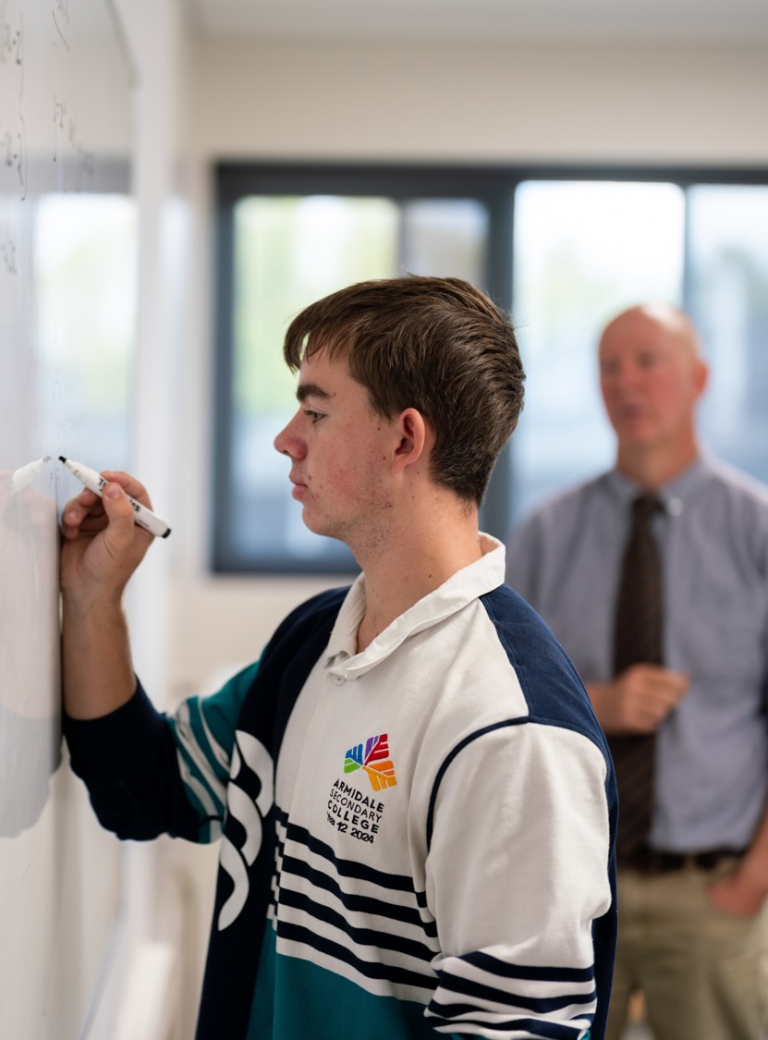
Graphing the derivative function
Mathematics Advanced – Stage 6 (Year 11)
Unit 6 – Differentiation techniques and applications

Slide 2
Learning intentions and success criteria
Learning intentions
To be able to graph the derivative function of a given function.
Success criteria
I can identify on the graph of a function, where the gradient is zero, positive or negative.
I can explain what shape a derivative function will take based on the power of the original function.
I can sketch the derivative function of a given function.
Notes:
Notes for teachers:
Learning intentions and success criteria are best co-constructed with students. Adapt the learning intention as required and add matching success criteria.
For more information See ⁠AITSL or the NSW Department of Education explicit teaching strategies, ⁠Sharing learning intentions and ⁠Sharing success criteria
LISC is not necessarily presented at the beginning of the lesson. Teacher needs to consider most effectual time to introduce
LISC should be revisited during the lesson to support students' evaluation of their learning

Slide 3
Activating prior knowledge

Slide 4
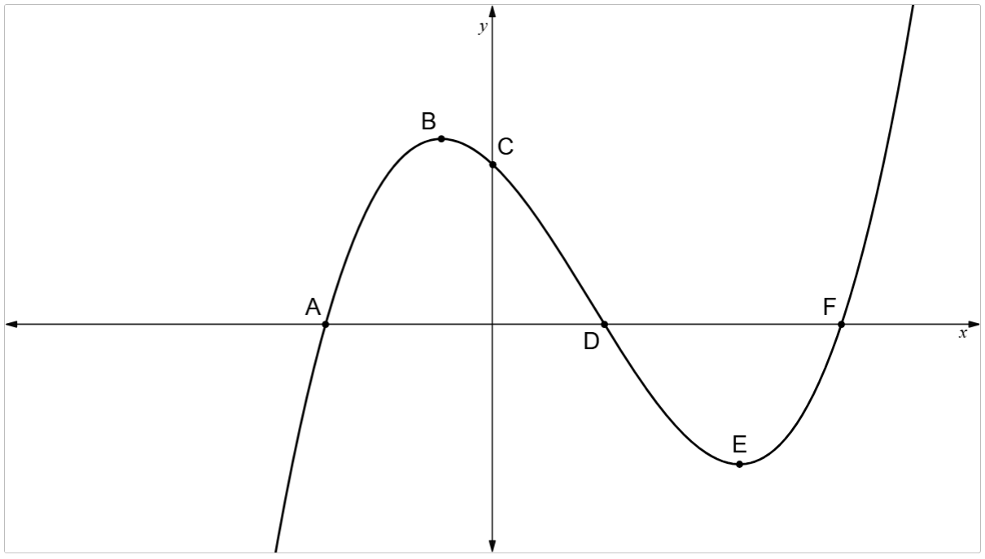
Graph of a function

Slide 5
Connecting learning

Slide 6
Considerations
Shape
Sign
Steepness
Do I know the type of function?
Do I know what its derivative looks like?
Where is the gradient zero?
Where is it positive and negative?
Where is the gradient steep? So, the value of the derivative is larger?
Where is the gradient less steep? So, value of the derivative is smaller?

Slide 7
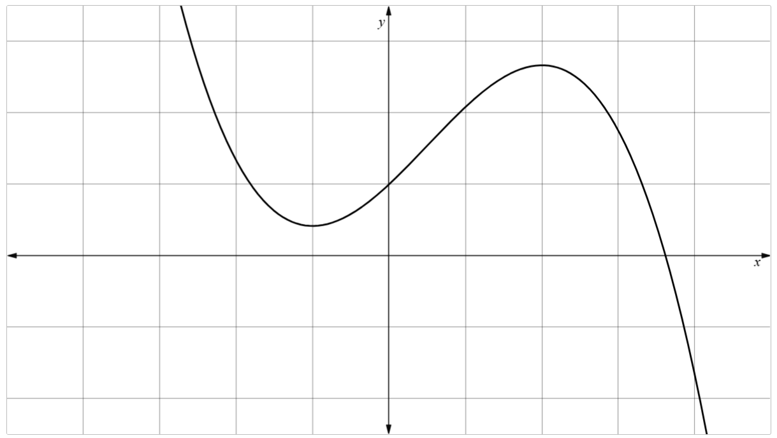


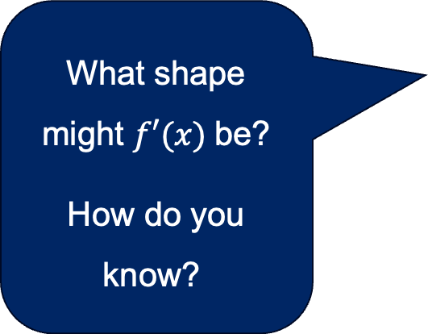
Sketching the derivative (1)
Step 1 – Place zeros where the derivative is zero.
$$0$$
What shape might $f′(x)$be?
How do you know?
$$0$$

Slide 8
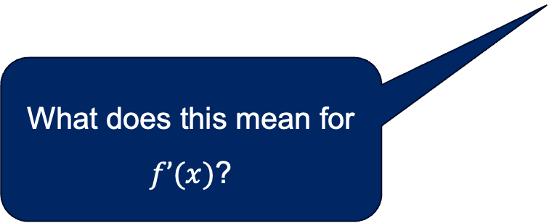

Sketching the derivative (2)
Step 2 – Place pluses along the $x$-axis where is the derivative positive.
$$0$$
$$0$$
$$+ + + + + + + + +$$
What does this mean for $f’(x)$?

Slide 9



Sketching the derivative (3)
Step 3 – Place minuses along the $x$-axis where is the derivative negative.
$$0$$
$$− − − −$$
$$+ + ++ ++$$
$$− − − −$$
$$0$$
Where is the derivative large and positive?
Where is it small and positive?

Slide 10
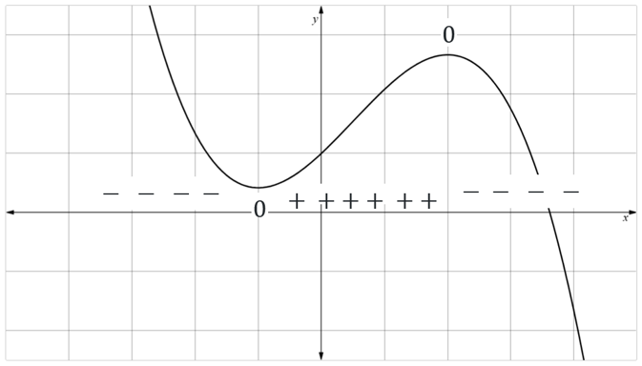
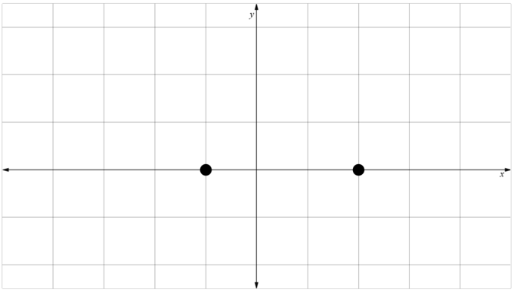
Sketching the derivative (4)
Step 4 – Place points on the $x$-axis of the sketch, corresponding to where the derivative is zero.
Why are these points important?

Slide 11


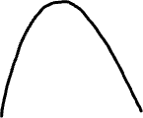
Sketching the derivative (5)
Step 5 – Using all the information you’ve gathered, smoothly sketch a gradient function.
Ensure that your sketch goes through the points where the gradient is zero.
Will all our sketches look the same?
Why or why not?

Slide 12
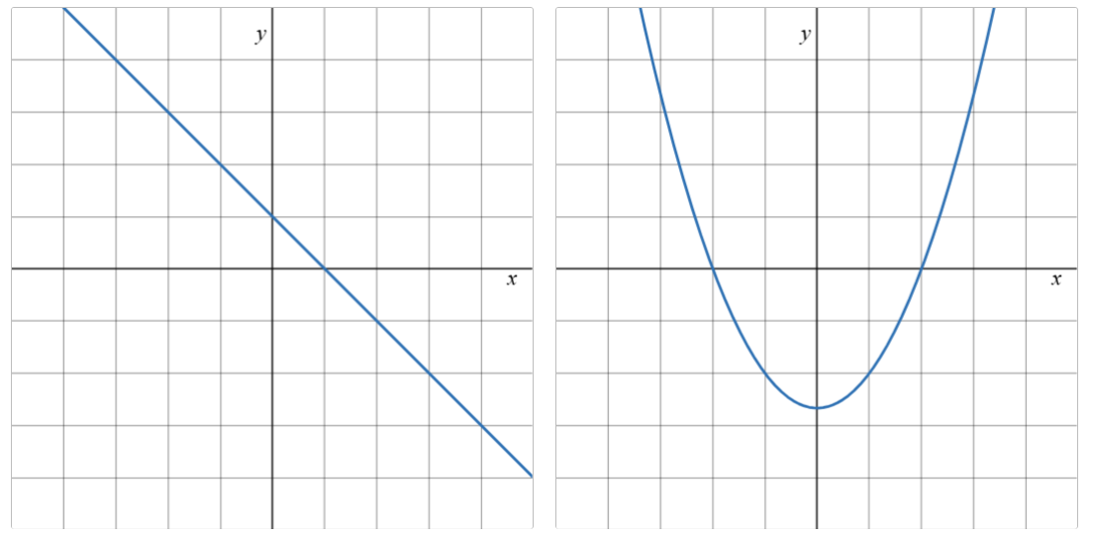
Solutions
Sketching the derivative

Slide 13
References
This presentation contains NSW Curriculum and syllabus content. The NSW Curriculum is developed by the NSW Education Standards Authority. This content is prepared by NESA for and on behalf of the Crown in the right of the State of New South Wales. The material is protected by Crown copyright.
Please refer to the NESA Copyright Disclaimer for more information https://educationstandards.nsw.edu.au/wps/portal/nesa/mini-footer/copyright.
NESA holds the only official and up-to-date versions of the NSW Curriculum and syllabus documents. Please visit the NSW Education Standards Authority (NESA) website https://educationstandards.nsw.edu.au/wps/portal/nesa/home and the NSW Curriculum website https://curriculum.nsw.edu.au.
Mathematics Advanced 11-12 Syllabus © NSW Education Standards Authority (NESA) for and on behalf of the Crown in right of the State of New South Wales, 2024.

Slide 14
Copyright
© State of New South Wales (Department of Education), 2026
The copyright material published in this resource is subject to the Copyright Act 1968 (Cth) and is owned by the NSW Department of Education or, where indicated, by a party other than the NSW Department of Education (third-party material).
Copyright material available in this resource and owned by the NSW Department of Education is licensed under a Creative Commons Attribution 4.0 International (CC BY 4.0) license.
This license allows you to share and adapt the material for any purpose, even commercially.
Attribution should be given to © State of New South Wales (Department of Education), 2026.
Material in this resource not available under a Creative Commons license:
the NSW Department of Education logo, other logos and trademark-protected material
Material owned by a third party that has been reproduced with permission. You will need to obtain permission from the third party to reuse its material.
Links to third-party material and websites
Please note that the provided (reading/viewing material/list/links/texts) are a suggestion only and implies no endorsement, by the New South Wales Department of Education, of any author, publisher, or book title. School principals and teachers are best placed to assess the suitability of resources that would complement the curriculum and reflect the needs and interests of their students.
If you use the links provided in this document to access a third-party’s website, you acknowledge that the terms of use, including licence terms set out on the third-party’s website apply to the use which may be made of the materials on that third-party website or where permitted by the Copyright Act 1968 (Cth). The department accepts no responsibility for content on third-party websites.

