Slide 1
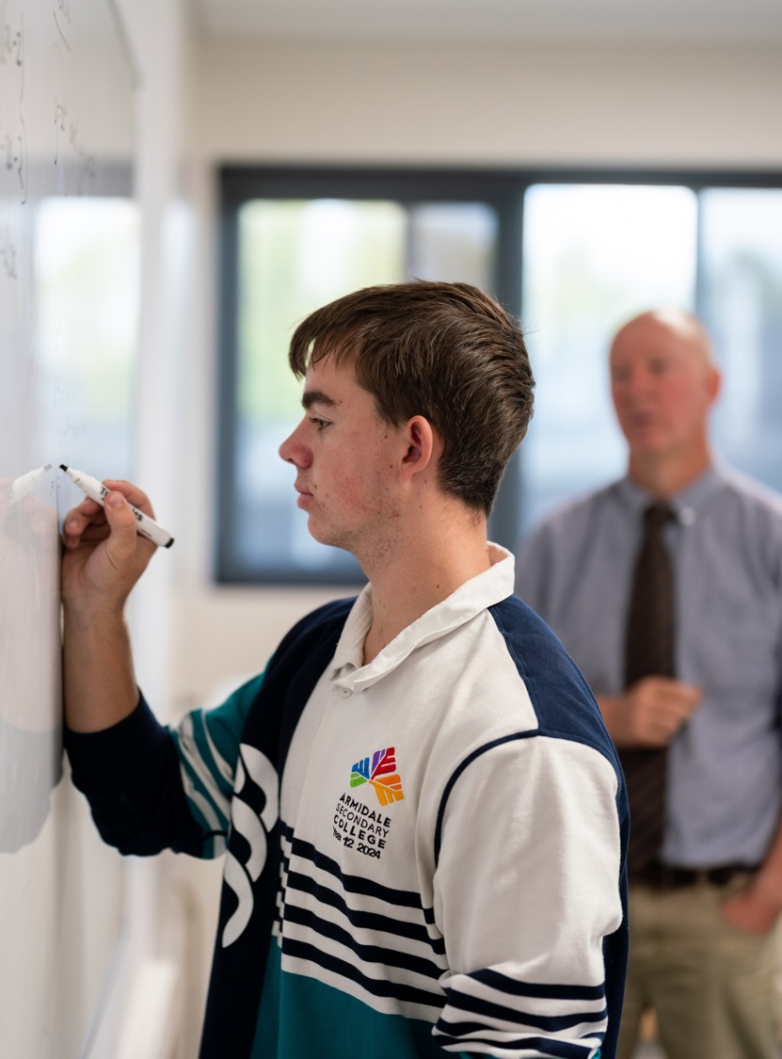
Increasing decreasing functions
Mathematics Advanced – Stage 6 (Year 11)
Unit 6 – Differentiation techniques and applications

Slide 2
Retrieval practice

Slide 3
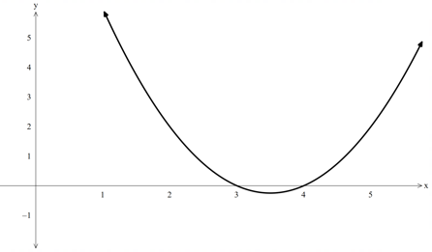
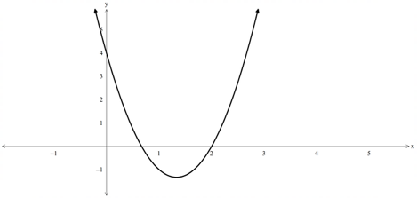
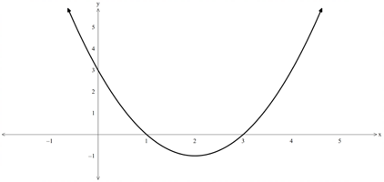











Quadratic equations and inequalities
Solve by factorising
$$x^{2}−7x+12<0$$
$$x^{2}−4x+3>0$$
$$3x^{2}−8x+4<0$$
$$\left(x−3\right)\left(x−4\right)<0$$
$$\left(x−3\right)\left(x−1\right)>0$$
$$\left(3x−2\right)\left(x−2\right)<0$$
$$\frac{2}{3}<x<2$$
$$3<x<4$$
$$x<1\text{, }x>3$$

Slide 4
Connecting learning

Slide 5
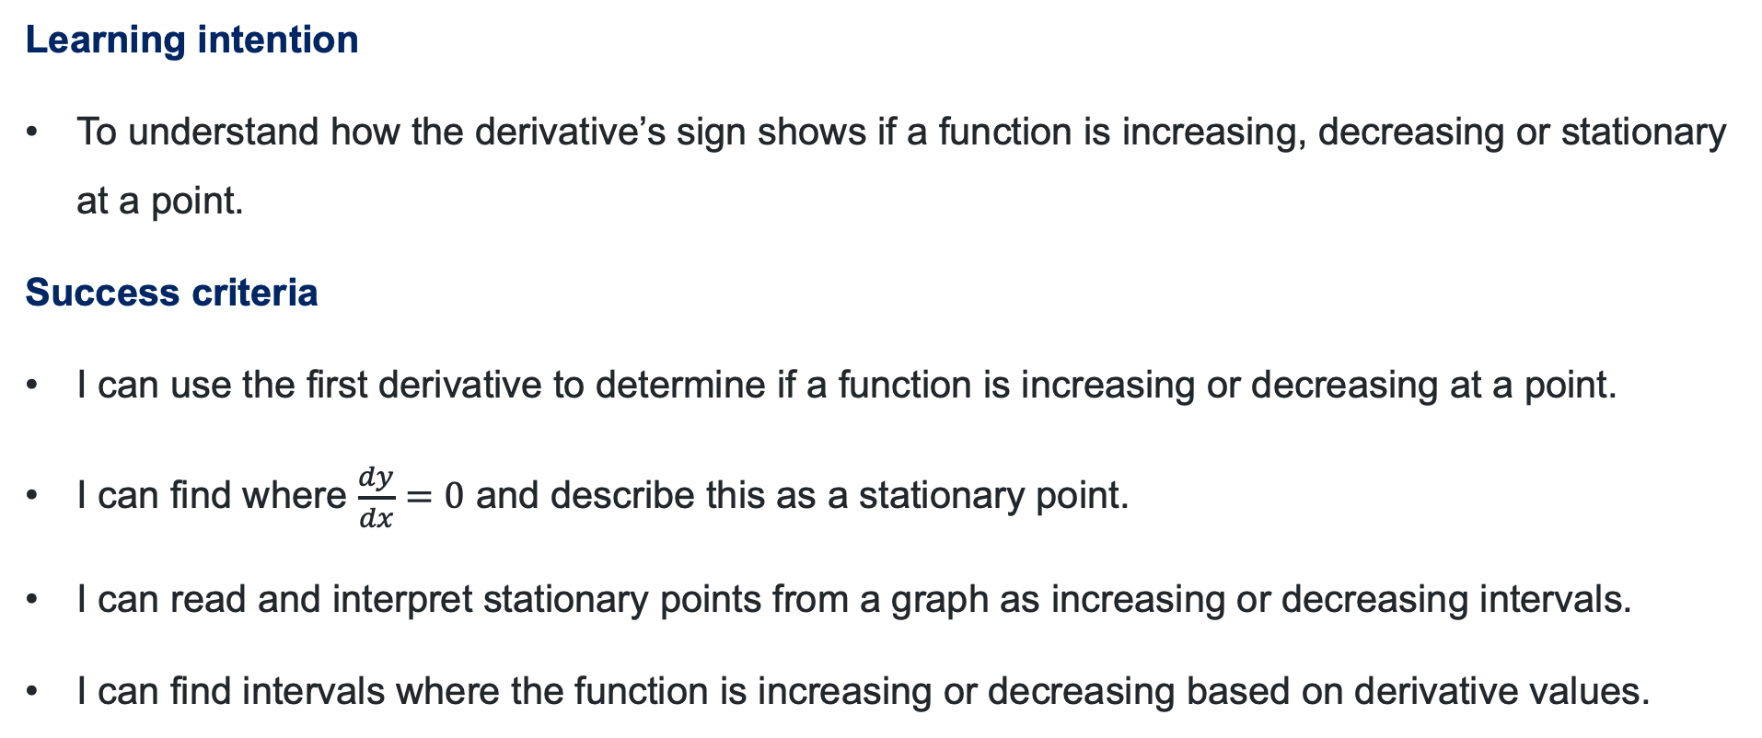
Learning intention and success criteria
Learning intention
To understand how the derivative’s sign shows if a function is increasing, decreasing or stationary at a point.
Success criteria
I can use the first derivative to determine if a function is increasing or decreasing at a point.
I can find where $\frac{dy}{dx}=0$ and describe this as a stationary point.
I can read and interpret stationary points from a graph as increasing or decreasing intervals.
I can find intervals where the function is increasing or decreasing based on derivative values.
Notes:
Notes for teachers:
Learning intentions and success criteria are best co-constructed with students. Adapt the learning intention as required and add matching success criteria.
For more information See ⁠AITSL or the NSW Department of Education explicit teaching strategies, ⁠Sharing learning intentions and ⁠Sharing success criteria
LISC is not necessarily presented at the beginning of the lesson. Teacher needs to consider most effectual time to introduce
LISC should be revisited during the lesson to support students' evaluation of their learning

Slide 6
Releasing responsibility

Slide 7
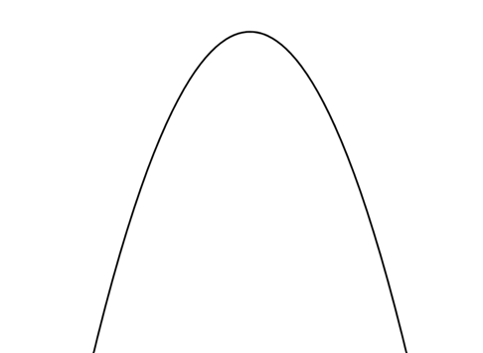
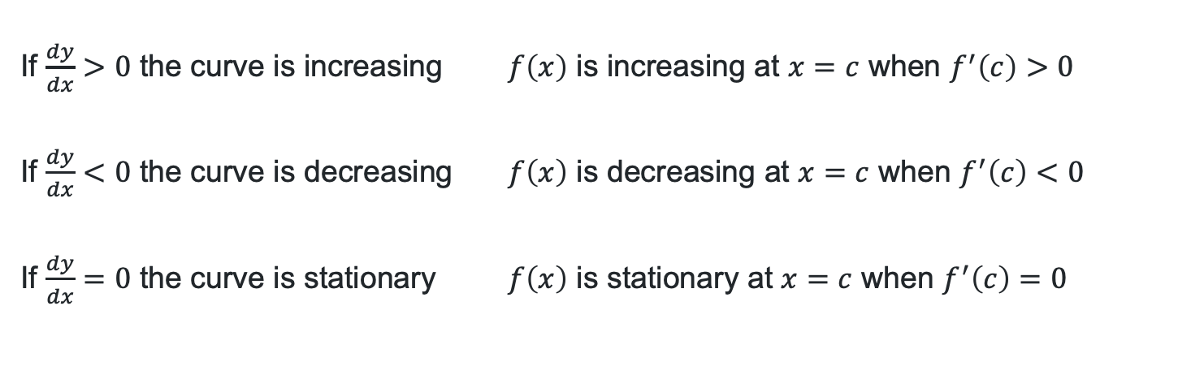
Graphical applications of the derivative
If $\frac{dy}{dx}>0$ the curve is increasing $f\left(x\right)$ is increasing at $x=c$ when $f^{′}\left(c\right)>0$
If $\frac{dy}{dx}<0$ the curve is decreasing $f\left(x\right)$ is decreasing at $x=c$ when $f^{′}\left(c\right)<0$
If $\frac{dy}{dx}=0$ the curve is stationary $f\left(x\right)$ is stationary at $x=c$ when $f^{′}\left(c\right)=0$
stationary
increasing
increasing
decreasing
decreasing
stationary

Slide 8
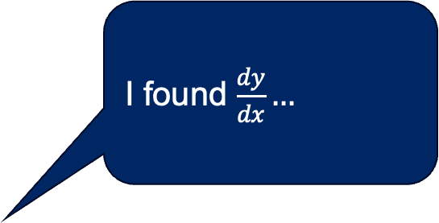
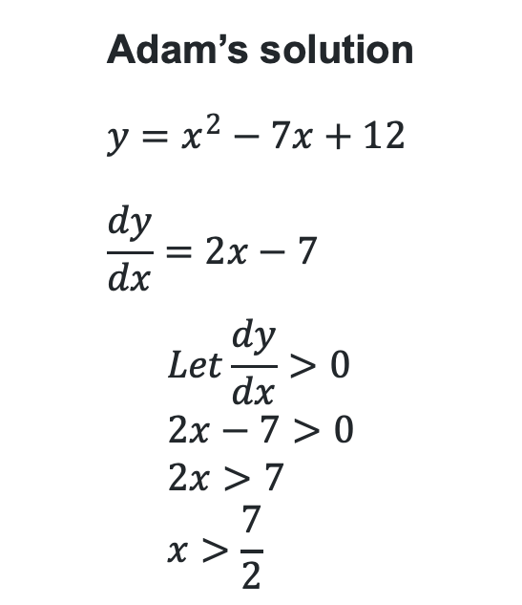

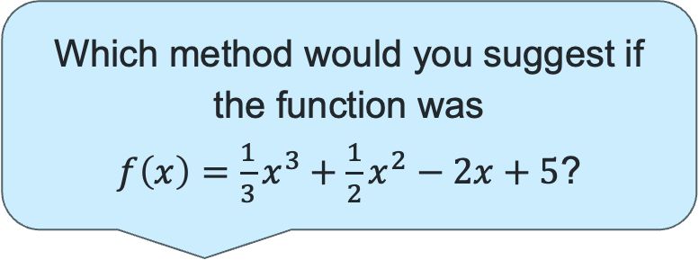
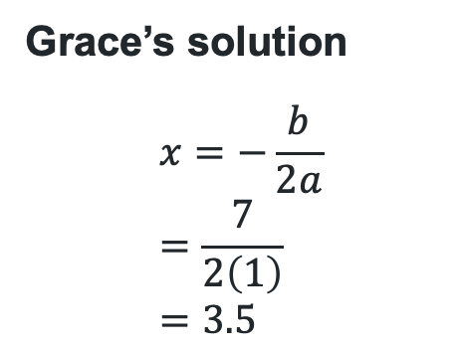
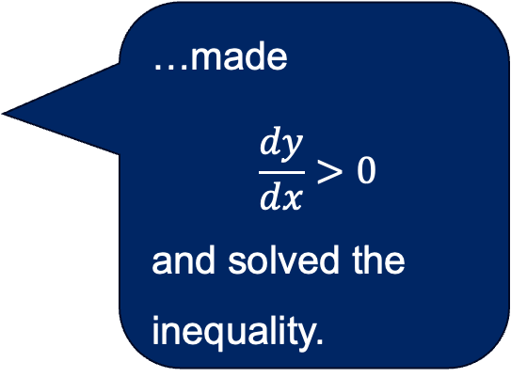
Compare the strategies
Which method would you suggest if the function was
$f\left(x\right)=\frac{1}{3}x^{3}+\frac{1}{2}x^{2}−2x+5$?
If $y=x^{2}−7x+12$ find the values of $x$ for which $\frac{dy}{dx}>0$
Grace’s solution
$$x=−\frac{b}{2a} \\ =\frac{7}{2\left(1\right)} \\ =3.5$$
I found the axis of symmetry then graphed the parabola.
Adam’s solution
$$y=x^{2}−7x+12 \\ \frac{dy}{dx}=2x−7$$
$$Let\frac{dy}{dx}>0 \\ 2x−7>0 \\ 2x>7 \\ x>\frac{7}{2}$$
I found $\frac{dy}{dx}…$
…made
$$\frac{dy}{dx}>0$$
and solved the inequality.
I then found the increasing values from the graph.
$$x>3.5$$

Slide 9
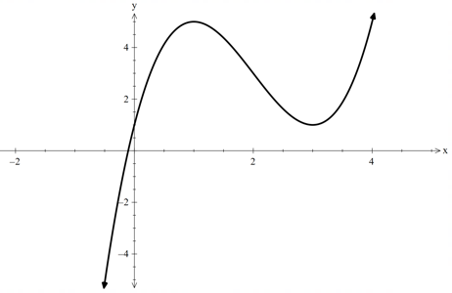
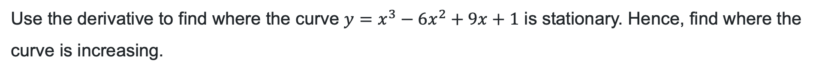
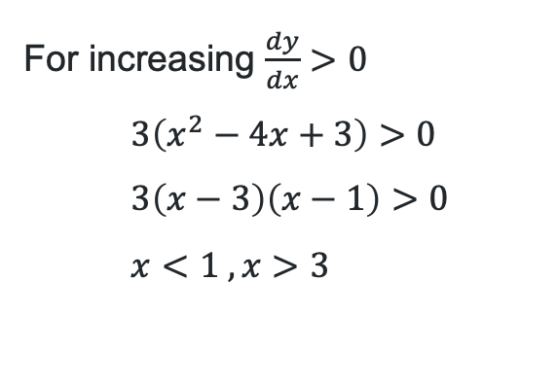
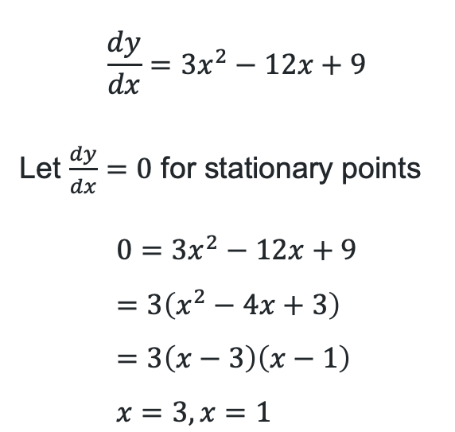
Example 1
Example 1
Use the derivative to find where the curve $y=x^{3}−6x^{2}+9x+1$ is stationary. Hence, find where the curve is increasing.
Describe how this inequality was formed?
What would change if the question was to find where the curve is decreasing?
For increasing $\frac{dy}{dx}>0$
$$3\left(x^{2}−4x+3\right)>0 \\ 3\left(x−3\right)\left(x−1\right)>0 \\ x<1 ,x>3$$
$$\frac{dy}{dx}=3x^{2}−12x+9$$
Let $\frac{dy}{dx}=0$ for stationary points
$$0=3x^{2}−12x+9 \\ =3\left(x^{2}−4x+3\right) \\ =3\left(x−3\right)\left(x−1\right) \\ x=3, x=1$$
Describe a strategy you could use to find the solution to a quadratic inequality.

Slide 10
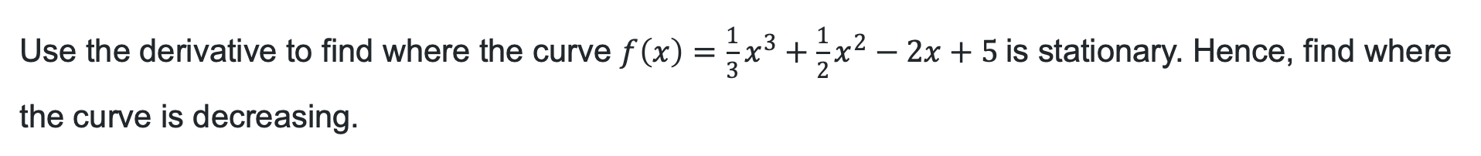
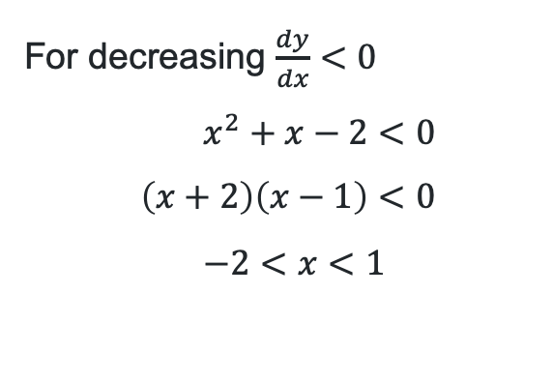
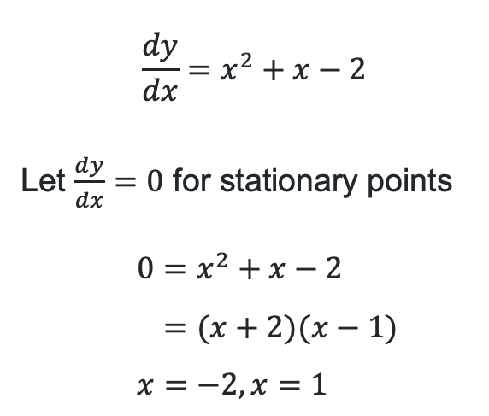
Question 1
Your turn – question 1
Use the derivative to find where the curve $f\left(x\right)=\frac{1}{3}x^{3}+\frac{1}{2}x^{2}−2x+5$is stationary. Hence, find where the curve is decreasing.
$$\frac{dy}{dx}=x^{2}+x−2$$
Let $\frac{dy}{dx}=0$ for stationary points
$$0=x^{2}+x−2 \\ =(x+2)(x−1) \\ x=−2, x=1$$
For decreasing $\frac{dy}{dx}<0$
$$x^{2}+x−2<0 \\ \left(x+2\right)\left(x−1\right)<0 \\ −2<x<1$$

Slide 11
References
This presentation contains NSW Curriculum and syllabus content. The NSW Curriculum is developed by the NSW Education Standards Authority. This content is prepared by NESA for and on behalf of the Crown in the right of the State of New South Wales. The material is protected by Crown copyright.
Please refer to the NESA Copyright Disclaimer for more information https://educationstandards.nsw.edu.au/wps/portal/nesa/mini-footer/copyright.
NESA holds the only official and up-to-date versions of the NSW Curriculum and syllabus documents. Please visit the NSW Education Standards Authority (NESA) website https://educationstandards.nsw.edu.au/wps/portal/nesa/home and the NSW Curriculum website https://curriculum.nsw.edu.au.
Mathematics Advanced 11-12 Syllabus © NSW Education Standards Authority (NESA) for and on behalf of the Crown in right of the State of New South Wales, 2024.

Slide 12
Copyright
© State of New South Wales (Department of Education), 2026
The copyright material published in this resource is subject to the Copyright Act 1968 (Cth) and is owned by the NSW Department of Education or, where indicated, by a party other than the NSW Department of Education (third-party material).
Copyright material available in this resource and owned by the NSW Department of Education is licensed under a Creative Commons Attribution 4.0 International (CC BY 4.0) license.
This license allows you to share and adapt the material for any purpose, even commercially.
Attribution should be given to © State of New South Wales (Department of Education), 2026.
Material in this resource not available under a Creative Commons license:
the NSW Department of Education logo, other logos and trademark-protected material
Material owned by a third party that has been reproduced with permission. You will need to obtain permission from the third party to reuse its material.
Links to third-party material and websites
Please note that the provided (reading/viewing material/list/links/texts) are a suggestion only and implies no endorsement, by the New South Wales Department of Education, of any author, publisher, or book title. School principals and teachers are best placed to assess the suitability of resources that would complement the curriculum and reflect the needs and interests of their students.
If you use the links provided in this document to access a third-party’s website, you acknowledge that the terms of use, including licence terms set out on the third-party’s website apply to the use which may be made of the materials on that third-party website or where permitted by the Copyright Act 1968 (Cth). The department accepts no responsibility for content on third-party websites.

