Slide 1
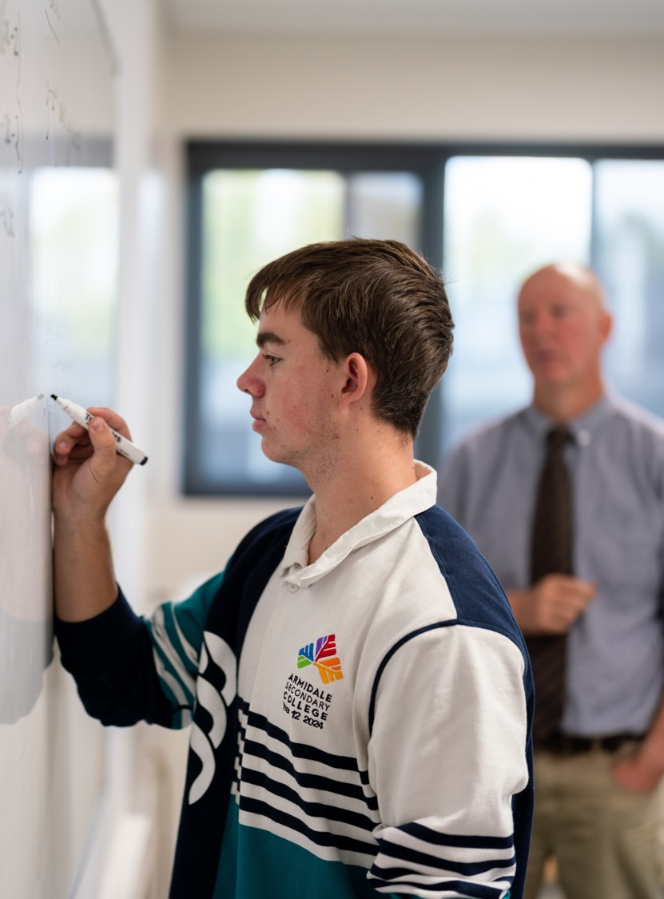
The product rule
Mathematics Advanced – Stage 6 (Year 11)
Unit 6 – Differentiation techniques and applications

Slide 2
Learning intentions and success criteria
Learning intentions
To be able to differentiate a function that is the product of 2 functions.
Success criteria
I can identify functions where the product rule can be used to differentiate.
I can apply the product rule to differentiate a function.
I can solve problems which require the use of the product rule.
Notes:
Notes for teachers:
Learning intentions and success criteria are best co-constructed with students. Adapt the learning intention as required and add matching success criteria.
For more information See ⁠AITSL or the NSW Department of Education explicit teaching strategies, ⁠Sharing learning intentions and ⁠Sharing success criteria
LISC is not necessarily presented at the beginning of the lesson. Teacher needs to consider most effectual time to introduce
LISC should be revisited during the lesson to support students' evaluation of their learning

Slide 3
Activating prior knowledge

Slide 4


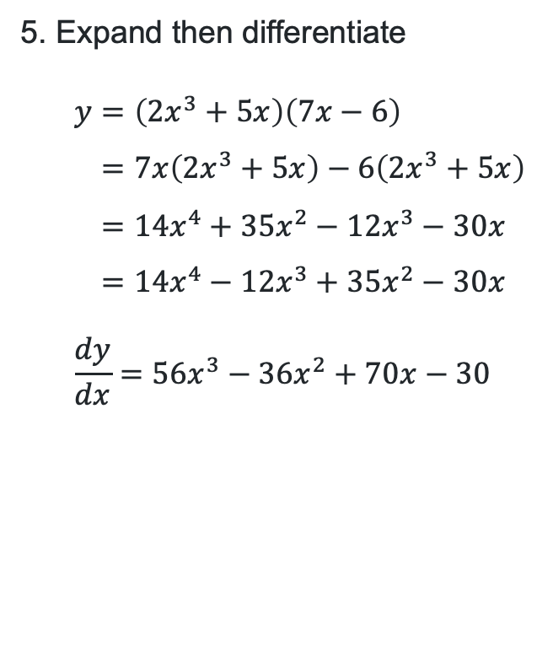
Differentiating (1)
Differentiate the following
  1. $u=$ $7x−6$
2. $v=2x^{3}+5x$
3. $u={\left(7x−6\right)}^{3}$
4. $v={\left(2x^{3}+5x\right)}^{4}$
5. $y=\left(2x^{3}+5x\right)\left(7x−6\right)$
  $\frac{du}{dx}=7$
  $\frac{dv}{dx}=6x^{2}+5$
$\frac{du}{dx}=3{\left(7x−6\right)}^{2}×7=21{\left(7x−6\right)}^{2}$
$\frac{dv}{dx}=4{\left(2x^{3}+5x\right)}^{3}(6x^{2}+5)$
5. Expand then differentiate
$$y=\left(2x^{3}+5x\right)\left(7x−6\right) \\ =7x\left(2x^{3}+5x\right)−6\left(2x^{3}+5x\right) \\ =14x^{4}+35x^{2}−12x^{3}−30x \\ =14x^{4}−12x^{3}+35x^{2}−30x \\ \frac{dy}{dx}=56x^{3}−36x^{2}+70x−30$$

Slide 5
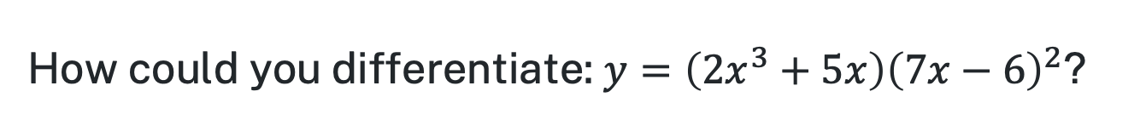
Differentiating (2)
How could you differentiate: $y={\left(2x^{3}+5x\right)\left(7x−6\right)}^{2}$?
What challenges might be faced when using our existing strategies to differentiate this question?

Slide 6
Connecting learning

Slide 7
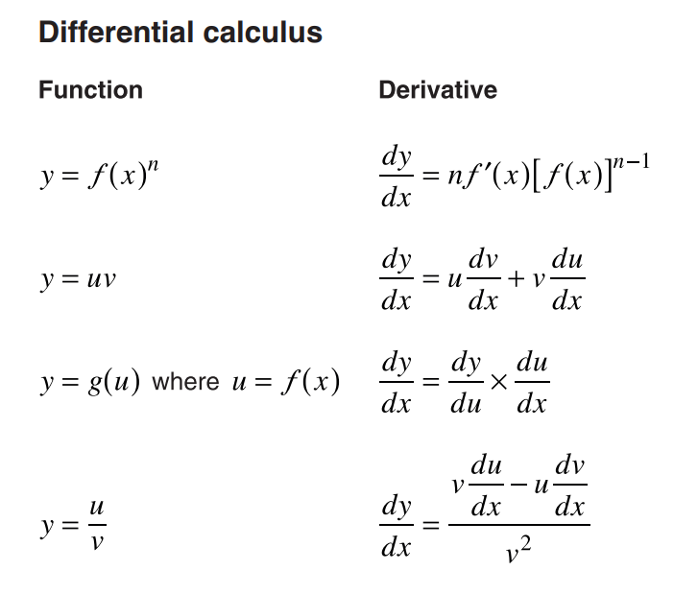
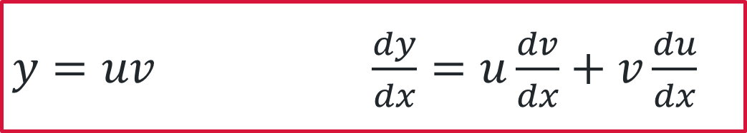
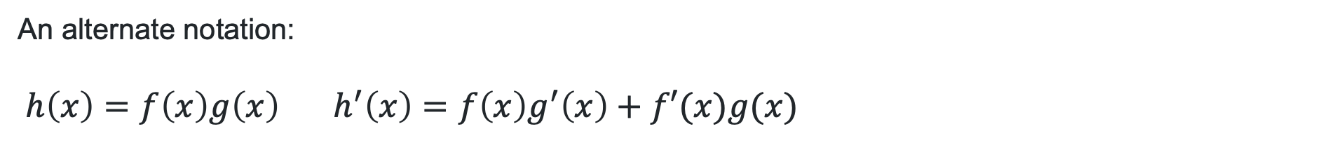
Reference sheet
Can you find the rule on the reference sheet?
$y=uv$ $\frac{dy}{dx}=u\frac{dv}{dx}+v\frac{du}{dx}$
An alternate notation:
$h\left(x\right)=f\left(x\right)g\left(x\right)$ $h^{′}\left(x\right)=f\left(x\right)g^{′}\left(x\right)+f′(x)g(x)$
Mathematics Advanced – HSC reference sheet page 2.
When might you use different notations?

Slide 8
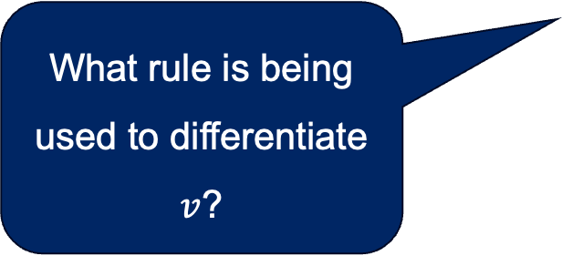

Using the product rule (1)
Why did we first differentiate each function separately?
Worked example
Find the derivative of $y=$ $(7x−3)(x^{2}+1)$.
$u=(7x−3)$, $\frac{du}{dx}=7$
$v=(x^{2}+1)$, $\frac{dv}{dx}=2x$
$$\frac{dy}{dx}=u\frac{dv}{dx}+v\frac{du}{dx} \\ =\left(7x−3\right)×2x+(x^{2}+1)×7 \\ =2x\left(7x−3\right)+7\left(x^{2}+1\right) \\ =14x^{2}−6x+7x^{2}+7x \\ =21x^{2}+x$$
What does the red shading represent? What does the blue shading represent?
What rule is being used to differentiate $v$?

Slide 9


Using the product rule (2)
Your turn
Find the derivative of $y=(x+1)(x^{3}−4)$.
$u=x+1,$ $\frac{du}{dx}=1$
$v=x^{3}−4$, $\frac{dv}{dx}=3x^{2}$
$$\frac{dy}{dx}=u\frac{dv}{dx}+v\frac{du}{dx} \\ =\left(x+1\right)×3x^{2}+(x^{3}−4)×1 \\ =3x^{3}+3x^{2}+x^{3}−4 \\ =4x^{3}+3x^{2}−4$$

Slide 10

Using the product rule (3)
Why did we first differentiate each function separately?
Worked example
Find the derivative of $y={\left(7x−3\right)\left(x+1\right)}^{5}$.
$u=(7x−3)$, $\frac{du}{dx}=7$
$v={\left(x+1\right)}^{5}$, $\frac{dv}{dx}=5{\left(x+1\right)}^{4}×1=5 {\left(x+1\right)}^{4}$
$$\frac{dy}{dx}=u\frac{dv}{dx}+v\frac{du}{dx} \\ =\left(7x−3\right)×5{\left(x+1\right)}^{4}+{\left(x+1\right)}^{5}×7 \\ =5\left(7x−3\right){\left(x+1\right)}^{4}+7{\left(x+1\right)}^{5}$$
What does the red shading represent? What does the blue shading represent?
What rule is being used to differentiate $v$?

Slide 11

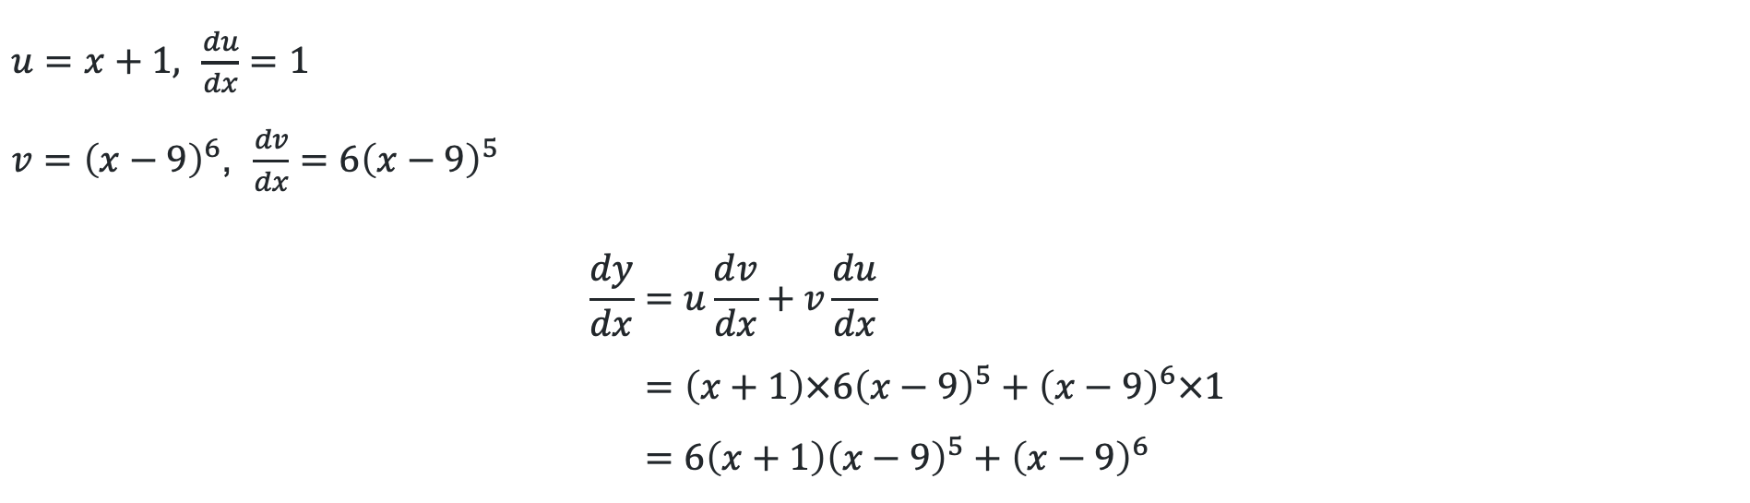
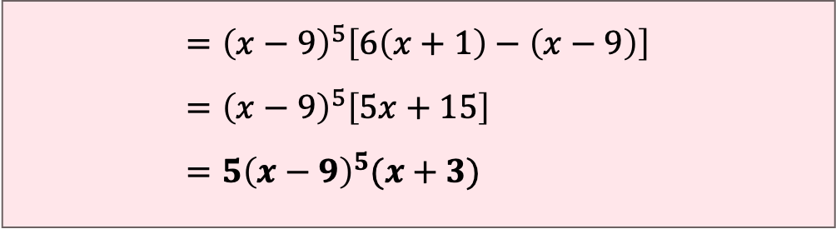
Using the product rule (4)
Your turn
Find the derivative of $y=(x+1){\left(x−9\right)}^{6}$.
$u=x+1,$ $\frac{du}{dx}=1$
$v={\left(x−9\right)}^{6}$, $\frac{dv}{dx}=6{\left(x−9\right)}^{5}$
$$\frac{dy}{dx}=u\frac{dv}{dx}+v\frac{du}{dx} \\ =\left(x+1\right)×6{\left(x−9\right)}^{5}+{\left(x−9\right)}^{6}×1 \\ =6\left(x+1\right){\left(x−9\right)}^{5}+{\left(x−9\right)}^{6}$$
$$={\left(x−9\right)}^{5}\left[6\left(x+1\right)−\left(x−9\right)\right] \\ ={\left(x−9\right)}^{5}\left[5x+15\right] \\ =5{\left(x−9\right)}^{5}(x+3)$$

Slide 12
Independent practice

Slide 13

Approaching questions scaffold

Slide 14
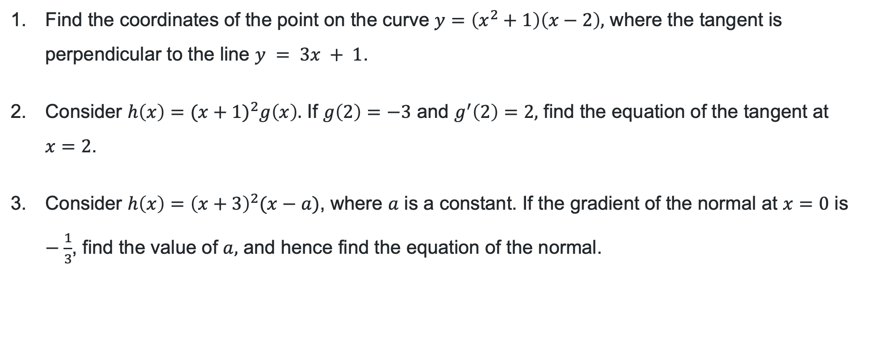
HSC style questions
Working mathematically
Find the coordinates of the point on the curve $y=\left(x^{2}+1\right)\left(x−2\right),$ where the tangent is perpendicular to the line $y = 3x + 1$.
Consider $h\left(x\right)=(x+{1)}^{2}g\left(x\right).$ If $g\left(2\right)=−3$ and $g^{′}\left(2\right)=2,$ find the equation of the tangent at
$x=2$.
Consider $h\left(x\right)={\left(x+3\right)}^{2}(x−a)$, where $a$ is a constant. If the gradient of the normal at $x=0$ is $−\frac{1}{3}$, find the value of $a,$ and hence find the equation of the normal.

Slide 15

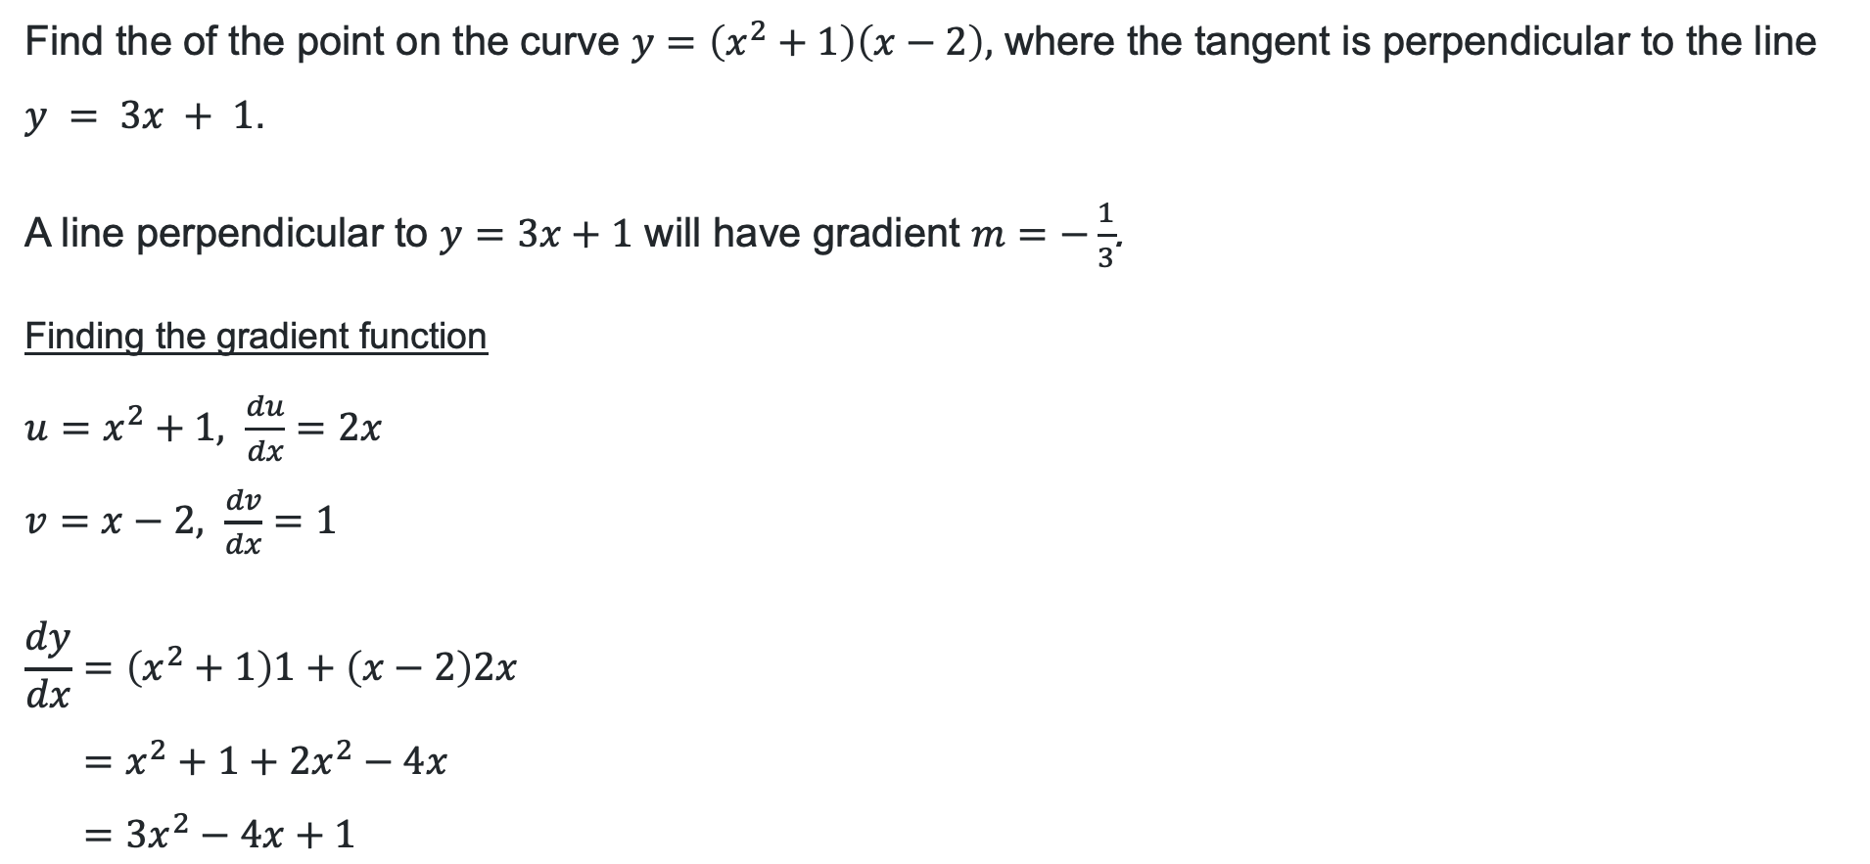
Question 1
Solution
Find the of the point on the curve $y=\left(x^{2}+1\right)\left(x−2\right),$ where the tangent is perpendicular to the line $y = 3x + 1$.
A line perpendicular to $y=3x+1$ will have gradient $m=−\frac{1}{3}$.
Finding the gradient function
$u=x^{2}+1, \frac{du}{dx}=2x$
$v=x−2, \frac{dv}{dx}=1$
$$\frac{dy}{dx}=\left(x^{2}+1\right)1+\left(x−2\right)2x \\ =x^{2}+1+2x^{2}−4x \\ =3x^{2}−4x+1$$
Determining the $x−$coordinates
Let $\frac{dy}{dx}=−\frac{1}{3}$
$$3x^{2}−4x+1=−\frac{1}{3} \\ x^{2}−4x+\frac{4}{3}=0$$
$∴x=\frac{1}{3},1$ (by quadratic formula)

Slide 16


Question 2
Solution
Consider $h\left(x\right)=(x+{1)}^{2}g\left(x\right).$ If $g\left(2\right)=−3$ and $g^{′}\left(2\right)=2,$ find the equation of the tangent at
$x=2$.
$f\left(x\right)={\left(x+1\right)}^{2}, f^{′}\left(x\right)=2\left(x+1\right)=2x+2$
$$f\left(2\right)={\left(2+1\right)}^{2}=9, f^{′}\left(2\right)=2×2+2=6$$
Finding the gradient at $x=2$
$$h^{′}\left(x\right)=f\left(x\right)g^{′}\left(x\right)+g\left(x\right)f^{′}\left(x\right)$$
$$h^{′}\left(2\right)=f\left(2\right)g^{′}\left(2\right)+g\left(2\right)f^{′}\left(2\right) \\ =9×2+\left(−3\right)×6 \\ =0$$
Finding y value at $x=2$.
$$h\left(2\right)=f\left(2\right)g\left(2\right) \\ =9×\left(−3\right) \\ =−27$$
Equation of tangent:
$$y−\left(−27\right)=0\left(x−2\right) \\ y+27=0 \\ y=−27$$

Slide 17
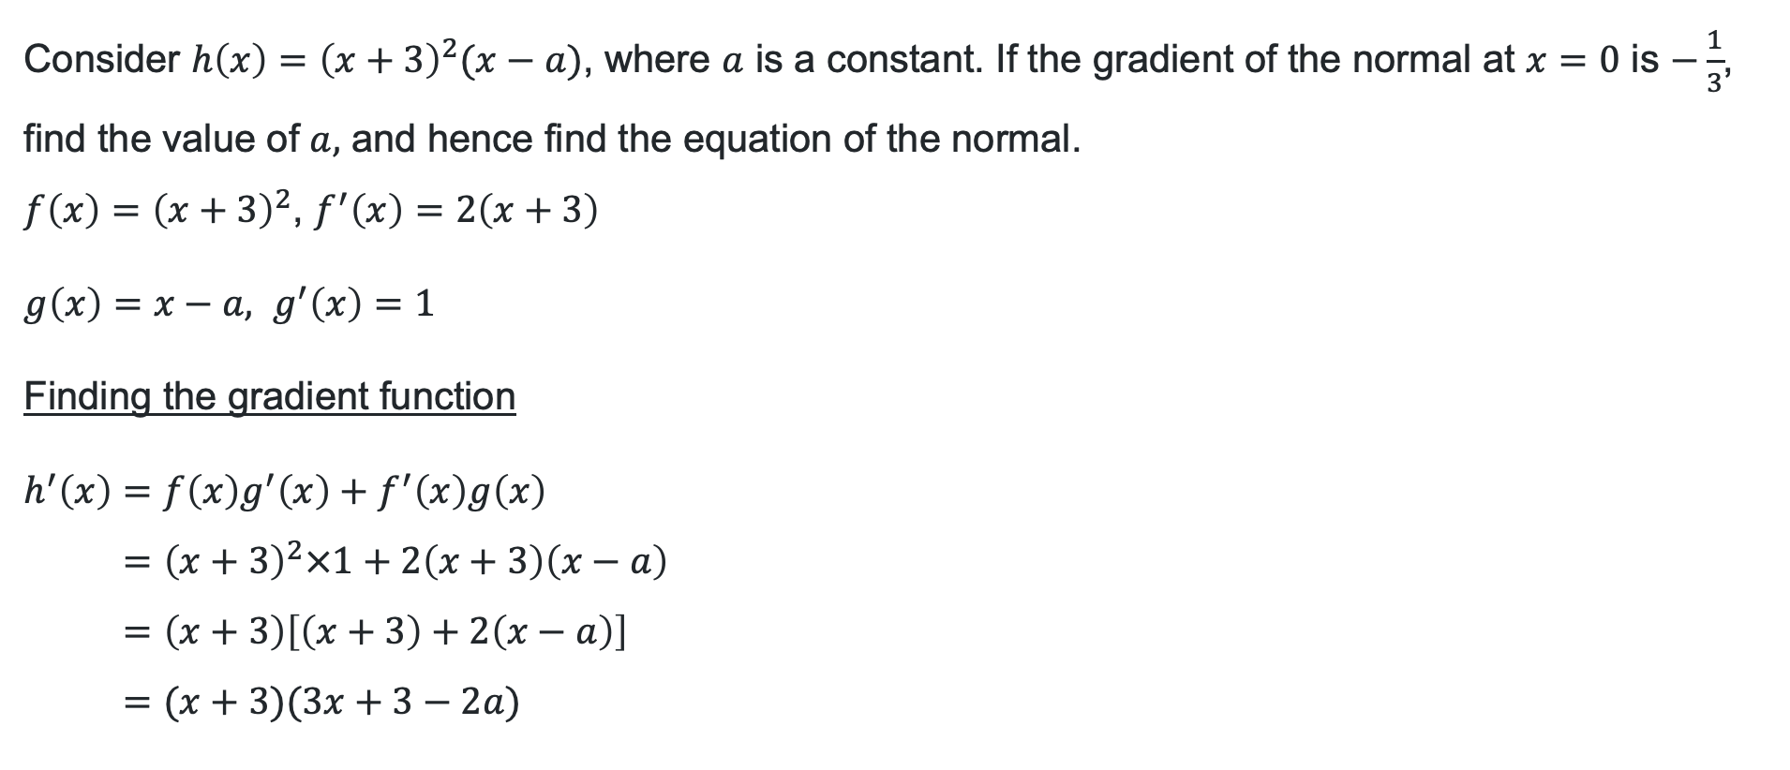
Question 3 (1)
Solution
Consider $h\left(x\right)={\left(x+3\right)}^{2}(x−a)$, where $a$ is a constant. If the gradient of the normal at $x=0$ is $−\frac{1}{3}$, find the value of $a,$ and hence find the equation of the normal.
$f\left(x\right)={\left(x+3\right)}^{2}$, $f^{′}\left(x\right)=2\left(x+3\right)$
$g\left(x\right)=x−a, g^{′}\left(x\right)=1$
Finding the gradient function
$$h^{′}\left(x\right)=f\left(x\right)g^{′}\left(x\right)+f^{′}\left(x\right)g\left(x\right) \\ {=\left(x+3\right)}^{2}×1+2\left(x+3\right)\left(x−a\right) \\ =\left(x+3\right)\left[\left(x+3\right)+2\left(x−a\right)\right] \\ =(x+3)(3x+3−2a)$$
Solution continues on the next slide.

Slide 18


Question 3 (2)
Solution
At $x=0$, the gradient of normal is $m_{normal}=−\frac{1}{3}$
Therefore, the gradient of the tangent is $m=3$
Finding the value of $a$ for which gradient function is 3.
$$∴h^{′}\left(0\right)=3$$
$$h\left(x\right)=\left(x+3\right)\left(3x+3−2a\right)=3$$
$$h^{′}\left(0\right)=\left(0+3\right)\left(3×0+3−2a\right)=3 \\ =3\left(3−2a\right)=3 \\ 3=9−6a \\ ∴a=1$$
Finding the y value at $x=0$
At $x=0,$ $h\left(0\right)={\left(0+3\right)}^{2}\left(0−1\right)=−9$
The equation of the normal is:
$$y−\left(−9\right)=−\frac{1}{3}\left(x−0\right) \\ y=−\frac{1}{3}x−9$$

Slide 19
References
This presentation contains NSW Curriculum and syllabus content. The NSW Curriculum is developed by the NSW Education Standards Authority. This content is prepared by NESA for and on behalf of the Crown in the right of the State of New South Wales. The material is protected by Crown copyright.
Please refer to the NESA Copyright Disclaimer for more information https://educationstandards.nsw.edu.au/wps/portal/nesa/mini-footer/copyright.
NESA holds the only official and up-to-date versions of the NSW Curriculum and syllabus documents. Please visit the NSW Education Standards Authority (NESA) website https://educationstandards.nsw.edu.au/wps/portal/nesa/home and the NSW Curriculum website https://curriculum.nsw.edu.au.
Mathematics Advanced 11-12 Syllabus © NSW Education Standards Authority (NESA) for and on behalf of the Crown in right of the State of New South Wales, 2024.

Slide 20
Copyright
© State of New South Wales (Department of Education), 2026
The copyright material published in this resource is subject to the Copyright Act 1968 (Cth) and is owned by the NSW Department of Education or, where indicated, by a party other than the NSW Department of Education (third-party material).
Copyright material available in this resource and owned by the NSW Department of Education is licensed under a Creative Commons Attribution 4.0 International (CC BY 4.0) license.
This license allows you to share and adapt the material for any purpose, even commercially.
Attribution should be given to © State of New South Wales (Department of Education), 2026.
Material in this resource not available under a Creative Commons license:
the NSW Department of Education logo, other logos and trademark-protected material
Material owned by a third party that has been reproduced with permission. You will need to obtain permission from the third party to reuse its material.
Links to third-party material and websites
Please note that the provided (reading/viewing material/list/links/texts) are a suggestion only and implies no endorsement, by the New South Wales Department of Education, of any author, publisher, or book title. School principals and teachers are best placed to assess the suitability of resources that would complement the curriculum and reflect the needs and interests of their students.
If you use the links provided in this document to access a third-party’s website, you acknowledge that the terms of use, including licence terms set out on the third-party’s website apply to the use which may be made of the materials on that third-party website or where permitted by the Copyright Act 1968 (Cth). The department accepts no responsibility for content on third-party websites.

