Slide 1
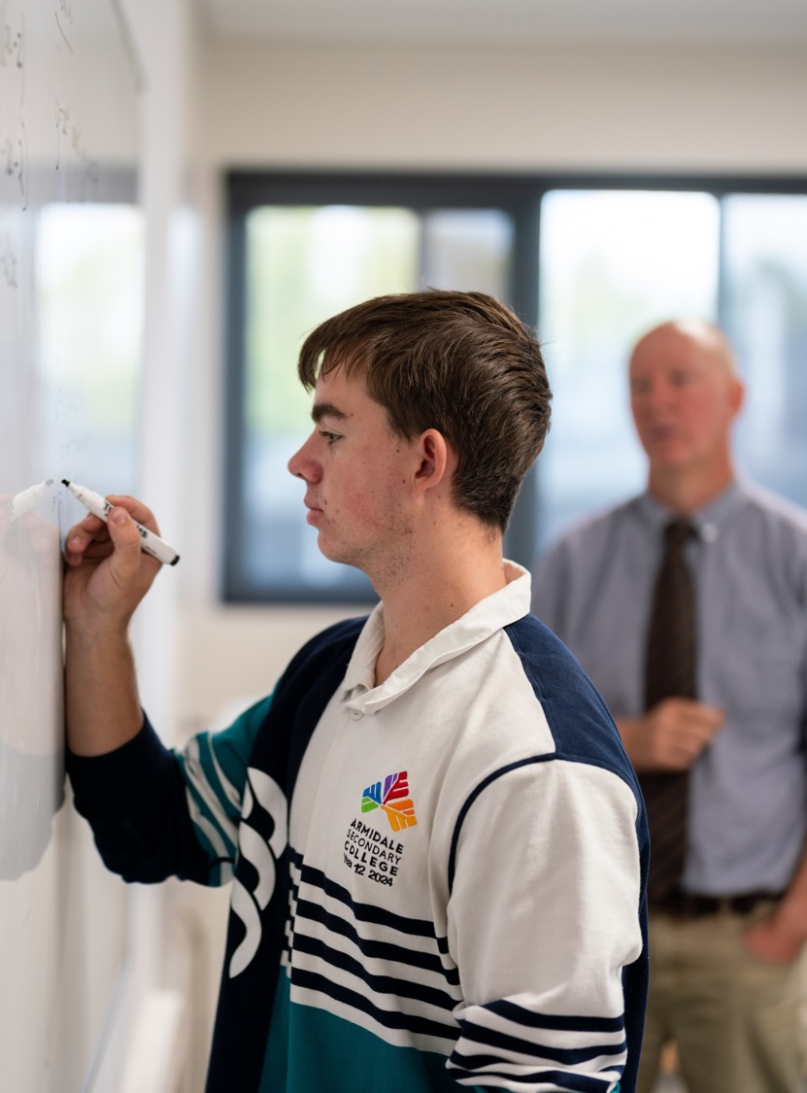
The chain rule – part 2
Mathematics Advanced – Stage 6 (Year 11)
Unit 6 – Differentiation techniques and applications

Slide 2
Connecting learning

Slide 3

The chain rule (1)
$$\frac{dV}{dt}=\frac{dV}{dr}×\frac{dr}{dt}$$

Slide 4
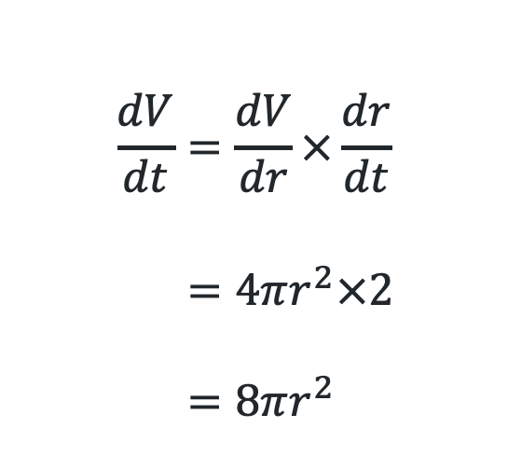
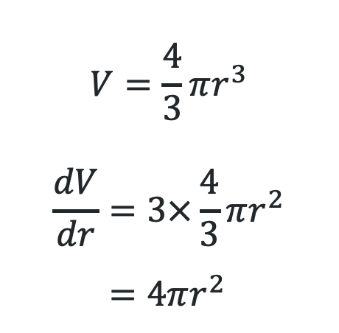
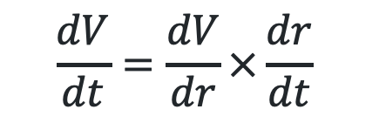
Volume
$$V=\frac{4}{3}πr^{3}$$
Find an expression for the rate the volume changes per second $\left(\frac{dV}{dt}\right)$ in a sphere if the radius is changing at $2mm/s$ $\left(\frac{dr}{dt}=2\right).$
$$\frac{dV}{dt}=\frac{dV}{dr}×\frac{dr}{dt} \\ =4πr^{2}×2 \\ =8πr^{2}$$
$$\frac{dV}{dt}=\frac{dV}{dr}×\frac{dr}{dt}$$
$$V=\frac{4}{3}πr^{3}$$
$$\frac{dV}{dr}=3×\frac{4}{3}πr^{2} \\ =4πr^{2}$$

Slide 5
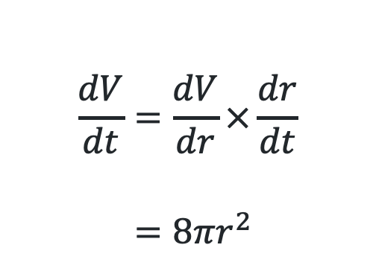
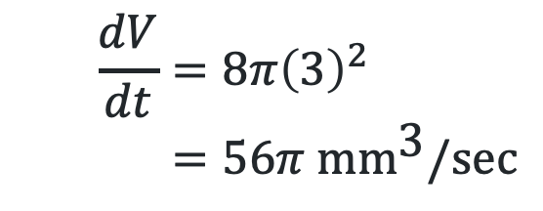
Volume (1)
$$V=\frac{4}{3}πr^{3}$$
Find an expression for the rate the volume changes per second $\left(\frac{dV}{dt}\right)$ in a sphere if the radius is changing at $2mm/s$ $\left(\frac{dr}{dt}=2\right).$
$$\frac{dV}{dt}=\frac{dV}{dr}×\frac{dr}{dt} \\ =8πr^{2}$$
How might you find the rate of change of the volume per second when the radius is 3mm?
$$\frac{dV}{dt}=8π{\left(3\right)}^{2} \\ =56π \text{m}{\text{m}}^{\text{3}}\text{/}\text{sec}$$

Slide 6
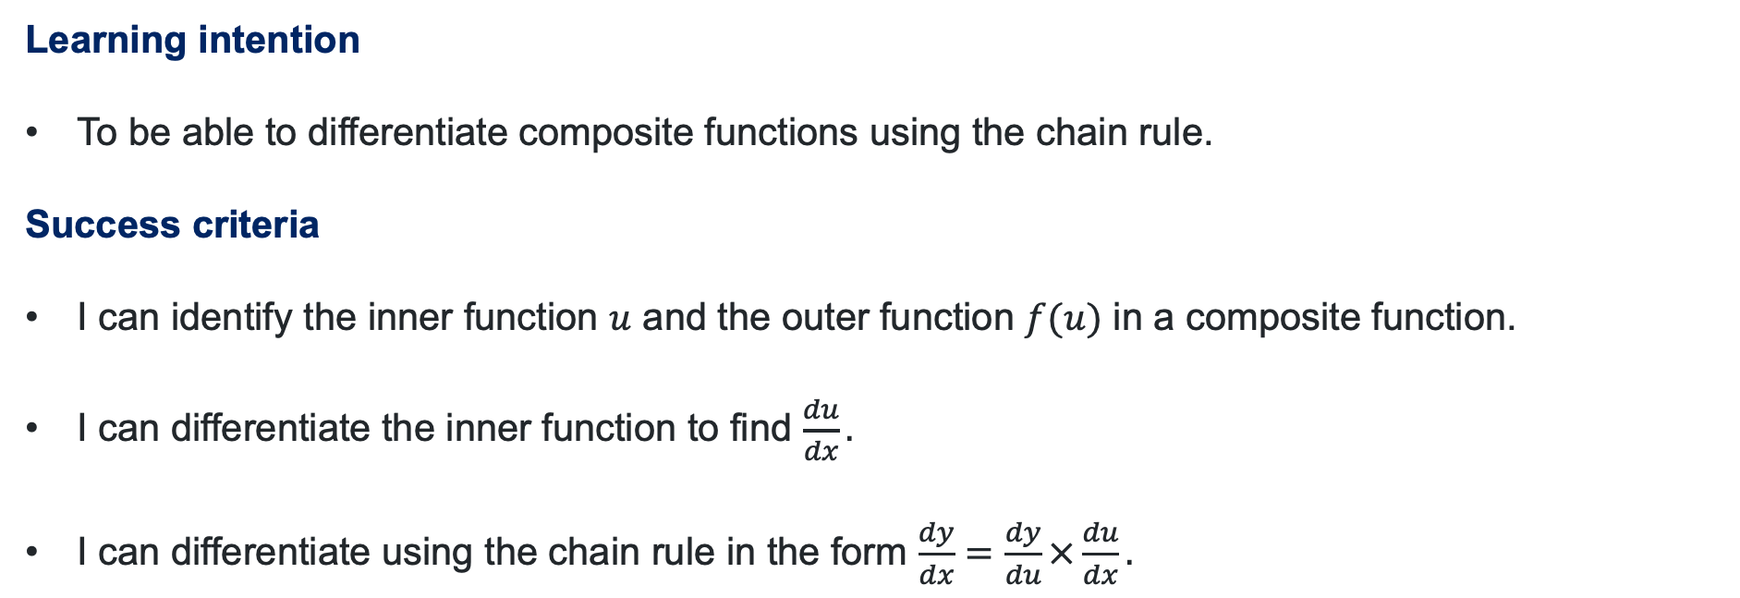
Learning intention and success criteria
Learning intention
To be able to differentiate composite functions using the chain rule.
Success criteria
I can identify the inner function $u$ and the outer function $f(u)$ in a composite function.
I can differentiate the inner function to find $\frac{du}{dx}.$
I can differentiate using the chain rule in the form $\frac{dy}{dx}=\frac{dy}{du}×\frac{du}{dx}.$
Notes:
Notes for teachers:
Learning intentions and success criteria are best co-constructed with students. Adapt the learning intention as required and add matching success criteria.
For more information See ⁠AITSL or the NSW Department of Education explicit teaching strategies, ⁠Sharing learning intentions and ⁠Sharing success criteria
LISC is not necessarily presented at the beginning of the lesson. Teacher needs to consider most effectual time to introduce
LISC should be revisited during the lesson to support students' evaluation of their learning

Slide 7
Releasing responsibility

Slide 8
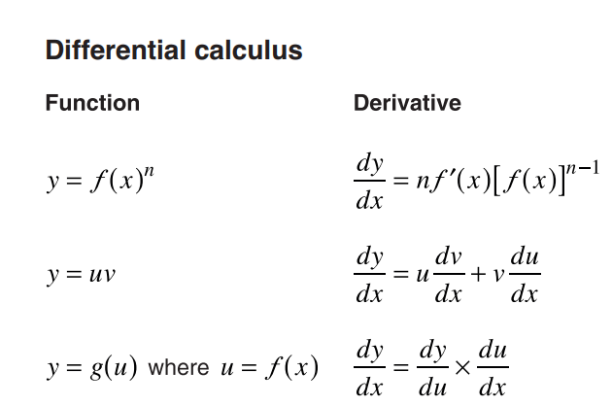
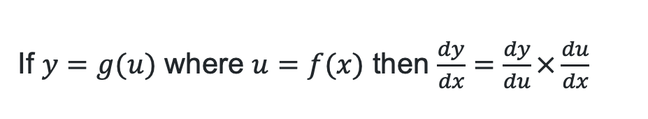
The chain rule (2)
Different notation
If $y=g(u)$ where $u=f(x)$ then $\frac{dy}{dx}=\frac{dy}{du}×\frac{du}{dx}$

Slide 9

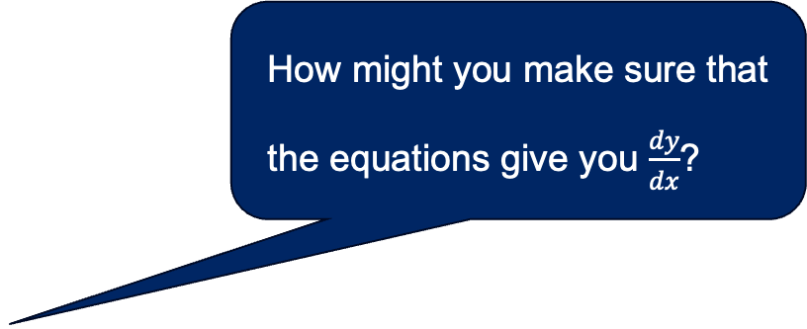
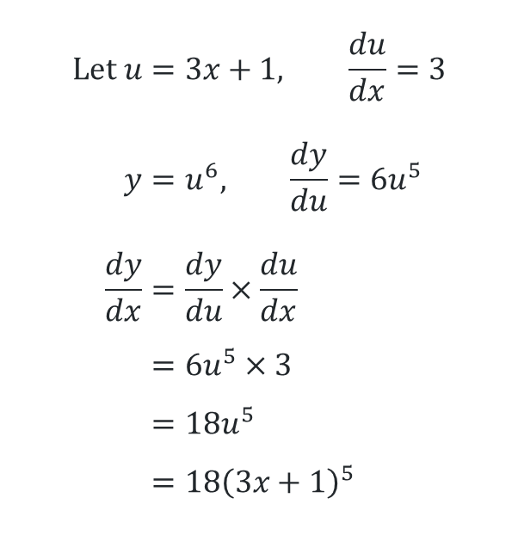

Differentiate using the chain rule (1)
Example 1
Find $\frac{dy}{dx}$ if $y={\left(3x+1\right)}^{6}$.
$$Let u=3x+1, \frac{du}{dx}=3 \\ y=u^{6}, \frac{dy}{du}=6u^{5} \\ \frac{dy}{dx}=\frac{dy}{du}×\frac{du}{dx} \\ =6u^{5}×3 \\ =18u^{5} \\ =18{\left(3x+1\right)}^{5}$$
How might you make sure that the equations give you $\frac{dy}{dx}$?
How do we determine what $u$ will be?
Why is it important that $u$ is replaced in the final answer?

Slide 10
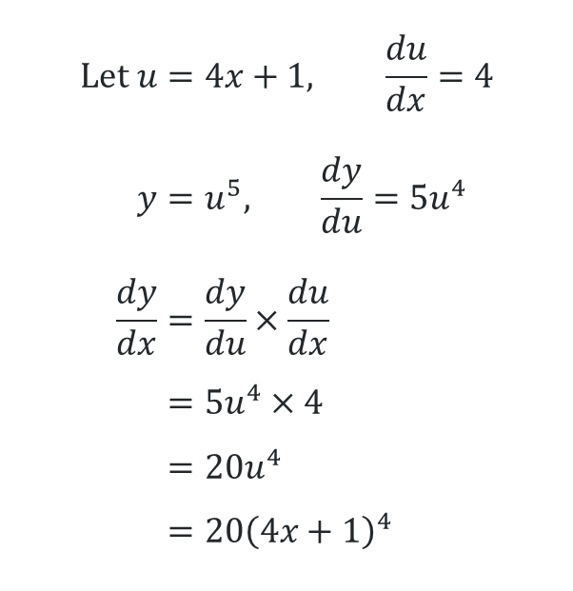
Differentiating using the chain rule (2)
Your turn – Question 1
Find $\frac{dy}{dx}$ if $y={\left(4x+1\right)}^{5}$.
$$Let u=4x+1, \frac{du}{dx}=4 \\ y=u^{5}, \frac{dy}{du}=5u^{4} \\ \frac{dy}{dx}=\frac{dy}{du}×\frac{du}{dx} \\ =5u^{4}×4 \\ =20u^{4} \\ =20{\left(4x+1\right)}^{4}$$

Slide 11


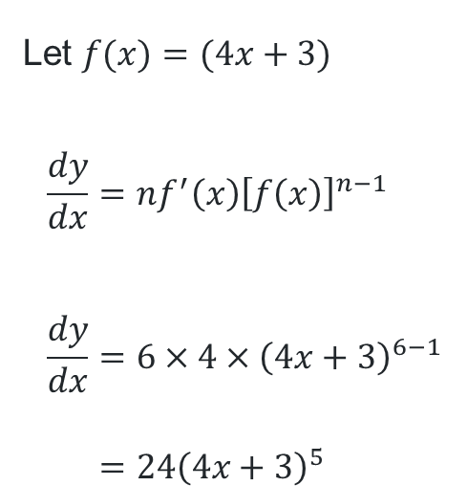
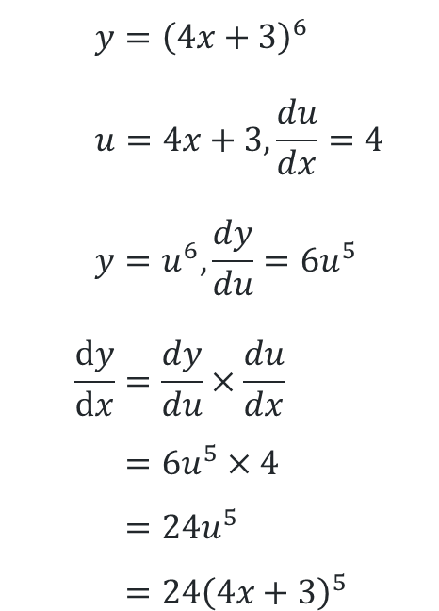
Differentiate $y={\left(4x+3\right)}^{6}$
Linda’s solutions
Scott’s solutions
When might each method be used?
Let $f(x)=(4x+3)$
$$\frac{dy}{dx}=nf^{′}\left(x\right){\left[f\left(x\right)\right]}^{n−1} \\ \frac{dy}{dx}=6×4×{\left(4x+3\right)}^{6−1} \\ =24{\left(4x+3\right)}^{5}$$
$$y={\left(4x+3\right)}^{6} \\ u=4x+3,\frac{du}{dx}=4 \\ y=u^{6}, \frac{dy}{du}=6u^{5} \\ \frac{dy}{dx}=\frac{dy}{du}×\frac{du}{dx} \\ =6u^{5}×4 \\ =24u^{5} \\ =24{\left(4x+3\right)}^{5}$$

Slide 12
Independent practice

Slide 13

Approaching questions scaffold

Slide 14
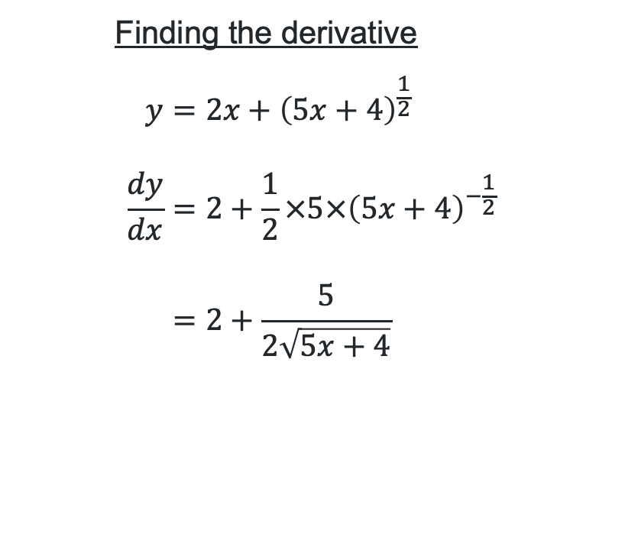
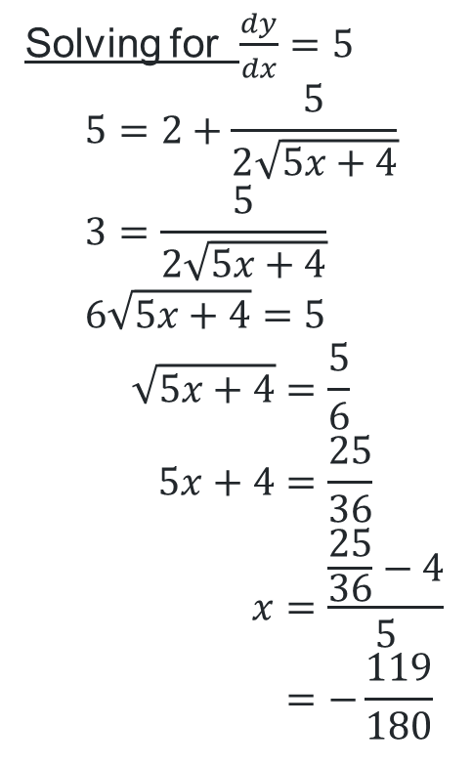
HSC Style questions (1)
If $y=2x+\sqrt{5x+4},$ find the value of $x$ when $\frac{dy}{dx}=5.$
Finding the derivative
$$y=2x+{\left(5x+4\right)}^{\frac{1}{2}} \\ \frac{dy}{dx}=2+\frac{1}{2}×5×{\left(5x+4\right)}^{−\frac{1}{2}} \\ =2+\frac{5}{2\sqrt{5x+4}}$$
Solving for $\frac{dy}{dx}=5$
$$5=2+\frac{5}{2\sqrt{5x+4}} \\ 3=\frac{5}{2\sqrt{5x+4}} \\ 6\sqrt{5x+4}=5$$
$$\sqrt{5x+4}=\frac{5}{6} \\ 5x+4=\frac{25}{36} \\ x=\frac{\frac{25}{36}−4}{5} \\ =−\frac{119}{180}$$
What is the domain of the curve? Does this answer exist in this domain?

Slide 15
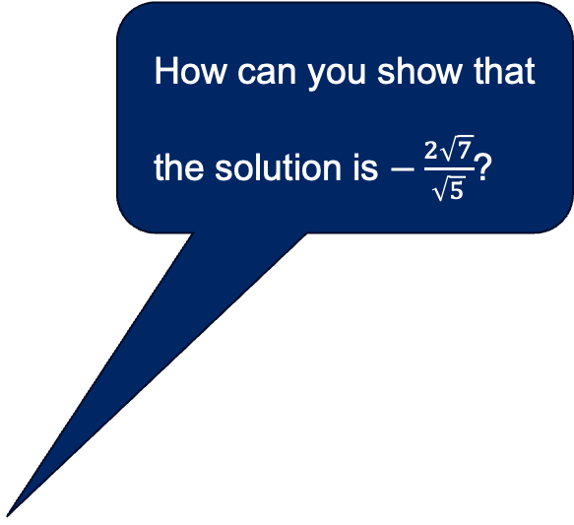
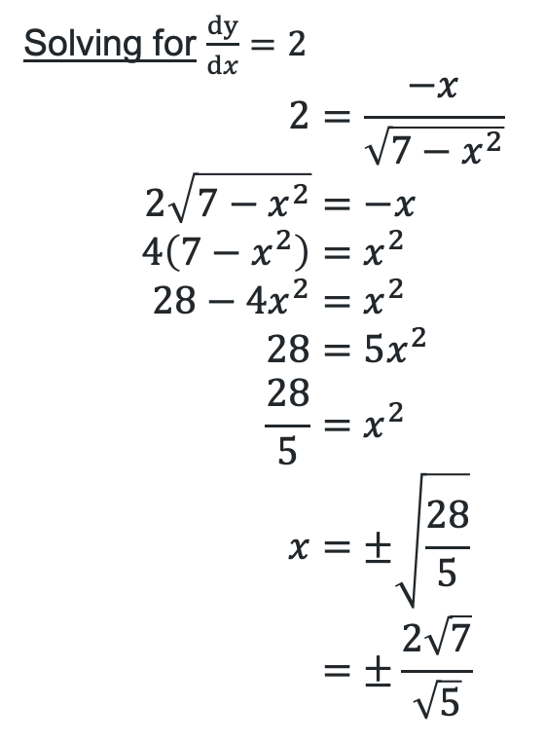
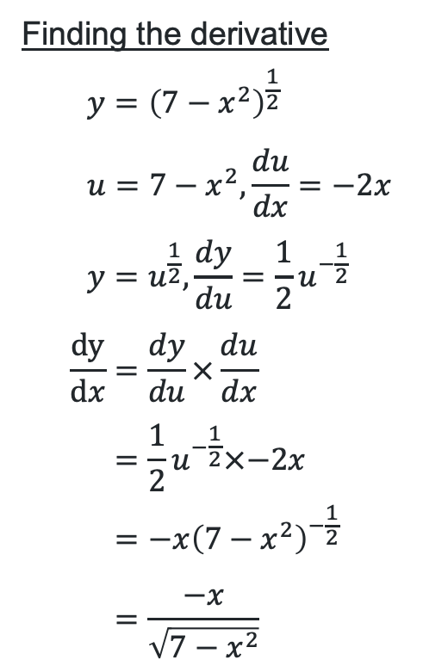
HSC Style questions (2)
Show that $x=\frac{−2\sqrt{7}}{\sqrt{5}}$ when the derivative of the graph $y=\sqrt{7−x^{2}}$is equal to 2.
Finding the derivative
$$y={\left(7−x^{2}\right)}^{\frac{1}{2}} \\ u=7−x^{2},\frac{du}{dx}=−2x \\ y=u^{\frac{1}{2}}, \frac{dy}{du}=\frac{1}{2}u^{−\frac{1}{2}} \\ \frac{dy}{dx}=\frac{dy}{du}×\frac{du}{dx} \\ =\frac{1}{2}u^{−\frac{1}{2}}×−2x \\ =−{x\left(7−x^{2}\right)}^{−\frac{1}{2}} \\ =\frac{−x}{\sqrt{7−x^{2}}}$$
Solving for $\frac{dy}{dx}=2$
$$2=\frac{−x}{\sqrt{7−x^{2}}} \\ 2\sqrt{7−x^{2}}=−x \\ 4\left(7−x^{2}\right)=x^{2} \\ 28−4x^{2}=x^{2} \\ 28=5x^{2} \\ \frac{28}{5}=x^{2} \\ x=±\sqrt{\frac{28}{5}} \\ =±\frac{2\sqrt{7}}{\sqrt{5}}$$
How can you show that the solution is $−\frac{2\sqrt{7}}{\sqrt{5}}$?

Slide 16
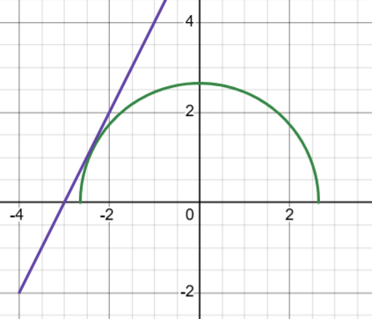
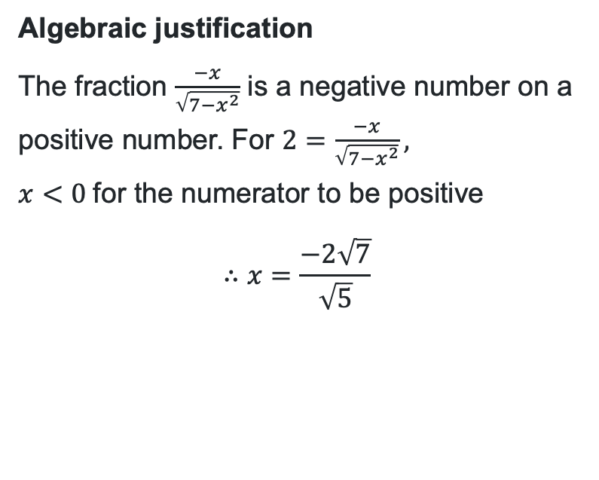
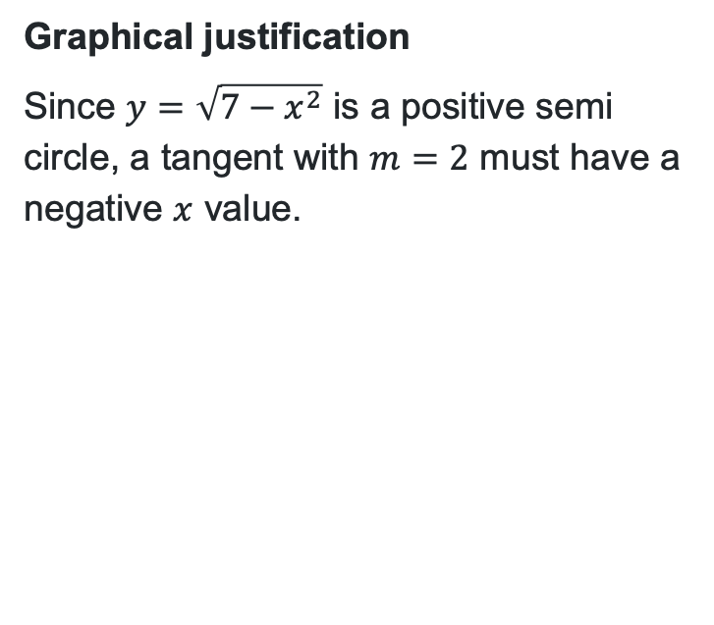
HSC Style questions (3)
Show that the $x=\frac{−2\sqrt{7}}{\sqrt{5}}$ when the derivative of the graph $y=\sqrt{7−x^{2}}$is equal to 2.
Graphical justification
Since $y=\sqrt{7−x^{2}}$ is a positive semi circle, a tangent with $m=2$ must have a negative $x$ value.
Algebraic justification
The fraction $\frac{−x}{\sqrt{7−x^{2}}}$ is a negative number on a positive number. For $2=\frac{−x}{\sqrt{7−x^{2}}},$
$x<0$ for the numerator to be positive
$$∴x=\frac{−2\sqrt{7}}{\sqrt{5}}$$

Slide 17
References
This presentation contains NSW Curriculum and syllabus content. The NSW Curriculum is developed by the NSW Education Standards Authority. This content is prepared by NESA for and on behalf of the Crown in the right of the State of New South Wales. The material is protected by Crown copyright.
Please refer to the NESA Copyright Disclaimer for more information https://educationstandards.nsw.edu.au/wps/portal/nesa/mini-footer/copyright.
NESA holds the only official and up-to-date versions of the NSW Curriculum and syllabus documents. Please visit the NSW Education Standards Authority (NESA) website https://educationstandards.nsw.edu.au/wps/portal/nesa/home and the NSW Curriculum website https://curriculum.nsw.edu.au.
Mathematics Advanced 11-12 Syllabus © NSW Education Standards Authority (NESA) for and on behalf of the Crown in right of the State of New South Wales, 2024.

Slide 18
Copyright
© State of New South Wales (Department of Education), 2026
The copyright material published in this resource is subject to the Copyright Act 1968 (Cth) and is owned by the NSW Department of Education or, where indicated, by a party other than the NSW Department of Education (third-party material).
Copyright material available in this resource and owned by the NSW Department of Education is licensed under a Creative Commons Attribution 4.0 International (CC BY 4.0) license.
This license allows you to share and adapt the material for any purpose, even commercially.
Attribution should be given to © State of New South Wales (Department of Education), 2026.
Material in this resource not available under a Creative Commons license:
the NSW Department of Education logo, other logos and trademark-protected material
Material owned by a third party that has been reproduced with permission. You will need to obtain permission from the third party to reuse its material.
Links to third-party material and websites
Please note that the provided (reading/viewing material/list/links/texts) are a suggestion only and implies no endorsement, by the New South Wales Department of Education, of any author, publisher, or book title. School principals and teachers are best placed to assess the suitability of resources that would complement the curriculum and reflect the needs and interests of their students.
If you use the links provided in this document to access a third-party’s website, you acknowledge that the terms of use, including licence terms set out on the third-party’s website apply to the use which may be made of the materials on that third-party website or where permitted by the Copyright Act 1968 (Cth). The department accepts no responsibility for content on third-party websites.

