Slide 1

Parallel and perpendicular lines
Mathematics Advanced – Stage 6 (Year 11)
Foundations of differentiation

Slide 2
Connecting learning

Slide 3
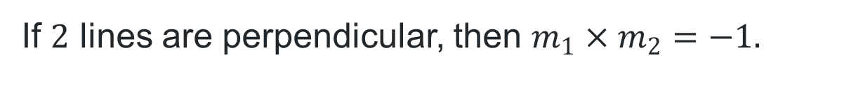
Perpendicular lines
If-then statements
If $2$ lines are perpendicular, then $m_{1}×m_{2}=−1.$
If $m_{1}×m_{2}=−1,$ then the $2$ lines are perpendicular.

Slide 4
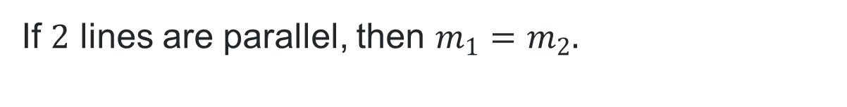
Parallel lines
If-then statements
If $2$ lines are parallel, then $m_{1}=m_{2}.$
If $m_{1}=m_{2}$, then the $2$ lines are parallel.

Slide 5
Learning intentions and success criteria
Learning intention
To be able to find the equation of a line that is parallel or perpendicular to a given line.
Success criteria
I can find the gradient of a line parallel to another.
I can find the gradient of a line perpendicular to another.
I can justify why 2 lines are parallel or perpendicular.
I can find the equation of a line parallel or perpendicular to a given line, using a point and gradient.

Slide 6
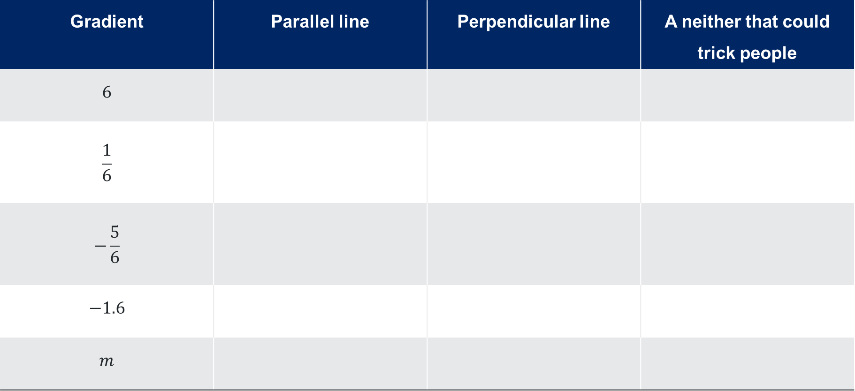
Finding gradients (1)
Complete the table by finding gradients
Gradient | Parallel line | Perpendicular line | A neither that could trick people
$$6$$
$$\frac{1}{6}$$
$$−\frac{5}{6}$$
$$−1.6$$
$$m$$

Slide 7
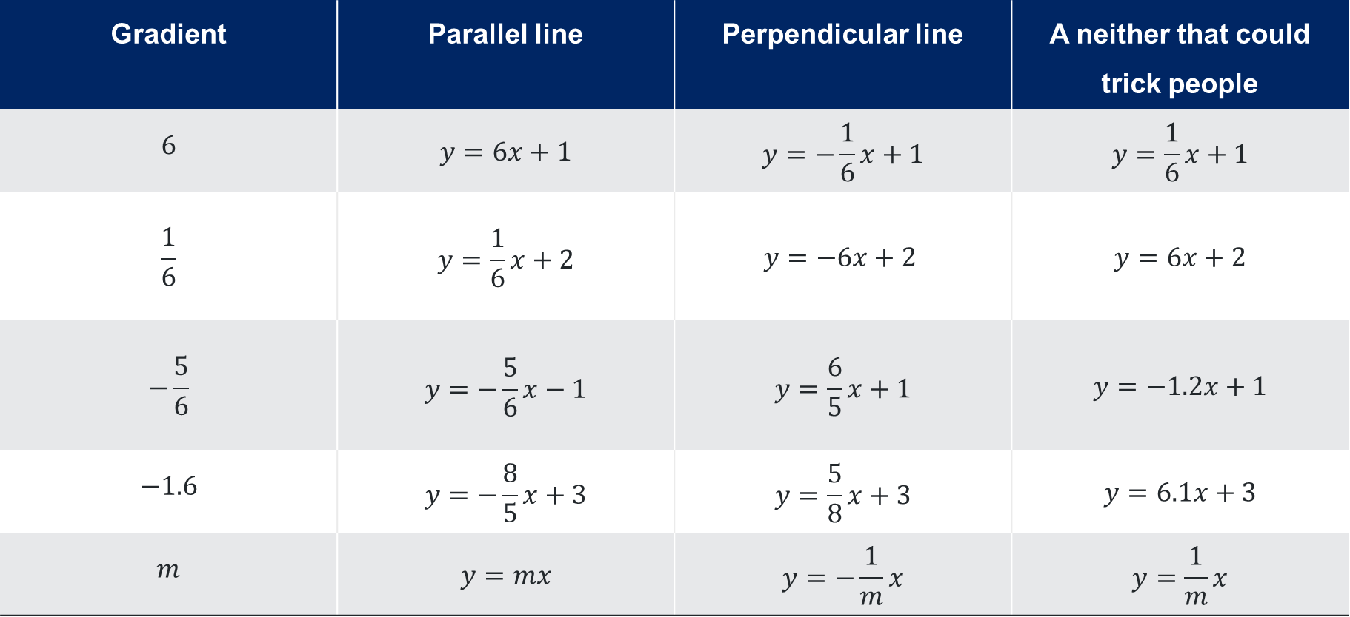
Finding gradients (2)
Sample answers
Gradient | Parallel line | Perpendicular line | A neither that could trick people
$$6$$ | $$y=6x+1$$ | $$y=−\frac{1}{6}x+1$$ | $$y=\frac{1}{6}x+1$$
$$\frac{1}{6}$$ | $$y=\frac{1}{6}x+2$$ | $$y=−6x+2$$ | $$y=6x+2$$
$$−\frac{5}{6}$$ | $$y=−\frac{5}{6}x−1$$ | $$y=\frac{6}{5}x+1$$ | $$y=−1.2x+1$$
$$−1.6$$ | $$y=−\frac{8}{5}x+3$$ | $$y=\frac{5}{8}x+3$$ | $$y=6.1x+3$$
$$m$$ | $$y=mx$$ | $$y=−\frac{1}{m}x$$ | $$y=\frac{1}{m}x$$

Slide 8
Releasing responsibility

Slide 9
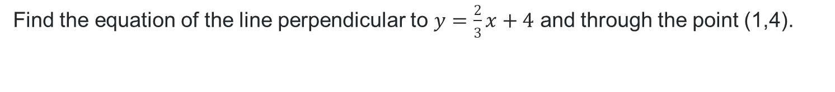
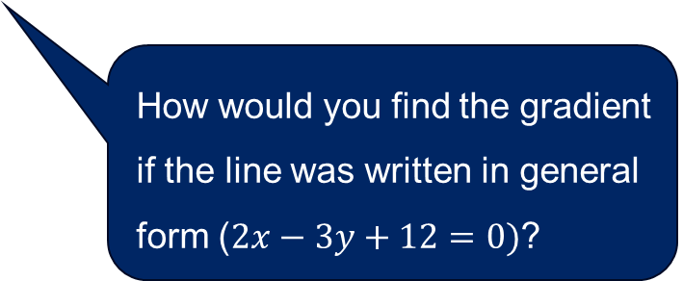
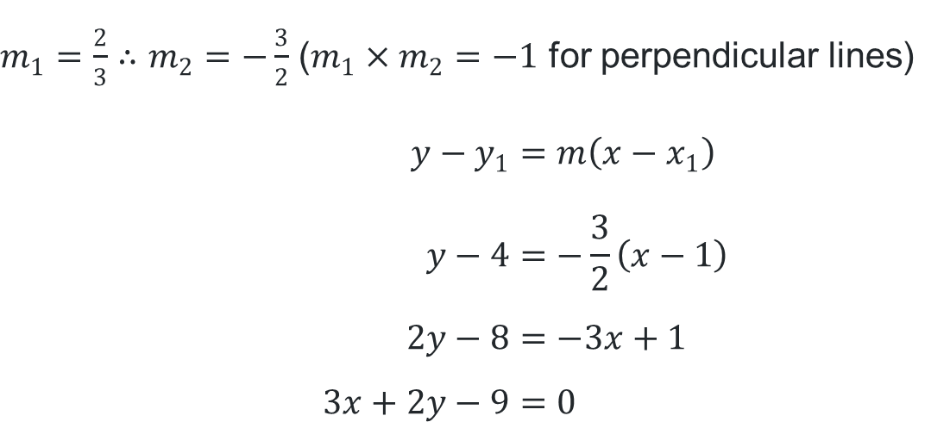
Finding a line perpendicular to another (1)
Example 1
Find the equation of the line perpendicular to $y=\frac{2}{3}x+4$ and through the point (1,4).
$m_{1}=\frac{2}{3}∴m_{2}=−\frac{3}{2}$ ($m_{1}×m_{2}=−1$ for perpendicular lines)
$$y−y_{1}=m\left(x−x_{1}\right) \\ y−4=−\frac{3}{2}\left(x−1\right) \\ 2y−8=−3x+1 \\ 3x+2y−9=0$$
What is the equation of the line through the same point but parallel rather than perpendicular?
Describe how the gradient of the perpendicular line was found.
How would you find the gradient if the line was written in general form ($2x−3y+12=0)$?

Slide 10
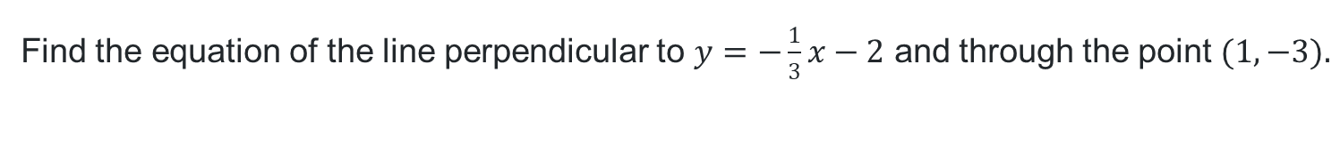
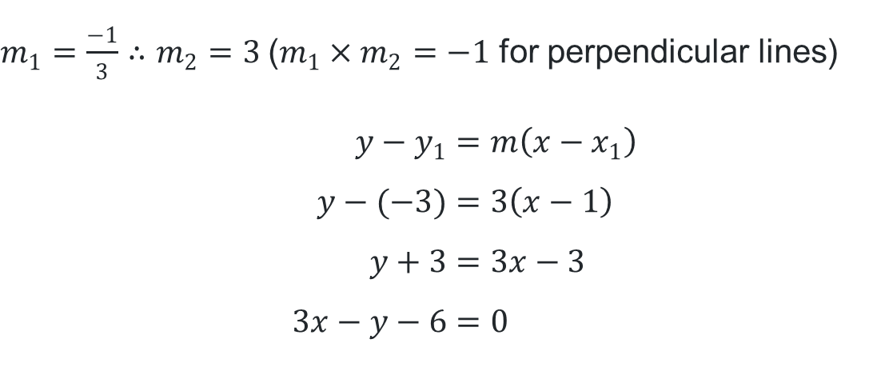
Finding a line perpendicular to another (2)
Your turn – Question 1
Find the equation of the line perpendicular to $y=−\frac{1}{3}x−2$ and through the point $(1,−3).$
$m_{1}=\frac{−1}{3}∴m_{2}=3$($m_{1}×m_{2}=−1$ for perpendicular lines)
$$y−y_{1}=m\left(x−x_{1}\right) \\ y−(−3)=3\left(x−1\right) \\ y+3=3x−3 \\ 3x−y−6=0$$

Slide 11
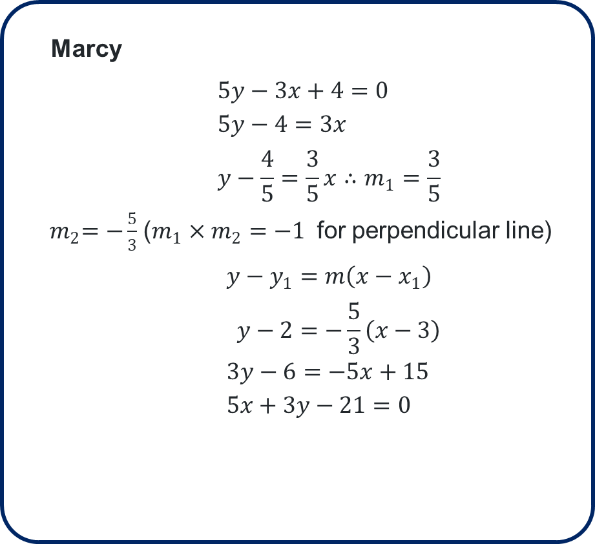
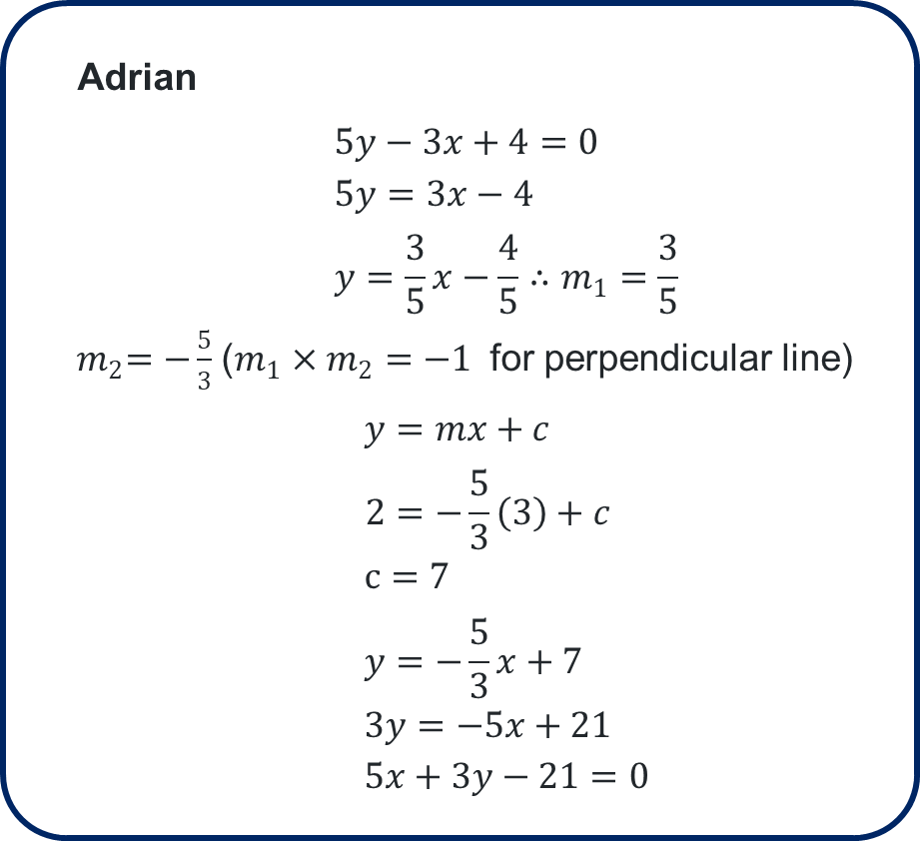
Compare the pair
Marcy and Adrian found a line perpendicular to $5y−3x+4=0$ and through $(3,2)$.
Marcy
$$5y−3x+4=0 \\ 5y−4=3x \\ y−\frac{4}{5}=\frac{3}{5}x∴m_{1}=\frac{3}{5}$$
${ m}_{2}=−\frac{5}{3}$($m_{1}×m_{2}=−1$ for perpendicular line)
$$y−y_{1}=m\left(x−x_{1}\right) \\ y−2=−\frac{5}{3}\left(x−3\right) \\ 3y−6=−5x+15 \\ 5x+3y−21=0$$
Adrian
$$5y−3x+4=0 \\ 5y=3x−4 \\ y=\frac{3}{5}x−\frac{4}{5}∴m_{1}=\frac{3}{5}$$
${ m}_{2}=−\frac{5}{3}$($m_{1}×m_{2}=−1$ for perpendicular line)
$$y=mx+c \\ 2=−\frac{5}{3}\left(3\right)+c \\ c=7 \\ y=−\frac{5}{3}x+7 \\ 3y=−5x+21 \\ 5x+3y−21=0$$

Slide 12
Independent practice

Slide 13
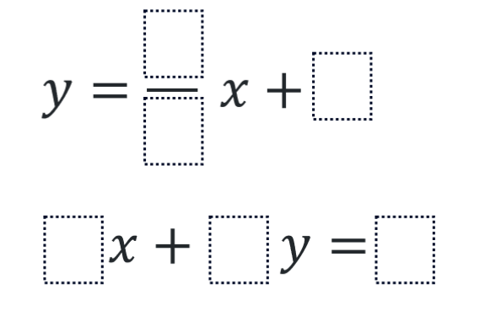
Use the digits 0-9
To create 2 perpendicular lines

Slide 14
References
This presentation contains NSW Curriculum and syllabus content. The NSW Curriculum is developed by the NSW Education Standards Authority. This content is prepared by NESA for and on behalf of the Crown in the right of the State of New South Wales. The material is protected by Crown copyright.
Please refer to the NESA Copyright Disclaimer for more information https://educationstandards.nsw.edu.au/wps/portal/nesa/mini-footer/copyright.
NESA holds the only official and up-to-date versions of the NSW Curriculum and syllabus documents. Please visit the NSW Education Standards Authority (NESA) website https://educationstandards.nsw.edu.au/wps/portal/nesa/home and the NSW Curriculum website https://curriculum.nsw.edu.au.
Mathematics Advanced 11-12 Syllabus © NSW Education Standards Authority (NESA) for and on behalf of the Crown in right of the State of New South Wales, 2024.

Slide 15
Copyright
© State of New South Wales (Department of Education), 2025
The copyright material published in this resource is subject to the Copyright Act 1968 (Cth) and is owned by the NSW Department of Education or, where indicated, by a party other than the NSW Department of Education (third-party material).
Copyright material available in this resource and owned by the NSW Department of Education is licensed under a Creative Commons Attribution 4.0 International (CC BY 4.0) license.
This license allows you to share and adapt the material for any purpose, even commercially.
Attribution should be given to © State of New South Wales (Department of Education), 2025.
Material in this resource not available under a Creative Commons license:
the NSW Department of Education logo, other logos and trademark-protected material
Material owned by a third party that has been reproduced with permission. You will need to obtain permission from the third party to reuse its material.
Links to third-party material and websites
Please note that the provided (reading/viewing material/list/links/texts) are a suggestion only and implies no endorsement, by the New South Wales Department of Education, of any author, publisher, or book title. School principals and teachers are best placed to assess the suitability of resources that would complement the curriculum and reflect the needs and interests of their students.
If you use the links provided in this document to access a third-party’s website, you acknowledge that the terms of use, including licence terms set out on the third-party’s website apply to the use which may be made of the materials on that third-party website or where permitted by the Copyright Act 1968 (Cth). The department accepts no responsibility for content on third-party websites.

