Slide 1

Differentiating by first principles
Mathematics Advanced – Stage 6 (Year 11)
Foundations of differentiation

Slide 2
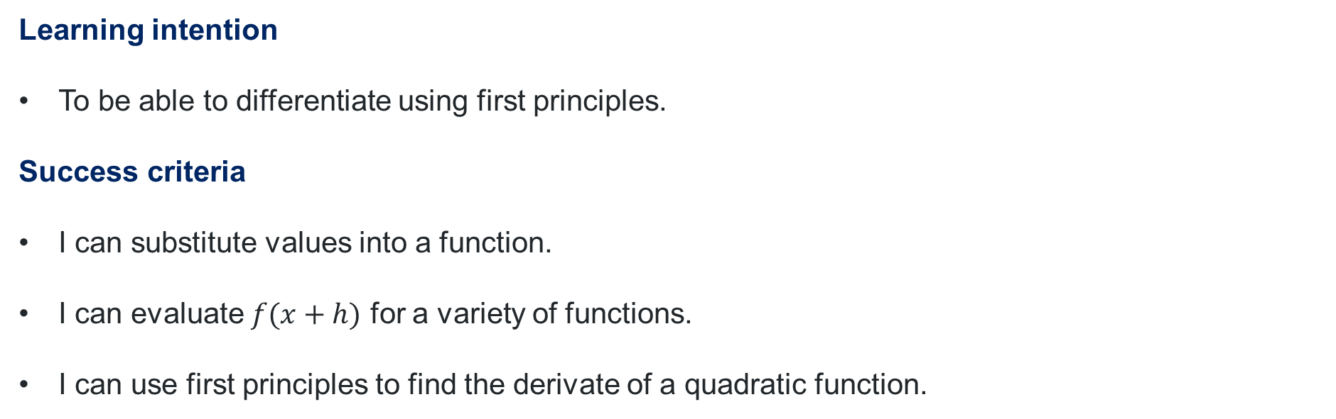
Learning intentions and success criteria
Learning intention
To be able to differentiate using first principles.
Success criteria
I can substitute values into a function.
I can evaluate $f(x+h)$ for a variety of functions.
I can use first principles to find the derivate of a quadratic function.
Notes:
Notes for teachers:
Learning intentions and success criteria are best co-constructed with students. Adapt the learning intention as required and add matching success criteria.
For more information See ⁠AITSL or the NSW Department of Education explicit teaching strategies, ⁠Sharing learning intentions and ⁠Sharing success criteria
LISC is not necessarily presented at the beginning of the lesson. Teacher needs to consider most effectual time to introduce
LISC should be revisited during the lesson to support students' evaluation of their learning

Slide 3
Retrieval practice

Slide 4
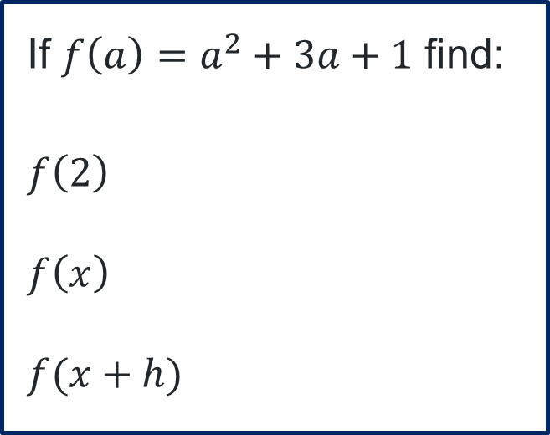

Substituting into functions
If ${f\left(a\right)=a}^{2}+3a+1$ find:
$$f\left(2\right)$$
$$f\left(x\right)$$
$$f(x+h)$$
$$f\left(2\right)={\left(2\right)}^{2}+3\left(2\right)+1 \\ =11$$
$$f\left(x\right)=x^{2}+3x+1$$
$$f\left(x+h\right)={\left(x+h\right)}^{2}+3\left(x+h\right)+1 \\ =x^{2}+2xh+h^{2}+3x+3h+1$$

Slide 5
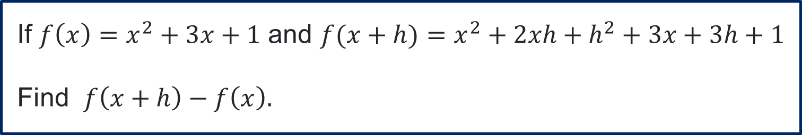
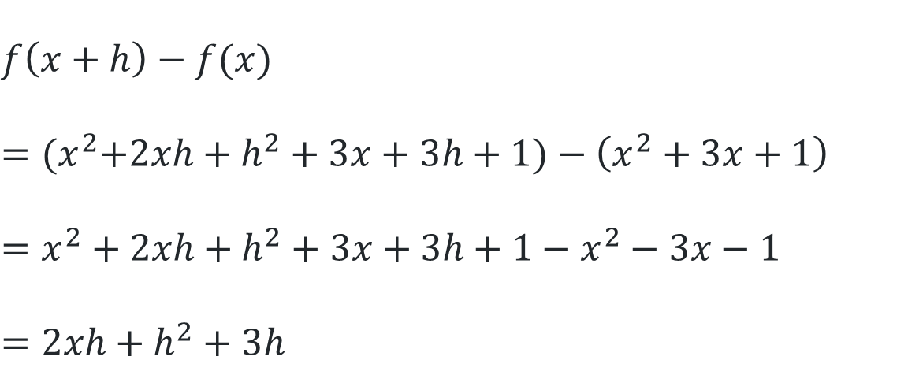
Using the substitution
If $f\left(x\right)=x^{2}+3x+1$ and $f(x+h)=x^{2}+2xh+h^{2}+3x+3h+1$
Find $f\left(x+h\right)−f\left(x\right).$
$$f\left(x+h\right)−f(x)$$
$$={(x}^{2}+2xh+h^{2}+3x+3h+1)−\left(x^{2}+3x+1\right) \\ =x^{2}+2xh+h^{2}+3x+3h+1−x^{2}−3x−1 \\ =2xh+h^{2}+3h$$

Slide 6
Activating prior knowledge

Slide 7
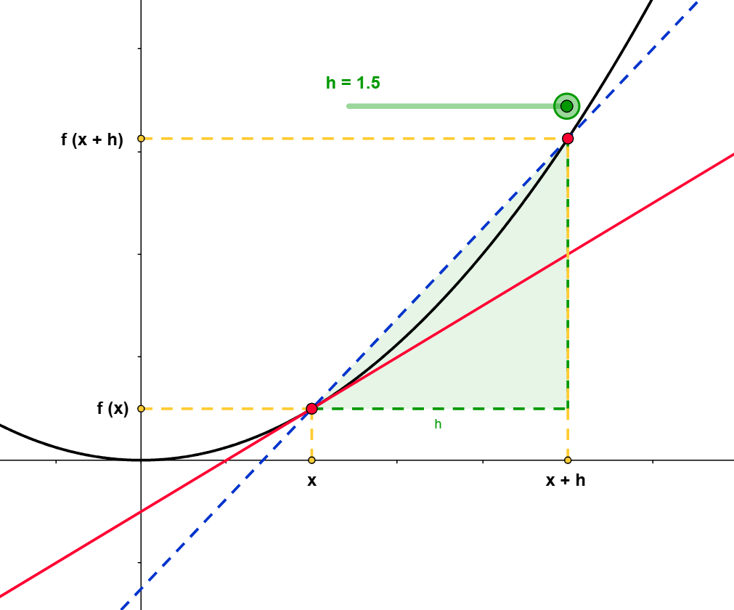
Understanding the diagram
What is the blue line called? What rate of change does it represent?
Write the 2 red points as coordinates.
What is the red line called? What rate of change does it represent?
Made with GeoGebra®, applet originally created by E. Davison and L.McLanachan

Slide 8
Connecting learning

Slide 9
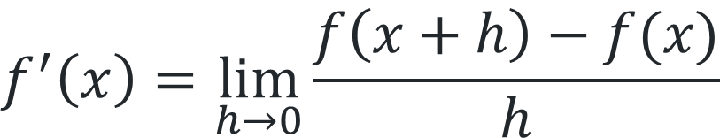
First principles formula
Understanding the parts
$$f^{′}\left(x\right)=\lim_{h→0}{\frac{f\left(x+h\right)−f(x)}{h}}$$
Made with GeoGebra®, applet originally created by E. Davison and L.McLanachan

Slide 10
Releasing responsibility

Slide 11
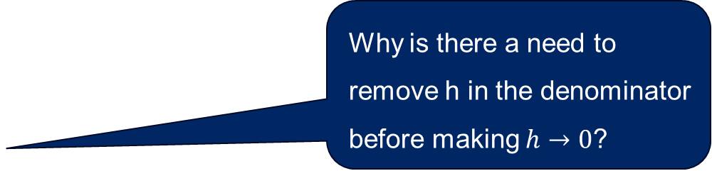


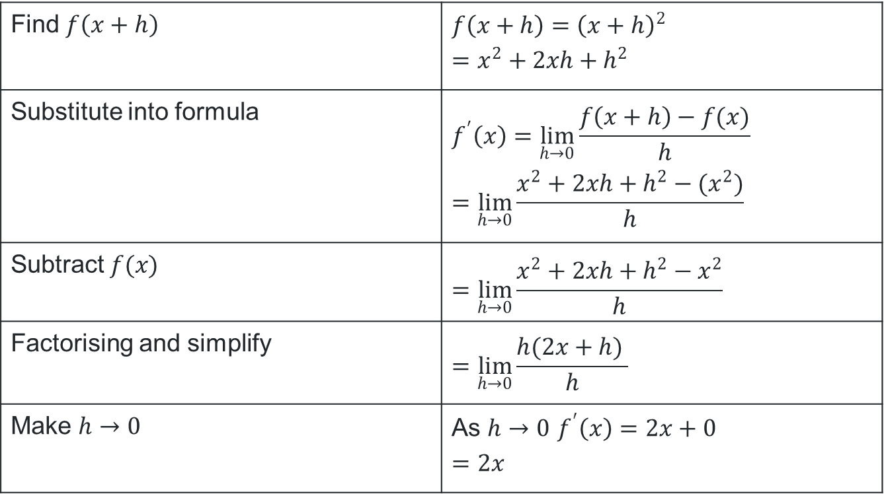
Differentiate $x^{2}$ by first principles (1)
Example 1
What changes will occur if $f\left(x\right)=4x^{2}$?
Find the derivative of ${f\left(x\right)=x}^{2}$ by first principles.
Find $f\left(x+h\right)$ | $$f\left(x+h\right)={\left(x+h\right)}^{2} \\ =x^{2}+2xh+h^{2}$$
Substitute into formula | $$f^{′}\left(x\right)=\lim_{h→0}{\frac{f\left(x+h\right)−f(x)}{h}} \\ =\lim_{h→0}{\frac{x^{2}+2xh+h^{2}−{(x}^{2})}{h}}$$
Subtract $f(x)$ | $$=\lim_{h→0}{\frac{x^{2}+2xh+h^{2}−x^{2}}{h}}$$
Factorising and simplify | $$=\lim_{h→0}{\frac{h(2x+h) }{h}}$$
Make $h→0$ | As $h→0$ $f^{′}\left(x\right)=2x+0$ $$=2x$$
What changes would occur if $f\left(x\right)=x^{2}+1$?
Why is there a need to remove h in the denominator before making $h→0$?

Slide 12
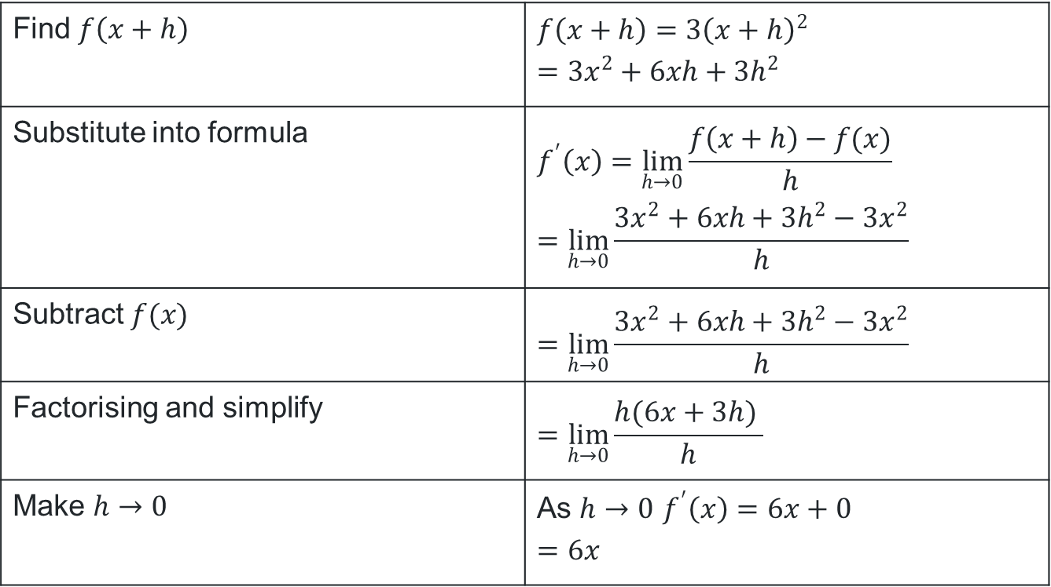
Differentiate ${3x}^{2}$ by first principles (1)
Your turn
Find the derivative of ${f\left(x\right)=3x}^{2}$ by first principles.
Find $f\left(x+h\right)$ | $$f\left(x+h\right)={3\left(x+h\right)}^{2} \\ =3x^{2}+6xh+3h^{2}$$
Substitute into formula | $$f^{′}\left(x\right)=\lim_{h→0}{\frac{f\left(x+h\right)−f(x)}{h}} \\ =\lim_{h→0}{\frac{{3x}^{2}+6xh+{3h}^{2}−3x^{2}}{h}}$$
Subtract $f(x)$ | $$=\lim_{h→0}{\frac{{3x}^{2}+6xh+3h^{2}−{3x}^{2}}{h}}$$
Factorising and simplify | $$=\lim_{h→0}{\frac{h(6x+3h) }{h}}$$
Make $h→0$ | As $h→0$ $f^{′}\left(x\right)=6x+0$ $$=6x$$

Slide 13

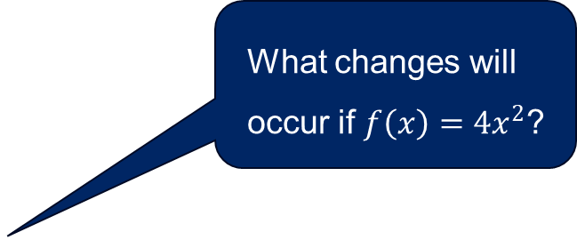
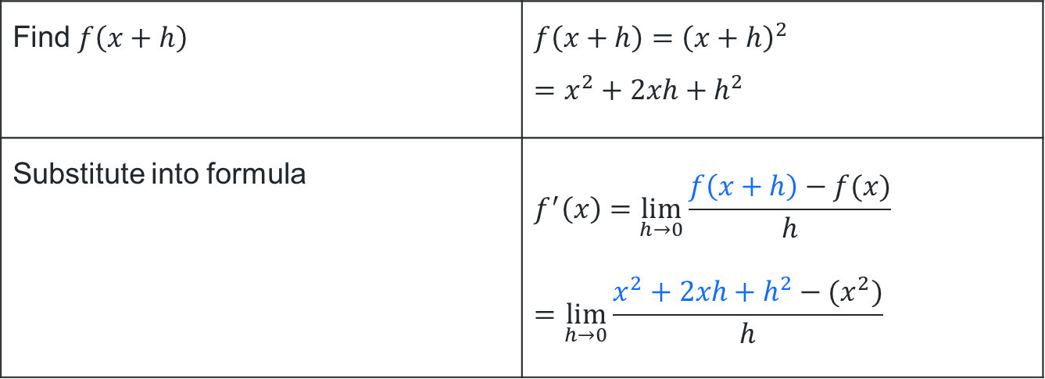
Differentiate $x^{2}$ by first principles (2)
Example 1 – Part 1
Find the derivative of ${f\left(x\right)=x}^{2}$ by first principles.
What changes will occur if $f\left(x\right)=4x^{2}$?
Find $f\left(x+h\right)$ | $$f\left(x+h\right)={\left(x+h\right)}^{2} \\ =x^{2}+2xh+h^{2}$$
Substitute into formula | $$f^{′}\left(x\right)=\lim_{h→0}{\frac{f\left(x+h\right)−f(x)}{h}} \\ =\lim_{h→0}{\frac{x^{2}+2xh+h^{2}−{(x}^{2})}{h}}$$
Where is the $x^{2}$ from?

Slide 14
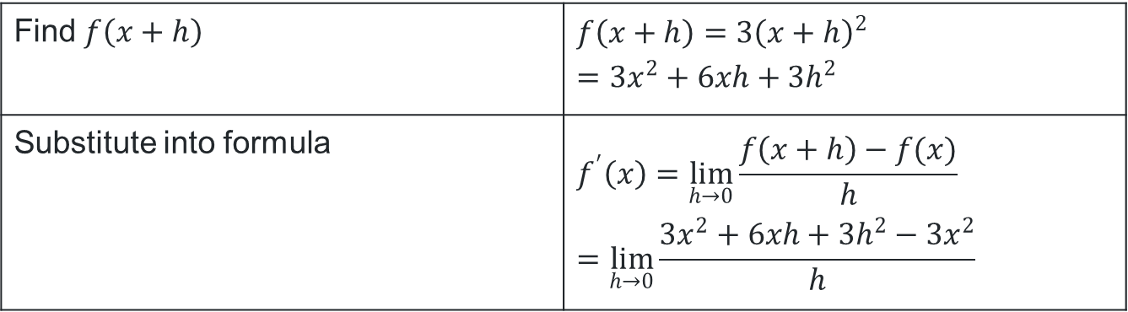
Differentiate ${3x}^{2}$ by first principles (2)
Your turn – Part 1
Find the derivative of ${f\left(x\right)=3x}^{2}$ by first principles.
Find $f\left(x+h\right)$ | $$f\left(x+h\right)={3\left(x+h\right)}^{2} \\ =3x^{2}+6xh+3h^{2}$$
Substitute into formula | $$f^{′}\left(x\right)=\lim_{h→0}{\frac{f\left(x+h\right)−f(x)}{h}} \\ =\lim_{h→0}{\frac{{3x}^{2}+6xh+{3h}^{2}−3x^{2}}{h}}$$

Slide 15
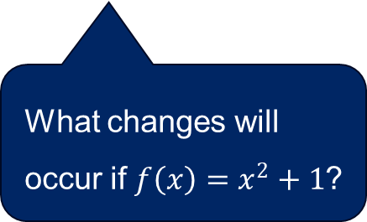
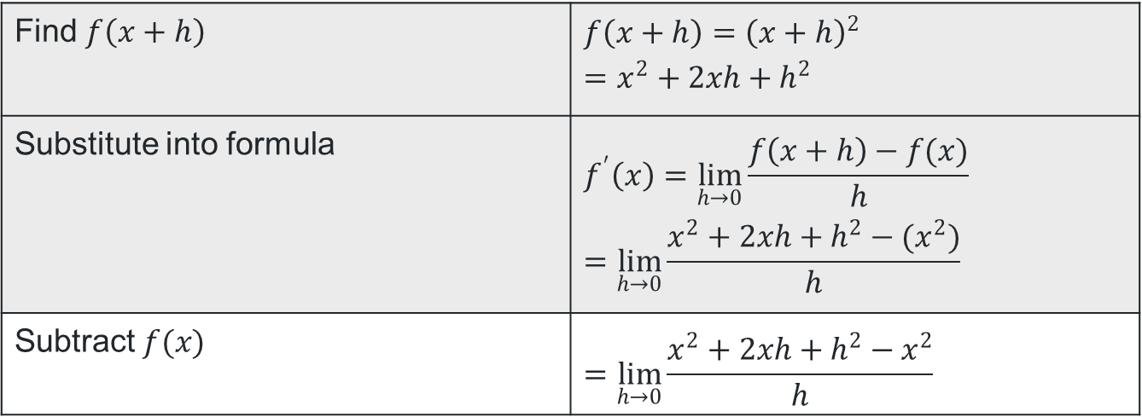
Differentiate $x^{2}$ by first principles (3)
Example 1 – Part 2
Find the derivative of ${f\left(x\right)=x}^{2}$ by first principles.
Find $f\left(x+h\right)$ | $$f\left(x+h\right)={\left(x+h\right)}^{2} \\ =x^{2}+2xh+h^{2}$$
Substitute into formula | $$f^{′}\left(x\right)=\lim_{h→0}{\frac{f\left(x+h\right)−f(x)}{h}} \\ =\lim_{h→0}{\frac{x^{2}+2xh+h^{2}−{(x}^{2})}{h}}$$
Subtract $f(x)$ | $$=\lim_{h→0}{\frac{x^{2}+2xh+h^{2}−x^{2}}{h}}$$
What changes will occur if $f\left(x\right)=x^{2}+1$?

Slide 16
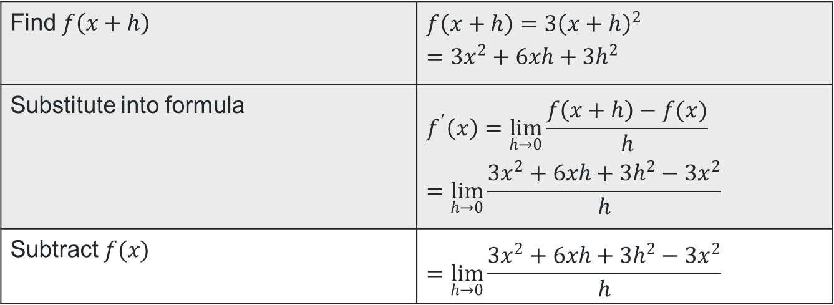
Differentiate ${3x}^{2}$ by first principles (3)
Your turn – Part 2
Find the derivative of ${f\left(x\right)=3x}^{2}$ by first principles.
Find $f\left(x+h\right)$ | $$f\left(x+h\right)={3\left(x+h\right)}^{2} \\ =3x^{2}+6xh+3h^{2}$$
Substitute into formula | $$f^{′}\left(x\right)=\lim_{h→0}{\frac{f\left(x+h\right)−f(x)}{h}} \\ =\lim_{h→0}{\frac{{3x}^{2}+6xh+{3h}^{2}−3x^{2}}{h}}$$
Subtract $f(x)$ | $$=\lim_{h→0}{\frac{{3x}^{2}+6xh+3h^{2}−{3x}^{2}}{h}}$$

Slide 17
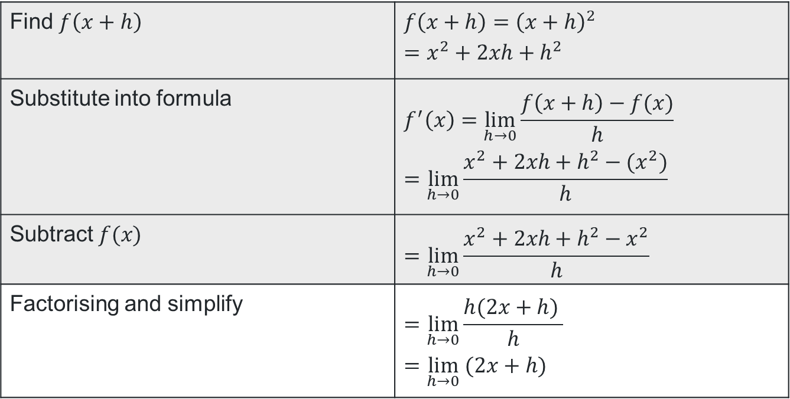
Differentiate $x^{2}$ by first principles (4)
Example 1 – Part 3
Find the derivative of ${f\left(x\right)=x}^{2}$ by first principles.
Find $f\left(x+h\right)$ | $$f\left(x+h\right)={\left(x+h\right)}^{2} \\ =x^{2}+2xh+h^{2}$$
Substitute into formula | $$f^{′}\left(x\right)=\lim_{h→0}{\frac{f\left(x+h\right)−f(x)}{h}} \\ =\lim_{h→0}{\frac{x^{2}+2xh+h^{2}−{(x}^{2})}{h}}$$
Subtract $f(x)$ | $$=\lim_{h→0}{\frac{x^{2}+2xh+h^{2}−x^{2}}{h}}$$
Factorising and simplify | $$=\lim_{h→0}{\frac{h(2x+h) }{h}} \\ =\lim_{h→0} (2x+h)$$
Why do I need to factorise before removing the denominator?

Slide 18
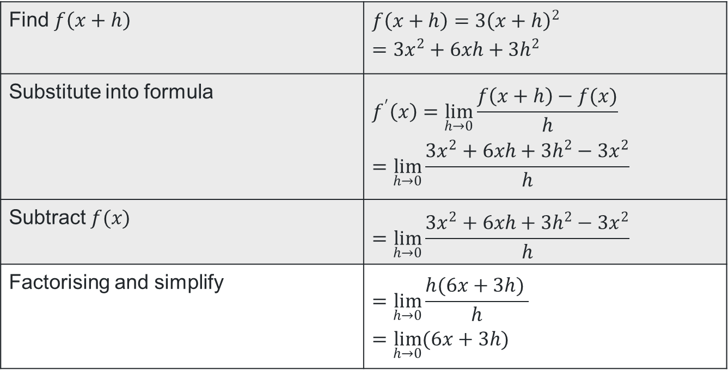
Differentiate ${3x}^{2}$ by first principles (4)
Your turn – Part 3
Find the derivative of ${f\left(x\right)=3x}^{2}$ by first principles.
Find $f\left(x+h\right)$ | $$f\left(x+h\right)={3\left(x+h\right)}^{2} \\ =3x^{2}+6xh+3h^{2}$$
Substitute into formula | $$f^{′}\left(x\right)=\lim_{h→0}{\frac{f\left(x+h\right)−f(x)}{h}} \\ =\lim_{h→0}{\frac{{3x}^{2}+6xh+{3h}^{2}−3x^{2}}{h}}$$
Subtract $f(x)$ | $$=\lim_{h→0}{\frac{{3x}^{2}+6xh+3h^{2}−{3x}^{2}}{h}}$$
Factorising and simplify | $$=\lim_{h→0}{\frac{h(6x+3h) }{h}} \\ =\lim_{h→0}{(6x+3h)}$$

Slide 19
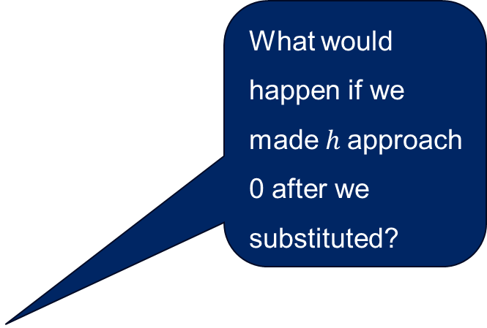
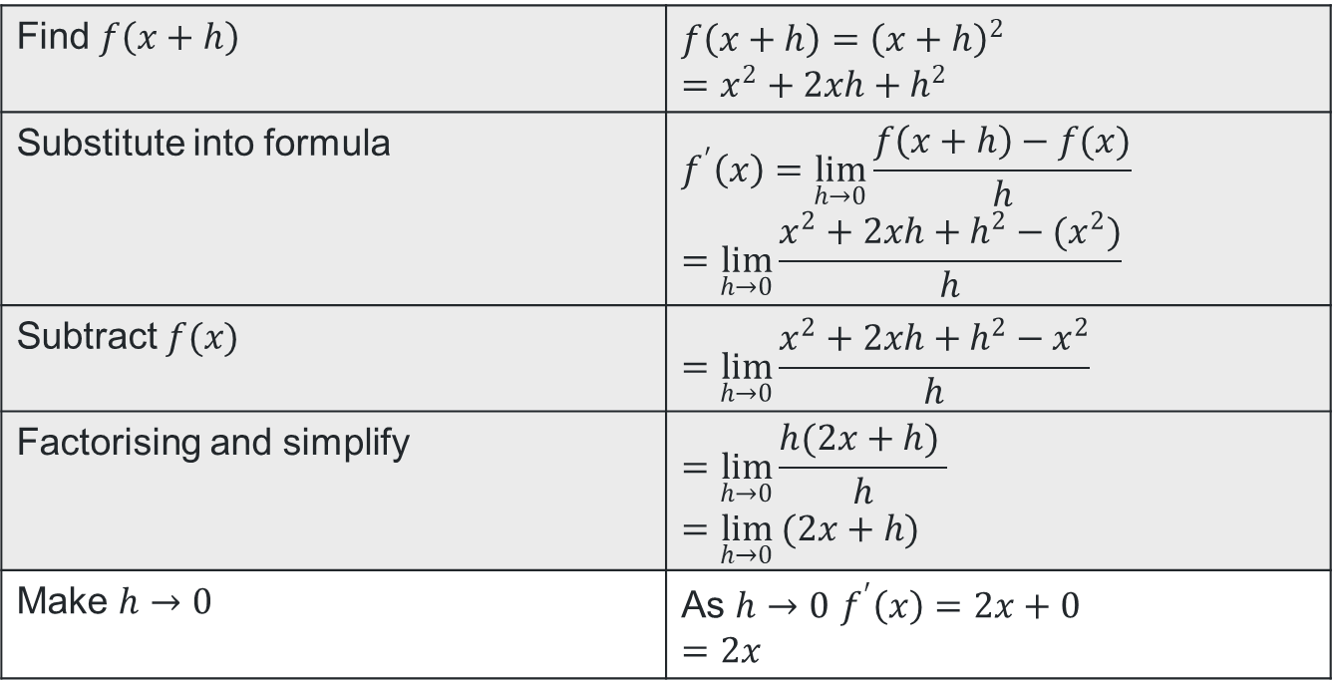
Differentiate $x^{2}$ by first principles (5)
Example 1 – Part 4
Find the derivative of ${f\left(x\right)=x}^{2}$ by first principles.
Find $f\left(x+h\right)$ | $$f\left(x+h\right)={\left(x+h\right)}^{2} \\ =x^{2}+2xh+h^{2}$$
Substitute into formula | $$f^{′}\left(x\right)=\lim_{h→0}{\frac{f\left(x+h\right)−f(x)}{h}} \\ =\lim_{h→0}{\frac{x^{2}+2xh+h^{2}−{(x}^{2})}{h}}$$
Subtract $f(x)$ | $$=\lim_{h→0}{\frac{x^{2}+2xh+h^{2}−x^{2}}{h}}$$
Factorising and simplify | $$=\lim_{h→0}{\frac{h(2x+h) }{h}} \\ =\lim_{h→0} (2x+h)$$
Make $h→0$ | As $h→0$ $f^{′}\left(x\right)=2x+0$ $$=2x$$
What would happen if we made $h$approach 0 after we substituted?

Slide 20
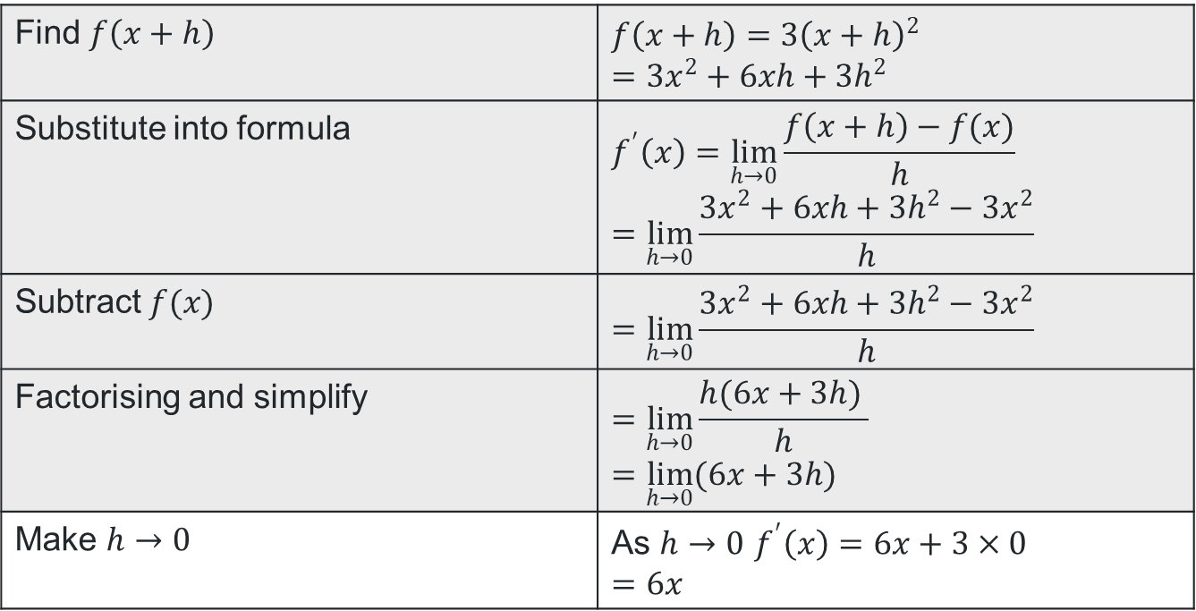
Differentiate ${3x}^{2}$ by first principles (5)
Your turn – Part 4
Find the derivative of ${f\left(x\right)=3x}^{2}$ by first principles.
Find $f\left(x+h\right)$ | $$f\left(x+h\right)={3\left(x+h\right)}^{2} \\ =3x^{2}+6xh+3h^{2}$$
Substitute into formula | $$f^{′}\left(x\right)=\lim_{h→0}{\frac{f\left(x+h\right)−f(x)}{h}} \\ =\lim_{h→0}{\frac{{3x}^{2}+6xh+{3h}^{2}−3x^{2}}{h}}$$
Subtract $f(x)$ | $$=\lim_{h→0}{\frac{{3x}^{2}+6xh+3h^{2}−{3x}^{2}}{h}}$$
Factorising and simplify | $$=\lim_{h→0}{\frac{h(6x+3h) }{h}} \\ =\lim_{h→0}{(6x+3h)}$$
Make $h→0$ | As $h→0$ $f^{′}\left(x\right)=6x+3×0$ $$=6x$$

Slide 21
References
This presentation contains NSW Curriculum and syllabus content. The NSW Curriculum is developed by the NSW Education Standards Authority. This content is prepared by NESA for and on behalf of the Crown in the right of the State of New South Wales. The material is protected by Crown copyright.
Please refer to the NESA Copyright Disclaimer for more information https://educationstandards.nsw.edu.au/wps/portal/nesa/mini-footer/copyright.
NESA holds the only official and up-to-date versions of the NSW Curriculum and syllabus documents. Please visit the NSW Education Standards Authority (NESA) website https://educationstandards.nsw.edu.au/wps/portal/nesa/home and the NSW Curriculum website https://curriculum.nsw.edu.au.
Mathematics Advanced 11-12 Syllabus © NSW Education Standards Authority (NESA) for and on behalf of the Crown in right of the State of New South Wales, 2024.
GeoGebra. © Licensed under the GNU General Public License

Slide 22
Copyright
© State of New South Wales (Department of Education), 2025
The copyright material published in this resource is subject to the Copyright Act 1968 (Cth) and is owned by the NSW Department of Education or, where indicated, by a party other than the NSW Department of Education (third-party material).
Copyright material available in this resource and owned by the NSW Department of Education is licensed under a Creative Commons Attribution 4.0 International (CC BY 4.0) license.
This license allows you to share and adapt the material for any purpose, even commercially.
Attribution should be given to © State of New South Wales (Department of Education), 2025.
Material in this resource not available under a Creative Commons license:
the NSW Department of Education logo, other logos and trademark-protected material
Material owned by a third party that has been reproduced with permission. You will need to obtain permission from the third party to reuse its material.
Links to third-party material and websites
Please note that the provided (reading/viewing material/list/links/texts) are a suggestion only and implies no endorsement, by the New South Wales Department of Education, of any author, publisher, or book title. School principals and teachers are best placed to assess the suitability of resources that would complement the curriculum and reflect the needs and interests of their students.
If you use the links provided in this document to access a third-party’s website, you acknowledge that the terms of use, including licence terms set out on the third-party’s website apply to the use which may be made of the materials on that third-party website or where permitted by the Copyright Act 1968 (Cth). The department accepts no responsibility for content on third-party websites.

