Slide 1

Algebraic fractions
Mathematics Advanced – Stage 6 (Year 11)
Foundations of differentiation

Slide 2
Learning intentions and success criteria
Learning intention
To be able to solve problems involving algebraic fractions.
Success criteria
I can add and subtract algebraic fractions.
I can multiply and divide algebraic fractions.
Notes:
Notes for teachers:
Learning intentions and success criteria are best co-constructed with students. Adapt the learning intention as required and add matching success criteria.
For more information See ⁠AITSL or the NSW Department of Education explicit teaching strategies, ⁠Sharing learning intentions and ⁠Sharing success criteria
LISC is not necessarily presented at the beginning of the lesson. Teacher needs to consider most effectual time to introduce
LISC should be revisited during the lesson to support students' evaluation of their learning

Slide 3
Activating prior knowledge

Slide 4
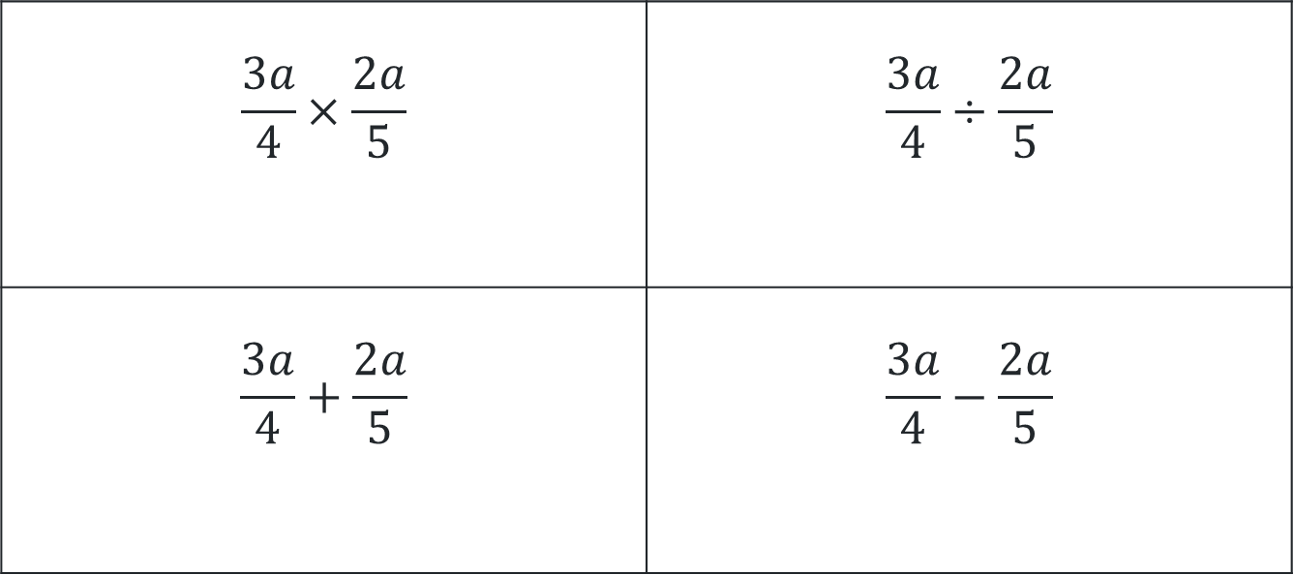
Same surface, different deep.
Simplify
$$\frac{3a}{4}×\frac{2a}{5}$$ | $$\frac{3a}{4}÷\frac{2a}{5}$$
$$\frac{3a}{4}+\frac{2a}{5}$$ | $$\frac{3a}{4}−\frac{2a}{5}$$

Slide 5
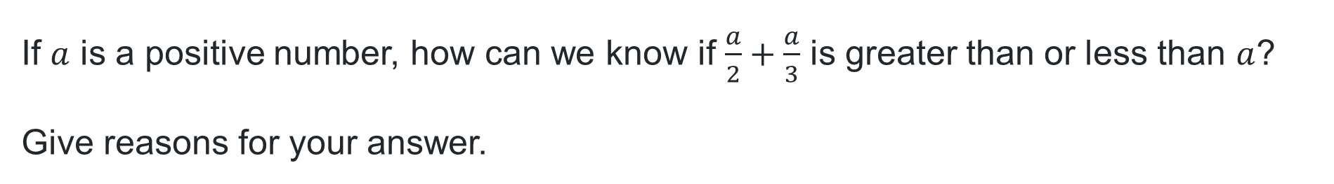
Speed dating
If $a$ is a positive number, how can we know if $\frac{a}{2}+\frac{a}{3}$ is greater than or less than $a$?
Give reasons for your answer.

Slide 6
Connecting learning

Slide 7
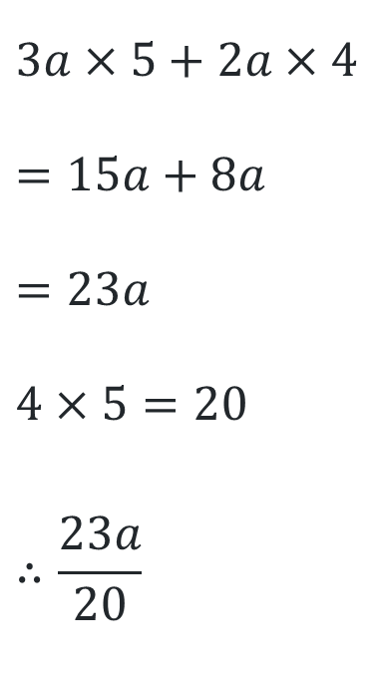
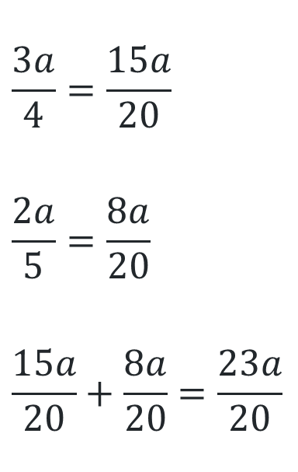
Compare the pair(1)
Suzie and Kirby were asked to solve $\frac{3a}{4}+\frac{2a}{5}$
Suzie’s way – Common denominator method
Kirby’s way – Cross multiplication method
I identified the denominators, 4 and 5. I then found the lowest common denominator, which was 20. I then rewrote each fraction with its equivalent fraction, but with a denominator of 20, before adding them together.
$$\frac{3a}{4}=\frac{15a}{20}$$
$$\frac{2a}{5}=\frac{8a}{20}$$
$$\frac{15a}{20}+\frac{8a}{20}=\frac{23a}{20}$$
First, I multiplied the numerator of each fraction by the denominator of the other fraction, then added them.
I then multiplied the denominators together before combing them.
$$3a×5+2a×4$$
$$=15a+8a$$
$$=23a$$
$$4×5=20$$
$$∴\frac{23a}{20}$$

Slide 8
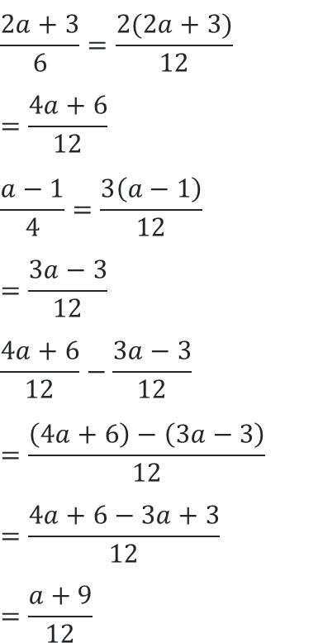
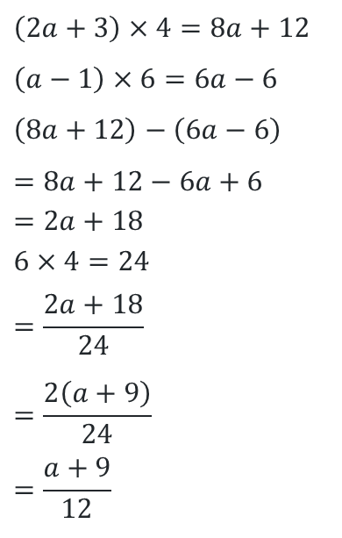
Compare the pair (2)
Suzie and Deb were asked to solve $\frac{2a+3}{6}−\frac{a−1}{4}$
Suzie’s way – Common denominator method
Deb’s way – Cross multiplication method
I found the LCM of 4 and 6 which is 12. I made each fraction the equivalent with a denominator of 12. I then subtracted the numerators before simplifying the answer.
$$\frac{2a+3}{6}=\frac{2(2a+3)}{12}$$
$$=\frac{4a+6}{12}$$
$$\frac{a−1}{4}=\frac{3\left(a−1\right)}{12}$$
$$=\frac{3a−3}{12}$$
$$\frac{4a+6}{12}−\frac{3a−3}{12}$$
$$=\frac{\left(4a+6\right)−\left(3a−3\right)}{12}$$
$$=\frac{4a+6−3a+3}{12}$$
$$=\frac{a+9}{12}$$
Multiply the numerator of the first fraction by the denominator of the second. Then multiply the numerator of the second fraction by the denominator of the first. Combine and then simplify.
$$\left(2a+3\right)×4=8a+12$$
$$\left(a−1\right)×6=6a−6$$
$$\left(8a+12\right)−\left(6a−6\right)$$
$$=8a+12−6a+6 \\ =2a+18$$
$$6×4=24 \\ =\frac{2a+18}{24}$$
$$=\frac{2\left(a+9\right)}{24} \\ =\frac{a+9}{12}$$

Slide 9
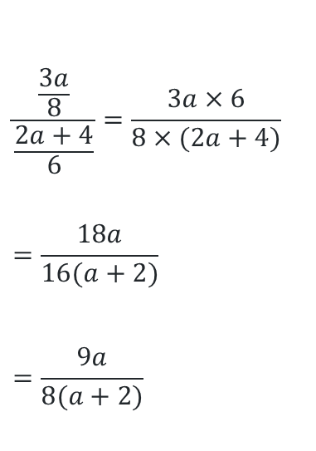
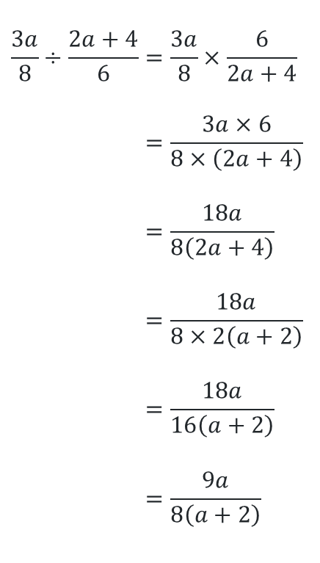
Compare the pair (3)
Lisa and Liz were asked to solve $\frac{3a+3}{8}÷\frac{2a+4}{6}$
Lisa’s way – Keep-Change-Flip
Liz’s way – Cross multiplication
I multiplied the first fraction by the reciprocal of the second fraction. I then simplified it and took out a factor 2 from both the numerator and denominator to simplify.
$$\frac{3a}{8}÷\frac{2a+4}{6}=\frac{3a}{8}×\frac{6}{2a+4} \\ ​=\frac{3a×6}{8×\left(2a+4\right)} \\ =\frac{18a}{8\left(2a+4\right)} \\ =\frac{18a}{8×2\left(a+2\right)} \\ =\frac{18a}{16\left(a+2\right)}​ \\ =\frac{9a}{8\left(a+2\right)}$$
I wrote the division as a fraction. I then multiplied the numerator of the first with the denominator of the second and the numerator of the second with the denominator of the first. I then took out a common factor of 2 to simplify.
$$\frac{\frac{3a}{8}}{\frac{2a+4}{6}}=\frac{3a×6}{8×(2a+4)}$$
$$=\frac{18a}{16(a+2)}$$
$$=\frac{9a}{8(a+2)}$$

Slide 10
Releasing responsibility

Slide 11

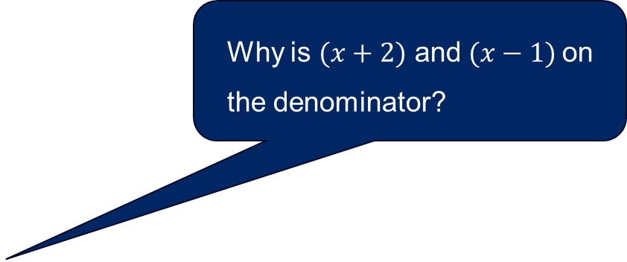
Worked example (1)
Example 1
Why is $(x+2)$ and $(x−1)$on the denominator?
Simplify
$$\frac{3}{x+2}−\frac{2}{x−1}= \frac{3×\left(x−1\right)−2×\left(x+2\right)}{\left(x+2\right)\left(x−1\right)} \\ =\frac{3x−3−2x−4}{(x+2)(x+1)} \\ =\frac{x−7}{(x+2)(x+1)}$$
Why is the last term -4?

Slide 12
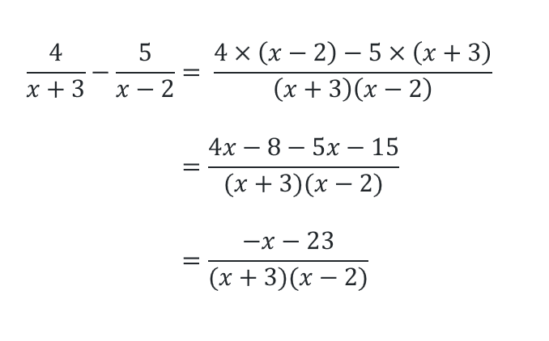

Worked example (2)
Your turn – Question 1
Simplify
$$\frac{4}{x+3}−\frac{5}{x−2}=$$

Slide 13

Worked example (3)
Example 2
Why do we factorise these expressions?
Simplify
$$\frac{x^{2}−4}{x^{2}−5x+6}÷\frac{x^{2}−x−6}{x^{2}−2x}=\frac{(x+2)(x−2)}{(x−3)(x−2)}÷\frac{(x+2)(x−3)}{x(x−2)} \\ =\frac{(x+2)(x−2)}{(x−3)(x−2)}×\frac{x(x−2)}{(x+2)(x−3)} \\ =\frac{x(x−2)}{{(x−3)}^{2}}$$
Why did some of the terms disappear from the line above?

Slide 14

Worked example (4)
Your turn – Question 2
Simplify
$$\frac{x^{2}−9}{x^{2}+x−6}×\frac{x^{2}−4x+4}{x^{2}−2x−3}$$
$$=\frac{(x+3)(x−3)}{(x+3)(x−2)}×\frac{(x−2)(x−2)}{(x−3)(x+1)}$$
$$=\frac{x−2}{x+1}$$

Slide 15
Independent practice

Slide 16
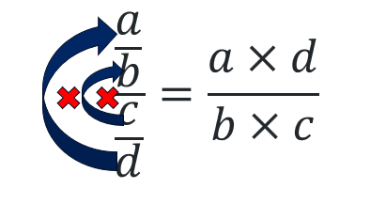

Shortcut division method.
Outside inside method
When $\frac{a}{b}÷\frac{c}{d},$where $a,b, c$and$d$are expressions,
then the outside expressions multiplied are the numerator
and the inside expressions are the denominator. $\frac{a×d}{b×c}$

Slide 17
References
This presentation contains NSW Curriculum and syllabus content. The NSW Curriculum is developed by the NSW Education Standards Authority. This content is prepared by NESA for and on behalf of the Crown in the right of the State of New South Wales. The material is protected by Crown copyright.
Please refer to the NESA Copyright Disclaimer for more information https://educationstandards.nsw.edu.au/wps/portal/nesa/mini-footer/copyright.
NESA holds the only official and up-to-date versions of the NSW Curriculum and syllabus documents. Please visit the NSW Education Standards Authority (NESA) website https://educationstandards.nsw.edu.au/wps/portal/nesa/home and the NSW Curriculum website https://curriculum.nsw.edu.au.
Mathematics Advanced 11-12 Syllabus © NSW Education Standards Authority (NESA) for and on behalf of the Crown in right of the State of New South Wales, 2024.

Slide 18
Copyright
© State of New South Wales (Department of Education), 2025
The copyright material published in this resource is subject to the Copyright Act 1968 (Cth) and is owned by the NSW Department of Education or, where indicated, by a party other than the NSW Department of Education (third-party material).
Copyright material available in this resource and owned by the NSW Department of Education is licensed under a Creative Commons Attribution 4.0 International (CC BY 4.0) license.
This license allows you to share and adapt the material for any purpose, even commercially.
Attribution should be given to © State of New South Wales (Department of Education), 2025.
Material in this resource not available under a Creative Commons license:
the NSW Department of Education logo, other logos and trademark-protected material
Material owned by a third party that has been reproduced with permission. You will need to obtain permission from the third party to reuse its material.
Links to third-party material and websites
Please note that the provided (reading/viewing material/list/links/texts) are a suggestion only and implies no endorsement, by the New South Wales Department of Education, of any author, publisher, or book title. School principals and teachers are best placed to assess the suitability of resources that would complement the curriculum and reflect the needs and interests of their students.
If you use the links provided in this document to access a third-party’s website, you acknowledge that the terms of use, including licence terms set out on the third-party’s website apply to the use which may be made of the materials on that third-party website or where permitted by the Copyright Act 1968 (Cth). The department accepts no responsibility for content on third-party websites.

