Slide 1
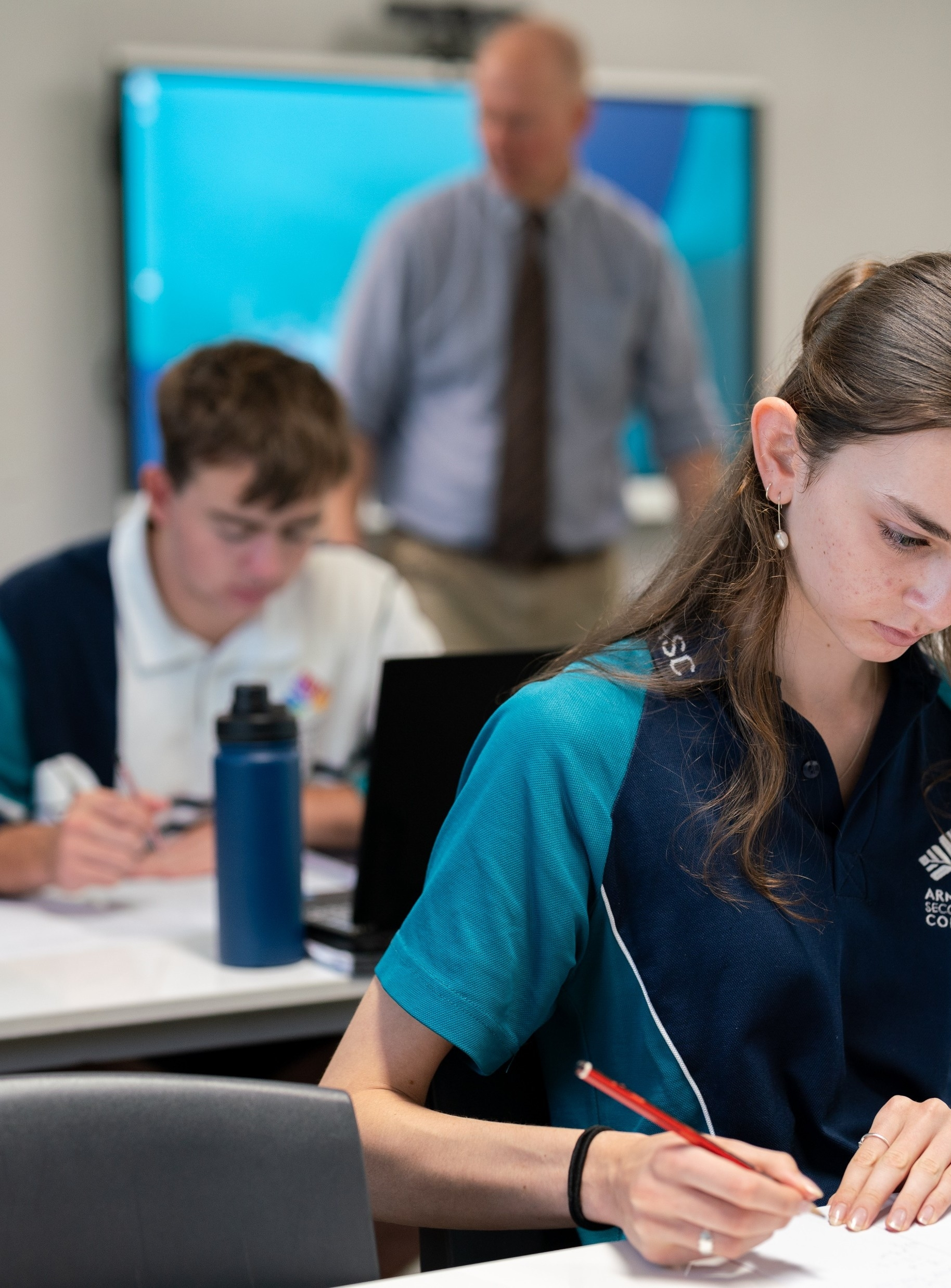
Introducing the derivative
Mathematics Advanced – Stage 6 (Year 11)
Foundations of differentiation

Slide 2
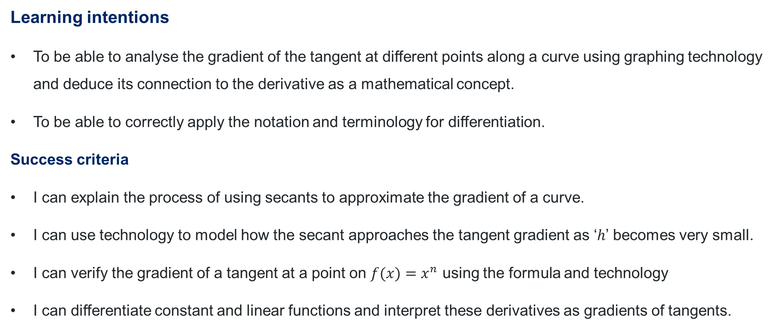
Learning intentions and success criteria
Learning intentions
To be able to analyse the gradient of the tangent at different points along a curve using graphing technology and deduce its connection to the derivative as a mathematical concept.
To be able to correctly apply the notation and terminology for differentiation.
Success criteria
I can explain the process of using secants to approximate the gradient of a curve.
I can use technology to model how the secant approaches the tangent gradient as ‘$h$’ becomes very small.
I can verify the gradient of a tangent at a point on $f(x)=x^{n}$ using the formula and technology
I can differentiate constant and linear functions and interpret these derivatives as gradients of tangents.

Slide 3
Activating prior knowledge

Slide 4
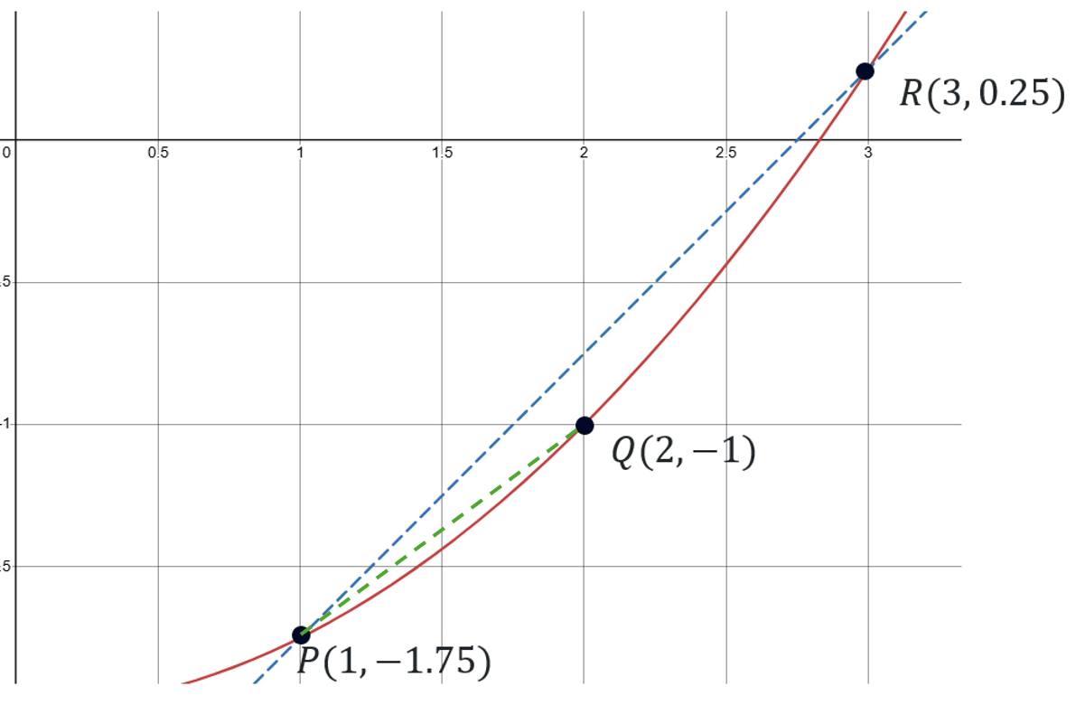
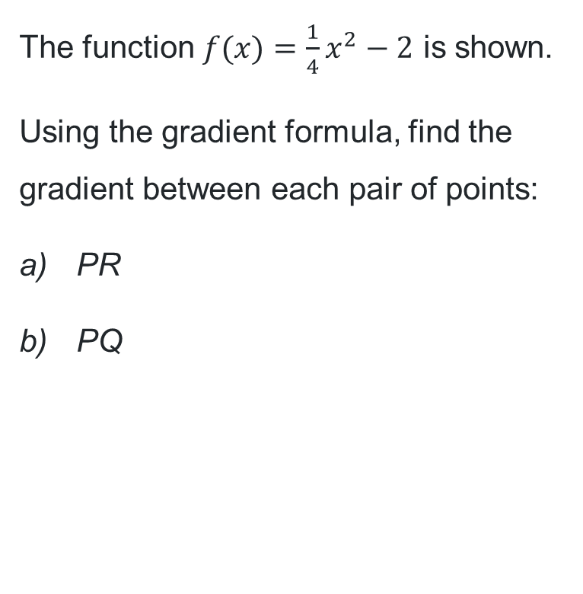


Gradient of secants
The function $f(x)=\frac{1}{4}x^{2}−2$ is shown.
Using the gradient formula, find the
gradient between each pair of points:
PR
PQ
$$m_{PR}=\frac{y_{2}−y_{1}}{x_{2}−x_{1}} \\ =\frac{0.25−(−1.75)}{3−1} \\ =1$$
$$m_{PQ}=\frac{y_{2}−y_{1}}{x_{2}−x_{1}} \\ =\frac{−1−(−1.75)}{2−1} \\ =0.75$$

Slide 5
Releasing responsibility

Slide 6
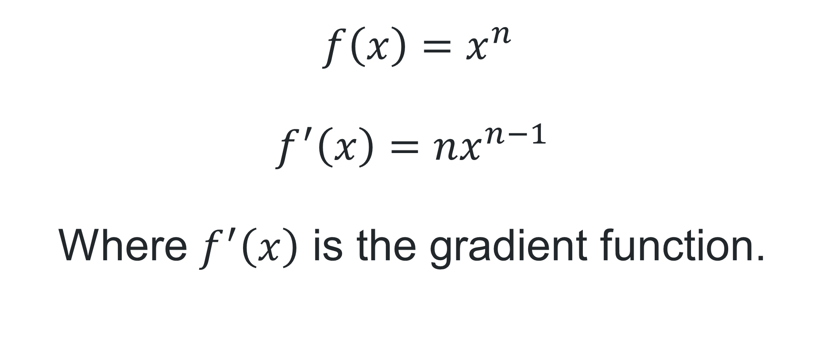
Gradient function
$f\left(x\right)=x^{n}$
$$f^{′}\left(x\right)=nx^{n−1}$$
Where $f^{′}\left(x\right)$ is the gradient function.

Slide 7
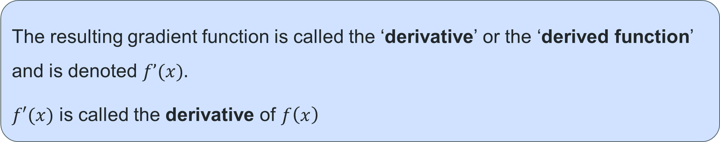
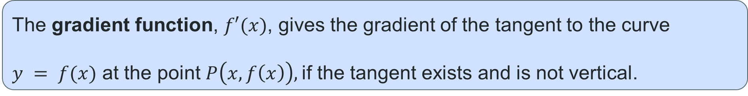
Derivatives
The gradient function, $f′(x)$, gives the gradient of the tangent to the curve
$y = f(x)$ at the point $P\left(x,f\left(x\right)\right),$if the tangent exists and is not vertical.
The resulting gradient function is called the ‘derivative’ or the ‘derived function’ and is denoted $f’(x).$
$f′(x)$ is called the derivative of $f\left(x\right)$
Differentiation is the process used to find the derivative of a function.

Slide 8
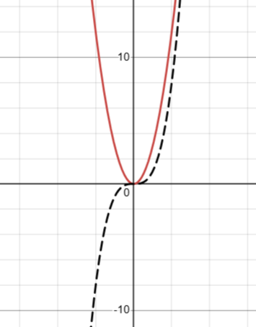

Worked Example
The derivative of ${f\left(x\right)=x}^{3}$ is $f^{′}\left(x\right)=3x^{2}$

Slide 9
References
This presentation contains NSW Curriculum and syllabus content. The NSW Curriculum is developed by the NSW Education Standards Authority. This content is prepared by NESA for and on behalf of the Crown in the right of the State of New South Wales. The material is protected by Crown copyright.
Please refer to the NESA Copyright Disclaimer for more information https://educationstandards.nsw.edu.au/wps/portal/nesa/mini-footer/copyright.
NESA holds the only official and up-to-date versions of the NSW Curriculum and syllabus documents. Please visit the NSW Education Standards Authority (NESA) website https://educationstandards.nsw.edu.au/wps/portal/nesa/home and the NSW Curriculum website https://curriculum.nsw.edu.au.
Mathematics Advanced 11-12 Syllabus © NSW Education Standards Authority (NESA) for and on behalf of the Crown in right of the State of New South Wales, 2024.

Slide 10
Copyright
© State of New South Wales (Department of Education), 2025
The copyright material published in this resource is subject to the Copyright Act 1968 (Cth) and is owned by the NSW Department of Education or, where indicated, by a party other than the NSW Department of Education (third-party material).
Copyright material available in this resource and owned by the NSW Department of Education is licensed under a Creative Commons Attribution 4.0 International (CC BY 4.0) license.
This license allows you to share and adapt the material for any purpose, even commercially.
Attribution should be given to © State of New South Wales (Department of Education), 2025.
Material in this resource not available under a Creative Commons license:
the NSW Department of Education logo, other logos and trademark-protected material
Material owned by a third party that has been reproduced with permission. You will need to obtain permission from the third party to reuse its material.
Links to third-party material and websites
Please note that the provided (reading/viewing material/list/links/texts) are a suggestion only and implies no endorsement, by the New South Wales Department of Education, of any author, publisher, or book title. School principals and teachers are best placed to assess the suitability of resources that would complement the curriculum and reflect the needs and interests of their students.
If you use the links provided in this document to access a third-party’s website, you acknowledge that the terms of use, including licence terms set out on the third-party’s website apply to the use which may be made of the materials on that third-party website or where permitted by the Copyright Act 1968 (Cth). The department accepts no responsibility for content on third-party websites.

