Slide 1
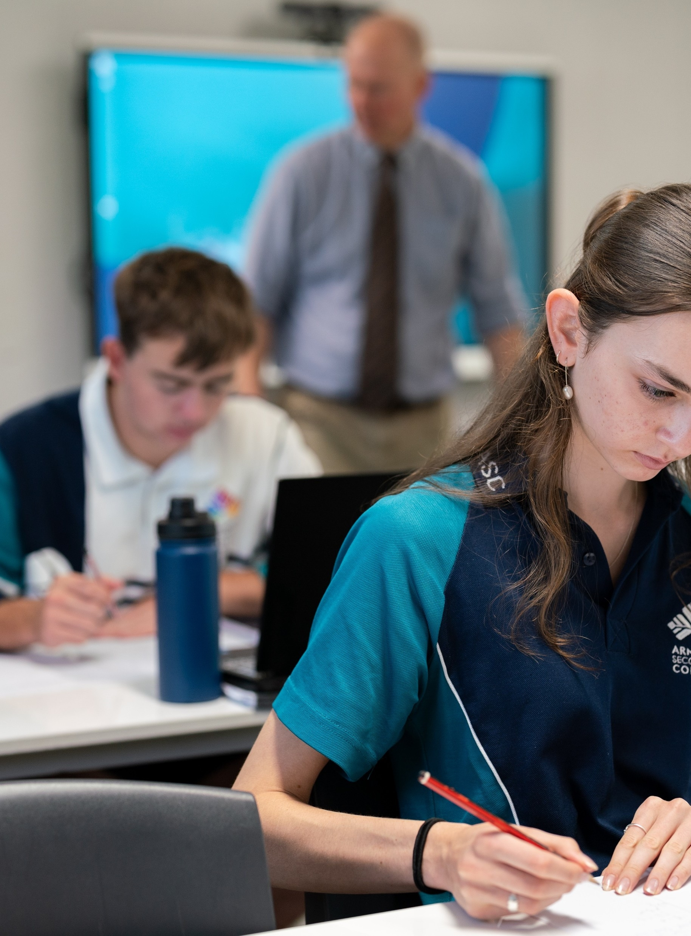
Average speed
Mathematics Advanced – Stage 6 (Year 11)
Foundations of differentiation

Slide 2
Learning intentions and success criteria
Learning intentions
To understand and calculate average speed as a rate of change of distance with respect to time.
To be able to interpret and analyse distance-time graphs.
Success criteria
I can identify and calculate the change in distance and the change in time from data and graphs to calculate average speed.
I can determine average speed from a distance-time graph.
I can explain why average speed may differ from instantaneous speeds during a journey.
I can recognise that the average speed is represented by the gradient of a linear function.
Notes:
Notes for teachers:
Learning intentions and success criteria are best co-constructed with students. Adapt the learning intention as required and add matching success criteria.
For more information See ⁠AITSL or the NSW Department of Education explicit teaching strategies, ⁠Sharing learning intentions and ⁠Sharing success criteria
LISC is not necessarily presented at the beginning of the lesson. Teacher needs to consider most effectual time to introduce
LISC should be revisited during the lesson to support students' evaluation of their learning

Slide 3
Activating prior knowledge

Slide 4
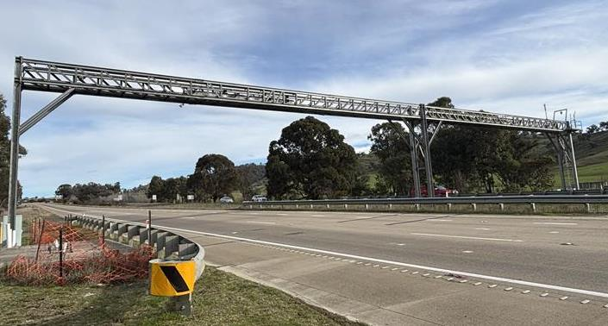
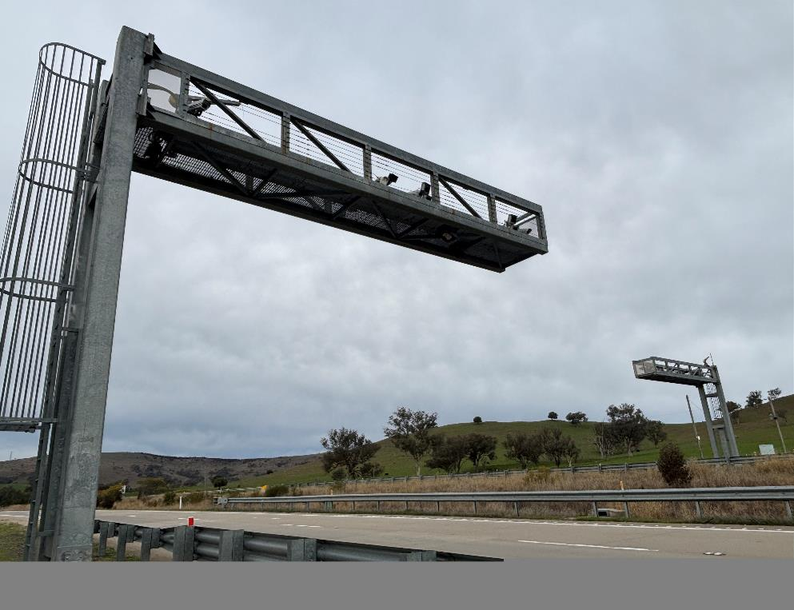
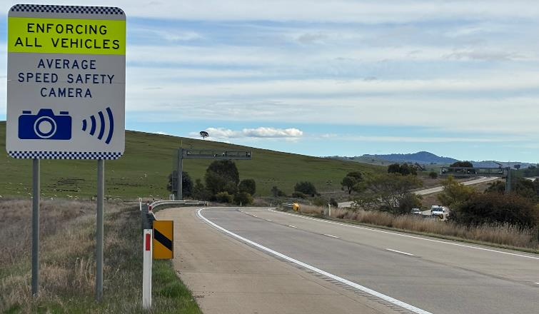
Average speed camera (1)
Examples

Slide 5
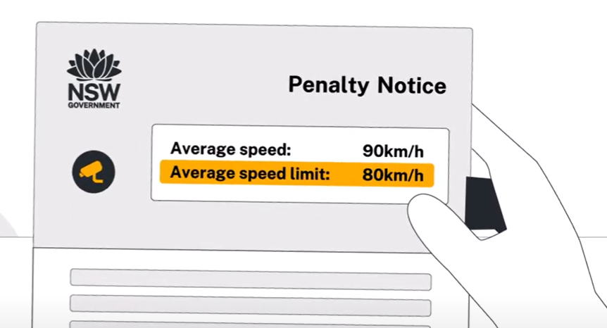
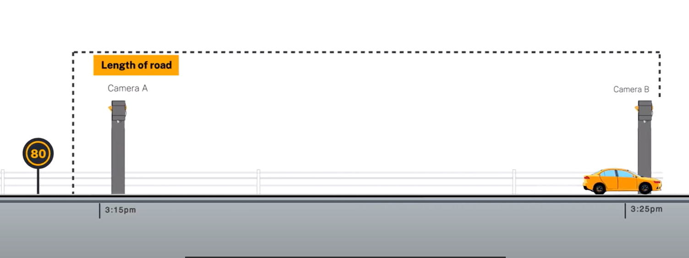
Average speed camera (2)
‘How average speed cameras work’, © Transport for NSW. Accessed September 8, 2025, https://www.youtube.com/watch?v=njICGHZG6po

Slide 6
Connecting learning

Slide 7
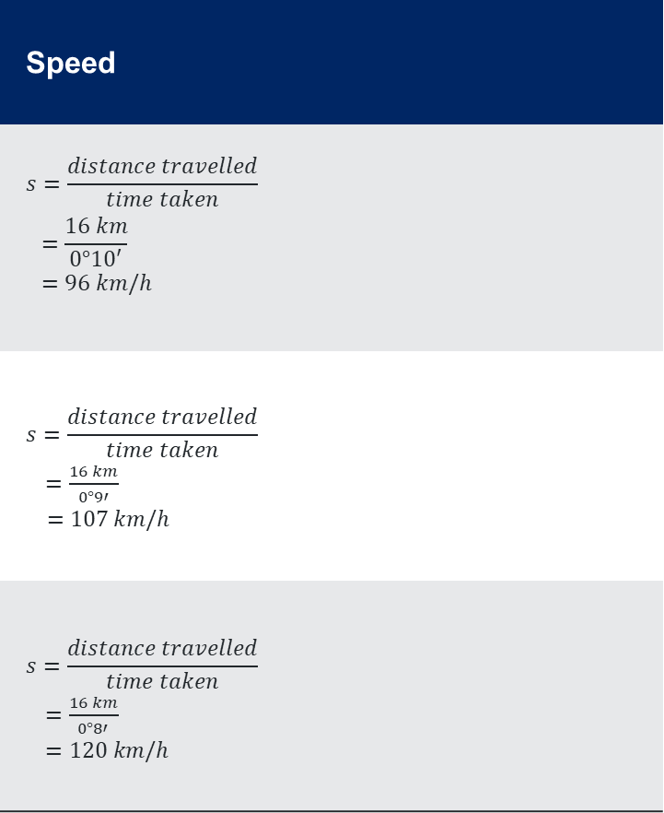
Average speed cameras (3)
Time taken between the 2 cameras that are 16km apart. Speed limit is $110 km/h.$
Time
10 minutes
9 minutes
8 minutes
Speed
$$s=\frac{distance travelled}{time taken}$$ $$=\frac{16 km}{0°10′}$$ $$=96 km/h$$
$$s=\frac{distance travelled}{time taken}$$ $=\frac{16 km}{0°9′}$ $$=107 km/h$$
$$s=\frac{distance travelled}{time taken}$$ $=\frac{16 km}{0°8′}$ $=120 km/h$

Slide 8
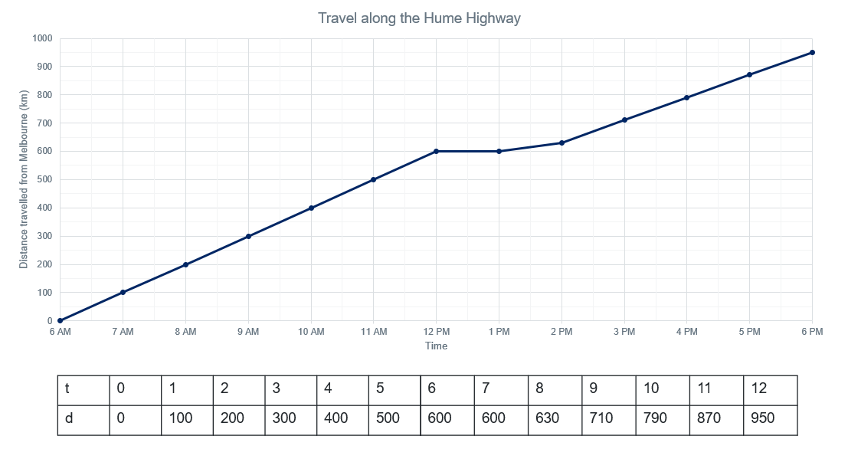
Jack’s Hume Highway trip (1)

Slide 9
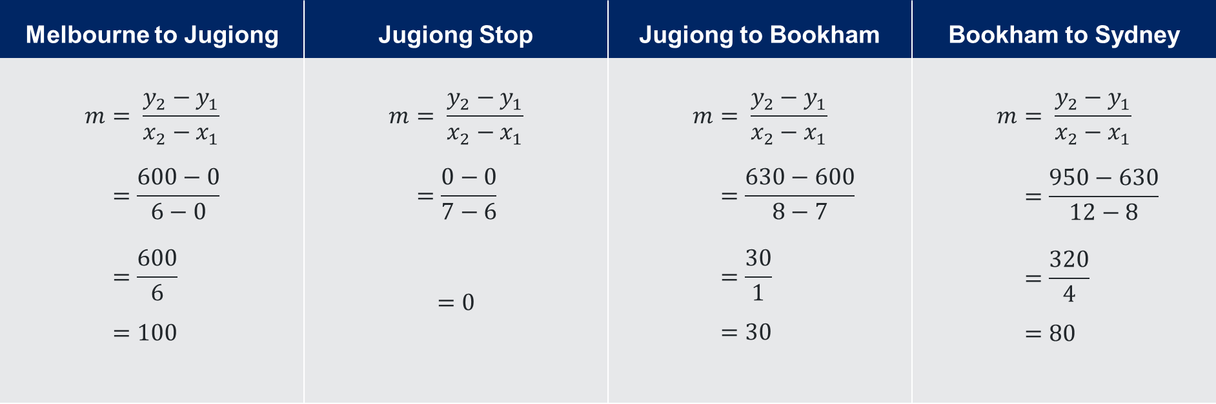
Jack’s Hume Highway trip (2)
Melbourne to Jugiong | Jugiong Stop | Jugiong to Bookham | Bookham to Sydney
$$m= \frac{y_{2}−y_{1}}{x_{2}−x_{1}} \\ =\frac{600−0}{6−0} \\ =\frac{600}{6} \\ =100$$ | $$m= \frac{y_{2}−y_{1}}{x_{2}−x_{1}} \\ =\frac{0−0}{7−6}$$ $$=0$$ | $$m= \frac{y_{2}−y_{1}}{x_{2}−x_{1}} \\ =\frac{630−600}{8−7} \\ =\frac{30}{1} \\ =30$$ | $$m= \frac{y_{2}−y_{1}}{x_{2}−x_{1}} \\ =\frac{950−630}{12−8} \\ =\frac{320}{4} \\ =80$$

Slide 10
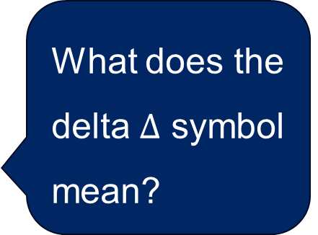
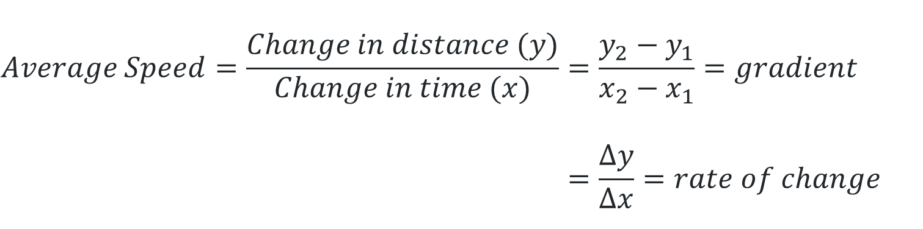
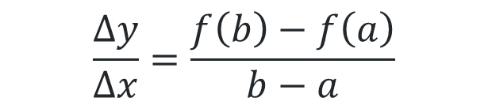
Average speed (1)
$$Average Speed=\frac{Change in distance (y)}{Change in time (x)}=\frac{y_{2}−y_{1}}{x_{2}−x_{1}}=gradient \\ =\frac{∆y}{∆x}=rate of change$$
What does the delta $∆$ symbol mean?
$$\frac{∆y}{∆x}=\frac{f\left(b\right)−f\left(a\right)}{b−a}$$

Slide 11
Releasing responsibility

Slide 12
Average speed camera(1)

Slide 13
Independent practice

Slide 14
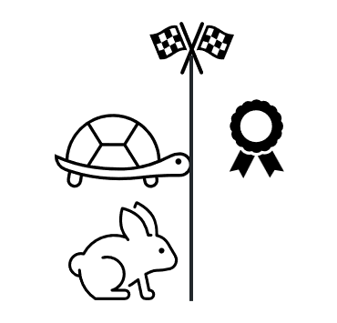
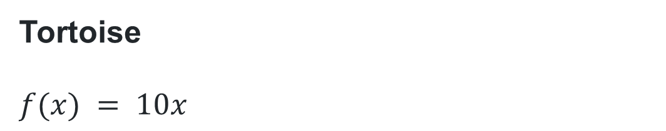
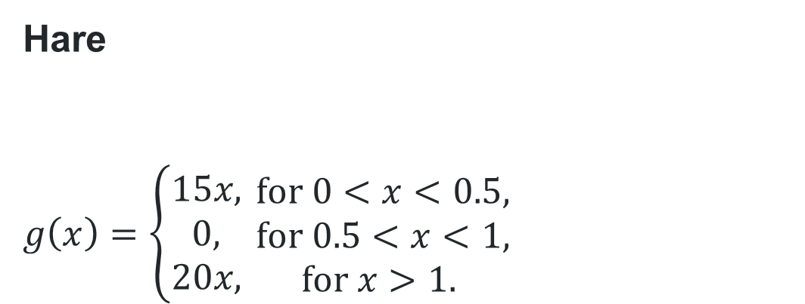
The race (1)
Tortoise
$$f(x) = 10x$$
Hare
$$g\left(x\right)=\left\{\begin{aligned}15x, \\ 0, \\ 20x,\end{aligned}\right.\begin{matrix} for 0<x<0.5, \\ for 0.5<x<1, \\ for x>1.\end{matrix}$$

Slide 15
The race (2)
A donkey also competed in the race. The donkey was confident that it could beat both the hare and the tortoise. When the race started, the donkey took off quickly. However, the donkey got lost, had to retrace its steps, stubbornly refused to cross a stream and slowed down to graze on some delicious grass as it raced. Donkey ended up finishing the race after the hare and the tortoise.

Slide 16
References
This presentation contains NSW Curriculum and syllabus content. The NSW Curriculum is developed by the NSW Education Standards Authority. This content is prepared by NESA for and on behalf of the Crown in the right of the State of New South Wales. The material is protected by Crown copyright.
Please refer to the NESA Copyright Disclaimer for more information https://educationstandards.nsw.edu.au/wps/portal/nesa/mini-footer/copyright.
NESA holds the only official and up-to-date versions of the NSW Curriculum and syllabus documents. Please visit the NSW Education Standards Authority (NESA) website https://educationstandards.nsw.edu.au/wps/portal/nesa/home and the NSW Curriculum website https://curriculum.nsw.edu.au.
Mathematics Advanced 11-12 Syllabus © NSW Education Standards Authority (NESA) for and on behalf of the Crown in right of the State of New South Wales, 2024.
.

Slide 17
Copyright
© State of New South Wales (Department of Education), 2025
The copyright material published in this resource is subject to the Copyright Act 1968 (Cth) and is owned by the NSW Department of Education or, where indicated, by a party other than the NSW Department of Education (third-party material).
Copyright material available in this resource and owned by the NSW Department of Education is licensed under a Creative Commons Attribution 4.0 International (CC BY 4.0) license.
This license allows you to share and adapt the material for any purpose, even commercially.
Attribution should be given to © State of New South Wales (Department of Education), 2025.
Material in this resource not available under a Creative Commons license:
the NSW Department of Education logo, other logos and trademark-protected material
Material owned by a third party that has been reproduced with permission. You will need to obtain permission from the third party to reuse its material.
Links to third-party material and websites
Please note that the provided (reading/viewing material/list/links/texts) are a suggestion only and implies no endorsement, by the New South Wales Department of Education, of any author, publisher, or book title. School principals and teachers are best placed to assess the suitability of resources that would complement the curriculum and reflect the needs and interests of their students.
If you use the links provided in this document to access a third-party’s website, you acknowledge that the terms of use, including licence terms set out on the third-party’s website apply to the use which may be made of the materials on that third-party website or where permitted by the Copyright Act 1968 (Cth). The department accepts no responsibility for content on third-party websites.

