Slide 1
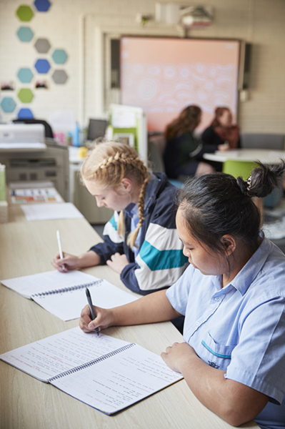
Inverse variation
Mathematics Advanced – Stage 6 (Year 11)
Unit 4 – graphing transformations

Slide 2
Activating prior knowledge

Slide 3
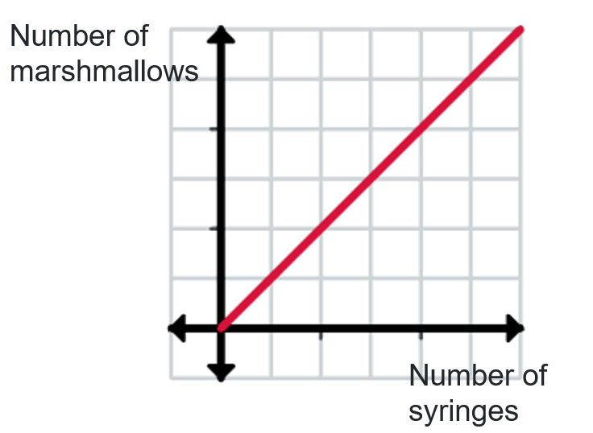
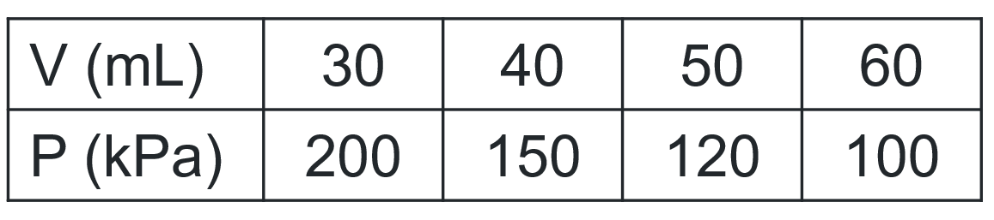
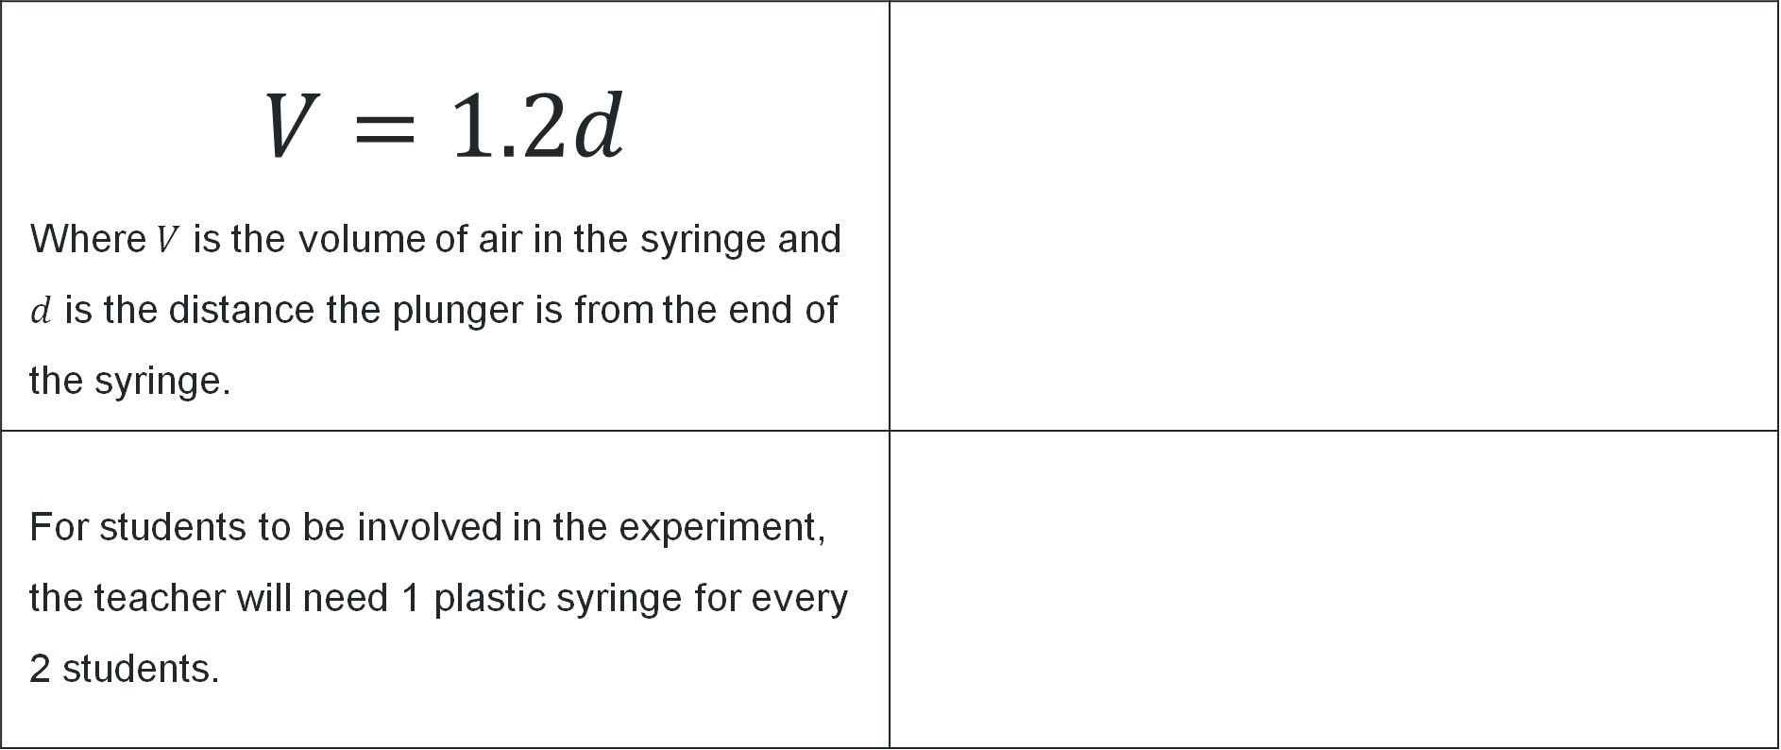
Which one doesn’t belong
Consider the items below
$$V=1.2d$$ Where $V$ is the volume of air in the syringe and $d$ is the distance the plunger is from the end of the syringe.
For students to be involved in the experiment, the teacher will need 1 plastic syringe for every 2 students.

Slide 4
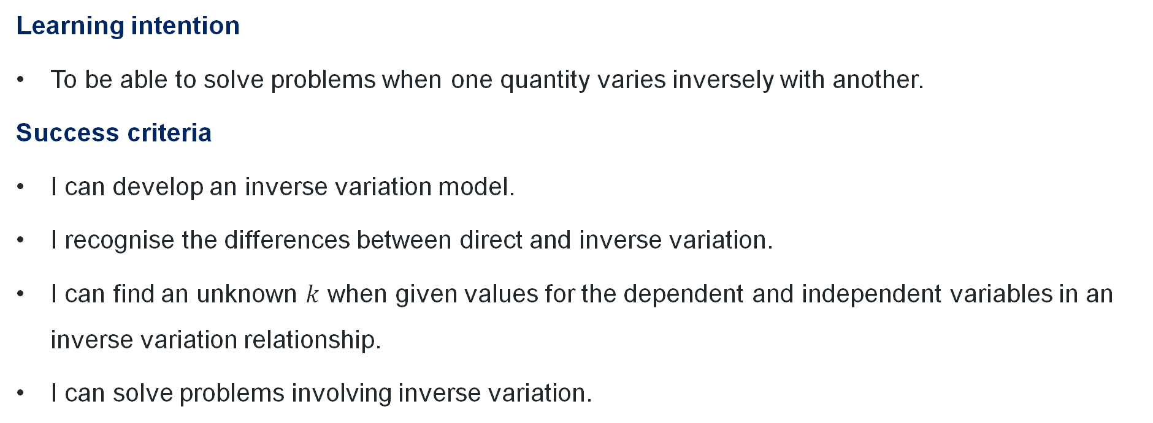
Learning intentions and success criteria
Learning intention
To be able to solve problems when one quantity varies inversely with another.
Success criteria
I can develop an inverse variation model.
I recognise the differences between direct and inverse variation.
I can find an unknown $k$ when given values for the dependent and independent variables in an inverse variation relationship.
I can solve problems involving inverse variation.
Notes:
Notes for teachers:
Learning intentions and success criteria are best co-constructed with students. Adapt the learning intention as required and add matching success criteria.
For more information See ⁠AITSL or the NSW Department of Education explicit teaching strategies, ⁠Sharing learning intentions and ⁠Sharing success criteria
LISC is not necessarily presented at the beginning of the lesson. Teacher needs to consider most effectual time to introduce
LISC should be revisited during the lesson to support students' evaluation of their learning

Slide 5
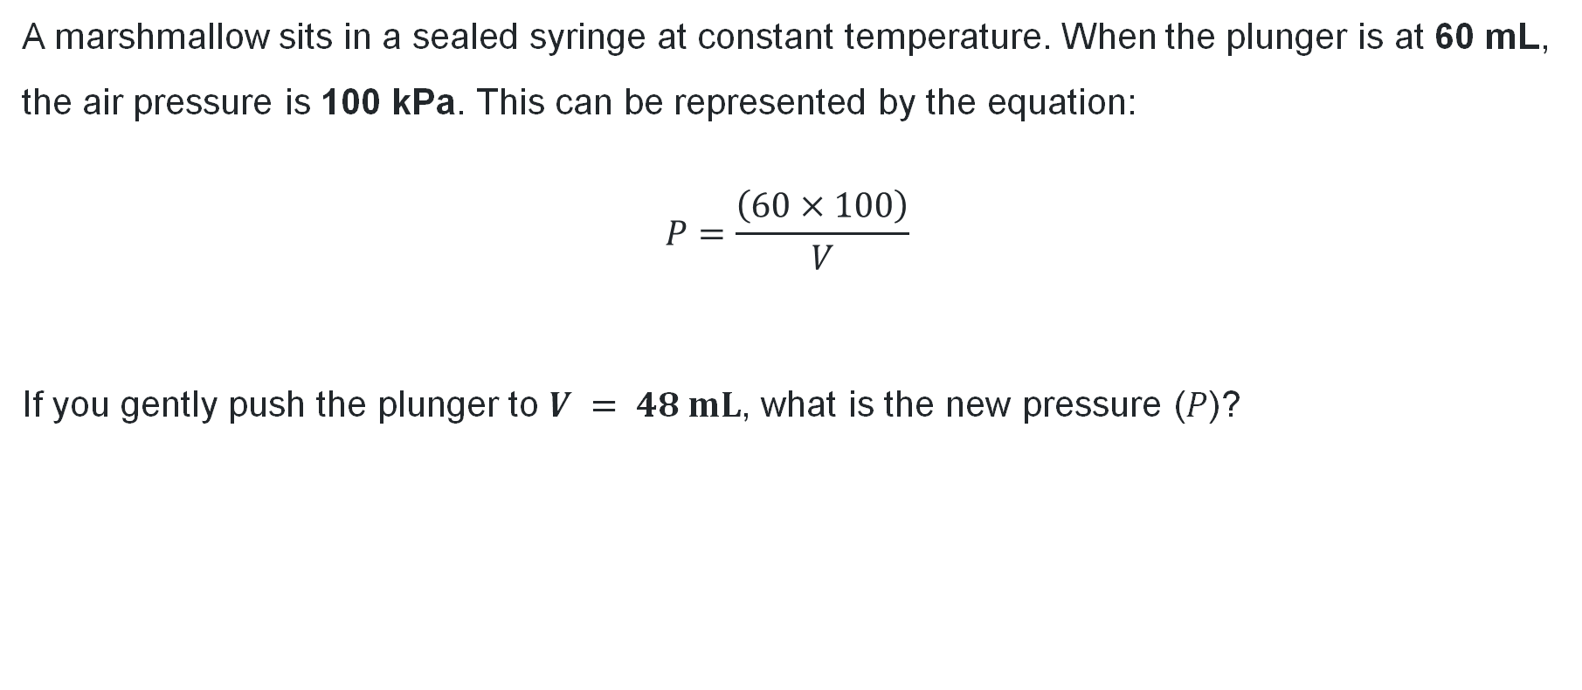
Marshmallow question
Consider this
A marshmallow sits in a sealed syringe at constant temperature. When the plunger is at 60 mL, the air pressure is 100 kPa. This can be represented by the equation:
$$P=\frac{\left(60×100\right)}{V}$$
If you gently push the plunger to $V = 48 mL$, what is the new pressure ($P$)?

Slide 6
Connecting learning

Slide 7
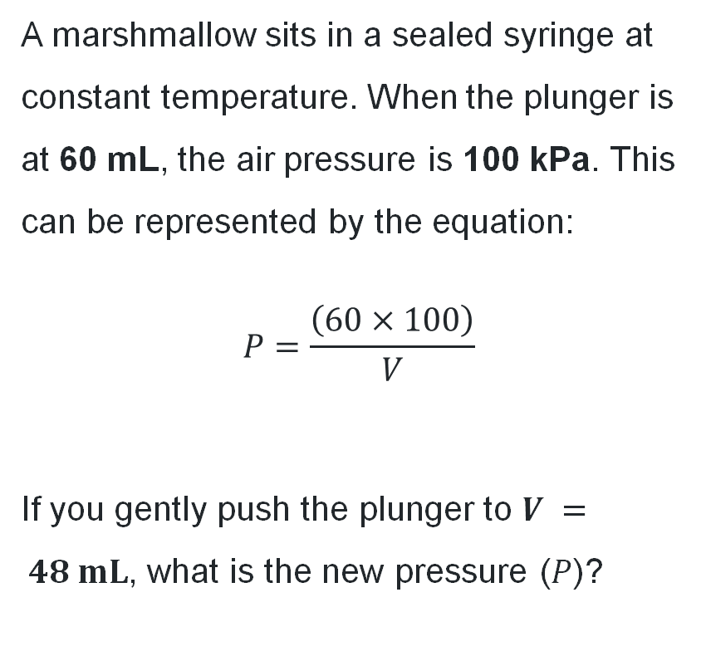
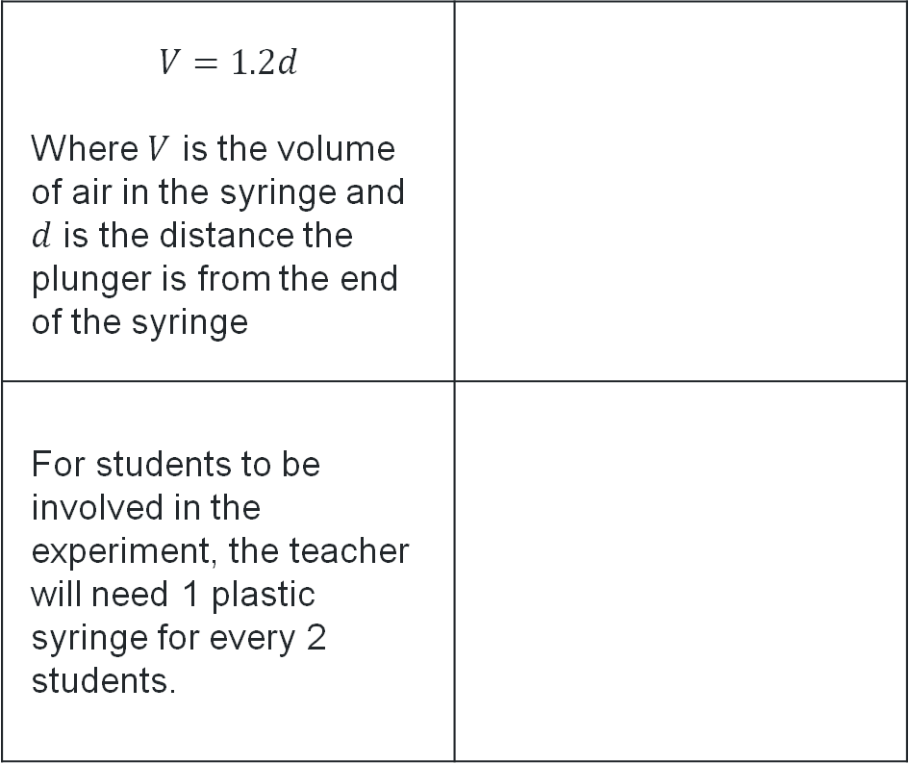
Are there any links?
Marshmallow question
A marshmallow sits in a sealed syringe at constant temperature. When the plunger is at 60 mL, the air pressure is 100 kPa. This can be represented by the equation:
$$P=\frac{\left(60×100\right)}{V}$$
If you gently push the plunger to $V = 48 mL$, what is the new pressure ($P$)?
$$V=1.2d$$ Where $V$ is the volume of air in the syringe and $d$ is the distance the plunger is from the end of the syringe
For students to be involved in the experiment, the teacher will need 1 plastic syringe for every 2 students.

Slide 8
Check for understanding (1)
Inverse variation
The time it takes to download a movie is inversely proportional to the internet speed. If it takes 20 minutes with a speed of 50 Mbps, what is the constant of variation?

Slide 9
Check for understanding (2)
Inverse variation
The battery life of a Bluetooth speaker is inversely proportional to the volume setting. If the speaker lasts 12 hours at 30% volume, what is the constant of variation?

Slide 10
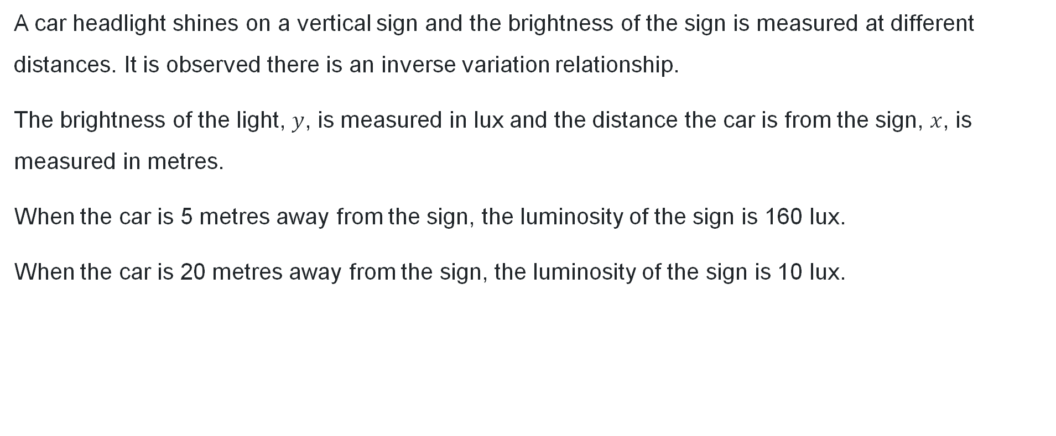
Consider this
Car headlight
A car headlight shines on a vertical sign and the brightness of the sign is measured at different distances. It is observed there is an inverse variation relationship.
The brightness of the light, $y$, is measured in lux and the distance the car is from the sign, $x$, is measured in metres.
When the car is 5 metres away from the sign, the luminosity of the sign is 160 lux.
When the car is 20 metres away from the sign, the luminosity of the sign is 10 lux.

Slide 11
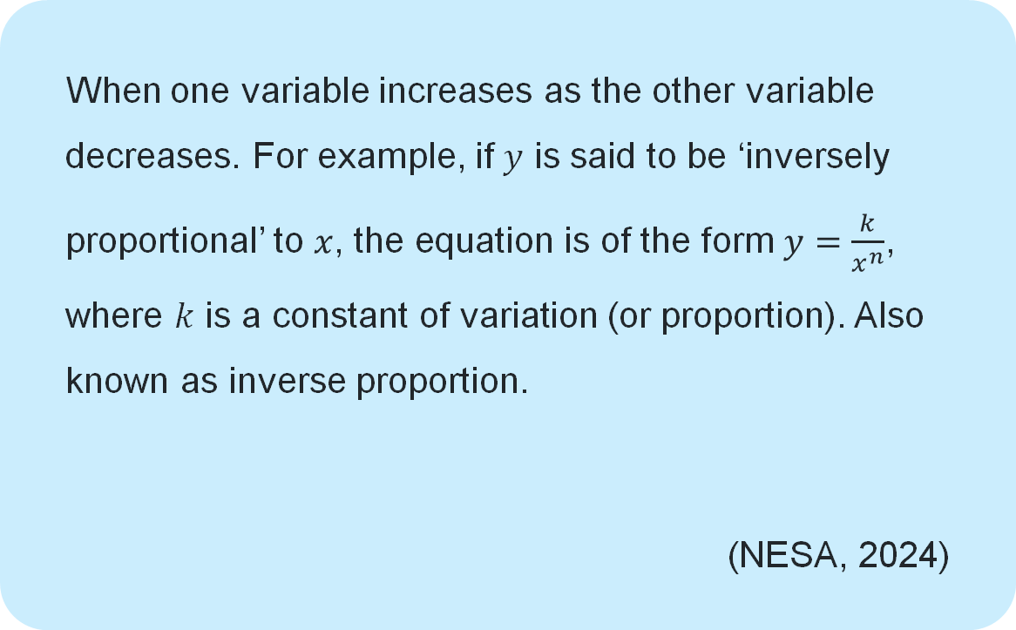
Inverse variation relationship
When one variable increases as the other variable decreases. For example, if $y$ is said to be ‘inversely proportional’ to $x$, the equation is of the form $y=\frac{k}{x^{n}}$, where $k$ is a constant of variation (or proportion). Also known as inverse proportion.
(NESA, 2024)

Slide 12
Releasing responsibility

Slide 13
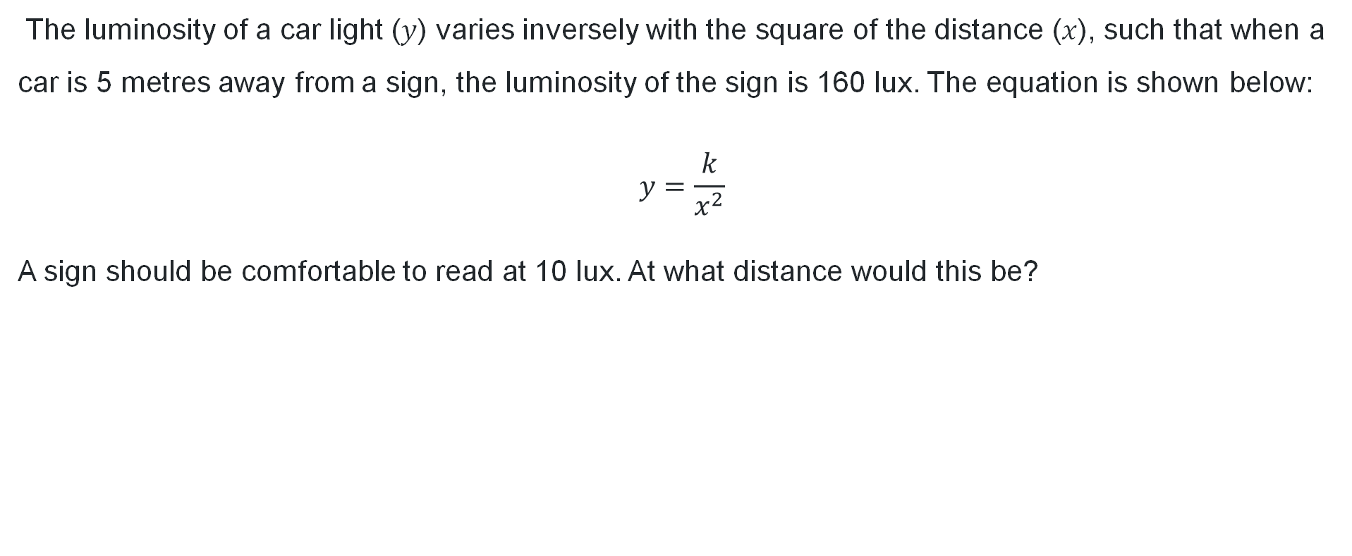
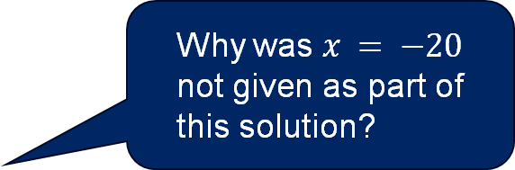
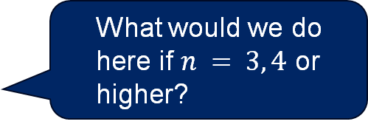
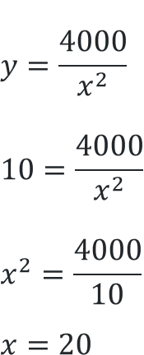
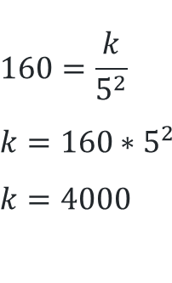
Inverse variation (worked example)
Example 1
The luminosity of a car light ($y$) varies inversely with the square of the distance ($x$), such that when a car is 5 metres away from a sign, the luminosity of the sign is 160 lux. The equation is shown below:
$$y=\frac{k}{x^{2}}$$
A sign should be comfortable to read at 10 lux. At what distance would this be?
$$160=\frac{k}{5^{2}}$$
$$k=160∗5^{2}$$
$$k=4000$$
$$y=\frac{4000}{x^{2}} \\ 10=\frac{4000}{x^{2}} \\ x^{2}=\frac{4000}{10} \\ x=20$$
What would we do here if $n = 3, 4$ or higher?
How did we know to do this step first?
Why was $x = −20$ not given as part of this solution?

Slide 14
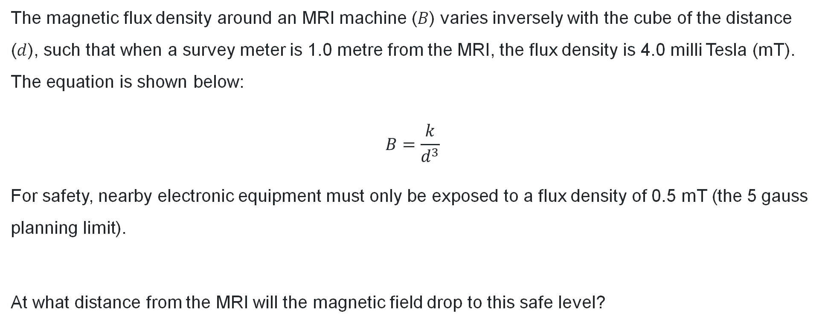
Inverse variation (your turn)
Your turn – Question 1
The magnetic flux density around an MRI machine ($B$) varies inversely with the cube of the distance ($d$), such that when a survey meter is 1.0 metre from the MRI, the flux density is 4.0 milli Tesla (mT). The equation is shown below:
$$B=\frac{k}{d^{3}}$$
For safety, nearby electronic equipment must only be exposed to a flux density of 0.5 mT (the 5 gauss planning limit).
At what distance from the MRI will the magnetic field drop to this safe level?

Slide 15
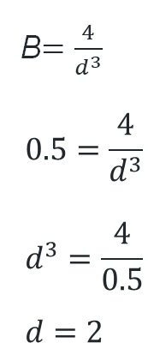

Inverse variation (your turn – solutions)
Your turn – Question 1
Objects need to be 2 metres away from the MRI machine.
$$4=\frac{k}{1^{2}}$$
$$k=4$$
$$k=4$$
B$=\frac{4}{d^{3}}$
$$0.5=\frac{4}{d^{3}} \\ d^{3}=\frac{4}{0.5} \\ d=2$$

Slide 16
Independent practice

Slide 17

Approaching questions scaffold

Slide 18
Sample marking criteria
Appendix C – part a and b
Part a
Part b
Criteria | Mark
Provides correct solution | 2
Writes down an equation representing inverse variation, or equivalent merit | 1
Criteria | Mark
Provides correct solution | 2
Completes the table, or equivalent merit | 1

Slide 19
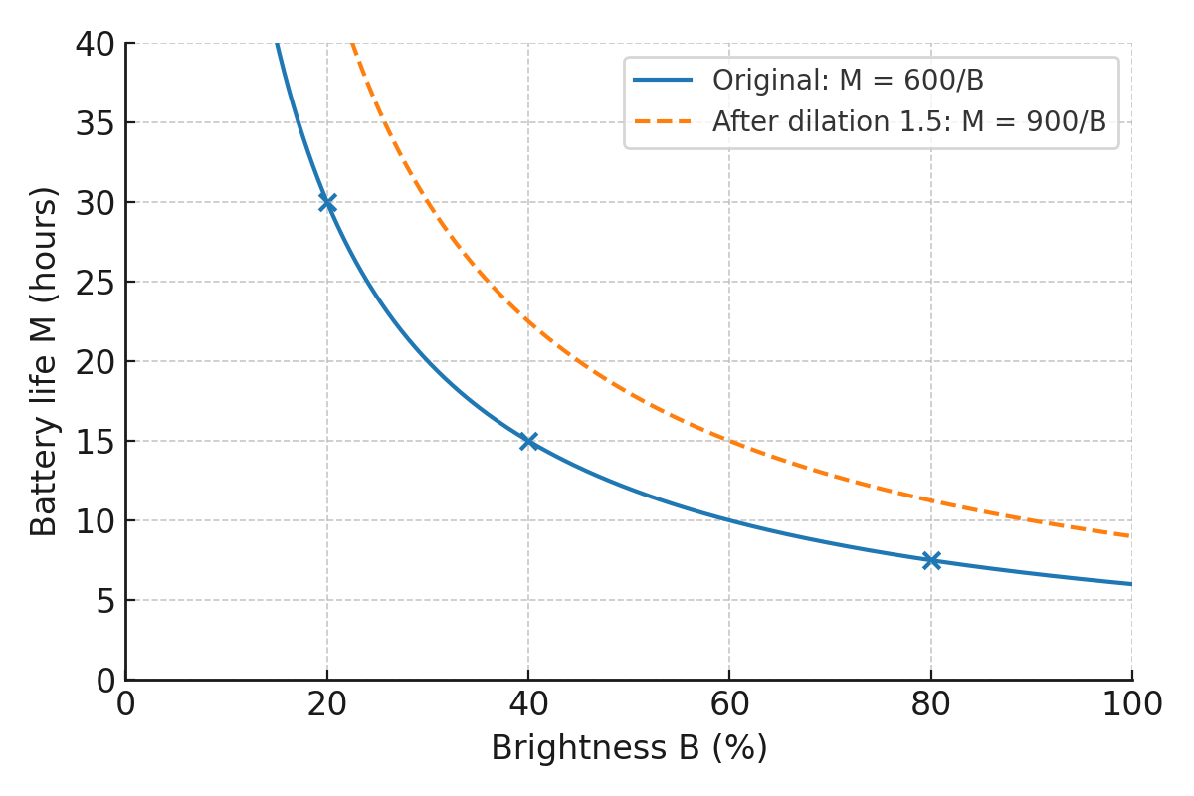
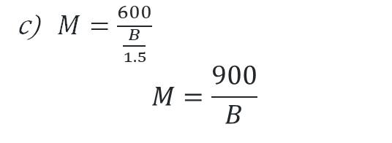
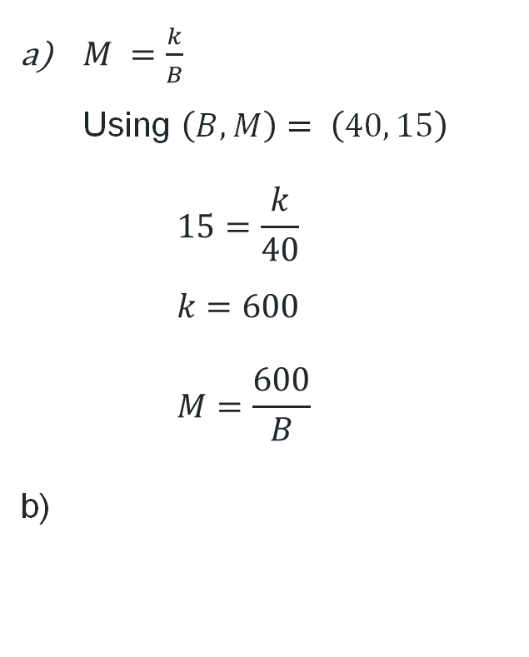
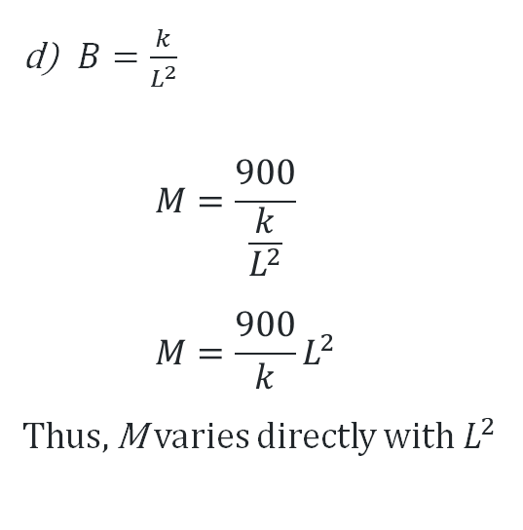
Solutions
$M =\frac{k}{B}$
Using $\left(B, M\right)= \left(40, 15\right)$
$15=\frac{k}{40}$
$k=600$
$M=\frac{600}{B}$
$M=\frac{600}{\frac{B}{1.5}}$
$M=\frac{900}{B}$
$B=\frac{k}{L^{2}}$
$M=\frac{900}{\frac{k}{L^{2}}}$
$M=\frac{900}{k}L^{2}$
Thus, M varies directly with $L^{2}$
B | 20 | 40 | 80
M | 30 | 15 | 7.5

Slide 20
References
This presentation contains NSW Curriculum and syllabus content. The NSW Curriculum is developed by the NSW Education Standards Authority. This content is prepared by NESA for and on behalf of the Crown in the right of the State of New South Wales. The material is protected by Crown copyright.
Please refer to the NESA Copyright Disclaimer for more information https://educationstandards.nsw.edu.au/wps/portal/nesa/mini-footer/copyright.
NESA holds the only official and up-to-date versions of the NSW Curriculum and syllabus documents. Please visit the NSW Education Standards Authority (NESA) website https://educationstandards.nsw.edu.au/wps/portal/nesa/home and the NSW Curriculum website https://curriculum.nsw.edu.au.
Mathematics Advanced 11–12 Syllabus © NSW Education Standards Authority (NESA) for and on behalf of the Crown in right of the State of New South Wales, 2024.

Slide 21
Copyright
© State of New South Wales (Department of Education), 2025
The copyright material published in this resource is subject to the Copyright Act 1968 (Cth) and is owned by the NSW Department of Education or, where indicated, by a party other than the NSW Department of Education (third-party material).
Copyright material available in this resource and owned by the NSW Department of Education is licensed under a Creative Commons Attribution 4.0 International (CC BY 4.0) license.
This license allows you to share and adapt the material for any purpose, even commercially.
Attribution should be given to © State of New South Wales (Department of Education), 2025.
Material in this resource not available under a Creative Commons license:
the NSW Department of Education logo, other logos and trademark-protected material
Material owned by a third party that has been reproduced with permission. You will need to obtain permission from the third party to reuse its material.
Links to third-party material and websites
Please note that the provided (reading/viewing material/list/links/texts) are a suggestion only and implies no endorsement, by the New South Wales Department of Education, of any author, publisher, or book title. School principals and teachers are best placed to assess the suitability of resources that would complement the curriculum and reflect the needs and interests of their students.
If you use the links provided in this document to access a third-party’s website, you acknowledge that the terms of use, including licence terms set out on the third-party’s website apply to the use which may be made of the materials on that third-party website or where permitted by the Copyright Act 1968 (Cth). The department accepts no responsibility for content on third-party websites.

