Slide 1

Direct variation
Mathematics Advanced – Stage 6 (Year 11)
Unit 4 – graphing transformations

Slide 2
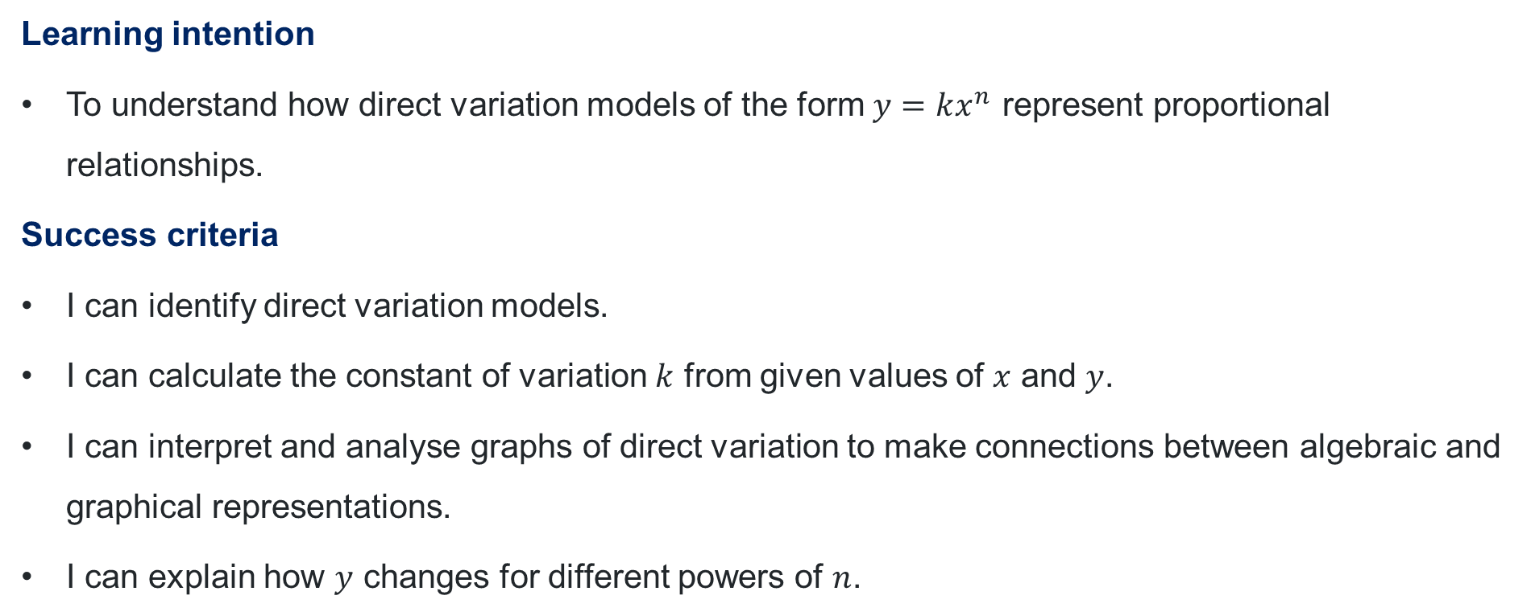
Learning intentions and success criteria
Learning intention
To understand how direct variation models of the form $y=kx^{n}$ represent proportional relationships.
Success criteria
I can identify direct variation models.
I can calculate the constant of variation $k$ from given values of $x$ and $y$.
I can interpret and analyse graphs of direct variation to make connections between algebraic and graphical representations.
I can explain how $y$ changes for different powers of $n$.
Notes:
Notes for teachers:
Learning intentions and success criteria are best co-constructed with students. Adapt the learning intention as required and add matching success criteria.
For more information See ⁠AITSL or the NSW Department of Education explicit teaching strategies, ⁠Sharing learning intentions and ⁠Sharing success criteria
LISC is not necessarily presented at the beginning of the lesson. Teacher needs to consider most effectual time to introduce
LISC should be revisited during the lesson to support students' evaluation of their learning

Slide 3
Activating prior knowledge

Slide 4
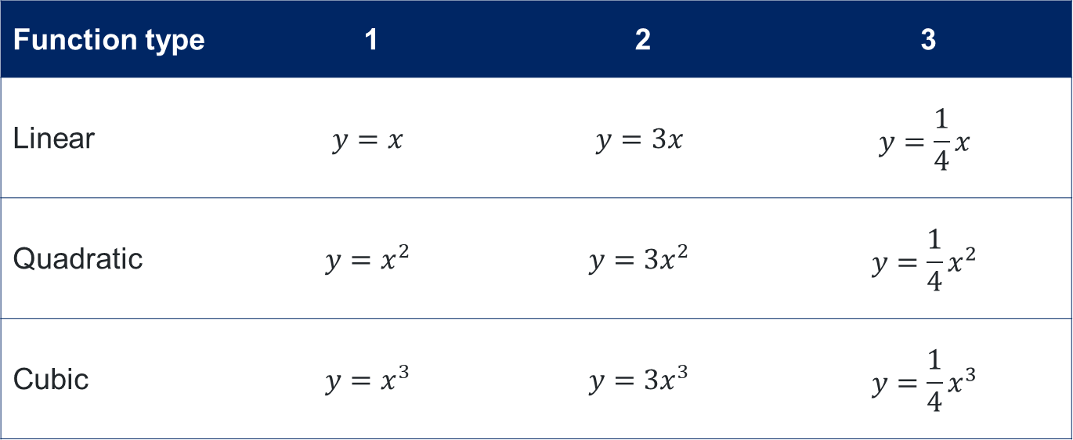
Activating prior knowledge activity
Linear, quadratic and cubic functions
For each function type (linear, quadratic and cubic), sketch the three given equations on the same set of axes. Clearly label each graph.
Function type | 1 | 2 | 3
Linear | $$y=x$$ | $$y=3x$$ | $$y=\frac{1}{4}x$$
Quadratic | $$y=x^{2}$$ | $$y=3x^{2}$$ | $$y=\frac{1}{4}x^{2}$$
Cubic | $$y=x^{3}$$ | $$y=3x^{3}$$ | $$y=\frac{1}{4}x^{3}$$
Describe the transformation that has occurred.
How does this transformation affect the linear, quadratic, and cubic functions? Is the effect similar for all three?

Slide 5
Connecting learning

Slide 6
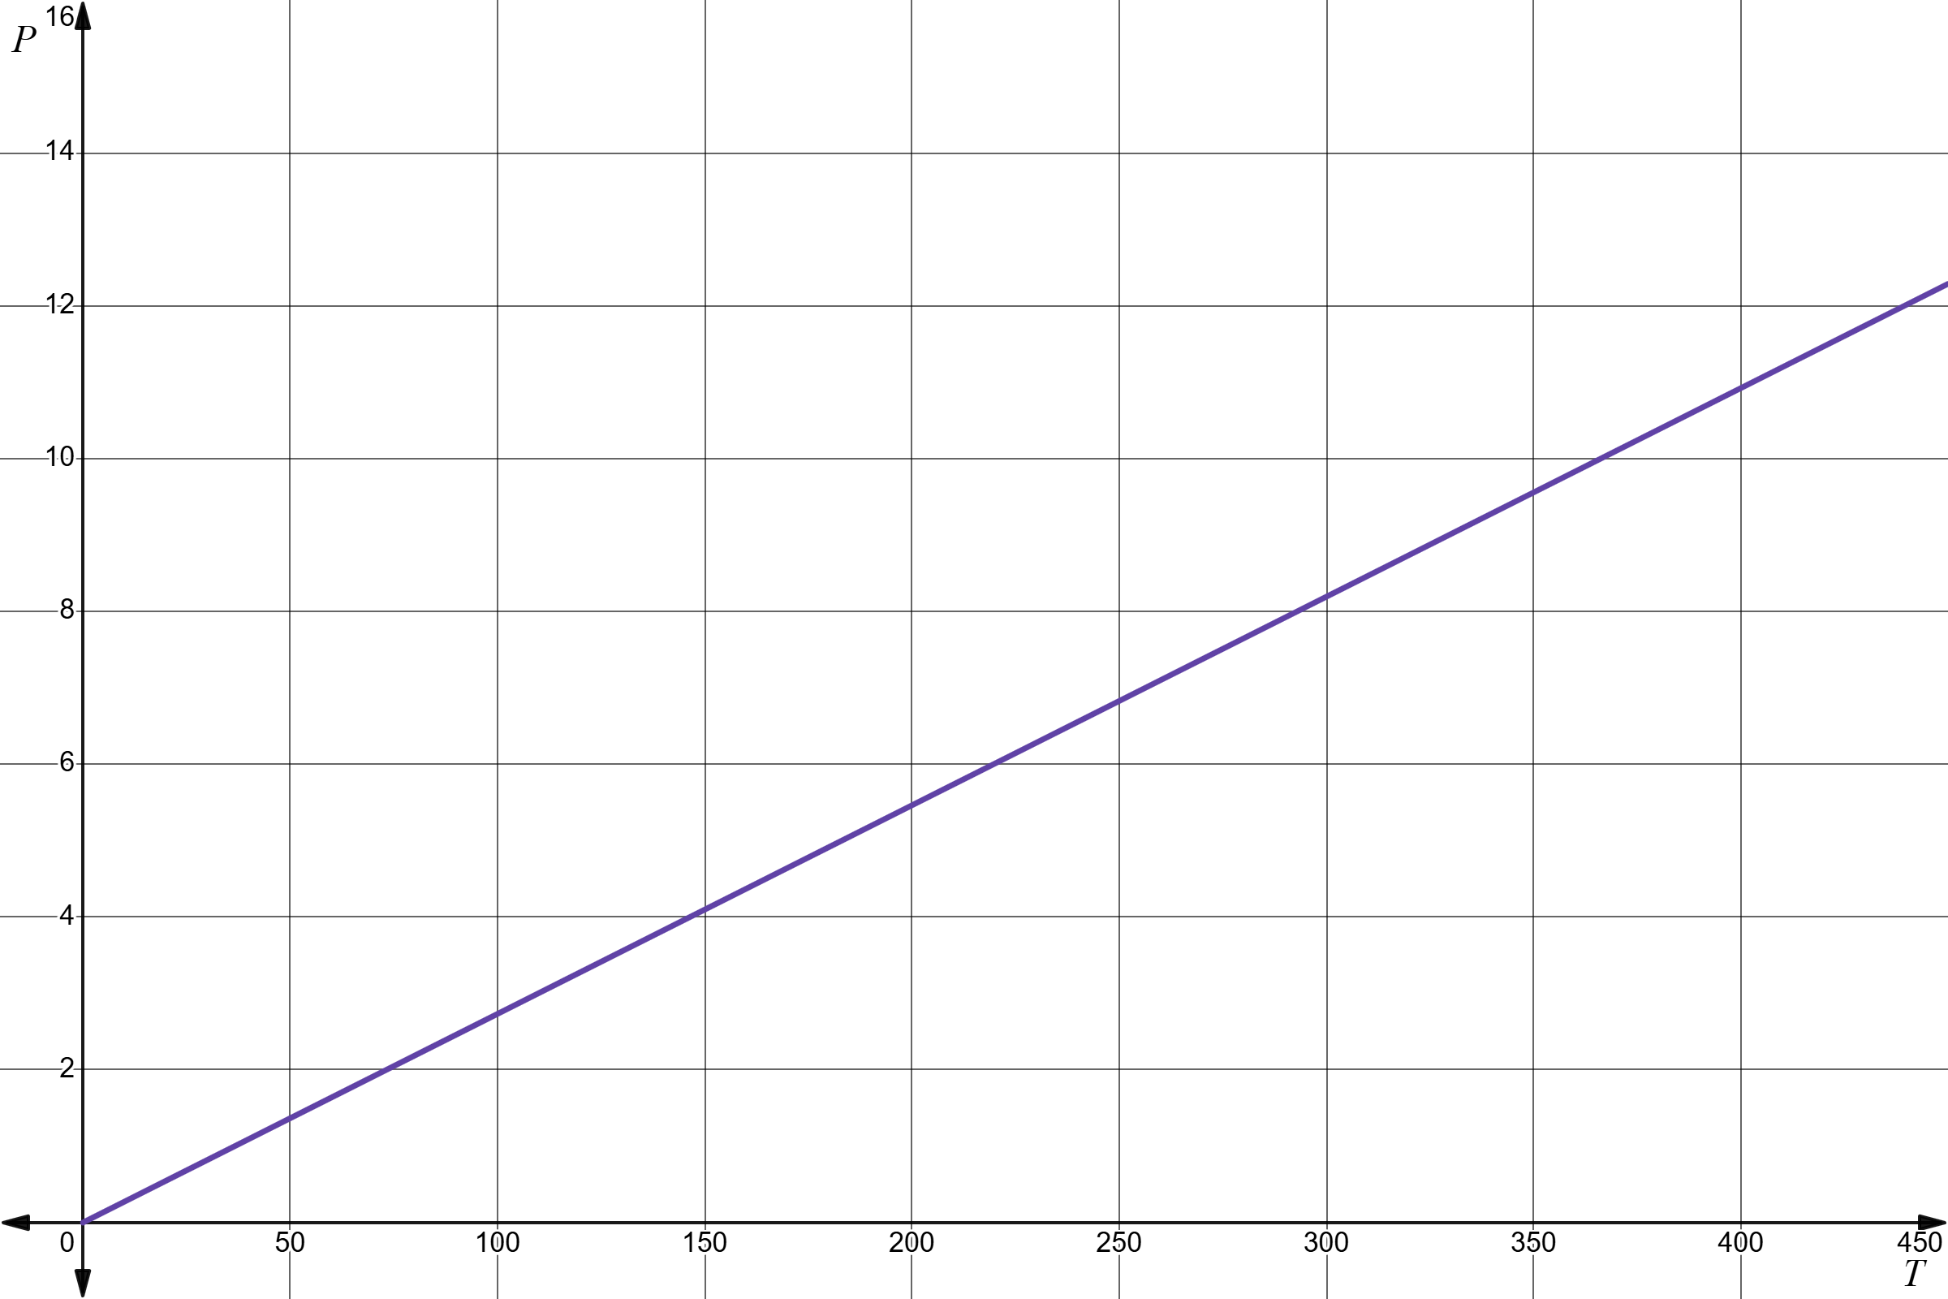
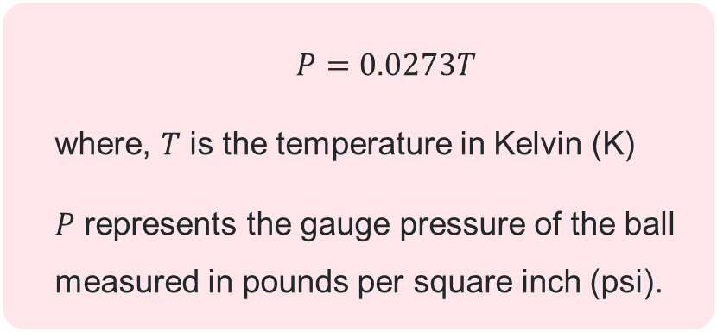
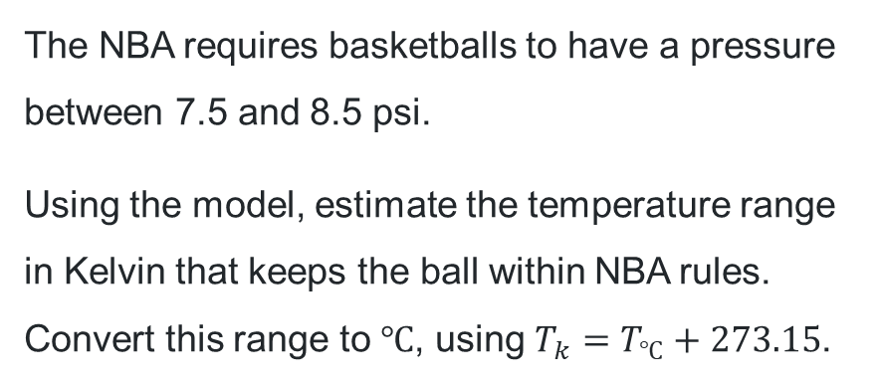
Basketball model
$$P=0.0273T$$
where, $T$ is the temperature in Kelvin (K)
$P$ represents the gauge pressure of the ball measured in pounds per square inch (psi).
The NBA requires basketballs to have a pressure between 7.5 and 8.5 psi.
Using the model, estimate the temperature range in Kelvin that keeps the ball within NBA rules. Convert this range to $℃$, using $T_{k}=T_{℃}+273.15$.

Slide 7
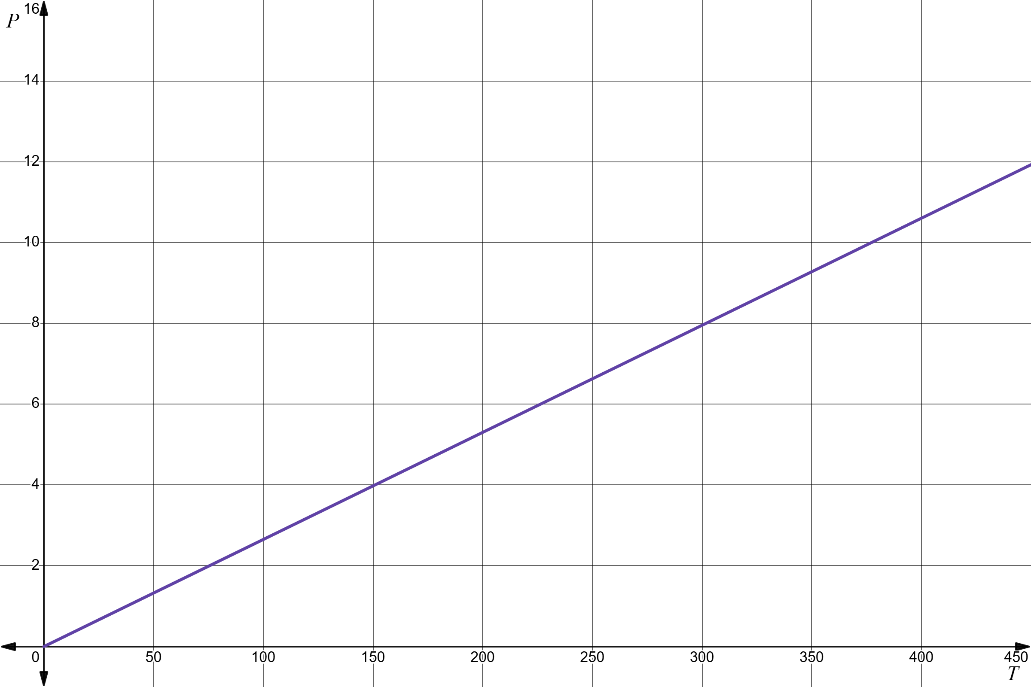
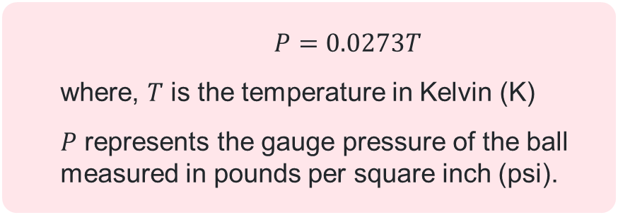
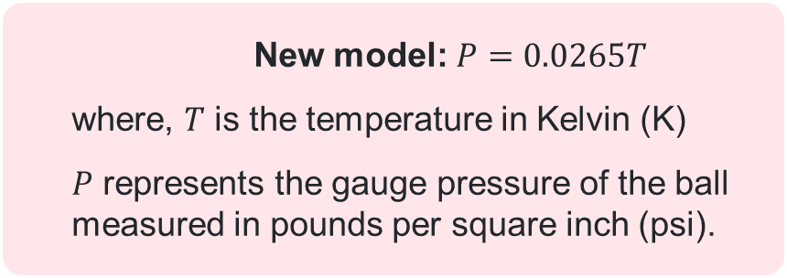
Comparing models
$$P=0.0273T$$
where, $T$ is the temperature in Kelvin (K)
$P$ represents the gauge pressure of the ball measured in pounds per square inch (psi).
New model: $P=0.0265T$
where, $T$ is the temperature in Kelvin (K)
$P$ represents the gauge pressure of the ball measured in pounds per square inch (psi).

Slide 8
Direct variation definition
‘A proportional relationship where one quantity directly varies with respect to a change in another quantity. This implies that if there is an increase (or decrease) in one quantity then the other quantity will experience a proportionate increase (or decrease).’
(NESA 2024)

Slide 9
Releasing responsibility

Slide 10
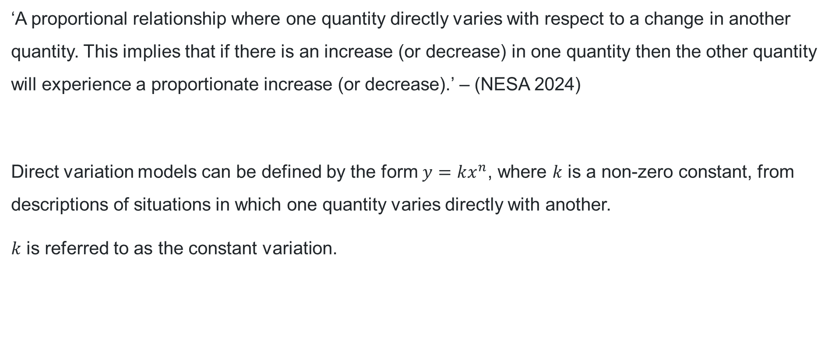
Direct variation equation
‘A proportional relationship where one quantity directly varies with respect to a change in another quantity. This implies that if there is an increase (or decrease) in one quantity then the other quantity will experience a proportionate increase (or decrease).’ – (NESA 2024)
Direct variation models can be defined by the form $y=kx^{n}$, where $k$ is a non-zero constant, from descriptions of situations in which one quantity varies directly with another.
$k$ is referred to as the constant variation.
Can you think of a real-world example where one quantity changes in direct proportion to another?
If you were to draw different direct variation models, what would the graphs look like? What features would all of them share?

Slide 11
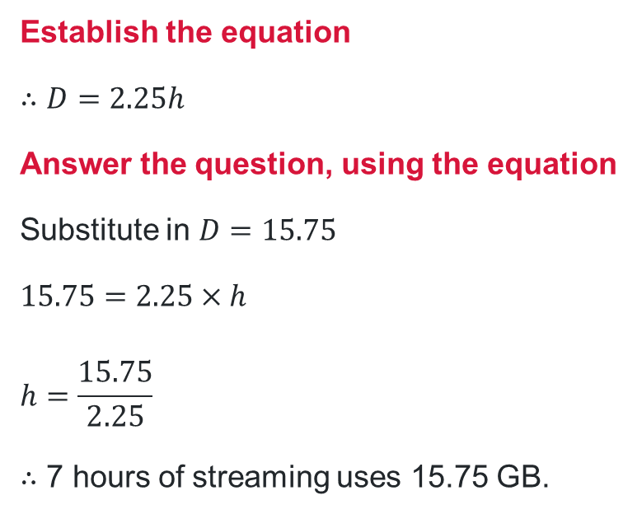

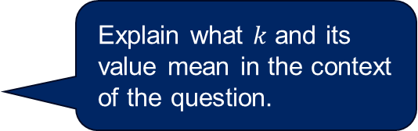
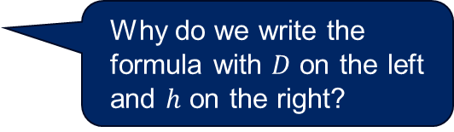
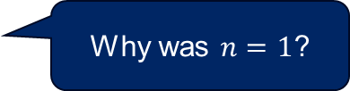
Direct variation problems (1)
Worked example 1
A student’s mobile data usage in GB, $D$, varies directly with the number of hours, $h$, spent streaming videos. 4 hours of streaming uses 9 GB of data. Determine the number of hours of streaming videos when 15.75 GB is used.
Identify the model
Direct variation model, $y=kx^{n}$
$$D=kh$$
Substitute in values to find $k$
When $D=9$, $h=4$
$$9=k×4$$
$$∴k=2.25$$
Establish the equation
$$∴D=2.25h$$
Answer the question, using the equation
Substitute in $D=15.75$
$$15.75=2.25×h$$
$$h=\frac{15.75}{2.25}$$
$∴$ 7 hours of streaming uses 15.75 GB.
Why was $n=1$?
Why do we write the formula with $D$ on the left and $h$ on the right?
Explain what $k$ and its value mean in the context of the question.

Slide 12
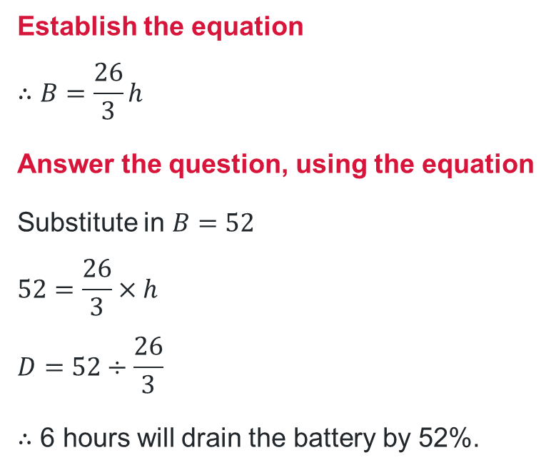
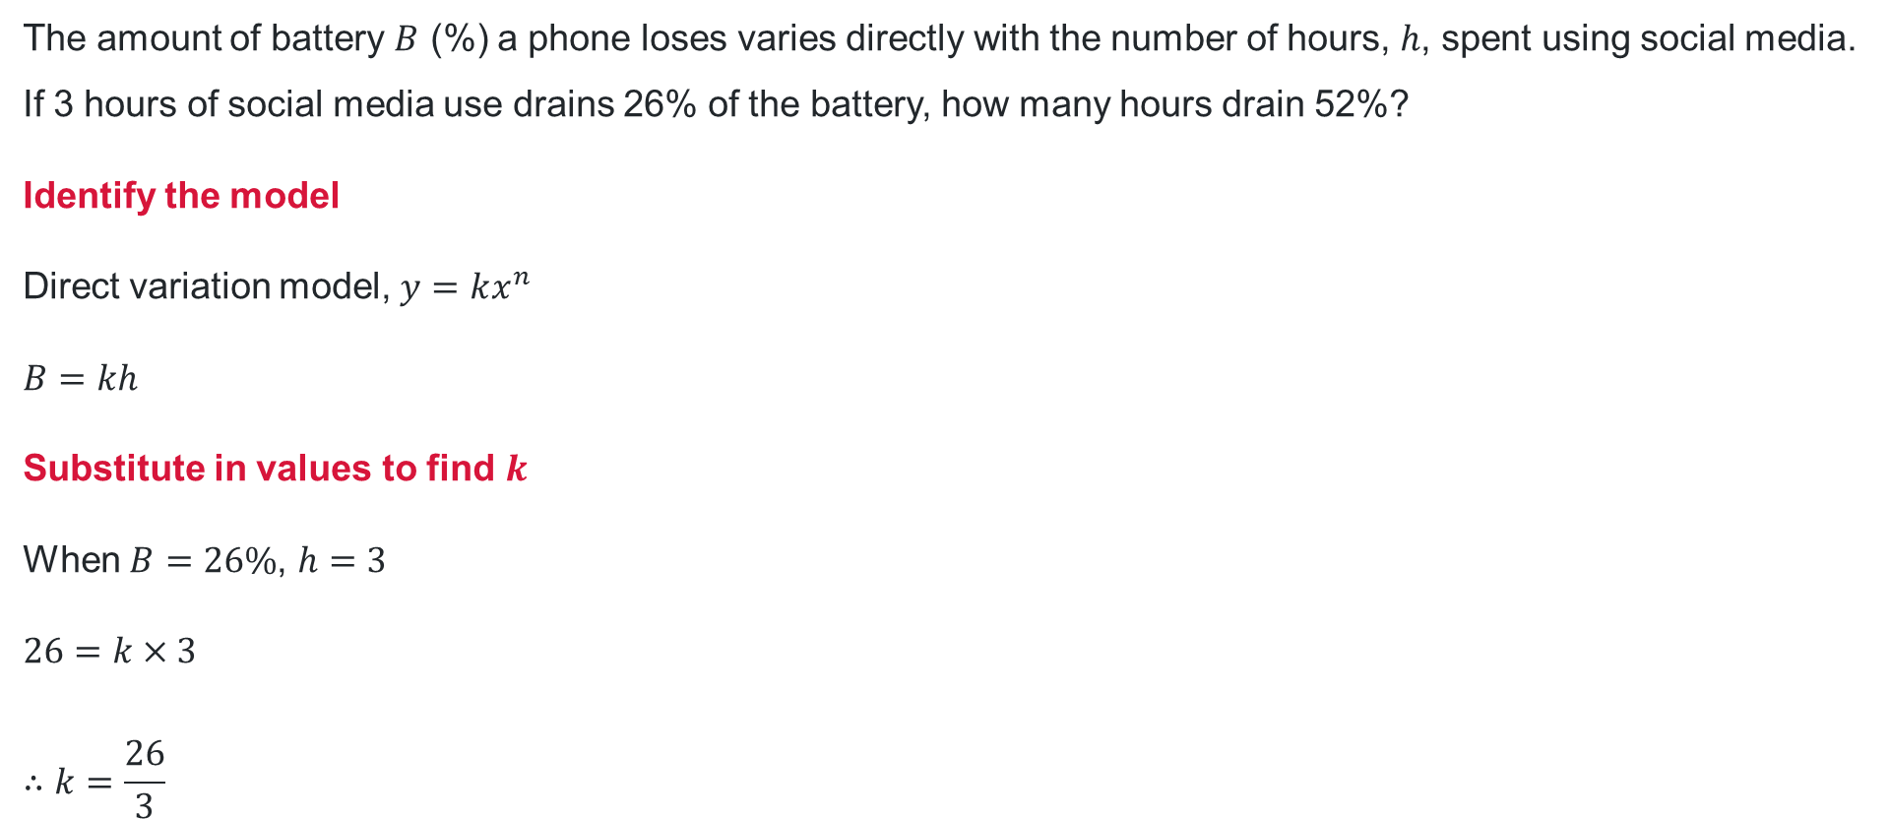
Direct variation problems (2)
Your turn – Question 1
The amount of battery $B$ (%) a phone loses varies directly with the number of hours, $h$, spent using social media. If 3 hours of social media use drains 26% of the battery, how many hours drain 52%?
Identify the model
Direct variation model, $y=kx^{n}$
$$B=kh$$
Substitute in values to find $k$
When $B=26\%$, $h=3$
$$26=k×3$$
$$∴k=\frac{26}{3}$$
Establish the equation
$$∴B=\frac{26}{3}h$$
Answer the question, using the equation
Substitute in $B=52$
$$52=\frac{26}{3}×h$$
$$D=52÷\frac{26}{3}$$
$∴$ 6 hours will drain the battery by 52%.

Slide 13
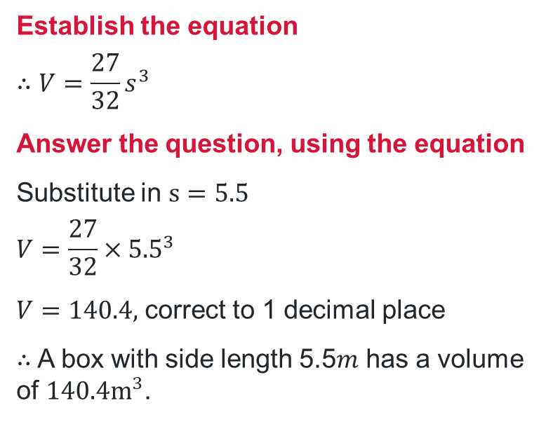
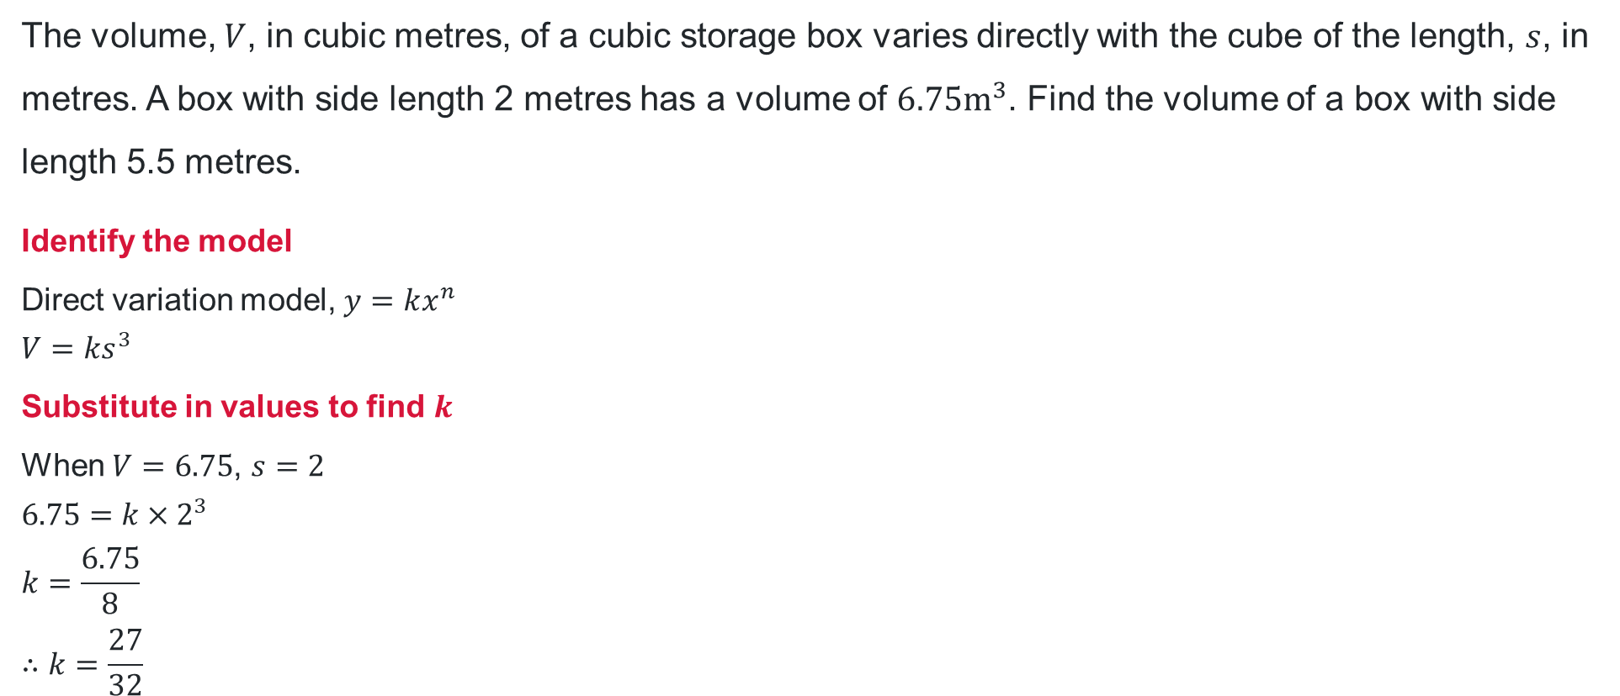
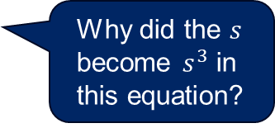
Direct variation problems (3)
Worked example 2
The volume, $V$, in cubic metres, of a cubic storage box varies directly with the cube of the length, $s$, in metres. A box with side length 2 metres has a volume of $6.75m^{3}$. Find the volume of a box with side length 5.5 metres.
Identify the model
Direct variation model, $y=kx^{n}$
$$V=ks^{3}$$
Substitute in values to find $k$
When $V=6.75$, $s=2$
$$6.75=k×2^{3}$$
$$k=\frac{6.75}{8}$$
$$∴k=\frac{27}{32}$$
Establish the equation
$$∴V=\frac{27}{32}s^{3}$$
Answer the question, using the equation
Substitute in $s=5.5$
$$V=\frac{27}{32}×{5.5}^{3}$$
$V=140.4,$ correct to 1 decimal place
$∴$ A box with side length 5.5$m$ has a volume of $140.4m^{3}$.
Why did the $s$ become $s^{3}$ in this equation?
How would this solution change if we were to determine the side length, given a volume?

Slide 14
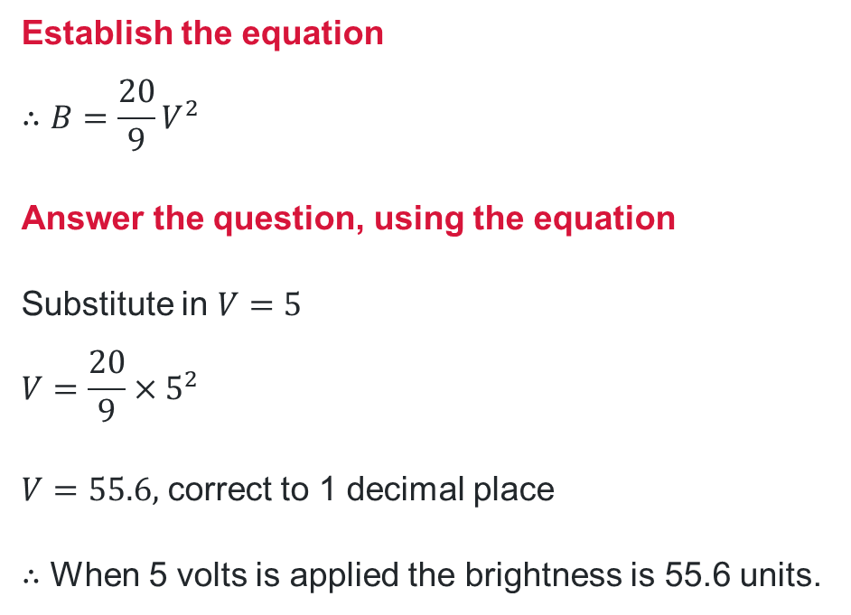
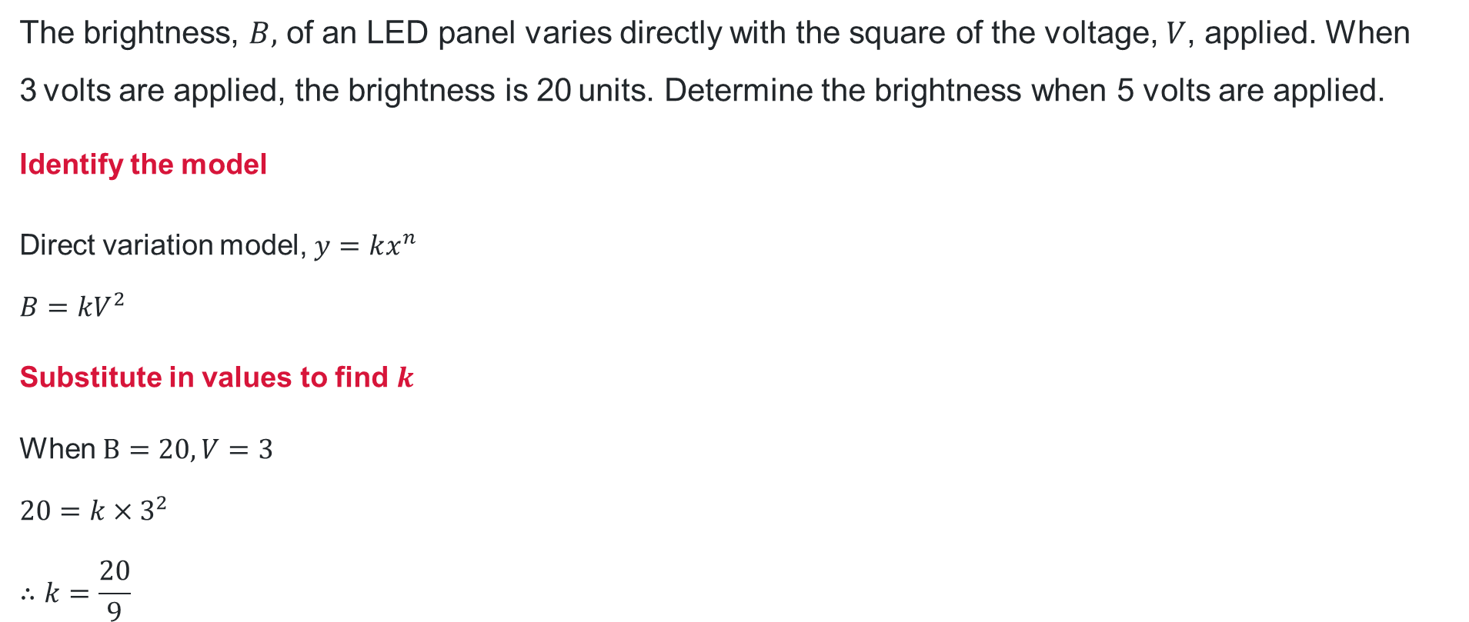
Direct variation problems (4)
Your turn – Question 2
The brightness, $B,$ of an LED panel varies directly with the square of the voltage, $V$, applied. When 3 volts are applied, the brightness is 20 units. Determine the brightness when 5 volts are applied.
Identify the model
Direct variation model, $y=kx^{n}$
$$B=kV^{2}$$
Substitute in values to find $k$
When $B=20, V=3$
$$20=k×3^{2}$$
$$∴k=\frac{20}{9}$$
Establish the equation
$$∴B=\frac{20}{9}V^{2}$$
Answer the question, using the equation
Substitute in $V=5$
$$V=\frac{20}{9}×5^{2}$$
$V=55.6,$ correct to 1 decimal place
$∴$ When 5 volts is applied the brightness is 55.6 units.

Slide 15
Independent practice

Slide 16

Direct variation comparison (1)
Problem 1
Consider the two direct variation models:
$$y=3x$$
$$y=3x^{2}$$
For each model, when $x$ doubles in value does $y$ also double in value? Why or why not?
What about for the direct variation model $y=3x^{3}$?
Can you identify the factor by which each model increases?

Slide 17
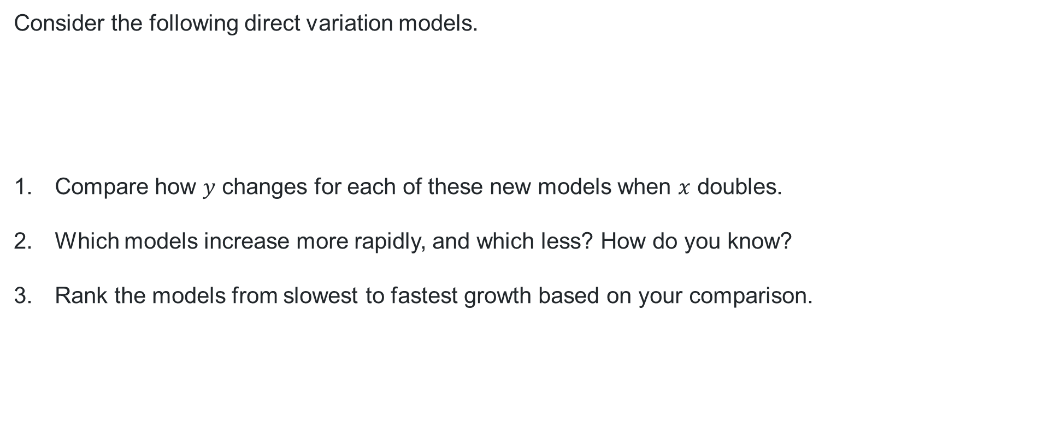
Direct variation comparison (2)
Problem 2
Consider the following direct variation models.
Compare how $y$ changes for each of these new models when $x$ doubles.
Which models increase more rapidly, and which less? How do you know?
Rank the models from slowest to fastest growth based on your comparison.
$$y=\frac{1}{4}x$$ | $$y=\frac{1}{4}x^{2}$$ | $$y=\frac{1}{4}x^{3}$$ | $$y=\frac{1}{4}x^{4}$$

Slide 18

Direct variation final problem (1)
Problem 3
A model gives the following:
When $x=2, y=18$ and when $x=6, y=1458$
Could this be a direct variation model of the form $y=kx^{n}$? Explain with relevant reasoning.

Slide 19



Direct variation final problem (2)
Problem 3 – solution
A model gives the following:
When $x=2, y=18$ and when $x=6, y=1458$
Could this be a direct variation model of the form $y=kx^{n}$? Explain with relevant reasoning.
$$18=k×2^{n}$$
$$1458=k×6^{n}$$
From 1 $k=\frac{18}{2^{n}}$
Sub into 2 $1454=\frac{12}{2^{n}}×6^{n}$
$$\frac{1454}{12}=\frac{6^{n}}{2^{n}}$$
$$81=\frac{6^{n}}{2^{n}}$$
$${\left(\frac{6}{2}\right)}^{n}=81$$
$$3^{n}=81$$
$81=3^{}$, guess and check
$$81=3^{4}$$
$$∴n=4$$
Sub into 1 $18=k×2^{4}$
$$k=\frac{18}{2^{4}}$$
$$∴k=\frac{9}{8}$$
Yes this could be a direction variation model, $y=\frac{9}{8}x^{4}$.
1
1
2
1
2

Slide 20
References
This presentation contains NSW Curriculum and syllabus content. The NSW Curriculum is developed by the NSW Education Standards Authority. This content is prepared by NESA for and on behalf of the Crown in the right of the State of New South Wales. The material is protected by Crown copyright.
Please refer to the NESA Copyright Disclaimer for more information https://educationstandards.nsw.edu.au/wps/portal/nesa/mini-footer/copyright.
NESA holds the only official and up-to-date versions of the NSW Curriculum and syllabus documents. Please visit the NSW Education Standards Authority (NESA) website https://educationstandards.nsw.edu.au/wps/portal/nesa/home and the NSW Curriculum website https://curriculum.nsw.edu.au.
Mathematics Advanced 11–12 Syllabus © NSW Education Standards Authority (NESA) for and on behalf of the Crown in right of the State of New South Wales, 2024.

Slide 21
Copyright
© State of New South Wales (Department of Education), 2025
The copyright material published in this resource is subject to the Copyright Act 1968 (Cth) and is owned by the NSW Department of Education or, where indicated, by a party other than the NSW Department of Education (third-party material).
Copyright material available in this resource and owned by the NSW Department of Education is licensed under a Creative Commons Attribution 4.0 International (CC BY 4.0) license.
This license allows you to share and adapt the material for any purpose, even commercially.
Attribution should be given to © State of New South Wales (Department of Education), 2025.
Material in this resource not available under a Creative Commons license:
the NSW Department of Education logo, other logos and trademark-protected material
Material owned by a third party that has been reproduced with permission. You will need to obtain permission from the third party to reuse its material.
Links to third-party material and websites
Please note that the provided (reading/viewing material/list/links/texts) are a suggestion only and implies no endorsement, by the New South Wales Department of Education, of any author, publisher, or book title. School principals and teachers are best placed to assess the suitability of resources that would complement the curriculum and reflect the needs and interests of their students.
If you use the links provided in this document to access a third-party’s website, you acknowledge that the terms of use, including licence terms set out on the third-party’s website apply to the use which may be made of the materials on that third-party website or where permitted by the Copyright Act 1968 (Cth). The department accepts no responsibility for content on third-party websites.

