Slide 1

Applying graphing transformations
Mathematics Advanced – Stage 6 (Year 11)
Unit 4 – graphing transformations

Slide 2
Learning intentions and success criteria
Learning intention
To be able to recognise and apply transformations to functions.
Success criteria
I can apply multiple transformations to graphs of functions.
I can describe the key features of the transformed graph.
I can identify the order and type of transformation applied to the equation of a graph.
Notes:
Notes for teachers:
Learning intentions and success criteria are best co-constructed with students. Adapt the learning intention as required and add matching success criteria.
For more information See ⁠AITSL or the NSW Department of Education explicit teaching strategies, ⁠Sharing learning intentions and ⁠Sharing success criteria
LISC is not necessarily presented at the beginning of the lesson. Teacher needs to consider most effectual time to introduce
LISC should be revisited during the lesson to support students' evaluation of their learning

Slide 3
Activating prior knowledge

Slide 4
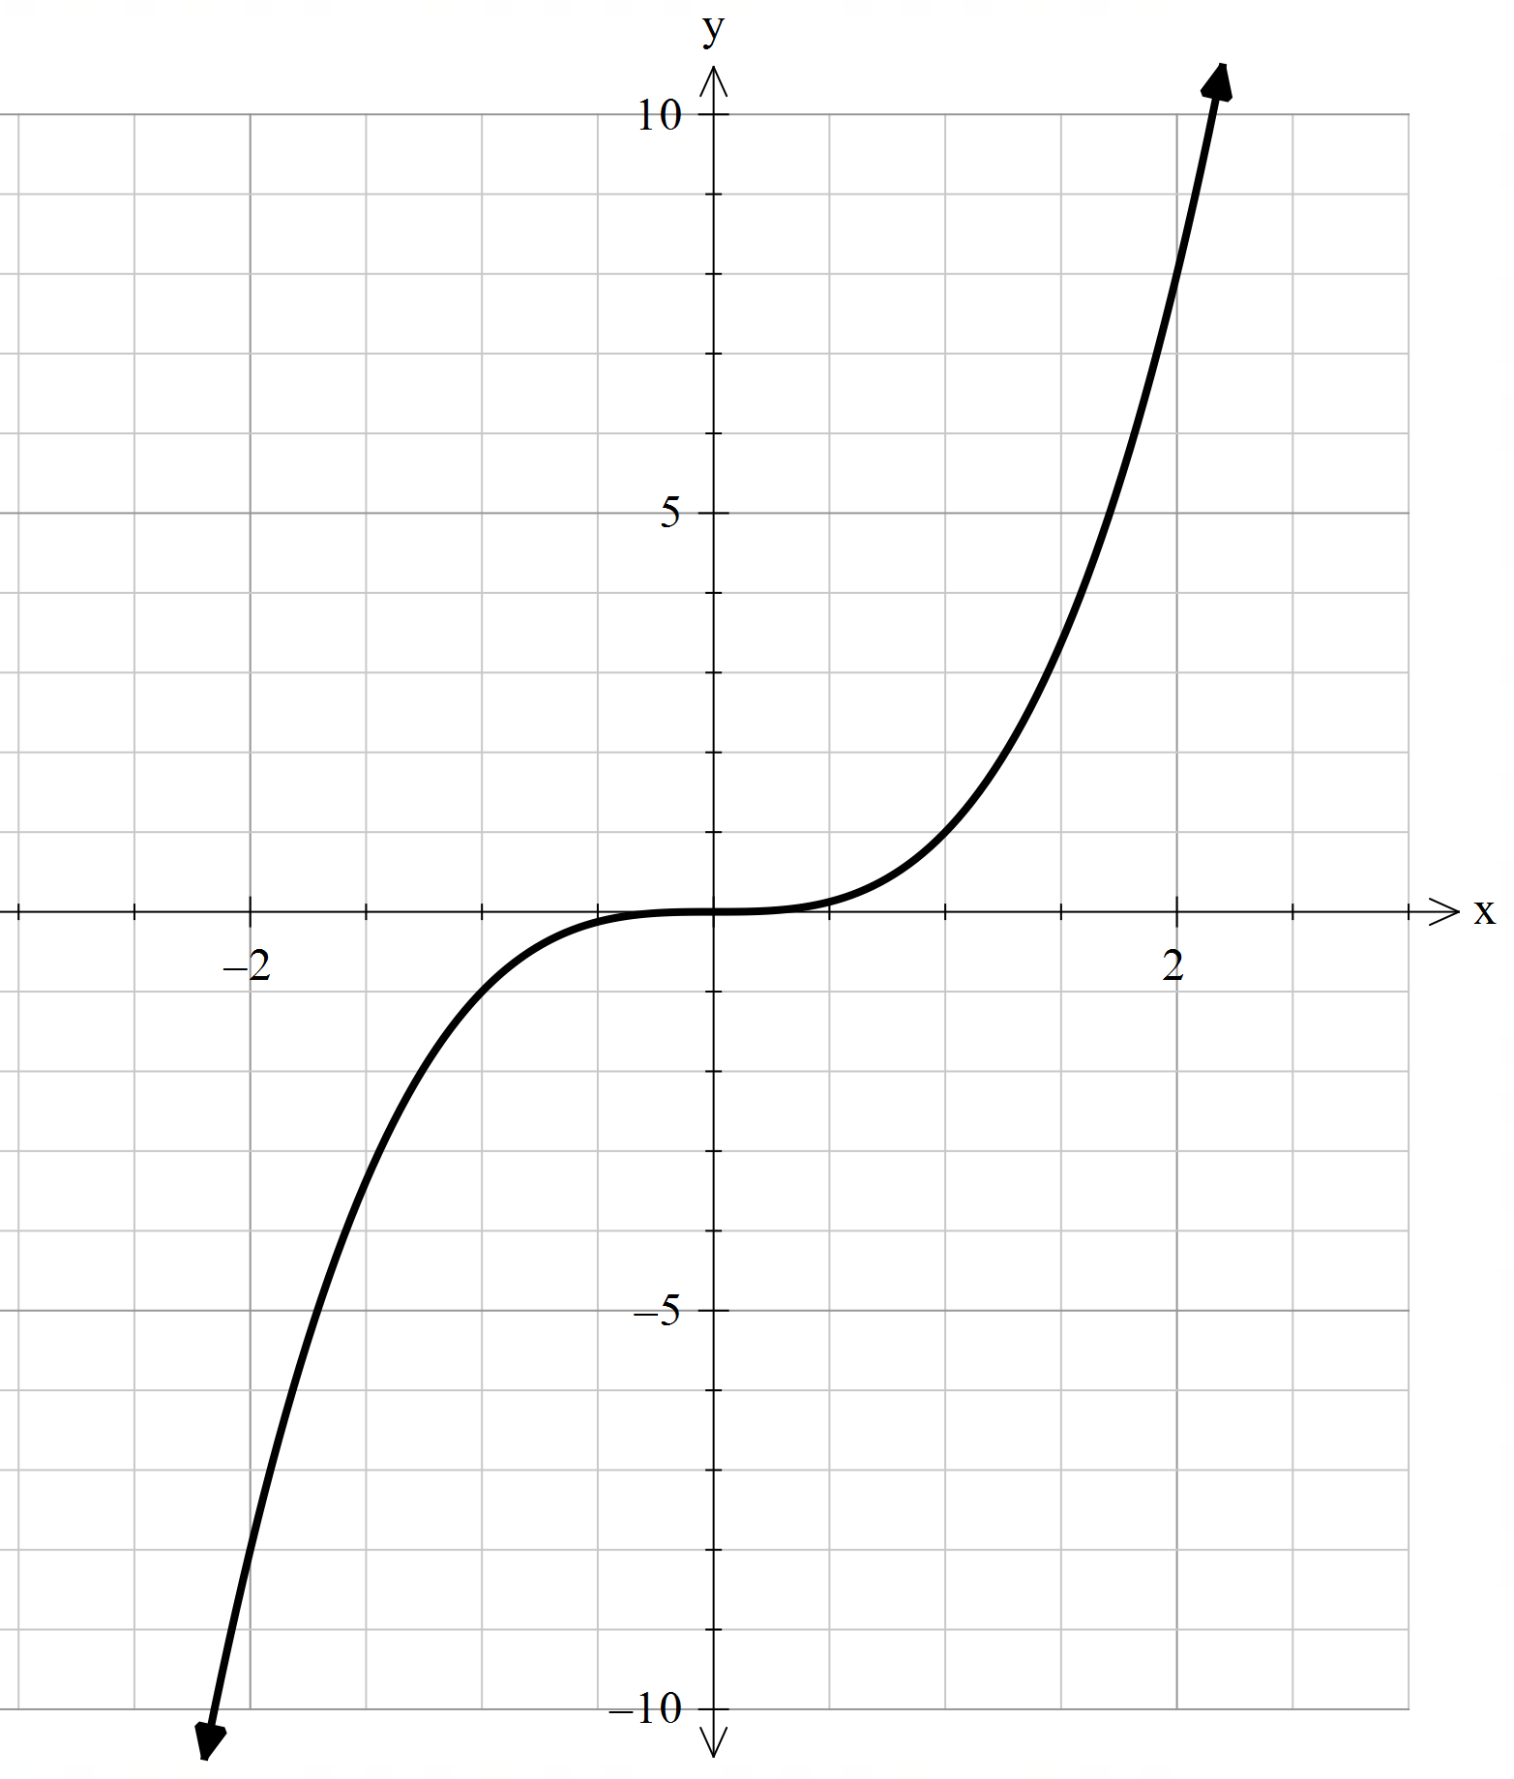
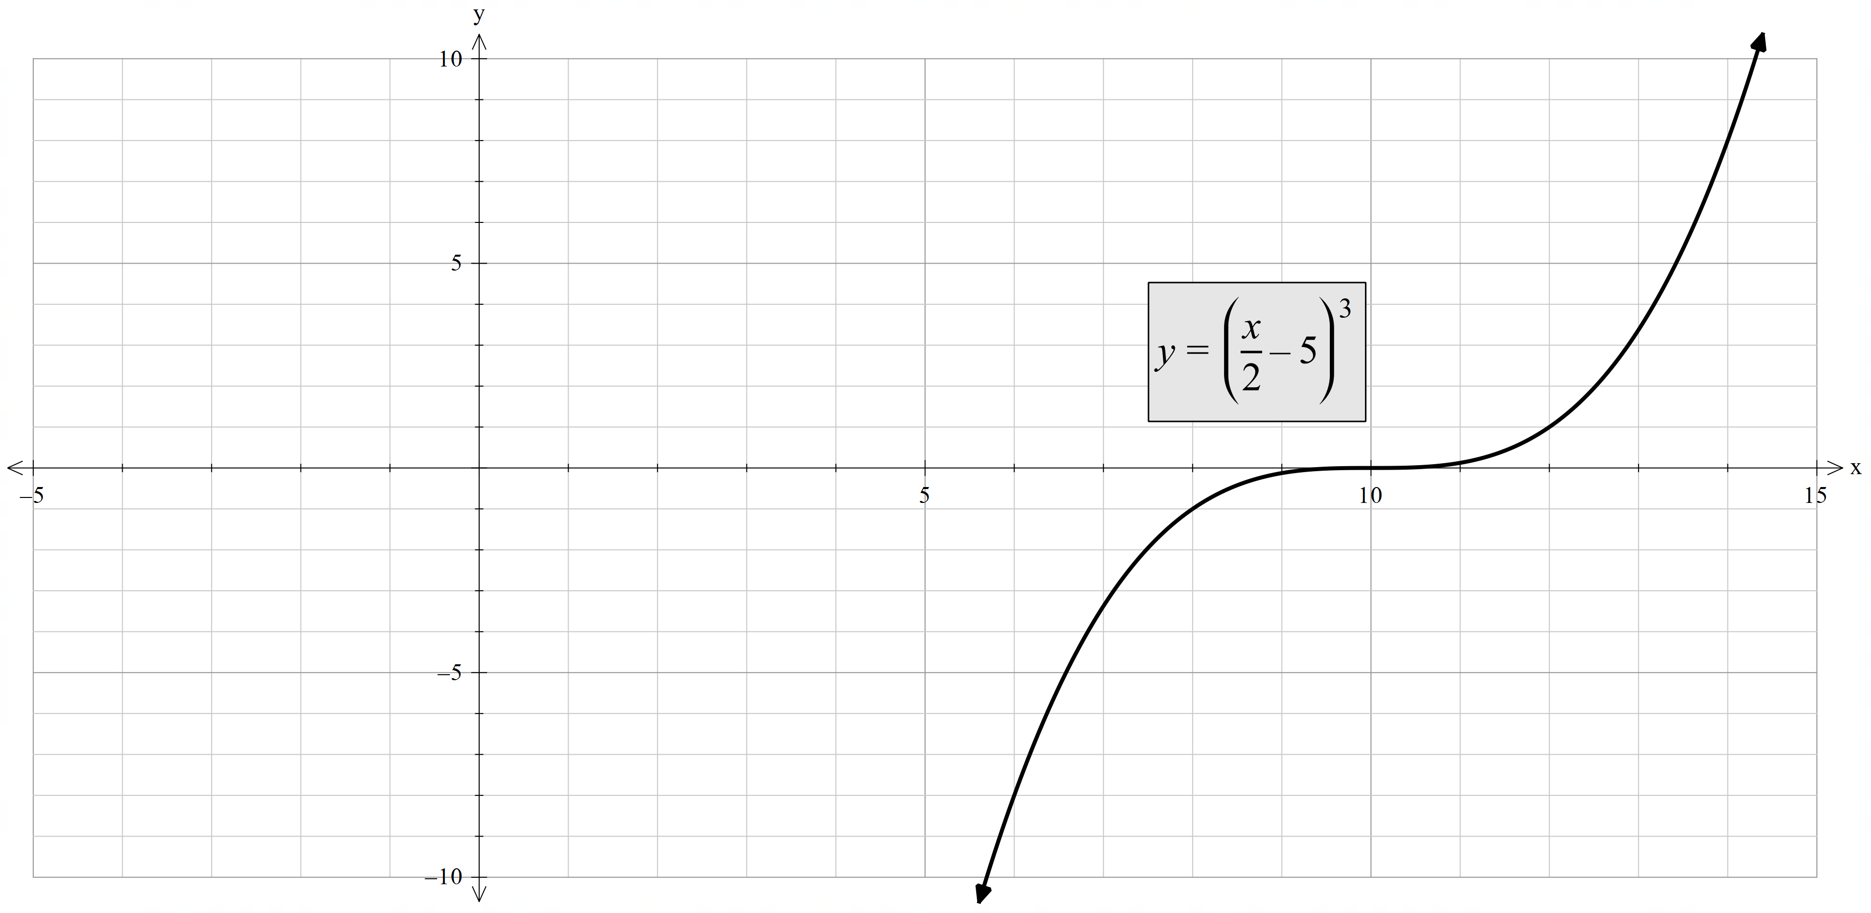
Transformation of $x^{3}$
Transform the graph by translating 5 units to the right and then dilating horizontally by a factor of 2.

Slide 5
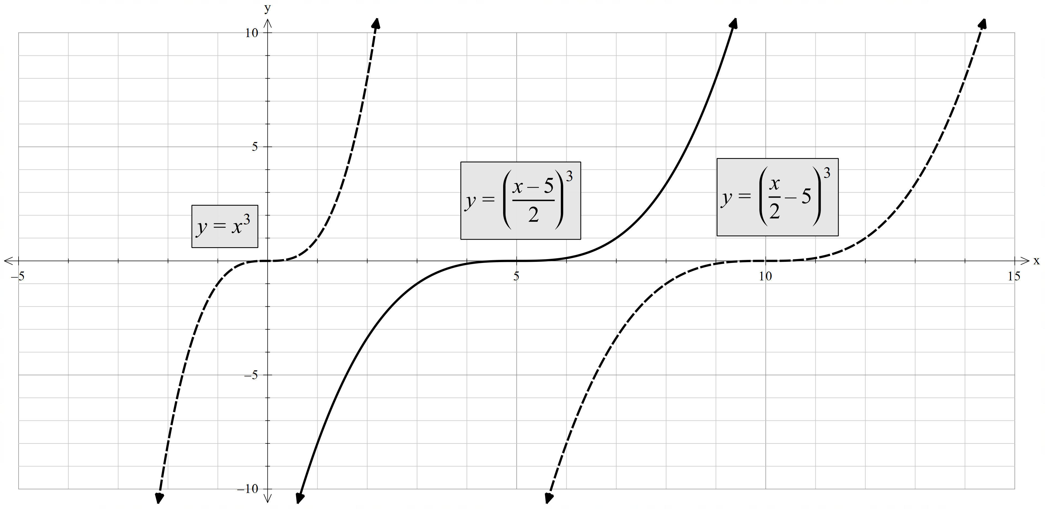
Transformation comparison

Slide 6
Connecting learning

Slide 7

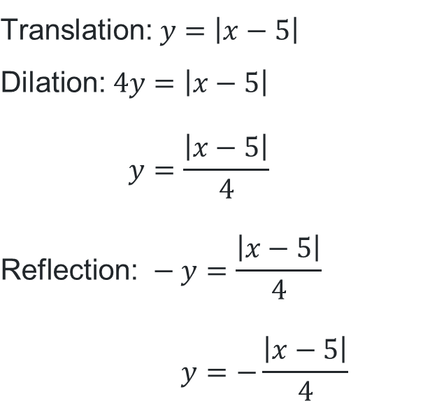

Applying transformations (1)
Worked example
For the function $y=|x|$, translate the function to the right by 5 units, then vertically dilate by a factor of 0.25 and then reflect across the $x$-axis. What is the transformed function?
$$\text{Translate}\text{: }x →x−5$$
$$\text{Vertically} \text{dilate}\text{: }y→\frac{y}{0.25}=4y$$
$$\text{Reflect} \text{across} x\text{−}\text{axis}: y→−y$$
$$\text{Translation}\text{:} y=\left|x−5\right|$$
$$\text{Dilation}\text{:} 4y=\left|x−5\right| \\ y=\frac{\left|x−5\right|}{4}$$
$$\text{Reflection}\text{: }−y=\frac{\left|x−5\right|}{4} \\ y=−\frac{\left|x−5\right|}{4}$$
Will the order of transformation matter?
Describe the dilation effect on the graph?

Slide 8
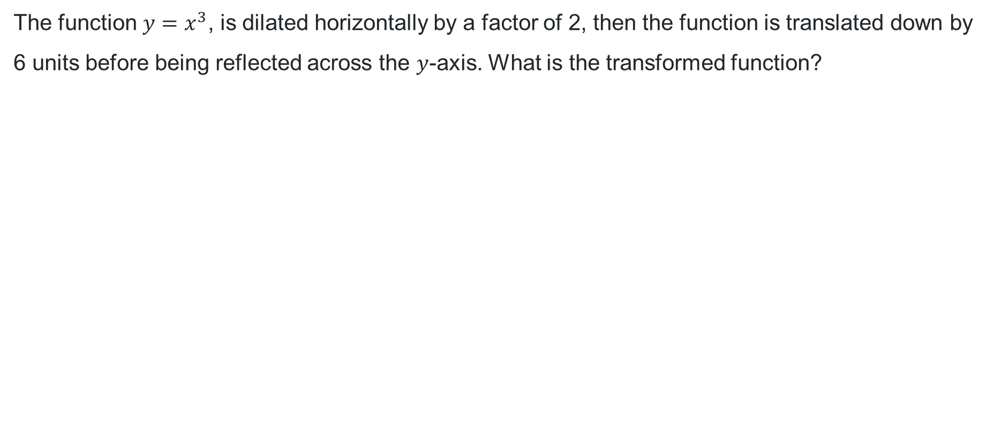



Applying transformations (2)
Your turn
The function $y=x^{3}$, is dilated horizontally by a factor of 2, then the function is translated down by 6 units before being reflected across the $y$-axis. What is the transformed function?
$$\text{Horizontal} \text{dilation}\text{: }x→\frac{x}{2}$$
$$\text{Translate}\text{: }y →y+6$$
$$\text{Reflect} \text{across} y\text{−}\text{axis}: x→−x$$
$$\text{Dilation}\text{:} y={\left(\frac{x}{2}\right)}^{3} \\ y=\frac{x^{3}}{8}$$
$$\text{Translation}\text{:} y+6=\frac{x^{3}}{8} \\ y=\frac{x^{3}}{8}−6$$
$$\text{Reflection}\text{: }y=\frac{{\left(−x\right)}^{3}}{8}−6 \\ y=−\frac{x^{3}}{8}−6$$

Slide 9




Applying transformations (3)
Worked example
For the function $y=\frac{1}{x}$, a translation of 4 units to the left is applied. It is then dilated horizontally by a factor of 0.4 before being reflected across the $y$-axis. What is the transformed function?
$$\text{Translate}\text{: }x→x+4$$
$$\text{Horizontal} \text{dilation}\text{: }x→\frac{x}{0.4}=\frac{5}{2}x$$
$$\text{Reflect} \text{across} y\text{−}\text{axis}:x→−x$$
$$\text{Translation}\text{:} y=\frac{1}{x+4}$$
$$\text{Dilation}\text{:} y=\frac{1}{\frac{5}{2}x+4} \\ y=\frac{2}{5x+8}$$
$$\text{Reflection}\text{: }y=\frac{2}{5\left(−x\right)+8} \\ y=\frac{2}{8−5x}$$
What are the asymptotes for this function? How were they affected by the transformation?
What would the function be if it was dilated before translated?

Slide 10




Applying transformations (4)
Your turn
The function $y=2^{x}$, is reflected across the $x$-axis before being vertically dilated by a factor of 0.125 and shifted 4 units up. What is the transformed function?
$$\text{Reflect} \text{across} x\text{−}\text{axis}:y→−y$$
$$\text{Vertically} \text{dilate}\text{: }y→\frac{y}{0.125}=8y$$
$$\text{Translate}\text{: }y →y−4$$
$$\text{Reflection}\text{: }−y=2^{x} \\ y=−2^{x}$$
$$\text{Dilation}\text{:} 8y=−2^{x} \\ y=−\frac{2^{x}}{8}$$
$$\text{Translation}\text{:} y−4=−\frac{2^{x}}{8} \\ y=4−\frac{2^{x}}{8}$$

Slide 11
Independent practice

Slide 12
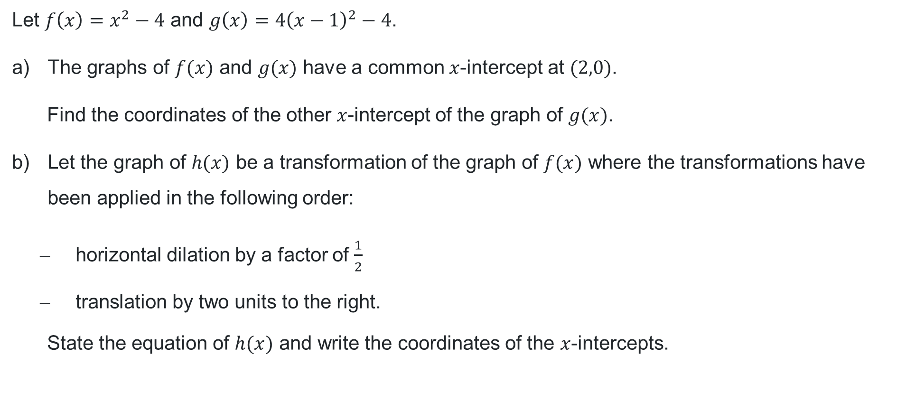
HSC-style question
Let $f\left(x\right)=x^{2}−4$ and $g\left(x\right)=4{\left(x−1\right)}^{2}−4$.
The graphs of $f(x)$ and $g(x)$ have a common $x$-intercept at $(2,0)$.
Find the coordinates of the other $x$-intercept of the graph of $g(x)$.
Let the graph of $h(x)$ be a transformation of the graph of $f(x)$ where the transformations have been applied in the following order:
        horizontal dilation by a factor of $\frac{1}{2}$
        translation by two units to the right.
      State the equation of $h(x)$ and write the coordinates of the $x$-intercepts.

Slide 13

Approaching questions scaffold

Slide 14

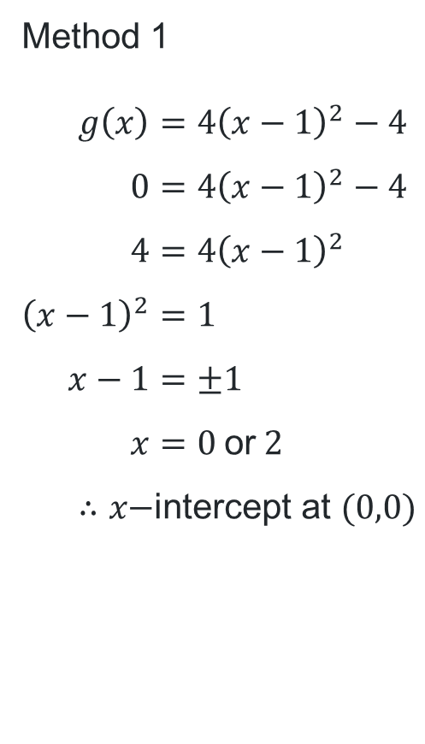
Worked solution to part a
Method 1
$$g\left(x\right)=4{\left(x−1\right)}^{2}−4 \\ 0=4{\left(x−1\right)}^{2}−4 \\ 4=4{\left(x−1\right)}^{2} \\ {\left(x−1\right)}^{2}=1 \\ x−1=±1 \\ x=0 \text{or} 2 \\ ∴x\text{−}\text{intercept} \text{at} (0,0)$$
Method 2
$$g\left(x\right)=4{\left(x−1\right)}^{2}−4 \text{is} \text{a} \text{parabola} \text{with} \text{vertex} \text{at} \left(1,−4\right) \\ \text{Since} \left(2,0\right) \text{is} \text{an} \text{intercept} \text{and} \text{intercepts} \text{are} \text{symmetrical} \text{around} \\ \text{vertex}, ∴\left(0,0\right) \text{is} \text{the} \text{second} \text{intercept}.$$

Slide 15
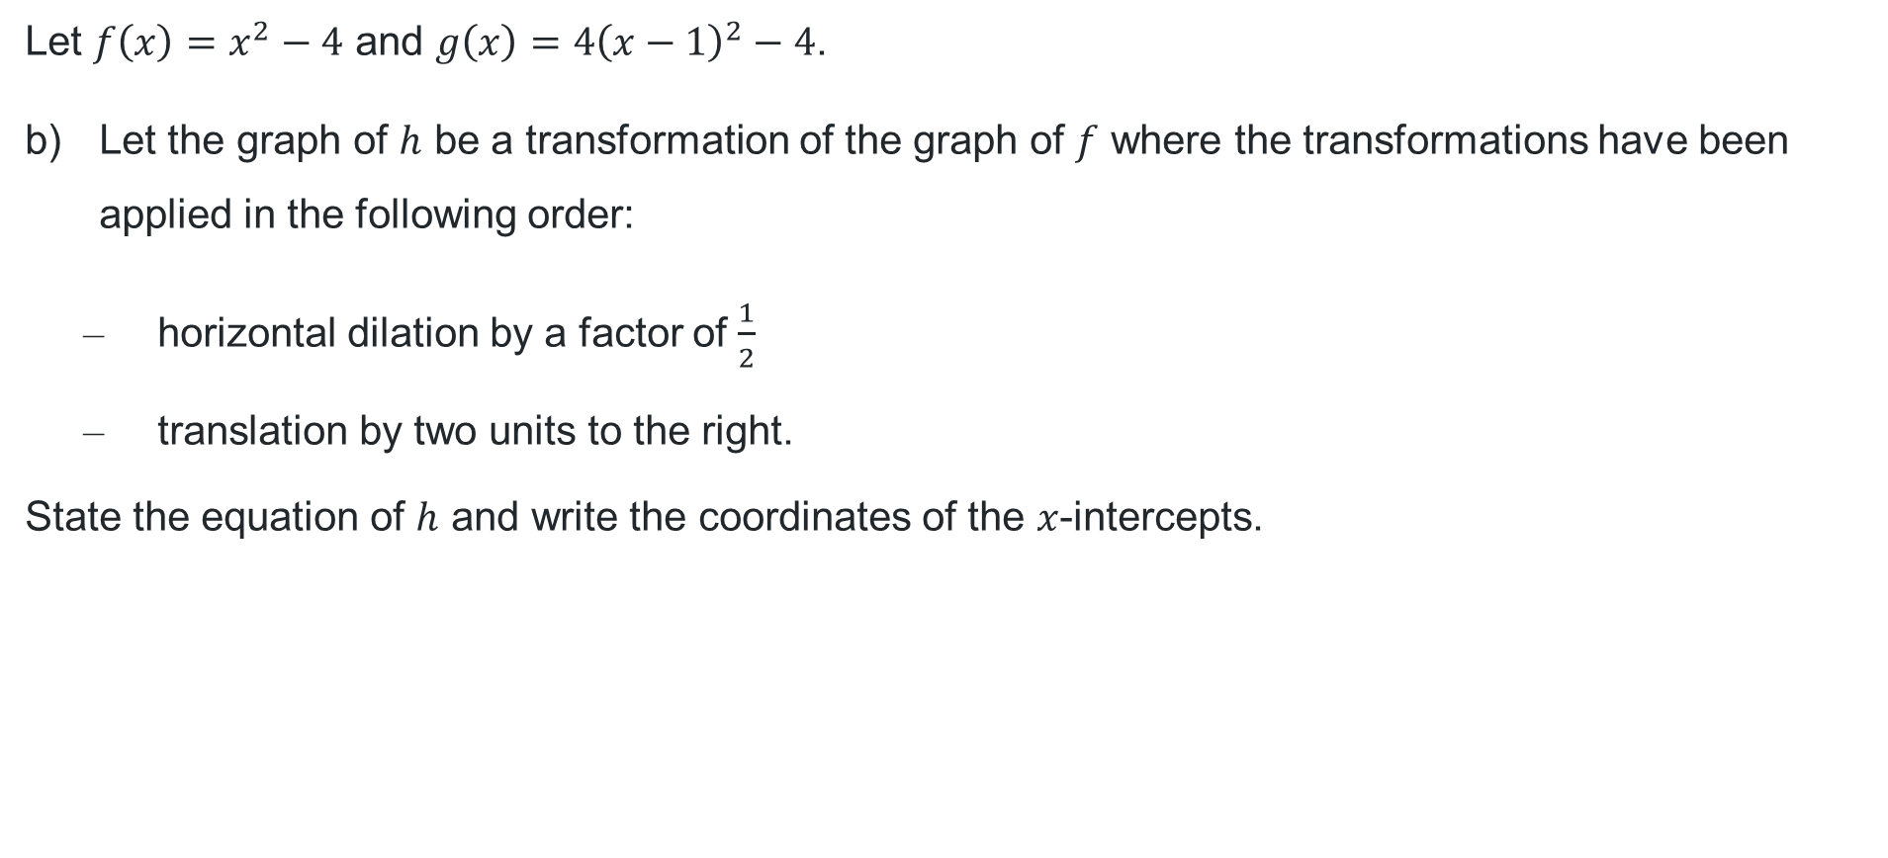
HSC style question part b
Let $f\left(x\right)=x^{2}−4$ and $g\left(x\right)=4{\left(x−1\right)}^{2}−4$.
Let the graph of $h$ be a transformation of the graph of $f$ where the transformations have been applied in the following order:
        horizontal dilation by a factor of $\frac{1}{2}$
        translation by two units to the right.
      State the equation of $h$ and write the coordinates of the $x$-intercepts.

Slide 16
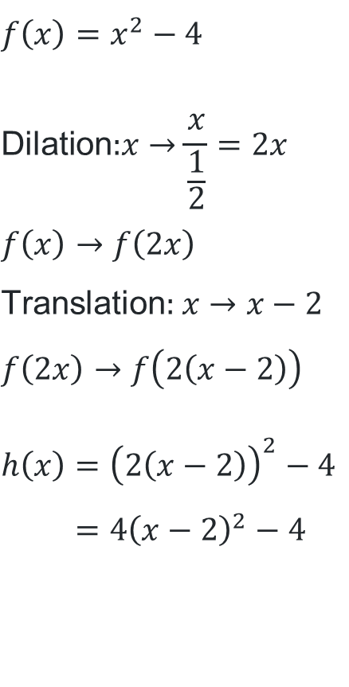
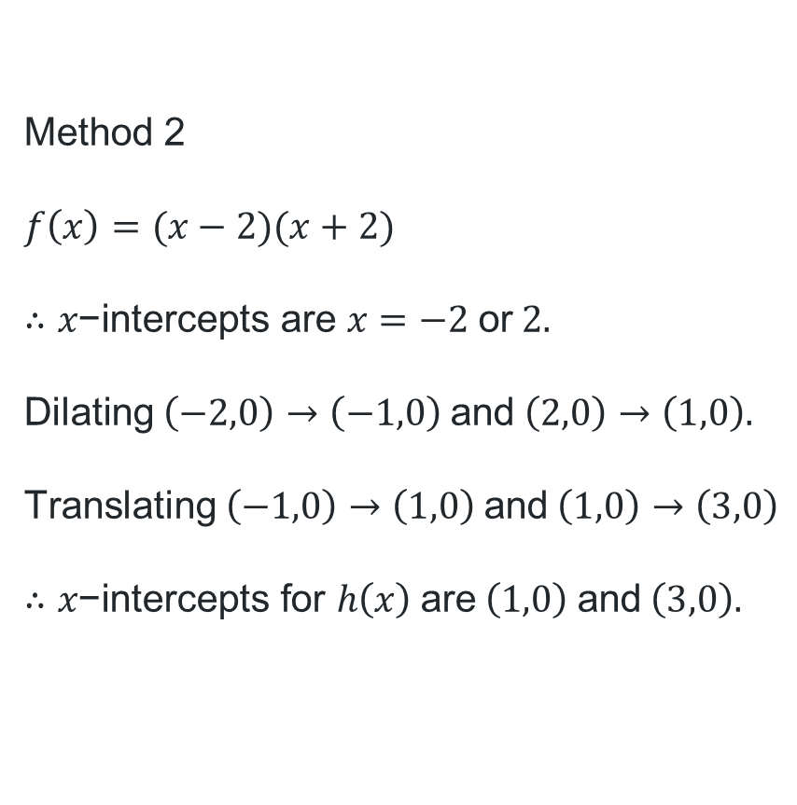
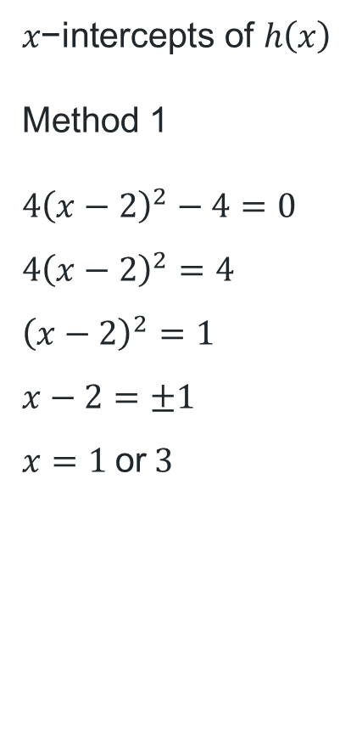
Worked solution to part b
$$f\left(x\right)=x^{2}−4 \\ \text{Dilation}\text{:}x→\frac{x}{\frac{1}{2}}=2x \\ f\left(x\right)→f\left(2x\right) \\ \text{Translation}\text{: }x→x−2 \\ f\left(2x\right)→f\left(2\left(x−2\right)\right)$$
$$h\left(x\right)={\left(2\left(x−2\right)\right)}^{2}−4 \\ =4{\left(x−2\right)}^{2}−4$$
$$x\text{−}\text{intercepts} \text{of} h\left(x\right)$$
Method 1
$$4{\left(x−2\right)}^{2}−4=0 \\ 4{\left(x−2\right)}^{2}=4 \\ {\left(x−2\right)}^{2}=1 \\ x−2=±1 \\ x=1 \text{or} 3$$
Method 2
$$f\left(x\right)=(x−2)(x+2)$$
$$∴x\text{−}\text{intercepts} \text{are} x=−2 \text{or} 2.$$
$$\text{Dilating} \left(−2,0\right)→\left(−1,0\right) \text{and} \left(2,0\right)→\left(1,0\right).$$
$$\text{Translating} \left(−1,0\right)→\left(1,0\right) \text{and} \left(1,0\right)→\left(3,0\right)$$
$$∴x\text{−}\text{intercepts} \text{for} h\left(x\right) \text{are} \left(1,0\right) \text{and} \left(3,0\right).$$

Slide 17
References
This presentation contains NSW Curriculum and syllabus content. The NSW Curriculum is developed by the NSW Education Standards Authority. This content is prepared by NESA for and on behalf of the Crown in the right of the State of New South Wales. The material is protected by Crown copyright.
Please refer to the NESA Copyright Disclaimer for more information https://educationstandards.nsw.edu.au/wps/portal/nesa/mini-footer/copyright.
NESA holds the only official and up-to-date versions of the NSW Curriculum and syllabus documents. Please visit the NSW Education Standards Authority (NESA) website https://educationstandards.nsw.edu.au/wps/portal/nesa/home and the NSW Curriculum website https://curriculum.nsw.edu.au.
Mathematics Standard Stage 6 Syllabus © NSW Education Standards Authority (NESA) for and on behalf of the Crown in right of the State of New South Wales, 2024.
Mathematics Advanced 11–12 Syllabus © NSW Education Standards Authority (NESA) for and on behalf of the Crown in right of the State of New South Wales, 2024.
Mathematics Extension 1 Stage 6 Syllabus © NSW Education Standards Authority (NESA) for and on behalf of the Crown in right of the State of New South Wales, 2024.

Slide 18
Copyright
© State of New South Wales (Department of Education), 2025
The copyright material published in this resource is subject to the Copyright Act 1968 (Cth) and is owned by the NSW Department of Education or, where indicated, by a party other than the NSW Department of Education (third-party material).
Copyright material available in this resource and owned by the NSW Department of Education is licensed under a Creative Commons Attribution 4.0 International (CC BY 4.0) license.
This license allows you to share and adapt the material for any purpose, even commercially.
Attribution should be given to © State of New South Wales (Department of Education), 2025.
Material in this resource not available under a Creative Commons license:
the NSW Department of Education logo, other logos and trademark-protected material
Material owned by a third party that has been reproduced with permission. You will need to obtain permission from the third party to reuse its material.
Links to third-party material and websites
Please note that the provided (reading/viewing material/list/links/texts) are a suggestion only and implies no endorsement, by the New South Wales Department of Education, of any author, publisher, or book title. School principals and teachers are best placed to assess the suitability of resources that would complement the curriculum and reflect the needs and interests of their students.
If you use the links provided in this document to access a third-party’s website, you acknowledge that the terms of use, including licence terms set out on the third-party’s website apply to the use which may be made of the materials on that third-party website or where permitted by the Copyright Act 1968 (Cth). The department accepts no responsibility for content on third-party websites.

