Slide 1

Dilations (horizontal and vertical)
Mathematics Advanced – Year 11
Unit 4 – graphing transformations

Slide 2
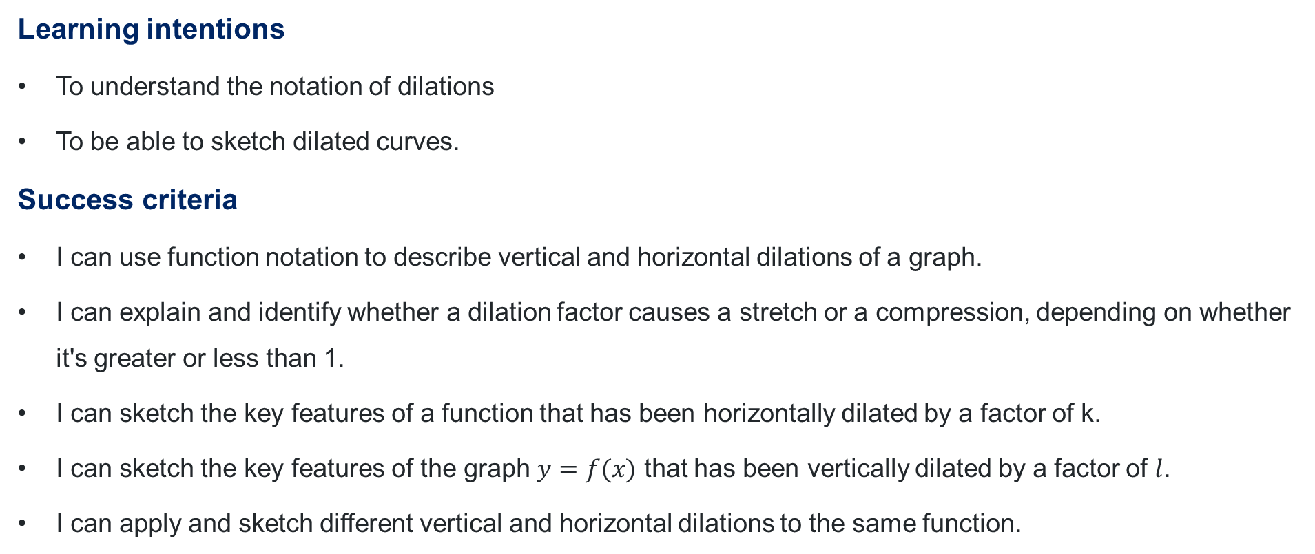
Learning intentions and success criteria
Learning intentions
To understand the notation of dilations
To be able to sketch dilated curves.
Success criteria
I can use function notation to describe vertical and horizontal dilations of a graph.
I can explain and identify whether a dilation factor causes a stretch or a compression, depending on whether it's greater or less than 1.
I can sketch the key features of a function that has been horizontally dilated by a factor of k.
I can sketch the key features of the graph $y=f(x)$ that has been vertically dilated by a factor of $l$.
I can apply and sketch different vertical and horizontal dilations to the same function.
Notes:
Notes for teachers:
Learning intentions and success criteria are best co-constructed with students. Adapt the learning intention as required and add matching success criteria.
For more information See ⁠AITSL or the NSW Department of Education explicit teaching strategies, ⁠Sharing learning intentions and ⁠Sharing success criteria
LISC is not necessarily presented at the beginning of the lesson. Teacher needs to consider most effectual time to introduce
LISC should be revisited during the lesson to support students' evaluation of their learning

Slide 3
Activating prior knowledge

Slide 4
The tennis ball
What do you notice and wonder?

Slide 5
Releasing responsibility

Slide 6
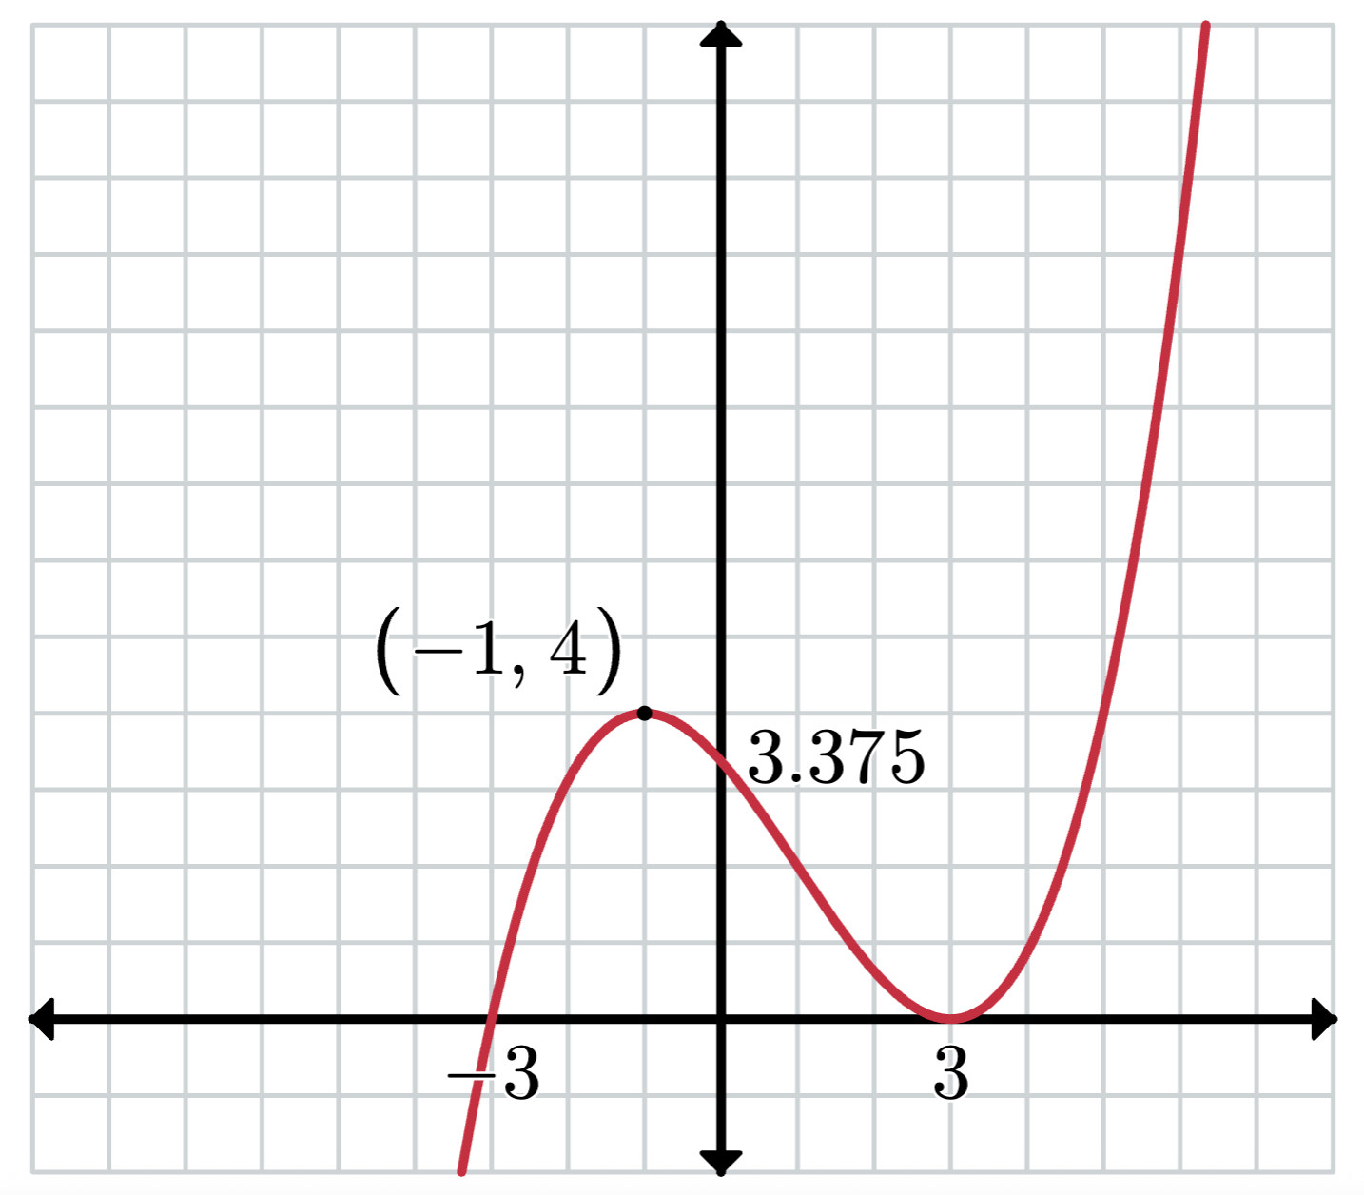
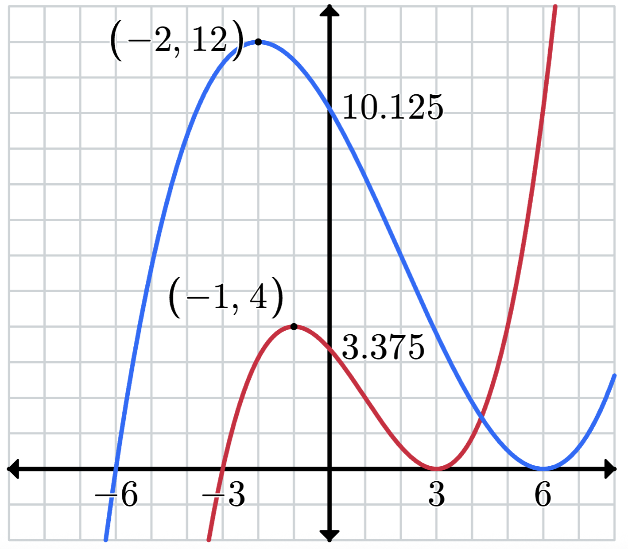

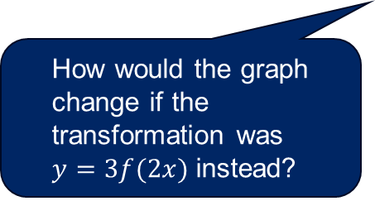
Applying dilations (1)
Example 1
Consider the graph of $f(x)$ as shown.
Sketch the graph of $y=3f\left(\frac{x}{2}\right)$ showing the intercepts and the coordinates of the turning points.
Solution
Why does the blue graph appear both taller and wider than the red graph?
How were known points used to draw the dilation?
How would the graph change if the transformation was
$y=3f(2x)$ instead?

Slide 7
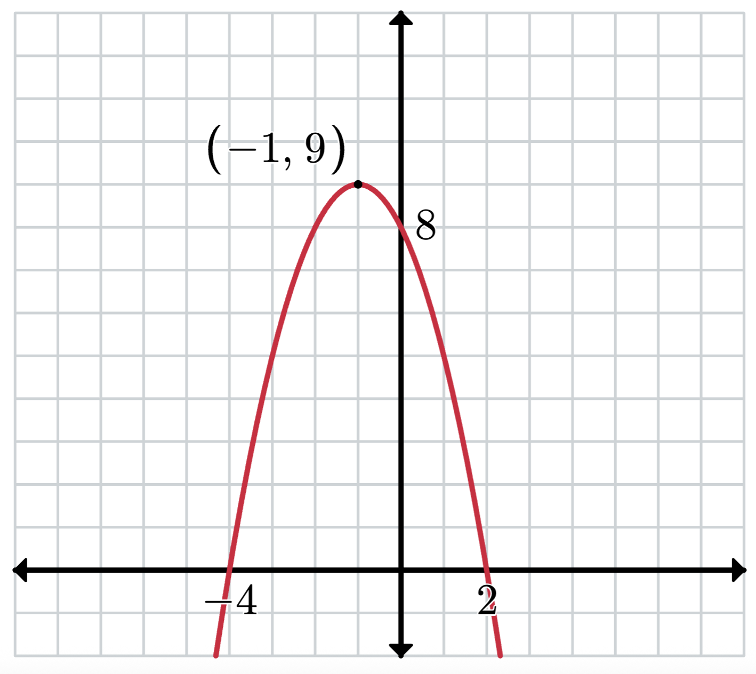
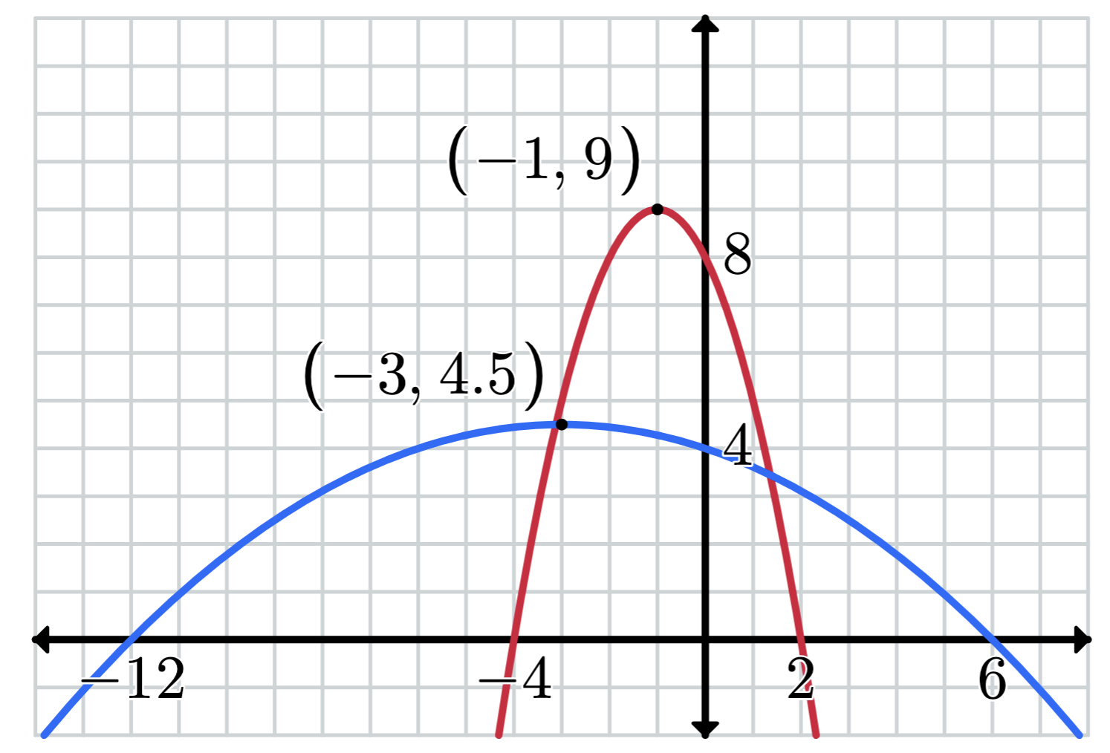

Applying dilations (2)
Your turn – Question 1
Consider the graph of $g(x)$ as shown.
Sketch the graph of $y=\frac{g\left(\frac{x}{3}\right)}{2}$ showing the $x$-intercepts and the coordinates of the turning points.
Solution

Slide 8
Independent practice

Slide 9

Approaching questions scaffold

Slide 10
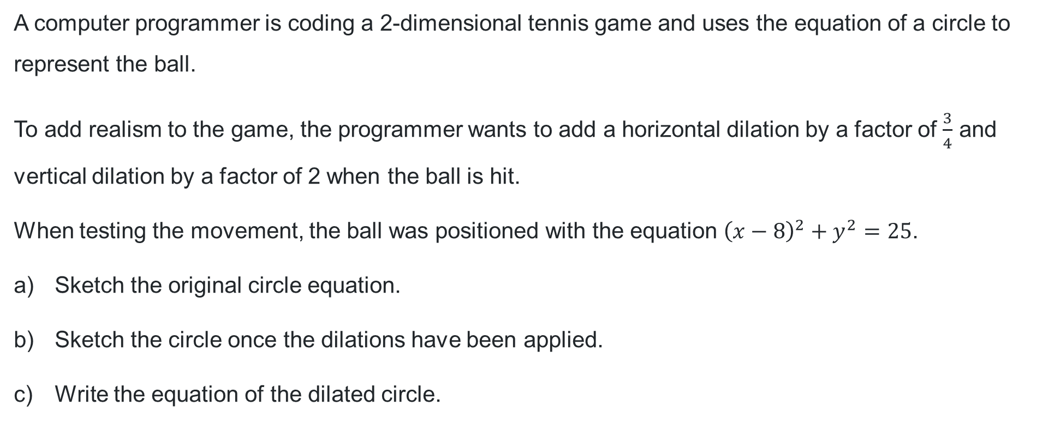
HSC style problem (1)
Dilations
A computer programmer is coding a 2-dimensional tennis game and uses the equation of a circle to represent the ball.
To add realism to the game, the programmer wants to add a horizontal dilation by a factor of $\frac{3}{4}$ and vertical dilation by a factor of 2 when the ball is hit.
When testing the movement, the ball was positioned with the equation ${\left(x−8\right)}^{2}+y^{2}=25$.
Sketch the original circle equation.
Sketch the circle once the dilations have been applied.
Write the equation of the dilated circle.

Slide 11
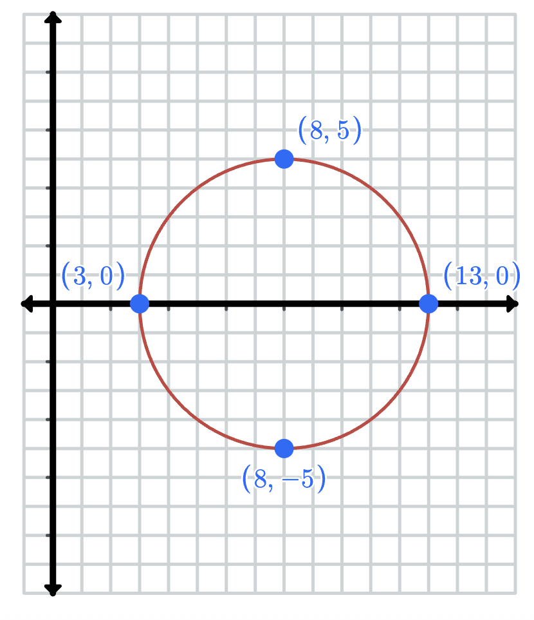
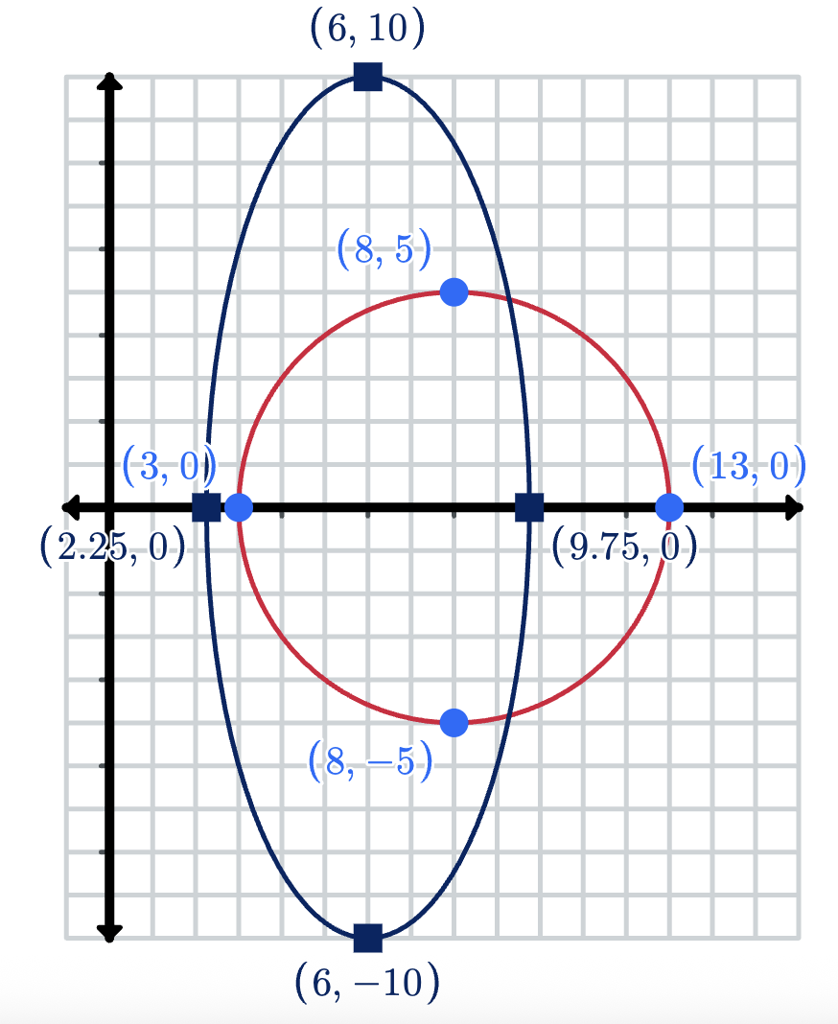

HSC style problem (2)
Solution
a) b) c) ${\left(\frac{4x}{3}−8\right)}^{2}+{\left(\frac{y}{2}\right)}^{2}=25$
Why did the 8 and 25 not change because of the dilation?
How did you remember to apply the appropriate dilation?

Slide 12
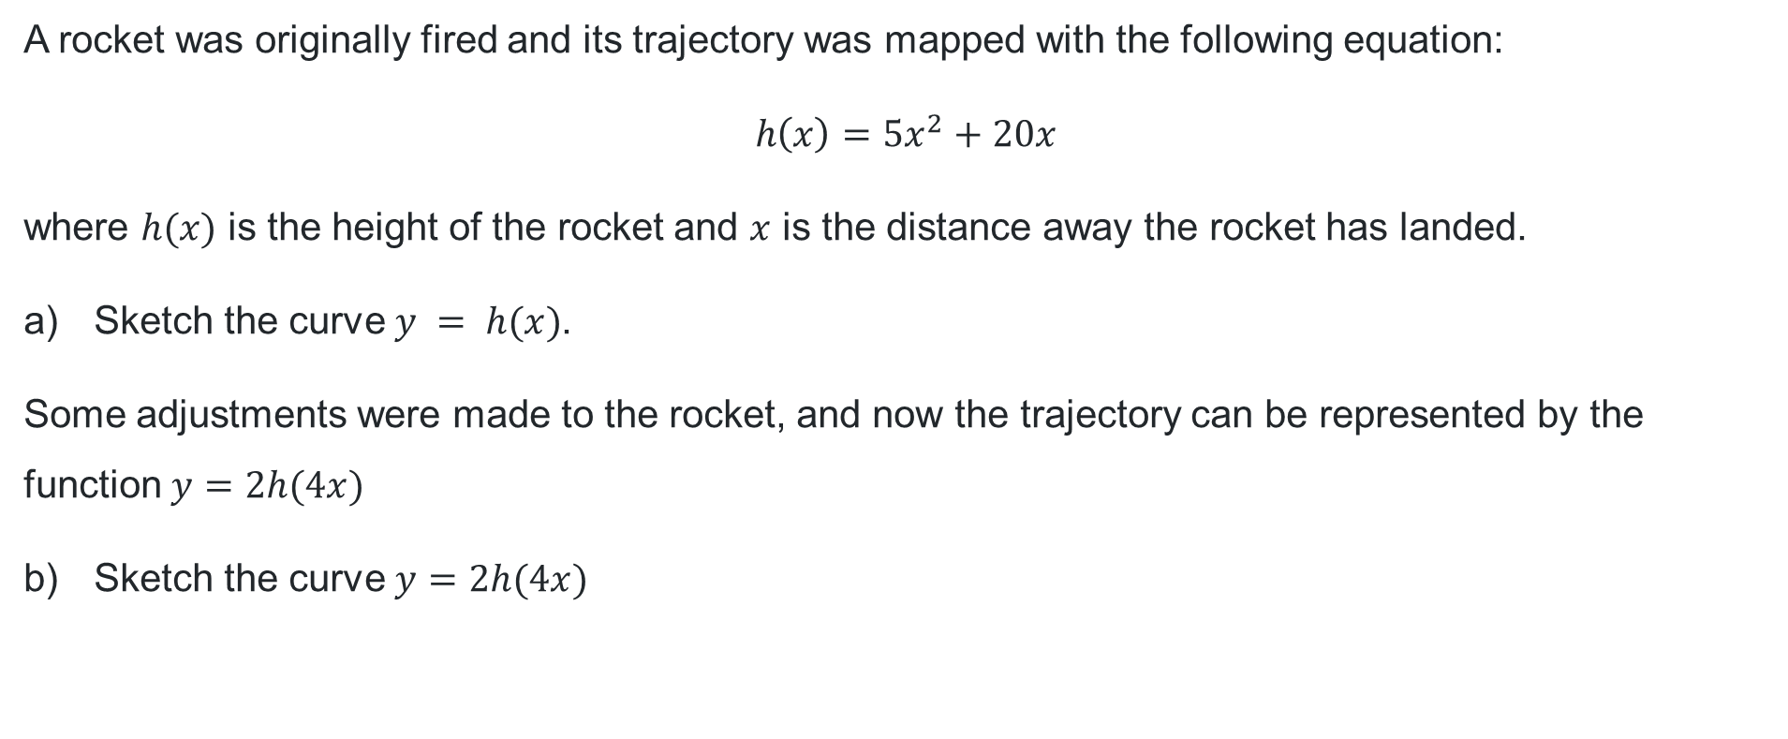
HSC style problem (3)
Dilations
A rocket was originally fired and its trajectory was mapped with the following equation:
$$h\left(x\right)=5x^{2}+20x$$
where $h(x)$ is the height of the rocket and $x$ is the distance away the rocket has landed.
Sketch the curve $y = h(x)$.
Some adjustments were made to the rocket, and now the trajectory can be represented by the function $y=2h(4x)$
Sketch the curve $y=2h(4x)$

Slide 13
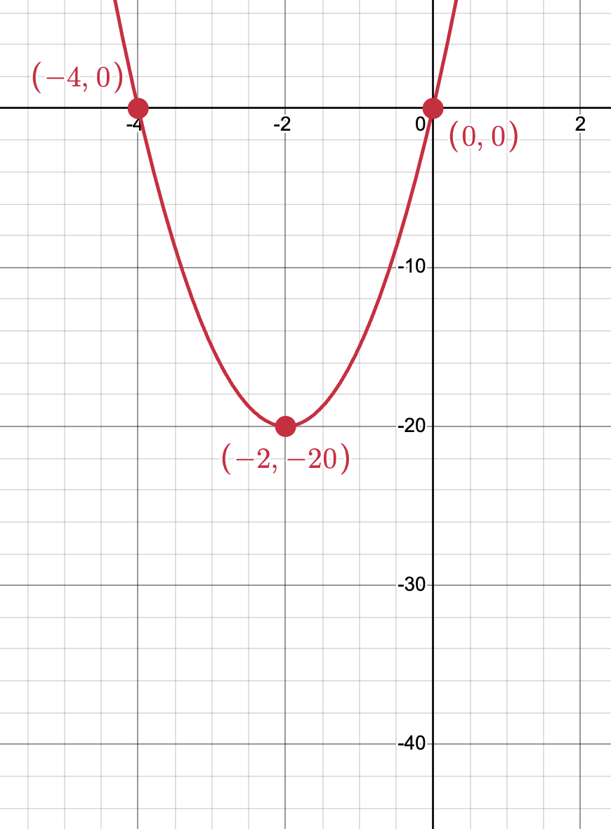
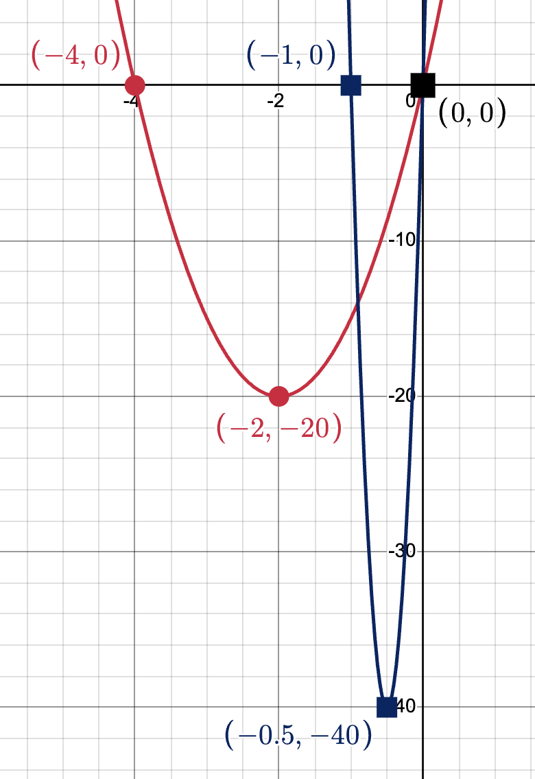
HSC style problem (4)
Solution
a) b)

Slide 14
References
This presentation contains NSW Curriculum and syllabus content. The NSW Curriculum is developed by the NSW Education Standards Authority. This content is prepared by NESA for and on behalf of the Crown in the right of the State of New South Wales. The material is protected by Crown copyright.
Please refer to the NESA Copyright Disclaimer for more information https://educationstandards.nsw.edu.au/wps/portal/nesa/mini-footer/copyright.
NESA holds the only official and up-to-date versions of the NSW Curriculum and syllabus documents. Please visit the NSW Education Standards Authority (NESA) website https://educationstandards.nsw.edu.au/wps/portal/nesa/home and the NSW Curriculum website https://curriculum.nsw.edu.au.
Mathematics Advanced 11–12 Syllabus © NSW Education Standards Authority (NESA) for and on behalf of the Crown in right of the State of New South Wales, 2024.

Slide 15
Copyright
© State of New South Wales (Department of Education), 2025
The copyright material published in this resource is subject to the Copyright Act 1968 (Cth) and is owned by the NSW Department of Education or, where indicated, by a party other than the NSW Department of Education (third-party material).
Copyright material available in this resource and owned by the NSW Department of Education is licensed under a Creative Commons Attribution 4.0 International (CC BY 4.0) license.
This license allows you to share and adapt the material for any purpose, even commercially.
Attribution should be given to © State of New South Wales (Department of Education), 2025.
Material in this resource not available under a Creative Commons license:
the NSW Department of Education logo, other logos and trademark-protected material
Material owned by a third party that has been reproduced with permission. You will need to obtain permission from the third party to reuse its material.
Links to third-party material and websites
Please note that the provided (reading/viewing material/list/links/texts) are a suggestion only and implies no endorsement, by the New South Wales Department of Education, of any author, publisher, or book title. School principals and teachers are best placed to assess the suitability of resources that would complement the curriculum and reflect the needs and interests of their students.
If you use the links provided in this document to access a third-party’s website, you acknowledge that the terms of use, including licence terms set out on the third-party’s website apply to the use which may be made of the materials on that third-party website or where permitted by the Copyright Act 1968 (Cth). The department accepts no responsibility for content on third-party websites.

