Slide 1
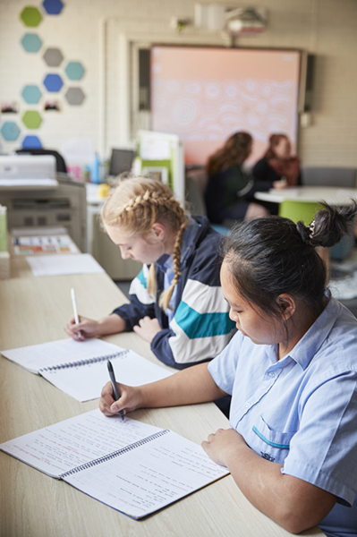
Further circles
Mathematics Advanced – Stage 6 (Year 11)
Unit 4 – graphing transformations

Slide 2
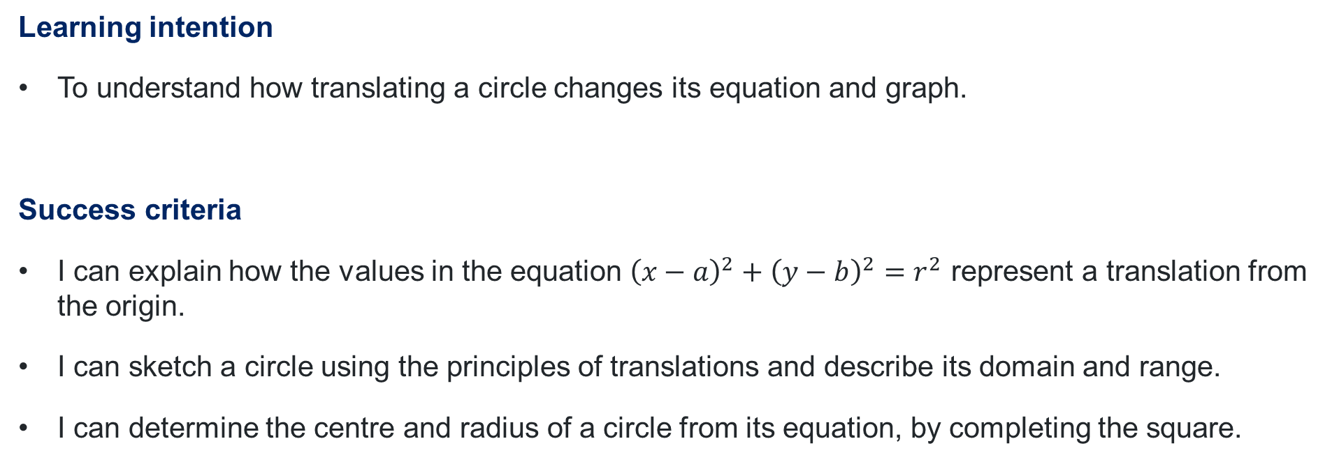
Learning intentions and success criteria
Learning intention
To understand how translating a circle changes its equation and graph.
Success criteria
I can explain how the values in the equation ${\left(x−a\right)}^{2}+{\left(y−b\right)}^{2}=r^{2}$ represent a translation from the origin.
I can sketch a circle using the principles of translations and describe its domain and range.
I can determine the centre and radius of a circle from its equation, by completing the square.
Notes:
Notes for teachers:
Learning intentions and success criteria are best co-constructed with students. Adapt the learning intention as required and add matching success criteria.
For more information See ⁠AITSL or the NSW Department of Education explicit teaching strategies, ⁠Sharing learning intentions and ⁠Sharing success criteria
LISC is not necessarily presented at the beginning of the lesson. Teacher needs to consider most effectual time to introduce
LISC should be revisited during the lesson to support students' evaluation of their learning

Slide 3
Activating prior knowledge

Slide 4

Parabolas
Domain and range
Draw a sketch of each quadratic function, showing all key features.
$$y=3x^{2}+1$$
$$y=3{\left(x+2\right)}^{2}+1$$
$$y−4=3x^{2}+1$$
$$y−4=3{\left(x+2\right)}^{2}+1$$
Explain how and why the domain and range change for each translation.

Slide 5

Reciprocal functions
Domain and range
Sketch each reciprocal function, showing all key features.
$$y=\frac{2}{x}$$
$$y=\frac{2}{x−1}$$
$$y+3=\frac{2}{x}$$
$$y+3=\frac{2}{x−1}$$
Explain how and why the domain and range change for each translation.

Slide 6
Circles
Starting with a circle centred at the origin, with a radius of 4
Question 1
Question 2
Question 3
Would the domain or range change if the circle was translated 3 units to the right? How would they change?
Would the domain or range change if the circle was translated 5 units up?
How would they change?
Would the domain or range change if the circle was translated 3 units to the right and 5 units up? How would they change?

Slide 7
Connecting learning

Slide 8
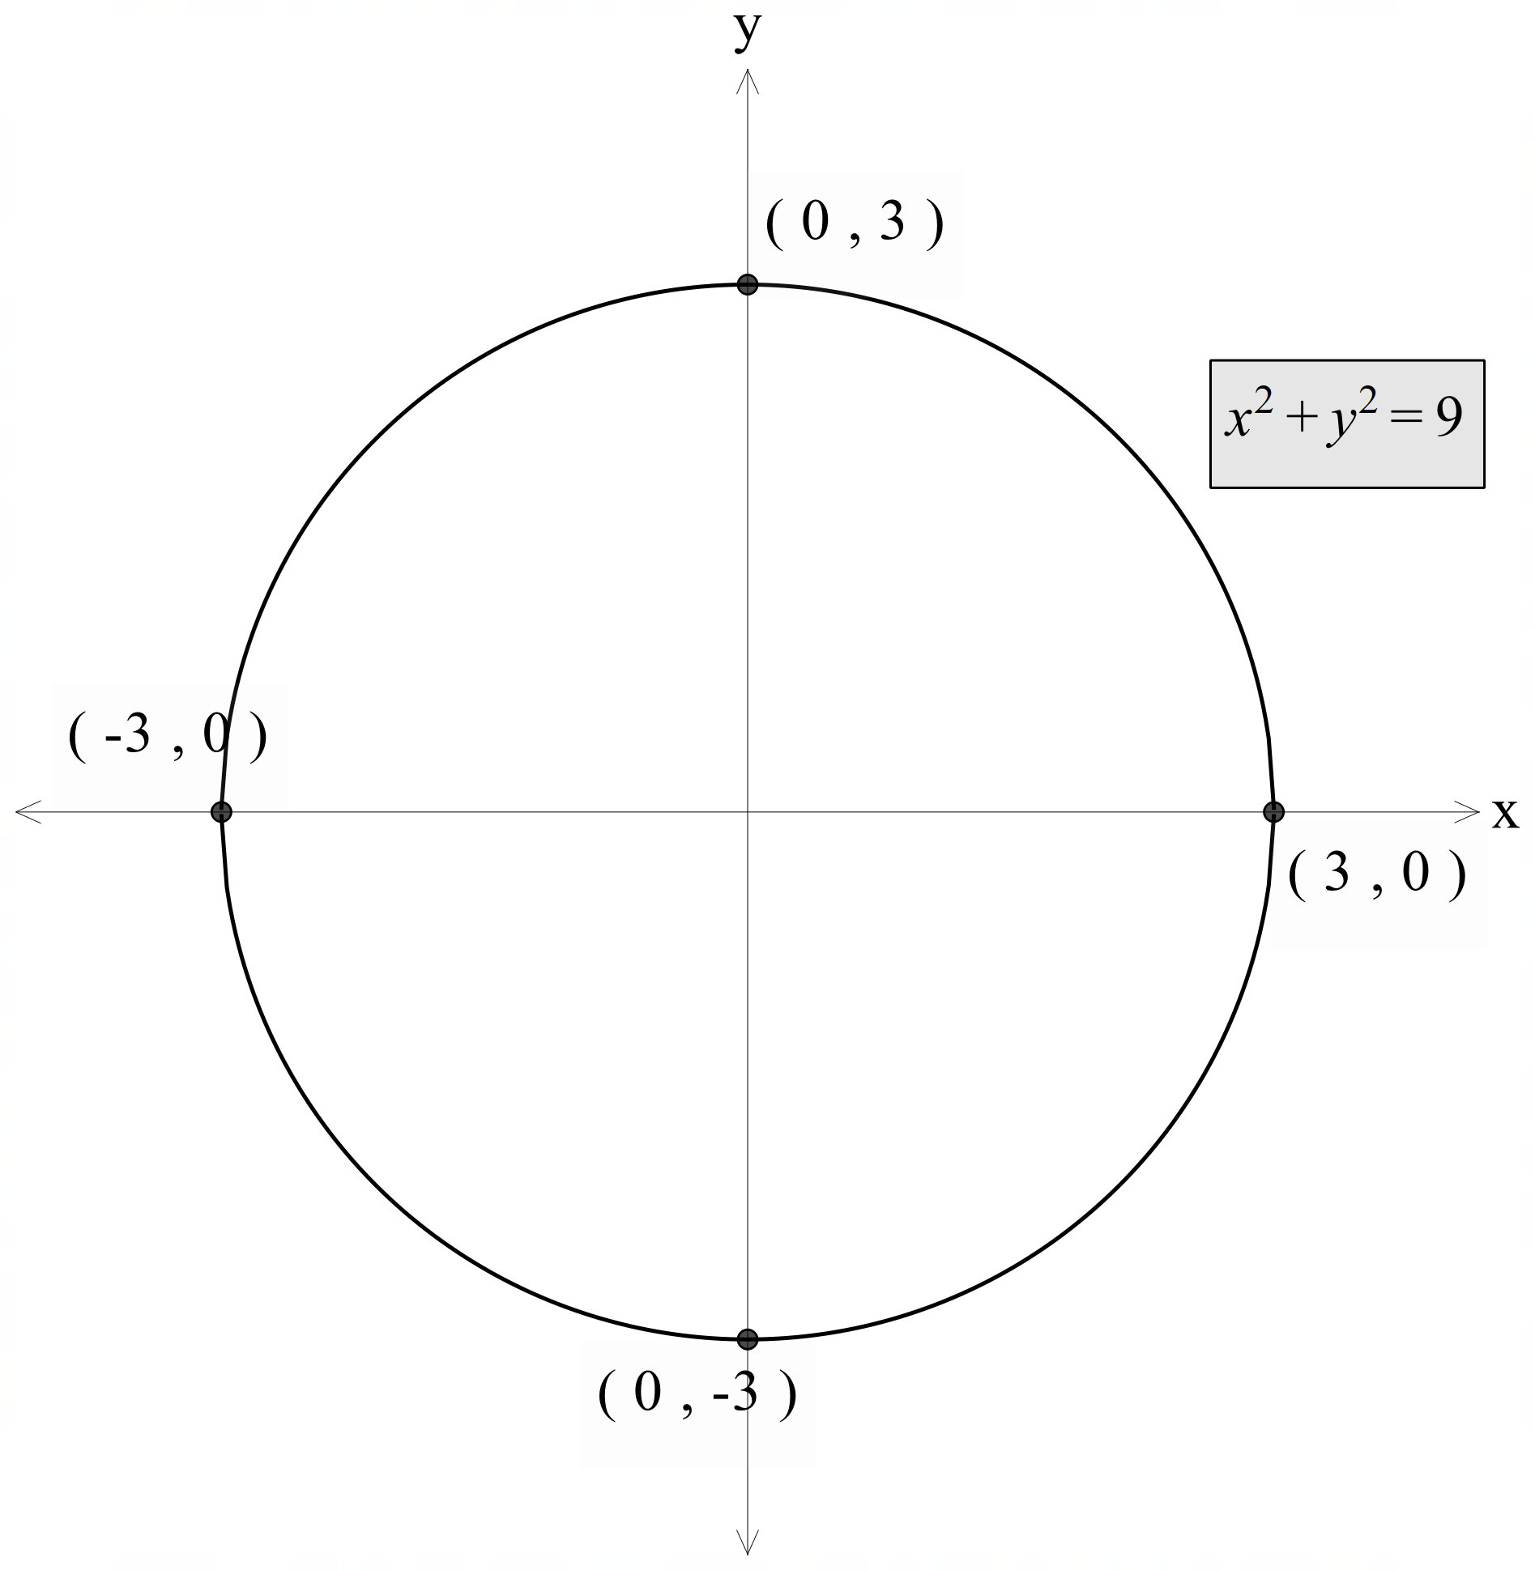
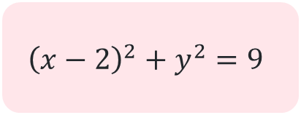
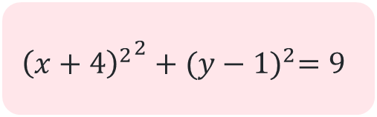
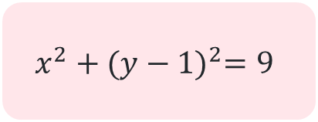
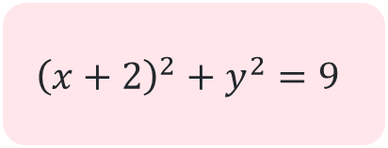
Circles with centre $(a, b)$
$${\left(x−2\right)}^{2}+y^{2}=9$$
$$x^{2}+{(y−1)}^{2}=9$$
$${\left(x+2\right)}^{2}+y^{2}=9$$
$${{\left(x+4\right)}^{2}}^{2}+{(y−1)}^{2}=9$$

Slide 9
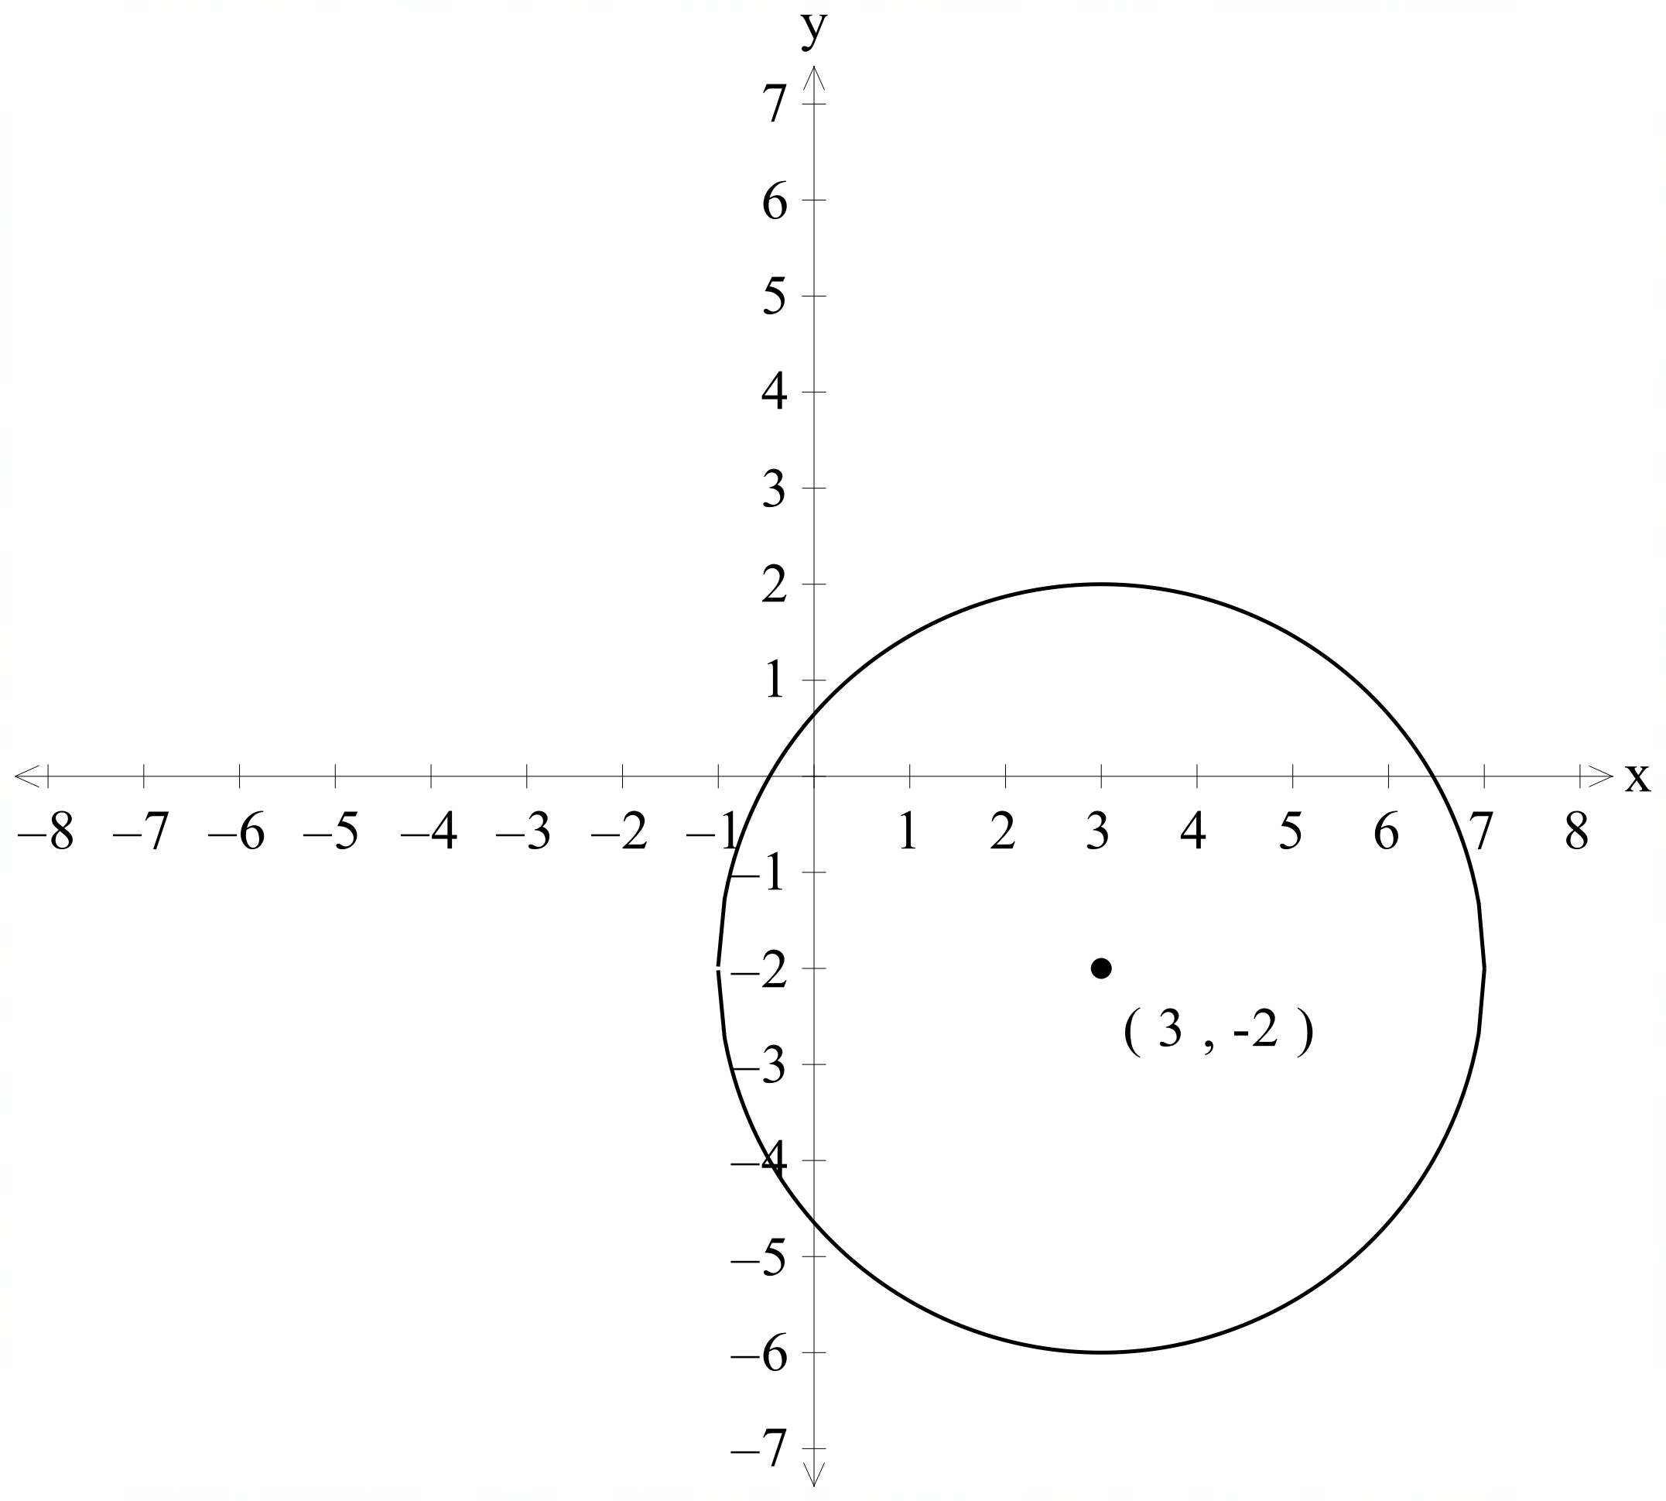
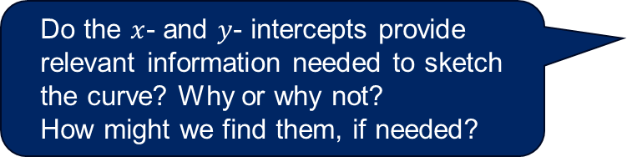
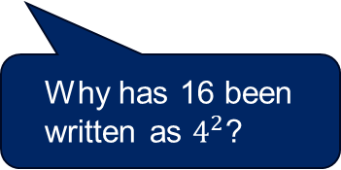

Graphing circles (1)
Worked example 1
Identify the centre and radius of the circle ${\left(x−3\right)}^{2}+{\left(y+2\right)}^{2}=16$ and sketch the circle.
$${\left(x−3\right)}^{2}+{\left(y+2\right)}^{2}=4^{2}$$
Radius is 4
Centre at $(3, −2)$
Can the centre of the circle be found easily from the equation of the circle?
Why has 16 been written as $4^{2}$?
Do the $x$- and $y$- intercepts provide relevant information needed to sketch the curve? Why or why not?
How might we find them, if needed?

Slide 10
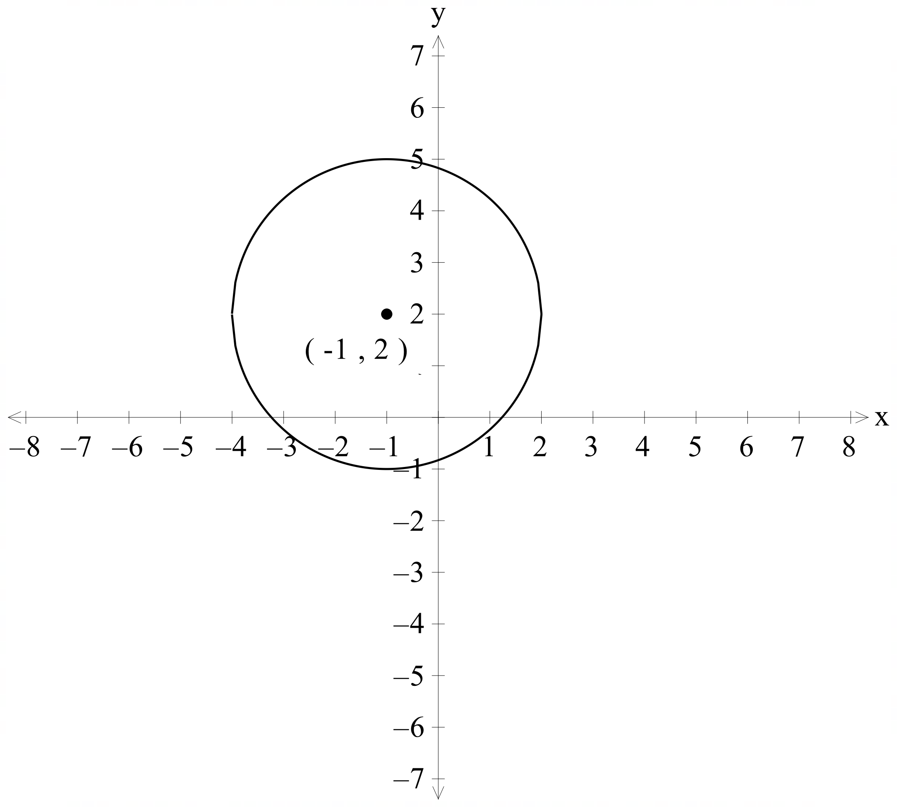
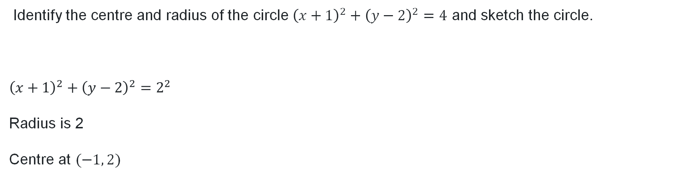
Graphing circles (2)
Your turn – question 1
Identify the centre and radius of the circle ${\left(x+1\right)}^{2}+{\left(y−2\right)}^{2}=4$ and sketch the circle.
$${\left(x+1\right)}^{2}+{\left(y−2\right)}^{2}=2^{2}$$
Radius is 2
Centre at $(−1, 2)$

Slide 11
Releasing responsibility

Slide 12
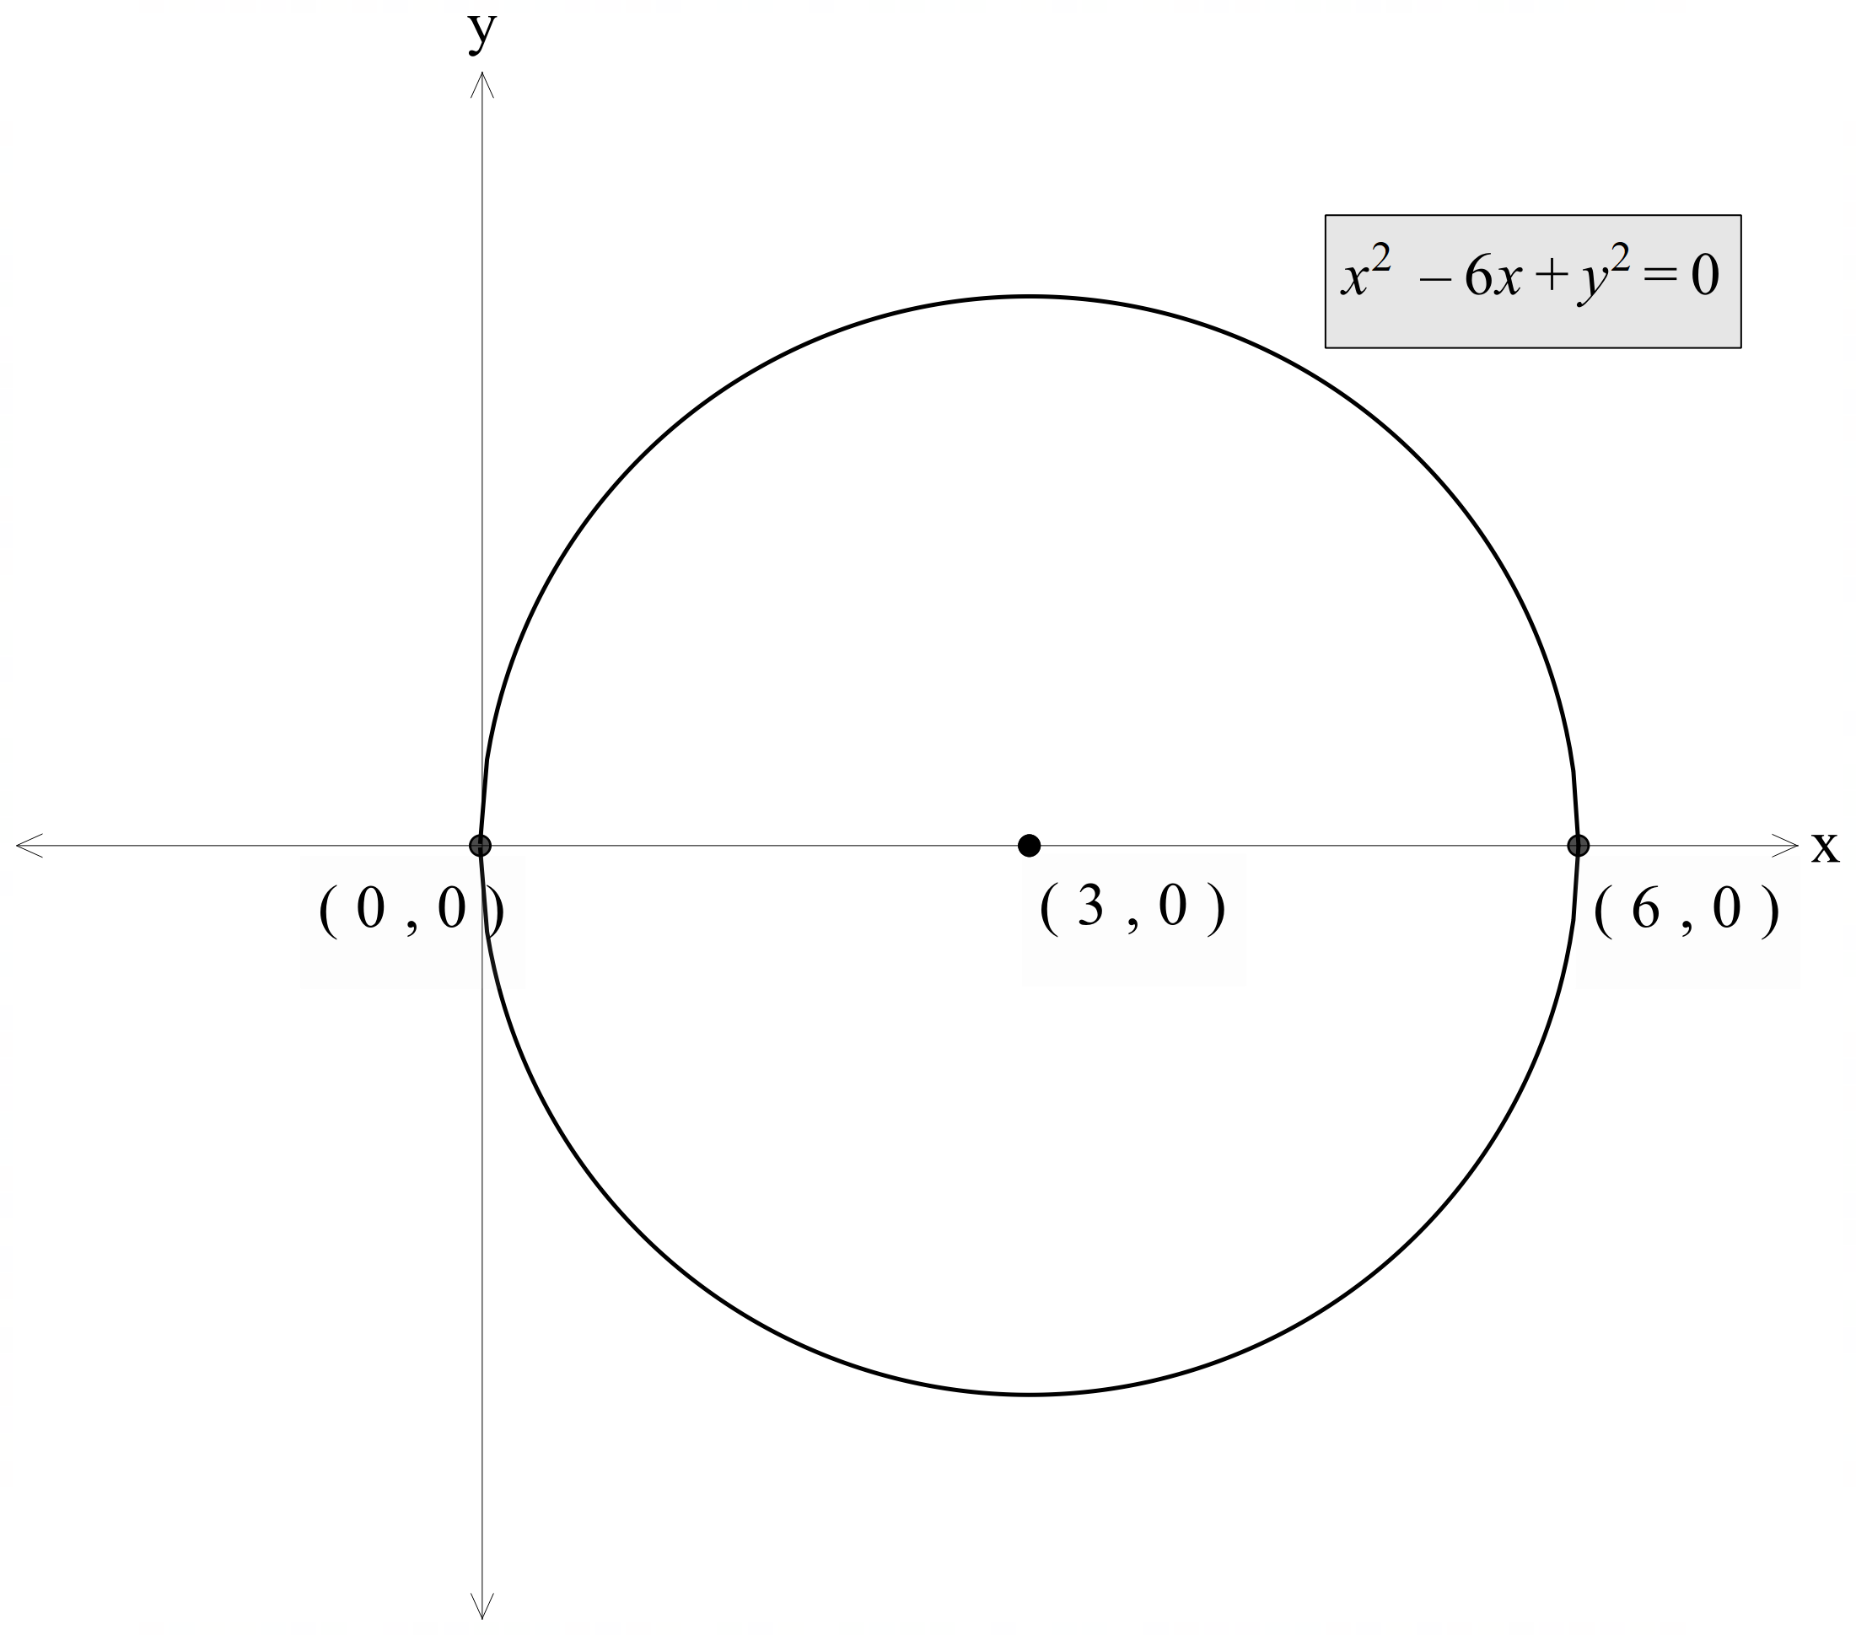
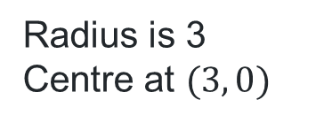

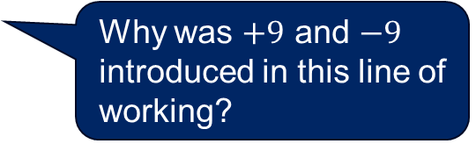

Completing the square (1)
Worked example 1
Find the centre and radius of the circle, $x^{2}−6x+y^{2}=0$, by completing the square and then sketch the circle.
$$x^{2}−6x+□+y^{2}=0$$
$$x^{2}−6x+9+y^{2}−9=0$$
$${\left(x−3\right)}^{2}+y^{2}−9=0$$
$${\left(x−3\right)}^{2}+y^{2}=9$$
$${\left(x−3\right)}^{2}+y^{2}=3^{2}$$
Why was a gap left after the $−6x$?
Why was $+9$ and $−9$ introduced in this line of working?
Which graphical features can be found from this equation in its current format?
Radius is 3
Centre at $(3, 0)$

Slide 13
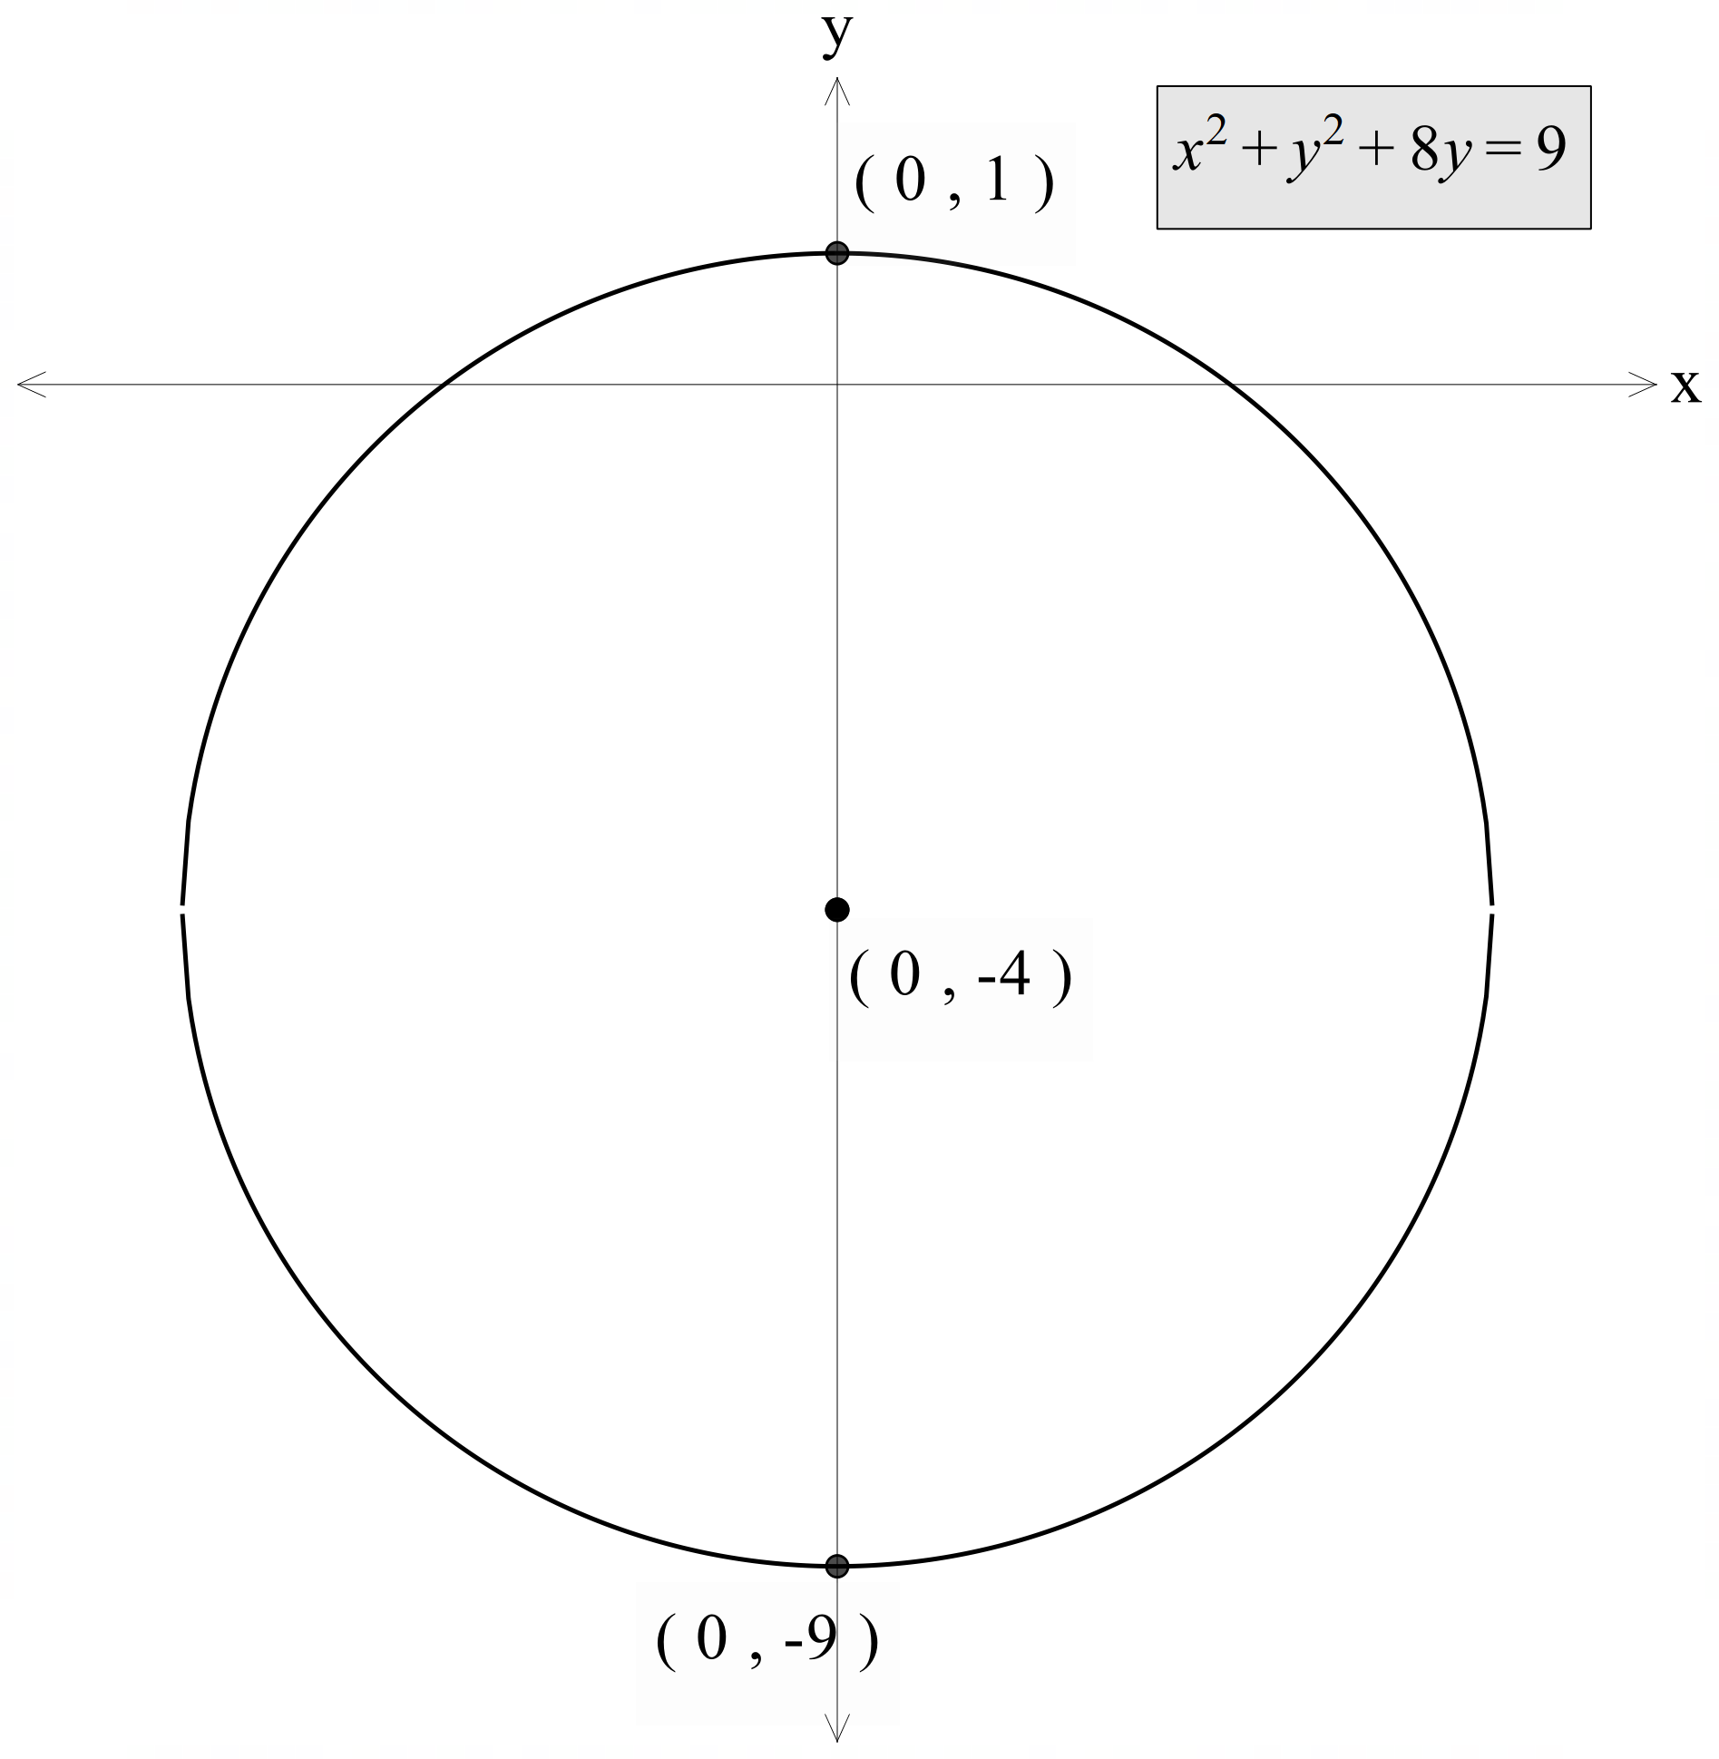
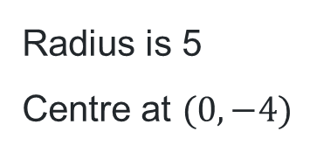

Completing the square (2)
Your turn – Question 1
Find the centre and radius of the circle, $x^{2}+y^{2}+8y=9$, by completing the square and then sketch the circle.
$$x^{2}+y^{2}+8y+□=9$$
$$x^{2}+y^{2}+8y+16−16=9$$
$$x^{2}+{\left(y+4\right)}^{2}−16=9$$
$$x^{2}+{(y+4)}^{2}=25$$
$$x^{2}+{\left(y+4\right)}^{2}=5^{2}$$
Radius is 5
Centre at $(0, −4)$

Slide 14
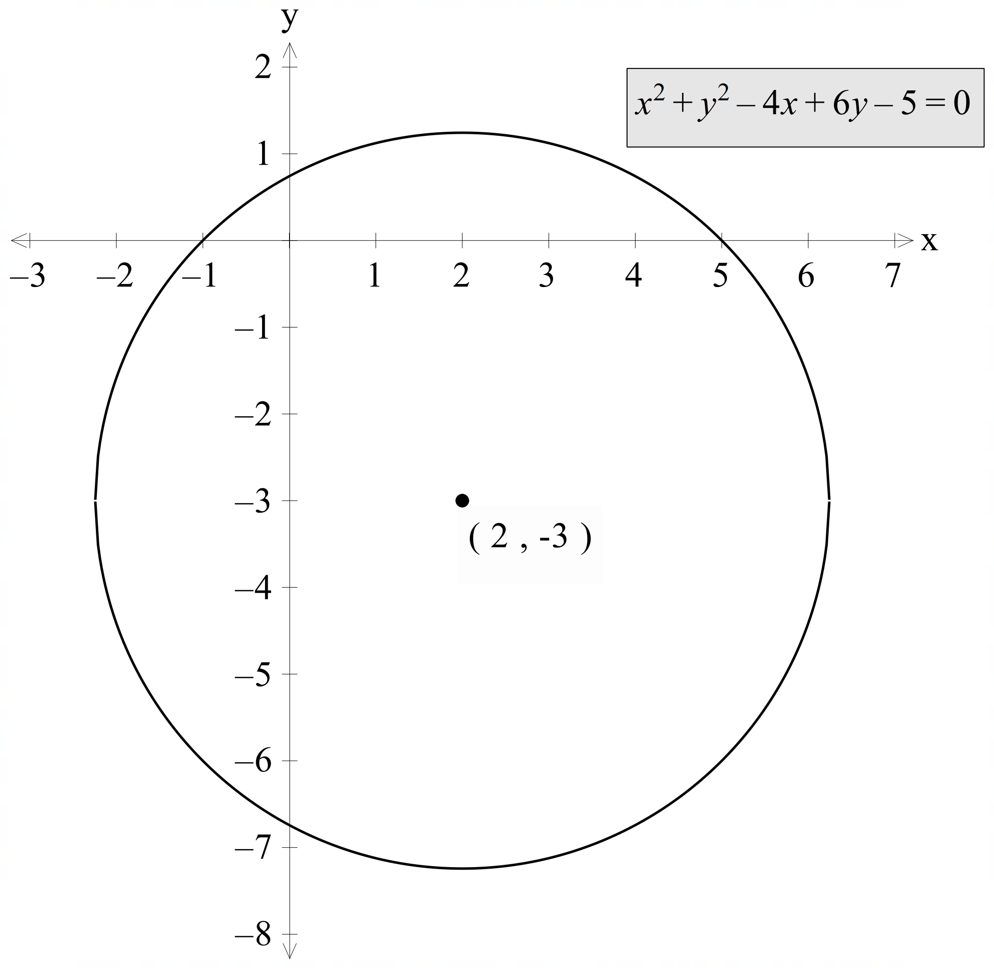

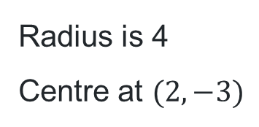
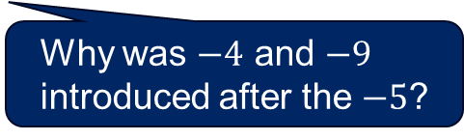
Completing the square (3)
Worked example 2
Find the centre and radius of the circle, $x^{2}+y^{2}−4x+6y−5=0$, by completing the square and then sketch the circle.
$$x^{2}−4x+□+y^{2}+6y+□−5=0$$
$$x^{2}−4x+4+y^{2}+6y+9−5−4−9=0$$
$${\left(x−2\right)}^{2}+{\left(y+3\right)}^{2}−16=0$$
$${\left(x−2\right)}^{2}+{\left(y+3\right)}^{2}=16$$
$${\left(x−2\right)}^{2}+{\left(y+3\right)}^{2}=4^{2}$$
Why were the terms rearranged?
Radius is 4
Centre at $(2, −3)$
Why was $−4$ and $−9$ introduced after the $−5$?
What would the domain and range be of this circle?

Slide 15
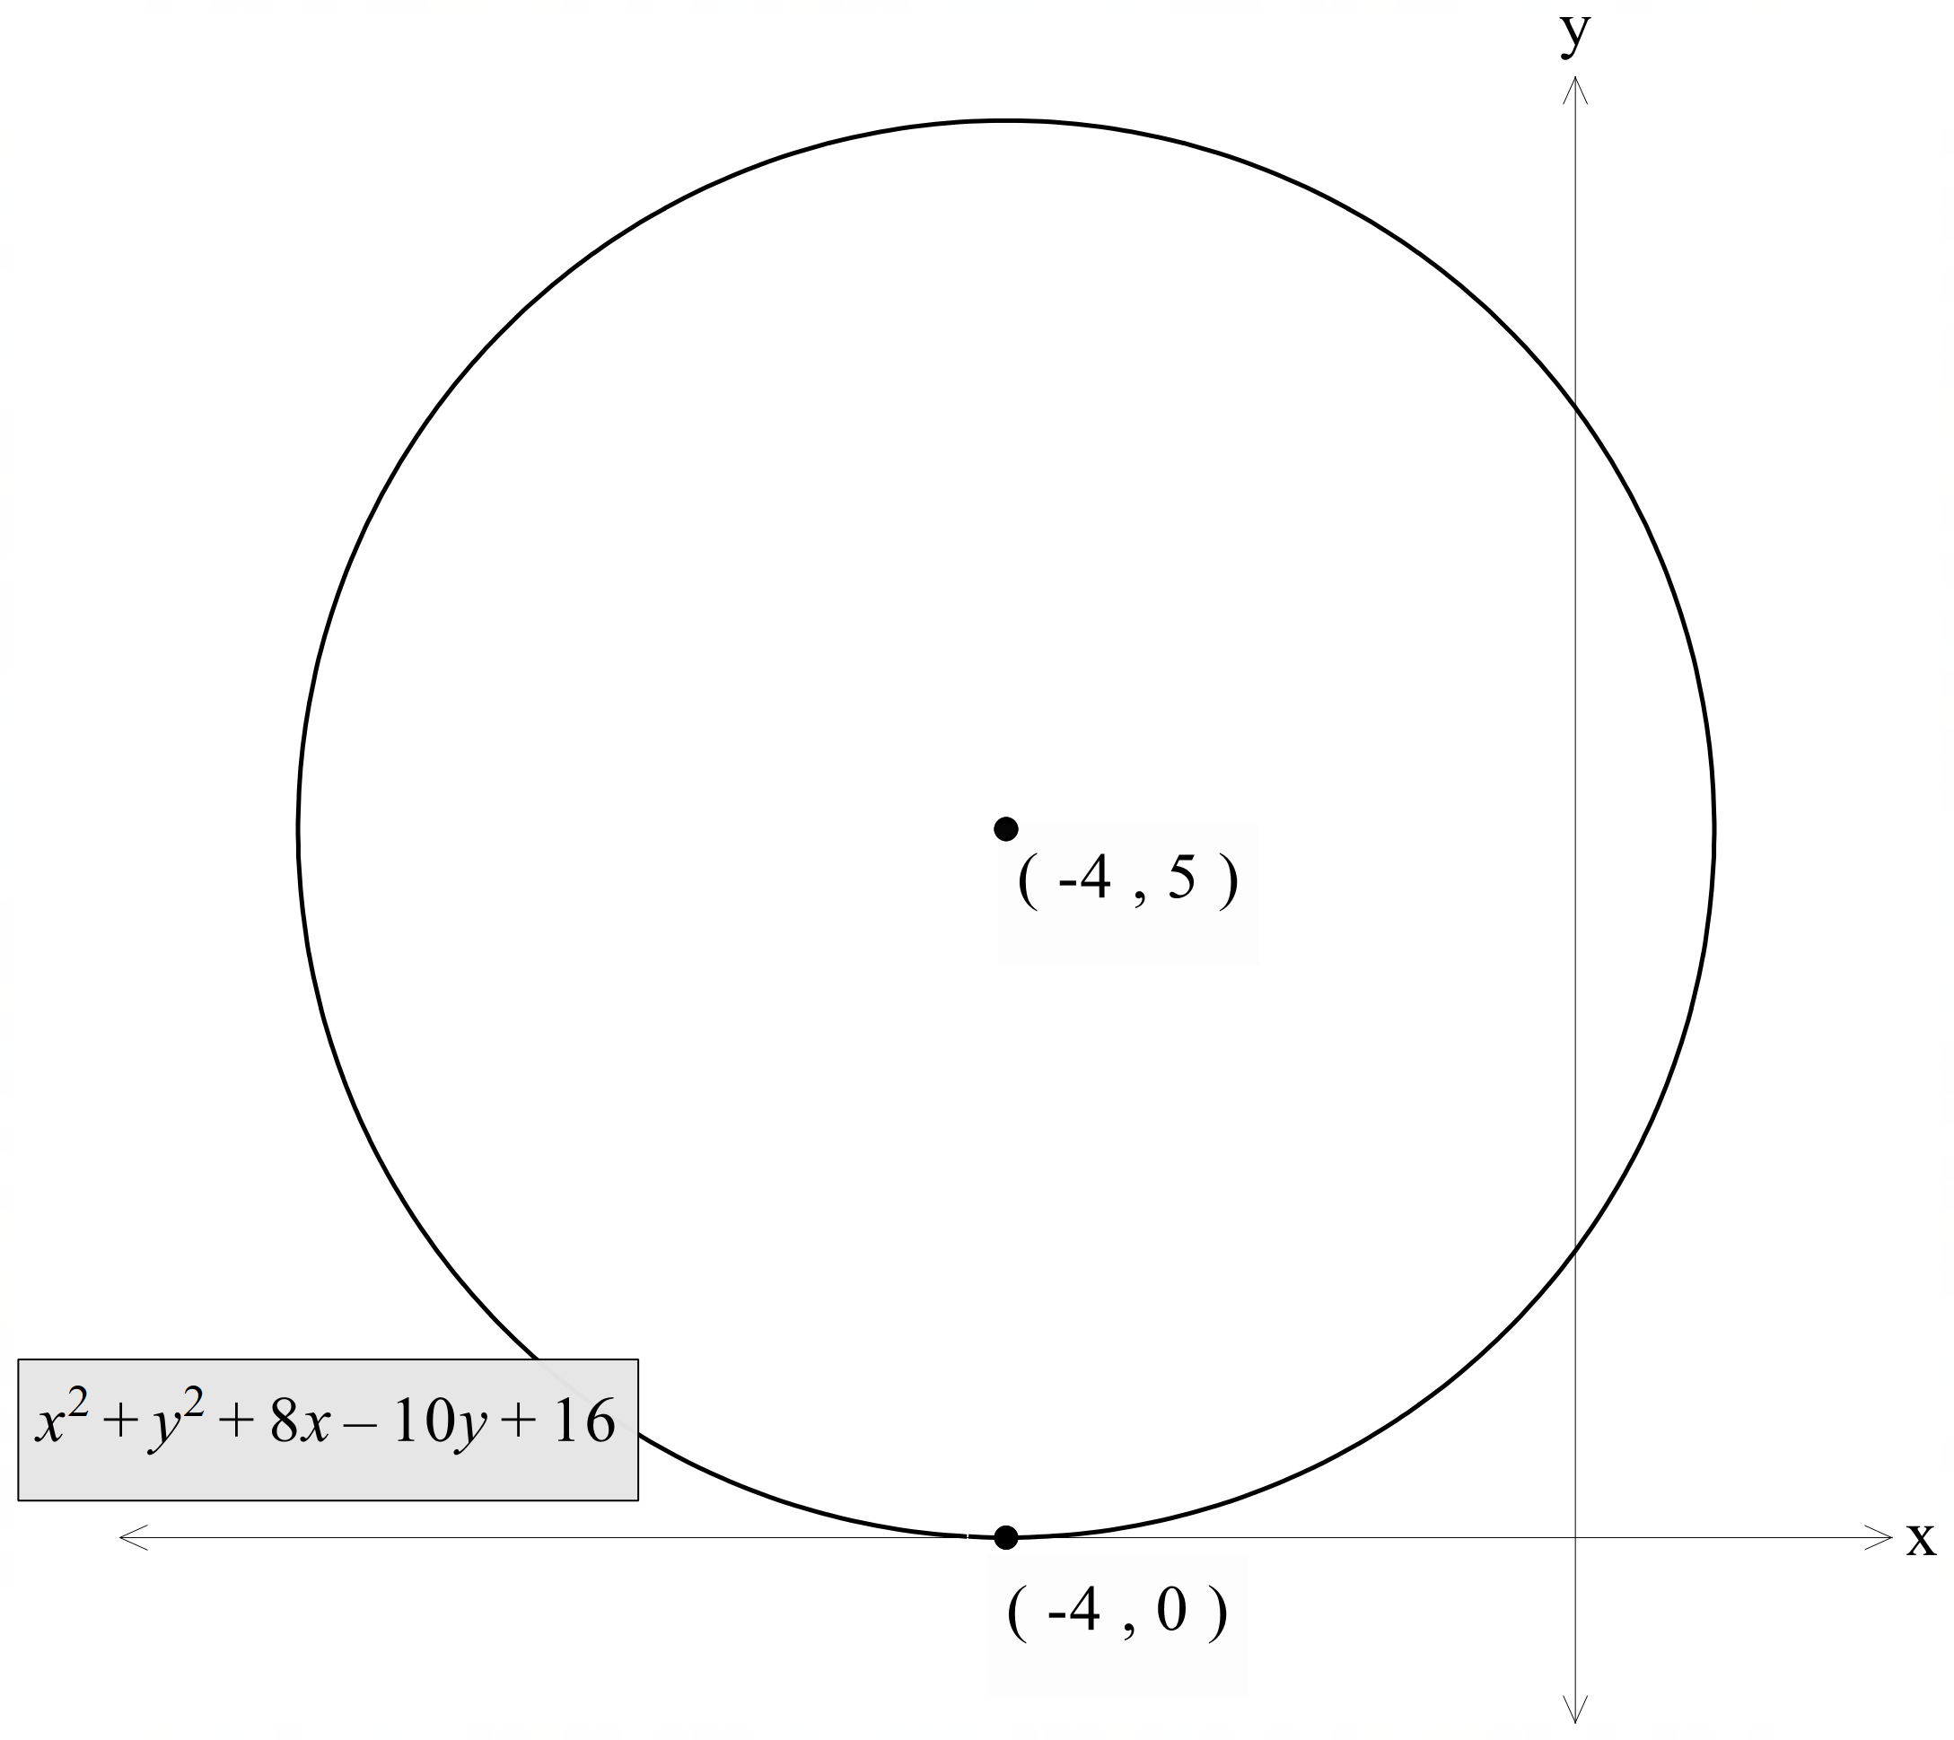

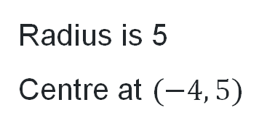
Completing the square (4)
Your turn – Question 2
Find the centre and radius of the circle, $x^{2}+y^{2}+8x−10y+16=0$, by completing the square and then sketch the circle.
$$x^{2}+8x+□+y^{2}−10y+□+16=0$$
$$x^{2}+8x+16+y^{2}−10y+25+16−16−25=0$$
$${\left(x+4\right)}^{2}+{\left(y−5\right)}^{2}−25=0$$
$${\left(x+4\right)}^{2}+{\left(y−5\right)}^{2}=25$$
$${\left(x+4\right)}^{2}+{\left(y−5\right)}^{2}=5^{2}$$
Radius is 5
Centre at $(−4, 5)$

Slide 16
Independent practice

Slide 17

Reflecting circles
Question
The circle $x^{2}+y^{2}−2x+4y−4=0$ is reflected in the $x$- axis.
Sketch the reflected circle, showing the coordinates of the centre and the radius.

Slide 18
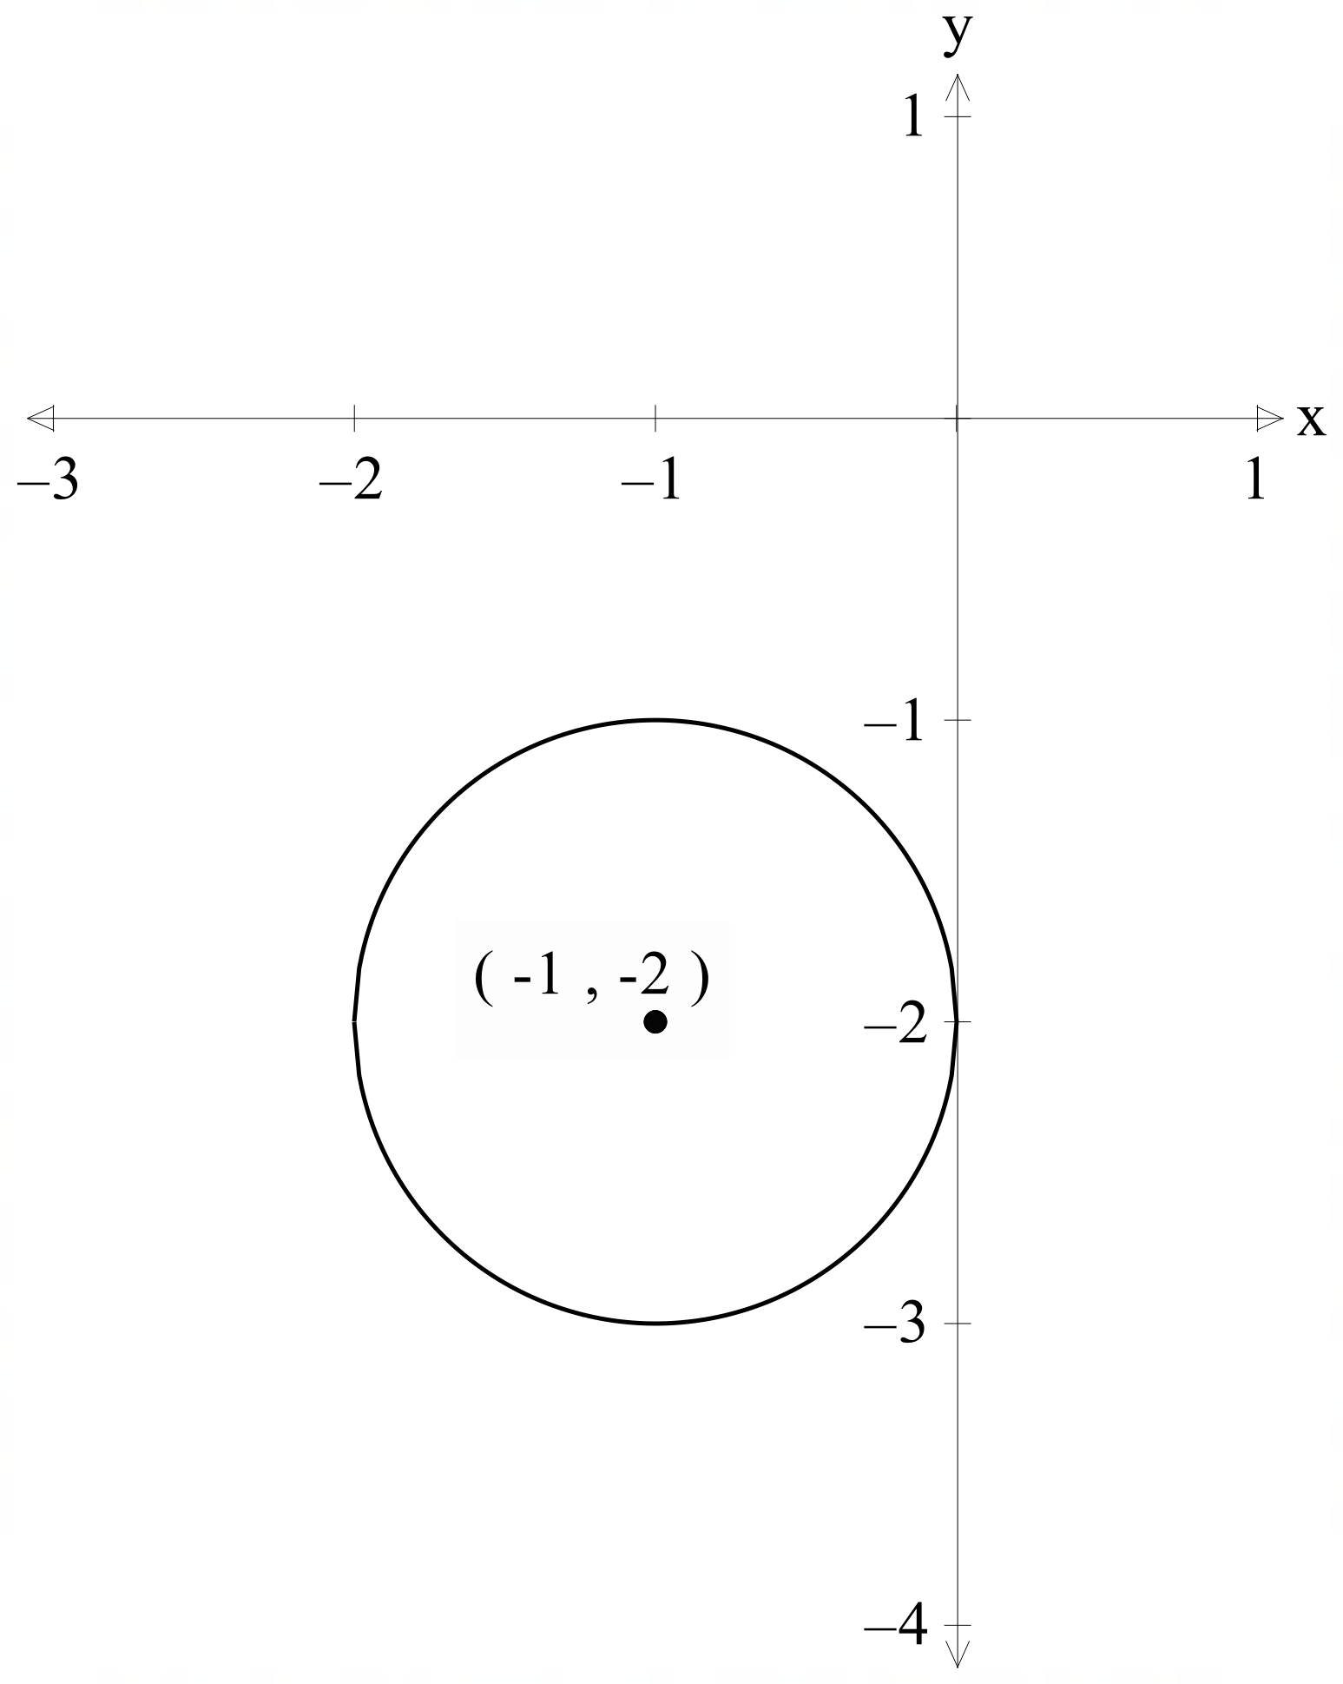
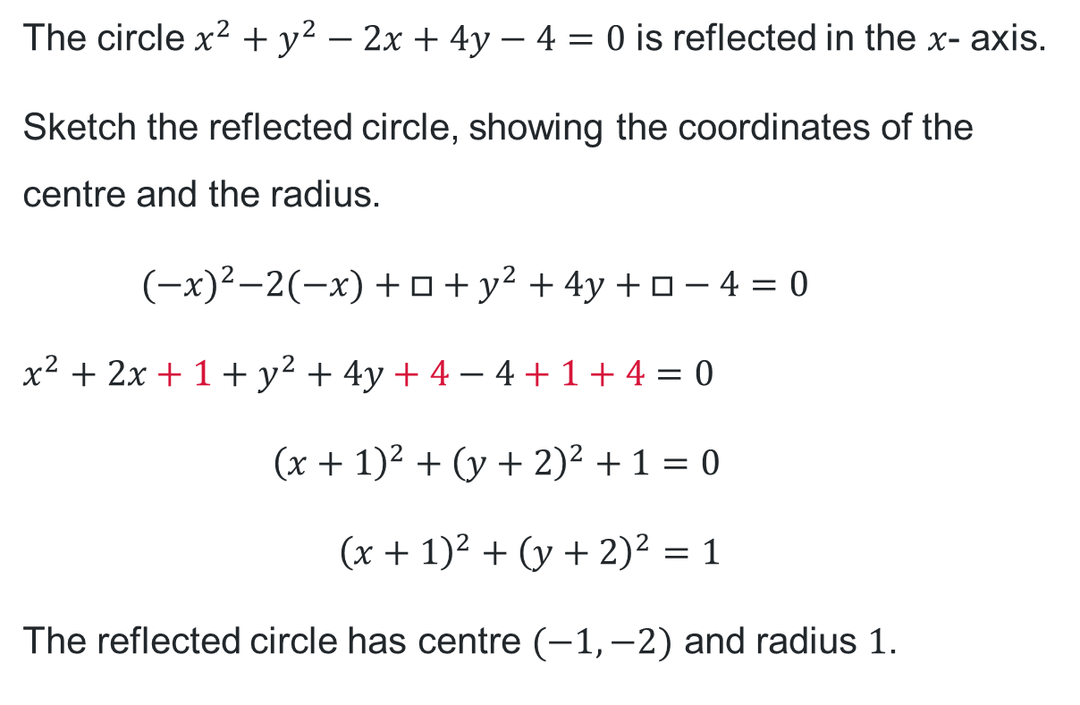
Incorrect worked example (1)
Incorrect solution 1
The circle $x^{2}+y^{2}−2x+4y−4=0$ is reflected in the $x$- axis.
Sketch the reflected circle, showing the coordinates of the centre and the radius.
$${(−x)}^{2}−2(−x)+□+y^{2}+4y+□−4=0$$
$$x^{2}+2x+1+y^{2}+4y+4−4+1+4=0$$
$${\left(x+1\right)}^{2}+{\left(y+2\right)}^{2}+1=0$$
$${\left(x+1\right)}^{2}+{\left(y+2\right)}^{2}=1$$
The reflected circle has centre $(−1, −2)$ and radius $1$.
Why is this solution incorrect or incomplete?

Slide 19
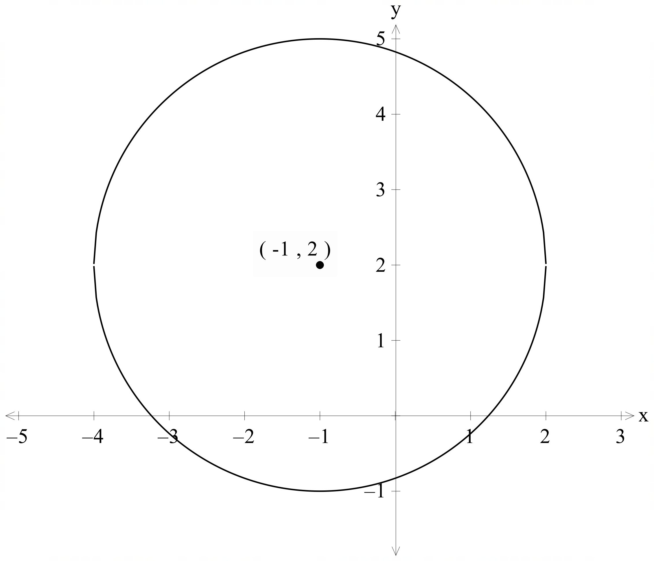
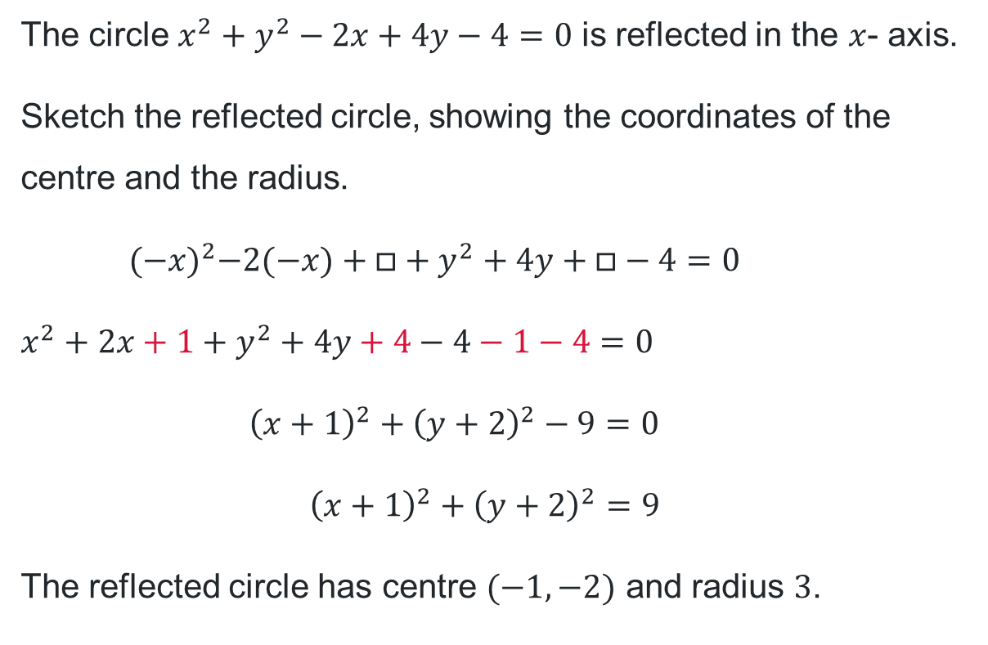
Incorrect worked example (2)
Incorrect solution 2
The circle $x^{2}+y^{2}−2x+4y−4=0$ is reflected in the $x$- axis.
Sketch the reflected circle, showing the coordinates of the centre and the radius.
$${(−x)}^{2}−2(−x)+□+y^{2}+4y+□−4=0$$
$$x^{2}+2x+1+y^{2}+4y+4−4−1−4=0$$
$${\left(x+1\right)}^{2}+{\left(y+2\right)}^{2}−9=0$$
$${\left(x+1\right)}^{2}+{\left(y+2\right)}^{2}=9$$
The reflected circle has centre $(−1, −2)$ and radius $3$.
Why is this solution incorrect or incomplete?

Slide 20
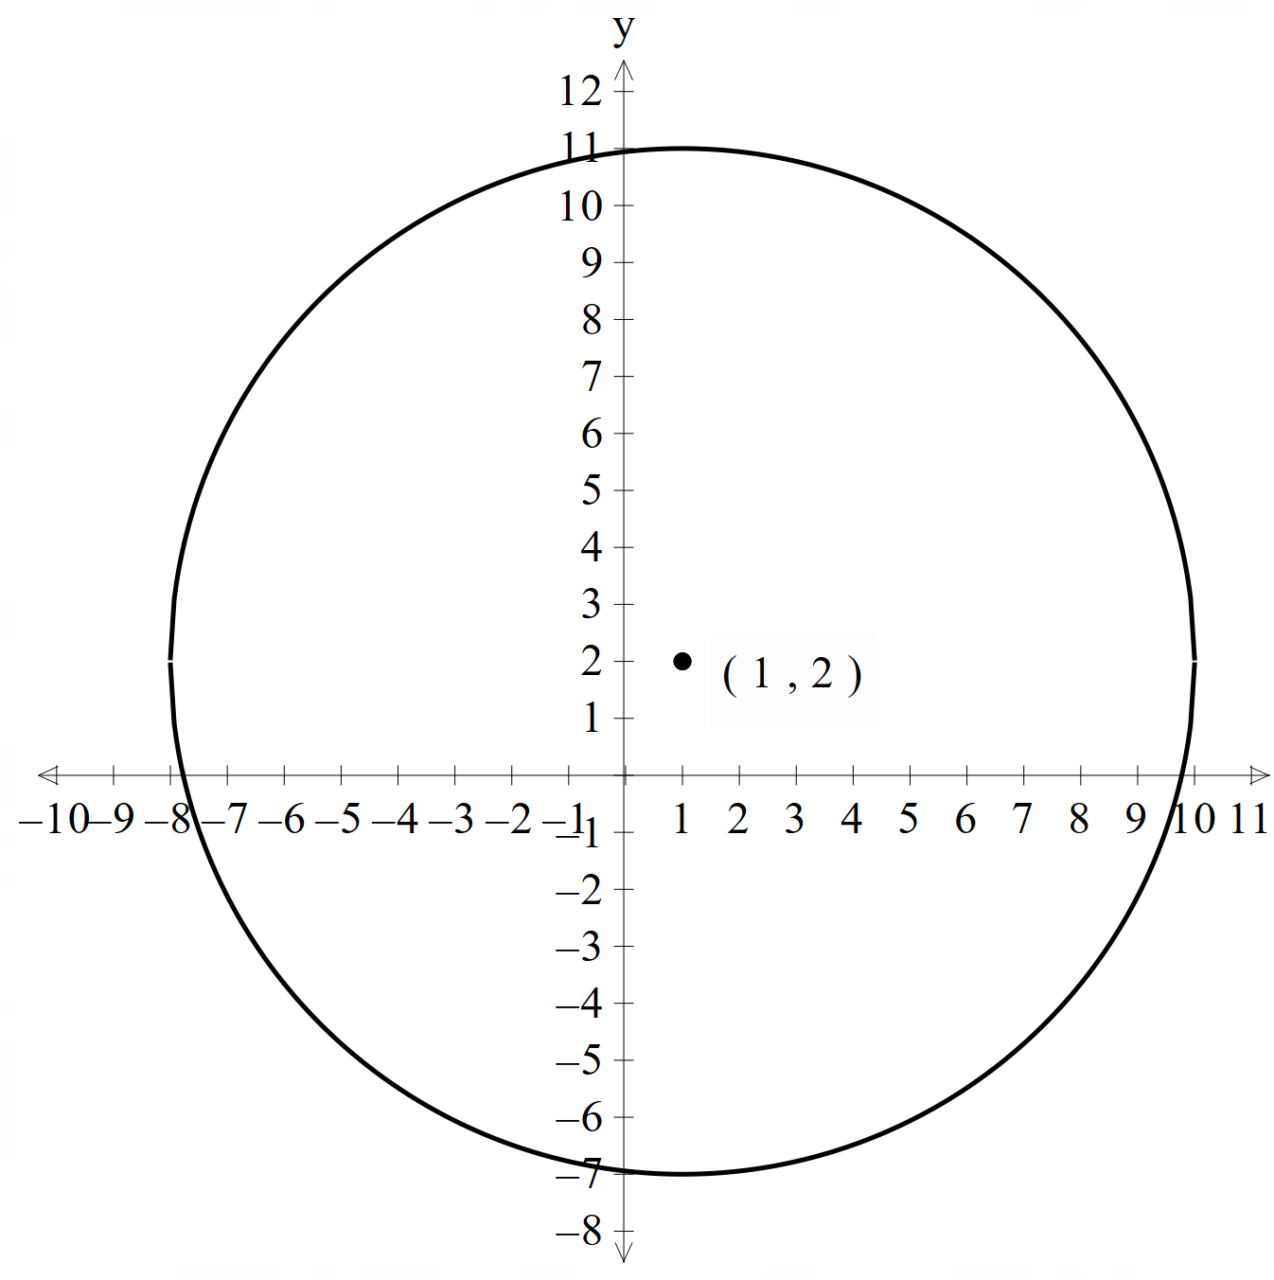
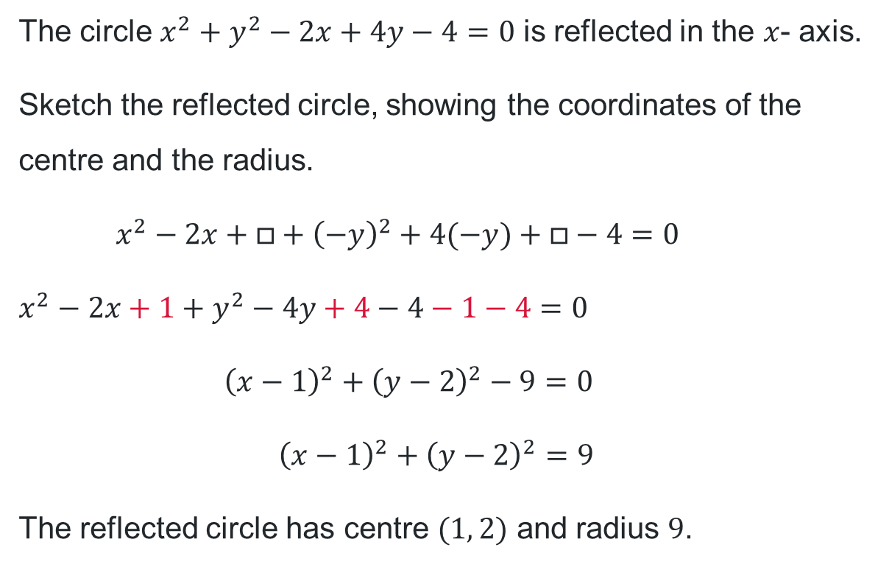
Incorrect worked example (3)
Incorrect solution 3
The circle $x^{2}+y^{2}−2x+4y−4=0$ is reflected in the $x$- axis.
Sketch the reflected circle, showing the coordinates of the centre and the radius.
$$x^{2}−2x+□+{\left(−y\right)}^{2}+4(−y)+□−4=0$$
$$x^{2}−2x+1+y^{2}−4y+4−4−1−4=0$$
$${\left(x−1\right)}^{2}+{\left(y−2\right)}^{2}−9=0$$
$${\left(x−1\right)}^{2}+{\left(y−2\right)}^{2}=9$$
The reflected circle has centre $(1, 2)$ and radius $9$.
Why is this solution incorrect or incomplete?

Slide 21
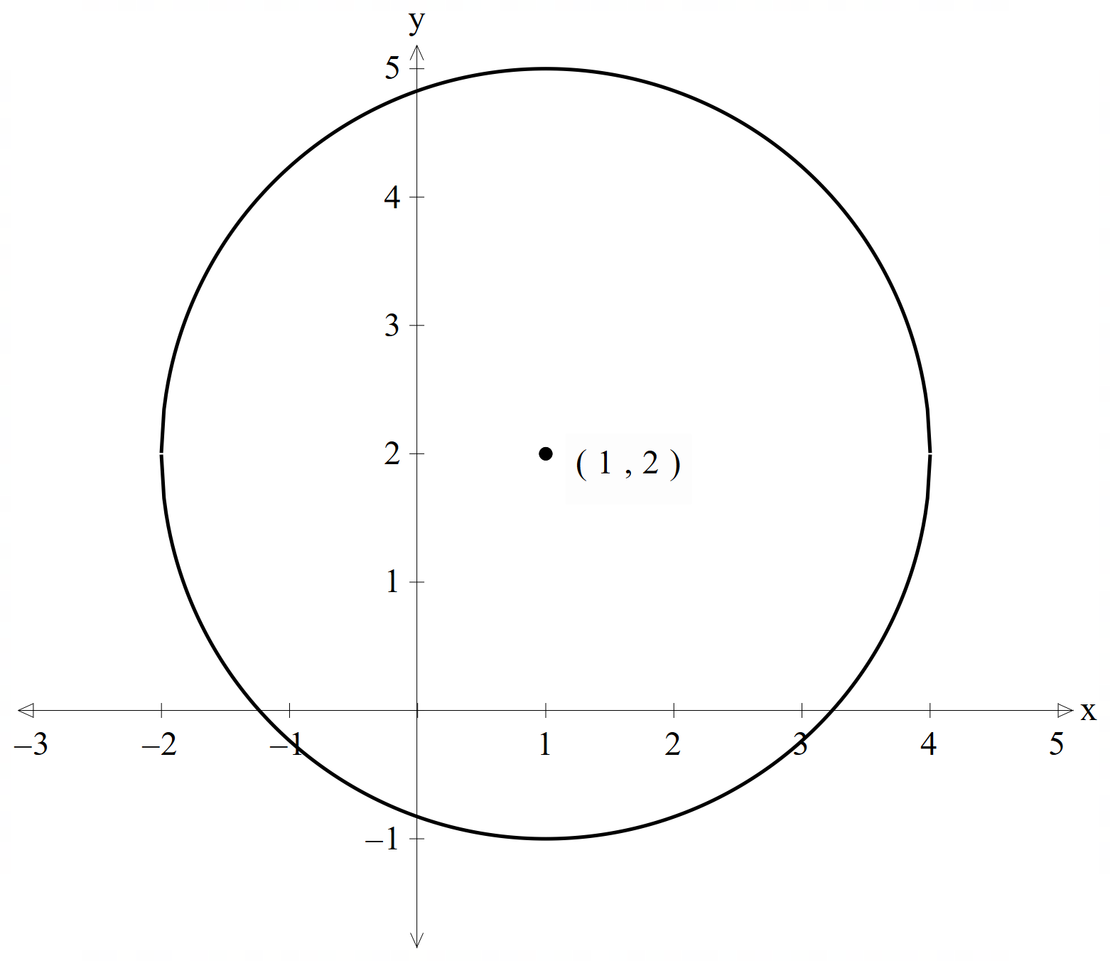
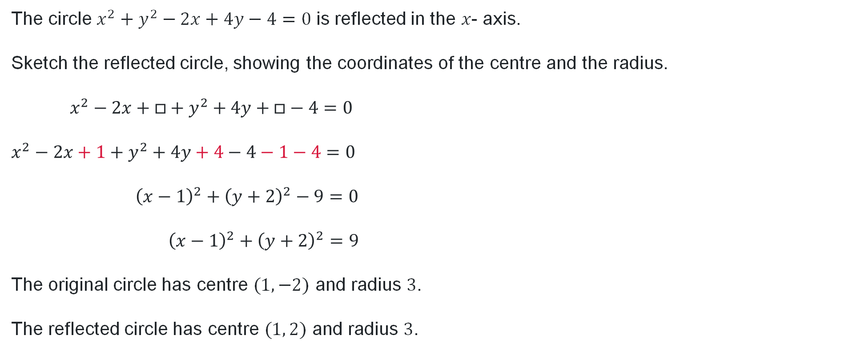
Reflection and translation – correct solution
Question
The circle $x^{2}+y^{2}−2x+4y−4=0$ is reflected in the $x$- axis.
Sketch the reflected circle, showing the coordinates of the centre and the radius.
$$x^{2}−2x+□+y^{2}+4y+□−4=0$$
$$x^{2}−2x+1+y^{2}+4y+4−4−1−4=0$$
$${\left(x−1\right)}^{2}+{\left(y+2\right)}^{2}−9=0$$
$${\left(x−1\right)}^{2}+{\left(y+2\right)}^{2}=9$$
The original circle has centre $(1, −2)$ and radius $3$.
The reflected circle has centre $(1, 2)$ and radius $3$.

Slide 22
References
This presentation contains NSW Curriculum and syllabus content. The NSW Curriculum is developed by the NSW Education Standards Authority. This content is prepared by NESA for and on behalf of the Crown in the right of the State of New South Wales. The material is protected by Crown copyright.
Please refer to the NESA Copyright Disclaimer for more information https://educationstandards.nsw.edu.au/wps/portal/nesa/mini-footer/copyright.
NESA holds the only official and up-to-date versions of the NSW Curriculum and syllabus documents. Please visit the NSW Education Standards Authority (NESA) website https://educationstandards.nsw.edu.au/wps/portal/nesa/home and the NSW Curriculum website https://curriculum.nsw.edu.au.
Mathematics Advanced 11–12 Syllabus © NSW Education Standards Authority (NESA) for and on behalf of the Crown in right of the State of New South Wales, 2024.

Slide 23
Copyright
© State of New South Wales (Department of Education), 2025
The copyright material published in this resource is subject to the Copyright Act 1968 (Cth) and is owned by the NSW Department of Education or, where indicated, by a party other than the NSW Department of Education (third-party material).
Copyright material available in this resource and owned by the NSW Department of Education is licensed under a Creative Commons Attribution 4.0 International (CC BY 4.0) license.
This license allows you to share and adapt the material for any purpose, even commercially.
Attribution should be given to © State of New South Wales (Department of Education), 2025.
Material in this resource not available under a Creative Commons license:
the NSW Department of Education logo, other logos and trademark-protected material
Material owned by a third party that has been reproduced with permission. You will need to obtain permission from the third party to reuse its material.
Links to third-party material and websites
Please note that the provided (reading/viewing material/list/links/texts) are a suggestion only and implies no endorsement, by the New South Wales Department of Education, of any author, publisher, or book title. School principals and teachers are best placed to assess the suitability of resources that would complement the curriculum and reflect the needs and interests of their students.
If you use the links provided in this document to access a third-party’s website, you acknowledge that the terms of use, including licence terms set out on the third-party’s website apply to the use which may be made of the materials on that third-party website or where permitted by the Copyright Act 1968 (Cth). The department accepts no responsibility for content on third-party websites.

