Slide 1

Solving absolute value equations
Mathematics Advanced – Stage 6 (Year 11)
Unit 4 – graphing transformations

Slide 2
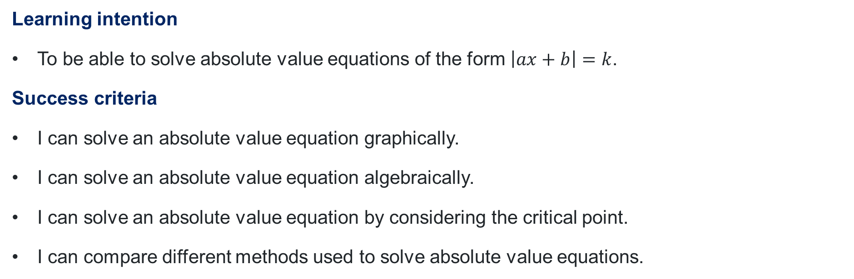
Learning intentions and success criteria
Learning intention
To be able to solve absolute value equations of the form $\left|ax+b\right|=k$.
Success criteria
I can solve an absolute value equation graphically.
I can solve an absolute value equation algebraically.
I can solve an absolute value equation by considering the critical point.
I can compare different methods used to solve absolute value equations.
Notes:
Notes for teachers:
Learning intentions and success criteria are best co-constructed with students. Adapt the learning intention as required and add matching success criteria.
For more information See ⁠AITSL or the NSW Department of Education explicit teaching strategies, ⁠Sharing learning intentions and ⁠Sharing success criteria
LISC is not necessarily presented at the beginning of the lesson. Teacher needs to consider most effectual time to introduce
LISC should be revisited during the lesson to support students' evaluation of their learning

Slide 3
Activating prior knowledge

Slide 4
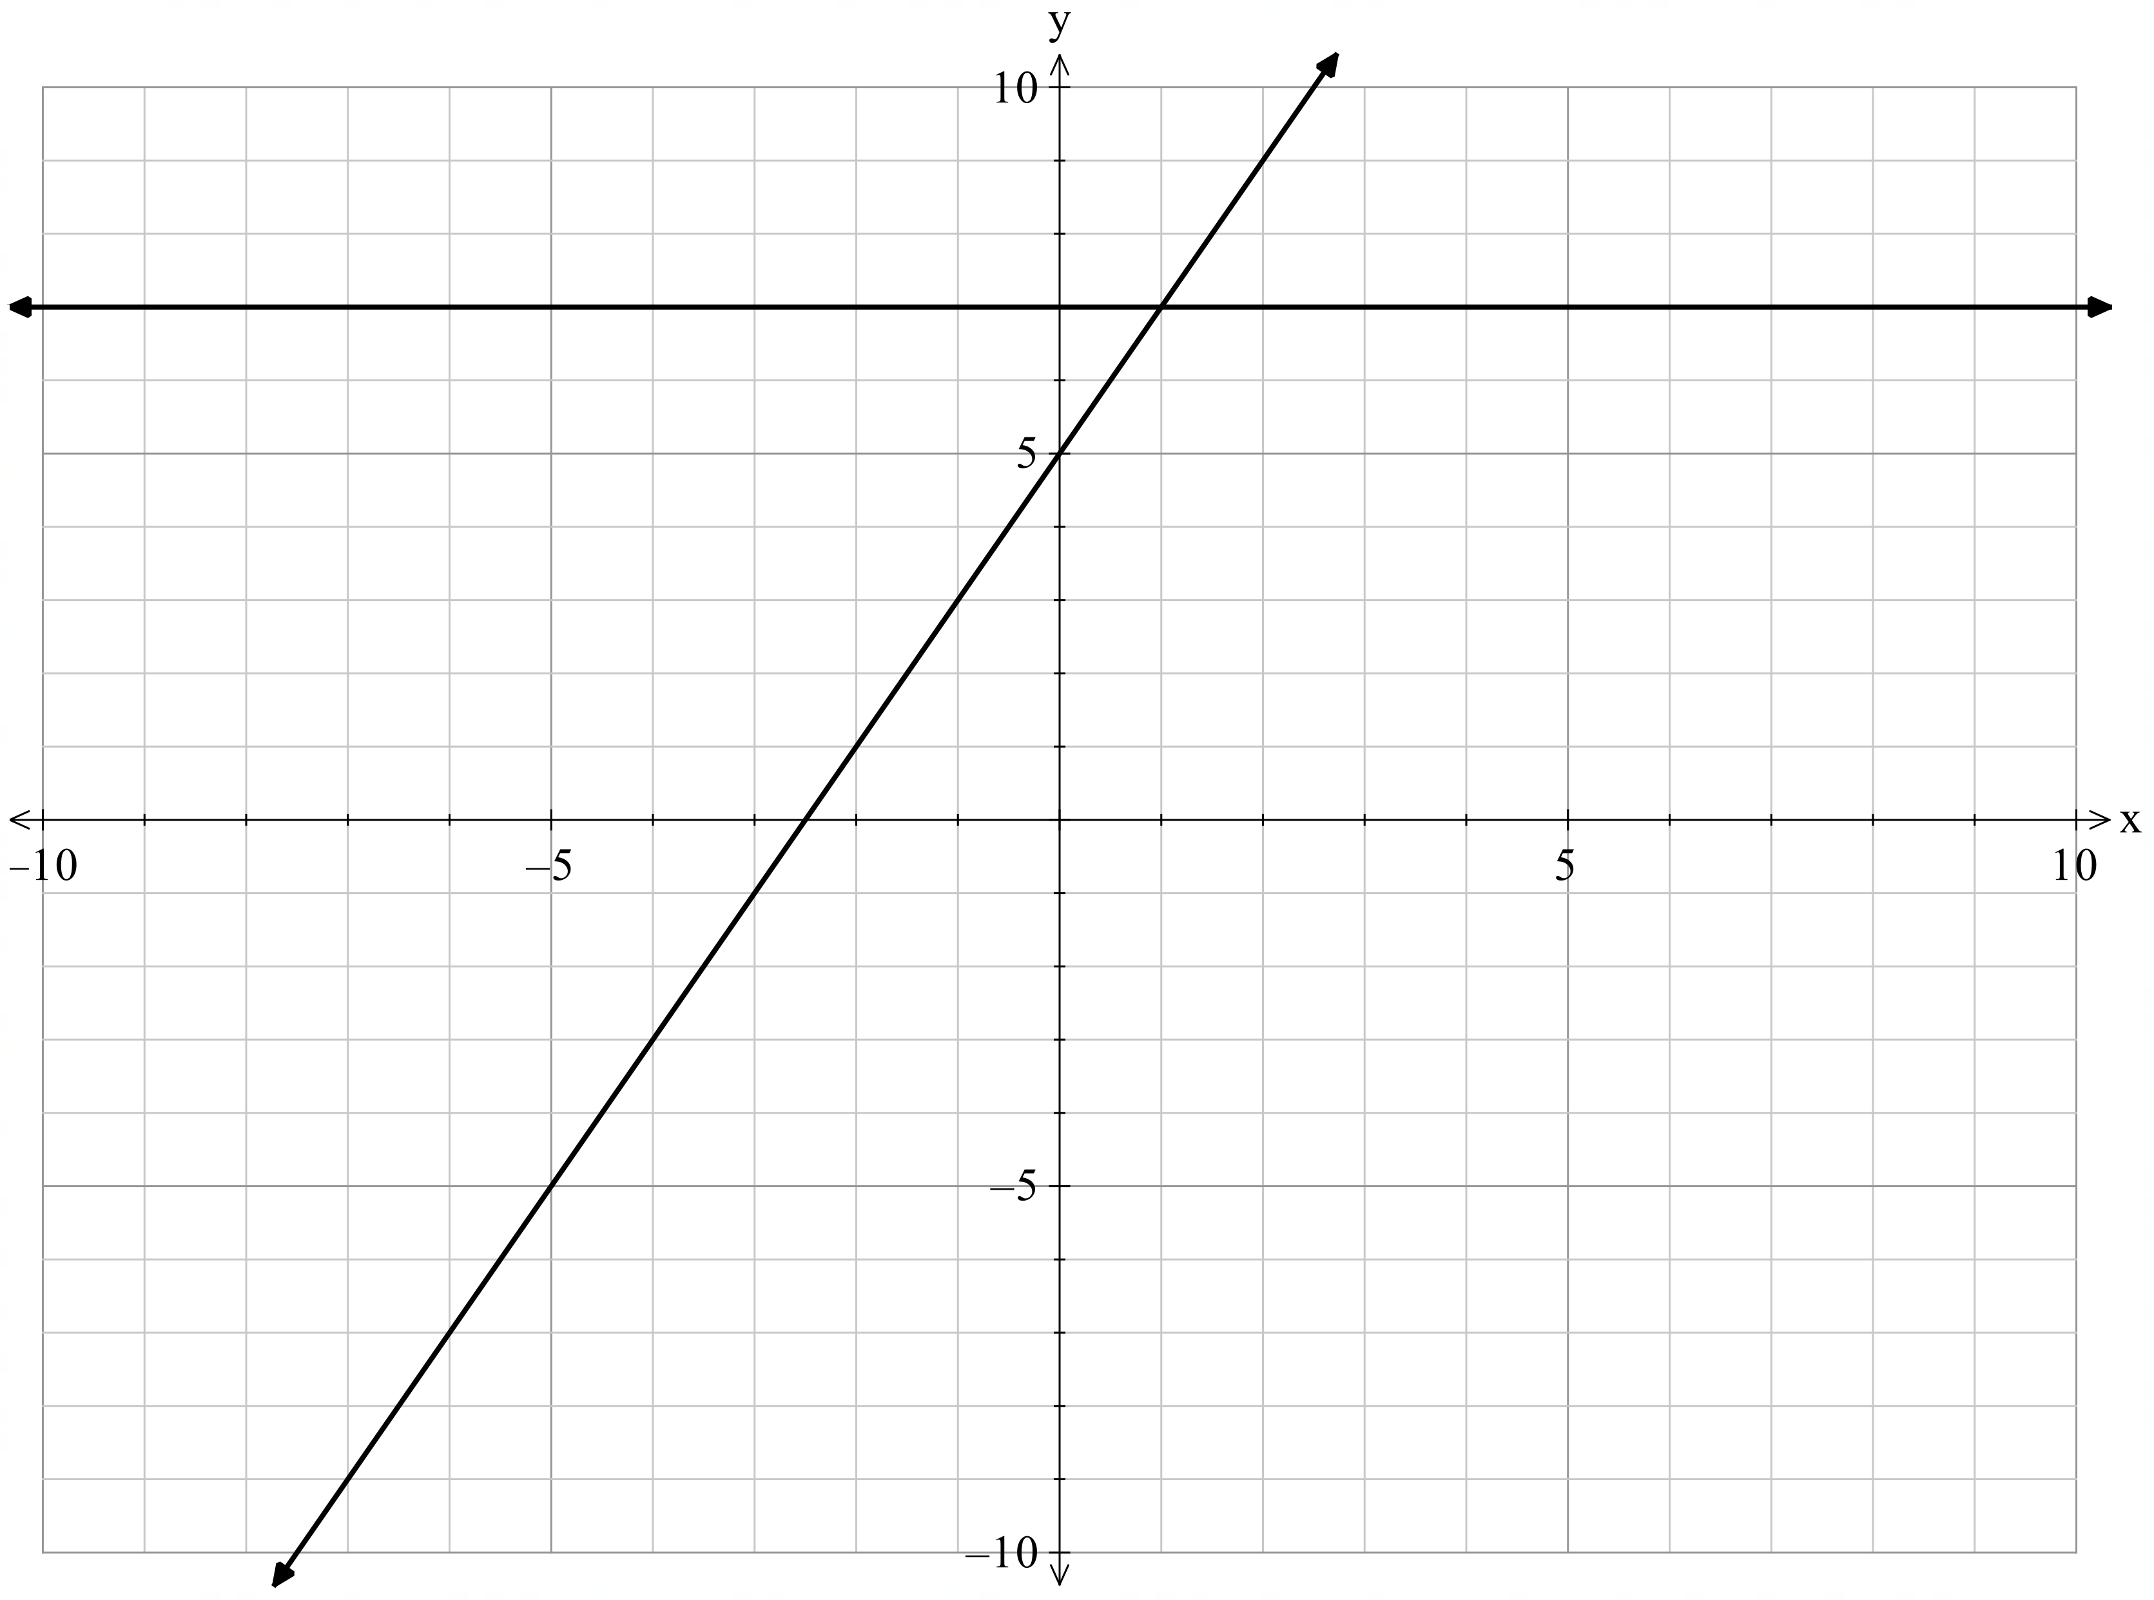
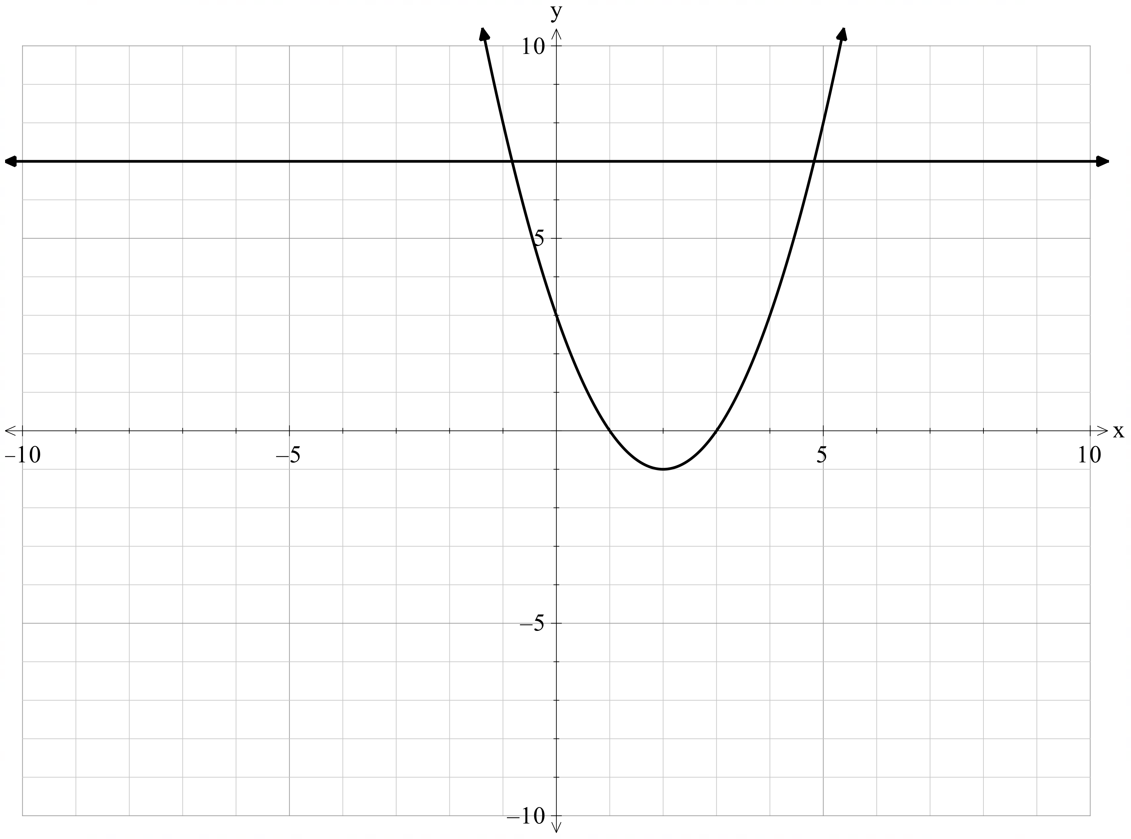


Pairs of equations
How many solutions are in each pair of equations? Use the graphs to support your answer.
$$y=2x+5 \text{and} y=7$$
$$y=x^{2}−4x+3 \text{and} y=7$$

Slide 5
Connecting learning

Slide 6
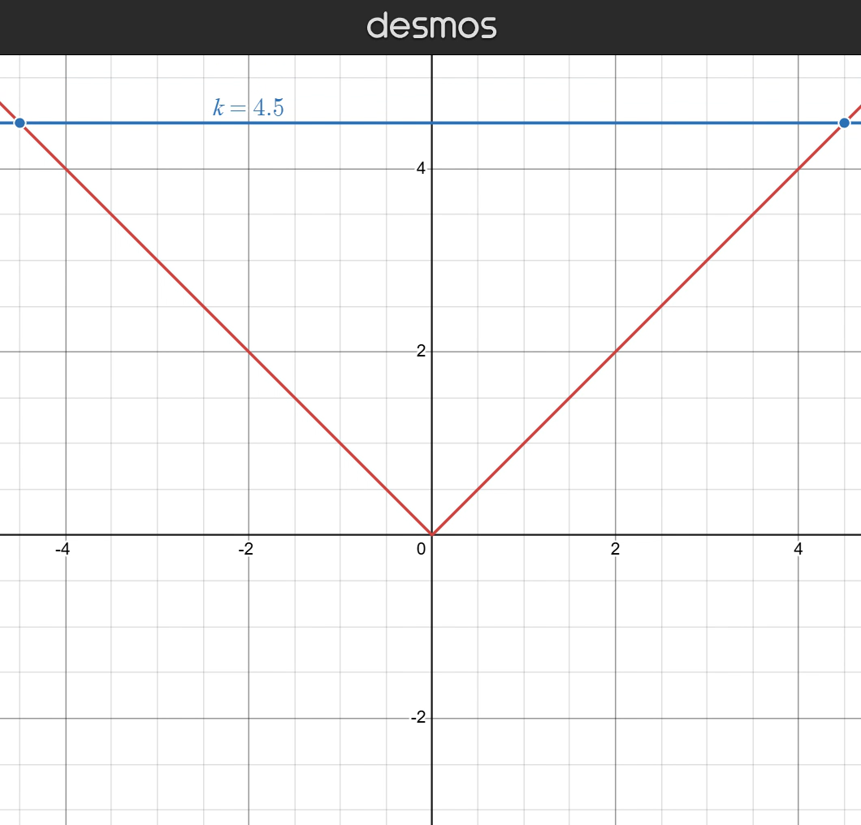
Number of intercepts

Slide 7
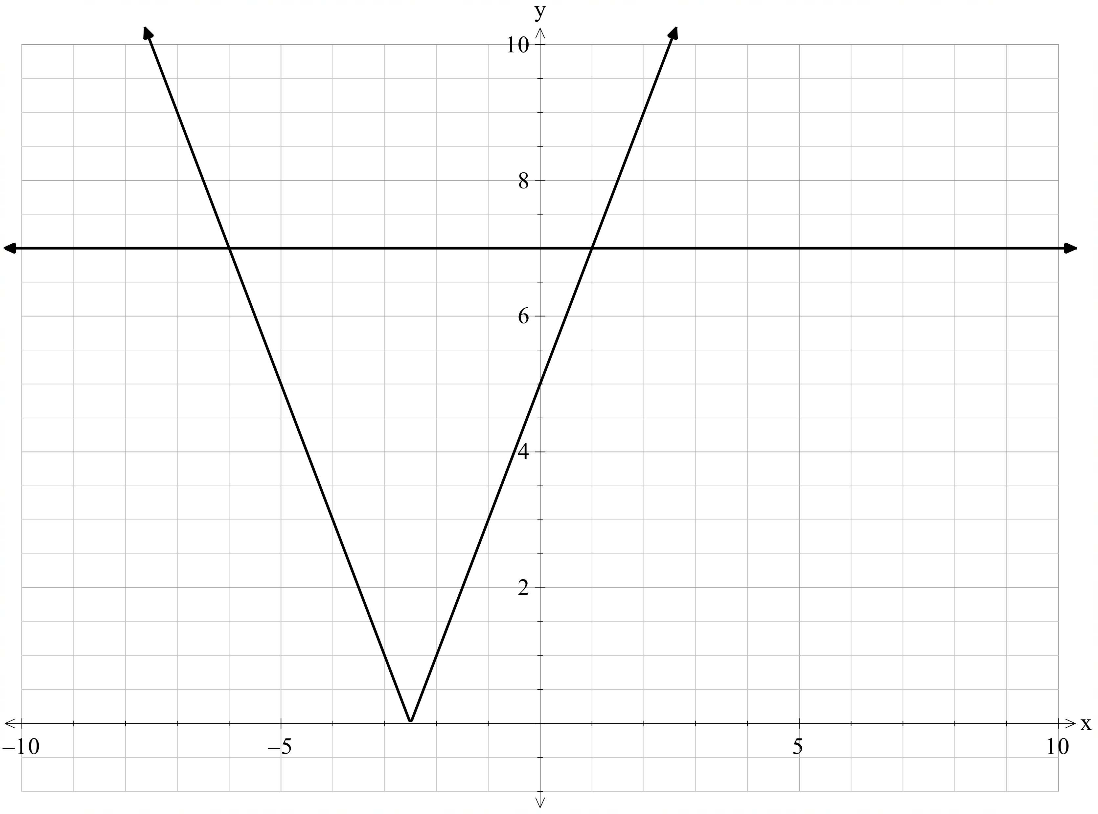

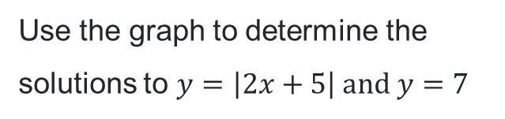


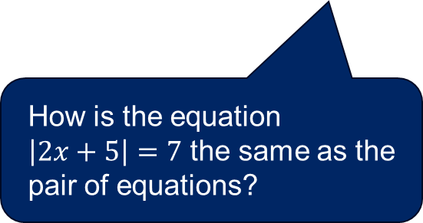
Solving absolute value equations graphically (1)
Use the graph to determine the solutions to $y=\left|2x+5\right| \text{and} y=7$
How is the equation $\left|2x+5\right|=7$ the same as the pair of equations?
Point of intersection $(−6,7)$
Point of intersection $(1,7)$
$$∴x=−6 \text{and} 1$$

Slide 8
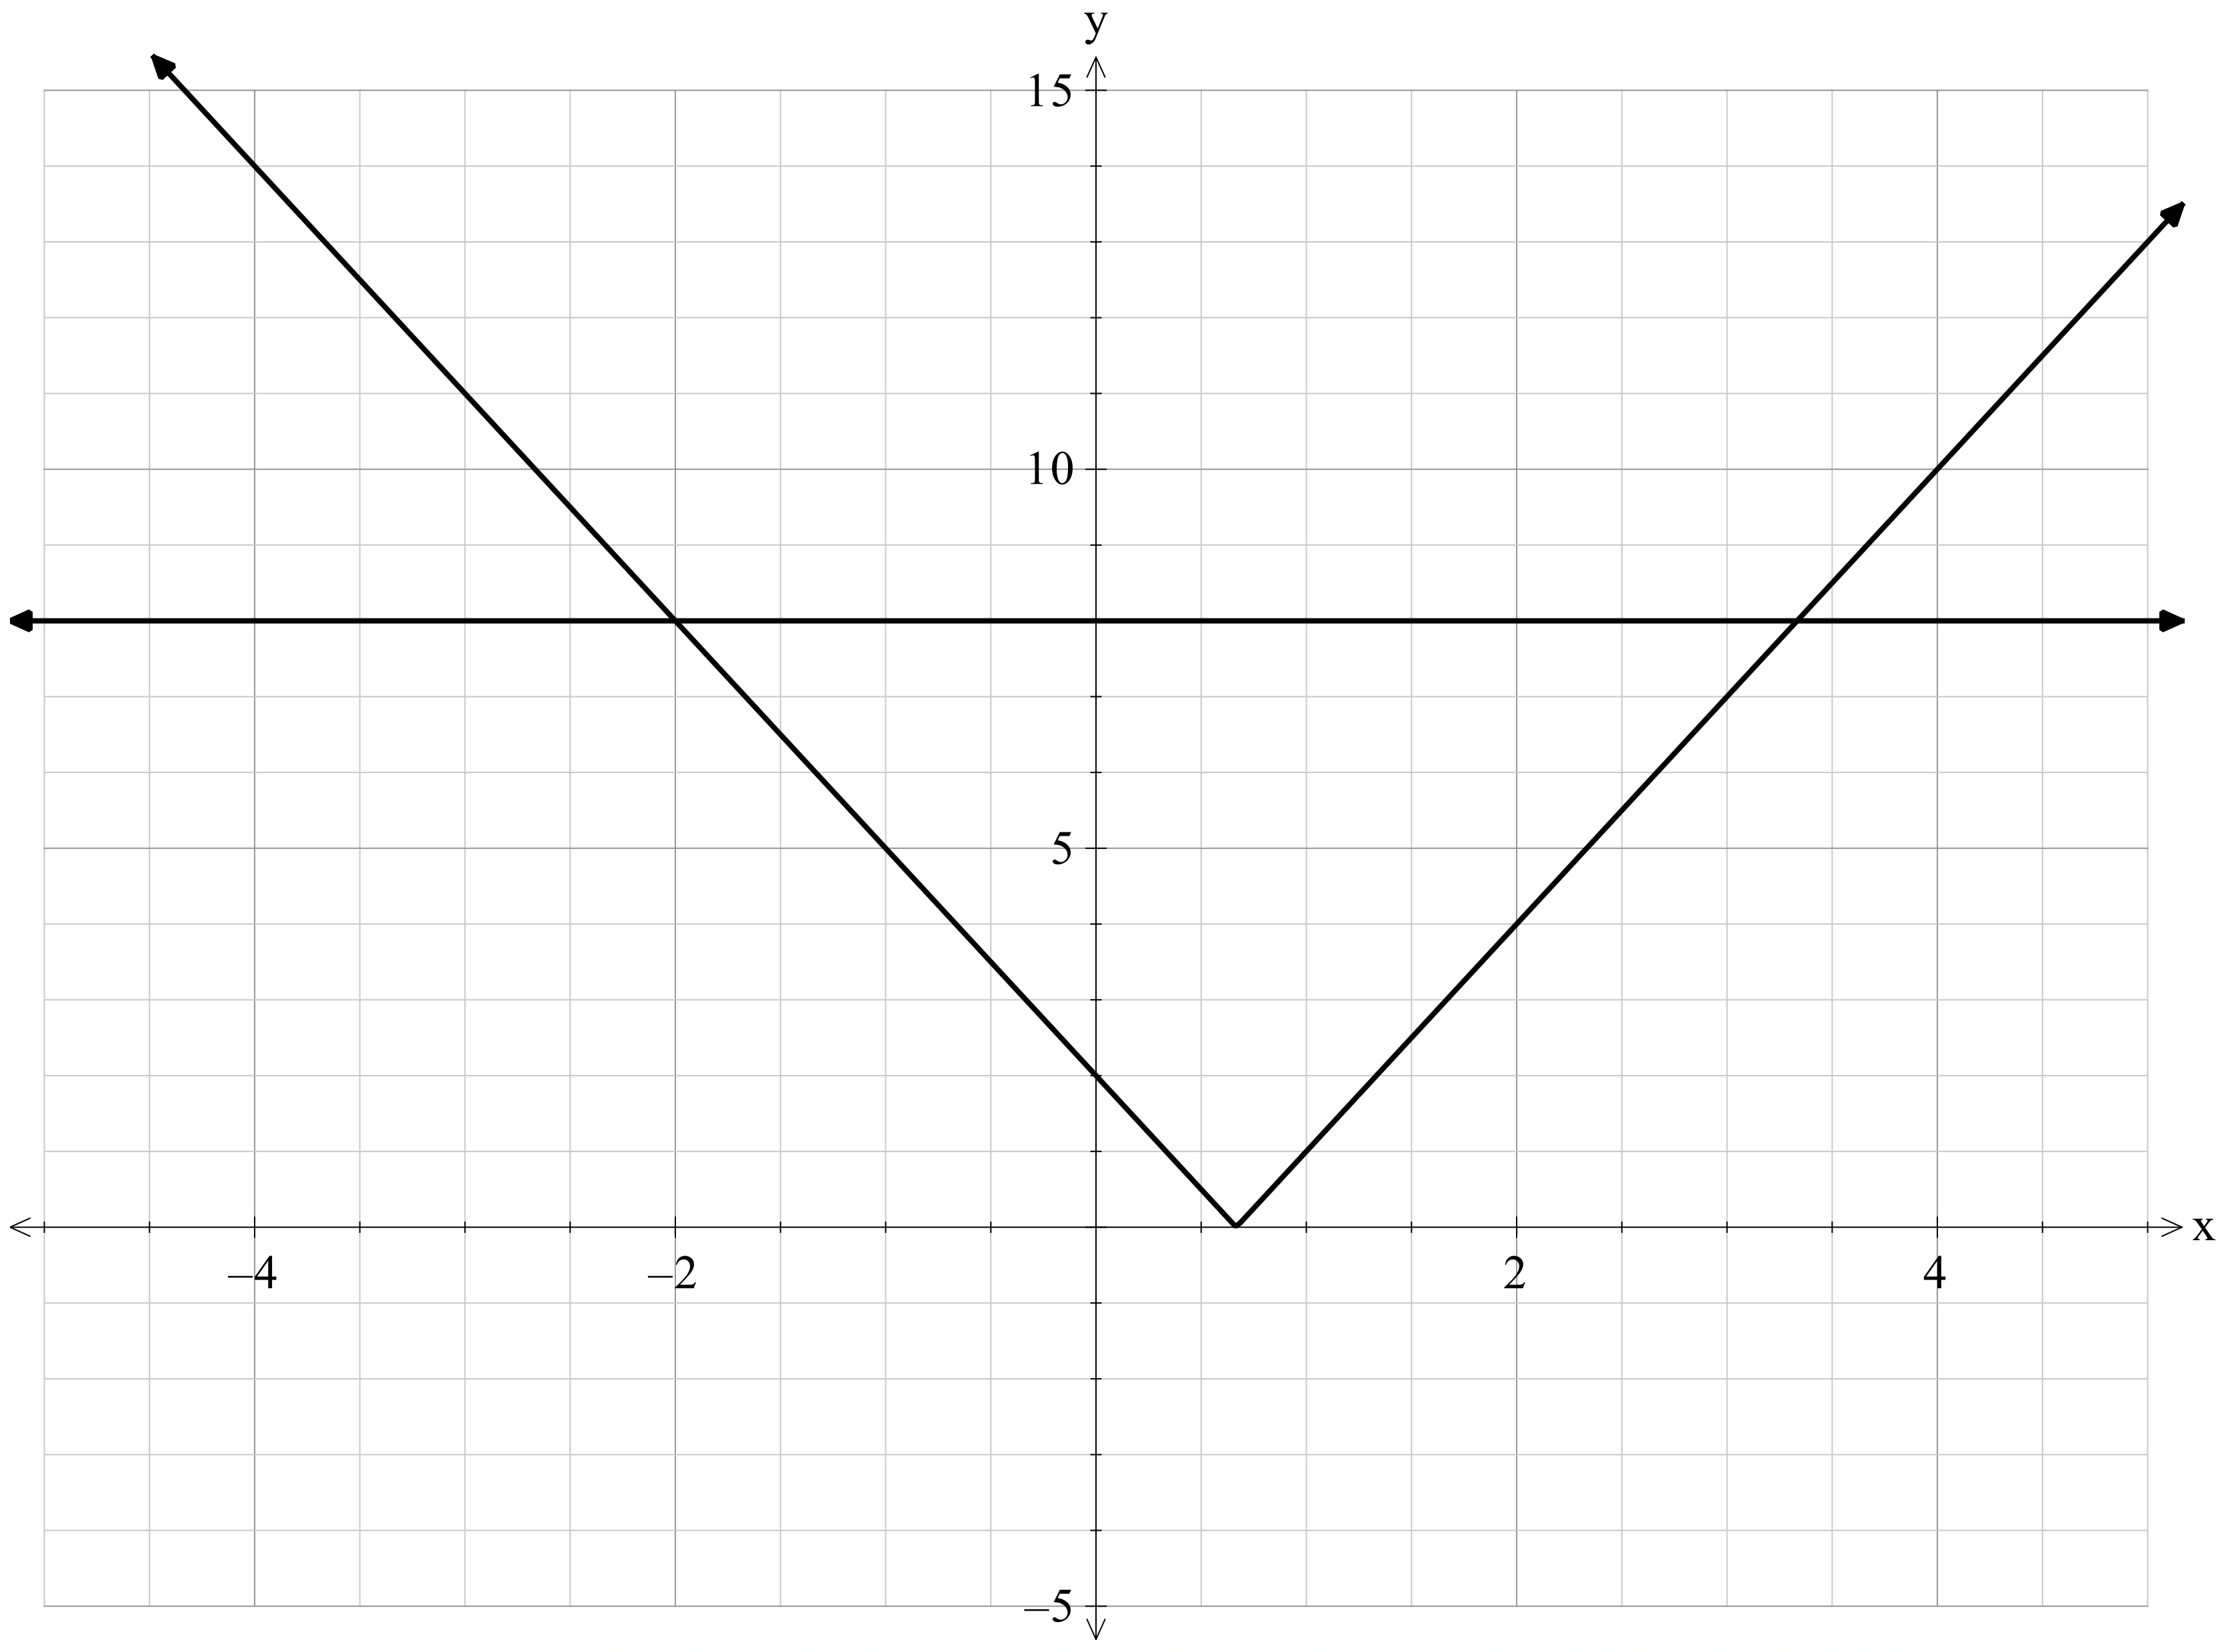
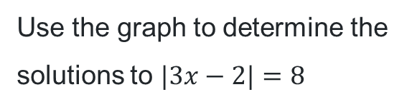


Solving absolute value equations graphically (2)
Use the graph to determine the solutions to $|3x−2|=8$
Point of intersection $(\frac{10}{3},8)$
Point of intersection $(−2,8)$

Slide 9
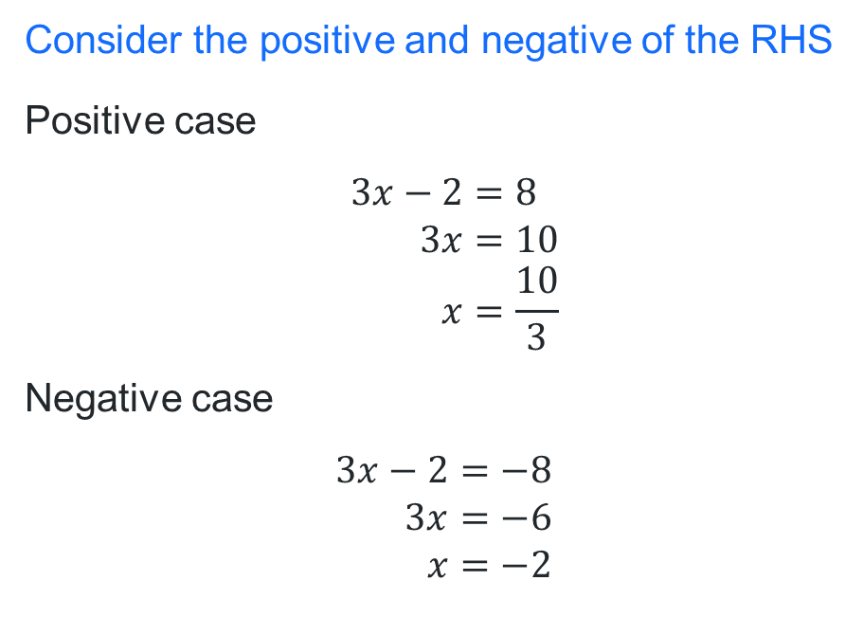
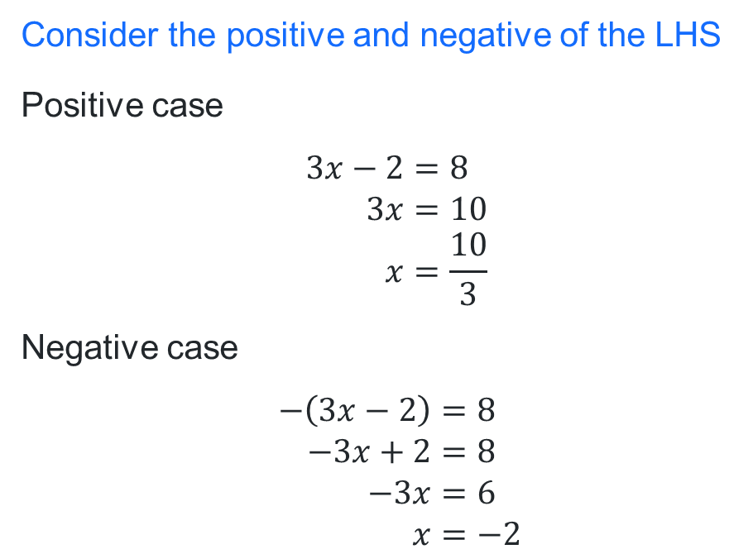
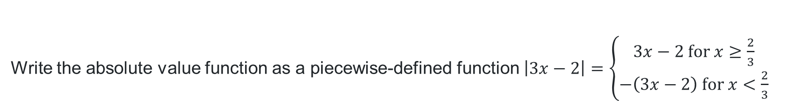
Solving $\left|3x−2\right|=8$
Write the absolute value function as a piecewise-defined function $\left|3x−2\right|=\left\{\begin{aligned}3x−2 \text{for} x≥\frac{2}{3} \\ −\left(3x−2\right) \text{for} x<\frac{2}{3}\end{aligned}\right.$
2 methods
Consider the positive and negative of the LHS
Positive case
$$3x−2=8 \\ 3x=10 \\ x=\frac{10}{3}$$
Negative case
$$−\left(3x−2\right)=8 \\ −3x+2=8 \\ −3x=6 \\ x=−2$$
Consider the positive and negative of the RHS
Positive case
$$3x−2=8 \\ 3x=10 \\ x=\frac{10}{3}$$
Negative case
$$3x−2=−8 \\ 3x=−6 \\ x=−2$$
What is similar and different about the two methods?

Slide 10
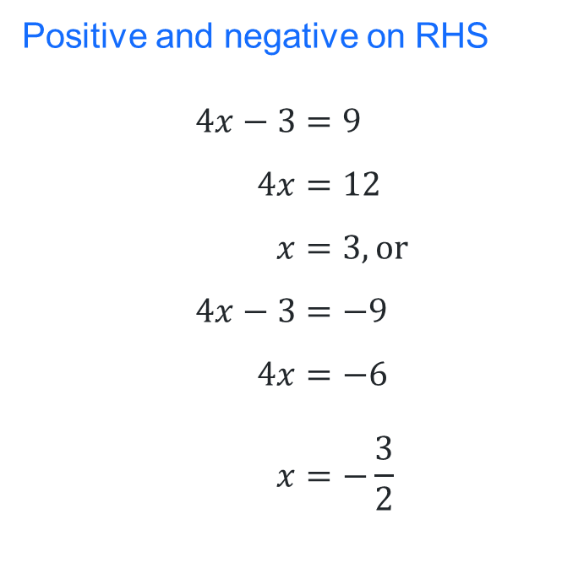
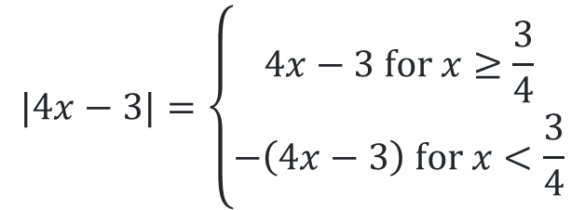
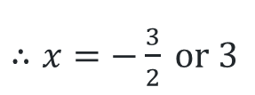

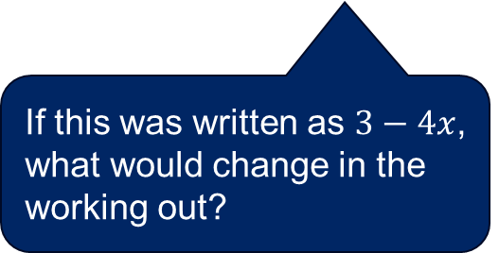
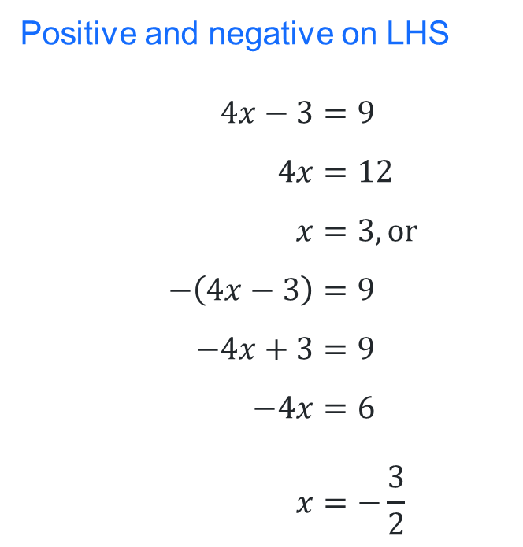
Solving absolute value equations algebraically (1)
Worked Example
Solve the equation $\left|4x−3\right|=9$
$$|4x−3|=\left\{\begin{aligned}4x−3 \text{for} x≥\frac{3}{4} \\ −\left(4x−3\right) \text{for} x<\frac{3}{4}\end{aligned}\right.$$
Positive and negative on LHS
$$4x−3=9 \\ 4x=12 \\ x=3, or \\ −\left(4x−3\right)=9 \\ −4x+3=9 \\ −4x=6 \\ x=−\frac{3}{2}$$
Positive and negative on RHS
$$4x−3=9 \\ 4x=12 \\ x=3, or \\ 4x−3=−9 \\ 4x=−6 \\ x=−\frac{3}{2}$$
If this was written as $3−4x$, what would change in the working out?
How could these solutions be verified?
$∴x=−\frac{3}{2} \text{or} 3$

Slide 11
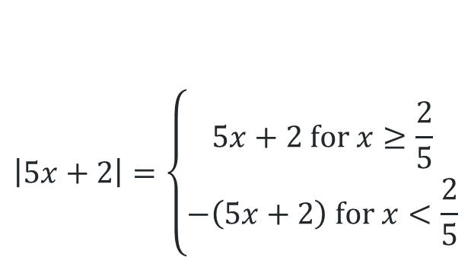

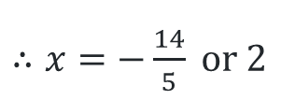
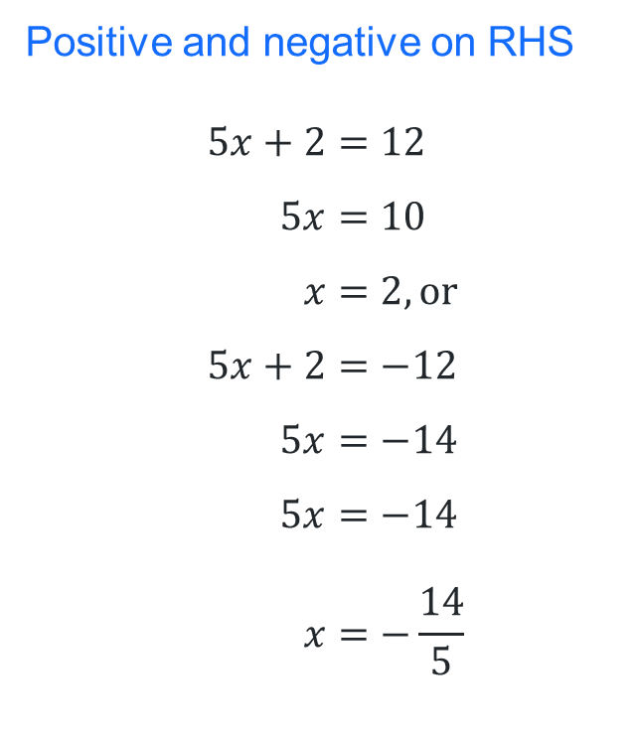
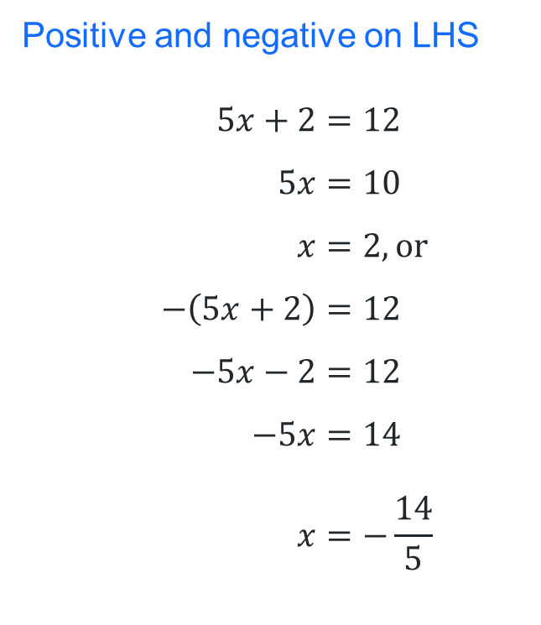
Solving absolute value equations algebraically (2)
Your turn
$$\left|5x+2\right|=\left\{\begin{aligned}5x+2 \text{for} x≥\frac{2}{5} \\ −\left(5x+2\right) \text{for} x<\frac{2}{5}\end{aligned}\right.$$
Positive and negative on LHS
$$5x+2=12 \\ 5x=10 \\ x=2, \text{or} \\ −\left(5x+2\right)=12 \\ −5x−2=12 \\ −5x=14 \\ x=−\frac{14}{5}$$
Positive and negative on RHS
$$5x+2=12 \\ 5x=10 \\ x=2, \text{or} \\ 5x+2=−12 \\ 5x=−14 \\ 5x=−14 \\ x=−\frac{14}{5}$$
Solve the equation $\left|5x+2\right|=12$
$∴x=−\frac{14}{5} \text{or} 2$

Slide 12



















































Solving using the critical point (1)
Solve $\left|x\right|=4$
Why did it jump 4 units away from zero in both the positive and negative direction?
$$x=−4 \text{or} 4$$
$$−5$$
$$−4$$
$−$3
$$−2$$
$−$1
$$0$$
$$1$$
$$2$$
$$3$$
$$4$$
$$5$$
Solve $\left|x+1\right|=4$
$$x=−5 \text{or} 3$$
How do you know where to start on the number line? What is this point called in an absolute value graph?
$$−5$$
$$−4$$
$−$3
$$−2$$
$−$1
$$0$$
$$1$$
$$2$$
$$3$$
$$4$$
$$5$$
Solve $\left|x−1\right|=4$
$$x=−3 \text{or} 5$$
$$−5$$
$$−4$$
$−$3
$$−2$$
$−$1
$$0$$
$$1$$
$$2$$
$$3$$
$$4$$
$$5$$
Solve $\left|x+3\right|=7$
How might you solve this question?
$$−5$$
$$−4$$
$−$3
$$−2$$
$−$1
$$0$$
$$1$$
$$2$$
$$3$$
$$4$$
$$5$$

Slide 13
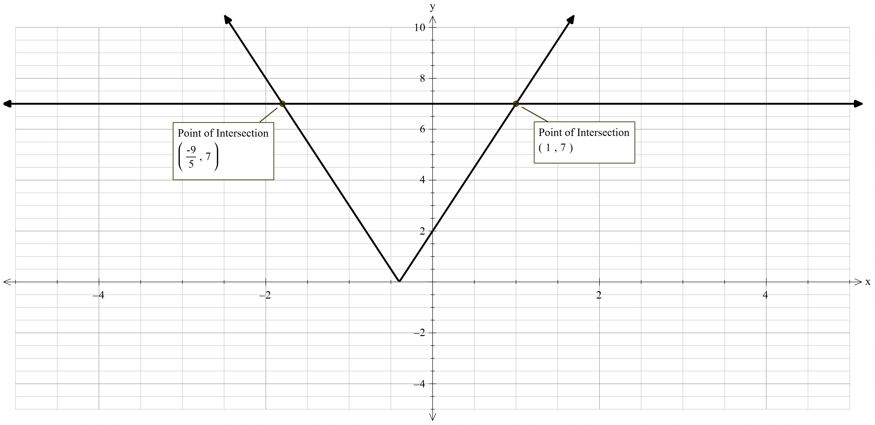

Solving using the critical point (2)
Solve $\left|5x+2\right|=7$

Slide 14

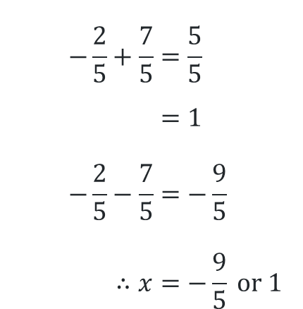




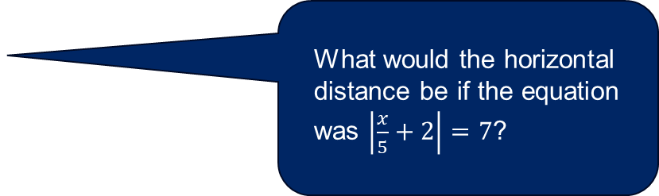
Solving using the critical point (3)
Worked example
Why was 7 divided by 5?
Solve $\left|5x+2\right|=7$
$$−\frac{7}{5}$$
$$+\frac{7}{5}$$
What would the horizontal distance be if the equation was $\left|\frac{x}{5}+2\right|=7$?
$$−\frac{9}{5}$$
$$−\frac{2}{5}$$
$$1$$
$$−\frac{2}{5}+\frac{7}{5}=\frac{5}{5} \\ =1 \\ −\frac{2}{5}−\frac{7}{5}=−\frac{9}{5} \\ ∴x=−\frac{9}{5} \text{or}\text{ 1}$$
How can you interpret the critical point from the question?

Slide 15







Solving using the critical point (4)
Your turn
Solve $\left|4x−9\right|=3$
$$\frac{9}{4}+\frac{3}{4}=\frac{12}{4} \\ =3 \\ \frac{9}{4}−\frac{3}{4}=\frac{6}{4} \\ =\frac{2}{3} \\ ∴x=\frac{2}{3} \text{or}\text{ 3}$$
$$−\frac{3}{4}$$
$$+\frac{3}{4}$$
$$\frac{2}{3}$$
$$\frac{9}{4}$$
$$3$$

Slide 16
Releasing responsibility

Slide 17
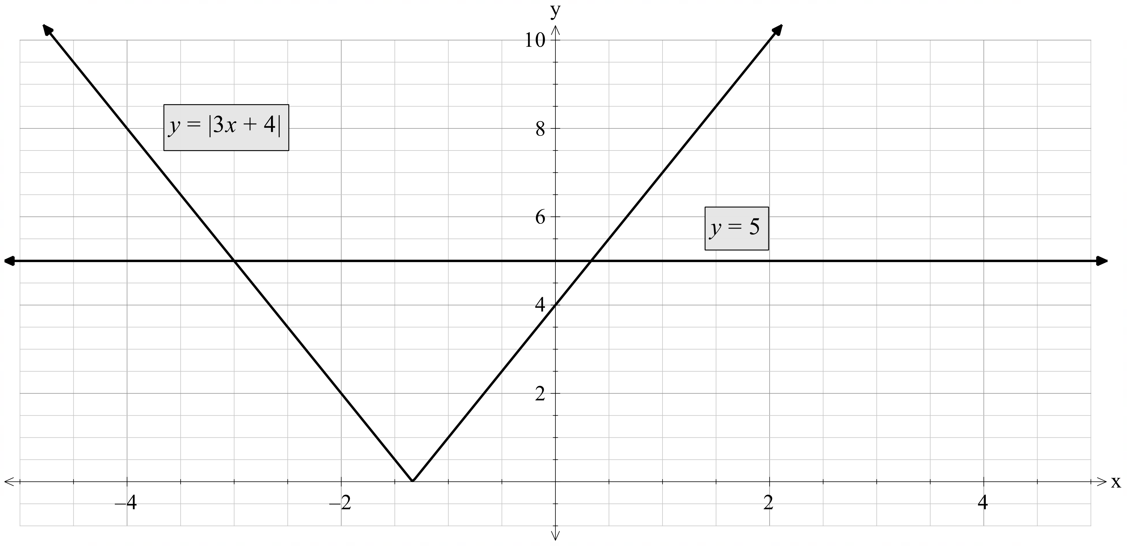
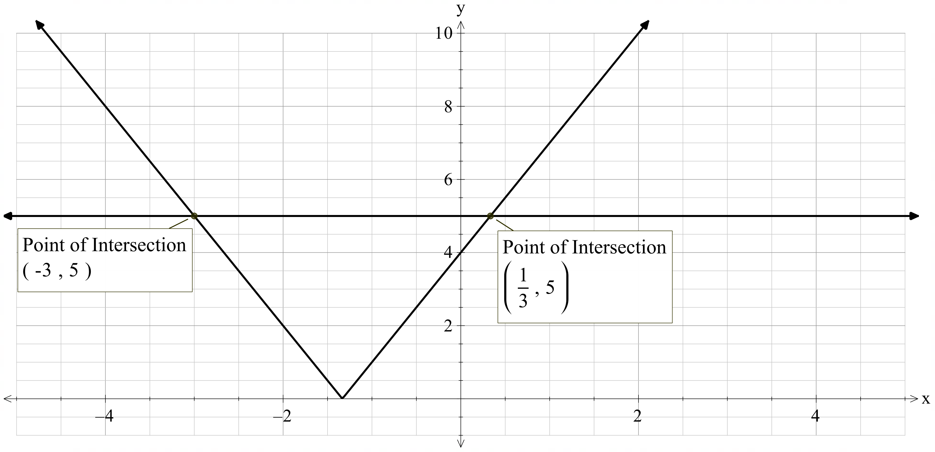
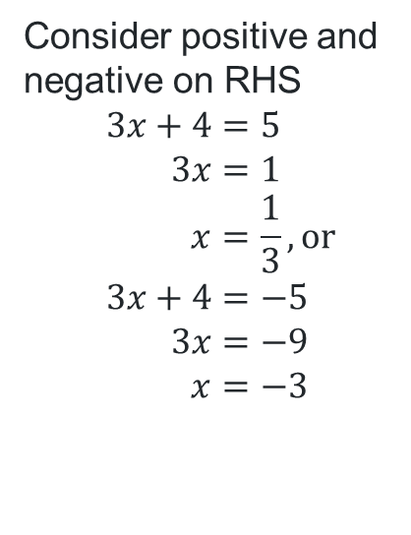


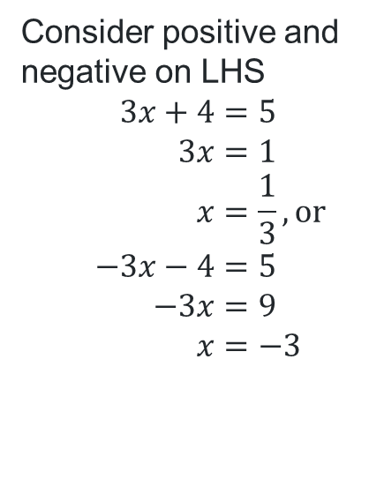

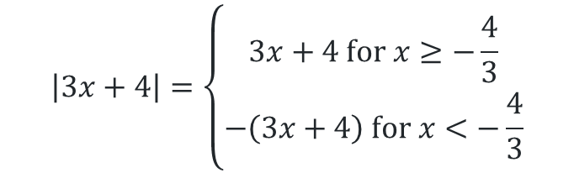




Worked example comparison
Solve the equation $\left|3x+4\right|=5$
Graphing method
Algebraic method
Critical point method
$$\left|3x+4\right|=\left\{\begin{aligned}3x+4 \text{for} x≥−\frac{4}{3} \\ −\left(3x+4\right) \text{for} x<−\frac{4}{3}\end{aligned}\right.$$
$$−\frac{5}{3}$$
$$+\frac{5}{3}$$
Consider positive and negative on LHS
$$3x+4=5 \\ 3x=1 \\ x=\frac{1}{3}, \text{or} \\ −3x−4=5 \\ −3x=9 \\ x=−3$$
Consider positive and negative on RHS
$$3x+4=5 \\ 3x=1 \\ x=\frac{1}{3}, \text{or} \\ 3x+4=−5 \\ 3x=−9 \\ x=−3$$
$$−\frac{19}{3}$$
$$−\frac{4}{3}$$
$$\frac{11}{3}$$
$$−\frac{4}{3}−\frac{5}{3}=−\frac{9}{3} \\ =−3 \\ −\frac{4}{3}+\frac{5}{3}=\frac{1}{3}$$
What are some of the advantages of each method?

Slide 18
References
This presentation contains NSW Curriculum and syllabus content. The NSW Curriculum is developed by the NSW Education Standards Authority. This content is prepared by NESA for and on behalf of the Crown in the right of the State of New South Wales. The material is protected by Crown copyright.
Please refer to the NESA Copyright Disclaimer for more information https://educationstandards.nsw.edu.au/wps/portal/nesa/mini-footer/copyright.
NESA holds the only official and up-to-date versions of the NSW Curriculum and syllabus documents. Please visit the NSW Education Standards Authority (NESA) website https://educationstandards.nsw.edu.au/wps/portal/nesa/home and the NSW Curriculum website https://curriculum.nsw.edu.au.
Mathematics Advanced 11–12 Syllabus © NSW Education Standards Authority (NESA) for and on behalf of the Crown in right of the State of New South Wales, 2024.

Slide 19
Copyright
© State of New South Wales (Department of Education), 2025
The copyright material published in this resource is subject to the Copyright Act 1968 (Cth) and is owned by the NSW Department of Education or, where indicated, by a party other than the NSW Department of Education (third-party material).
Copyright material available in this resource and owned by the NSW Department of Education is licensed under a Creative Commons Attribution 4.0 International (CC BY 4.0) license.
This license allows you to share and adapt the material for any purpose, even commercially.
Attribution should be given to © State of New South Wales (Department of Education), 2025.
Material in this resource not available under a Creative Commons license:
the NSW Department of Education logo, other logos and trademark-protected material
Material owned by a third party that has been reproduced with permission. You will need to obtain permission from the third party to reuse its material.
Links to third-party material and websites
Please note that the provided (reading/viewing material/list/links/texts) are a suggestion only and implies no endorsement, by the New South Wales Department of Education, of any author, publisher, or book title. School principals and teachers are best placed to assess the suitability of resources that would complement the curriculum and reflect the needs and interests of their students.
If you use the links provided in this document to access a third-party’s website, you acknowledge that the terms of use, including licence terms set out on the third-party’s website apply to the use which may be made of the materials on that third-party website or where permitted by the Copyright Act 1968 (Cth). The department accepts no responsibility for content on third-party websites.

