Slide 1

Solving quadratic inequalities
Mathematics Adanced – Stage 6 (Year 11)
Working with linear and quadratic functions

Slide 2
Activating prior knowledge

Slide 3
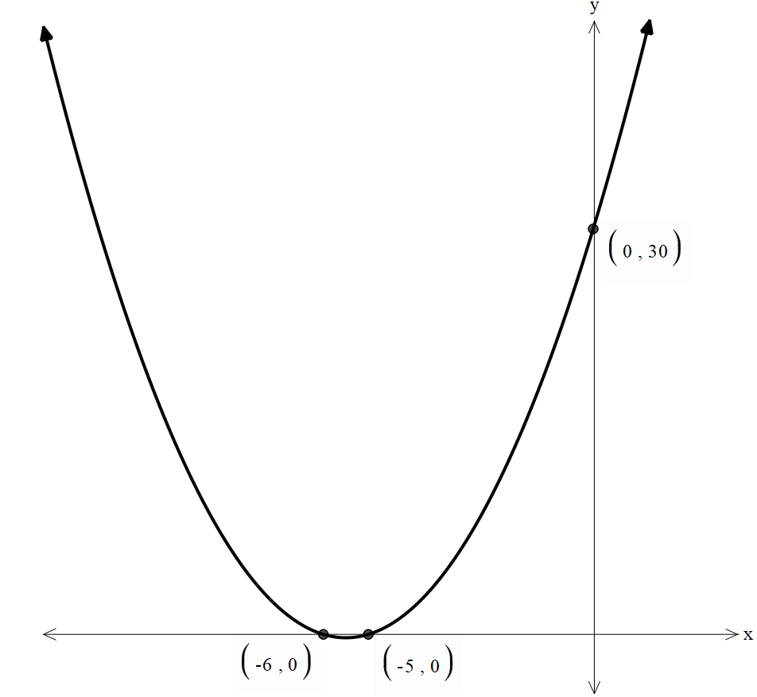
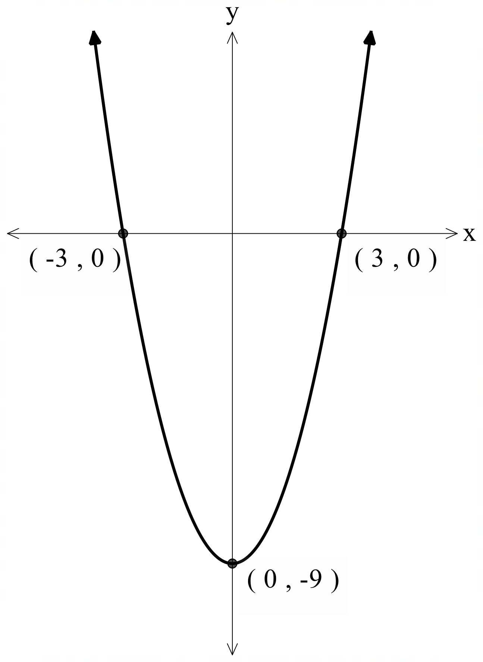







Graphing a quadratic function (1)
$f\left(x\right)=(x+6)(x+5)$
$f\left(x\right)=x^{2}−9$
$$(0, 30)$$
$$(−3, 0)$$
$$(3, 0)$$
$$(−6, 0)$$
$$(−5, 0)$$
$$(0, −9)$$

Slide 4
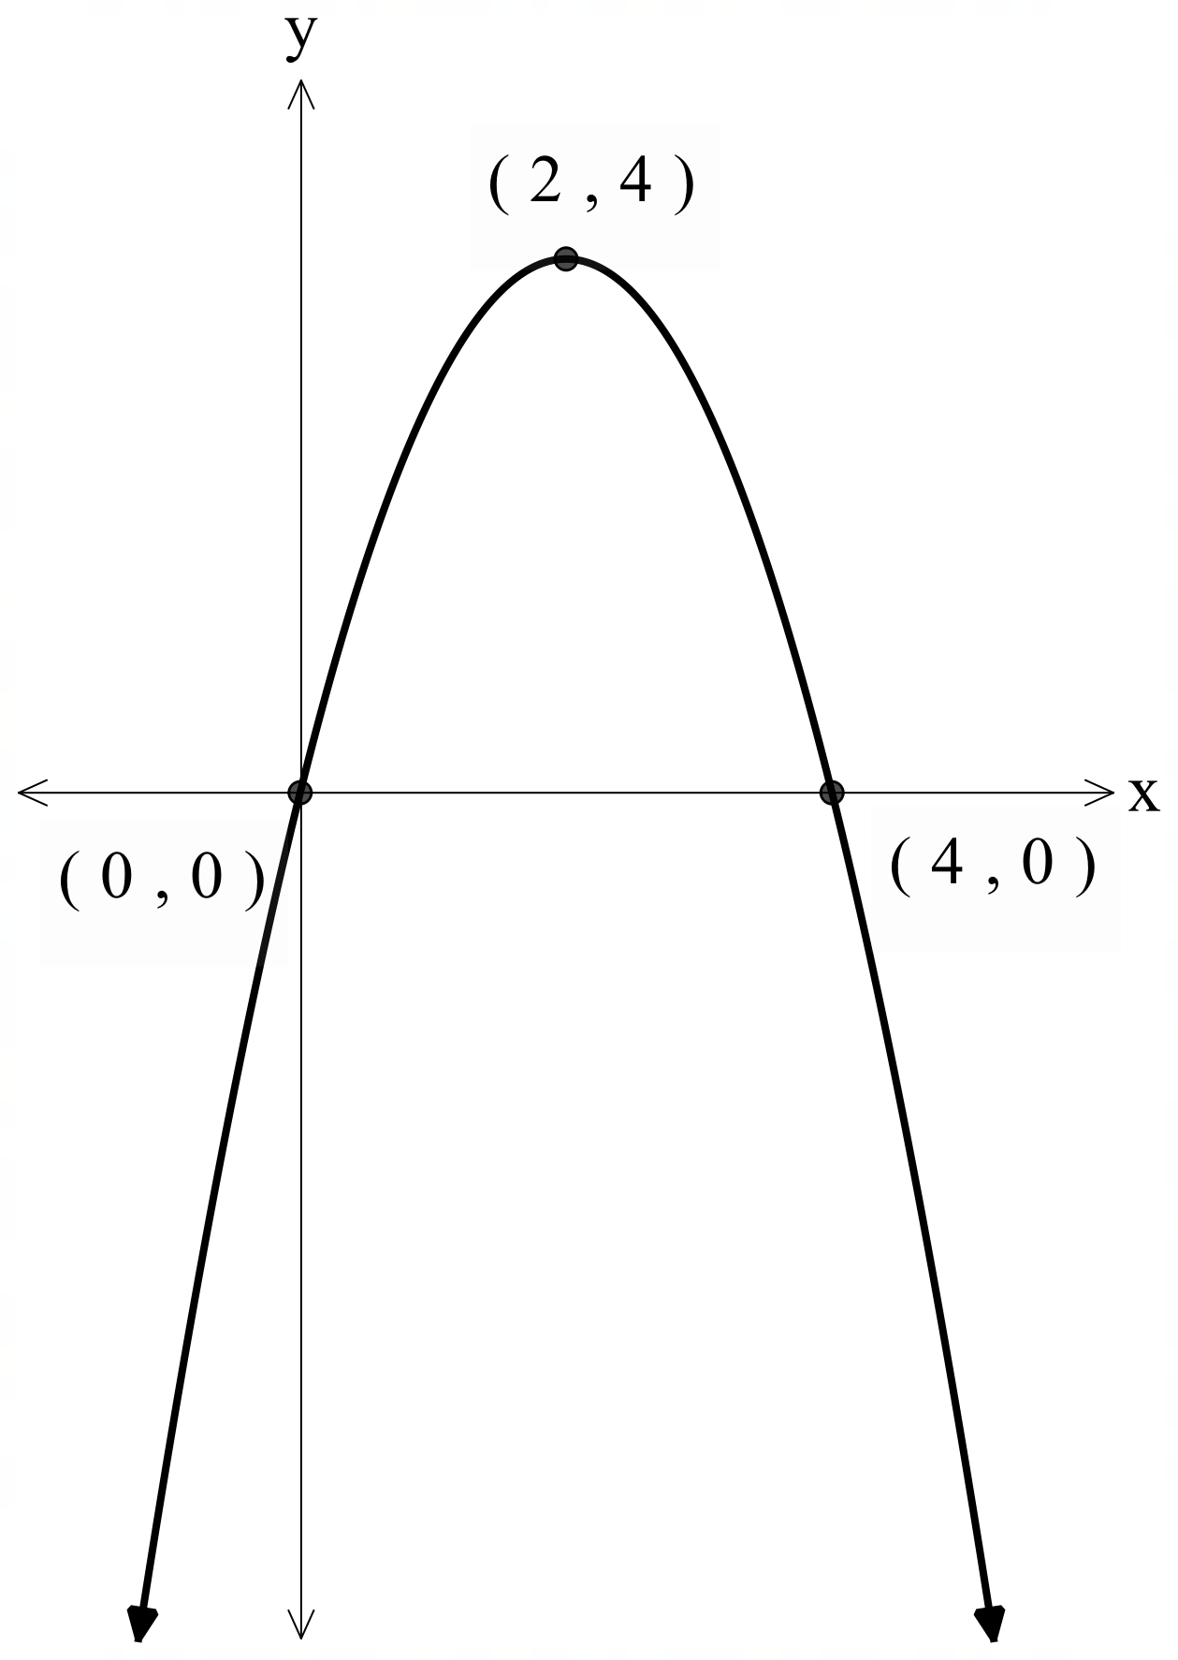
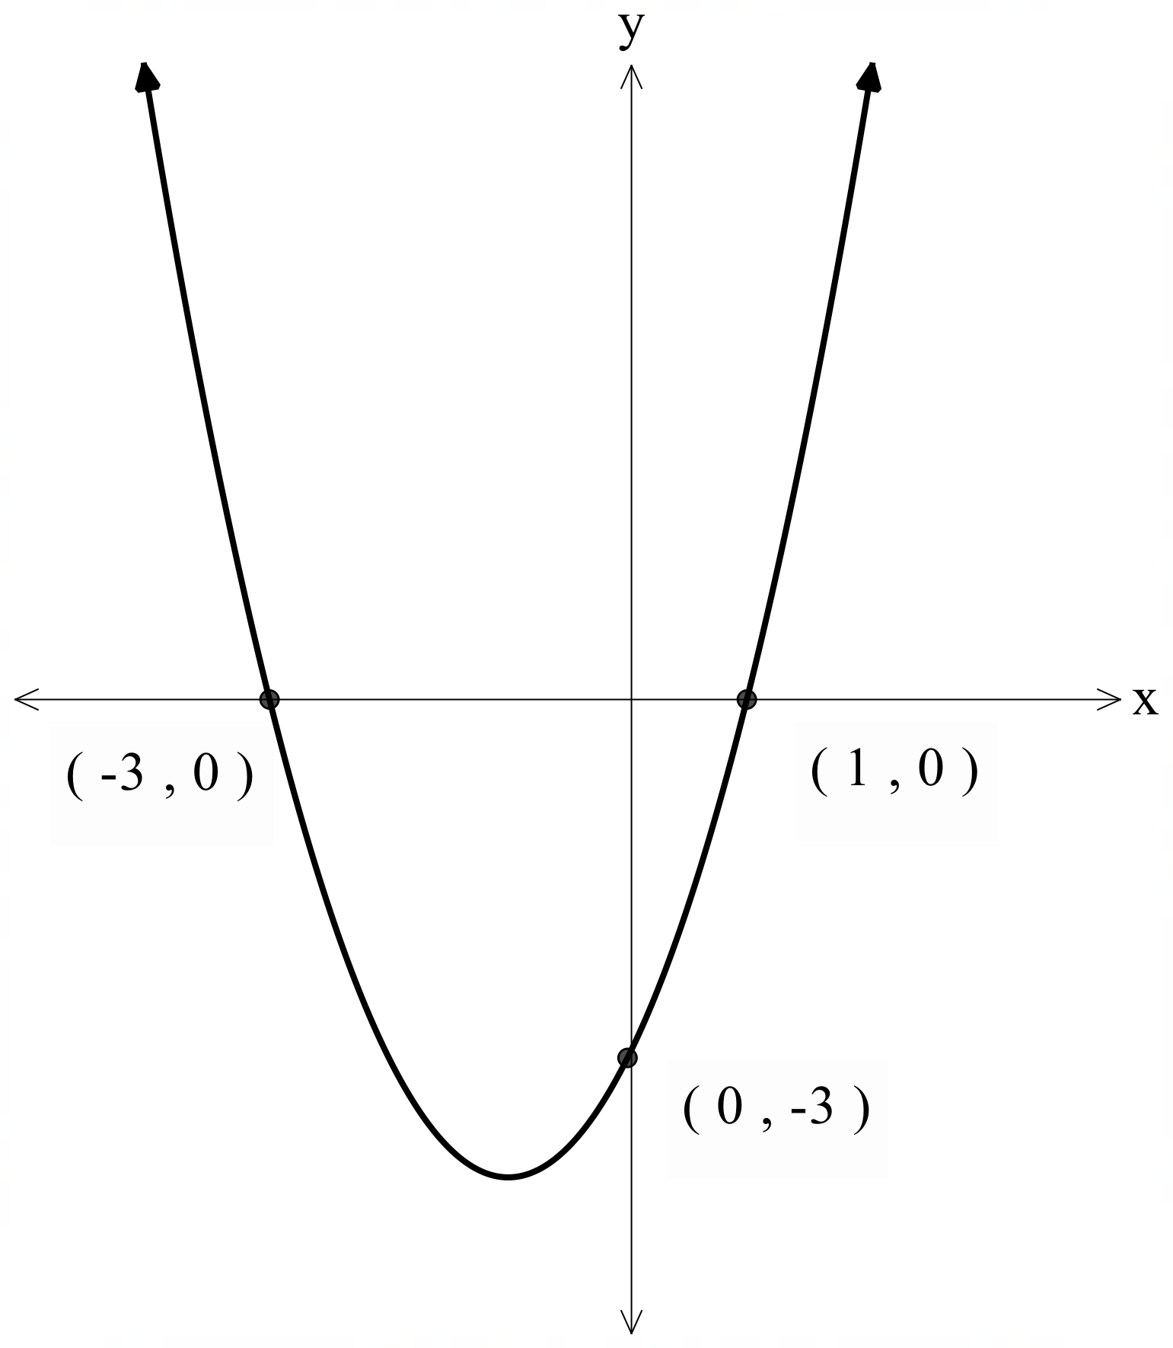







Graphing a quadratic function (2)
$f\left(x\right)=−x\left(x−4\right)$
$f\left(x\right)=x^{2}+2x−3$
$$(2, 4)$$
$$(0, 0)$$
$$(4, 0)$$
$$(−3, 0)$$
$$(1, 0)$$
$$(0, −3)$$

Slide 5
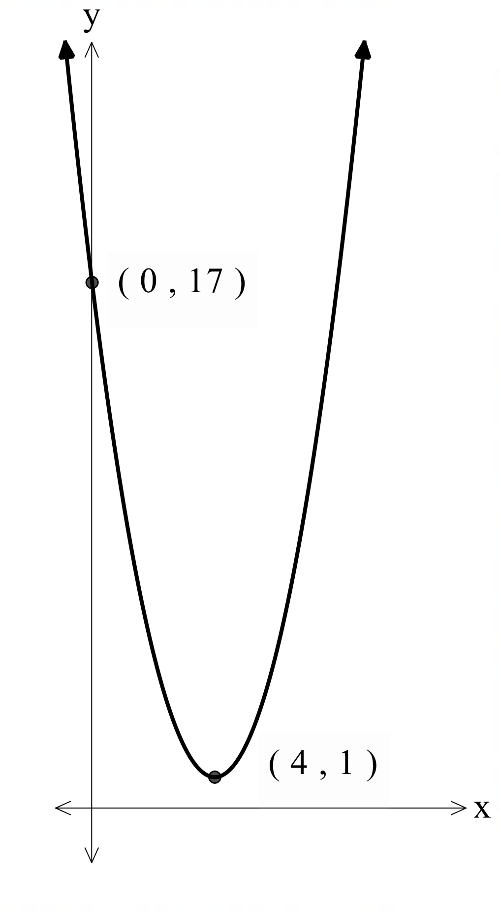
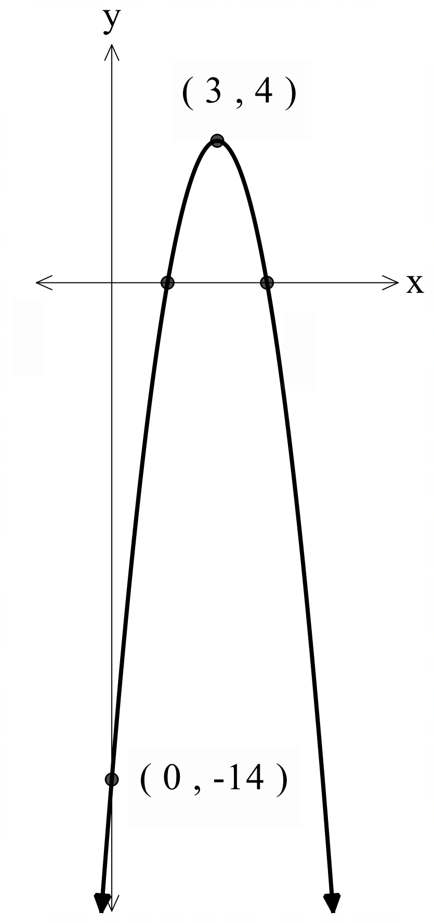







Graphing a quadratic function (3)
$f\left(x\right)={\left(x−4\right)}^{2}+1$
$f\left(x\right)=−2{\left(x−3\right)}^{2}+4$
$$(3, 4)$$
$$(0, 17)$$
$$(1.586, 0)$$
$$(4.414, 0)$$
$$(4, 1)$$
$$(0, −14)$$

Slide 6
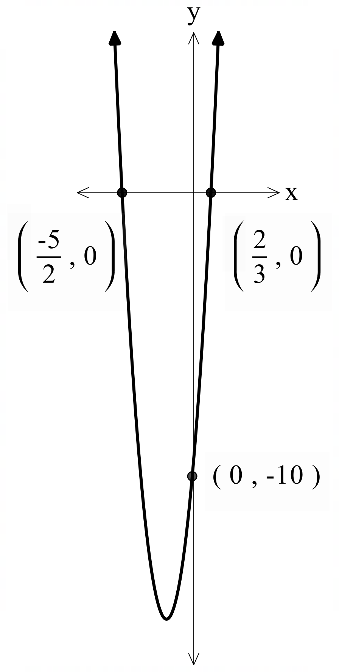
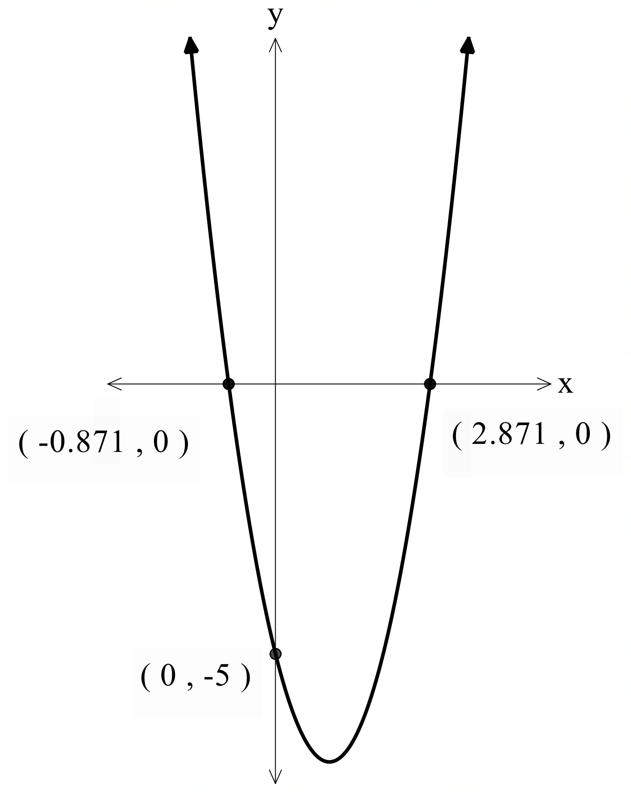

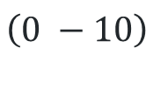





Graphing a quadratic function (4)
$f\left(x\right)=6x^{2}+11x−10$
$f\left(x\right)=2x^{2}−4x−5$
$$\left(−\frac{5}{2}, 0\right)$$
$$\left(\frac{2}{3}, 0\right)$$
$$\left(−0.871, 0\right)$$
$$\left(2.871, 0\right)$$
$$\left(0 −10\right)$$
$$\left(0, −5\right)$$

Slide 7
Connecting learning

Slide 8
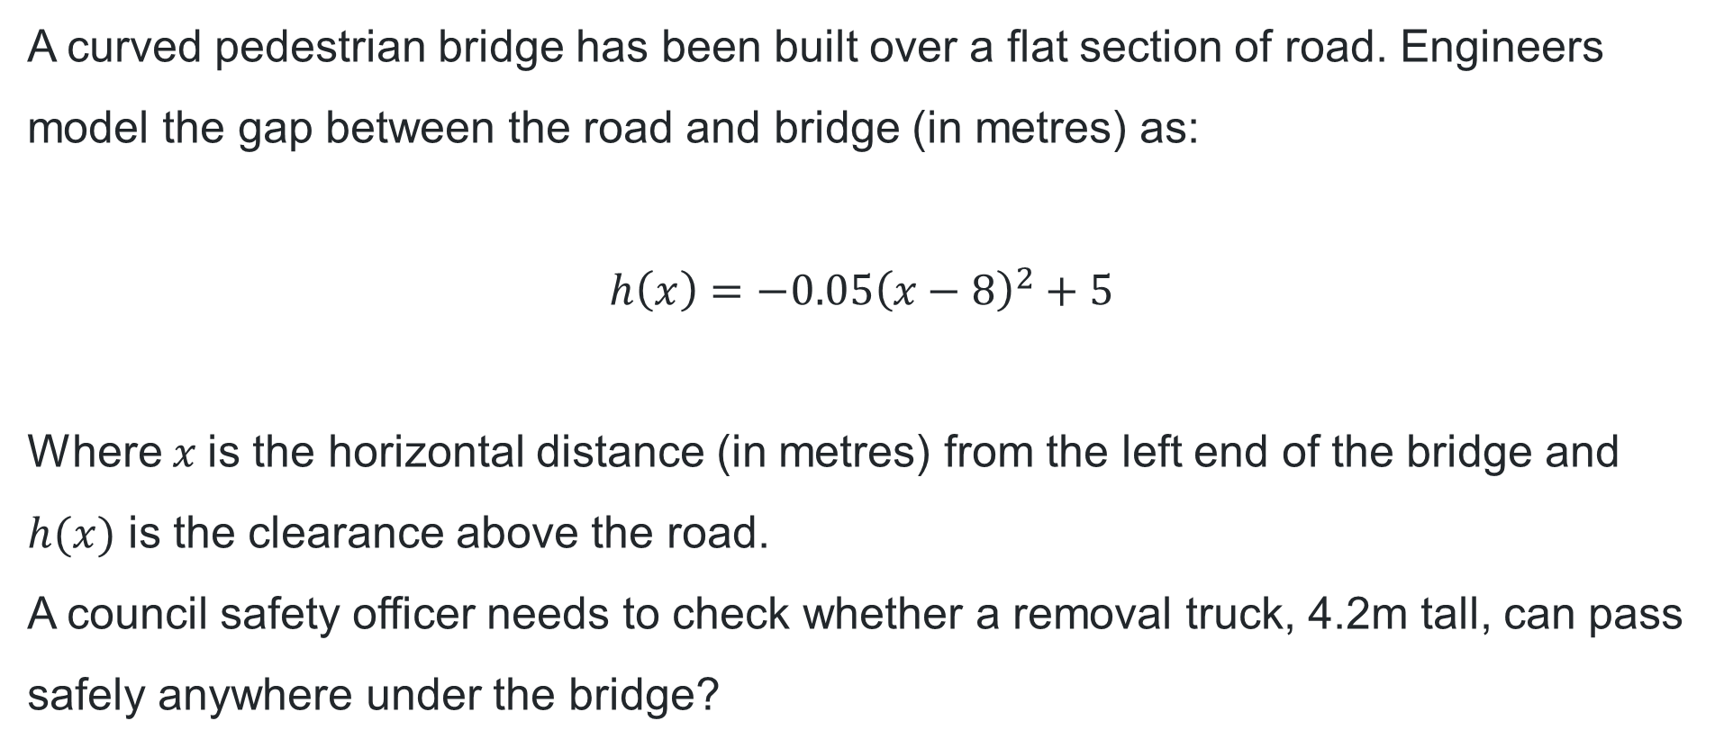
Will the truck make it? (1)
A curved pedestrian bridge has been built over a flat section of road. Engineers model the gap between the road and bridge (in metres) as:
$h\left(x\right)=−0.05{\left(x−8\right)}^{2}+5$
Where $x$is the horizontal distance (in metres) from the left end of the bridge and $h(x)$ is the clearance above the road.
A council safety officer needs to check whether a removal truck, 4.2m tall, can pass safely anywhere under the bridge?

Slide 9
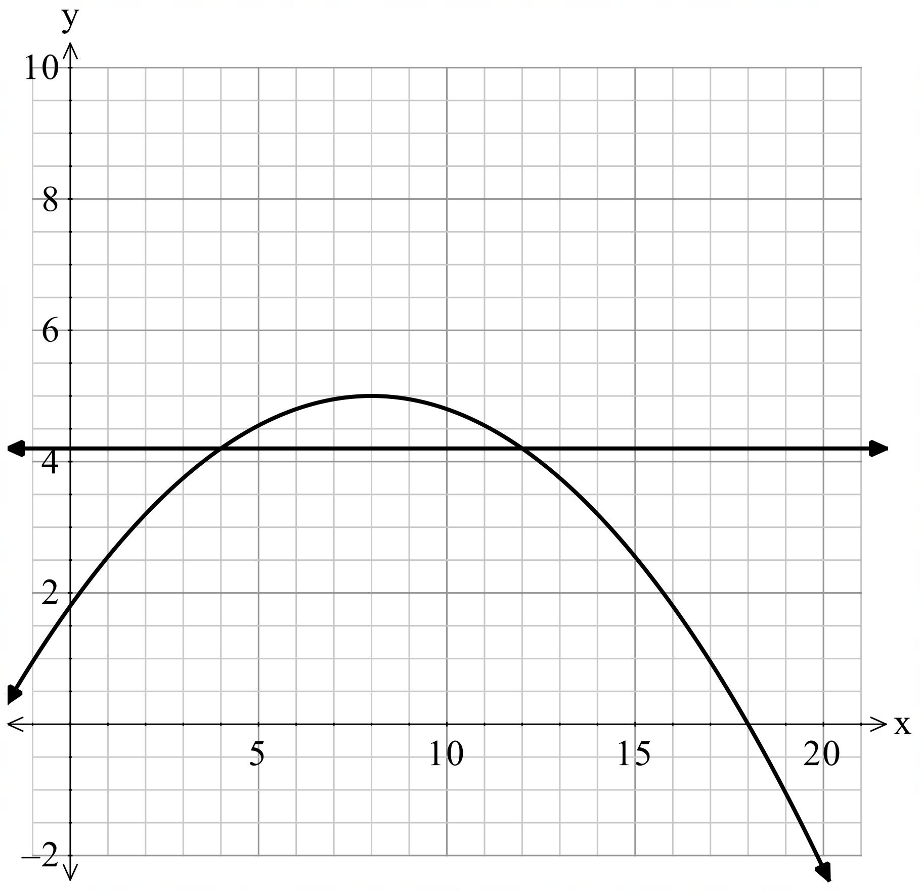
Will the truck make it? (2)

Slide 10
Learning intentions and success criteria
Learning intention
To be able to solve quadratic inequalities
Success criteria
I can solve quadratic inequalities with graphical techniques.
I can use algebraic techniques to solve quadratic inequalities, considering critical points.
I can apply my knowledge of quadratics and quadratic inequalities to solve unfamiliar, real-world problems.
Notes:
Notes for teachers:
Learning intentions and success criteria are best co-constructed with students. Adapt the learning intention as required and add matching success criteria.
For more information See ⁠AITSL or the NSW Department of Education explicit teaching strategies, ⁠Sharing learning intentions and ⁠Sharing success criteria
LISC is not necessarily presented at the beginning of the lesson. Teacher needs to consider most effectual time to introduce
LISC should be revisited during the lesson to support students' evaluation of their learning

Slide 11

Interpreting a quadratic function
$f\left(x\right)=−x\left(x−4\right)$
$f\left(x\right)=x^{2}+2x−3$
$$(2, 4)$$
$$(0, 0)$$
$$(4, 0)$$
$$(−3, 0)$$
$$(1, 0)$$
Where is each graph above the $x−$axis?
$$(0, −3)$$

Slide 12
Releasing responsibility

Slide 13
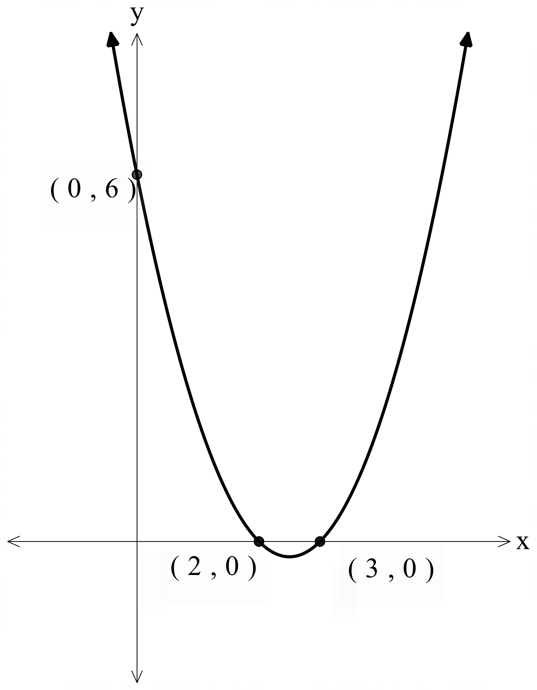

Solving a quadratic inequality graphically (1)
Worked example 1
Graph ${y=x}^{2}−5x+6$ to solve the inequality ${y=x}^{2}−5x+6<0$
Based on the graph $x^{2}−5x+6<0$ occurs when
$2<x<3$
How have the key features of this graph helped with solving this inequality?
How would the solution change if the inequality sign was reversed?

Slide 14
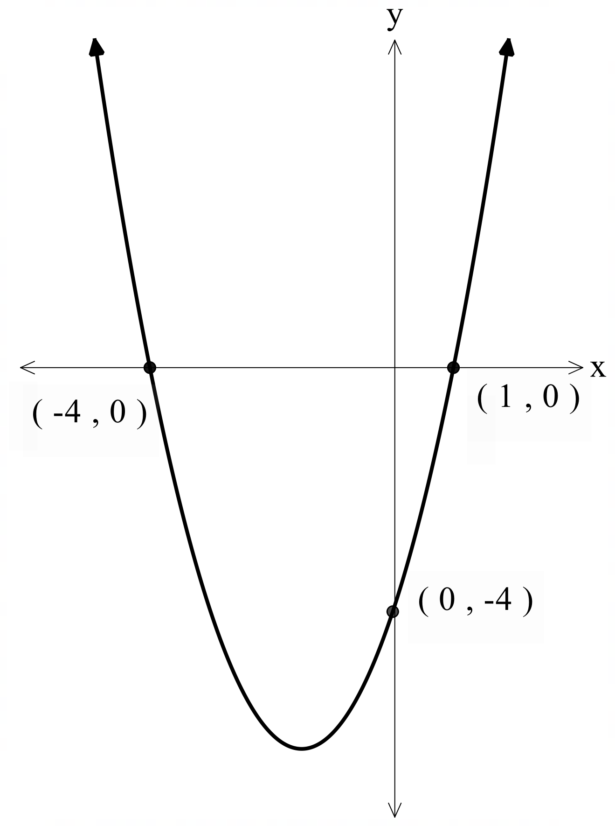





Solving a quadratic inequality graphically (2)
Your turn – question 1
Graph ${y=x}^{2}+3x−4$ to solve the inequality $x^{2}+3x−4<0$
Based on the graph $x^{2}+3x−4<0$ occurs when
$−4<x<1$
How would the solution change if the inequality sign was $≤$ ?

Slide 15
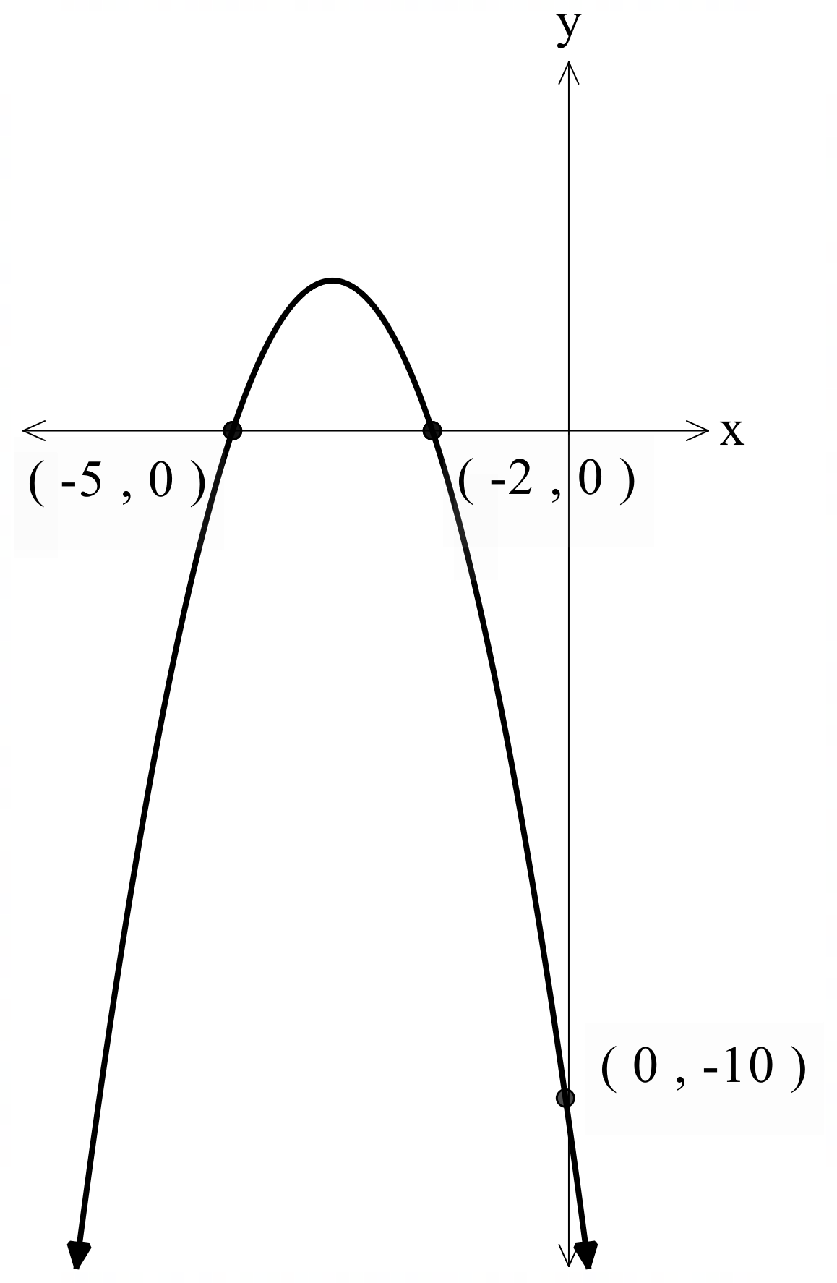



Solving a quadratic inequality graphically (3)
Worked example 2
Graph $y=−\left(x+2\right)\left(x+5\right)$ to solve $−\left(x+2\right)\left(x+5\right)≤0$.
Based on the graph $−\left(x+2\right)\left(x+5\right)≤0$occurs when $x≤−5$ and $x≥−2$
How would the solution change if we removed the negative from the quadratic?

Slide 16
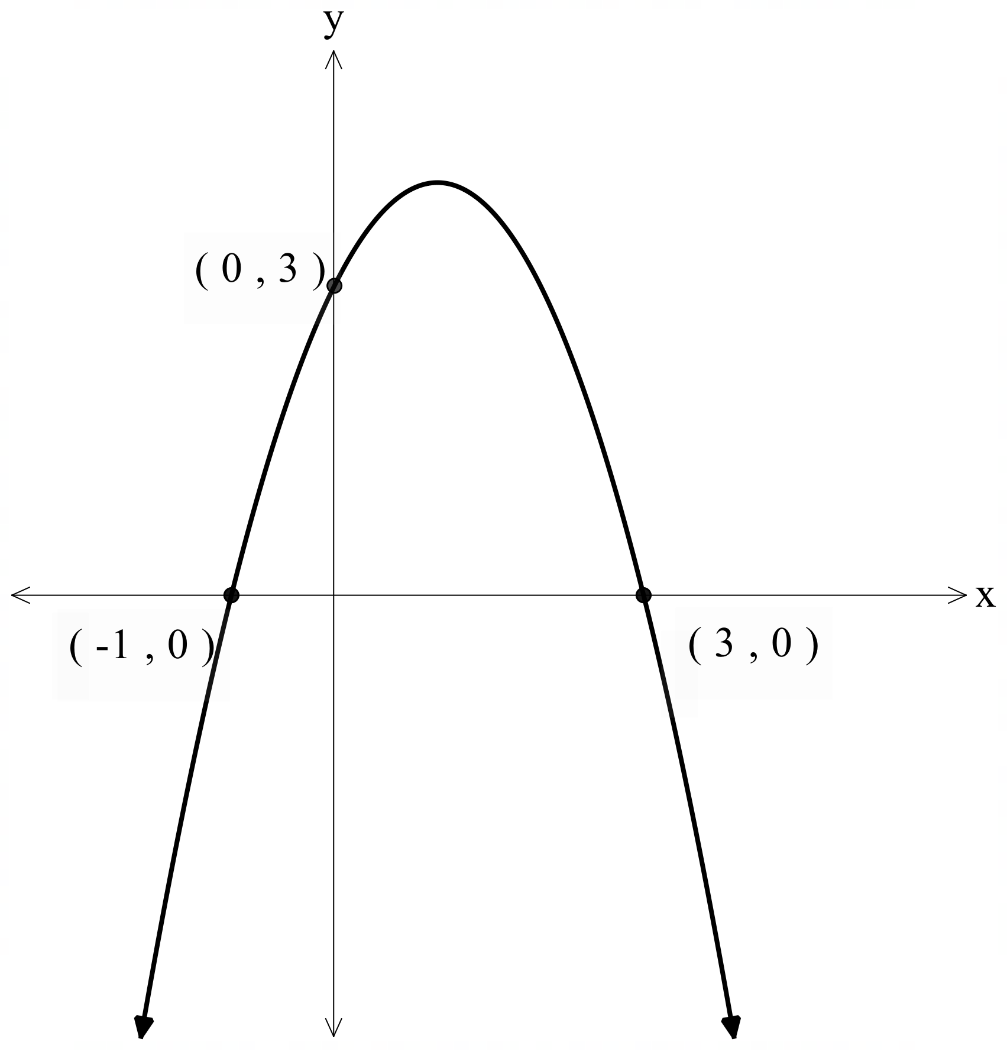

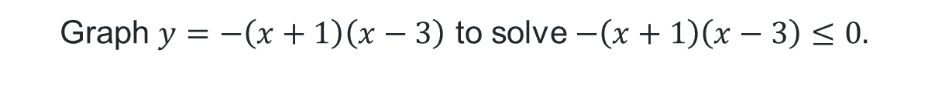


Solving a quadratic inequality graphically (4)
Your turn – question 2
Graph $y=−\left(x+1\right)\left(x−3\right)$ to solve $−\left(x+1\right)\left(x−3\right)≤0.$
Based on the graph$−\left(x+1\right)\left(x−3\right)≤0$ occurs when $x≤−1$ and $x≥3$

Slide 17
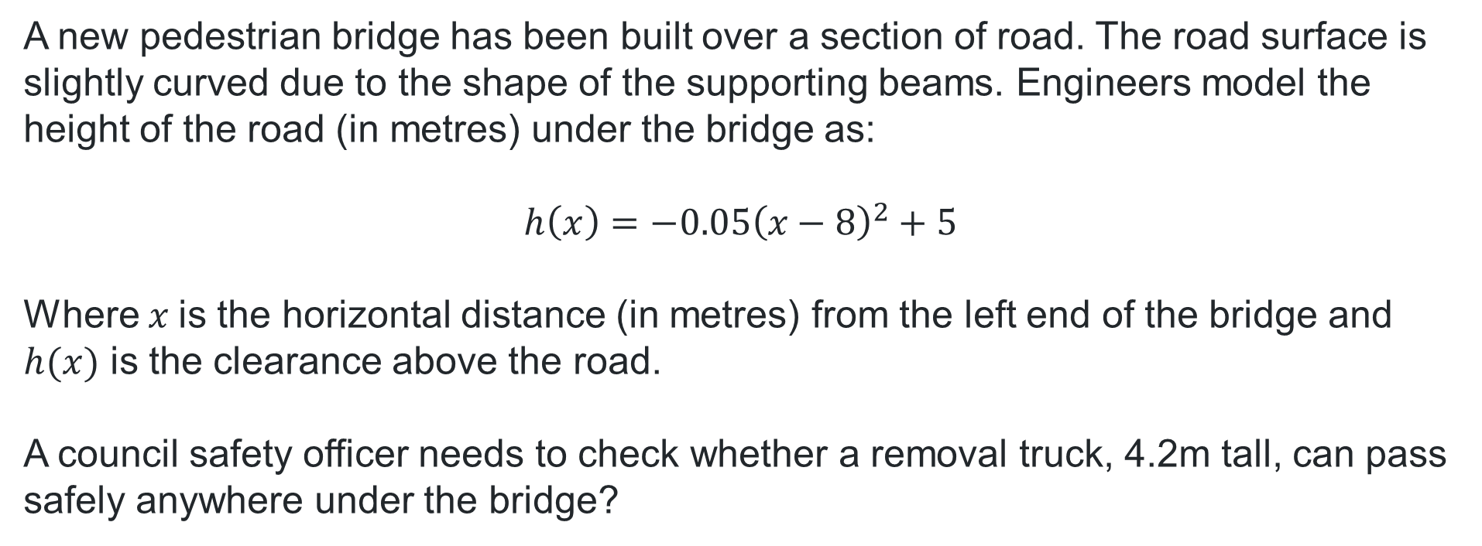
Will the truck make it? (3)
A new pedestrian bridge has been built over a section of road. The road surface is slightly curved due to the shape of the supporting beams. Engineers model the height of the road (in metres) under the bridge as:
$h\left(x\right)=−0.05{\left(x−8\right)}^{2}+5$
Where $x$is the horizontal distance (in metres) from the left end of the bridge and $h(x)$ is the clearance above the road.
A council safety officer needs to check whether a removal truck, 4.2m tall, can pass safely anywhere under the bridge?

Slide 18
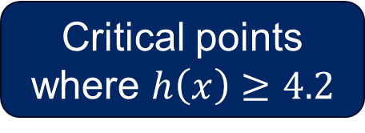
Critical points (1)
Critical points where $h\left(x\right)≥4.2$

Slide 19
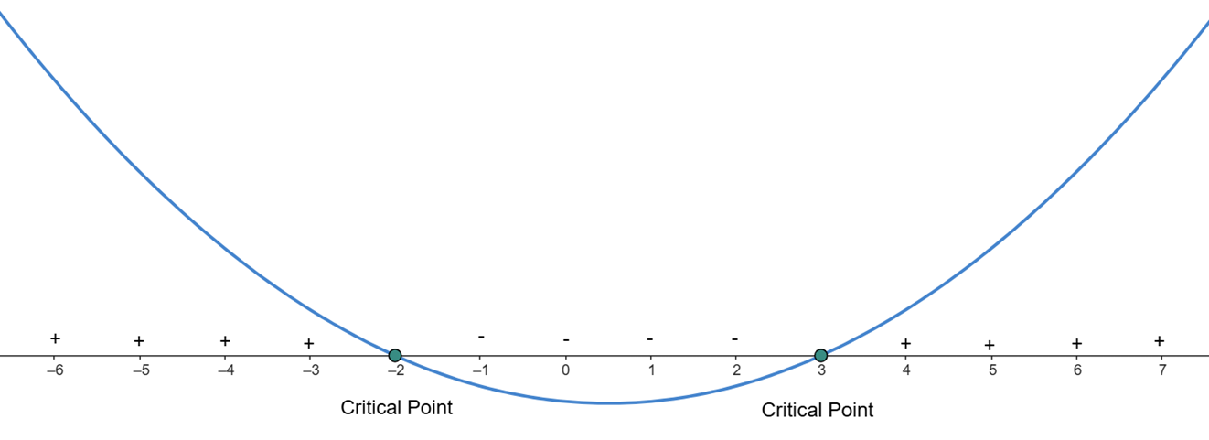

Critical points (2)
What is a critical point?
Critical points in a quadratic inequality are the $x$-values where the quadratic expression equals zero.
These points are where the graph of the quadratic intersects the $x$-axis.
Critical points divide the number line into intervals within which the quadratic expression keeps the same sign, either positive or negative.

Slide 20
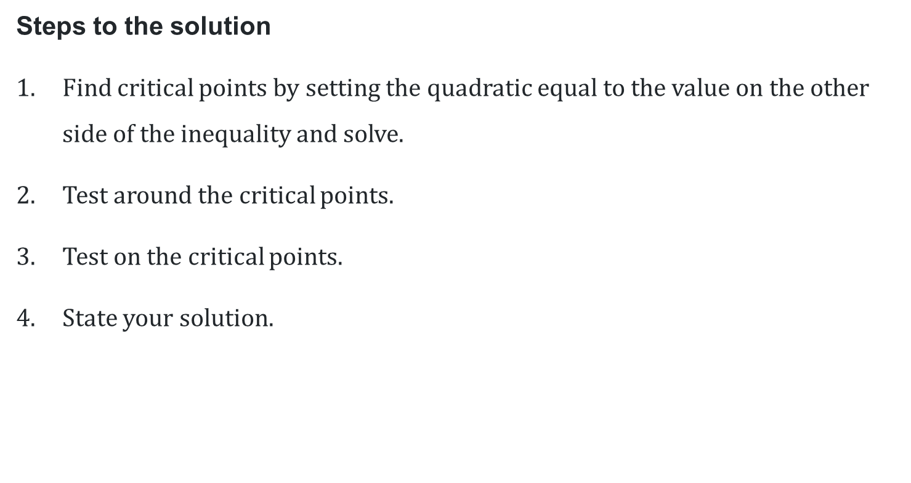
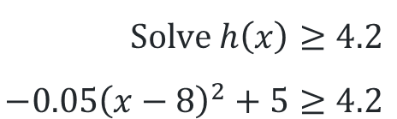
Solving a quadratic inequality algebraically (1)
Steps to the solution
Find critical points by setting the quadratic equal to the value on the other side of the inequality and solve.
Test around the critical points.
Test on the critical points.
State your solution.
Why is it important to test around and on the critical points?
$$Solve h\left(x\right)≥4.2 \\ −0.05{\left(x−8\right)}^{2}+5≥4.2$$

Slide 21

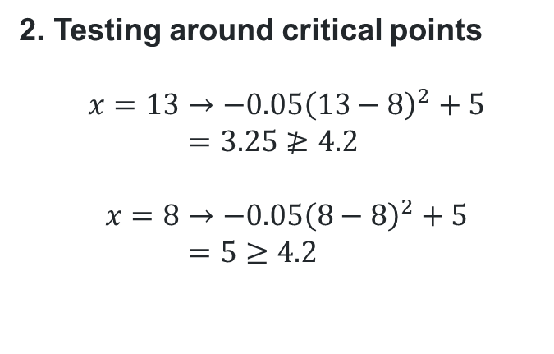
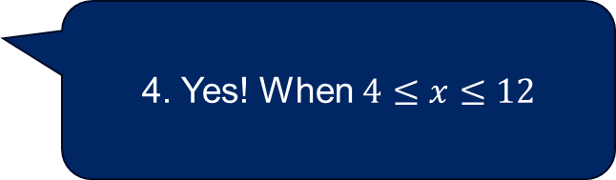
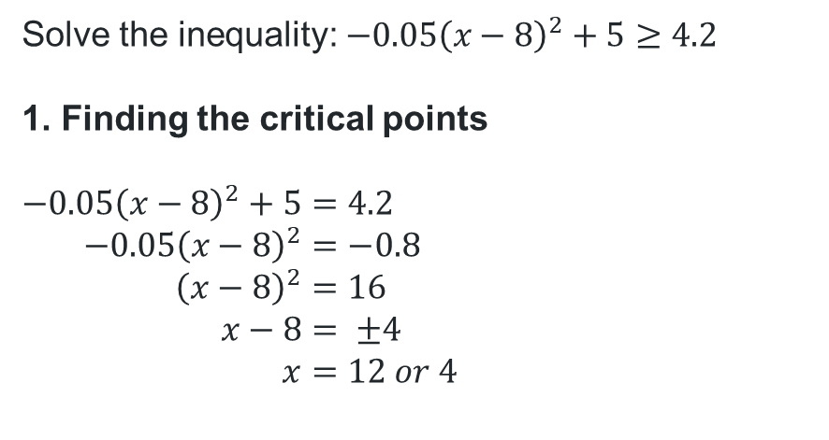
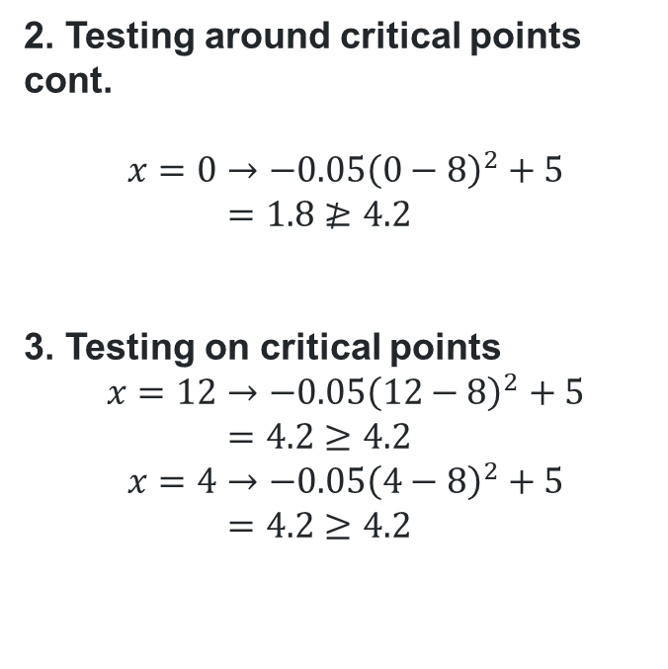
Solving a quadratic inequality algebraically (2)
Example 1
Solve the inequality: $−0.05{\left(x−8\right)}^{2}+5≥4.2$
1. Finding the critical points
$$−0.05{\left(x−8\right)}^{2}+5=4.2 \\ −0.05{\left(x−8\right)}^{2}=−0.8 \\ {\left(x−8\right)}^{2}=16 \\ x−8= ±4 \\ x=12 or 4$$
2. Testing around critical points cont.
$$x=0→−0.05{\left(0−8\right)}^{2}+5 \\ =1.8≱4.2$$
3. Testing on critical points
$$x=12→−0.05{\left(12−8\right)}^{2}+5 \\ =4.2≥4.2 \\ x=4→−0.05{\left(4−8\right)}^{2}+5 \\ =4.2≥4.2$$
2. Testing around critical points
$$x=13→−0.05{\left(13−8\right)}^{2}+5 \\ =3.25≱4.2$$
$$x=8→−0.05{\left(8−8\right)}^{2}+5 \\ =5≥4.2$$
Can the truck pass safely anywhere under the bridge?
4. Yes! When $4≤x≤12$

Slide 22
Independent practice

Slide 23


Application of a quadratic inequality (1)
A skateboarder rides up a ramp and becomes airborne. Their height above the ground is modelled by:
$$h\left(t\right)=−2{\left(t−2\right)}^{2}+11$$
Where $t$ is seconds after launch. They must stay at least 4 metres above the ground to clear an obstacle.
Graph $h(t)$
How long is the skateboarder at or above 4 metres?

Slide 24
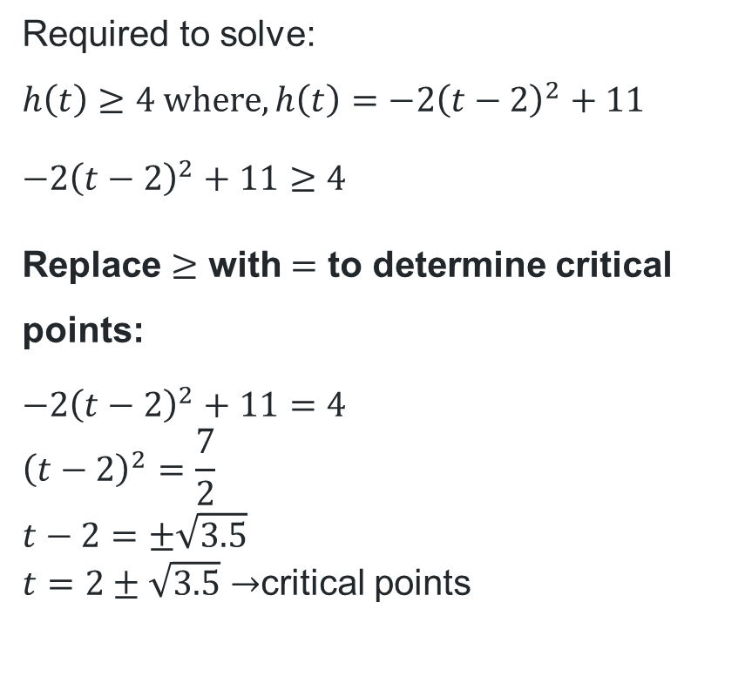
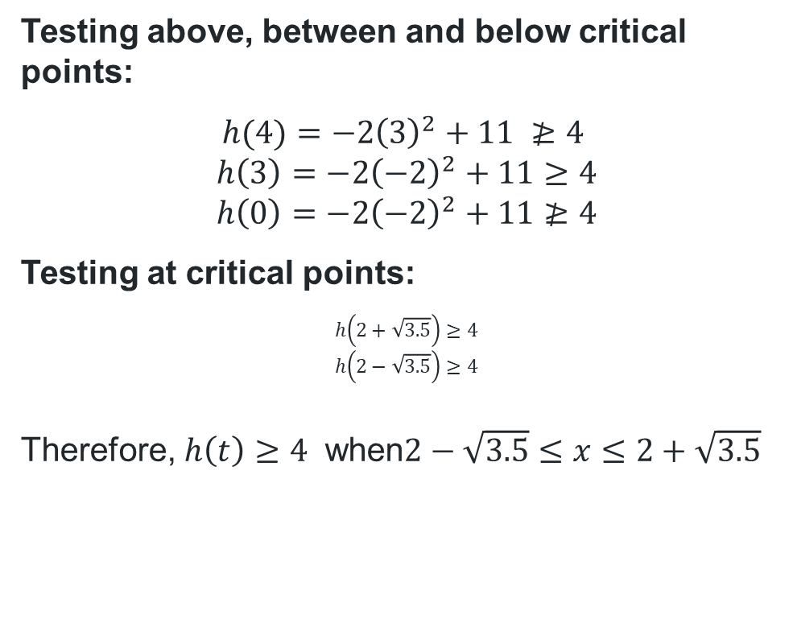
Application of a quadratic inequality (2)
Required to solve:
$h\left(t\right)≥4$ $where,h\left(t\right)=−2{\left(t−2\right)}^{2}+11$
$$−2{\left(t−2\right)}^{2}+11≥4$$
Replace $≥$ with $=$ to determine critical points:
$$−2{\left(t−2\right)}^{2}+11=4 \\ {\left(t−2\right)}^{2}=\frac{7}{2} \\ t−2=±\sqrt{3.5}$$
$t=2±\sqrt{3.5}→$critical points
Testing above, between and below critical points:
$$h(4)=−2{\left(3\right)}^{2}+11 ≱4$$
$$h\left(3\right)=−2{\left(−2\right)}^{2}+11≥4 \\ h\left(0\right)=−2{\left(−2\right)}^{2}+11≱4$$
Testing at critical points:
$$h\left(2+\sqrt{3.5}\right)≥4 \\ h\left(2−\sqrt{3.5}\right)≥4$$
Therefore, $h\left(t\right)≥4$ when$2−\sqrt{3.5}≤x≤2+\sqrt{3.5}$

Slide 25
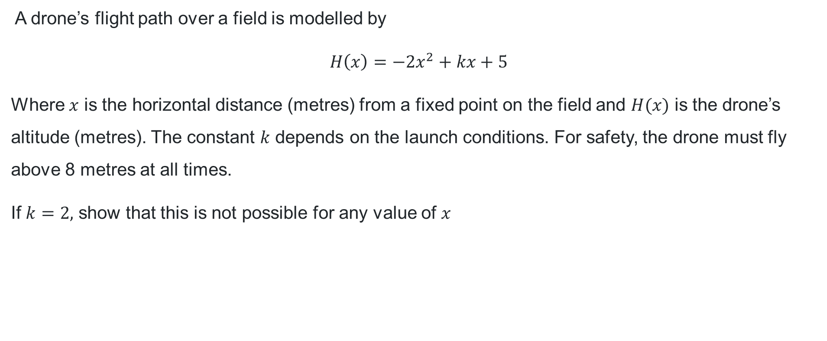
Application of a quadratic inequality (3)
A drone’s flight path over a field is modelled by
$H\left(x\right)=−2x^{2}+kx+5$
Where $x$ is the horizontal distance (metres) from a fixed point on the field and $H(x)$ is the drone’s altitude (metres). The constant $k$ depends on the launch conditions. For safety, the drone must fly above 8 metres at all times.
If $k=2,$ show that this is not possible for any value of $x$

Slide 26
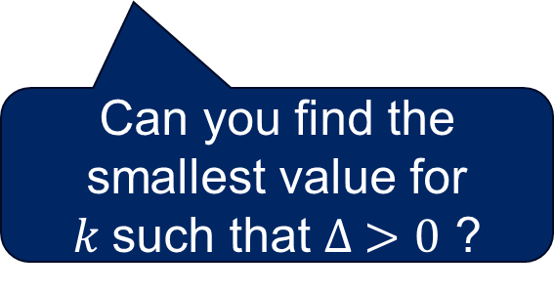
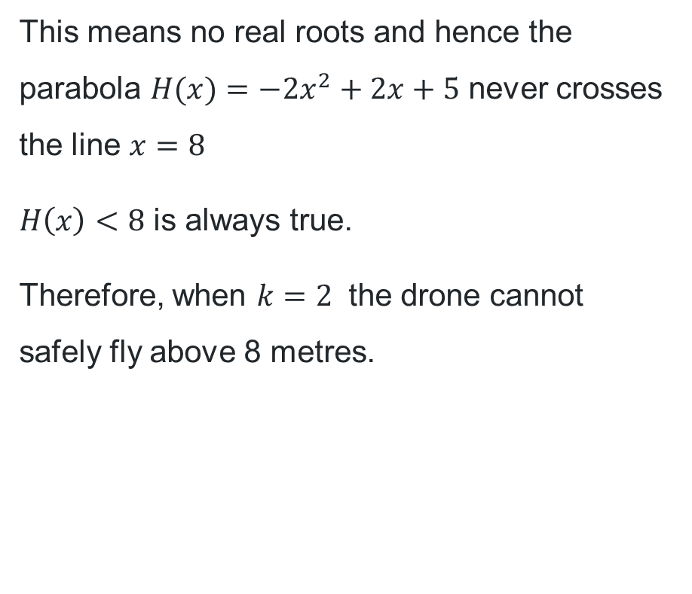
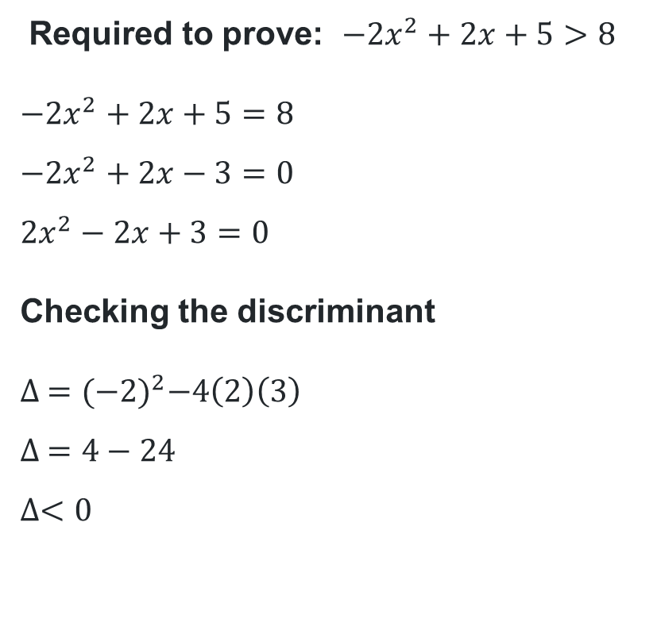
Application of a quadratic inequality (4)
Worked solution
Required to prove: $−2x^{2}+2x+5>8$
$$−2x^{2}+2x+5=8 \\ −2x^{2}+2x−3=0 \\ 2x^{2}−2x+3=0$$
Checking the discriminant
$$∆ ={(−2)}^{2}−4\left(2\right)\left(3\right) \\ ∆ =4−24 \\ ∆<0$$
This means no real roots and hence the parabola $H(x)=−2x^{2}+2x+5$ never crosses the line $x=8$
$H\left(x\right)<8$ is always true.
Therefore, when $k=2$ the drone cannot safely fly above 8 metres.
What does this indicate?
Can you find the smallest value for $k$such that $∆ >0$ ?

Slide 27
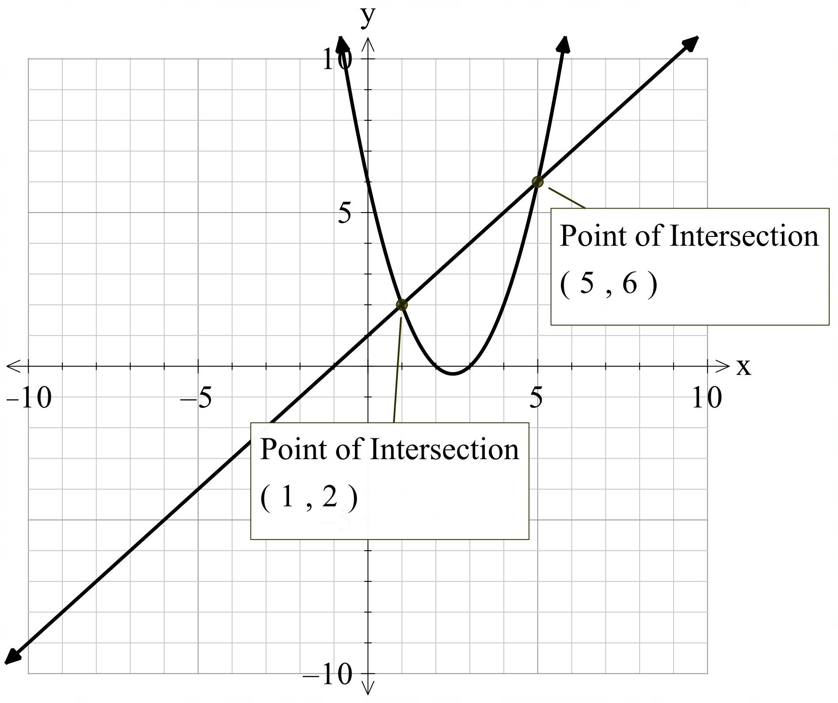
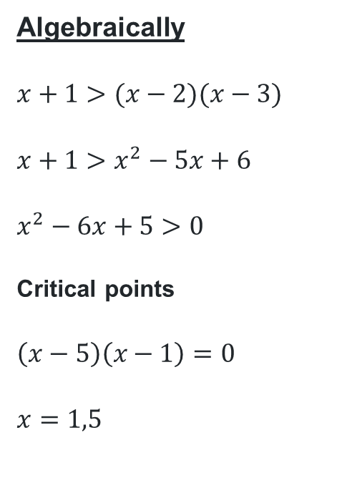



Solving quadratic inequalities (1)
Graphically
Graph $y=x+1$ and $y=(x−2)(x−3)$ on the same Cartesian plane.
HSC style question
Solve the inequality $x+1≥(x−2)(x−3)$
Algebraically
$$x+1>(x−2)(x−3)$$
$$x+1>x^{2}−5x+6$$
$$x^{2}−6x+5>0$$
Critical points
$$\left(x−5\right)\left(x−1\right)=0$$
$$x=1,5$$
Testing around critical points
$$x=0→0^{2}−6\left(0\right)+5$$
$$=5>0$$
$$x=3→3^{2}−6\left(3\right)+5$$
$=−4$ $which is not greater than 0$
$$x=6→6^{2}−6\left(6\right)+5$$
$$=5>0$$
$$∴1<x<5$$
Based on the graph$x+1>(x−2)(x−3)$
occurs when $1<x<5$.

Slide 28
References
This presentation contains NSW Curriculum and syllabus content. The NSW Curriculum is developed by the NSW Education Standards Authority. This content is prepared by NESA for and on behalf of the Crown in the right of the State of New South Wales. The material is protected by Crown copyright.
Please refer to the NESA Copyright Disclaimer for more information https://educationstandards.nsw.edu.au/wps/portal/nesa/mini-footer/copyright.
NESA holds the only official and up-to-date versions of the NSW Curriculum and syllabus documents. Please visit the NSW Education Standards Authority (NESA) website https://educationstandards.nsw.edu.au/wps/portal/nesa/home and the NSW Curriculum website https://curriculum.nsw.edu.au.
Mathematics Advanced 11-12 Syllabus © NSW Education Standards Authority (NESA) for and on behalf of the Crown in right of the State of New South Wales, 2024.

Slide 29
Copyright
© State of New South Wales (Department of Education), 2025
The copyright material published in this resource is subject to the Copyright Act 1968 (Cth) and is owned by the NSW Department of Education or, where indicated, by a party other than the NSW Department of Education (third-party material).
Copyright material available in this resource and owned by the NSW Department of Education is licensed under a Creative Commons Attribution 4.0 International (CC BY 4.0) license.
This license allows you to share and adapt the material for any purpose, even commercially.
Attribution should be given to © State of New South Wales (Department of Education), 2025.
Material in this resource not available under a Creative Commons license:
the NSW Department of Education logo, other logos and trademark-protected material
Material owned by a third party that has been reproduced with permission. You will need to obtain permission from the third party to reuse its material.
Links to third-party material and websites
Please note that the provided (reading/viewing material/list/links/texts) are a suggestion only and implies no endorsement, by the New South Wales Department of Education, of any author, publisher, or book title. School principals and teachers are best placed to assess the suitability of resources that would complement the curriculum and reflect the needs and interests of their students.
If you use the links provided in this document to access a third-party’s website, you acknowledge that the terms of use, including licence terms set out on the third-party’s website apply to the use which may be made of the materials on that third-party website or where permitted by the Copyright Act 1968 (Cth). The department accepts no responsibility for content on third-party websites.

