Slide 1
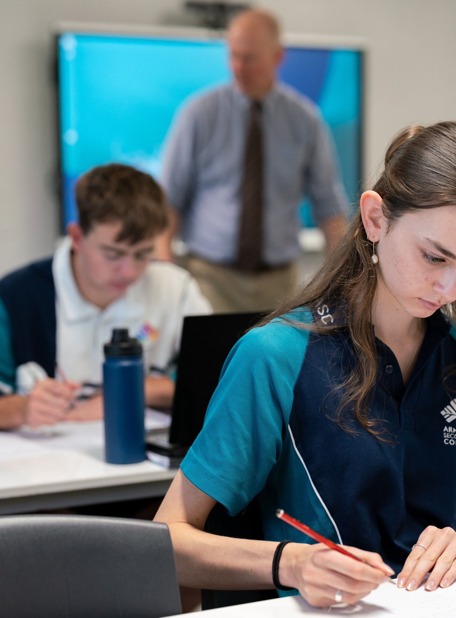
Simultaneous quadratic equations
Mathematics Advanced – Stage 6 Year 11
Unit 3 – Exploring linear and quadratic functions

Slide 2
Learning intentions and success criteria
Learning intention
To be able to solve simultaneous equations involving linear and quadratic functions or 2 quadratic functions.
Success criteria
I can identify the intersection points of a linear and quadratic function or 2 quadratic functions, using a graph.
I can solve simultaneous equations algebraically using substitution.
I can determine the number of solutions using the discriminant and explain which solutions are valid in context.
I can apply these methods to solve real-world or HSC style problems.
Notes:
Notes for teachers:
Learning intentions and success criteria are best co-constructed with students. Adapt the learning intention as required and add matching success criteria.
For more information See ⁠AITSL or the NSW Department of Education explicit teaching strategies, ⁠Sharing learning intentions and ⁠Sharing success criteria
LISC is not necessarily presented at the beginning of the lesson. Teacher needs to consider most effectual time to introduce
LISC should be revisited during the lesson to support students' evaluation of their learning

Slide 3
Activating prior knowledge

Slide 4
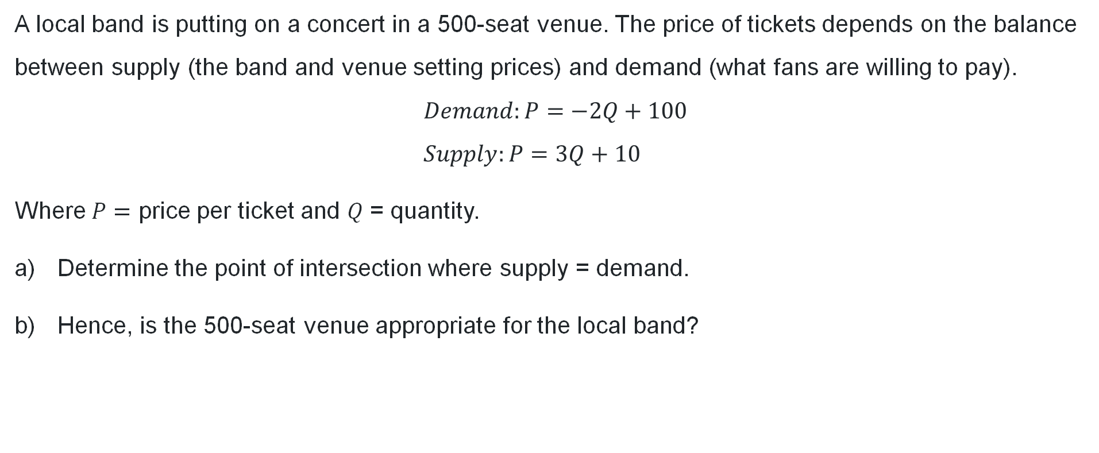
Supply and demand (1)
A local band is putting on a concert in a 500-seat venue. The price of tickets depends on the balance between supply (the band and venue setting prices) and demand (what fans are willing to pay).
$$Demand:P=−2Q+100 \\ Supply:P=3Q+10$$
Where $P=$ price per ticket and $Q$ = quantity.
Determine the point of intersection where supply = demand.
Hence, is the 500-seat venue appropriate for the local band?

Slide 5
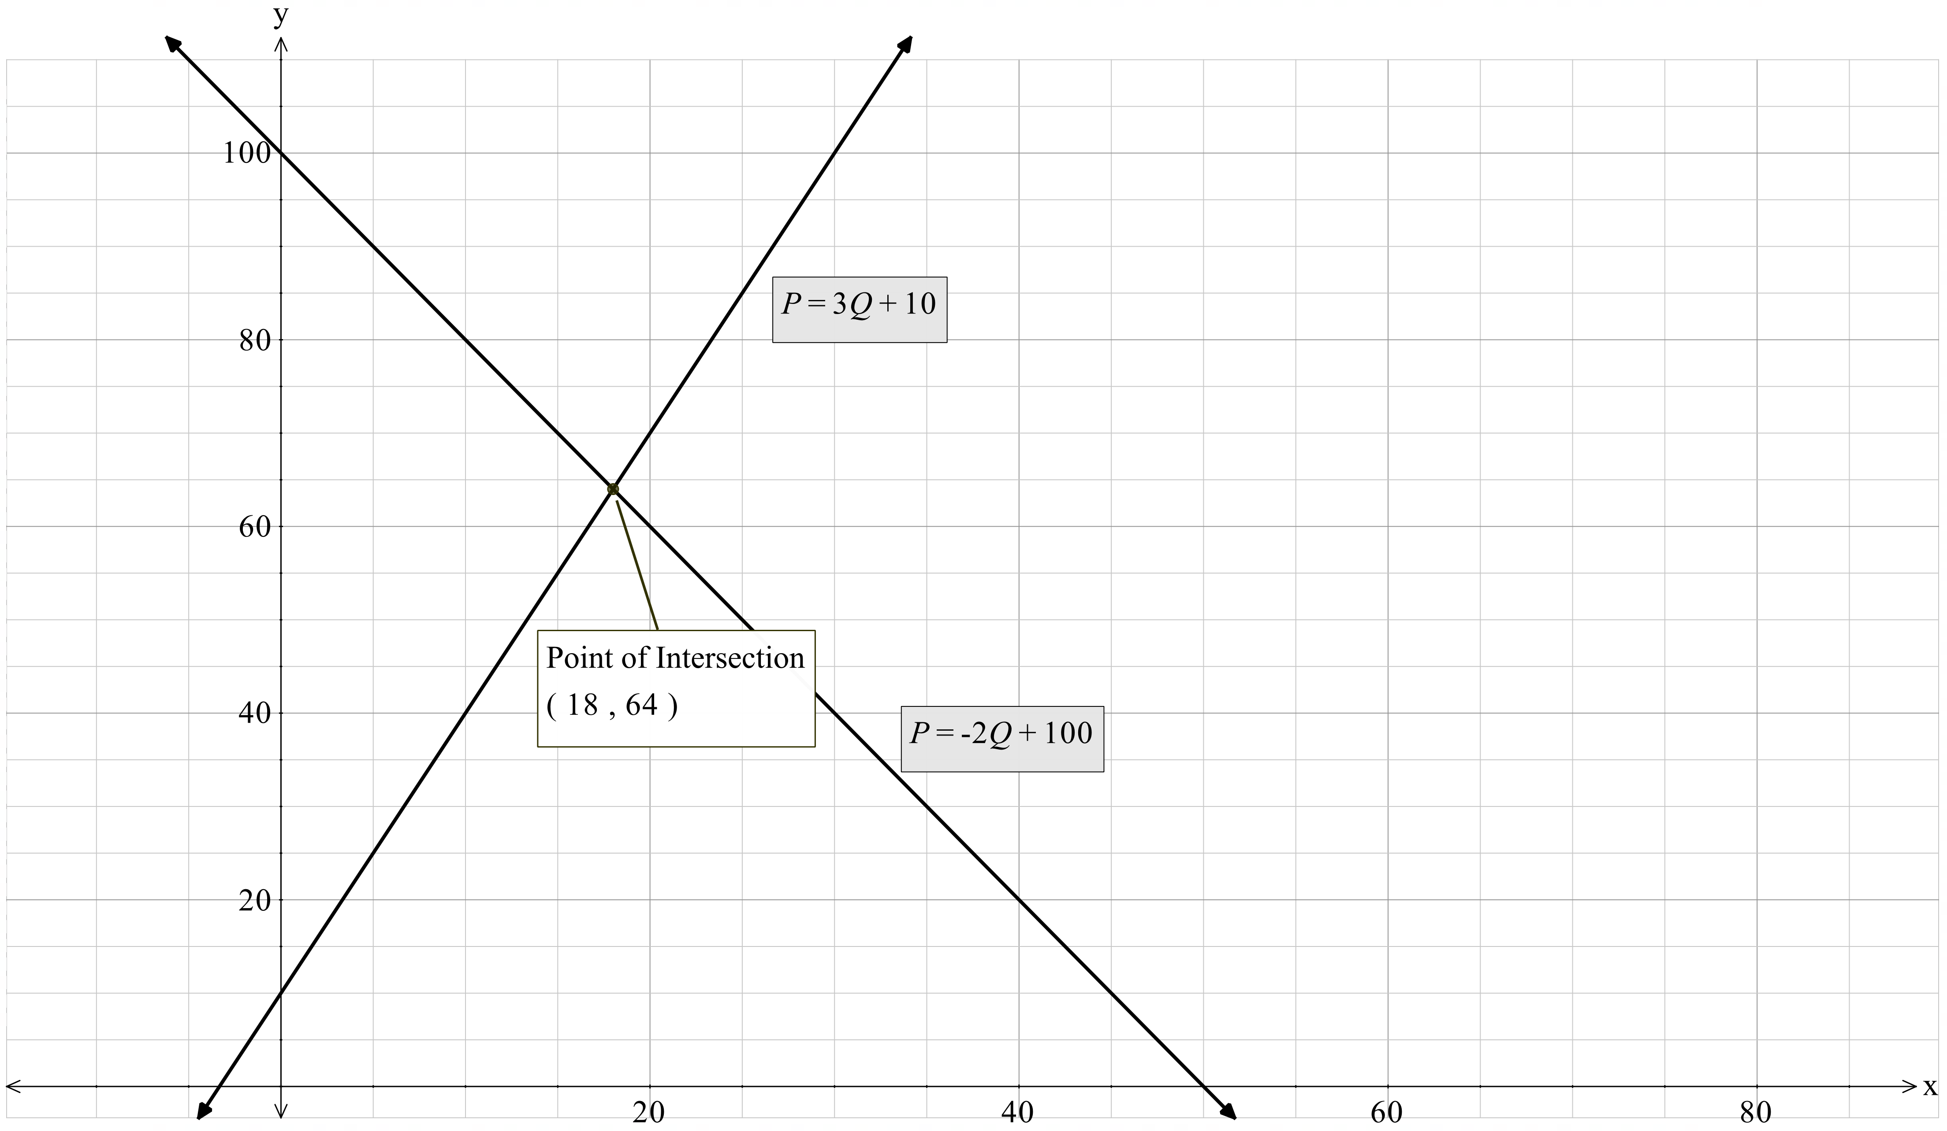
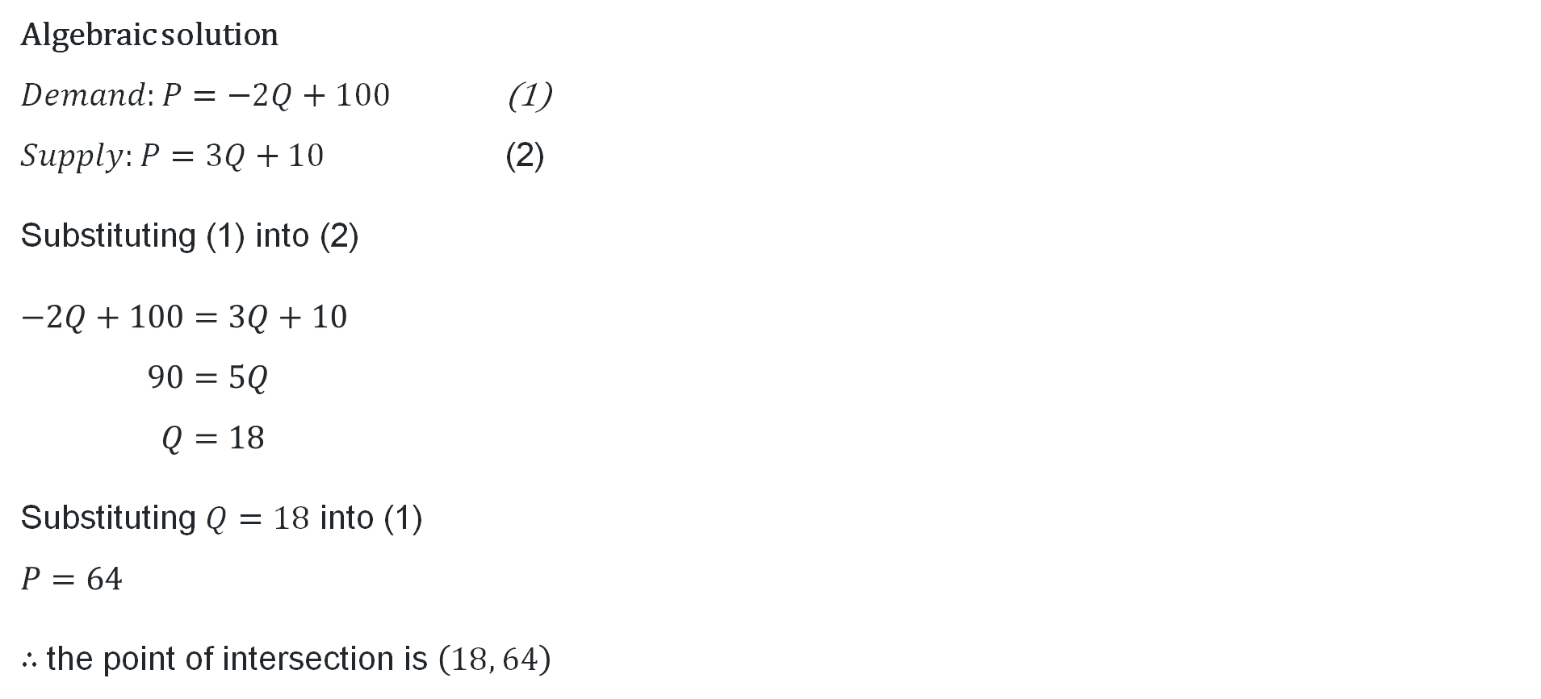
Supply and demand (2)
Algebraic solution
$Demand:P=−2Q+100$ (1)
$Supply:P=3Q+10$ (2)
Substituting (1) into (2)
$$−2Q+100=3Q+10 \\ 90=5Q \\ Q=18$$
Substituting $Q=18$ into (1)
$$P=64$$
$∴$the point of intersection is $\left(18, 64\right)$

Slide 6
Connecting learning

Slide 7
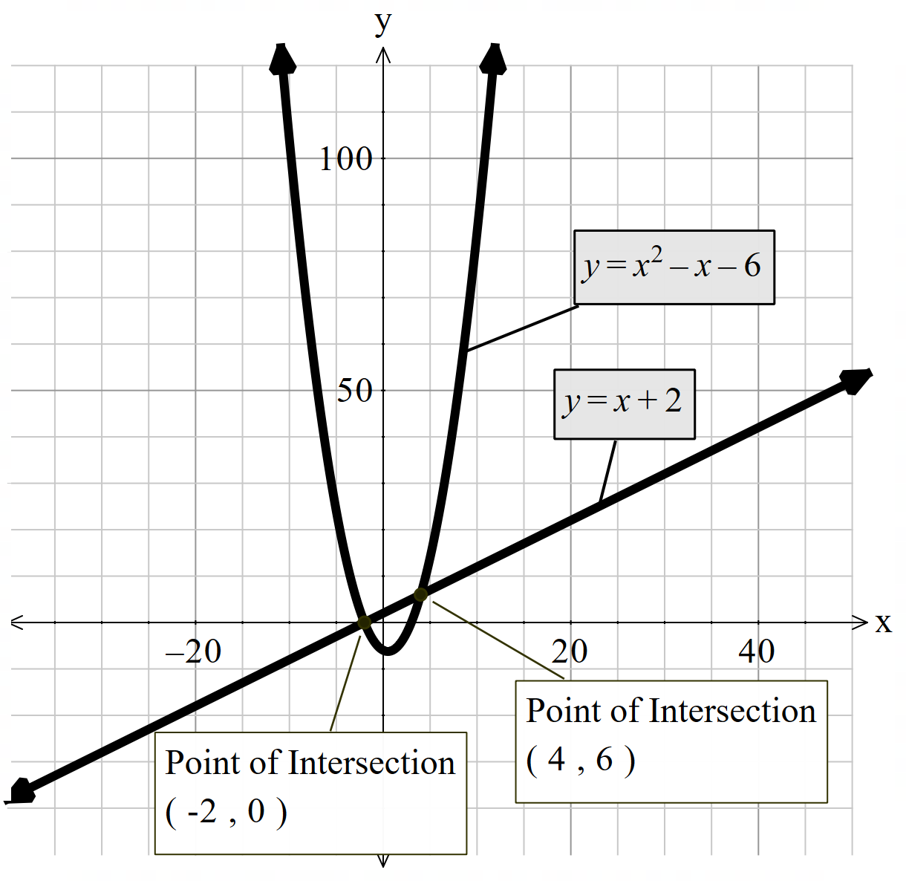
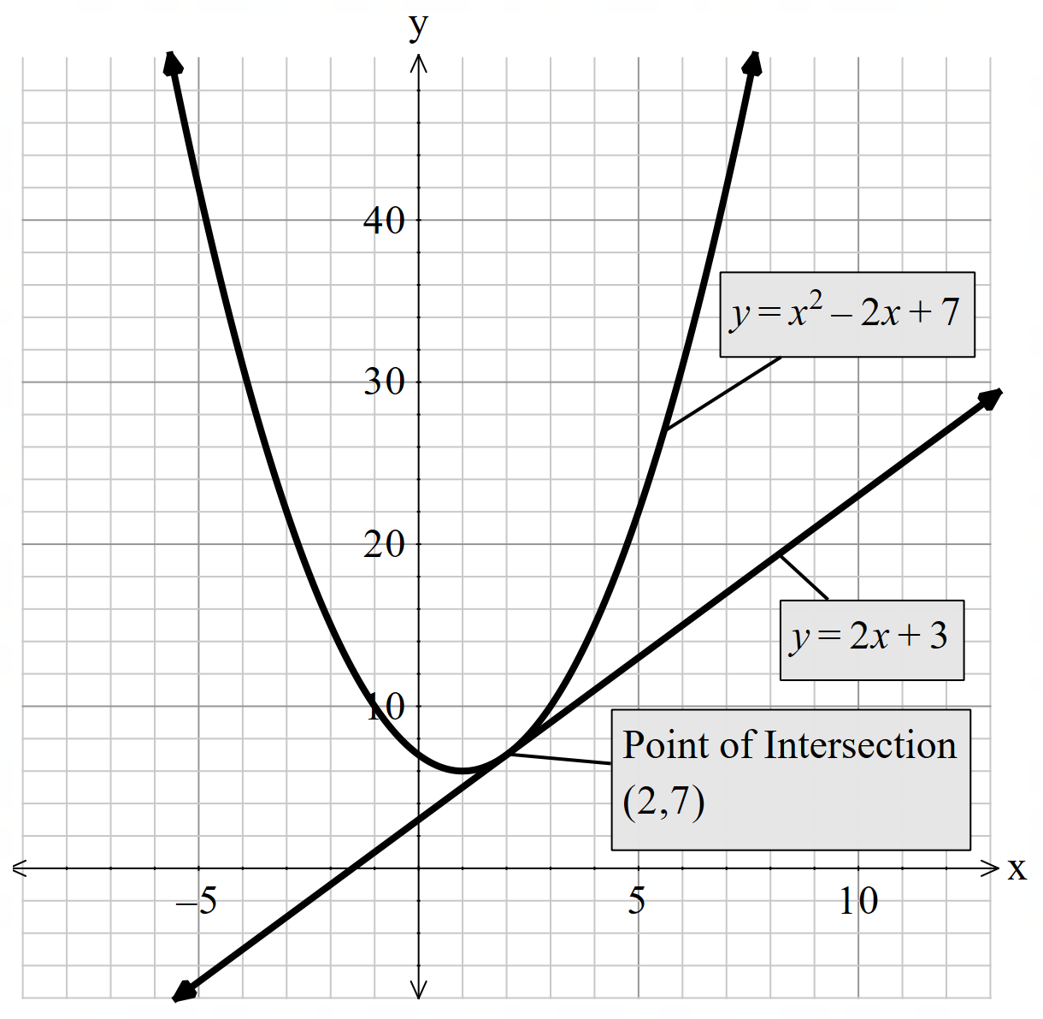
Solving graphically (1)

Slide 8


Solving graphically (2)
Prove that the following pair of simultaneous equations have no solutions
$y=x+1$ (1)
$y=x^{2}+2$ (2)
Solution:
Substitute (1) into (2)
$$x+1=x^{2}+2 \\ x^{2}−x+1=0 \\ ∆ =b^{2}−4ac \\ ∆={\left(1\right)}^{2}−4\left(1\right)\left(1\right)$$
$$∆ =−3$$
$$∆<0$$
$$∴no real solution.$$

Slide 9
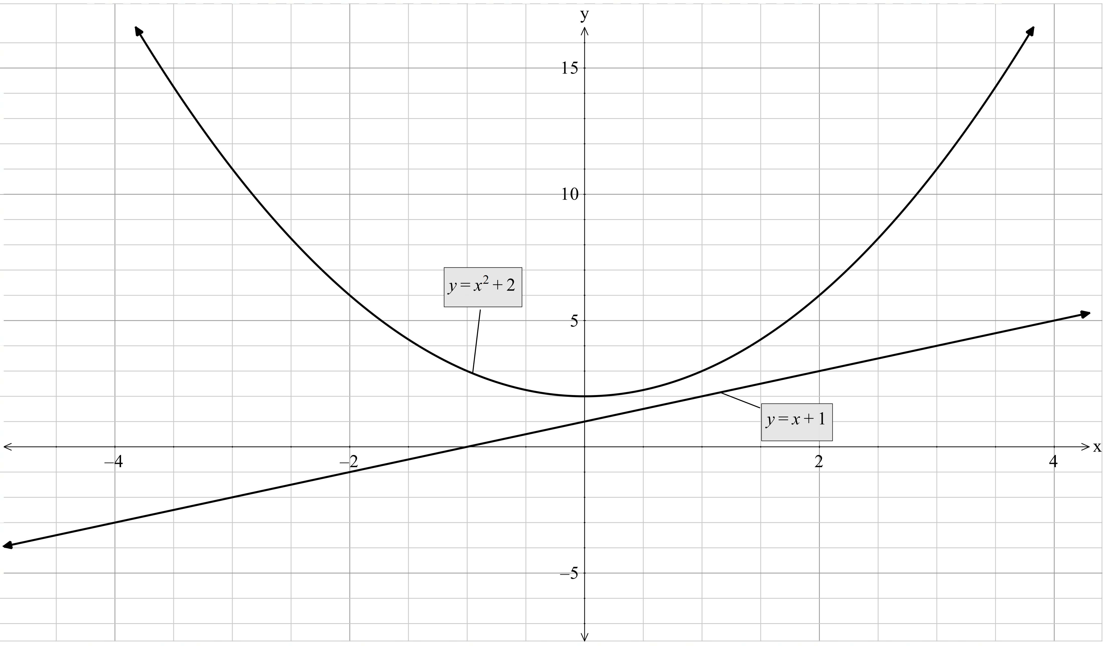
Solving graphically (3)

Slide 10
Releasing responsibility

Slide 11



Solve simultaneously (1)
$Demand:P=−Q^{2}+100$ (1)
$Supply:P=3Q+10$ (2)
Determine the solution to this pair of simultaneous equations
Solution:
Substitute (1) into (2)
$$3Q+10=−Q^{2}+100 \\ Q^{2}+3Q−90=0$$
Check number of solutions:
$$∆ ={\left(3\right)}^{2}−4\left(1\right)\left(−90\right) \\ ∆>0$$
Hence, we have two solutions to the problem
Solution:
Using the quadratic formula
$$Q=\frac{−3±\sqrt{3^{2}−4\left(1\right)\left(−90\right)}}{2} \\ Q=8.1 and −11.1$$
Hence our solutions are
$$Q=8.1, P=34.3 \\ Q=−11.1 , P=−23.3$$
For our context only $Q=8.1, P=34.3$ are applicable
What is the benefit of finding the discriminant?
Why have we removed a solution?

Slide 12


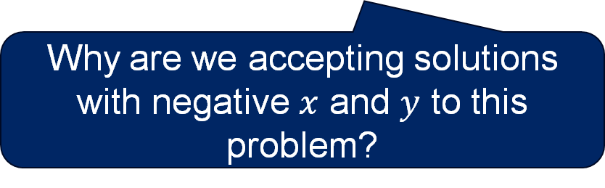

Solve simultaneously (2)
Worked example
Why was the quadratic formula used?
$y=2x+1$ (1)
$y=x^{2}+x−6$ (2)
Determine the solution to this pair of simultaneous equations
Solution:
Substitute (1) into (2)
$$2x+1=x^{2}+x−6 \\ x^{2}−x−7=0$$
Check number of solutions:
$$∆ ={\left(−1\right)}^{2}−4\left(1\right)(−7) \\ ∆>0$$
Hence, we have two solutions to the problem
Solution:
Using the quadratic formula
$$x=\frac{−(−1)±\sqrt{{(−1)}^{2}−4\left(1\right)(−7)}}{2} \\ x=3.19 and −2.19$$
Hence our solutions are
$$x=3.19, y=7.38 \\ x=−2.19 y=−3.38$$
Why are we accepting solutions with negative $x$ and $y$ to this problem?

Slide 13



Solve simultaneously (3)
Your turn
$y=x^{2}+2x+1$ (1)
$y=2x^{2}−x+3$ (2)
Determine the solution to this pair of simultaneous equations
Solution:
Substitute (1) into (2)
$$x^{2}+2x+1=2x^{2}−x+3 \\ x^{2}−3x+2=0$$
Check number of solutions:
$$∆ ={\left(−3\right)}^{2}−4\left(1\right)(2) \\ ∆>0$$
Hence, we have two solutions to the problem
Solution:
Factorising
$$\left(x−2\right)\left(x−1\right)=0 \\ x=2 and 1$$
Hence our solutions are:
$$x=2, y=9 \\ x=1, y=4$$

Slide 14
Independent practice

Slide 15

Approaching questions

Slide 16
Marking criteria (1)
Criteria | Marks
Approximate point of intersection indicated and labelled | 3
Correct sketch for Jet B: Straight line | 2
Correct sketch for Jet A: Parabola | 1

Slide 17
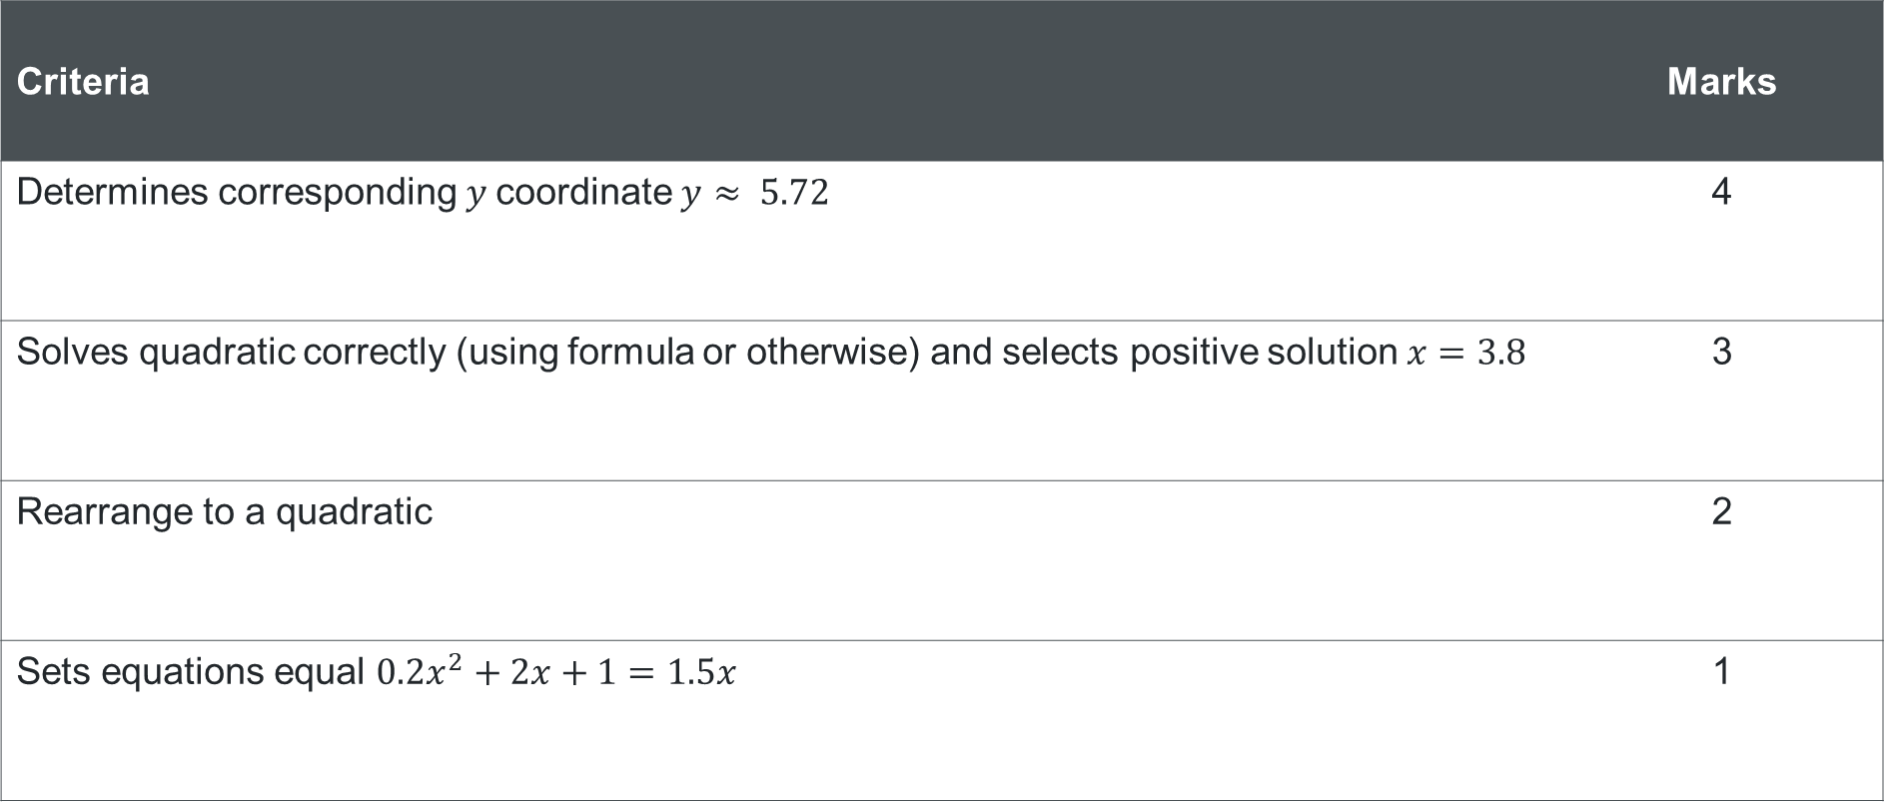
Marking criteria (2)
Criteria | Marks
Determines corresponding $y$coordinate $y≈ 5.72$ | 4
Solves quadratic correctly (using formula or otherwise) and selects positive solution $x=3.8$ | 3
Rearrange to a quadratic | 2
Sets equations equal $0.2x^{2}+2x+1=1.5x$ | 1

Slide 18
Marking criteria (3)
Criteria | Marks
Explains behaviour along fountain, linking algebra and sketch to context | 3
Uses sketch or algebra to identify intersection point where Jet B meets Jet A | 2
Recognises the designer’s statement is not correct | 1

Slide 19
References
This presentation contains NSW Curriculum and syllabus content. The NSW Curriculum is developed by the NSW Education Standards Authority. This content is prepared by NESA for and on behalf of the Crown in the right of the State of New South Wales. The material is protected by Crown copyright.
Please refer to the NESA Copyright Disclaimer for more information https://educationstandards.nsw.edu.au/wps/portal/nesa/mini-footer/copyright.
NESA holds the only official and up-to-date versions of the NSW Curriculum and syllabus documents. Please visit the NSW Education Standards Authority (NESA) website https://educationstandards.nsw.edu.au/wps/portal/nesa/home and the NSW Curriculum website https://curriculum.nsw.edu.au.
Mathematics Advanced 11-12 Syllabus © NSW Education Standards Authority (NESA) for and on behalf of the Crown in right of the State of New South Wales, 2024.

Slide 20
Copyright
© State of New South Wales (Department of Education), 2025
The copyright material published in this resource is subject to the Copyright Act 1968 (Cth) and is owned by the NSW Department of Education or, where indicated, by a party other than the NSW Department of Education (third-party material).
Copyright material available in this resource and owned by the NSW Department of Education is licensed under a Creative Commons Attribution 4.0 International (CC BY 4.0) license.
This license allows you to share and adapt the material for any purpose, even commercially.
Attribution should be given to © State of New South Wales (Department of Education), 2025.
Material in this resource not available under a Creative Commons license:
the NSW Department of Education logo, other logos and trademark-protected material
Material owned by a third party that has been reproduced with permission. You will need to obtain permission from the third party to reuse its material.
Links to third-party material and websites
Please note that the provided (reading/viewing material/list/links/texts) are a suggestion only and implies no endorsement, by the New South Wales Department of Education, of any author, publisher, or book title. School principals and teachers are best placed to assess the suitability of resources that would complement the curriculum and reflect the needs and interests of their students.
If you use the links provided in this document to access a third-party’s website, you acknowledge that the terms of use, including licence terms set out on the third-party’s website apply to the use which may be made of the materials on that third-party website or where permitted by the Copyright Act 1968 (Cth). The department accepts no responsibility for content on third-party websites.

