Slide 1
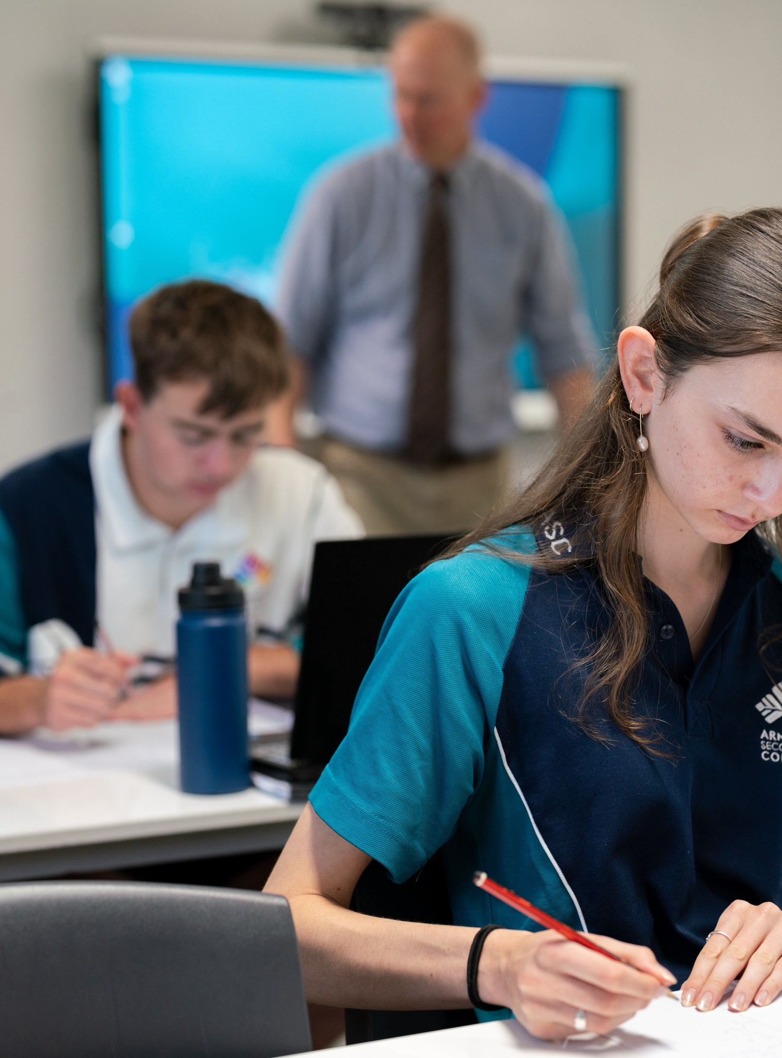
Modelling quadratic functions
Mathematics Advanced – Stage6 Year 11
Working with linear and quadratic functions

Slide 2
Learning intentions and success criteria
Learning intentions
To understand how quadratic functions can be used to model and solve practical problems.
To be able to make connections between key features of the graph of a quadratic function and the context of a problem.
Success criteria
I can identify real-world situations where quadratic functions are applicable.
I can interpret the solutions of a quadratic model to solve problems.
I can create a quadratic model to represent and solve a given practical problem.
Notes:
Notes for teachers:
Learning intentions and success criteria are best co-constructed with students. Adapt the learning intention as required and add matching success criteria.
For more information See ⁠AITSL or the NSW Department of Education explicit teaching strategies, ⁠Sharing learning intentions and ⁠Sharing success criteria
LISC is not necessarily presented at the beginning of the lesson. Teacher needs to consider most effectual time to introduce
LISC should be revisited during the lesson to support students' evaluation of their learning

Slide 3
Activating prior learning

Slide 4
Revenue and cost of production (1)
When the McRib first comes back onto McDonald’s menu:
It costs McDonald’s $250 000 to produce the McRib every day.
McDonald’s makes $400 000 each day in combined McRib sales.

Slide 5
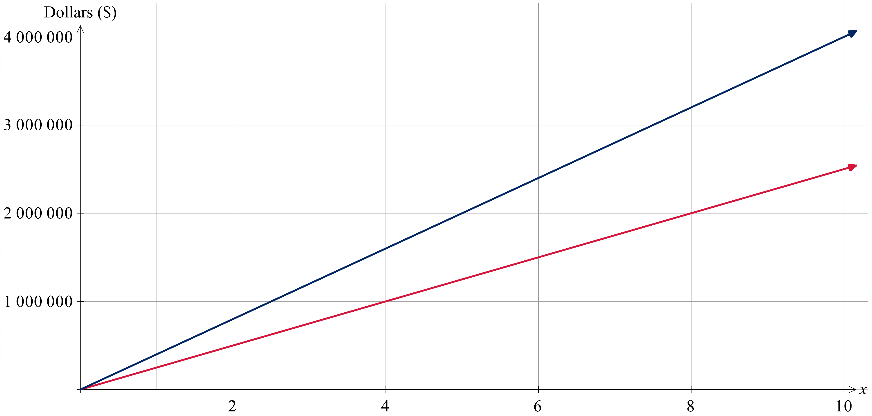


Revenue and cost of production (2)
$$C=250 000x$$
$$R=400 000x$$
$$R=400 000x$$
$$C=250 000x$$

Slide 6
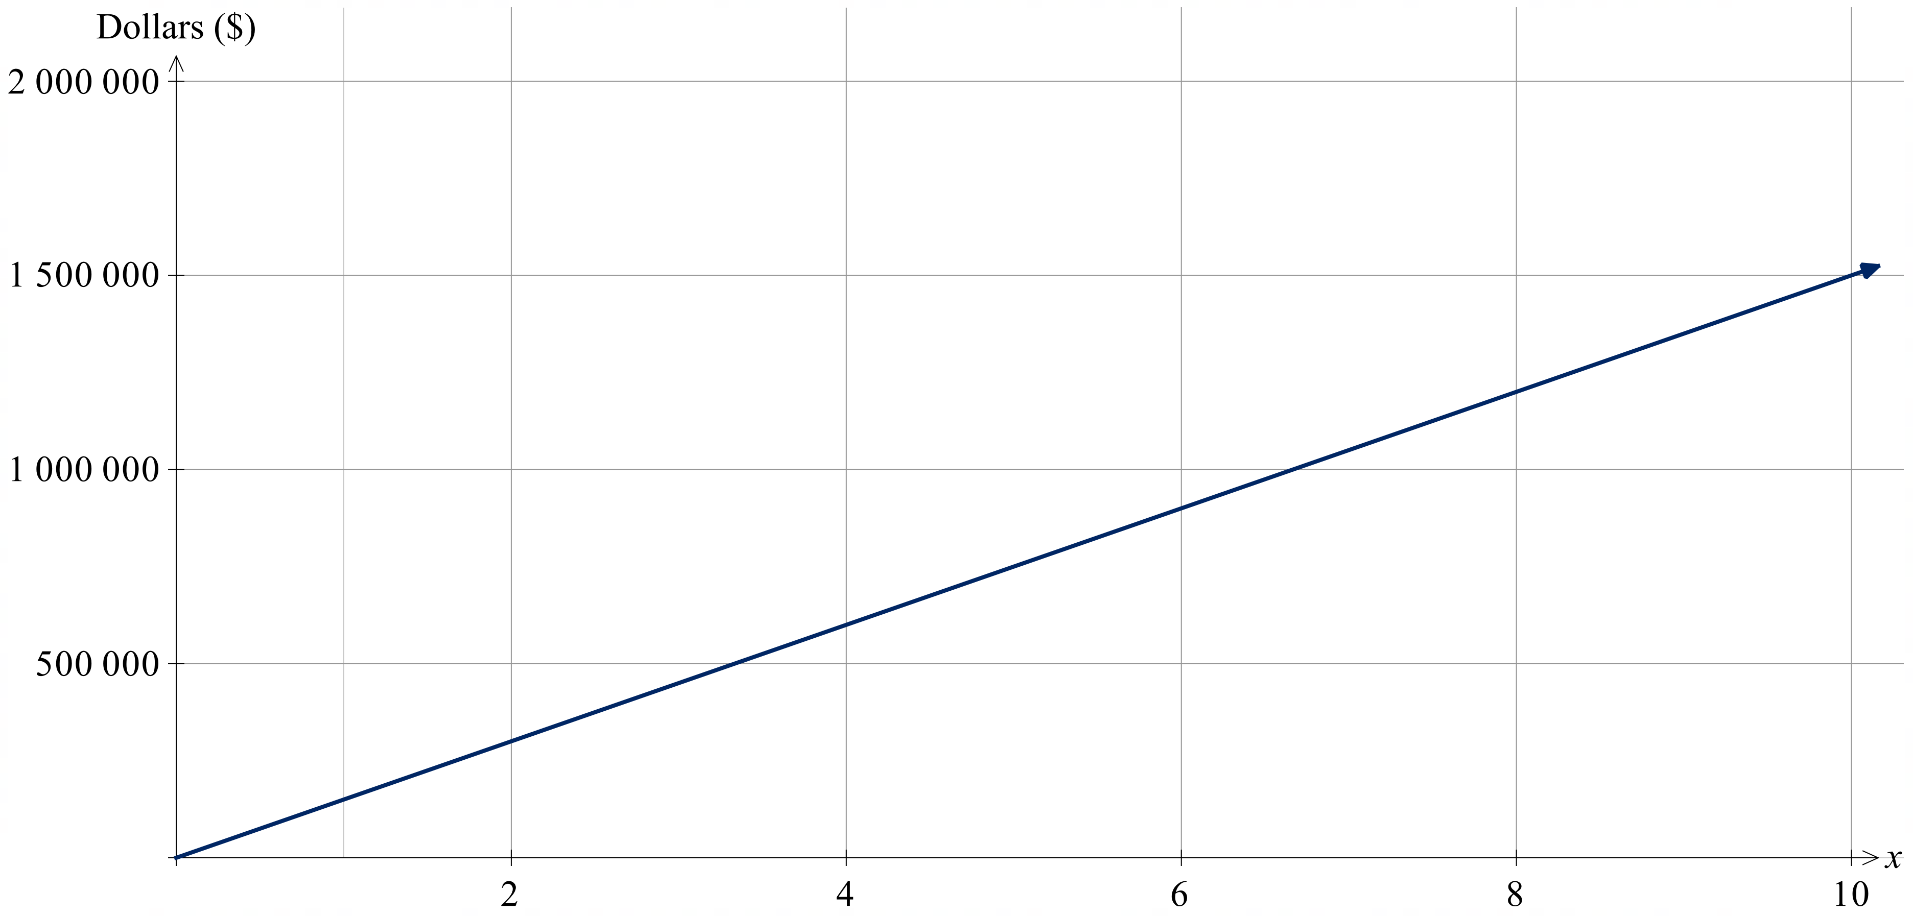

Profit
Is this a realistic representation of how sales would trend? Explain your reasoning.
$$P=150 000x$$

Slide 7
Connecting learning

Slide 8
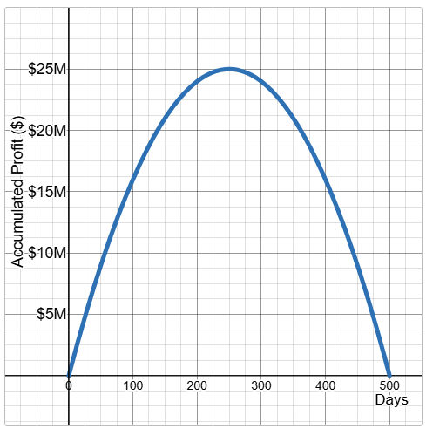

Alternate model
$$P=−400x^{2}+200 000x$$
Let $P=0$
$$0=−400x^{2}+200 000x$$
$$−400x\left(x−500\right)=0$$
$−400x=0$ or $x−500=0$
$$∴x=0 \text{or} 500$$

Slide 9
Releasing responsibility

Slide 10
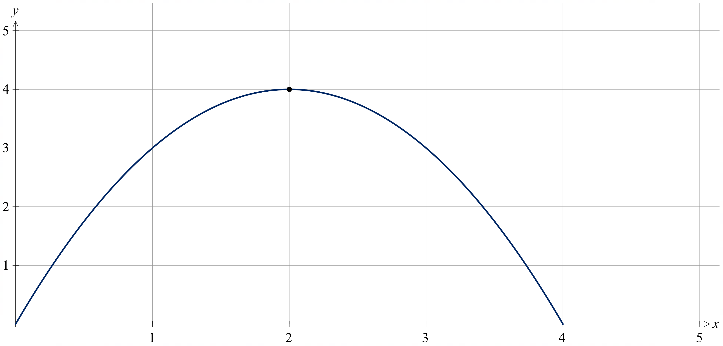

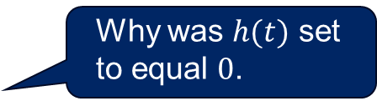
Modelling quadratic functions (1)
Worked example – part 1
A child jumps on a trampoline. Their height, $h$, in metres after $t$ seconds is modelled by:
$$h\left(t\right)=−t^{2}+4t$$
What is the maximum height the child reaches on the trampoline?
Let $h\left(t\right)=0$
$$−t^{2}+4t=0$$
$$−t\left(t−4\right)=0$$
$$∴t=0, 4$$
What information was needed to graph this function?
Why was $h(t)$ set to equal $0$.

Slide 11

Modelling quadratic functions (2)
Worked example – part 2
$h\left(t\right)=−t^{2}+4t$, what is the maximum height the child reaches on the trampoline?
$$x=−\frac{b}{2a}$$
$$=−\frac{4}{2×−1}$$
$$=2$$
$$h\left(2\right)=−{\left(2\right)}^{2}+4(2)$$
$∴$ The maximum height the child reaches is 4 metres.
Why was the axis of symmetry found?

Slide 12
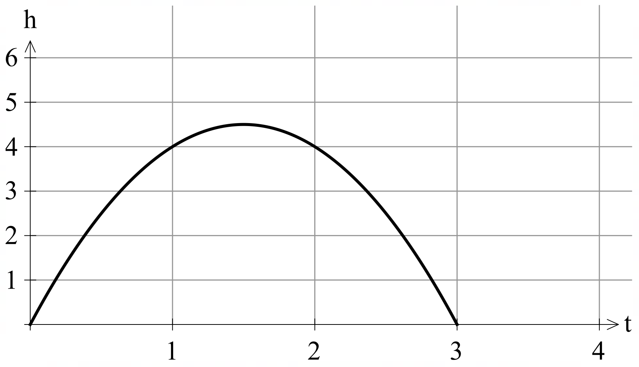
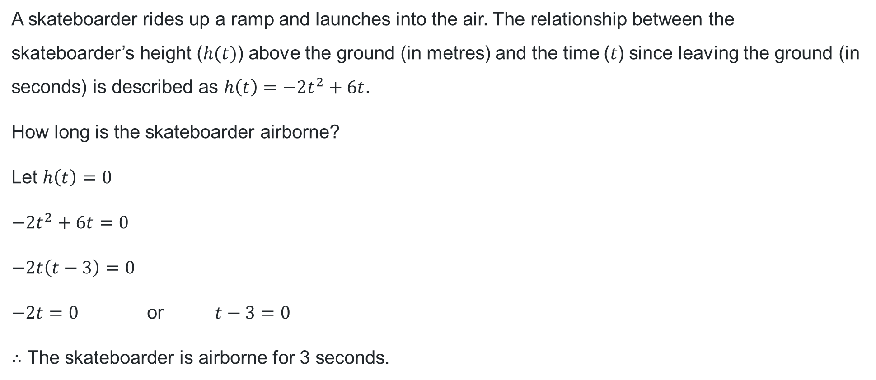
Modelling quadratic functions (3)
Your turn
A skateboarder rides up a ramp and launches into the air. The relationship between the skateboarder’s height ($h(t)$) above the ground (in metres) and the time ($t$) since leaving the ground (in seconds) is described as $h\left(t\right)=−2t^{2}+6t$.
How long is the skateboarder airborne?
Let $h\left(t\right)=0$
$$−2t^{2}+6t=0$$
$$−2t\left(t−3\right)=0$$
$−2t=0$ or $t−3=0$
$∴$ The skateboarder is airborne for 3 seconds.

Slide 13
Independent practice

Slide 14

14Approaching questions

Slide 15
Flower bed design
Modelling quadratic functions
You are designing a rectangular flower bed surrounded by a uniform-width path. The total area of the garden, including the flower bed and path, is 80 square metres.
If the dimensions of the flower bed are 6 metres by 4 metres, how wide is the path?

Slide 16
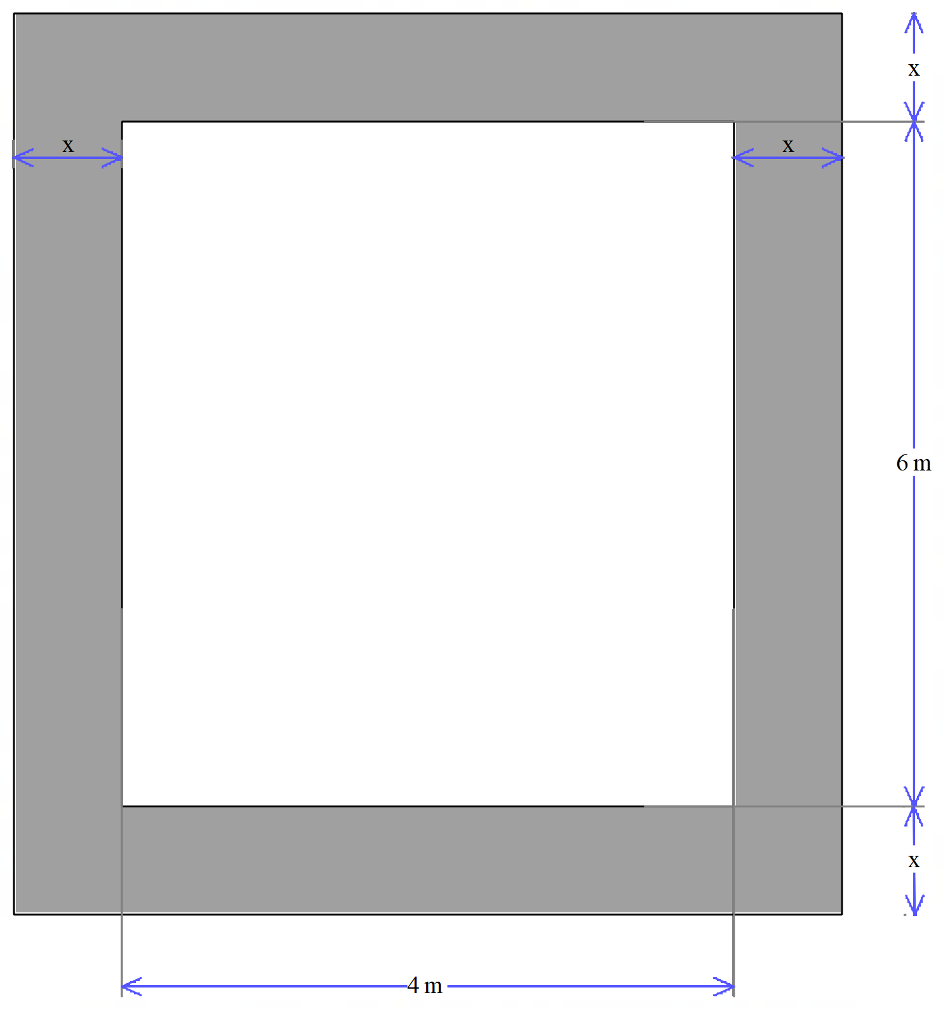
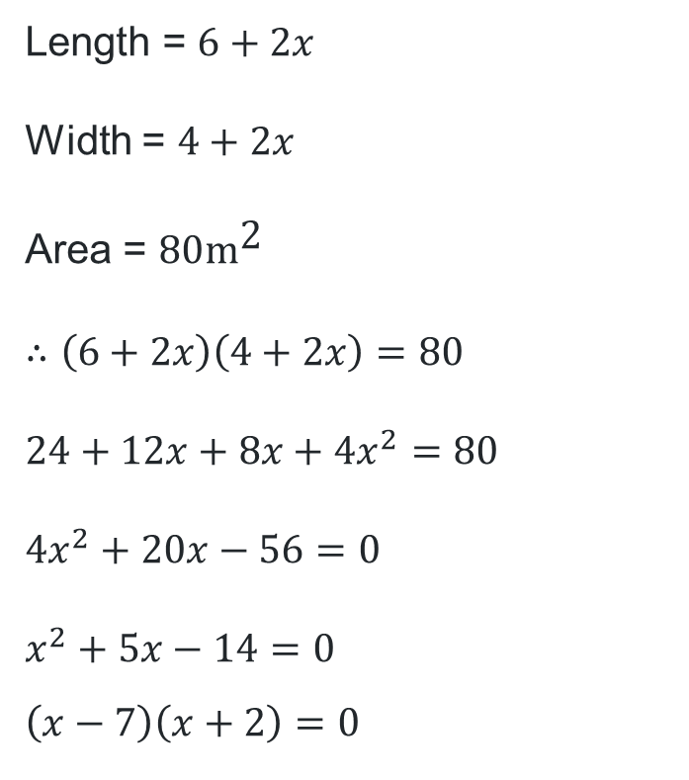
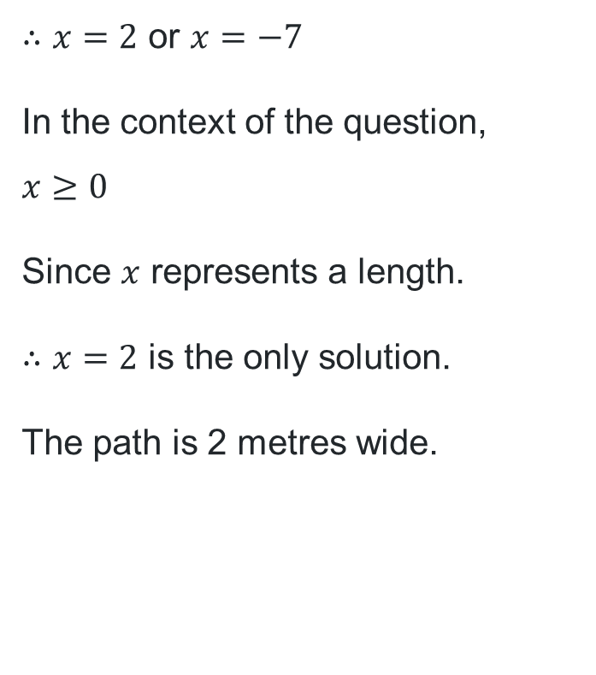
Flower bed design – solution
Modelling quadratic functions
Length = $6+2x$
Width = $4+2x$
Area = $80{\text{m}}^{\text{2}}$
$$∴\left(6+2x\right)\left(4+2x\right)=80$$
$$24+12x+8x+4x^{2}=80$$
$$4x^{2}+20x−56=0$$
$$x^{2}+5x−14=0$$
$$\left(x−7\right)\left(x+2\right)=0$$
$∴x=2$ or $x=−7$
In the context of the question,
$$x≥0$$
Since $x$ represents a length.
$∴x=2$ is the only solution.
The path is 2 metres wide.

Slide 17
References
This presentation contains NSW Curriculum and syllabus content. The NSW Curriculum is developed by the NSW Education Standards Authority. This content is prepared by NESA for and on behalf of the Crown in the right of the State of New South Wales. The material is protected by Crown copyright.
Please refer to the NESA Copyright Disclaimer for more information https://educationstandards.nsw.edu.au/wps/portal/nesa/mini-footer/copyright.
NESA holds the only official and up-to-date versions of the NSW Curriculum and syllabus documents. Please visit the NSW Education Standards Authority (NESA) website https://educationstandards.nsw.edu.au/wps/portal/nesa/home and the NSW Curriculum website https://curriculum.nsw.edu.au.
Mathematics Advanced 11-12 Syllabus © NSW Education Standards Authority (NESA) for and on behalf of the Crown in right of the State of New South Wales, 2024.

Slide 18
Copyright
© State of New South Wales (Department of Education), 2025
The copyright material published in this resource is subject to the Copyright Act 1968 (Cth) and is owned by the NSW Department of Education or, where indicated, by a party other than the NSW Department of Education (third-party material).
Copyright material available in this resource and owned by the NSW Department of Education is licensed under a Creative Commons Attribution 4.0 International (CC BY 4.0) license.
This license allows you to share and adapt the material for any purpose, even commercially.
Attribution should be given to © State of New South Wales (Department of Education), 2025.
Material in this resource not available under a Creative Commons license:
the NSW Department of Education logo, other logos and trademark-protected material
Material owned by a third party that has been reproduced with permission. You will need to obtain permission from the third party to reuse its material.
Links to third-party material and websites
Please note that the provided (reading/viewing material/list/links/texts) are a suggestion only and implies no endorsement, by the New South Wales Department of Education, of any author, publisher, or book title. School principals and teachers are best placed to assess the suitability of resources that would complement the curriculum and reflect the needs and interests of their students.
If you use the links provided in this document to access a third-party’s website, you acknowledge that the terms of use, including licence terms set out on the third-party’s website apply to the use which may be made of the materials on that third-party website or where permitted by the Copyright Act 1968 (Cth). The department accepts no responsibility for content on third-party websites.

