Slide 1
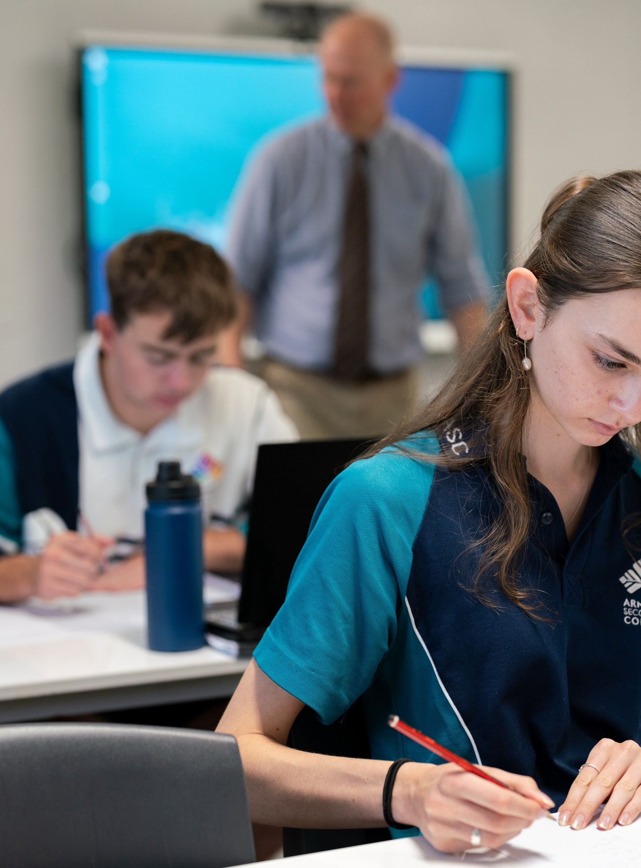
Finding quadratic functions from a graph
Mathematics Advanced – Stage 6 (Year 11)
Working with linear and quadratic functions

Slide 2
Learning intentions and success criteria
Learning intentions
To understand how many graphical features are required to find the equation of a parabola.
To be able to solve problems when 2 quadratic functions are equal.
Success criteria
I can use the features of a graph to find the equation of a parabola.
I can justify the minimum number of graphical features needed to find the equation of a parabola.
I can recognise that 2 quadratic functions are equal if their corresponding coefficients are equal.
I can solve problems by equating corresponding coefficients.
Notes:
Notes for teachers:
Learning intentions and success criteria are best co-constructed with students. Adapt the learning intention as required and add matching success criteria.
For more information See ⁠AITSL or the NSW Department of Education explicit teaching strategies, ⁠Sharing learning intentions and ⁠Sharing success criteria
LISC is not necessarily presented at the beginning of the lesson. Teacher needs to consider most effectual time to introduce
LISC should be revisited during the lesson to support students' evaluation of their learning

Slide 3
Activating prior knowledge

Slide 4
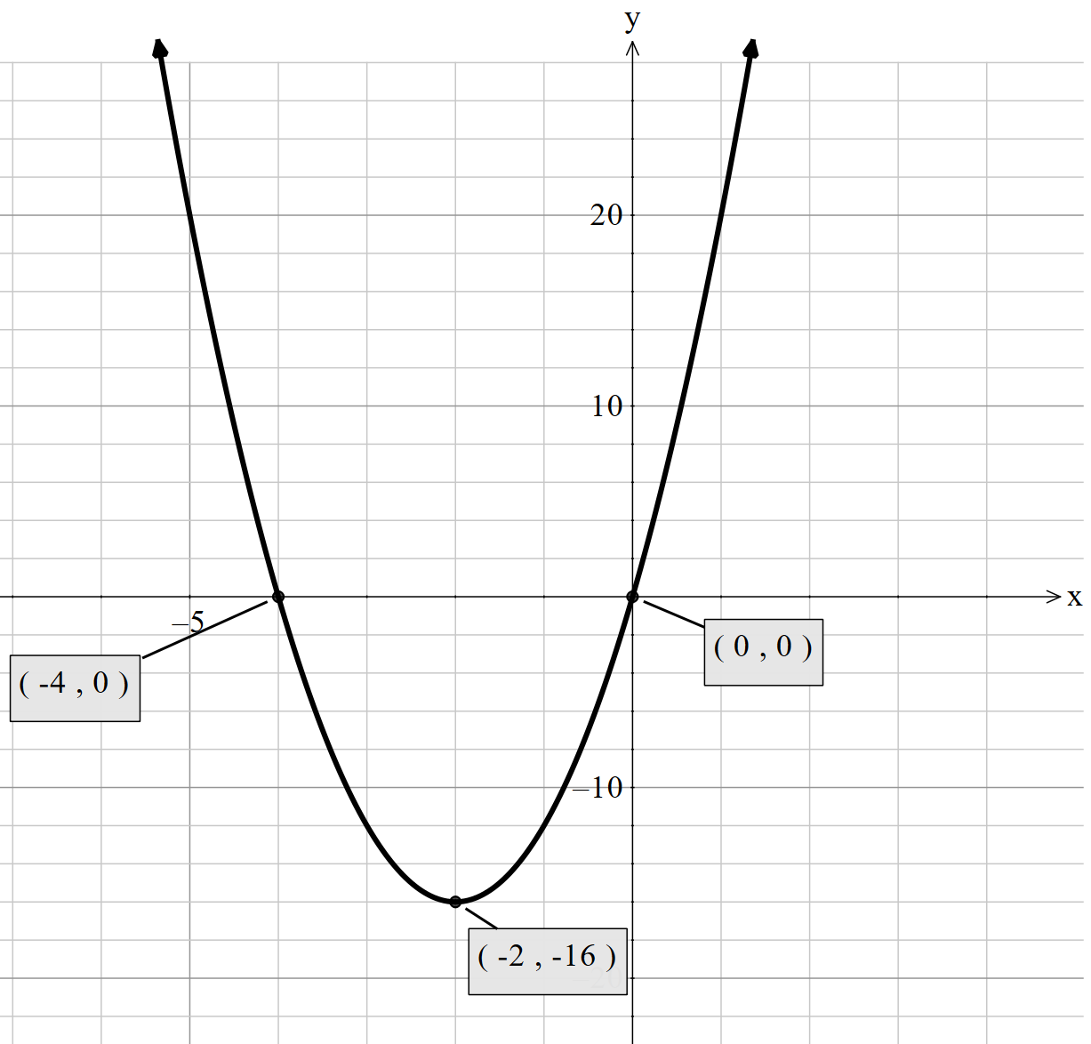






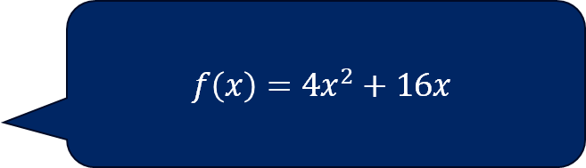

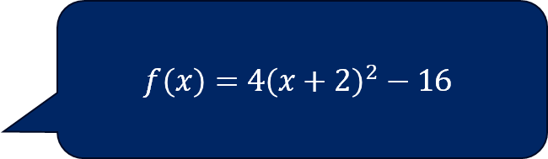
Consider this parabola (1)
Which statements are true?
$$f\left(x\right)=4{\left(x+2\right)}^{2}−16$$
$$f\left(x\right)=x(x+4)$$
$$f\left(x\right)=4x^{2}+16x$$

Slide 5
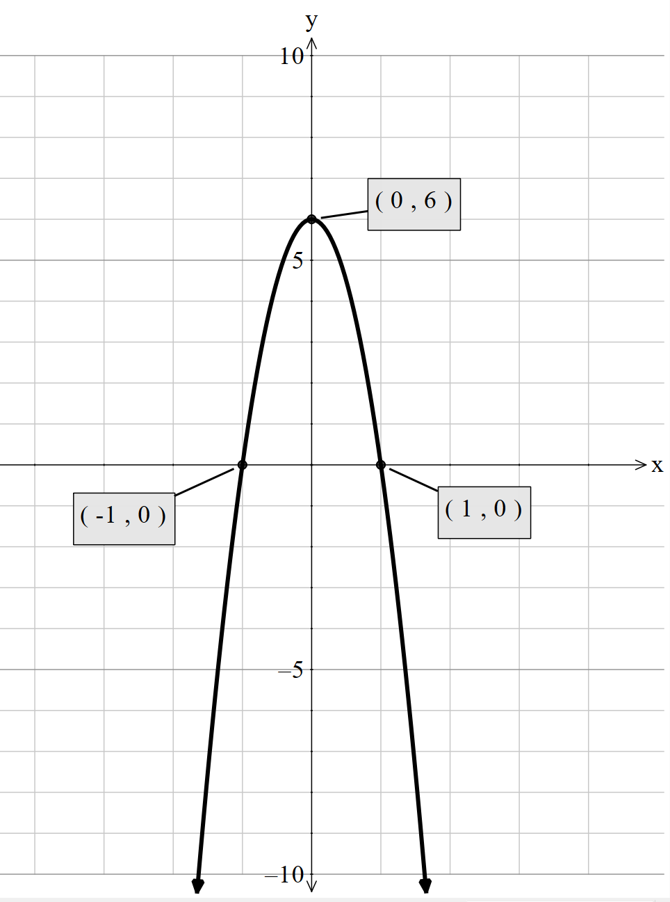







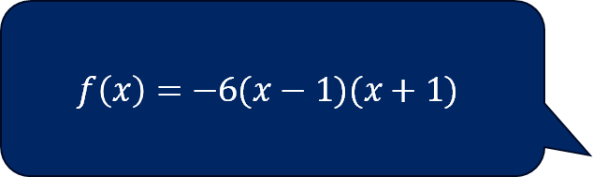

Consider this parabola (2)
Which statements are true?
$$f\left(x\right)={−x}^{2}+6$$
$$f\left(x\right)=−6(x−1)(x+1)$$
$$f\left(x\right)=−6x^{2}+6$$

Slide 6
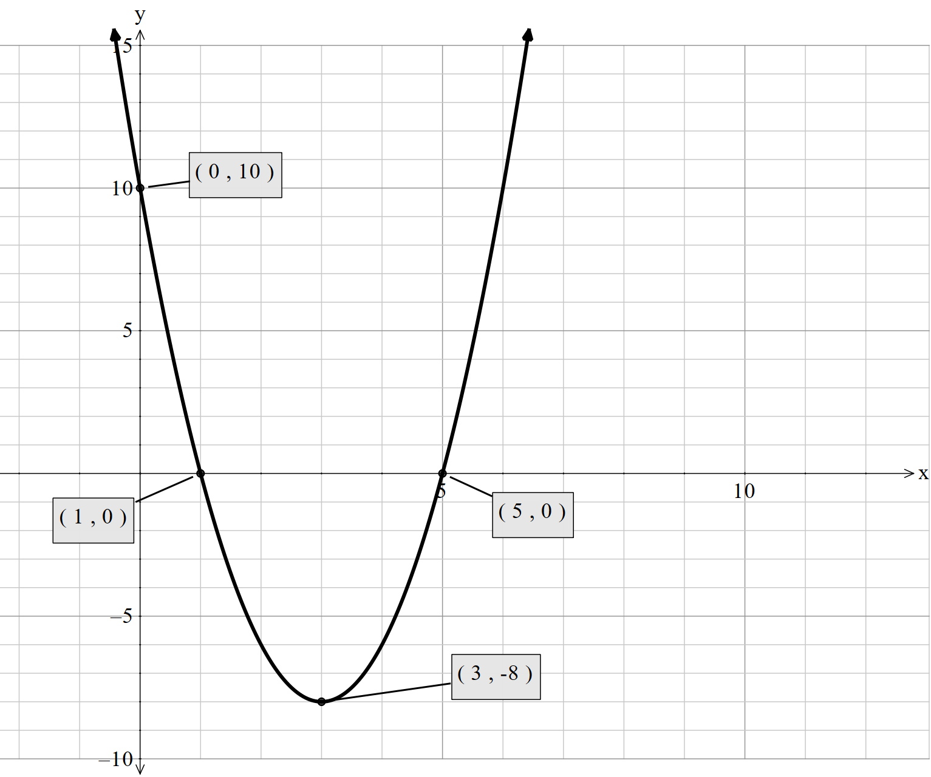


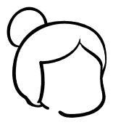




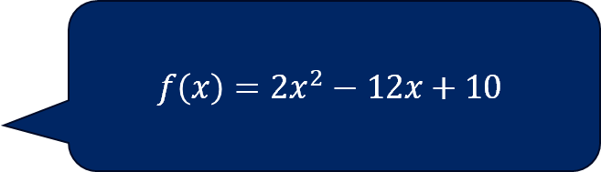
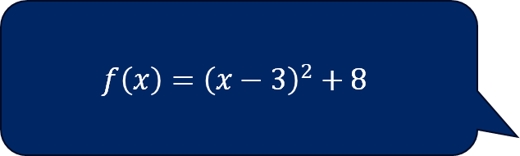
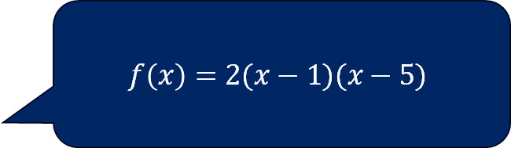
Consider this parabola (3)
Which statements are true?
$$f\left(x\right)=2(x−1)(x−5)$$
$$f\left(x\right)={\left(x−3\right)}^{2}+8$$
$$f\left(x\right)=2x^{2}−12x+10$$

Slide 7
Connecting learning

Slide 8
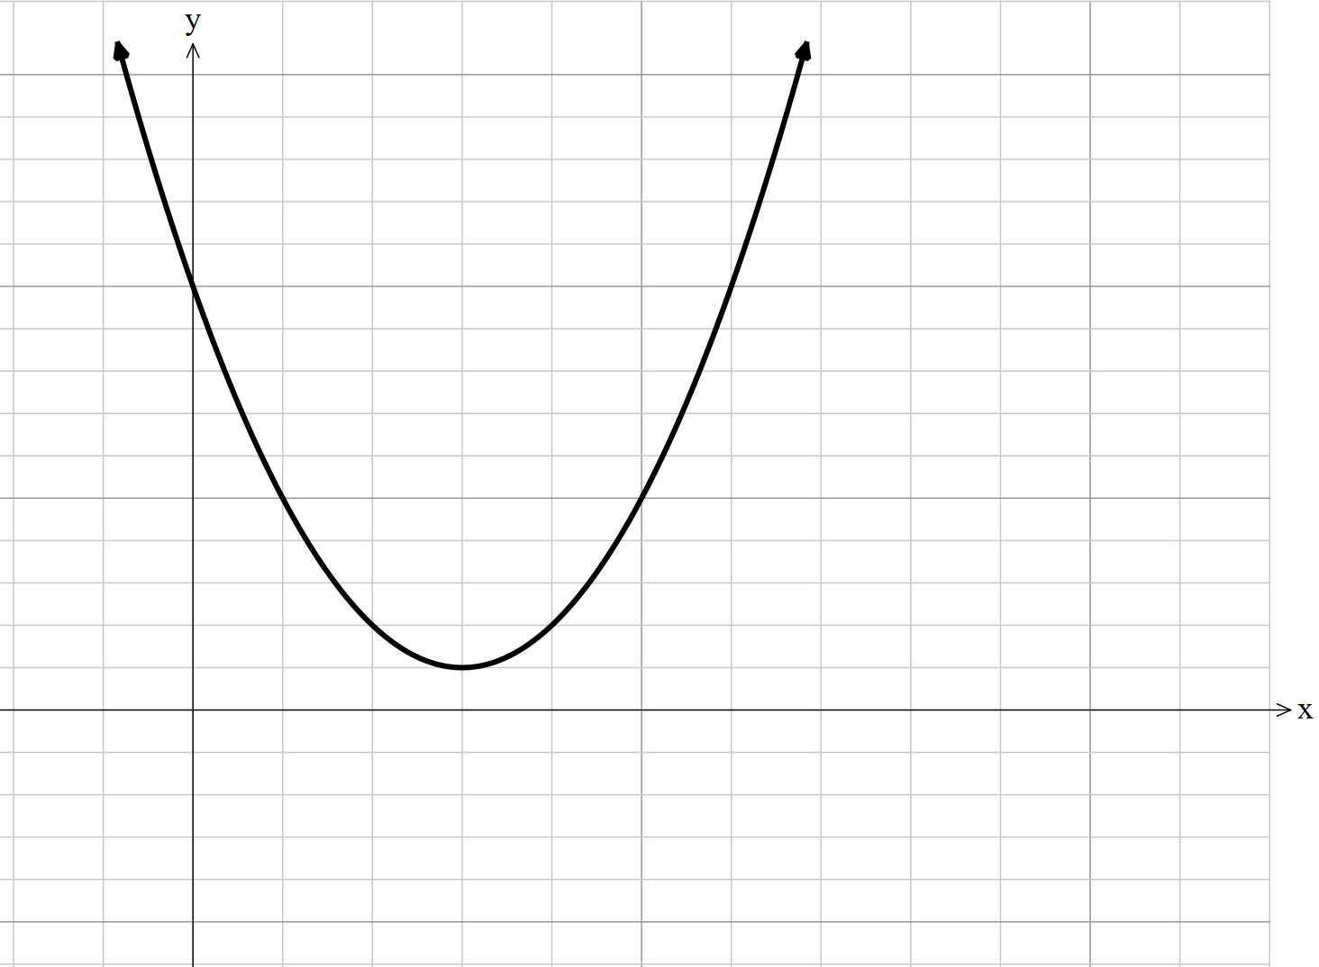
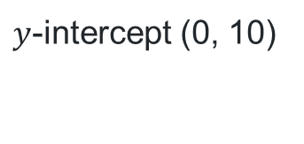
Slow reveal – Example 1
What do you notice and wonder?
$y$-intercept (0, 10)
Vertex (3, 1)

Slide 9
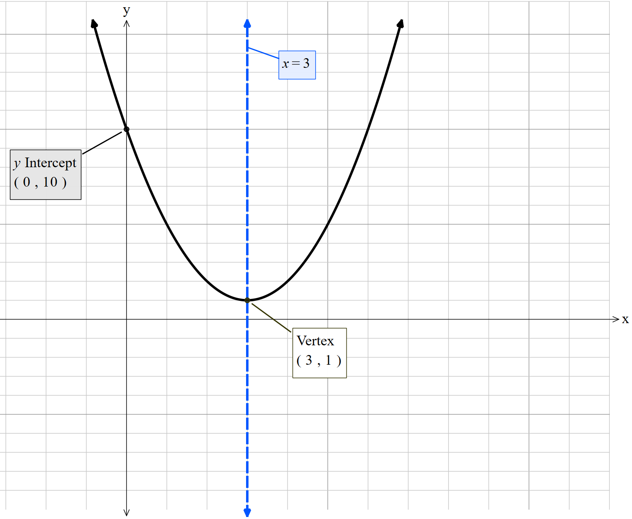

What’s the quadratic function? (1)
$$y={\left(x−3\right)}^{2}+1$$
$$y=x^{2}−6x+9+1$$
$$y=x^{2}−6x+10$$
Where did this substitution come from?
How do you know this is the equation of the parabola?

Slide 10
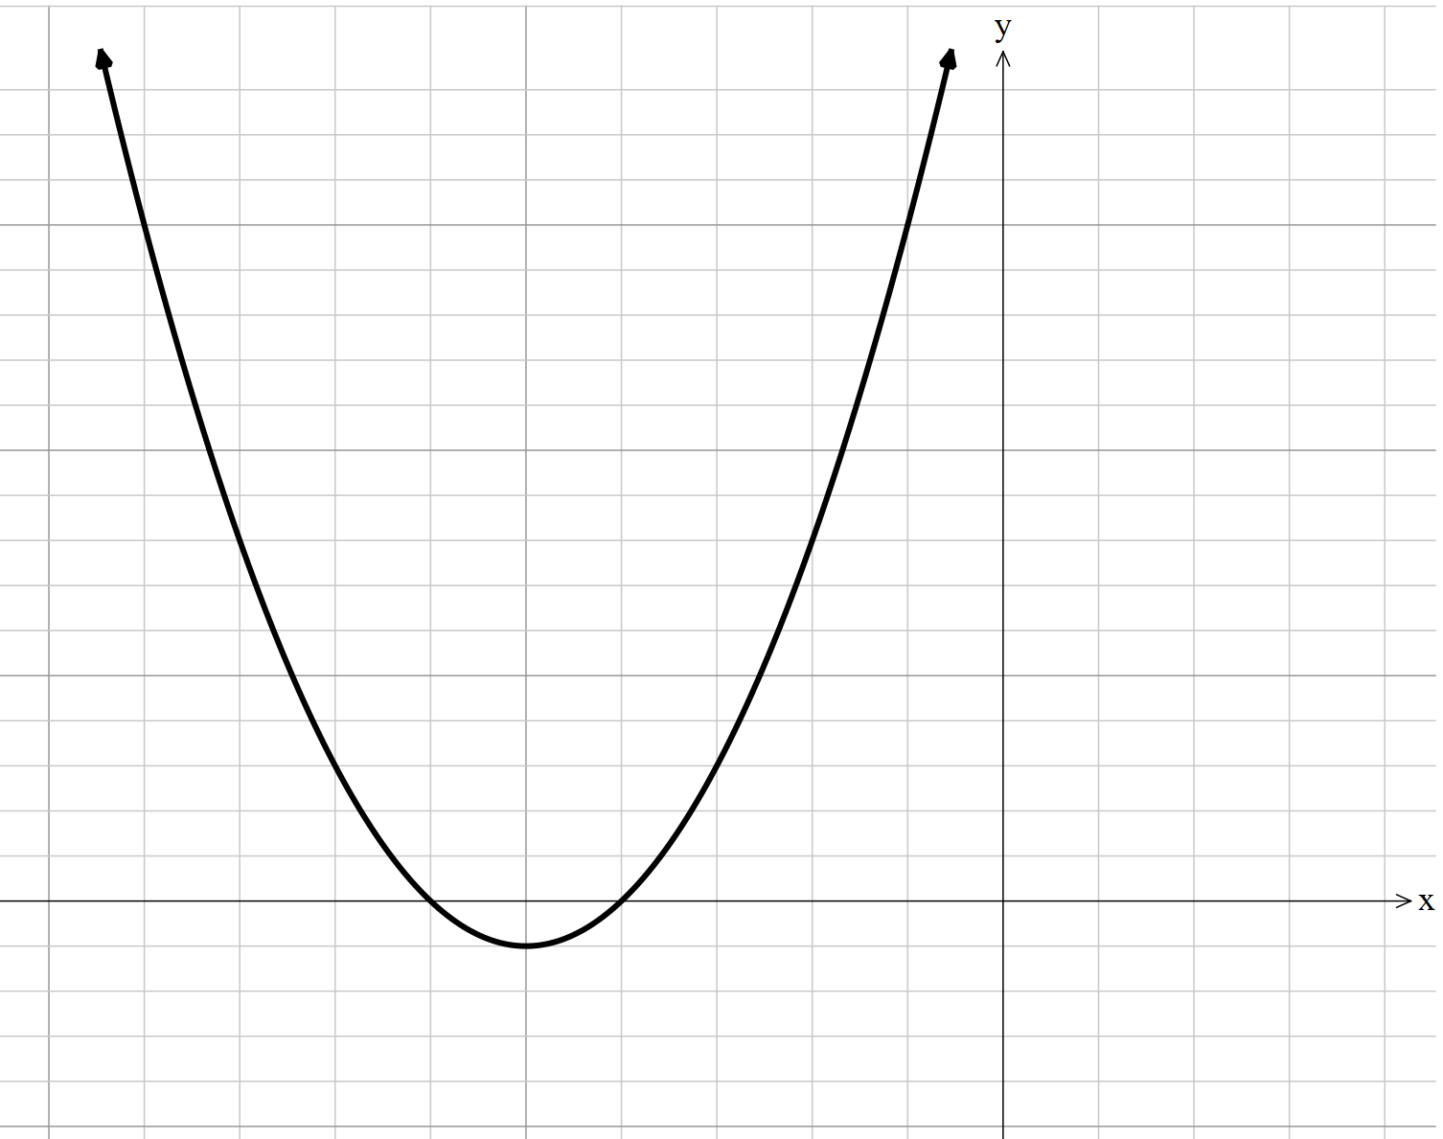

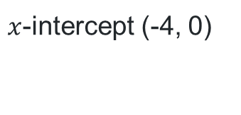
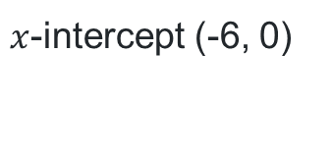
Slow reveal – Example 2
What do you notice and wonder?
$$x=−5$$
$x$-intercept (-4, 0)
$x$-intercept (-6, 0)
Vertex (-5, -1)
Notes:
Students should notice that it is concave up (a will be positive) and that the y-intercept will be positive but we can’t see it. Students will wonder what the equation is.

Slide 11
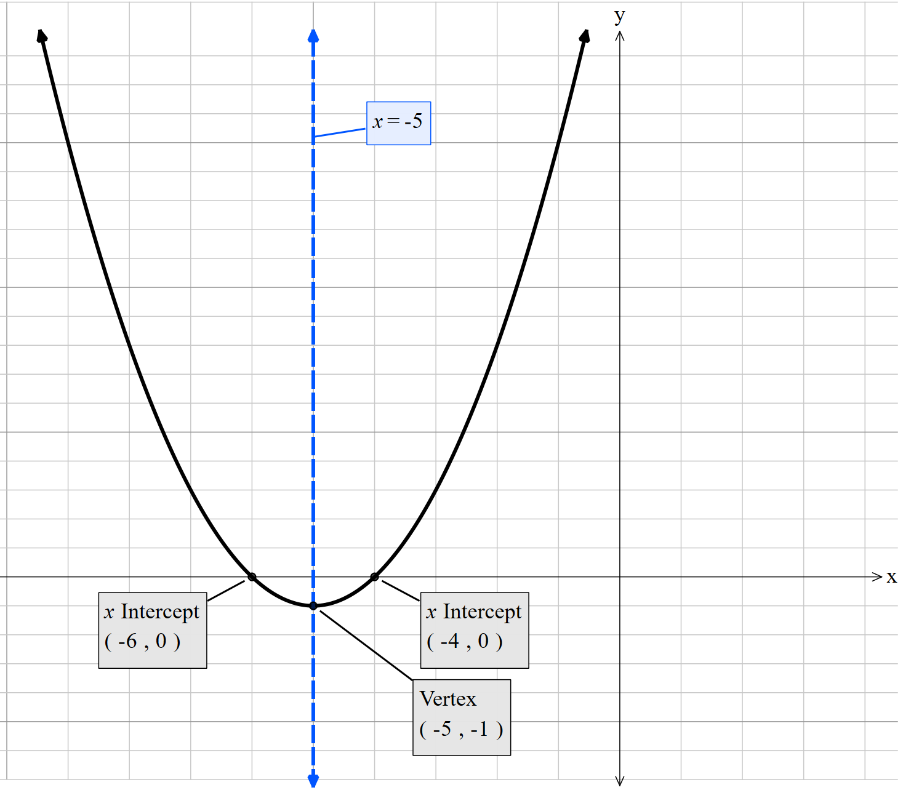

What’s the quadratic function? (2)
Where did these values come from?
$$y=\left(x+6\right)\left(x+4\right)$$
$$y=x^{2}+10x+24 \\ Check (−5,−1)$$
$$y={\left(−5\right)}^{2}+10×\left(−5\right)+24 \\ y=−1 \\ Since the point \left(−5,−1\right) satisfies the equation \\ y = x^{2}+ 10x + 24, this confirms that the point \\ lies on the parabola represented by the equation.$$
Why do we need to check this point?

Slide 12
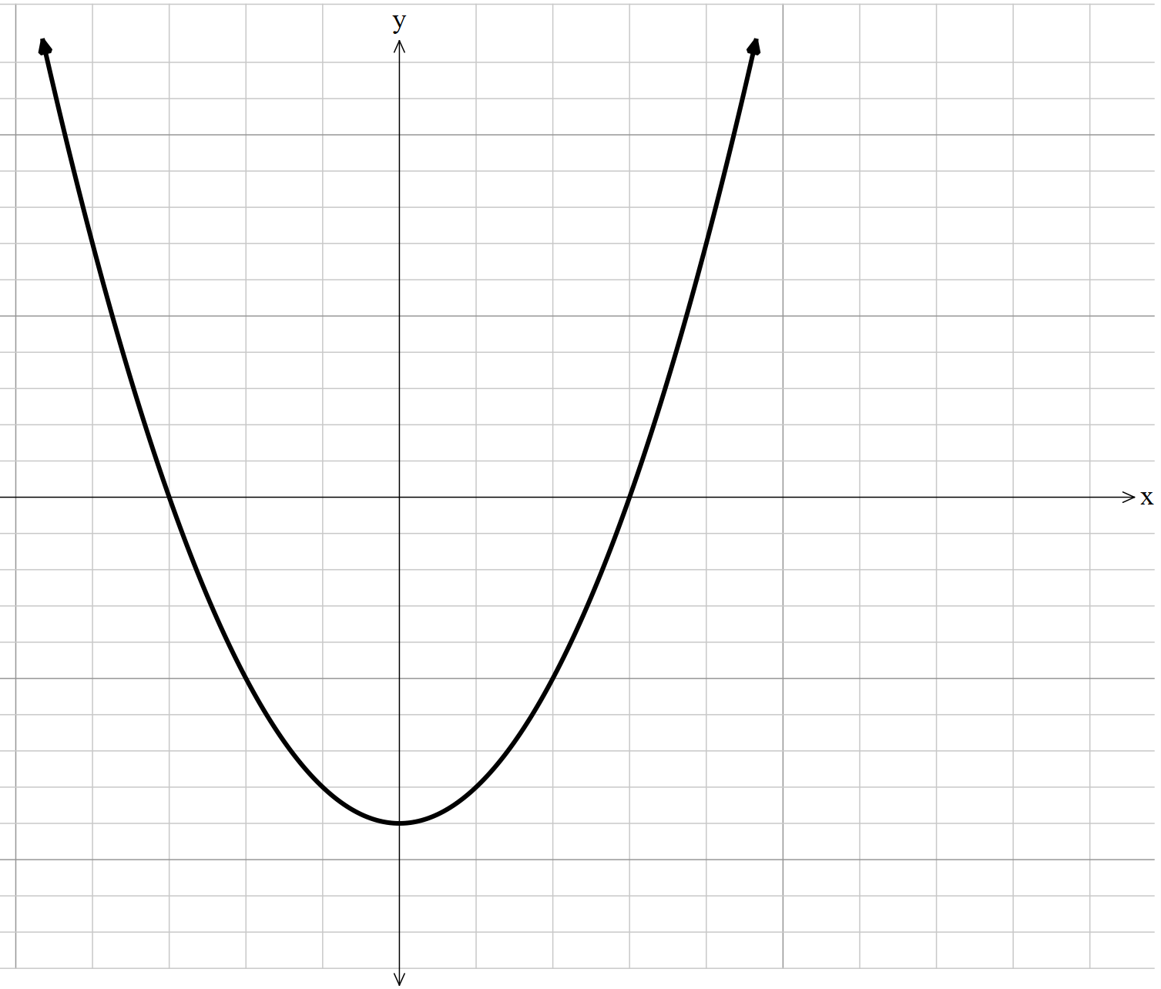
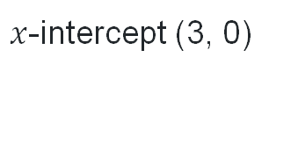
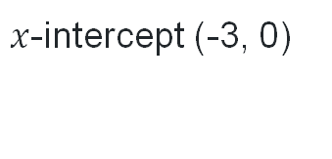
Slow reveal – Example 3
What do you notice and wonder?
$x$-intercept (-3, 0)
$x$-intercept (3, 0)
Vertex (0, -18)
Notes:
Students should notice that it is concave up (a will be positive) and that the y-intercept will be positive but we can’t see it. Students will wonder what the equation is.

Slide 13
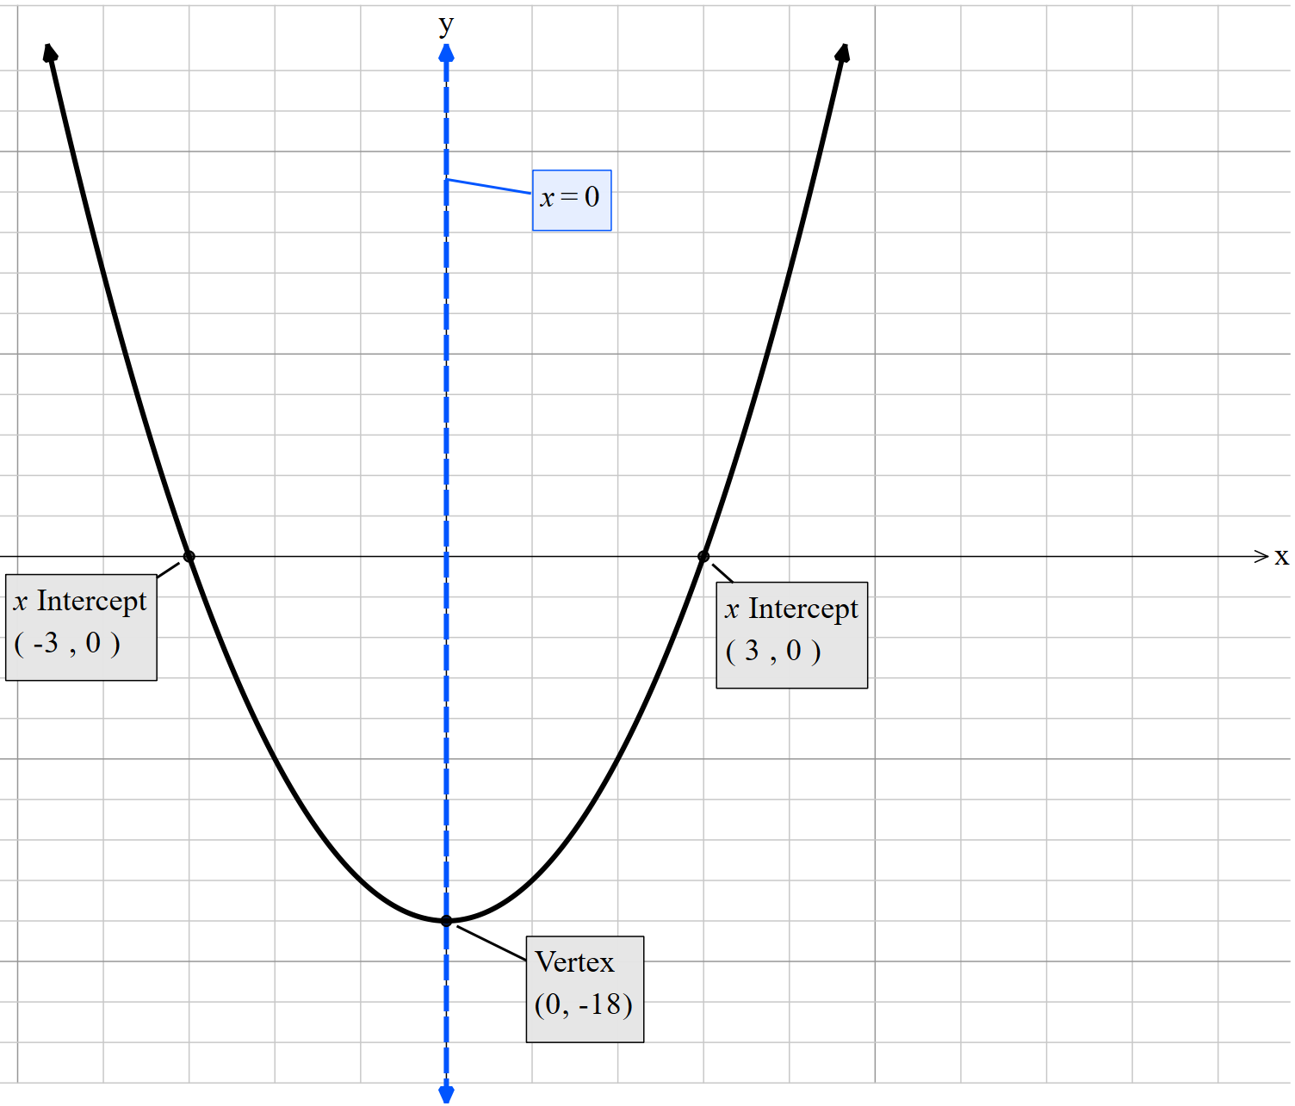

What’s the quadratic function? (3a)
This equation is incorrect
$$y=\left(x−3\right)\left(x+3\right)$$
$$y=x^{2}−9$$
Why is this incorrect?
What information could we use from the graph to make it correct?

Slide 14


What’s the quadratic function? (3b)
Determining non-monic equations
$$y=a\left(x−3\right)\left(x+3\right)$$
$$y={a(x}^{2}−9) \\ when x=0, y=−18 \\ −18=a\left({\left(0\right)}^{2}−9\right) \\ −18=−9a \\ a=2 \\ y=2\left(x−3\right)\left(x+3\right)$$

Slide 15
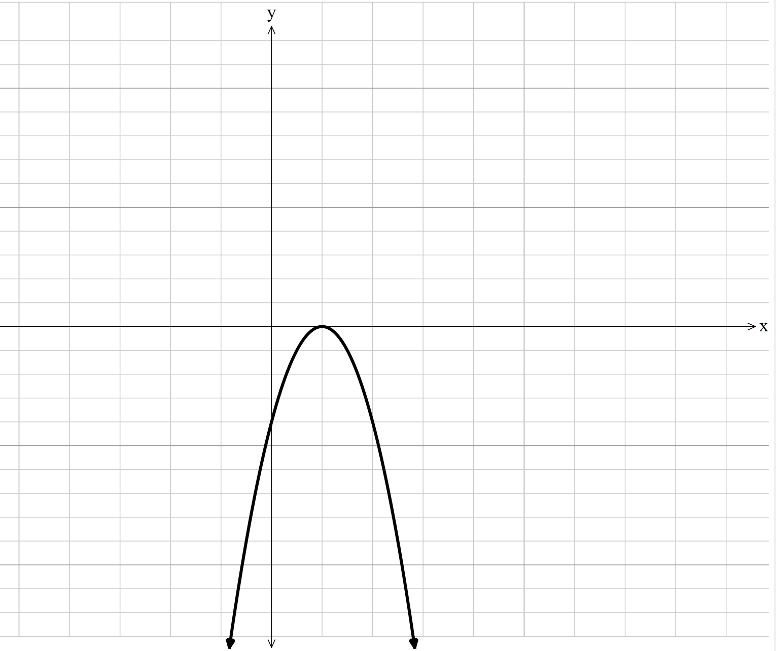
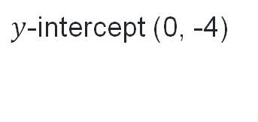
Slow reveal – Example 4
What do you notice and wonder?
Vertex (1, 0)
$y$-intercept (0, -4)
Notes:
Students should notice that it is concave up (a will be positive) and that the y-intercept will be positive but we can’t see it. Students will wonder what the equation is.

Slide 16
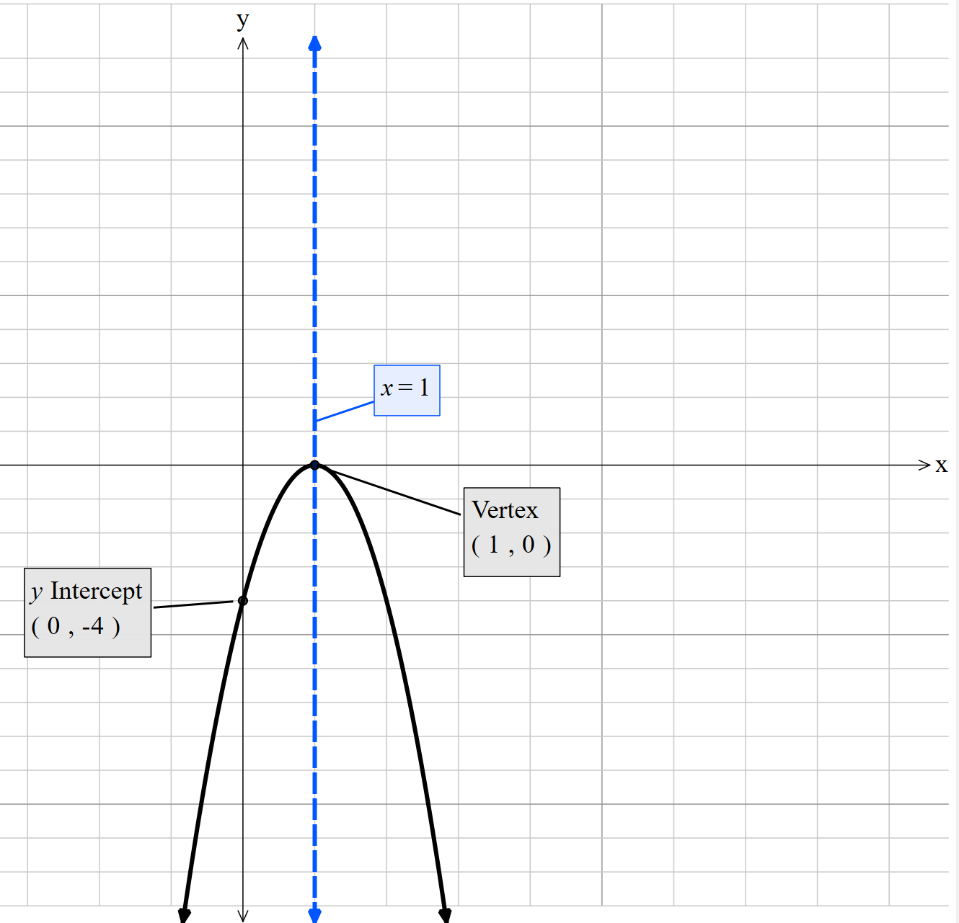

What’s the quadratic function? (4)
Determining non-monic equations
$$y=a{\left(x−1\right)}^{2}$$
$$y={a(x}^{2}−2x+1) \\ when x=0, y=−4 \\ −4=a\left({\left(0\right)}^{2}−2×0+1\right) \\ −4=a \\ a=−4 \\ y=−4{\left(x−1\right)}^{2}$$

Slide 17
Releasing responsibility

Slide 18

Are these the same?
Consider these parabolas
$$y=2x^{2}+16x+13 \\ y=2{\left(x+4\right)}^{2}−3$$

Slide 19
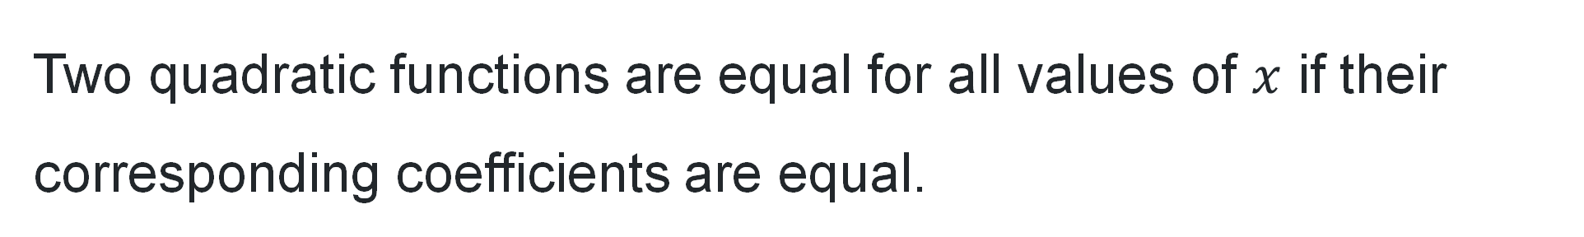
Equating quadratics
Key information
Two quadratic functions are equal for all values of $x$ if their corresponding coefficients are equal.

Slide 20

Worked example (your turn) (1)
Example 1
Find the values of $a$ and $c$ if the quadratic functions $f\left(x\right)={3x}^{2}+6x−5$ and
$g\left(x\right)=a{\left(x+1\right)}^{2}+c$ have the same graph.
Let $f\left(x\right)≡g\left(x\right)$
$$3x^{2}+6x−5=a{\left(x+1\right)}^{2}+c \\ =a\left(x^{2}+2x+1\right)+c \\ =ax^{2}+2ax+a+c$$
Equate coefficients of $x^{2}$ $a=3$
Equate constant terms $a+c=−5$
$3+c=−5$
$c=−8$
Why are we expanding this expression?
How do you know this is true?

Slide 21

Worked example (your turn) – (2)
Your turn – Question 1
Find the values of $a$ and $c$ if the quadratic functions $f\left(x\right)={2x}^{2}−12x+25$ and
$g\left(x\right)=a{\left(x−3\right)}^{2}+c$ have the same graph.
$$f\left(x\right)≡g\left(x\right) \\ 2x^{2}−12x+25=a{\left(x−3\right)}^{2}+c \\ 2x^{2}−12x+25=a\left(x^{2}−6x+9\right)+c \\ 2x^{2}−12x+25=ax^{2}−6ax+9a+c$$
Equate coefficients of $x^{2}$ $a=2$
Equate constant terms $a+c=25$
$2+c=25$
$c=23$

Slide 22
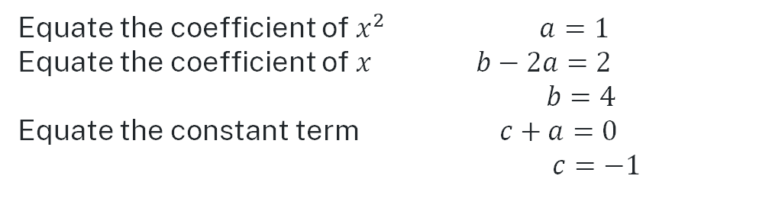

Worked example (your turn) (3)
Example 2
Find the values of $a$, $b$ and $c$ if the quadratic functions $f\left(x\right)=x^{2}+2x$ and
$g\left(x\right)=a{\left(x−1\right)}^{2}+bx+c$ have the same graph.
$$f\left(x\right)≡g\left(x\right) \\ x^{2}+2x=a{\left(x−1\right)}^{2}+bx+c \\ x^{2}+2x=a\left(x^{2}−2x+1\right)+bx+c \\ x^{2}+2x=ax^{2}−2ax+a+bx+c$$
$x^{2}+2x=ax^{2}+x\left(b−2a\right)+a+c$
What has happened in between these steps?
Equate the coefficient of $x^{2}$ $a=1$
Equate the coefficient of $x$ $b−2a=2$
$b=4$
Equate the constant term $c+a=0$
$c=−1$
What steps are missing?

Slide 23

Worked example (your turn) – (4)
Your turn – Question 2
Find the values of $a$, $b$ and $c$ if the quadratic functions $f\left(x\right)=x^{2}−4x+3$ and
$g\left(x\right)=a{(x−3)}^{2}+b+c+5$ have the same graph.
$$g\left(x\right)=a{\left(x−3\right)}^{2}+bx+c+5$$
$$g\left(x\right)=ax^{2}−6ax+9a+bx+c+5 \\ g\left(x\right)=ax^{2}+\left(b−6a\right)x+c+9a+5 \\ a=1 \\ b−6a=−4 \\ b=2 \\ c+9a+5=3 \\ c=−11$$

Slide 24
References
This presentation contains NSW Curriculum and syllabus content. The NSW Curriculum is developed by the NSW Education Standards Authority. This content is prepared by NESA for and on behalf of the Crown in the right of the State of New South Wales. The material is protected by Crown copyright.
Please refer to the NESA Copyright Disclaimer for more information https://educationstandards.nsw.edu.au/wps/portal/nesa/mini-footer/copyright.
NESA holds the only official and up-to-date versions of the NSW Curriculum and syllabus documents. Please visit the NSW Education Standards Authority (NESA) website https://educationstandards.nsw.edu.au/wps/portal/nesa/home and the NSW Curriculum website https://curriculum.nsw.edu.au.
Mathematics Advanced 11-12 Syllabus © NSW Education Standards Authority (NESA) for and on behalf of the Crown in right of the State of New South Wales, 2024.

Slide 25
Copyright
© State of New South Wales (Department of Education), 2025
The copyright material published in this resource is subject to the Copyright Act 1968 (Cth) and is owned by the NSW Department of Education or, where indicated, by a party other than the NSW Department of Education (third-party material).
Copyright material available in this resource and owned by the NSW Department of Education is licensed under a Creative Commons Attribution 4.0 International (CC BY 4.0) license.
This license allows you to share and adapt the material for any purpose, even commercially.
Attribution should be given to © State of New South Wales (Department of Education), 2025.
Material in this resource not available under a Creative Commons license:
the NSW Department of Education logo, other logos and trademark-protected material
Material owned by a third party that has been reproduced with permission. You will need to obtain permission from the third party to reuse its material.
Links to third-party material and websites
Please note that the provided (reading/viewing material/list/links/texts) are a suggestion only and implies no endorsement, by the New South Wales Department of Education, of any author, publisher, or book title. School principals and teachers are best placed to assess the suitability of resources that would complement the curriculum and reflect the needs and interests of their students.
If you use the links provided in this document to access a third-party’s website, you acknowledge that the terms of use, including licence terms set out on the third-party’s website apply to the use which may be made of the materials on that third-party website or where permitted by the Copyright Act 1968 (Cth). The department accepts no responsibility for content on third-party websites.

