Slide 1
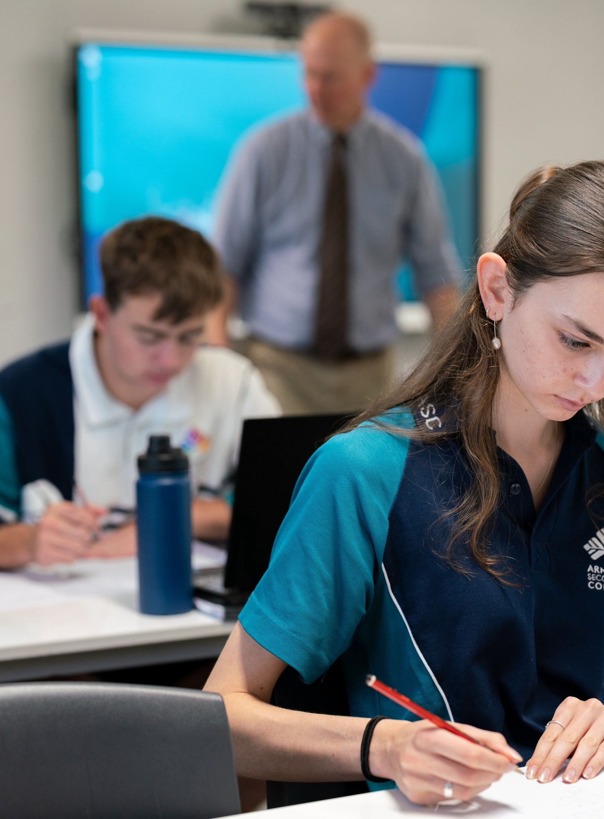
The discriminant
Mathematics Advanced – Stage 6 Year 11
Exploring linear and quadratic functions

Slide 2
Activating prior knowledge

Slide 3
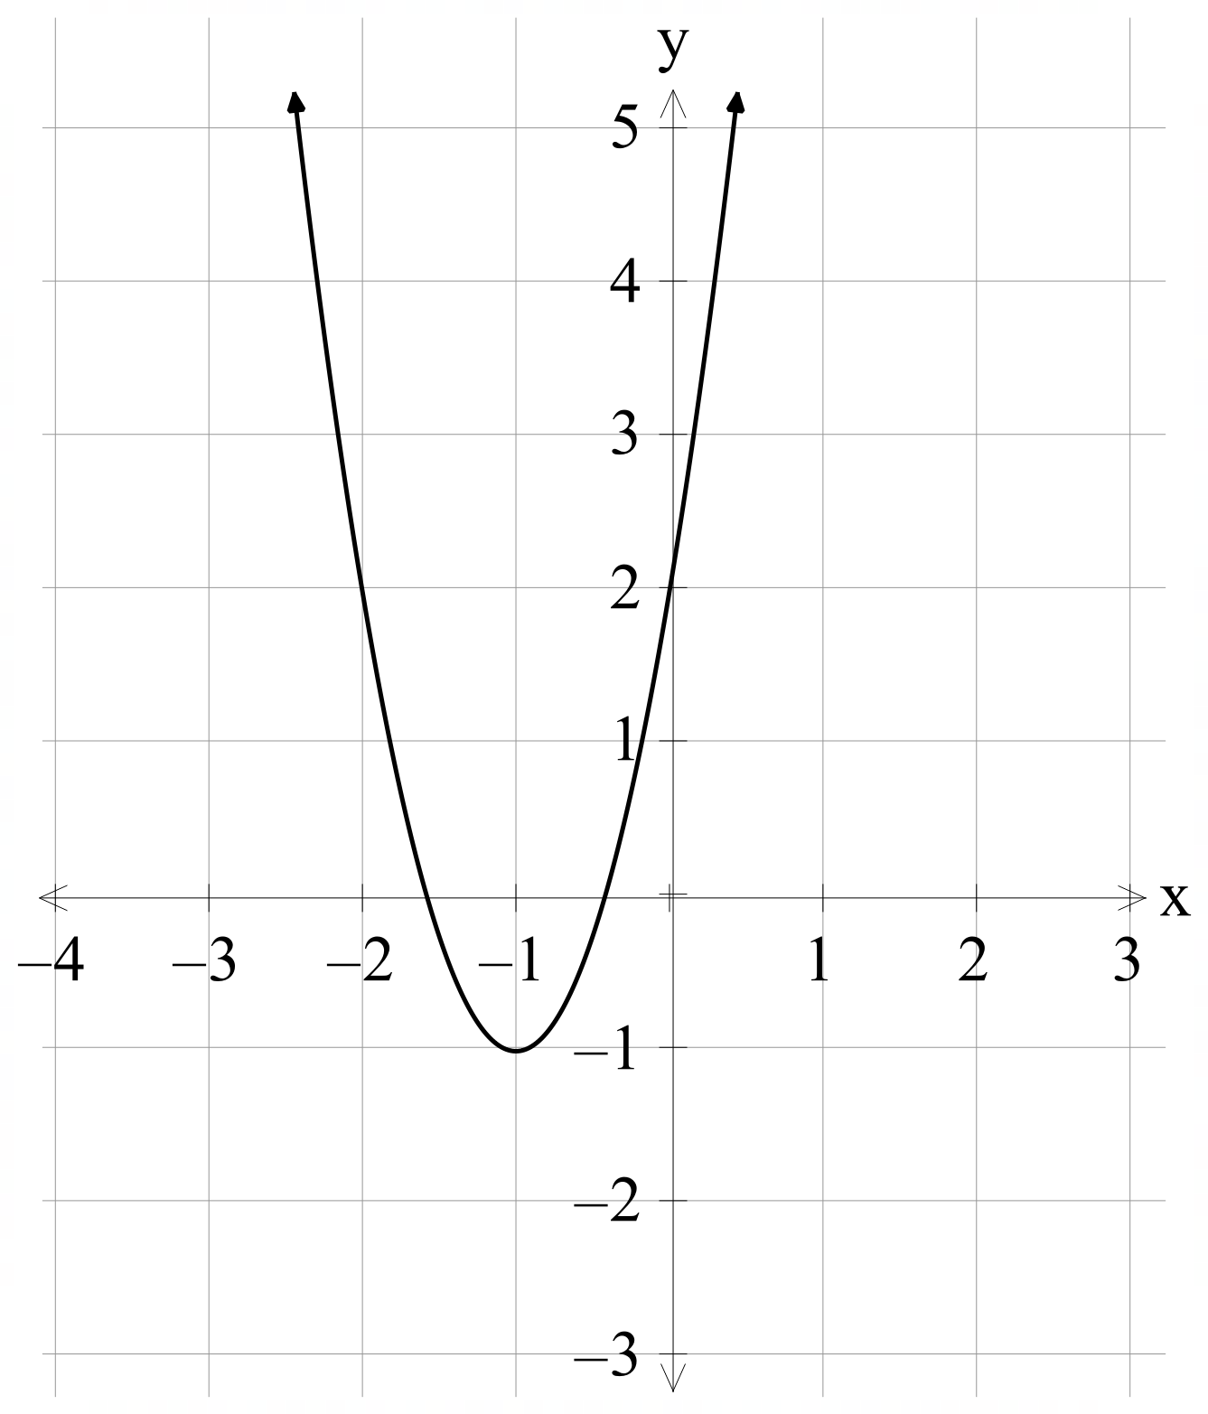
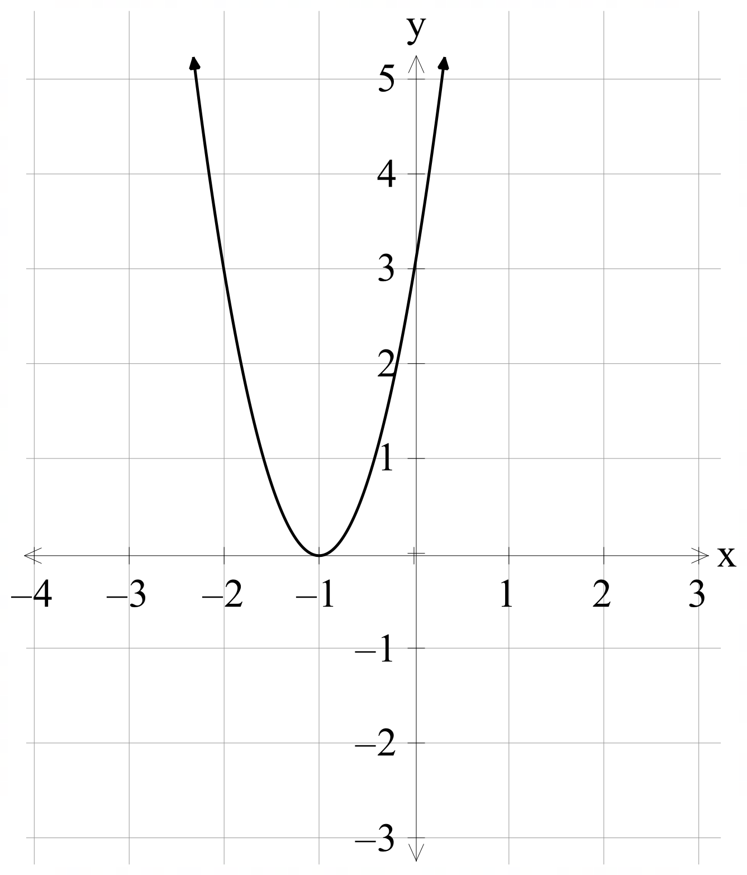
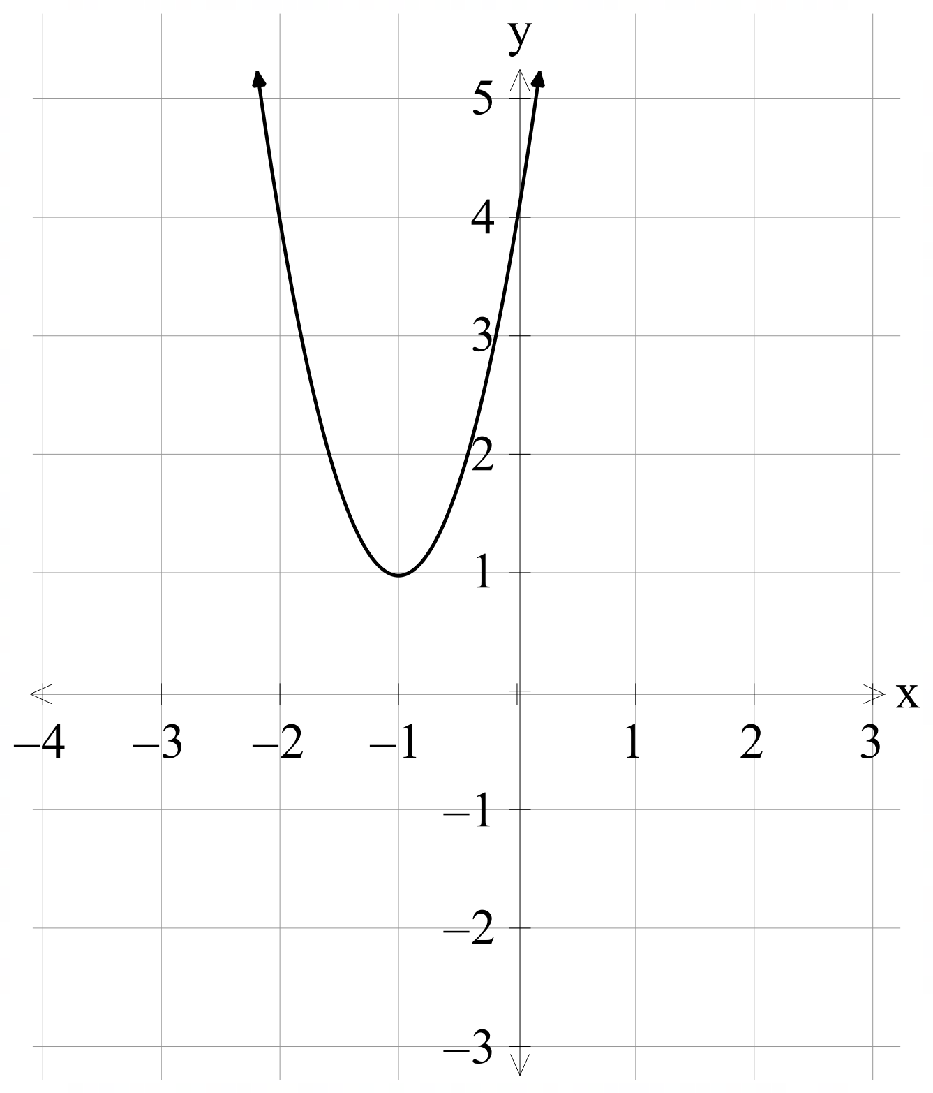



Notice and wonder
$$f\left(x\right)=3x^{2}+6x+2$$
$$f\left(x\right)=3x^{2}+6x+3$$
$$f(x)=3x^{2}+6x+4$$

Slide 4
Connecting learning

Slide 5
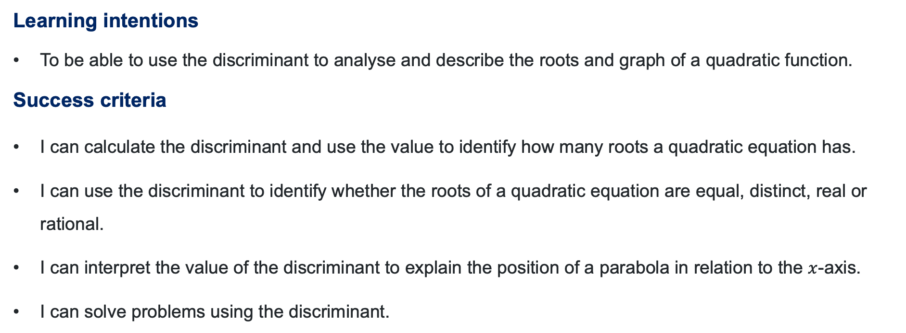
Learning intentions and success criteria
Learning intentions
To be able to use the discriminant to analyse and describe the roots and graph of a quadratic function.
Success criteria
I can calculate the discriminant and use the value to identify how many roots a quadratic equation has.
I can use the discriminant to identify whether the roots of a quadratic equation are equal, distinct, real or rational.
I can interpret the value of the discriminant to explain the position of a parabola in relation to the $x$-axis.
I can solve problems using the discriminant.
Notes:
Notes for teachers:
Learning intentions and success criteria are best co-constructed with students. Adapt the learning intention as required and add matching success criteria.
For more information See ⁠AITSL or the NSW Department of Education explicit teaching strategies, ⁠Sharing learning intentions and ⁠Sharing success criteria
LISC is not necessarily presented at the beginning of the lesson. Teacher needs to consider most effectual time to introduce
LISC should be revisited during the lesson to support students' evaluation of their learning

Slide 6
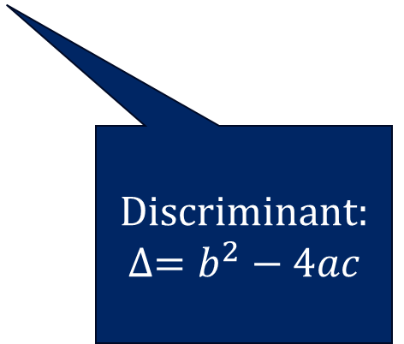
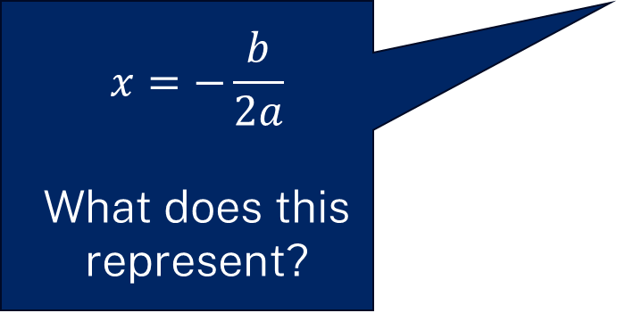

The quadratic formula
What does it tell us?
$$x=\frac{−b±\sqrt{b^{2}−4ac}}{2a }$$
$$x=−\frac{b}{2a}$$
What does this represent?
Discriminant:
$$∆=b^{2}−4ac$$

Slide 7
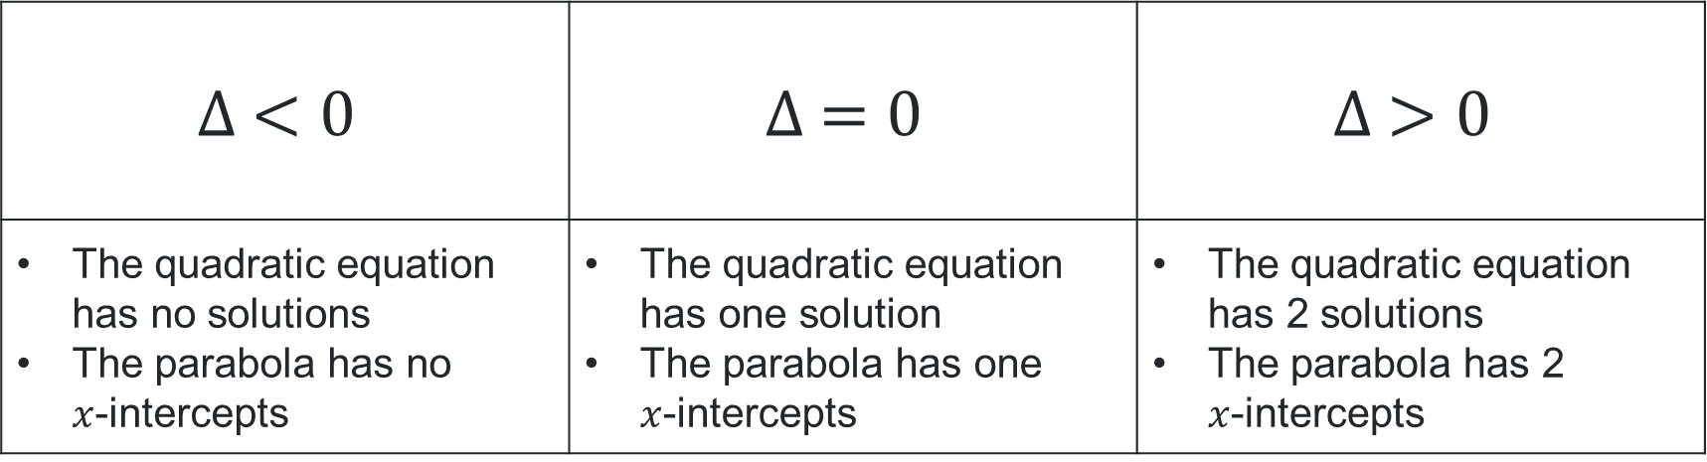
The discriminant, $∆=b^{2}−4ac$
Greater than, equal to or less than zero
$$∆ <0$$ | $$∆ =0$$ | $$∆ >0$$
The quadratic equation has no solutions The parabola has no $x$-intercepts | The quadratic equation has one solution The parabola has one $x$-intercepts | The quadratic equation has 2 solutions The parabola has 2 $x$-intercepts
No real roots | 1 real root | 2 real roots

Slide 8
Releasing responsibility

Slide 9
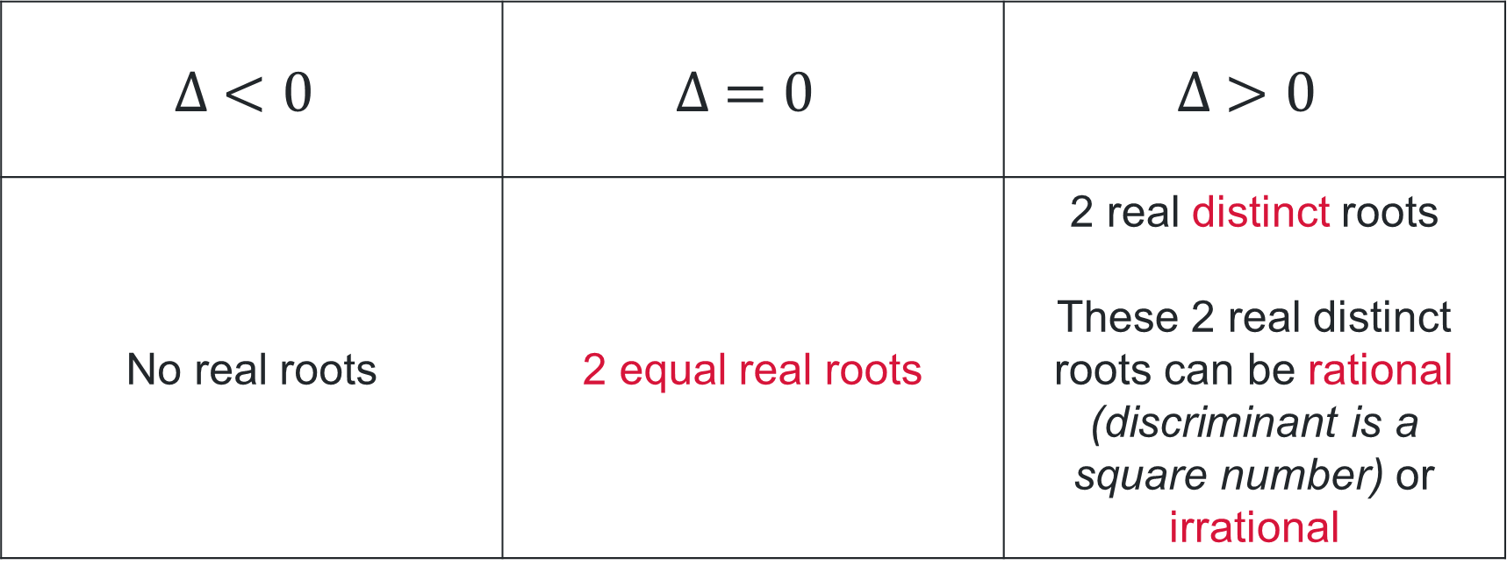
The discriminant $∆=b^{2}−4ac$
Greater than, equal to or less than zero
$$∆ <0$$ | $$∆ =0$$ | $$∆ >0$$
No real roots | 2 equal real roots | 2 real distinct roots These 2 real distinct roots can be rational (discriminant is a square number) or irrational

Slide 10
Independent practice

Slide 11

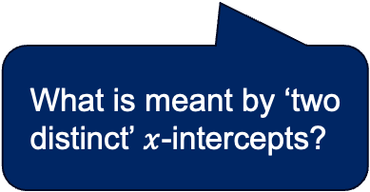
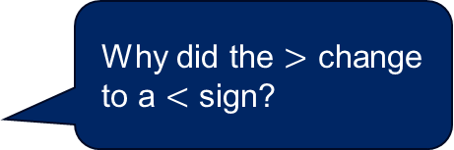

Solving problems involving the discriminant (1)
Worked example 1
Find the values of $m$, such that the quadratic equation $y=3x^{2}−5x+2m+1$will have two distinct $x$-intercepts.
$$∆ =b^{2}−4ac$$
$$={(−5)}^{2}−4\left(3\right)\left(2m+1\right)$$
$$=25−12(2m+1)$$
$$=25−12m−12$$
$$=13−12m$$
What is meant by ‘two distinct’ $x$-intercepts?
For the parabola to have 2 distinct $x$-intercepts, $∆ >0$
$$13−12m>0$$
$$−12m>13$$
$$m<−\frac{13}{12}$$
Why did the $>$ change to a $<$ sign?

Slide 12


Solving problems involving the discriminant (2)
Your turn – Question 1
Find the values of $k$ for which the parabola, ${y=x}^{2}−3x+(4−2k)$ has one $x$-intercept.
$$∆ =b^{2}−4ac$$
$$={\left(−3\right)}^{2}−4\left(1\right)\left(4−2k\right)$$
$$=9−4(4−2k)$$
$$=9−16+8k$$
$$=8k−7$$
For the vertex to be on the $x$-axis, the $∆ =0$
$$8k−7=0$$
$$8k=7$$
$$∴k=\frac{7}{8}$$

Slide 13
References
This presentation contains NSW Curriculum and syllabus content. The NSW Curriculum is developed by the NSW Education Standards Authority. This content is prepared by NESA for and on behalf of the Crown in the right of the State of New South Wales. The material is protected by Crown copyright.
Please refer to the NESA Copyright Disclaimer for more information https://educationstandards.nsw.edu.au/wps/portal/nesa/mini-footer/copyright.
NESA holds the only official and up-to-date versions of the NSW Curriculum and syllabus documents. Please visit the NSW Education Standards Authority (NESA) website https://educationstandards.nsw.edu.au/wps/portal/nesa/home and the NSW Curriculum website https://curriculum.nsw.edu.au.
Mathematics Advanced 11-12 Syllabus © NSW Education Standards Authority (NESA) for and on behalf of the Crown in right of the State of New South Wales, 2024.

Slide 14
Copyright
© State of New South Wales (Department of Education), 2025
The copyright material published in this resource is subject to the Copyright Act 1968 (Cth) and is owned by the NSW Department of Education or, where indicated, by a party other than the NSW Department of Education (third-party material).
Copyright material available in this resource and owned by the NSW Department of Education is licensed under a Creative Commons Attribution 4.0 International (CC BY 4.0) license.
This license allows you to share and adapt the material for any purpose, even commercially.
Attribution should be given to © State of New South Wales (Department of Education), 2025.
Material in this resource not available under a Creative Commons license:
the NSW Department of Education logo, other logos and trademark-protected material
Material owned by a third party that has been reproduced with permission. You will need to obtain permission from the third party to reuse its material.
Links to third-party material and websites
Please note that the provided (reading/viewing material/list/links/texts) are a suggestion only and implies no endorsement, by the New South Wales Department of Education, of any author, publisher, or book title. School principals and teachers are best placed to assess the suitability of resources that would complement the curriculum and reflect the needs and interests of their students.
If you use the links provided in this document to access a third-party’s website, you acknowledge that the terms of use, including licence terms set out on the third-party’s website apply to the use which may be made of the materials on that third-party website or where permitted by the Copyright Act 1968 (Cth). The department accepts no responsibility for content on third-party websites.

