Slide 1

Surds and quadratics
Mathematics Advanced – Stage 6 (Year 11)
Working with linear and quadratic functions

Slide 2
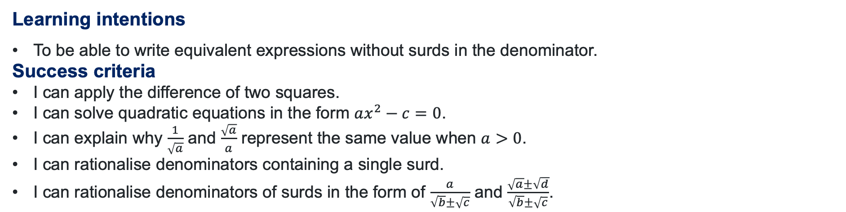
Learning intentions and success criteria
Learning intentions
To be able to write equivalent expressions without surds in the denominator.
Success criteria
I can apply the difference of two squares.
I can solve quadratic equations in the form $ax^{2}−c=0$.
I can explain why $\frac{1}{\sqrt{a}}$ and $\frac{\sqrt{a}}{a}$ represent the same value when $a>0$.
I can rationalise denominators containing a single surd.
I can rationalise denominators of surds in the form of $\frac{a}{\sqrt{b}±\sqrt{c}}$ and $\frac{\sqrt{a}±\sqrt{d}}{\sqrt{b}±\sqrt{c}}$.
Notes:
Notes for teachers:
Learning intentions and success criteria are best co-constructed with students. Adapt the learning intention as required and add matching success criteria.
For more information See ⁠AITSL or the NSW Department of Education explicit teaching strategies, ⁠Sharing learning intentions and ⁠Sharing success criteria
LISC is not necessarily presented at the beginning of the lesson. Teacher needs to consider most effectual time to introduce
LISC should be revisited during the lesson to support students' evaluation of their learning

Slide 3
Activating prior knowledge

Slide 4
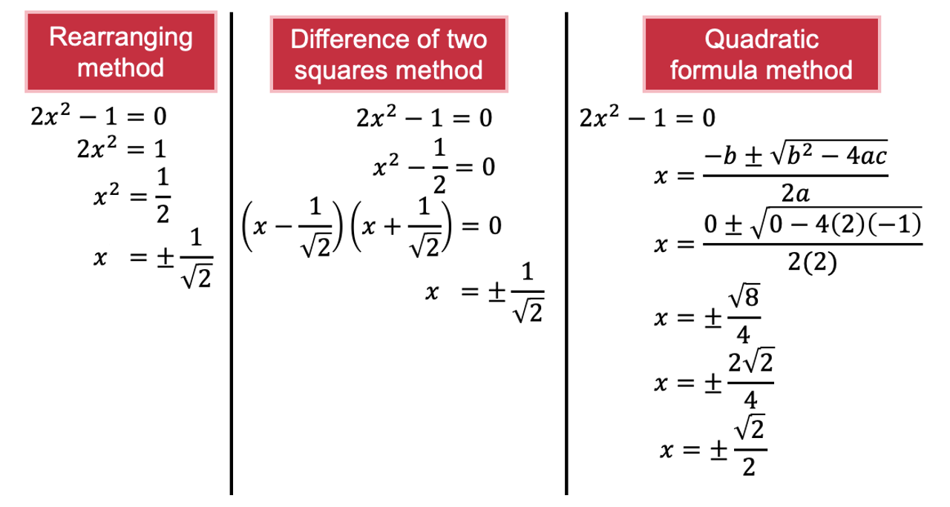

Comparative worked example (1)
Why is 0 substituted into the quadratic formula?
Solving quadratic expressions
Solve $2x^{2}−1=0$.
Why might this solution be different?
How would you decide which approach to take?

Slide 5
Connecting learning

Slide 6
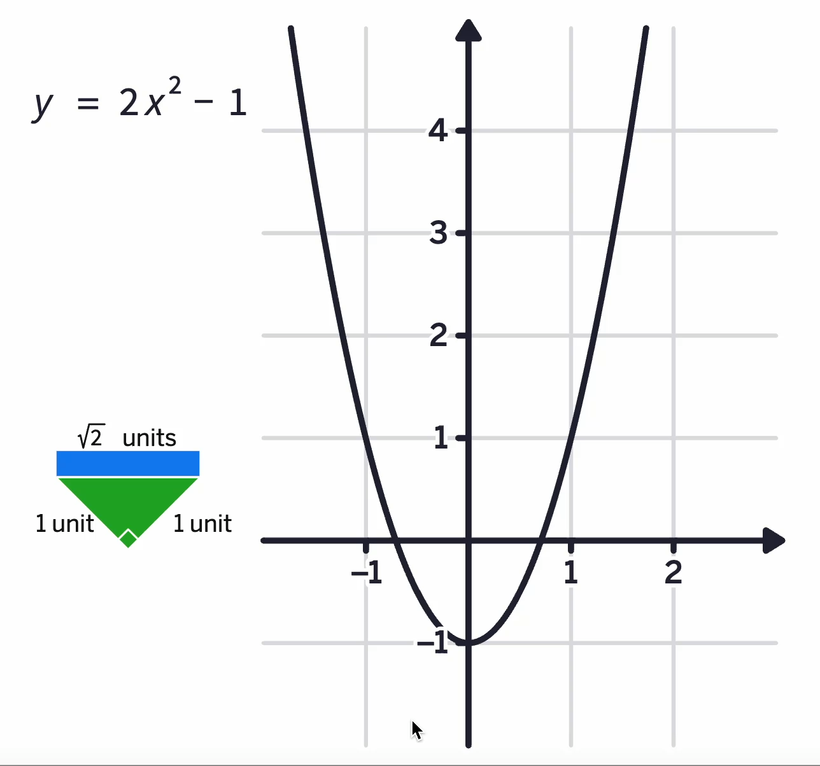
Another approach of $2x^{2}−1=0$

Slide 7
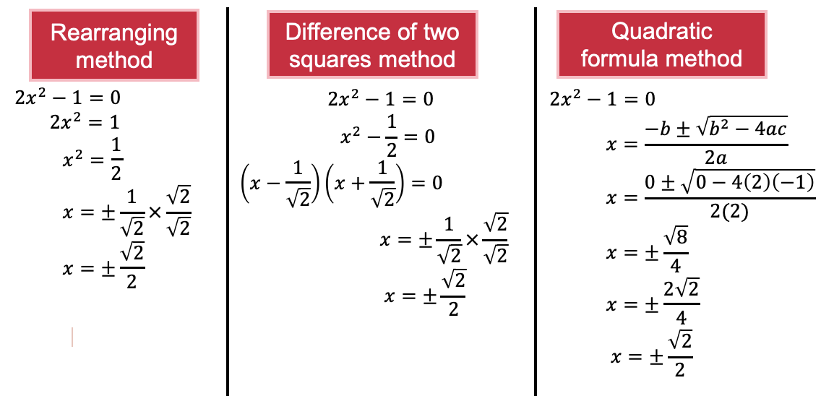
Comparative worked example (2)
Solving quadratic expressions
Solve $2x^{2}−1=0$.
Does knowing how to rationalise the denominator influence the choice in the approach that you make?

Slide 8


Your turn – solving quadratic expressions
Solve $3x^{2}−1=0$.

Slide 9

Consider this
How can we use what we have learnt so far to rationalise the denominator of this number?
$$\frac{3+\sqrt{5}}{\sqrt{2}−1}$$

Slide 10
Releasing responsibility

Slide 11


Rationalising the denominator (3)
Example 2
Rationalise the denominator and simplify $\frac{3+\sqrt{5}}{\sqrt{2}−1}$
How was the numerator calculated?
$$\frac{3+\sqrt{5}}{\sqrt{2}−1}×\frac{\sqrt{2}+1}{\sqrt{2}+1}=\frac{3\sqrt{2}+3+\sqrt{10}+\sqrt{5}}{2−1} \\ =3\sqrt{2}+3+\sqrt{10}+\sqrt{5}$$
Why are we multiplying by this?

Slide 12

Rationalising the denominator (4)
Your turn – Question 2
Rationalise the denominator and simplify $\frac{6+\sqrt{2}}{\sqrt{3}+1}$
$$\frac{6+\sqrt{2}}{\sqrt{3}+1}×\frac{\sqrt{3}−1}{\sqrt{3}−1}=\frac{6\sqrt{3}−6+\sqrt{6}−\sqrt{2} }{3−1} \\ =\frac{6\sqrt{3}−6+\sqrt{6}−\sqrt{2} }{2}$$

Slide 13
Independent practice

Slide 14
Variation spider
For each question around the outside
Reflect – how is this example the same and how is it different from the example in the middle?
Expect – based on what you noticed, can you predict anything about what the answer will be?
Check – work out the answer and write it in the box.
Explain – If your expectation and check are different, can you understand the relationship now? If your expectation and check are the same, how would you explain the relationship to someone who doesn’t understand yet?

Slide 15
References
This presentation contains NSW Curriculum and syllabus content. The NSW Curriculum is developed by the NSW Education Standards Authority. This content is prepared by NESA for and on behalf of the Crown in the right of the State of New South Wales. The material is protected by Crown copyright.
Please refer to the NESA Copyright Disclaimer for more information https://educationstandards.nsw.edu.au/wps/portal/nesa/mini-footer/copyright.
NESA holds the only official and up-to-date versions of the NSW Curriculum and syllabus documents. Please visit the NSW Education Standards Authority (NESA) website https://educationstandards.nsw.edu.au/wps/portal/nesa/home and the NSW Curriculum website https://curriculum.nsw.edu.au.
Mathematics Advanced 11-12 Syllabus © NSW Education Standards Authority (NESA) for and on behalf of the Crown in right of the State of New South Wales, 2024.

Slide 16
Copyright
© State of New South Wales (Department of Education), 2025
The copyright material published in this resource is subject to the Copyright Act 1968 (Cth) and is owned by the NSW Department of Education or, where indicated, by a party other than the NSW Department of Education (third-party material).
Copyright material available in this resource and owned by the NSW Department of Education is licensed under a Creative Commons Attribution 4.0 International (CC BY 4.0) license.
This license allows you to share and adapt the material for any purpose, even commercially.
Attribution should be given to © State of New South Wales (Department of Education), 2025.
Material in this resource not available under a Creative Commons license:
the NSW Department of Education logo, other logos and trademark-protected material
Material owned by a third party that has been reproduced with permission. You will need to obtain permission from the third party to reuse its material.
Links to third-party material and websites
Please note that the provided (reading/viewing material/list/links/texts) are a suggestion only and implies no endorsement, by the New South Wales Department of Education, of any author, publisher, or book title. School principals and teachers are best placed to assess the suitability of resources that would complement the curriculum and reflect the needs and interests of their students.
If you use the links provided in this document to access a third-party’s website, you acknowledge that the terms of use, including licence terms set out on the third-party’s website apply to the use which may be made of the materials on that third-party website or where permitted by the Copyright Act 1968 (Cth). The department accepts no responsibility for content on third-party websites.

