Slide 1
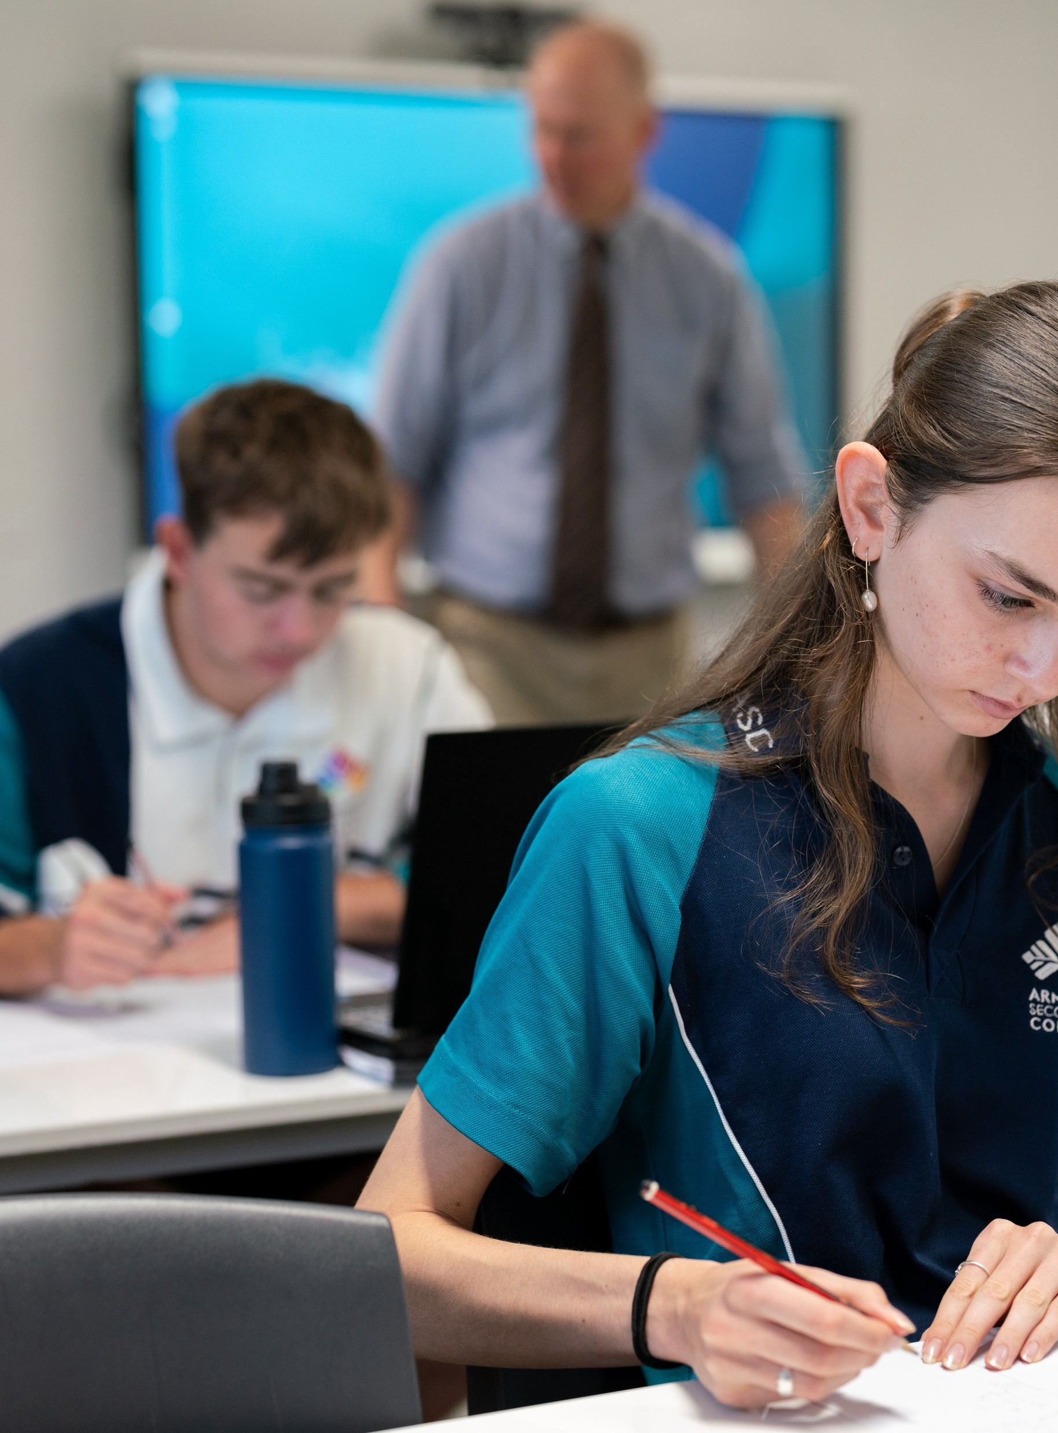
Simplifying surds
Mathematics Advanced – Year 11
Working with linear and quadratic functions

Slide 2
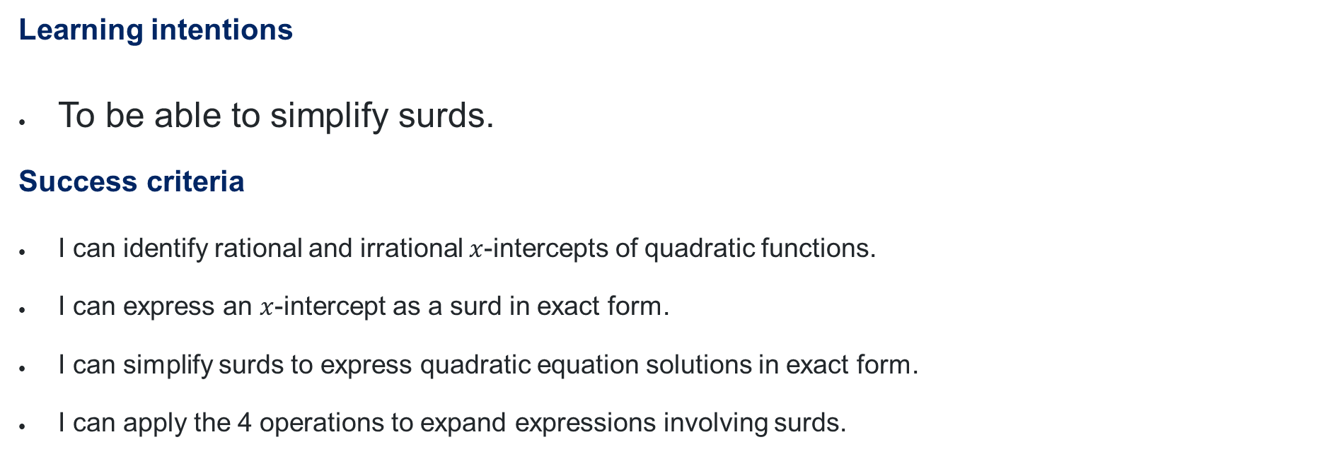
Learning intentions and success criteria
Learning intentions
To be able to simplify surds.
Success criteria
I can identify rational and irrational $x$-intercepts of quadratic functions.
I can express an $x$-intercept as a surd in exact form.
I can simplify surds to express quadratic equation solutions in exact form.
I can apply the 4 operations to expand expressions involving surds.
Notes:
Notes for teachers:
Learning intentions and success criteria are best co-constructed with students. Adapt the learning intention as required and add matching success criteria.
For more information See ⁠AITSL or the NSW Department of Education explicit teaching strategies, ⁠Sharing learning intentions and ⁠Sharing success criteria
LISC is not necessarily presented at the beginning of the lesson. Teacher needs to consider most effectual time to introduce
LISC should be revisited during the lesson to support students' evaluation of their learning

Slide 3
Activating prior knowledge

Slide 4
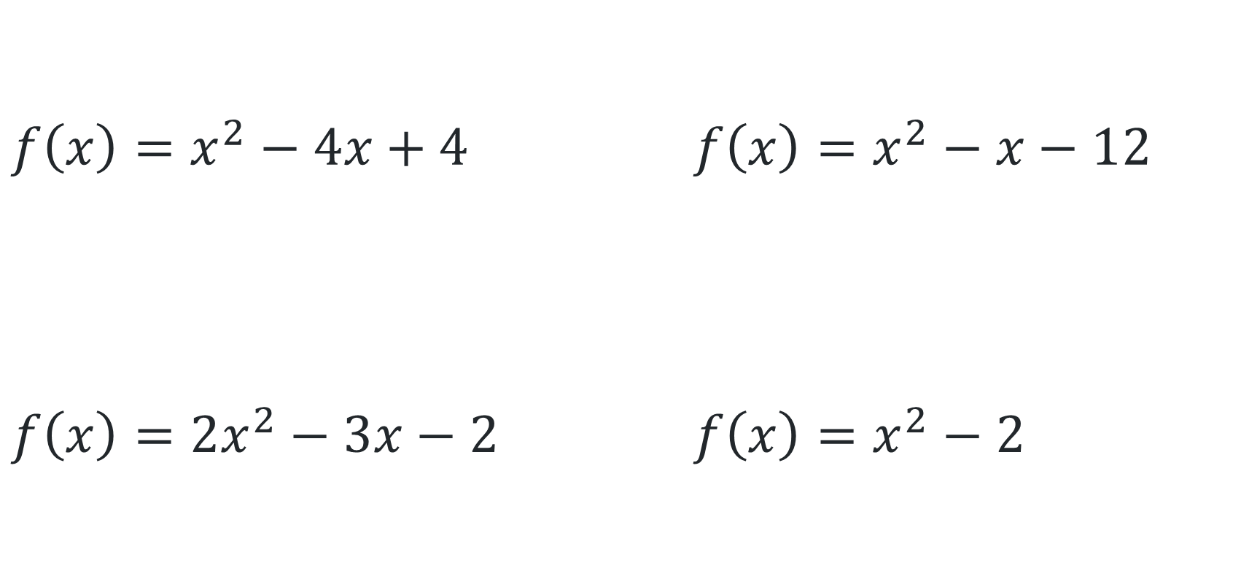
Which one doesn’t belong?
$$f\left(x\right)=x^{2}−4x+4$$ | $$f\left(x\right)=x^{2}−x−12$$
$$f\left(x\right)={2x}^{2}−3x−2$$ | $$f\left(x\right)=x^{2}−2$$
1
2
3
4

Slide 5


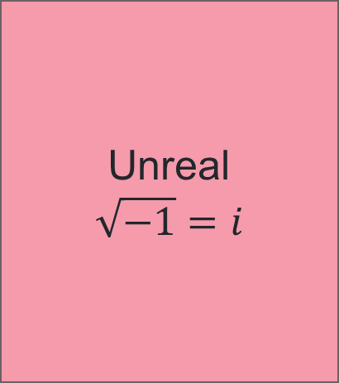
Types of numbers
Animate for examples
Unreal
$$\sqrt{−1}=i$$
Real
Integers
Positive and negative whole numbers
… -2, −1, 0, 1, 2, 3 …
Rational
can be written as a fraction
$$\frac{1}{2}, 1.\dot{2}, −0.05$$
Natural
All positive integers not zero
1, 2, 3, 4 …
Irrational
CANNOT be written as a fraction
$$π, e, \sqrt{2}$$

Slide 6
Connecting learning

Slide 7


Finding the hypotenuse in exact form
Find the unknown length, giving answers in an exact form.
2
$$\sqrt{8}$$
$$\sqrt{2}$$
1
1
2

Slide 8
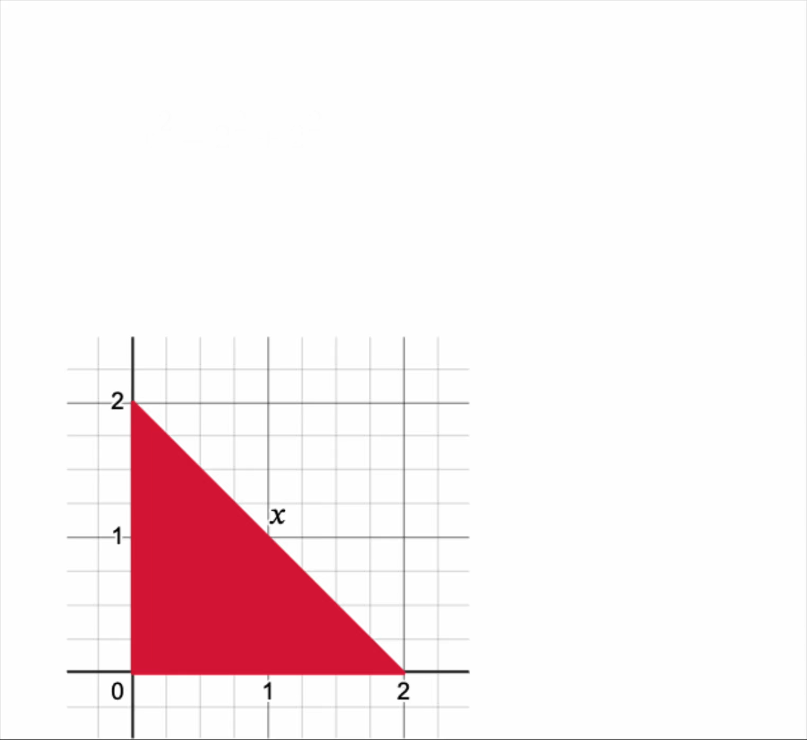
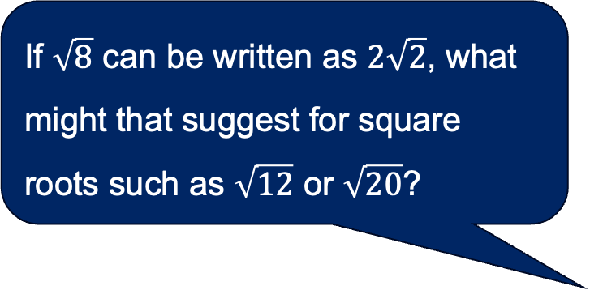
How do $\sqrt{2}$ and $\sqrt{8}$ relate?
When comparing the side lengths of the triangles, what patterns can you see?
If $\sqrt{8}$ can be written as $2\sqrt{2}$, what might that suggest for square roots such as $\sqrt{12}$ or $\sqrt{20}$?

Slide 9

Simplifying surds (1)
Worked example
Why has 25 been factored out?
Simplify $\sqrt{50}$
$$\sqrt{50}=\sqrt{25×2} \\ =\sqrt{25}×\sqrt{2} \\ =5\sqrt{2}$$
How could we find the square factors of a number?
Why am I allowed to separate the surds?

Slide 10

Simplifying surds (2)
Your turn
Simplify $\sqrt{27}$
$$\sqrt{27}=\sqrt{9×3} \\ =\sqrt{9}×\sqrt{3} \\ =3\sqrt{3}$$

Slide 11
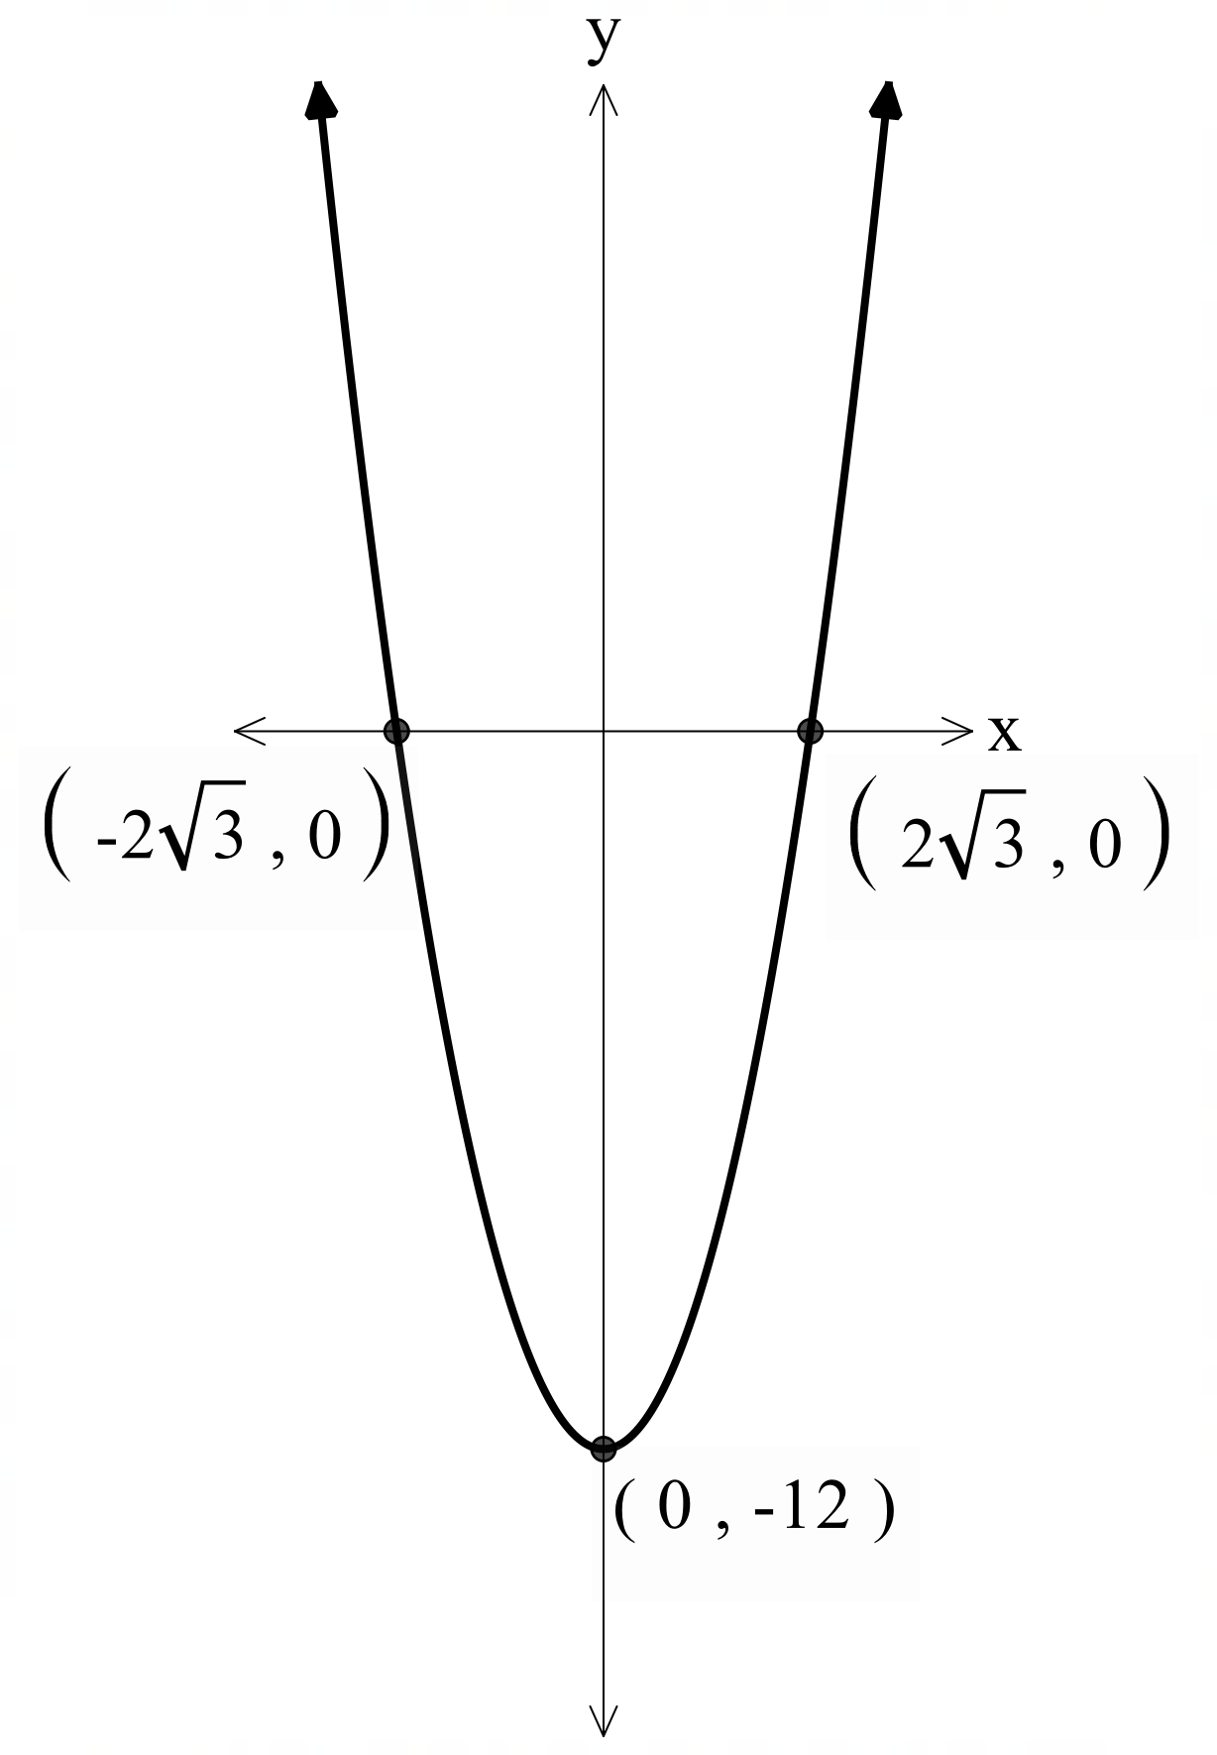
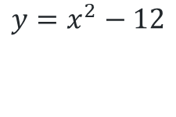
$x$-intercepts in exact form
$$y=x^{2}−12$$
Why might we use exact form?

Slide 12
Releasing responsibility

Slide 13
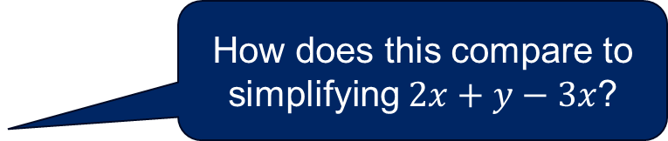

Adding and subtracting surds (1)
Worked example 1
Simplify $2\sqrt{3}+\sqrt{5}−\sqrt{27}$
$$=2\sqrt{3}+\sqrt{5}−\sqrt{9}×\sqrt{3}$$
$$=2\sqrt{3}+\sqrt{5}−3\sqrt{3}$$
$$=\sqrt{5}−\sqrt{3}$$
Why did this surd need to be simplified?
How does this compare to simplifying $2x+y−3x$?

Slide 14
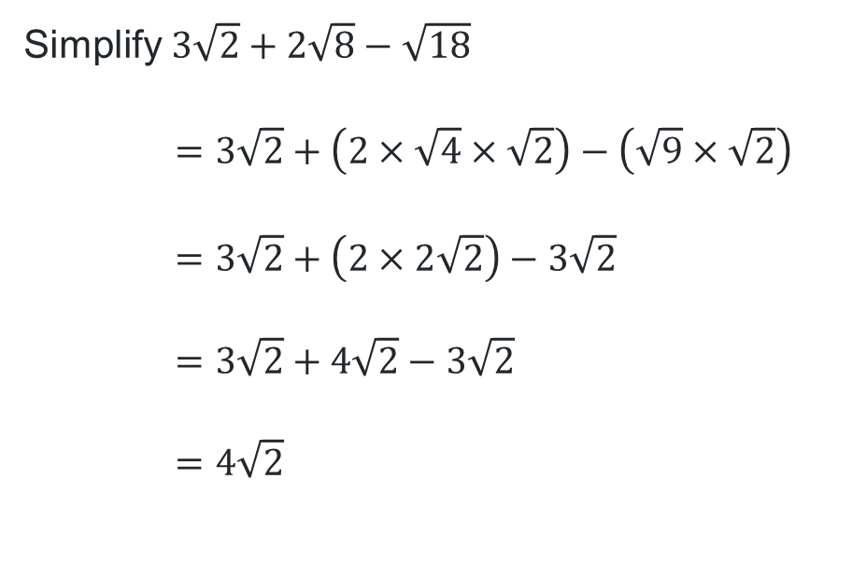
Adding and subtracting surds (2)
Your turn 1
Simplify $3\sqrt{2}+2\sqrt{8}−\sqrt{18}$
$$=3\sqrt{2}+\left(2×\sqrt{4}×\sqrt{2}\right)−\left(\sqrt{9}×\sqrt{2}\right)$$
$$=3\sqrt{2}+\left(2×2\sqrt{2}\right)−3\sqrt{2}$$
$$=3\sqrt{2}+4\sqrt{2}−3\sqrt{2}$$
$$=4\sqrt{2}$$

Slide 15
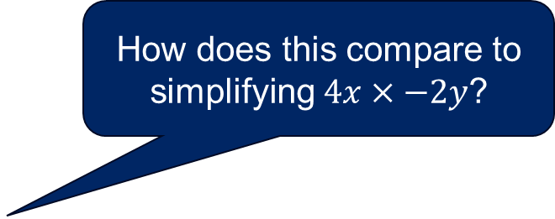
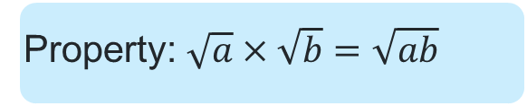
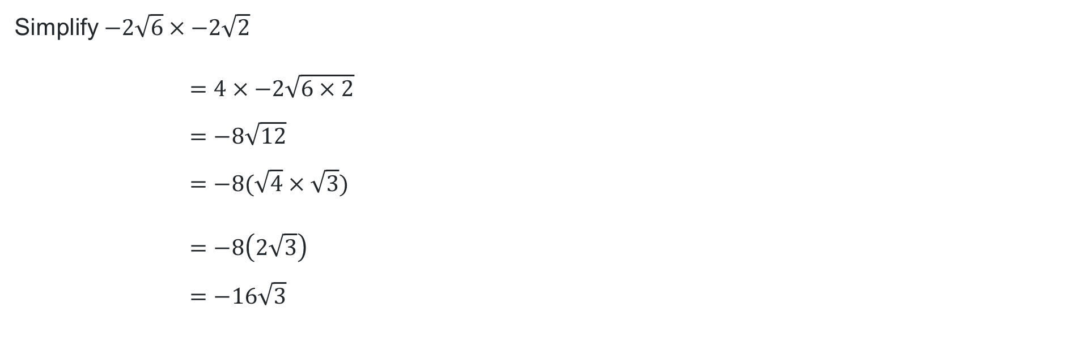
Multiplying surds (1)
Worked example 2
Property: $\sqrt{a}×\sqrt{b}=\sqrt{ab}$
How does this compare to simplifying $4x×−2y$?
Simplify $−2\sqrt{6}×−2\sqrt{2}$
$$=4×−2\sqrt{6×2} \\ =−8\sqrt{12} \\ =−8(\sqrt{4}×\sqrt{3})$$
$$=−8\left(2\sqrt{3}\right)$$
$$=−16\sqrt{3}$$
Why didn’t the solution stop here?

Slide 16
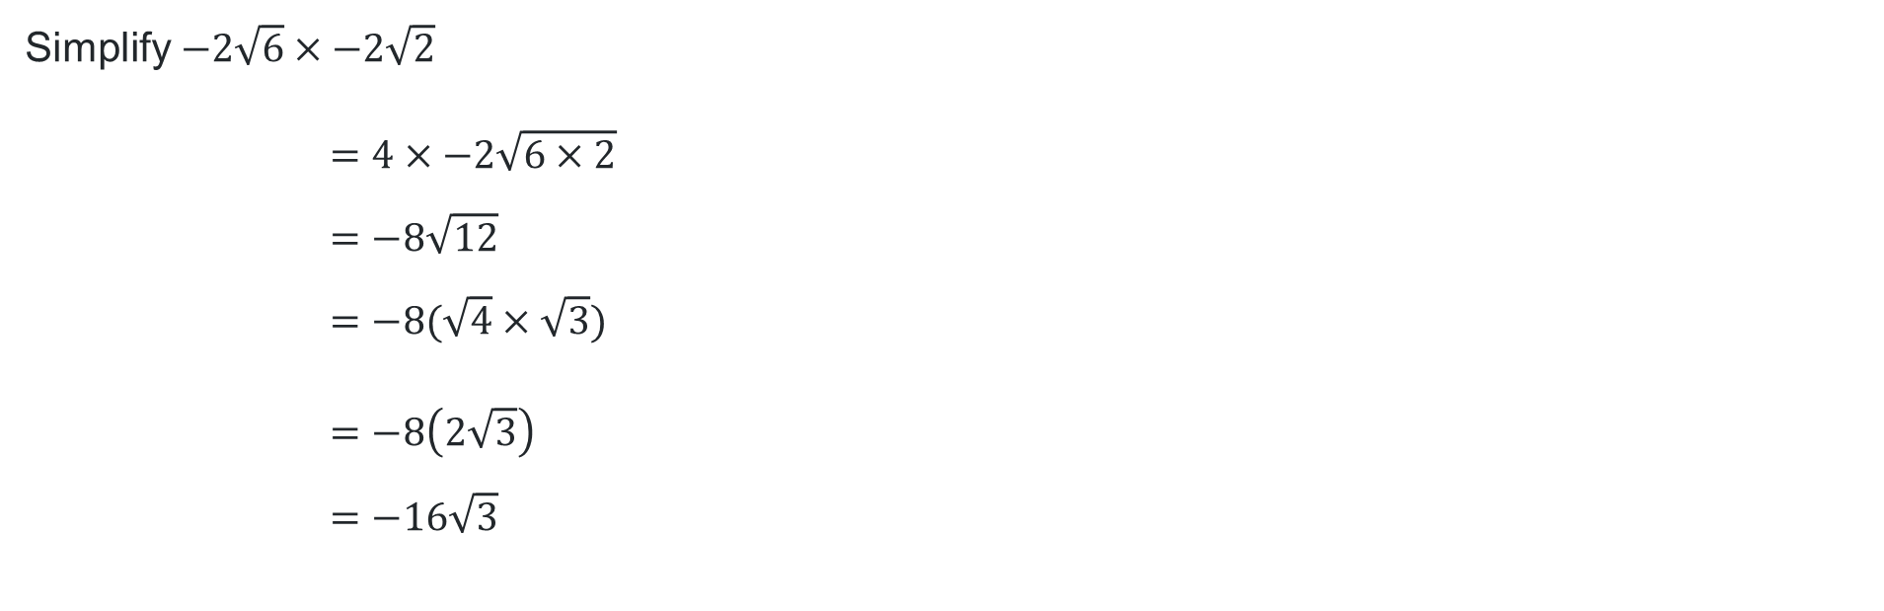
Multiplying surds (2)
Your turn 2
Simplify $−2\sqrt{6}×−2\sqrt{2}$
$$=4×−2\sqrt{6×2} \\ =−8\sqrt{12} \\ =−8(\sqrt{4}×\sqrt{3})$$
$$=−8\left(2\sqrt{3}\right)$$
$$=−16\sqrt{3}$$

Slide 17
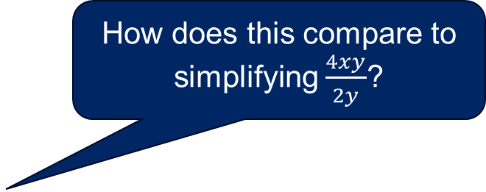
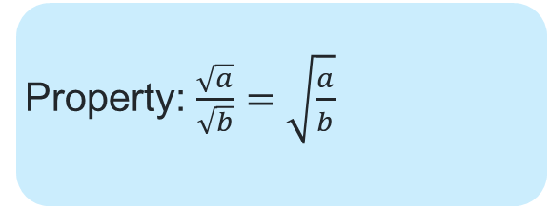
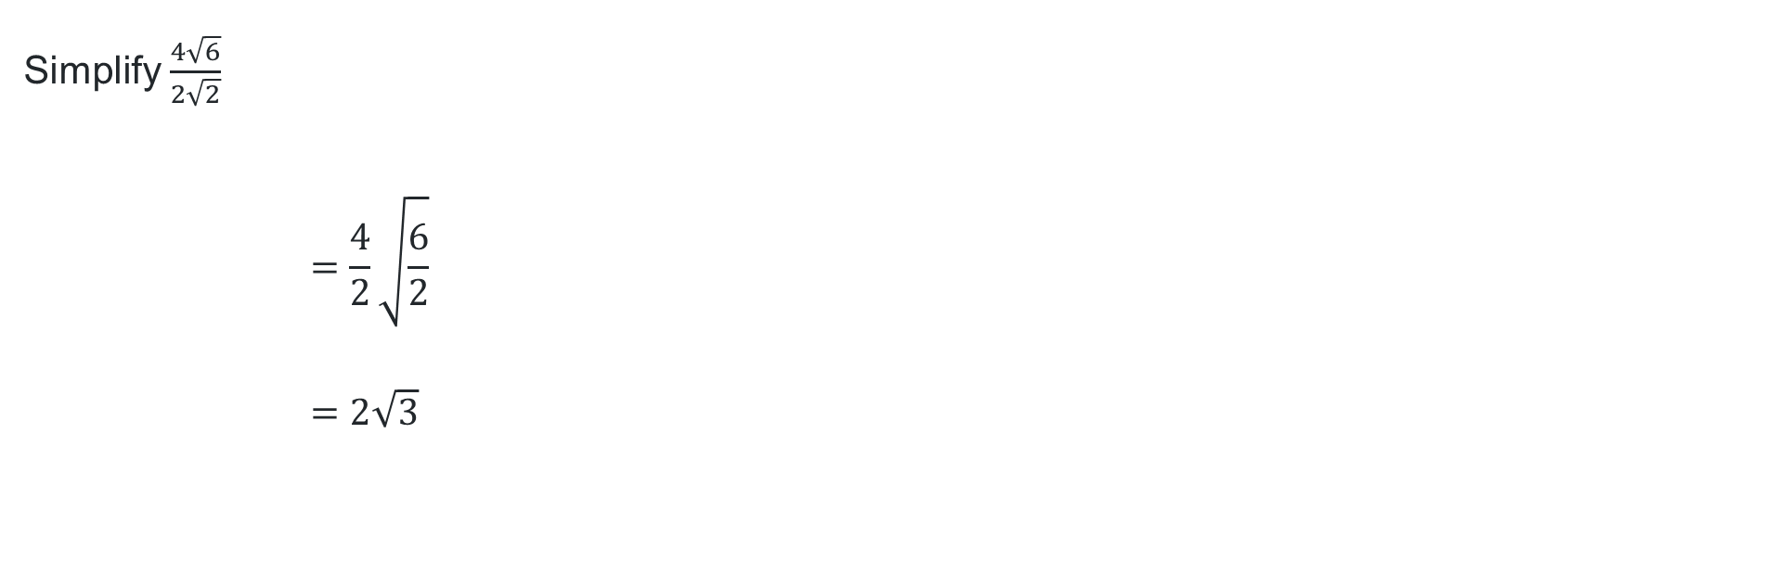
Dividing surds (1)
Worked example 3
Property: $\frac{\sqrt{a}}{\sqrt{b}}=\sqrt{\frac{a}{b}}$
Simplify $\frac{4\sqrt{6}}{2\sqrt{2}}$
$$=\frac{4}{2}\sqrt{\frac{6}{2}}$$
$$=2\sqrt{3}$$
How does this compare to simplifying $\frac{4xy}{2y}$?

Slide 18
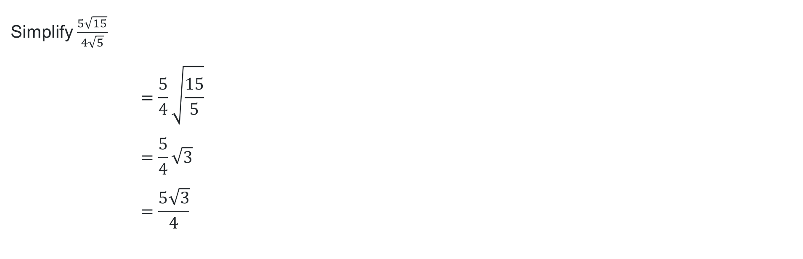
Dividing surds (2)
Your turn 3
Simplify $\frac{5\sqrt{15}}{4\sqrt{5}}$
$$=\frac{5}{4}\sqrt{\frac{15}{5}}$$
$$=\frac{5}{4}\sqrt{3}$$
$$=\frac{5\sqrt{3}}{4}$$

Slide 19
References
This presentation contains NSW Curriculum and syllabus content. The NSW Curriculum is developed by the NSW Education Standards Authority. This content is prepared by NESA for and on behalf of the Crown in the right of the State of New South Wales. The material is protected by Crown copyright.
Please refer to the NESA Copyright Disclaimer for more information https://educationstandards.nsw.edu.au/wps/portal/nesa/mini-footer/copyright.
NESA holds the only official and up-to-date versions of the NSW Curriculum and syllabus documents. Please visit the NSW Education Standards Authority (NESA) website https://educationstandards.nsw.edu.au/wps/portal/nesa/home and the NSW Curriculum website https://curriculum.nsw.edu.au.
Mathematics Advanced 11-12 Syllabus © NSW Education Standards Authority (NESA) for and on behalf of the Crown in right of the State of New South Wales, 2024.

Slide 20
Copyright
© State of New South Wales (Department of Education), 2025
The copyright material published in this resource is subject to the Copyright Act 1968 (Cth) and is owned by the NSW Department of Education or, where indicated, by a party other than the NSW Department of Education (third-party material).
Copyright material available in this resource and owned by the NSW Department of Education is licensed under a Creative Commons Attribution 4.0 International (CC BY 4.0) license.
This license allows you to share and adapt the material for any purpose, even commercially.
Attribution should be given to © State of New South Wales (Department of Education), 2025.
Material in this resource not available under a Creative Commons license:
the NSW Department of Education logo, other logos and trademark-protected material
Material owned by a third party that has been reproduced with permission. You will need to obtain permission from the third party to reuse its material.
Links to third-party material and websites
Please note that the provided (reading/viewing material/list/links/texts) are a suggestion only and implies no endorsement, by the New South Wales Department of Education, of any author, publisher, or book title. School principals and teachers are best placed to assess the suitability of resources that would complement the curriculum and reflect the needs and interests of their students.
If you use the links provided in this document to access a third-party’s website, you acknowledge that the terms of use, including licence terms set out on the third-party’s website apply to the use which may be made of the materials on that third-party website or where permitted by the Copyright Act 1968 (Cth). The department accepts no responsibility for content on third-party websites.

