Slide 1
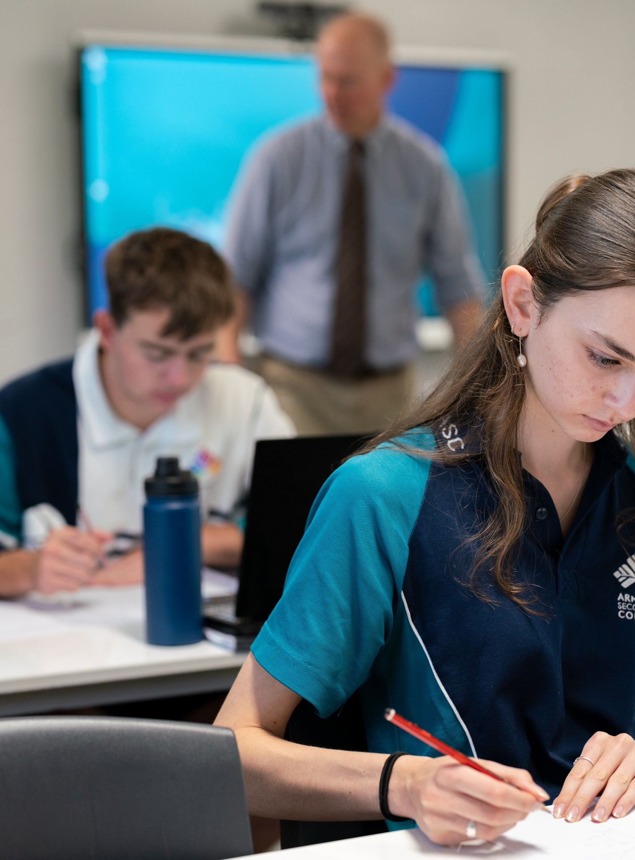
The quadratic formula
Mathematics Advanced – Stage 6 (Year 11)
Working with linear and quadratic functions

Slide 2
Learning intentions and success criteria
Learning intentions
To understand how to solve quadratic equations that cannot be factorised.
To be able to use different strategies to find key features of a parabola to support accurate graphing.
Success criteria
I can recognise when a quadratic function cannot be factorised.
I can use the quadratic formula solve a quadratic equation.
I can compare the quadratic formula and completing the square and explain which method is more efficient in a given context.
I can choose an appropriate strategy to sketch the graph of a quadratic function based on its equation
Notes:
Notes for teachers:
Learning intentions and success criteria are best co-constructed with students. Adapt the learning intention as required and add matching success criteria.
For more information See ⁠AITSL or the NSW Department of Education explicit teaching strategies, ⁠Sharing learning intentions and ⁠Sharing success criteria
LISC is not necessarily presented at the beginning of the lesson. Teacher needs to consider most effectual time to introduce
LISC should be revisited during the lesson to support students' evaluation of their learning

Slide 3
Activating prior knowledge

Slide 4
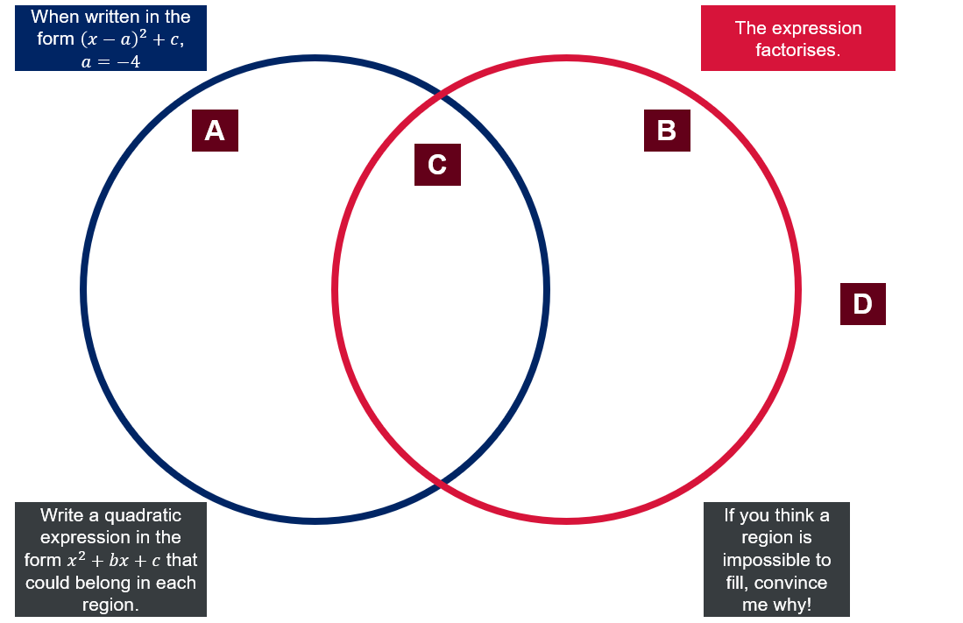
Venn diagram activity (1)
Option 1 – Monic quadratic

Slide 5
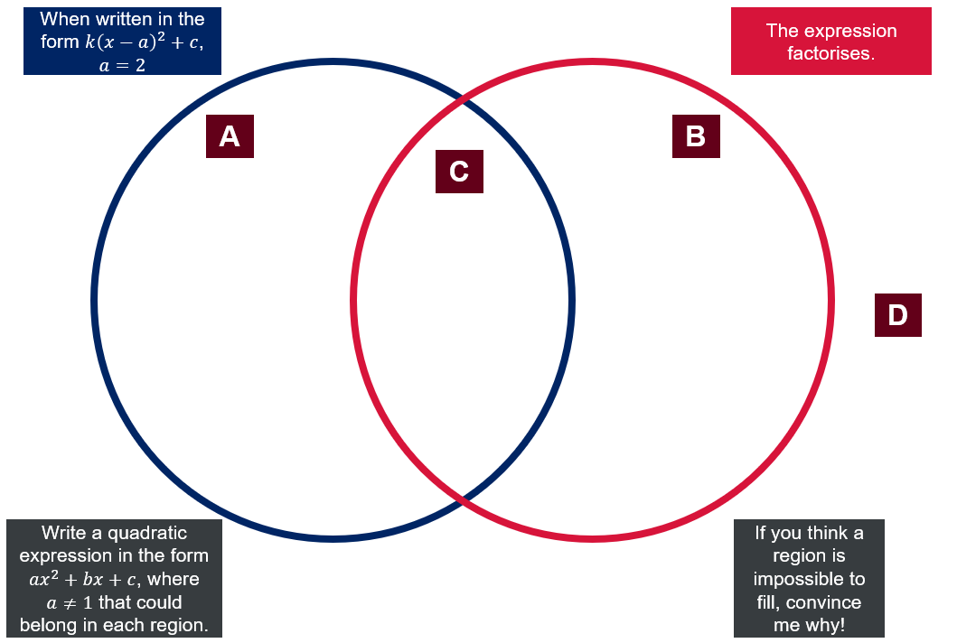
Venn diagram activity (2)
Option 2 – Non monic quadratic

Slide 6
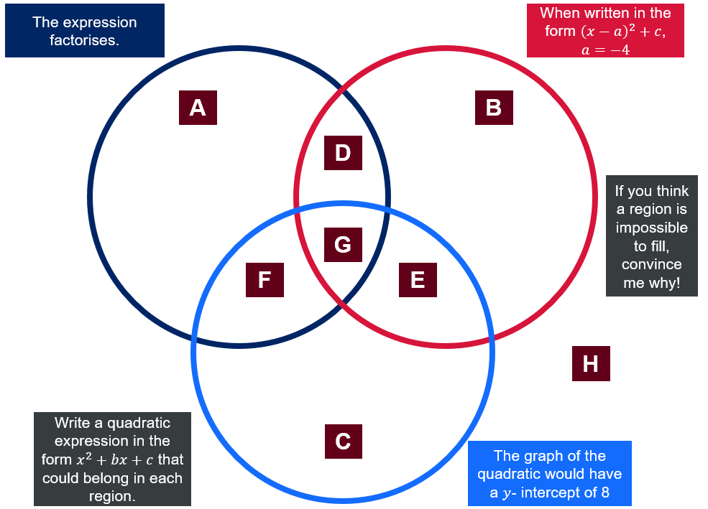
Venn diagram activity (3)
Option 3 – Monic quadratic

Slide 7
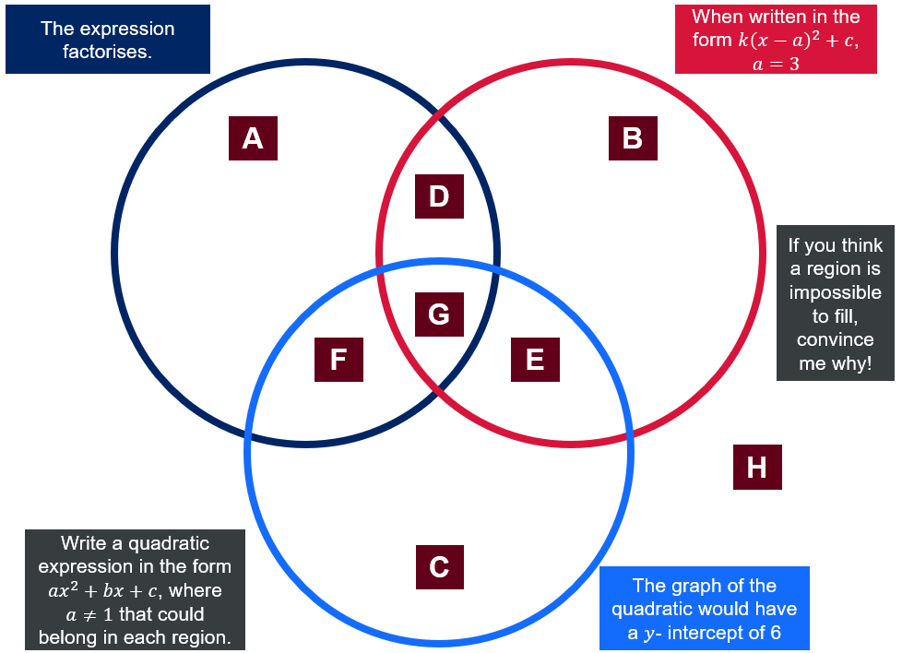
Venn diagram activity (4)
Option 4 – Non monic quadratic

Slide 8
Connecting learning

Slide 9
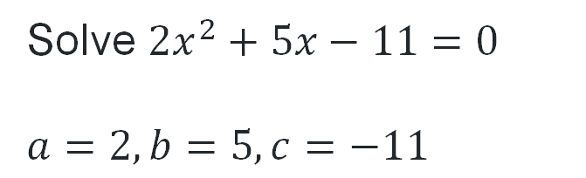
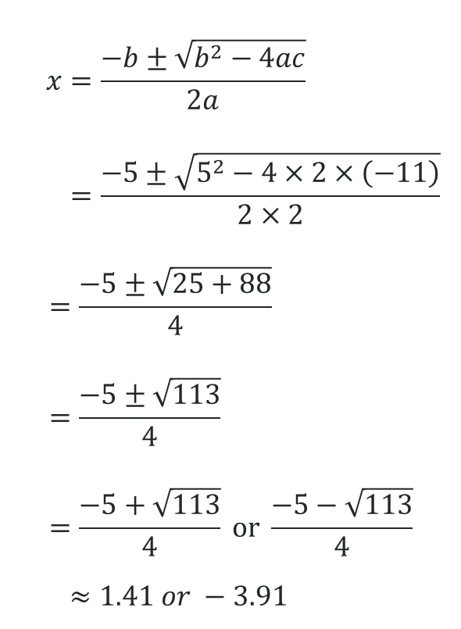
The quadratic formula (1)
Worked example 1
Solve $2x^{2}+5x−11=0$
$$a=2, b=5, c=−11$$
$$x=\frac{−b±\sqrt{b^{2}−4ac}}{2a} \\ =\frac{−5±\sqrt{5^{2}−4×2×\left(−11\right)}}{2×2}$$
$$=\frac{−5±\sqrt{25+88}}{4} \\ =\frac{−5±\sqrt{113}}{4} \\ =\frac{−5+\sqrt{113}}{4} \text{or} \frac{−5−\sqrt{113}}{4}$$
$$≈1.41 or −3.91$$
Can you explain why this must be a positive number to get a solution?
Why are there 2 answers? Will this always be the case?
How can I check my answer?

Slide 10

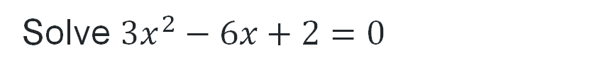

The quadratic formula (2)
$$x=\frac{−b±\sqrt{b^{2}−4ac}}{2a} \\ =\frac{−(−6)±\sqrt{{\left(−6\right)}^{2}−4×3×2}}{2×3} \\ =\frac{6±\sqrt{36−24}}{6} \\ =\frac{6±\sqrt{12}}{6} \\ =\frac{6+\sqrt{12}}{6} \text{or} \frac{6−\sqrt{12}}{6}$$
$≈1.\text{58 }\text{or} 0.42$
Your turn – Question 1
Solve $3x^{2}−6x+2=0$
$$a=3, b=−6, c=2$$

Slide 11
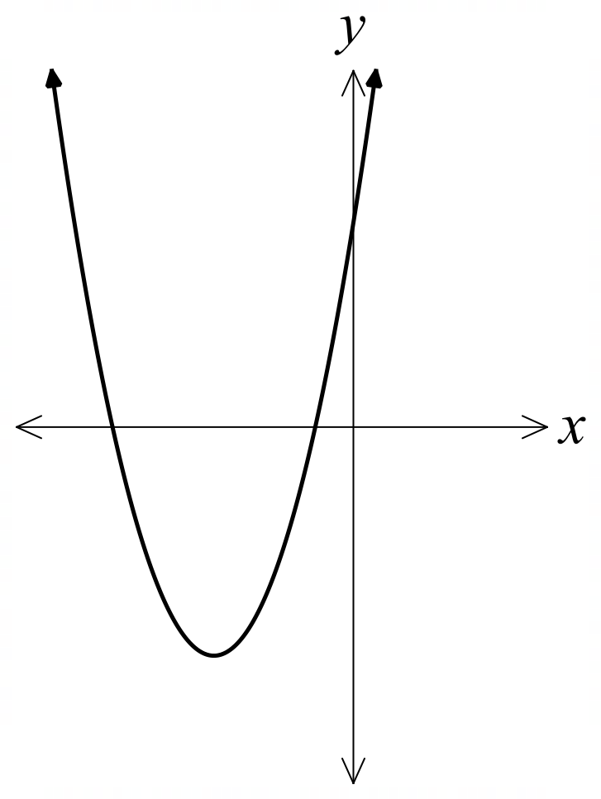


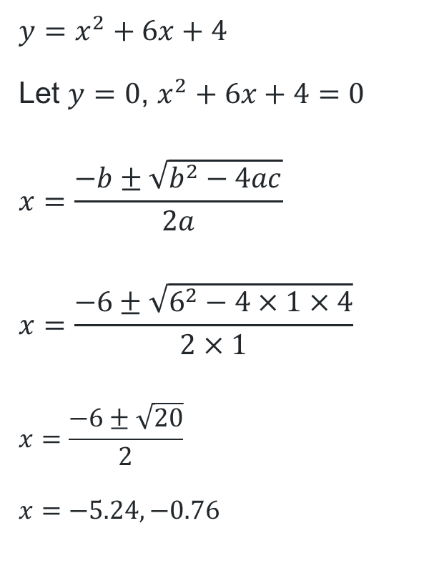


The quadratic formula (3)
Graph $y=x^{2}+6x+4$ by finding $x$- and $y$- intercepts.
Completing the square
The quadratic formula
$$y=x^{2}+6x+4$$
$$y={\left(x+3\right)}^{2}−5$$
Let $y=0$
$$0={\left(x+3\right)}^{2}−5$$
$${\left(x+3\right)}^{2}=5$$
$$x+3=±\sqrt{5}$$
$$x=±\sqrt{5}−3$$
$$x=−5.24, −0.76$$
$$y=x^{2}+6x+4$$
Let $y=0$, $x^{2}+6x+4=0$
$$x=\frac{−b±\sqrt{b^{2}−4ac}}{2a}$$
$$x=\frac{−6±\sqrt{6^{2}−4×1×4}}{2×1}$$
$$x=\frac{−6±\sqrt{20}}{2}$$
$$x=−5.24, −0.76$$
$$4$$
$$−5.24$$
$$−0.76$$

Slide 12
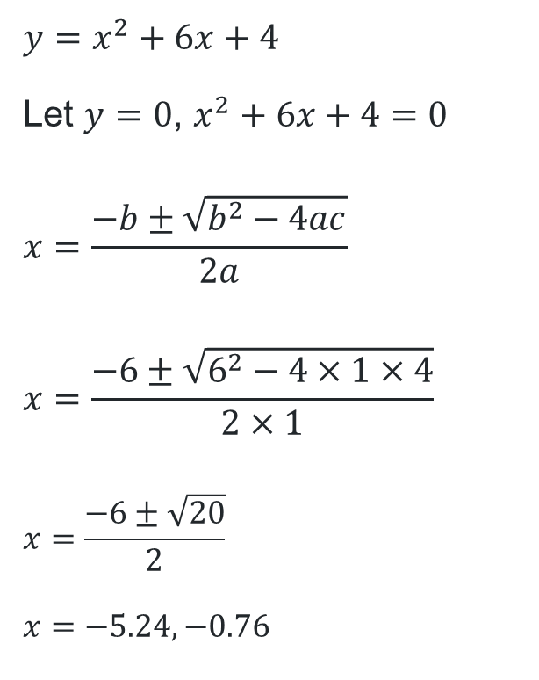

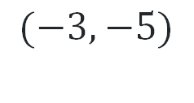
The quadratic formula (4)
Graph $y=x^{2}+6x+4$ by finding $x$- and $y$- intercepts.
Completing the square
The quadratic formula
$$y=x^{2}+6x+4$$
$$y={\left(x+3\right)}^{2}−5$$
Let $y=0$
$$0={\left(x+3\right)}^{2}−5$$
$${\left(x+3\right)}^{2}=5$$
$$x+3=±\sqrt{5}$$
$$x=±\sqrt{5}−3$$
$$x=−5.24, −0.76$$
$$y=x^{2}+6x+4$$
Let $y=0$, $x^{2}+6x+4=0$
$$x=\frac{−b±\sqrt{b^{2}−4ac}}{2a}$$
$$x=\frac{−6±\sqrt{6^{2}−4×1×4}}{2×1}$$
$$x=\frac{−6±\sqrt{20}}{2}$$
$$x=−5.24, −0.76$$
$$x=−3$$
$$4$$
$$−5.24$$
$$−0.76$$
$$(−3,−5)$$

Slide 13
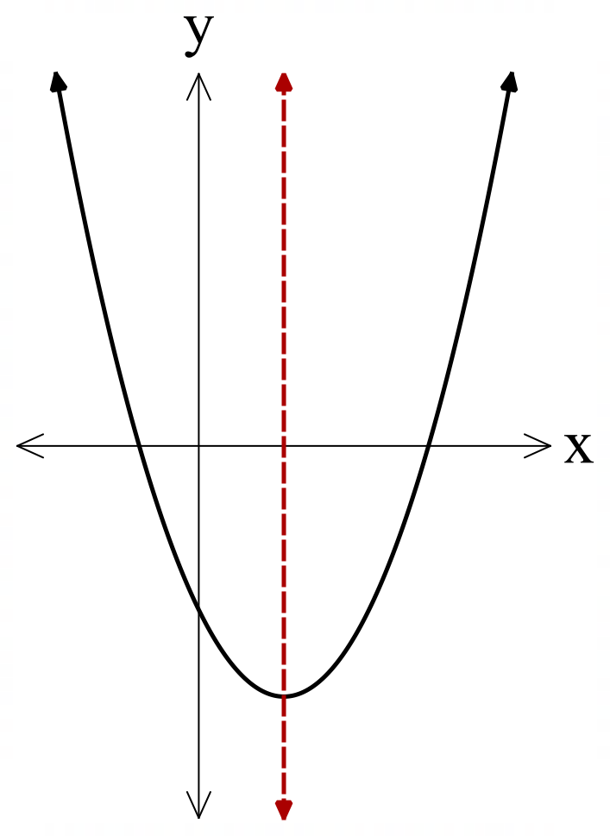
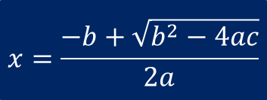
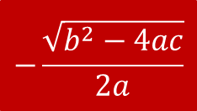
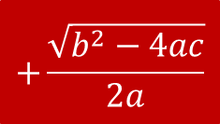
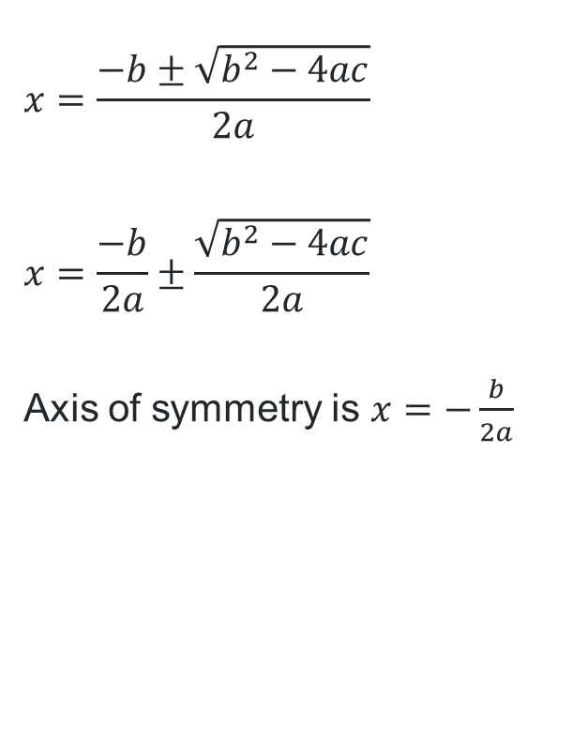


The quadratic formula (6)
$$x=−\frac{b}{2a}$$
The axis of symmetry
$$x=\frac{−b±\sqrt{b^{2}−4ac}}{2a}$$
$$x=\frac{−b}{2a}±\frac{\sqrt{b^{2}−4ac}}{2a}$$
Axis of symmetry is $x=−\frac{b}{2a}$
$$−\frac{\sqrt{b^{2}−4ac}}{2a}$$
$$+\frac{\sqrt{b^{2}−4ac}}{2a}$$
$$x=\frac{−b−\sqrt{b^{2}−4ac}}{2a}$$
$$x=\frac{−b+\sqrt{b^{2}−4ac}}{2a}$$

Slide 14

The axis of symmetry (2)
Identifying the formula by completing the square
Complete the square for the general quadratic $y=ax^{2}+bx+c$.
$$y=a\left(x^{2}+\frac{b}{a}x+\right)−a×□+c$$
$$y=a\left(x^{2}+\frac{b}{a}x+{\left(\frac{b}{2a}\right)}^{2}\right)−a{\left(\frac{b}{2a}\right)}^{2}+c$$
$$y=a{\left(x+\frac{b}{2a}\right)}^{2}−\frac{b^{2}}{4a}+c$$
Axis of symmetry

Slide 15
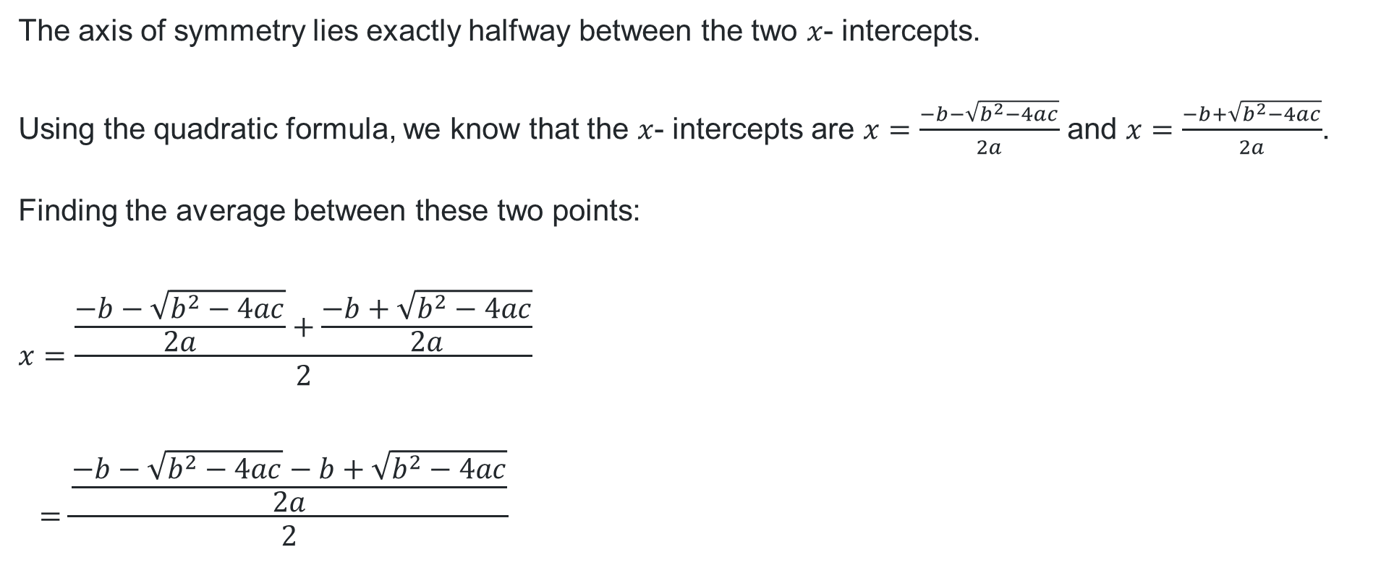
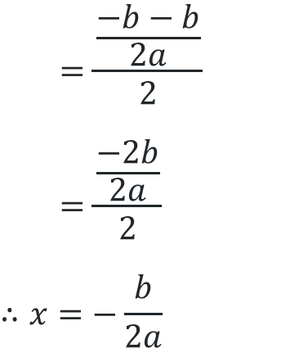
The axis of symmetry (1)
Deriving the formula from the quadratic formula
The axis of symmetry lies exactly halfway between the two $x$- intercepts.
Using the quadratic formula, we know that the $x$- intercepts are $x=\frac{−b−\sqrt{b^{2}−4ac}}{2a}$ and $x=\frac{−b+\sqrt{b^{2}−4ac}}{2a}$.
Finding the average between these two points:
$$x=\frac{\frac{−b−\sqrt{b^{2}−4ac}}{2a}+\frac{−b+\sqrt{b^{2}−4ac}}{2a}}{2}$$
$$=\frac{\frac{−b−\sqrt{b^{2}−4ac}−b+\sqrt{b^{2}−4ac}}{2a}}{2}$$
$$=\frac{\frac{−b−b}{2a}}{2}$$
$$=\frac{\frac{−2b}{2a}}{2}$$
$$∴x=−\frac{b}{2a}$$

Slide 16
Independent practice

Slide 17

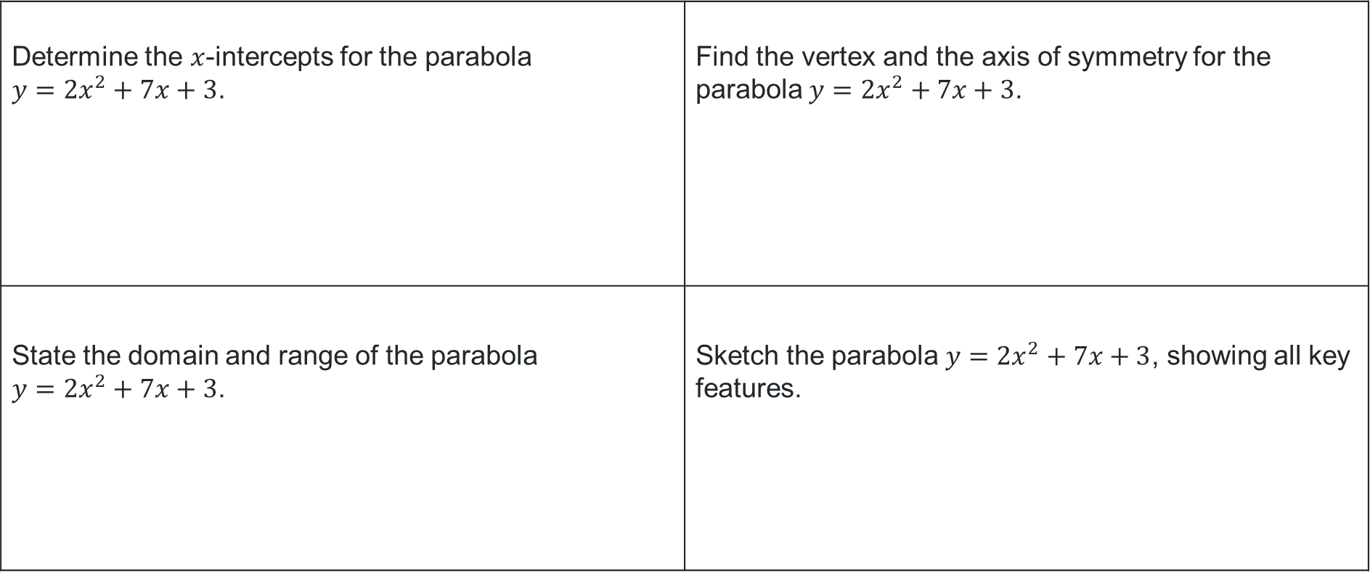
Same surface, different deep
Determine the $x$-intercepts for the parabola $y=2x^{2}+7x+3$. | Find the vertex and the axis of symmetry for the parabola $y=2x^{2}+7x+3$.
State the domain and range of the parabola $y=2x^{2}+7x+3$. | Sketch the parabola $y=2x^{2}+7x+3$, showing all key features.
$$y=2x^{2}+7x+3$$

Slide 18
References
This presentation contains NSW Curriculum and syllabus content. The NSW Curriculum is developed by the NSW Education Standards Authority. This content is prepared by NESA for and on behalf of the Crown in the right of the State of New South Wales. The material is protected by Crown copyright.
Please refer to the NESA Copyright Disclaimer for more information https://educationstandards.nsw.edu.au/wps/portal/nesa/mini-footer/copyright.
NESA holds the only official and up-to-date versions of the NSW Curriculum and syllabus documents. Please visit the NSW Education Standards Authority (NESA) website https://educationstandards.nsw.edu.au/wps/portal/nesa/home and the NSW Curriculum website https://curriculum.nsw.edu.au.
Mathematics Advanced 11-12 Syllabus © NSW Education Standards Authority (NESA) for and on behalf of the Crown in right of the State of New South Wales, 2024.

Slide 19
Copyright
© State of New South Wales (Department of Education), 2025
The copyright material published in this resource is subject to the Copyright Act 1968 (Cth) and is owned by the NSW Department of Education or, where indicated, by a party other than the NSW Department of Education (third-party material).
Copyright material available in this resource and owned by the NSW Department of Education is licensed under a Creative Commons Attribution 4.0 International (CC BY 4.0) license.
This license allows you to share and adapt the material for any purpose, even commercially.
Attribution should be given to © State of New South Wales (Department of Education), 2025.
Material in this resource not available under a Creative Commons license:
the NSW Department of Education logo, other logos and trademark-protected material
Material owned by a third party that has been reproduced with permission. You will need to obtain permission from the third party to reuse its material.
Links to third-party material and websites
Please note that the provided (reading/viewing material/list/links/texts) are a suggestion only and implies no endorsement, by the New South Wales Department of Education, of any author, publisher, or book title. School principals and teachers are best placed to assess the suitability of resources that would complement the curriculum and reflect the needs and interests of their students.
If you use the links provided in this document to access a third-party’s website, you acknowledge that the terms of use, including licence terms set out on the third-party’s website apply to the use which may be made of the materials on that third-party website or where permitted by the Copyright Act 1968 (Cth). The department accepts no responsibility for content on third-party websites.

