Slide 1

Completing the square
Mathematics Advanced – Stage 6 (Year 11)
Working with linear and quadratic functions

Slide 2
Connecting learning

Slide 3
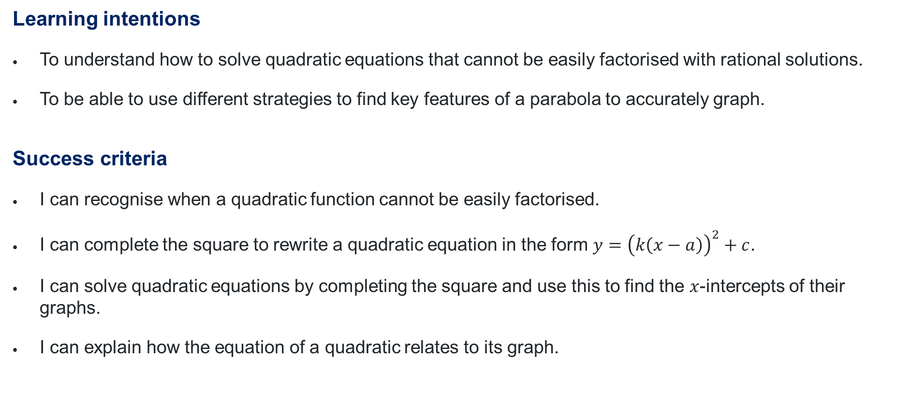
Learning intentions and success criteria
Learning intentions
To understand how to solve quadratic equations that cannot be easily factorised with rational solutions.
To be able to use different strategies to find key features of a parabola to accurately graph.
Success criteria
I can recognise when a quadratic function cannot be easily factorised.
I can complete the square to rewrite a quadratic equation in the form $y={\left(k\left(x−a\right)\right)}^{2}+c$.
I can solve quadratic equations by completing the square and use this to find the $x$-intercepts of their graphs.
I can explain how the equation of a quadratic relates to its graph.
Notes:
Notes for teachers:
Learning intentions and success criteria are best co-constructed with students. Adapt the learning intention as required and add matching success criteria.
For more information See ⁠AITSL or the NSW Department of Education explicit teaching strategies, ⁠Sharing learning intentions and ⁠Sharing success criteria
LISC is not necessarily presented at the beginning of the lesson. Teacher needs to consider most effectual time to introduce
LISC should be revisited during the lesson to support students' evaluation of their learning

Slide 4





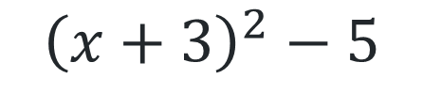
Balancing expressions
$$x^{2}+6x+4$$
$${\left(x+3\right)}^{2}$$
$$x^{2}+6x+4$$
$${\left(x+3\right)}^{2}−5$$

Slide 5
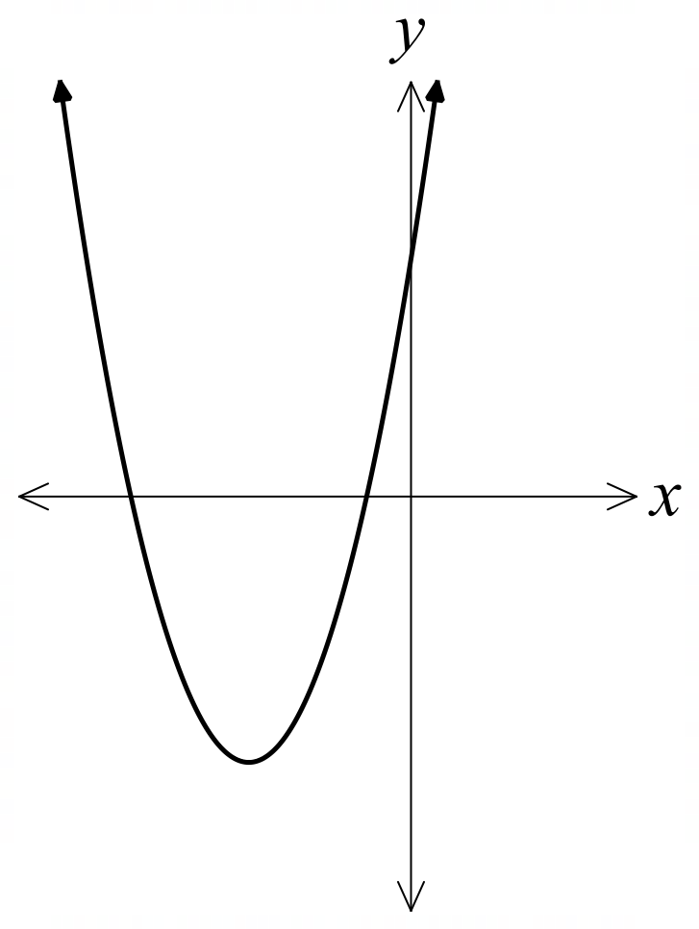




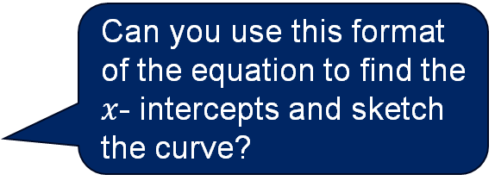
Connecting learning (1)
$$y=x^{2}+6x+4$$
$$y={\left(x+3\right)}^{2}−5$$
Let $y=0$
$$0={\left(x+3\right)}^{2}−5$$
$${\left(x+3\right)}^{2}=5$$
$$x+3=±\sqrt{5}$$
$$x=±\sqrt{5}−3$$
$$x=−5.24, −0.76$$
Can you use this format of the equation to find the $x$- intercepts and sketch the curve?
$$4$$
$$−5.24$$
$$−0.76$$

Slide 6
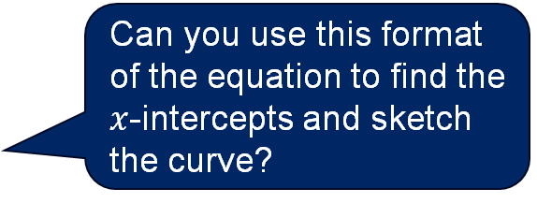


Connecting learning (2)
$$y=x^{2}+6x+4$$
$$y={\left(x+3\right)}^{2}−5$$
Let $y=0$
$$0={\left(x+3\right)}^{2}−5$$
$${\left(x+3\right)}^{2}=5$$
$$x+3=±\sqrt{5}$$
$$x=±\sqrt{5}−3$$
$$x=−5.24, −0.76$$
Can you use this format of the equation to find the $x$-intercepts and sketch the curve?
$$4$$
How does the vertex and the axis of symmetry connect to the equation?
$$−5.24$$
$$−0.76$$
$$(−3,−5)$$

Slide 7
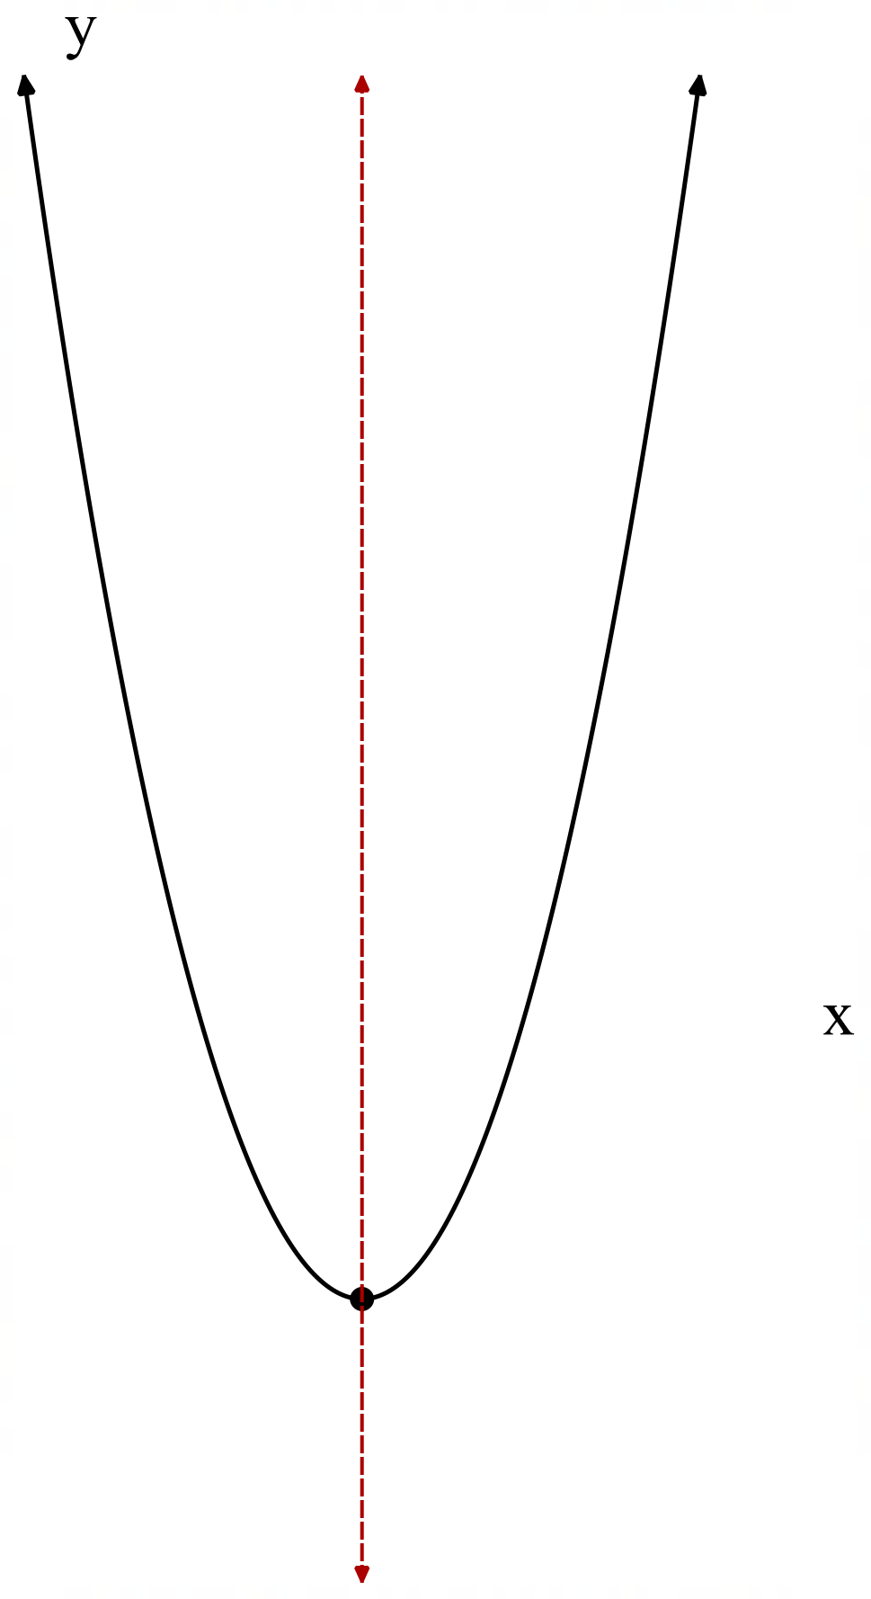
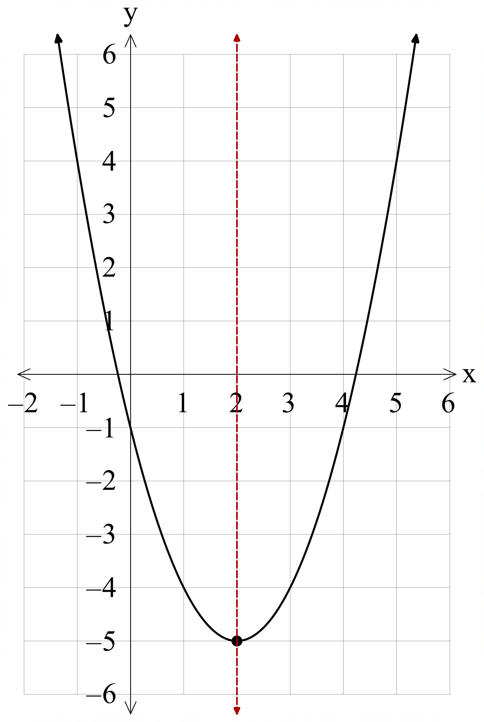
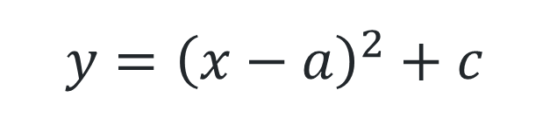
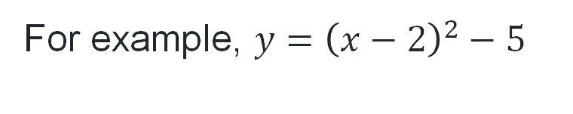
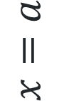

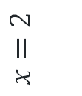

The form $y={\left(x−a\right)}^{2}+c$
$$y={\left(x−a\right)}^{2}+c$$
For example, $y={\left(x−2\right)}^{2}−5$
$$x=a$$
$$x=2$$
$$(a, c)$$
$$(2, −5)$$

Slide 8
Releasing responsibility

Slide 9

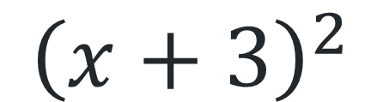
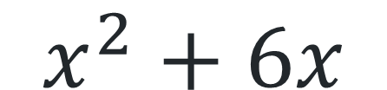
Balancing expressions (1)
$$x^{2}+6x$$
$${\left(x+3\right)}^{2}$$
What could be done to either side to make the sides balance?
Are the sides balanced?

Slide 10




Balancing expression (2)
Method 1
Method 2
$$x^{2}+6x+9$$
$${\left(x+3\right)}^{2}$$
$$x^{2}+6x$$
$${\left(x+3\right)}^{2}−9$$

Slide 11
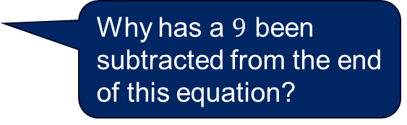

Completing the square (1)
Worked example 1
Express $y=x^{2}+6x+4$, in the form $y={\left(x−a\right)}^{2}+c$
$$y=x^{2}+6x++4$$
$$y=x^{2}+6x+9+4−9$$
$$y={\left(x+3\right)}^{2}−5$$
What strategies are used to find the missing value?
Why has a $9$ been subtracted from the end of this equation?
Which graphical features can be found from this equation in its current format?

Slide 12

Completing the square (2)
Your turn – question 1
Express $y=x^{2}−4x+1$, in the form $y={\left(x−a\right)}^{2}+c$
$$y=x^{2}−4x++1$$
$$y=x^{2}−4x+4+1−4$$
$$y={\left(x−2\right)}^{2}−3$$

Slide 13
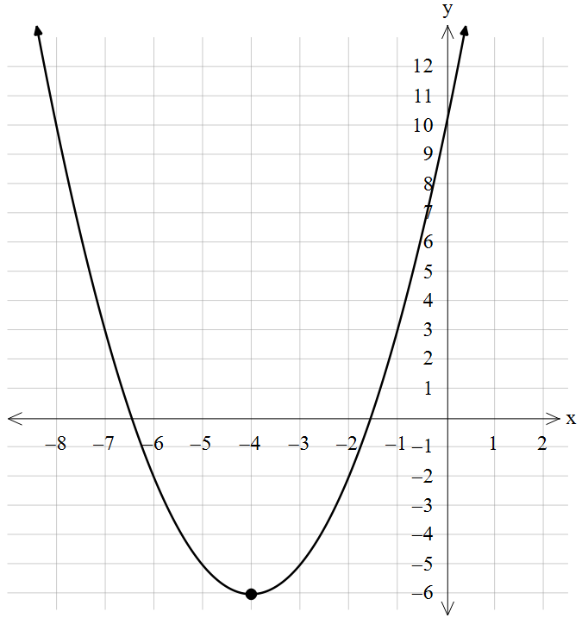

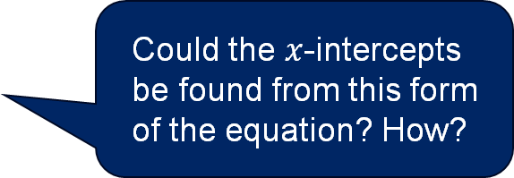

Completing the square (3)
Worked example 2
Sketch $y=x^{2}+8x+10$, by completing the square.
$$y=x^{2}+8x++10$$
$$y=x^{2}+8x+16+10−16$$
$$y={\left(x+4\right)}^{2}−6$$
Vertex $\left(−4,−6\right)$
$y$- intercept $=10$
Why was a $+16$ and $−16$ introduced in this line of working?
Could the $x$-intercepts be found from this form of the equation? How?

Slide 14
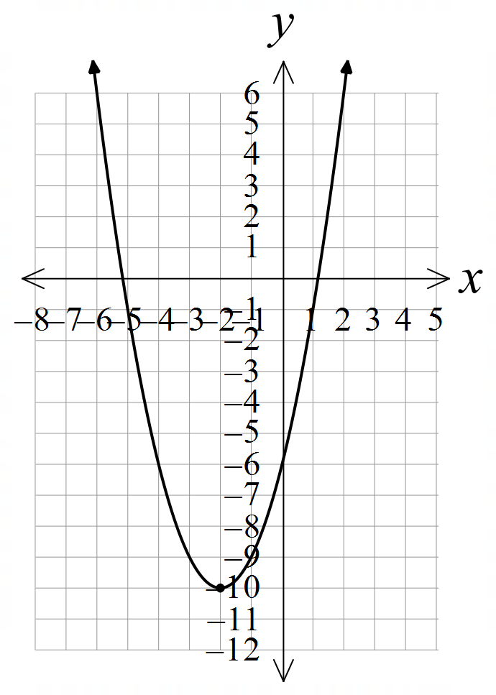

Completing the square (4)
Your turn – question 2
Sketch $y=x^{2}+4x−6$, by completing the square.
$$y=x^{2}+4x+−6$$
$$y=x^{2}+4x+4−6−4$$
$$y={\left(x+2\right)}^{2}−10$$
Vertex $\left(−2,−10\right)$
$y$- intercept $=−6$

Slide 15
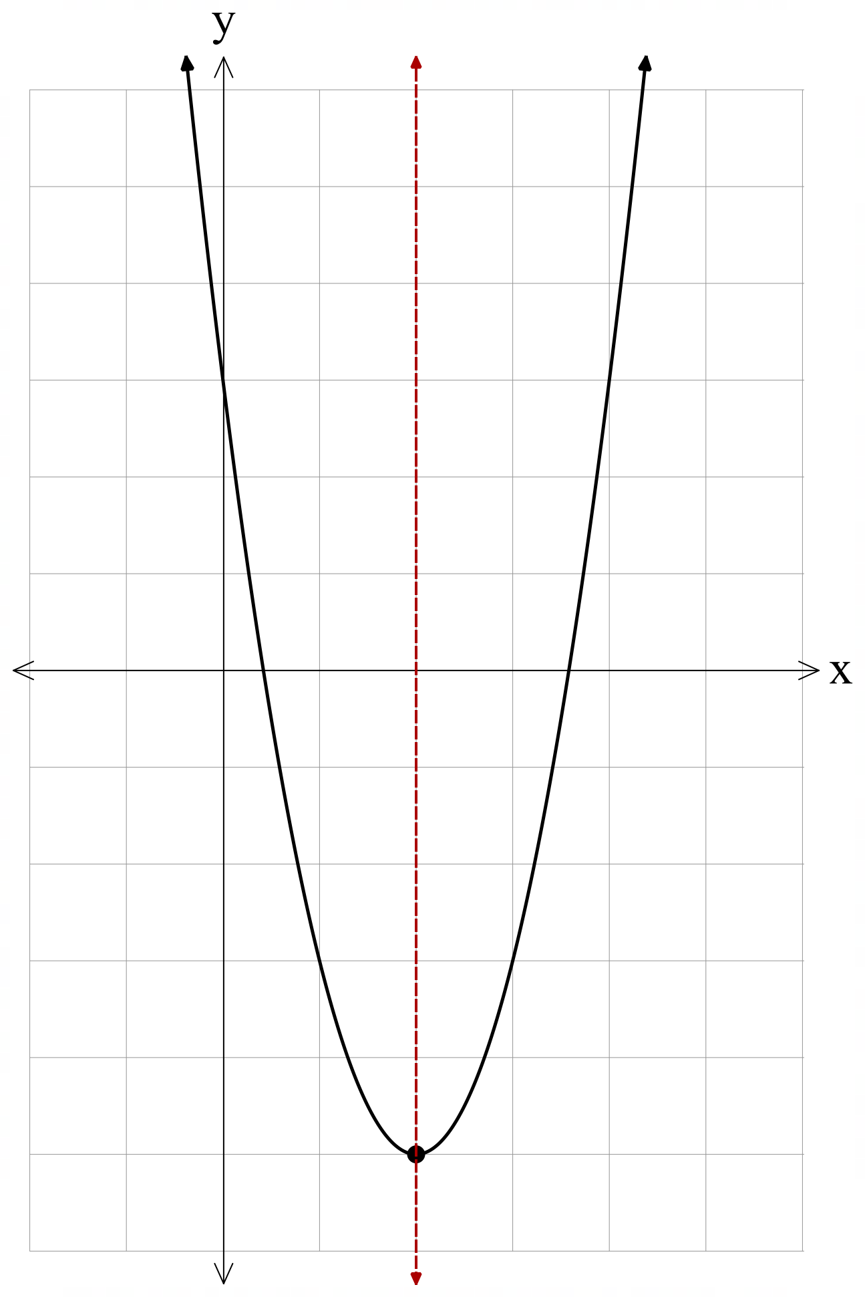
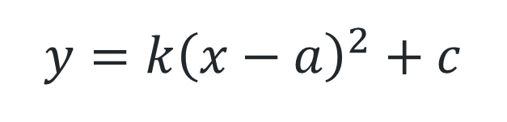
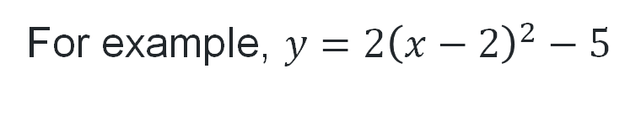
Completing the square for non-monic quadratics
$$y={k\left(x−a\right)}^{2}+c$$
For example, $y={2\left(x−2\right)}^{2}−5$
$$x=a$$
$$x=2$$
$$(a, c)$$
$$(2, −5)$$

Slide 16
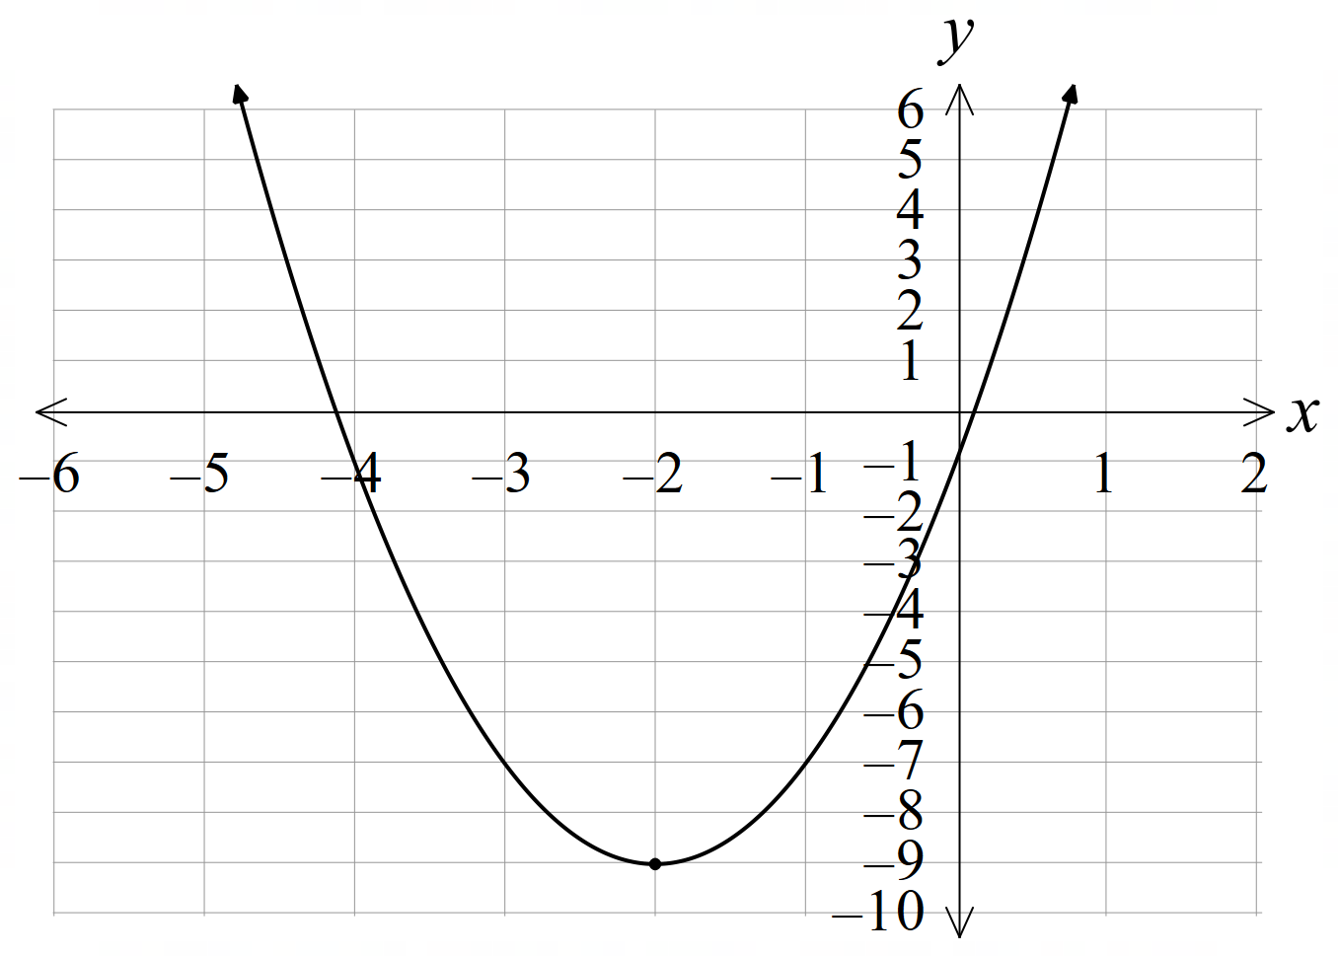

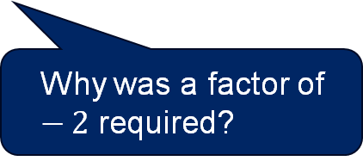
Completing the square for non-monic quadratics (1)
Worked example 3
Sketch $y={2x}^{2}+8x−1$
$$y={2(x}^{2}+4x+)−1$$
$$y=2\left(x^{2}+4x+4\right)−1−2×4$$
$$y={2\left(x+2\right)}^{2}−9$$
Vertex $\left(−2,−9\right)$
$y$- intercept $=−1$
Why was 2 factorised out of the first 2 terms?
Why was a factor of $−2$ required?

Slide 17
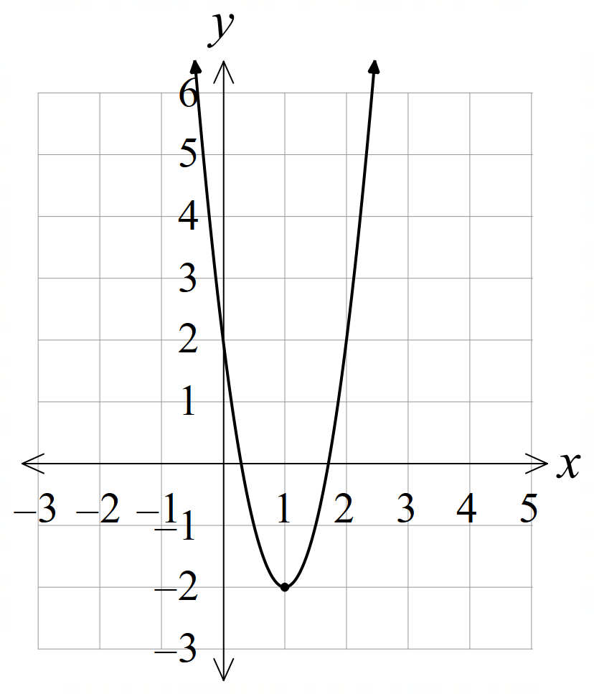

Completing the square for non-monic quadratics (2)
Your turn – question 2
Sketch $y={4x}^{2}−8x+2$
$$y={4(x}^{2}−2x+)+2$$
$$y=4\left(x^{2}−2x+1\right)+2−4×1$$
$$y={4\left(x−1\right)}^{2}−2$$
Vertex $\left(1,−2\right)$
$y$- intercept $=2$

Slide 18
References
This presentation contains NSW Curriculum and syllabus content. The NSW Curriculum is developed by the NSW Education Standards Authority. This content is prepared by NESA for and on behalf of the Crown in the right of the State of New South Wales. The material is protected by Crown copyright.
Please refer to the NESA Copyright Disclaimer for more information https://educationstandards.nsw.edu.au/wps/portal/nesa/mini-footer/copyright.
NESA holds the only official and up-to-date versions of the NSW Curriculum and syllabus documents. Please visit the NSW Education Standards Authority (NESA) website https://educationstandards.nsw.edu.au/wps/portal/nesa/home and the NSW Curriculum website https://curriculum.nsw.edu.au.
Mathematics Advanced 11-12 Syllabus © NSW Education Standards Authority (NESA) for and on behalf of the Crown in right of the State of New South Wales, 2024.

Slide 19
Copyright
© State of New South Wales (Department of Education), 2025
The copyright material published in this resource is subject to the Copyright Act 1968 (Cth) and is owned by the NSW Department of Education or, where indicated, by a party other than the NSW Department of Education (third-party material).
Copyright material available in this resource and owned by the NSW Department of Education is licensed under a Creative Commons Attribution 4.0 International (CC BY 4.0) license.
This license allows you to share and adapt the material for any purpose, even commercially.
Attribution should be given to © State of New South Wales (Department of Education), 2025.
Material in this resource not available under a Creative Commons license:
the NSW Department of Education logo, other logos and trademark-protected material
Material owned by a third party that has been reproduced with permission. You will need to obtain permission from the third party to reuse its material.
Links to third-party material and websites
Please note that the provided (reading/viewing material/list/links/texts) are a suggestion only and implies no endorsement, by the New South Wales Department of Education, of any author, publisher, or book title. School principals and teachers are best placed to assess the suitability of resources that would complement the curriculum and reflect the needs and interests of their students.
If you use the links provided in this document to access a third-party’s website, you acknowledge that the terms of use, including licence terms set out on the third-party’s website apply to the use which may be made of the materials on that third-party website or where permitted by the Copyright Act 1968 (Cth). The department accepts no responsibility for content on third-party websites.

