Slide 1

Factorising and graphing non-monic quadratic functions
Mathematics Advanced – Stage 6 (Year 11)
Working with linear and quadratic functions

Slide 2
Learning intentions and success criteria
Learning intentions
To understand how to factorise non-monic quadratic expressions.
To be able to use the factorised form of a quadratic function to sketch the related parabola.
Success criteria
I can select an appropriate strategy and use it to factorise non-monic quadratic expressions.
I can use the factorised form to identify x-intercepts and sketch a parabola accurately.
I can describe how the features of the graph relate to the algebraic form of the quadratic.
I can identify and explain common misconceptions in factorising and graphing quadratic functions and justify the correct solutions.
Notes:
Notes for teachers:
Learning intentions and success criteria are best co-constructed with students. Adapt the learning intention as required and add matching success criteria.
For more information See ⁠AITSL or the NSW Department of Education explicit teaching strategies, ⁠Sharing learning intentions and ⁠Sharing success criteria
LISC is not necessarily presented at the beginning of the lesson. Teacher needs to consider most effectual time to introduce
LISC should be revisited during the lesson to support students' evaluation of their learning

Slide 3
Activating prior knowledge

Slide 4
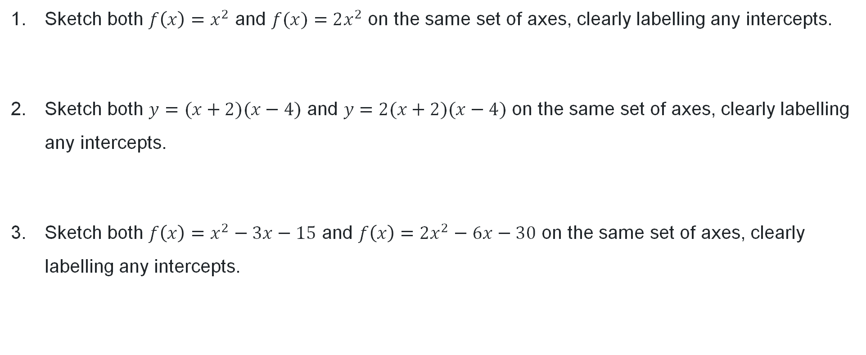
Graphing quadratic functions (1)
Sketch both $f\left(x\right)=x^{2}$ and $f(x)=2x^{2}$ on the same set of axes, clearly labelling any intercepts.
Sketch both $y=(x+2)(x−4)$ and $y=2(x+2)(x−4)$ on the same set of axes, clearly labelling any intercepts.
Sketch both $f\left(x\right)=x^{2}−3x−15$ and $f\left(x\right)=2x^{2}−6x−30$ on the same set of axes, clearly labelling any intercepts.

Slide 5

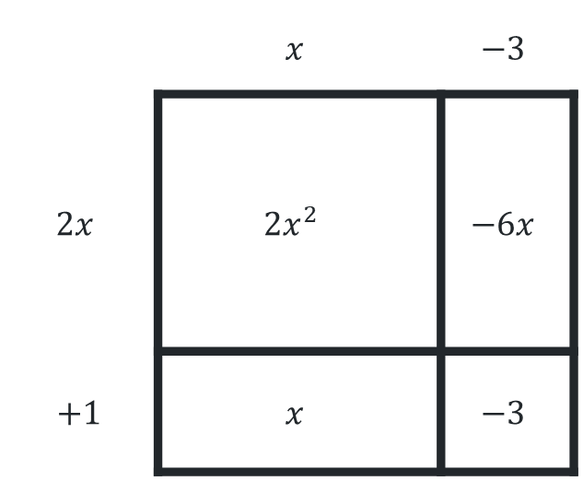
Graphing quadratic functions (2)
How might you go about sketching $y=2x^{2}−5x−3$?
Sketch $y=(2x+1)(x−3)$, clearly labelling any intercepts.
Use the area model, or otherwise,
to expand and simplify $\left(2x+1\right)\left(x−3\right).$
 | $$x$$ | $$−3$$
$$2x$$ | ${2x}^{2}$ | $$−6x$$
$+1$ | $$x$$ | $$−3$$

Slide 6
Connecting learning

Slide 7
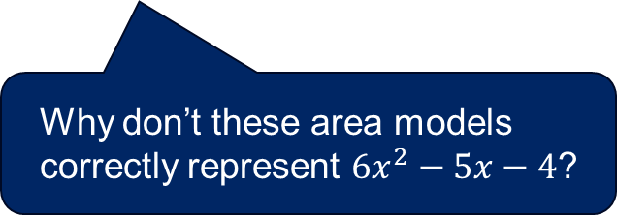
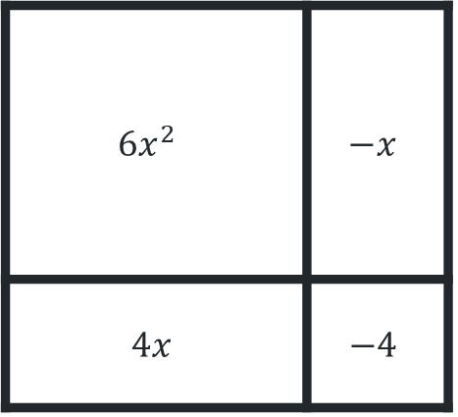
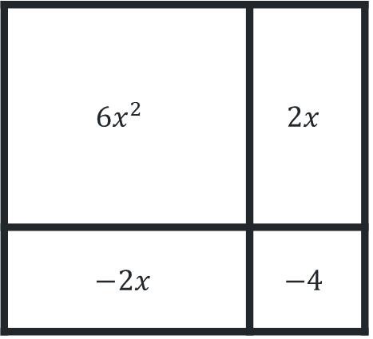
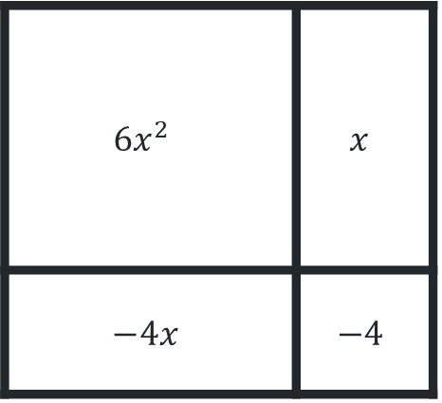
Factorising non-monic quadratics
Incorrect area model
Consider ${6x}^{2}−5x−4$ and the related incorrect area models
$6x^{2}$ | $$x$$
$$−4x$$ | $$−4$$
$6x^{2}$ | $$2x$$
$$−2x$$ | $$−4$$
$6x^{2}$ | $$−x$$
$$4x$$ | $$−4$$
Why don’t these area models correctly represent $6x^{2}−5x−4$?

Slide 8


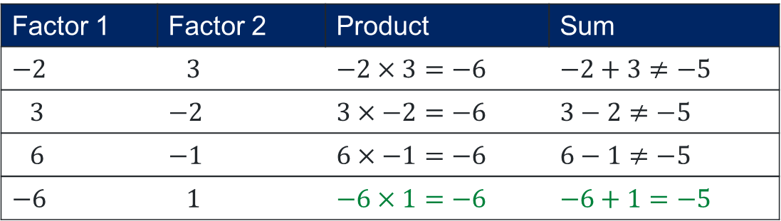
Product, sum, factor (1)
Worked example 1
Find the product, sum and factors for$2x^{2}−5x−3$.
How was the product found?
Product $=2×−3$
$$=−6$$
Sum $=−5$
How was the sum found?
Factor 1 | Factor 2 | Product | Sum
$$−2$$ | $$3$$ | $$−2×3=−6$$ | $$−2+3≠−5$$
$$3$$ | $$−2$$ | $$3×−2=−6$$ | $$3−2≠−5$$
$$6$$ | $$−1$$ | $$6×−1=−6$$ | $$6−1≠−5$$
$$−6$$ | $$1$$ | $$−6×1=−6$$ | $$−6+1=−5$$
Why is one of the factors always negative?
How were the factors determined?
Factors $=−6, 1$

Slide 9



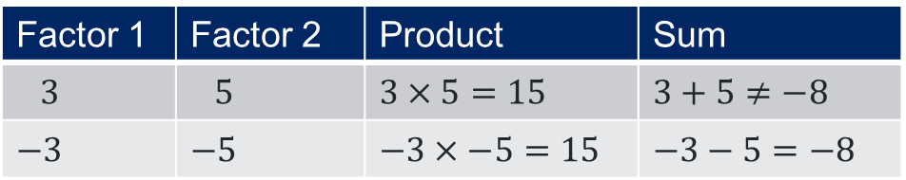
Product, sum, factor (2)
Your turn – question 1
Find the product, sum and factors for $3x^{2}−8x+5$.
Product $=3×5$
$$=15$$
Sum $=−8$
Factor 1 | Factor 2 | Product | Sum
$$3$$ | $$5$$ | $$3×5=15$$ | $$3+5≠−8$$
$$−3$$ | $$−5$$ | $$−3×−5=15$$ | $$−3−5=−8$$
Factors $=−3, −5$

Slide 10
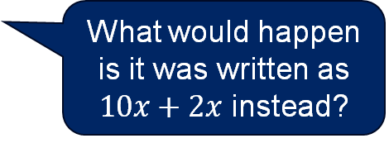

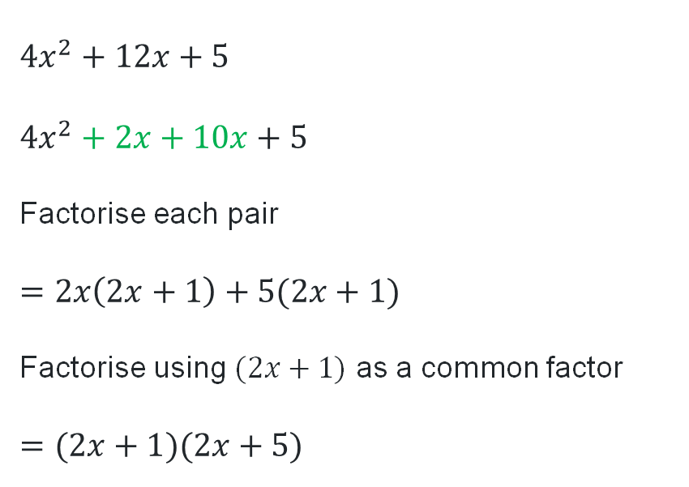

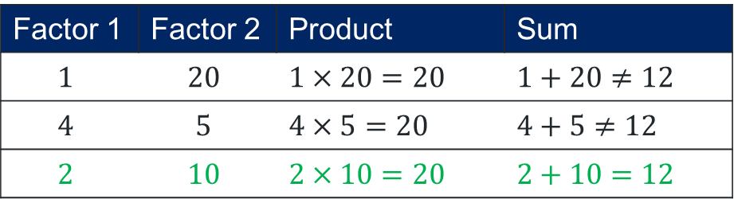
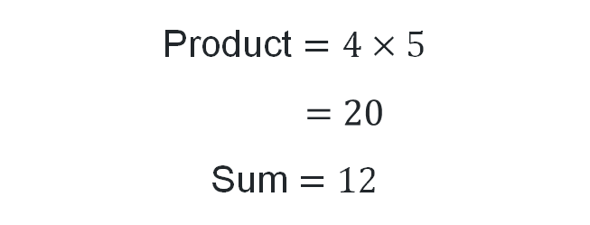
Grouping in pairs (1)
Worked example 2
Factorise $4x^{2}+12x+5$, by first finding the product, sum and factors.
Why is $12x$ rewritten as $2x+10x$?
Product $=4×5$
$$=20$$
Sum $=12$
$$4x^{2}+12x+5$$
$$4x^{2}+2x+10x+5$$
Factorise each pair
$$=2x\left(2x+1\right)+5(2x+1)$$
Factorise using $(2x+1)$ as a common factor
$$=(2x+1)(2x+5)$$
What would happen is it was written as $10x+2x$ instead?
Factor 1 | Factor 2 | Product | Sum
$$1$$ | $$20$$ | $$1×20=20$$ | $$1+20≠12$$
$$4$$ | $$5$$ | $$4×5=20$$ | $$4+5≠12$$
$$2$$ | $$10$$ | $$2×10=20$$ | $$2+10=12$$
How were the factors determined?
Factors $=2, 12$

Slide 11
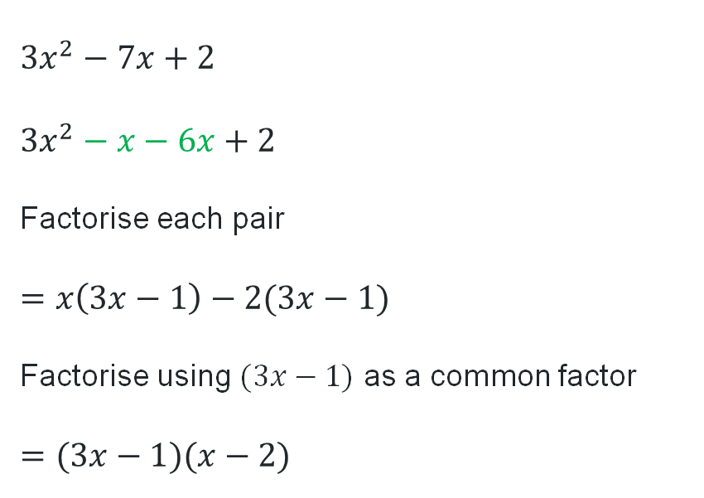

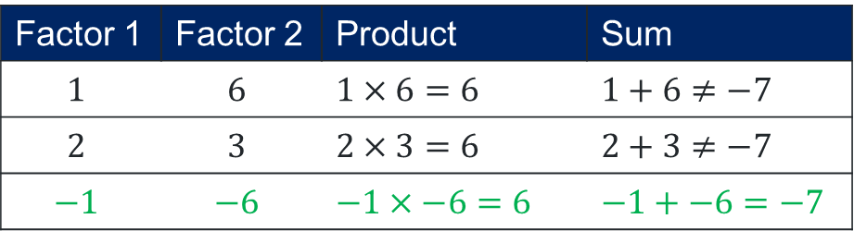
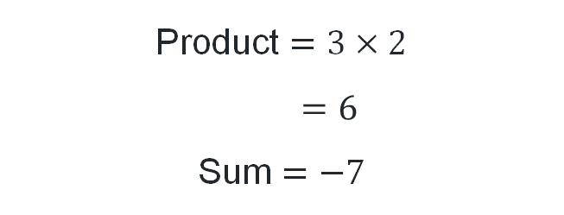
Grouping in pairs (2)
Your turn – question 2
Factorise$3x^{2}−7x+2$, by first finding the product, sum and factors.
Product $=3×2$
$$=6$$
Sum $=−7$
$$3x^{2}−7x+2$$
$$3x^{2}−x−6x+2$$
Factorise each pair
$$=x\left(3x−1\right)−2(3x−1)$$
Factorise using $(3x−1)$ as a common factor
$$=(3x−1)(x−2)$$
Factor 1 | Factor 2 | Product | Sum
$$1$$ | $$6$$ | $$1×6=6$$ | $$1+6≠−7$$
$$2$$ | $$3$$ | $$2×3=6$$ | $$2+3≠−7$$
$$−1$$ | $$−6$$ | $$−1×−6=6$$ | $$−1+−6=−7$$
Factors $=−1, −6$

Slide 12
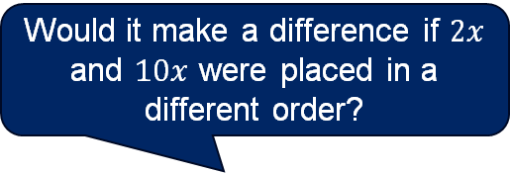

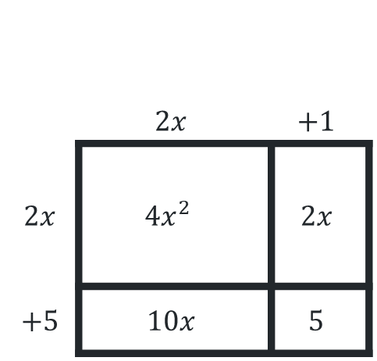
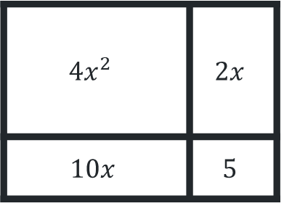
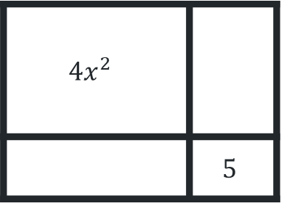
Area models (1)
Worked example 3
Factorise $4x^{2}+12x+5$, by first finding the product, sum and factors.
Product = $20$
Sum = $12$
Factors = $10, 2$
$$∴4x^{2}+12x+5=(2x+5)(2x+1)$$
Would it make a difference if $2x$ and $10x$ were placed in a different order?
 | $$2x$$ | $$+1$$
$$2x$$ | $4x^{2}$ | $$2x$$
$$+5$$ | $$10x$$ | $$5$$
$4x^{2}$
 | $$5$$
$4x^{2}$ | $$2x$$
$$10x$$ | $$5$$
How was it determined that 10 and 2 were the factors?
How does this answer come from the area model?

Slide 13
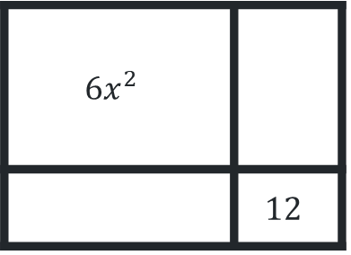

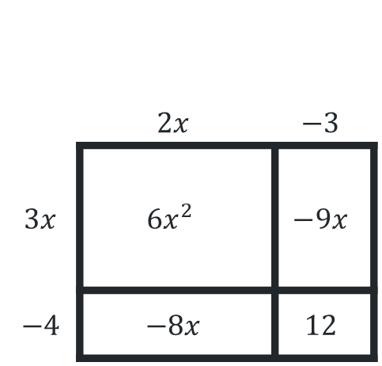
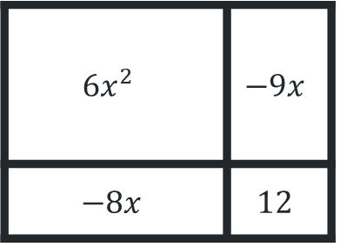
Area models (2)
Your turn – question 3
Factorise $6x^{2}−17x+12$, by first finding the product, sum and factors.
Product = $72$
Sum = $−17$
Factors = $−8,−9$
$$∴6x^{2}−17x+12=(2x−3)(3x−4)$$
 | $$2x$$ | $$−3$$
$$3x$$ | $6x^{2}$ | $$−9x$$
$$−4$$ | $$−8x$$ | $$12$$
$6x^{2}$
 | $$12$$
$6x^{2}$ | $$−9x$$
$$−8x$$ | $$12$$

Slide 14
References
This presentation contains NSW Curriculum and syllabus content. The NSW Curriculum is developed by the NSW Education Standards Authority. This content is prepared by NESA for and on behalf of the Crown in the right of the State of New South Wales. The material is protected by Crown copyright.
Please refer to the NESA Copyright Disclaimer for more information https://educationstandards.nsw.edu.au/wps/portal/nesa/mini-footer/copyright.
NESA holds the only official and up-to-date versions of the NSW Curriculum and syllabus documents. Please visit the NSW Education Standards Authority (NESA) website https://educationstandards.nsw.edu.au/wps/portal/nesa/home and the NSW Curriculum website https://curriculum.nsw.edu.au.
Mathematics Advanced 11-12 Syllabus © NSW Education Standards Authority (NESA) for and on behalf of the Crown in right of the State of New South Wales, 2024.

Slide 15
Copyright
© State of New South Wales (Department of Education), 2025
The copyright material published in this resource is subject to the Copyright Act 1968 (Cth) and is owned by the NSW Department of Education or, where indicated, by a party other than the NSW Department of Education (third-party material).
Copyright material available in this resource and owned by the NSW Department of Education is licensed under a Creative Commons Attribution 4.0 International (CC BY 4.0) license.
This license allows you to share and adapt the material for any purpose, even commercially.
Attribution should be given to © State of New South Wales (Department of Education), 2025.
Material in this resource not available under a Creative Commons license:
the NSW Department of Education logo, other logos and trademark-protected material
Material owned by a third party that has been reproduced with permission. You will need to obtain permission from the third party to reuse its material.
Links to third-party material and websites
Please note that the provided (reading/viewing material/list/links/texts) are a suggestion only and implies no endorsement, by the New South Wales Department of Education, of any author, publisher, or book title. School principals and teachers are best placed to assess the suitability of resources that would complement the curriculum and reflect the needs and interests of their students.
If you use the links provided in this document to access a third-party’s website, you acknowledge that the terms of use, including licence terms set out on the third-party’s website apply to the use which may be made of the materials on that third-party website or where permitted by the Copyright Act 1968 (Cth). The department accepts no responsibility for content on third-party websites.

