Slide 1
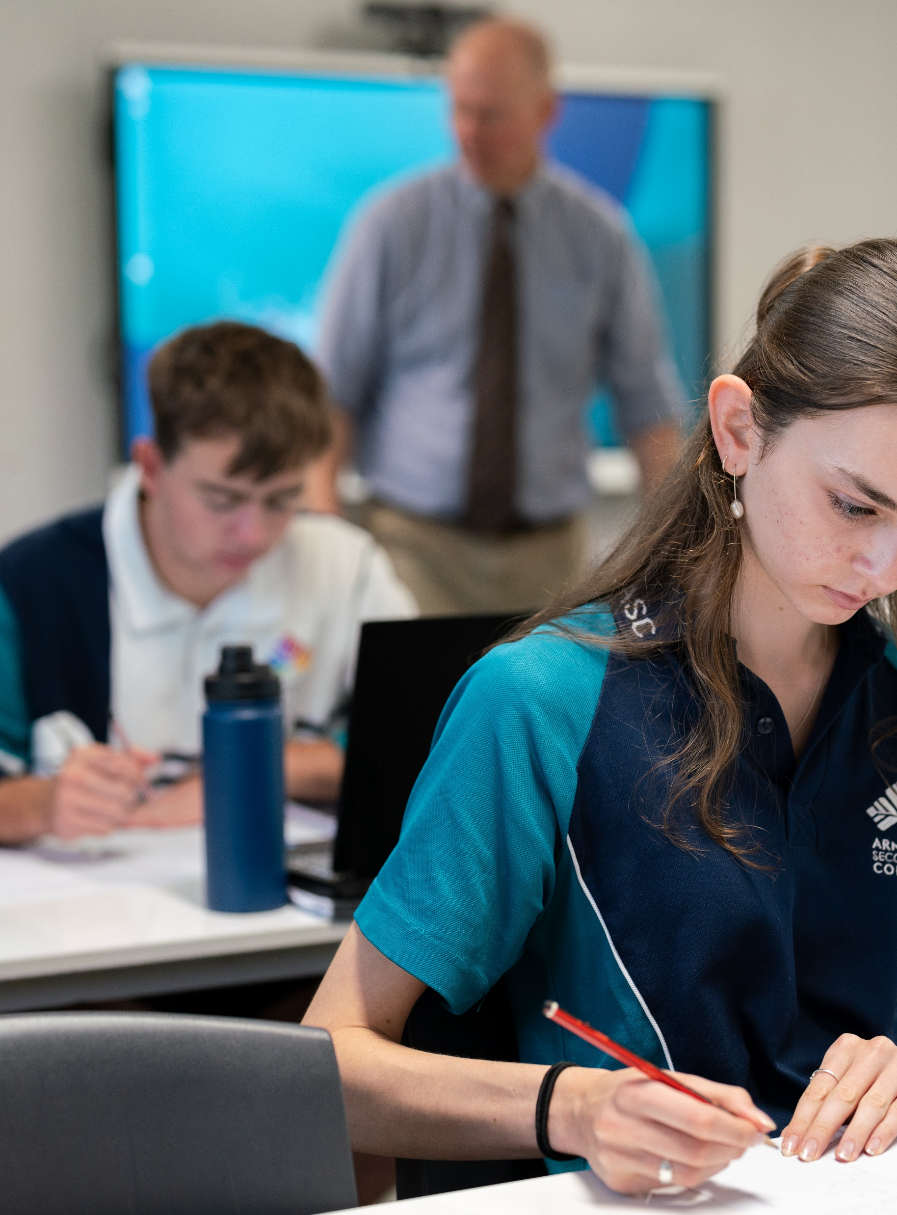
Solving simultaneous equations
Mathematics Advanced – Stage 6 (Year 11)
Working with linear and quadratic functions

Slide 2
Learning intentions and success criteria
Learning intention
To be able to solve simultaneous linear equations algebraically.
Success criteria
I can identify whether to add, subtract, or scale equations to use elimination.
I can rearrange an equation to make one variable the subject.
I can substitute one expression into another and simplify correctly.
I can solve for both variables using elimination or substitution.
I can check that my solution satisfies both original equations.
Notes:
Notes for teachers:
Learning intentions and success criteria are best co-constructed with students. Adapt the learning intention as required and add matching success criteria.
For more information See ⁠AITSL or the NSW Department of Education explicit teaching strategies, ⁠Sharing learning intentions and ⁠Sharing success criteria
LISC is not necessarily presented at the beginning of the lesson. Teacher needs to consider most effectual time to introduce
LISC should be revisited during the lesson to support students' evaluation of their learning

Slide 3
Connecting learning

Slide 4


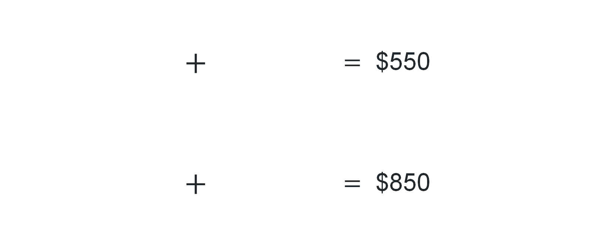
Picture puzzle
 | $+$ | $=$ $550
 | $+$ | $=$ $850
What is the cost of one guitar and one drumkit?

Slide 5
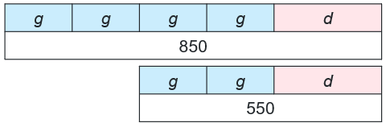
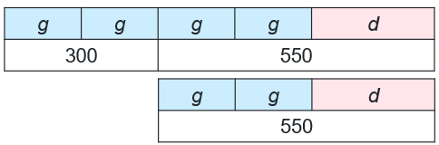


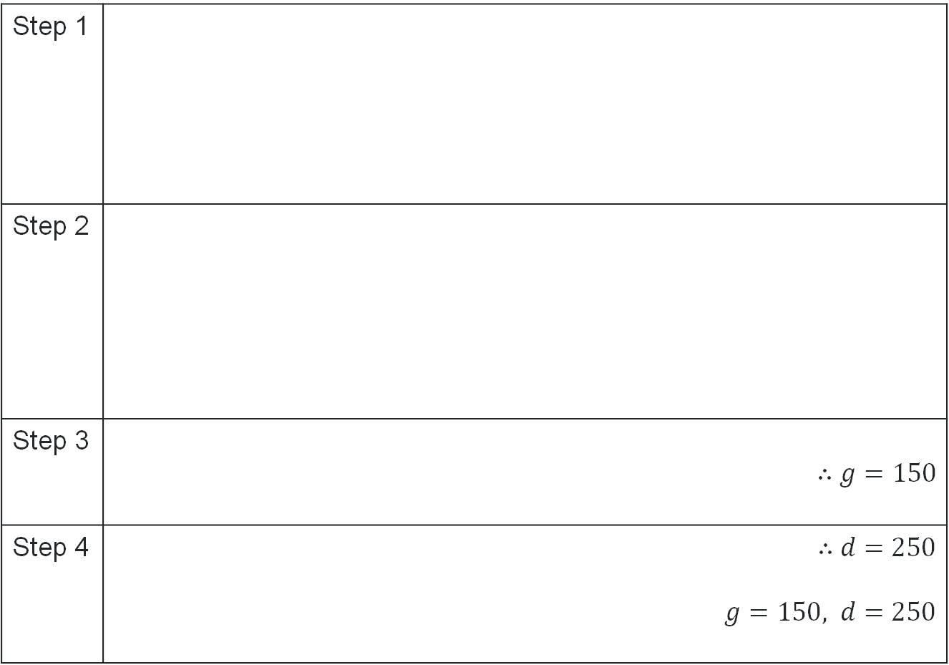
Bar model
Step 1
Step 2
Step 3 | $∴g=150$
Step 4 | $∴d=250$ $g=150, d=250$
How do we know this part is 550?
Why do we only look at this part of the bar?
What happened to $550

Slide 6
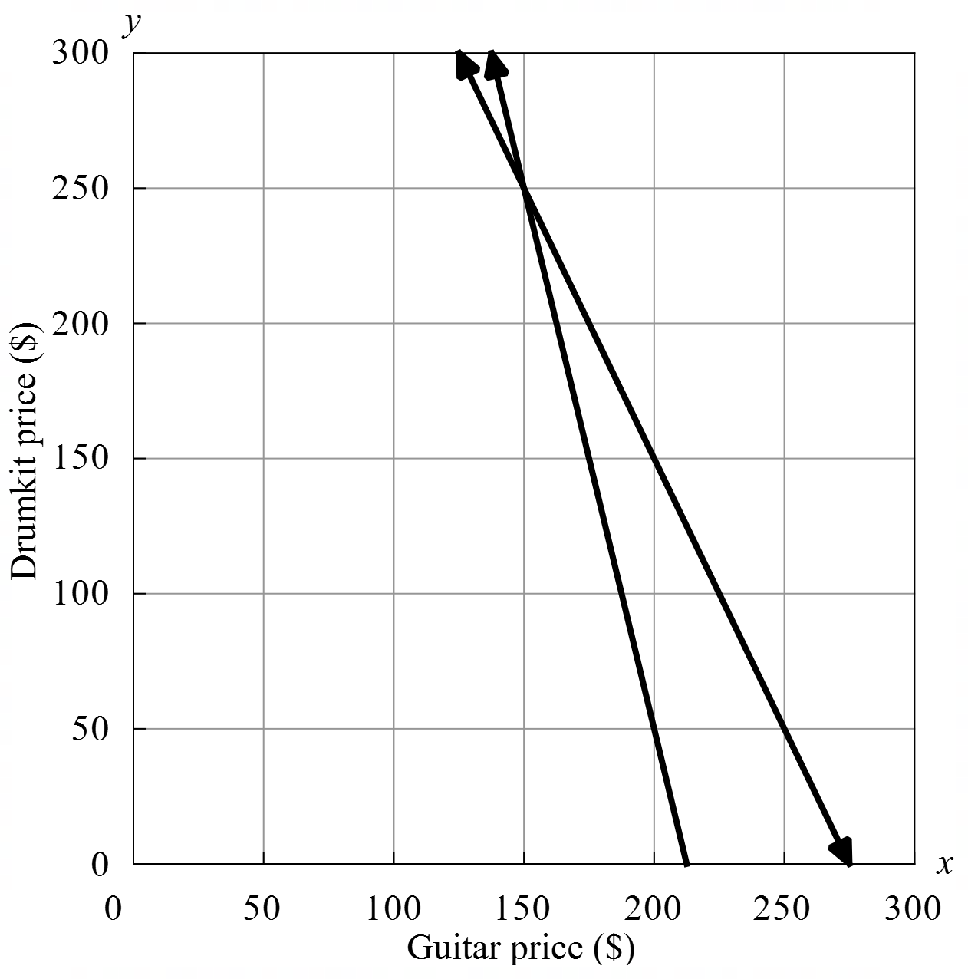
Solve graphically
Point of intersection:
Guitar price = $150
Drumkit price = $250

Slide 7
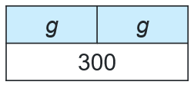
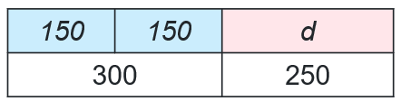

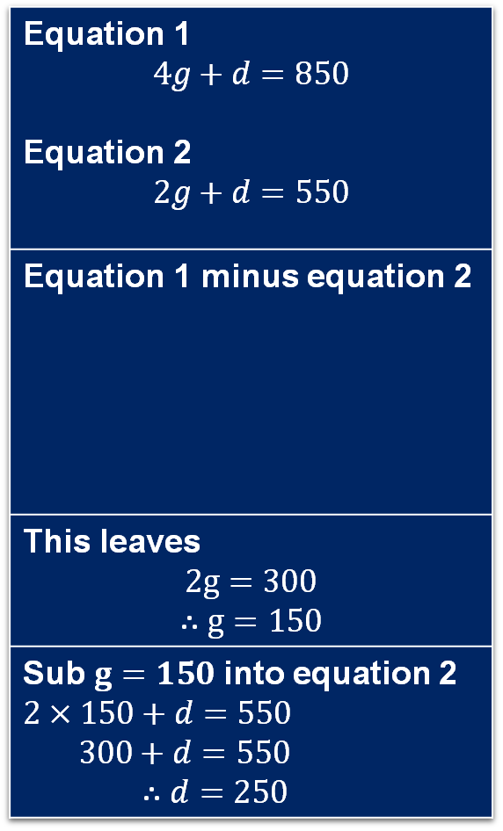

From bar model to equations
Step 1
Step 2
Step 3 | $∴g=150$
Step 4 | $∴d=250$ $g=150, d=250$
Equation 1 $$4g+d=850$$ Equation 2 $$2g+d=550$$
Equation 1 minus equation 2
This leaves $$2g=300$$ $$∴g=150$$
Sub $g=150$ into equation 2 $2×150+d=550$ $300+d=550$ $∴d=250$
$$4g+d=850 \\ −2g+d=550$$

Slide 8
Releasing responsibility

Slide 9
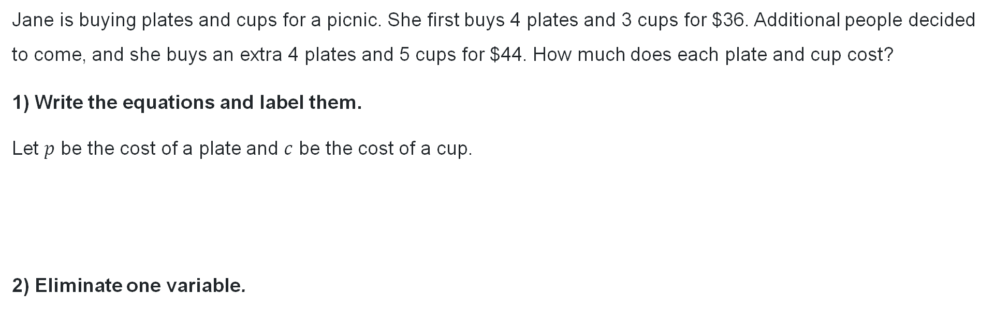
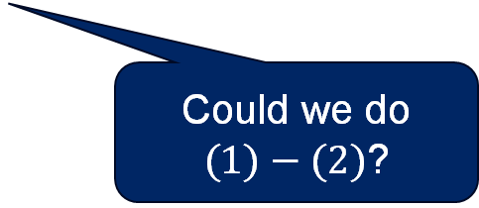


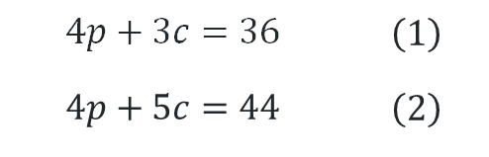
Elimination method (1)
Worked example 1
Jane is buying plates and cups for a picnic. She first buys 4 plates and 3 cups for $36. Additional people decided to come, and she buys an extra 4 plates and 5 cups for $44. How much does each plate and cup cost?
1) Write the equations and label them.
Let $p$ be the cost of a plate and $c$ be the cost of a cup.
2) Eliminate one variable.
3) Substitute $c$ into an equation to find the value of $p$
Sub $c=4$ into $(1)$: $4p+3×4=36$
$4p=36−12$
$p=\frac{24}{4}$
$p=6$
Therefore: $c=4, p=6$
Cups cost $4 and plates cost $6
$$4p+3c=36$$ $$4p+5c=44$$ | $$\left(1\right)$$ $$\left(2\right)$$
What are these numbers?
Why is this necessary?
 | $$4p+5c$$ | $$=$$ | $$44$$ | $$\left(2\right)−\left(1\right)$$
$$−$$ | $$4p+3c$$ | $$=$$ | $$36$$
 | $$2c$$ | $$=$$ | $$8$$
 | $$c$$ | $$=$$ | $$4$$
How can we check?
Could we do $(1)−(2)$?

Slide 10

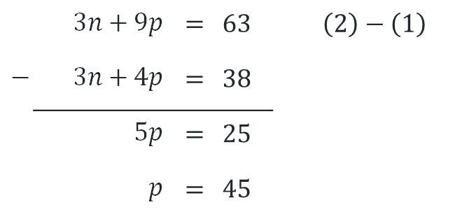

Elimination method (2)
Your turn – question 1
Rosie is buying notebooks and pens for school She first buys 3 notebooks and 4 pens for $38. Later, she buys another 3 notebooks and 9 pens for $63. How much does each notebook and pen cost? Let $n$ be the cost of a notebook and $p$ be the cost of a pen.
$3n+4p=38$ $(1)$
$3n+9p=63$ $\left(2\right)$
Sub $p=5$ into $(1)$: $3n+4×5=3$8
$3n=38−$20
$n=\frac{18}{3}$
$n=9$
Therefore: $p=5, n=$9
Pens cost $5 and notebooks cost $9
 | $$3n+9p$$ | $$=$$ | $$63$$ | $$\left(2\right)−\left(1\right)$$
$$−$$ | $$3n+4p$$ | $$=$$ | $$38$$
 | $$5p$$ | $$=$$ | $$25$$
 | $$p$$ | $$=$$ | $$45$$

Slide 11


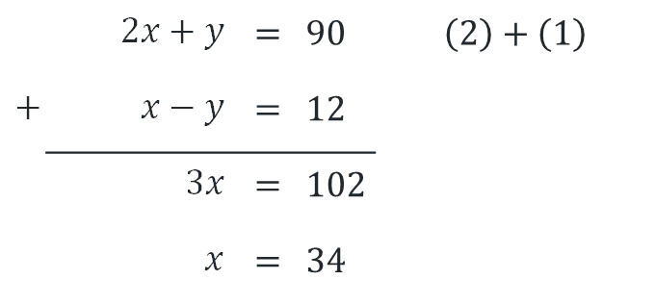
Elimination method (3)
Worked example 2
Twice one number plus another number equals 90. The difference between the two numbers is 12. What are the two numbers? Let $x$be the first number and $y$ be the second number.
$2x+y=90$ $(1)$
$x−y=12$ $\left(2\right)$
Sub $x=34$ into $(1)$: $2×34+y=90$
$y=90 −68$
$y=22$
Therefore: $x=34, y=22$
The two numbers are 34 and 22
 | $$2x+y$$ | $$=$$ | $$90$$ | $$\left(2\right)+\left(1\right)$$
$$+$$ | $$x−y$$ | $$=$$ | $$12$$
 | $$3x$$ | $$=$$ | $$102$$
 | $$x$$ | $$=$$ | $$34$$
How can we check?
Why did we do (2) + (1)?

Slide 12
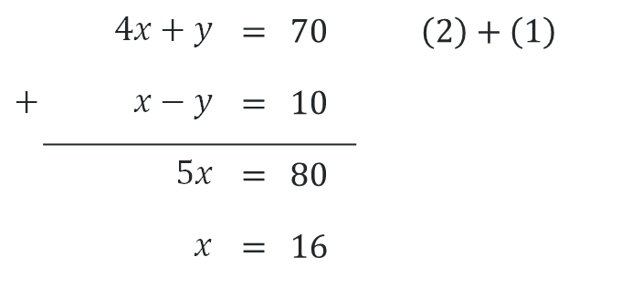


Elimination method (4)
Your turn – question 2
Four times one number plus another equals 70. The difference between the two numbers is 10. What are the two numbers? Let $x$be the first number and $y$ be the second number.
$4x+y=70$ $(1)$
$x−y=10$ $\left(2\right)$
Sub $x=15$into $(1)$:$4\left(16\right)+y=70$
$$y=6$$
$$∴x=16, y=6$$
The two numbers are 16 and 6
 | $$4x+y$$ | $$=$$ | $$70$$ | $$\left(2\right)+\left(1\right)$$
$$+$$ | $$x−y$$ | $$=$$ | $$10$$
 | $$5x$$ | $$=$$ | $$80$$
 | $$x$$ | $$=$$ | $$16$$

Slide 13


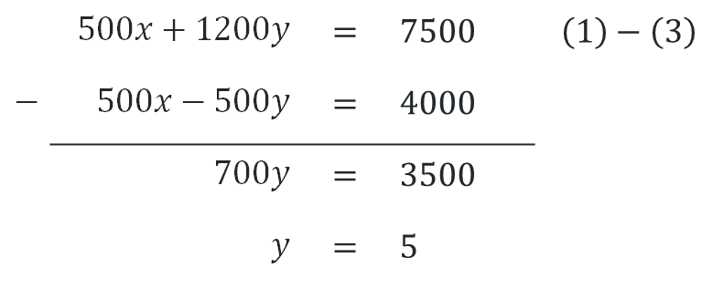
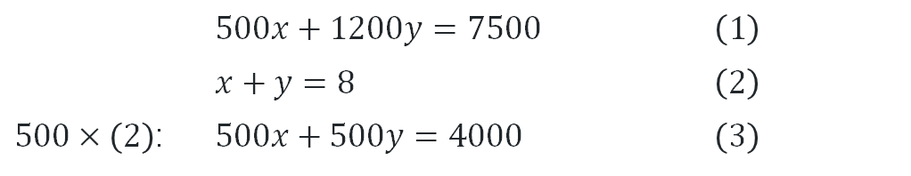
Elimination method (5)
Worked example 3
A solo artist charges $500, and a band charges $1200. You have $7200 and need 8 acts total. How many of each type can you book?
Let $x$ be the number of solo artists and $y$ be the number of bands.
Where does this equation come from?
 | $$500x+1200y=7500$$ | $$\left(1\right)$$
 | $$x+y=8$$ | $$\left(2\right)$$
$500×\left(2\right)$: | $$500x+500y=4000$$ | $$\left(3\right)$$
Sub $y=5$ into $(2)$:$x+5=8$
$x=3$
Therefore: $x=3, y=5$
We can book 3 solo artist and 5 bands.
 | $$500x+1200y$$ | $$=$$ | $$7500$$ | $$\left(1\right)−\left(3\right)$$
$$−$$ | $$500x−500y$$ | $$=$$ | $$4000$$
 | $$700y$$ | $$=$$ | $$3500$$
 | $$y$$ | $$=$$ | $$5$$
Why are we multiplying?
Why is there now a (3)?

Slide 14
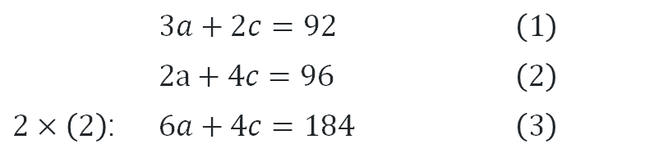


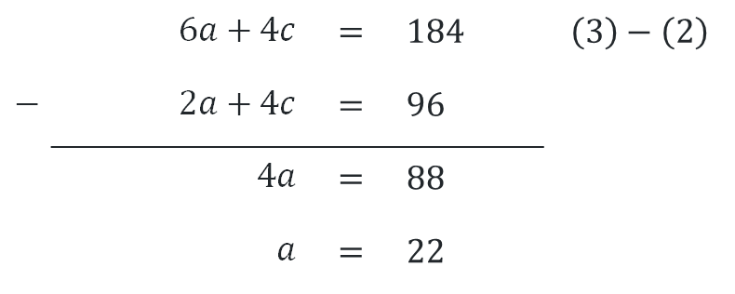
Elimination method (6)
Your turn – question 3
At a local cinema, a family buys 3 adult tickets and 2 child tickets for $92. Another group buys 2 adult tickets and 4 child tickets for $96. What is the cost of one adult ticket and one child ticket?
Let $a$ be the cost of adult tickets and $c$ be the cost child tickets.
 | $$3a+2c=92$$ | $$\left(1\right)$$
 | $$2a+4c=96$$ | $$\left(2\right)$$
$2×\left(2\right)$: | $$6a+4c=184$$ | $$\left(3\right)$$
Sub $a=22$ into $(1)$:$66+2c=92$
$$2c=26$$
$c=13$
$$∴a=22, c=13$$
An adult ticket is $22 and
a child ticket is $13.
 | $$6a+4c$$ | $$=$$ | $$184$$ | $$\left(3\right)−\left(2\right)$$
$$−$$ | $$2a+4c$$ | $$=$$ | $$96$$
 | $$4a$$ | $$=$$ | $$88$$
 | $$a$$ | $$=$$ | $$22$$

Slide 15


Substitution method (1)
Worked example 1
At a school fundraiser, adult tickets cost $5 more than child tickets. The total cost of 2 adult tickets and 3 child tickets is $49. Find the cost of each ticket. Let $a$ be the cost of adult tickets and $c$ be the cost of child tickets.
$a=c+5$ (1)
$2a+3c=70$ (2)
Sub (1) into (2): $2\left(c+5\right)+3c=70$
$2c+10+3c=70$
$5c+10=70$
$5c=60$
$c=12$
Sub $c=12$ into $(1)$:$a=12+5$
$a=17$
$∴a=17, c=12$
An adult costs $17 and a child costs $12.
Why didn’t we need to change equation (1) or (2) before using them?
Could we have solved the previous problems using this method?

Slide 16


Substitution method (2)
Your turn – question 1
Emma buys some fruit. An apple costs $1 more than a banana. If she buys 3 apples and 2 bananas for a total of $11, how much did they cost each? Let $a$ be the number of apples and $b$ be the number bananas.
$a=b+1$ $(1)$
$3a+2b=11$ $\left(2\right)$
Sub (1) into (2): $3\left(b+1\right)+2b=11$
$5b+3=11$
$5b=8$
$b=1.6$
Sub $b=1.6$ into $(1)$: $a=1.6+1$
$$a=2.6$$
$∴a=2.6, b=1.6$
An apple cost $2.60 and a banana
costs $1.60

Slide 17
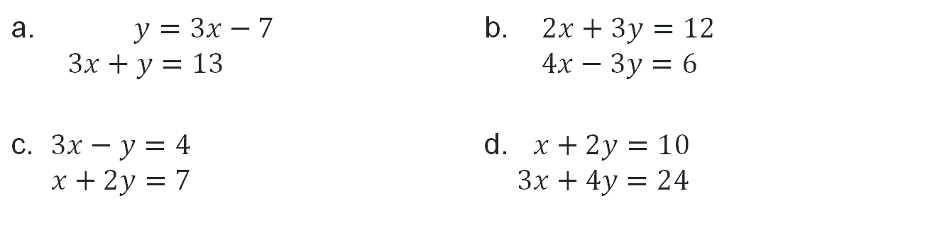
Choosing a method
Think-pair-share
Consider the following pairs of simultaneous equations (do not solve them).
For which pairs would you use the elimination method, or the substitution method? How did you make your choice? Are there any pairs you would solve graphically?
a. $y=3x−7$ $3x+y=13$ | b. $2x+3y=12$ $4x−3y​=6​$
c. $3x−y=4$ $x+2y​=7$ ​ | d. $x+2y=10$ $3x+4y​=24​$

Slide 18
Independent practice

Slide 19

Approaching questions scaffold

Slide 20
HSC style question – marking criteria
Criteria | Marks
Provides correct solution | 3
Writes both equations and attempts to solve them simultaneously, or equivalent merit | 2
Provides one correct solution, or equivalent merit | 1

Slide 21
References
This presentation contains NSW Curriculum and syllabus content. The NSW Curriculum is developed by the NSW Education Standards Authority. This content is prepared by NESA for and on behalf of the Crown in the right of the State of New South Wales. The material is protected by Crown copyright.
Please refer to the NESA Copyright Disclaimer for more information https://educationstandards.nsw.edu.au/wps/portal/nesa/mini-footer/copyright.
NESA holds the only official and up-to-date versions of the NSW Curriculum and syllabus documents. Please visit the NSW Education Standards Authority (NESA) website https://educationstandards.nsw.edu.au/wps/portal/nesa/home and the NSW Curriculum website https://curriculum.nsw.edu.au.
Mathematics Advanced 11-12 Syllabus © NSW Education Standards Authority (NESA) for and on behalf of the Crown in right of the State of New South Wales, 2024.

Slide 22
Copyright
© State of New South Wales (Department of Education), 2025
The copyright material published in this resource is subject to the Copyright Act 1968 (Cth) and is owned by the NSW Department of Education or, where indicated, by a party other than the NSW Department of Education (third-party material).
Copyright material available in this resource and owned by the NSW Department of Education is licensed under a Creative Commons Attribution 4.0 International (CC BY 4.0) license.
This license allows you to share and adapt the material for any purpose, even commercially.
Attribution should be given to © State of New South Wales (Department of Education), 2025.
Material in this resource not available under a Creative Commons license:
the NSW Department of Education logo, other logos and trademark-protected material
Material owned by a third party that has been reproduced with permission. You will need to obtain permission from the third party to reuse its material.
Links to third-party material and websites
Please note that the provided (reading/viewing material/list/links/texts) are a suggestion only and implies no endorsement, by the New South Wales Department of Education, of any author, publisher, or book title. School principals and teachers are best placed to assess the suitability of resources that would complement the curriculum and reflect the needs and interests of their students.
If you use the links provided in this document to access a third-party’s website, you acknowledge that the terms of use, including licence terms set out on the third-party’s website apply to the use which may be made of the materials on that third-party website or where permitted by the Copyright Act 1968 (Cth). The department accepts no responsibility for content on third-party websites.

