Slide 1
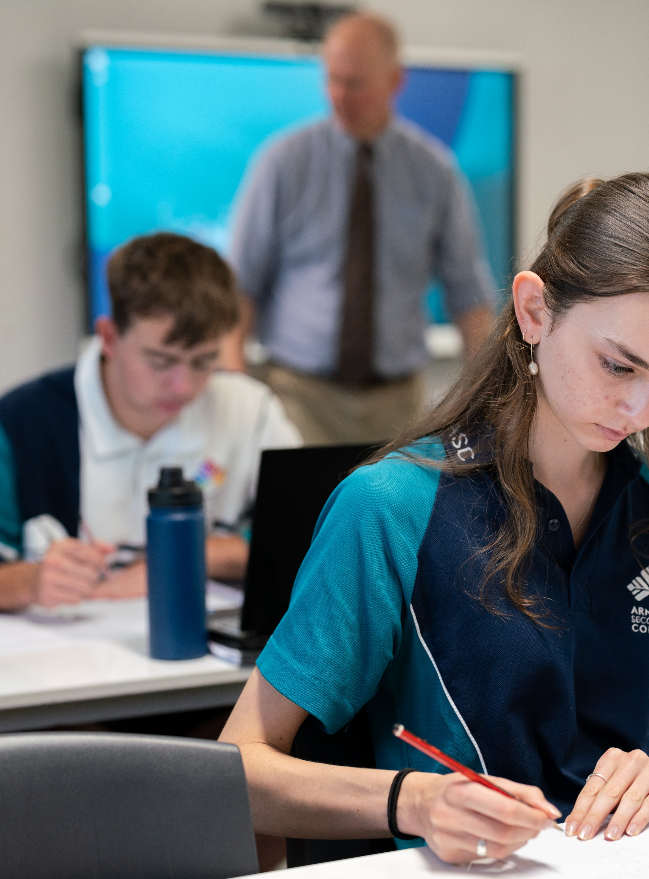
Linear inequalities
Mathematics Advanced – Stage 6 (Year 11)
Working with linear and quadratic functions

Slide 2
Learning intentions and success criteria
Learning intention
To be able to solve linear inequalities and plot them on a number line.
Success criteria
I can represent a solution set on a number line using open and closed circles.
I can represent a scenario as an inequality.
I can solve a linear equation.
I can explain why multiplication or division by a negative will reverse an inequality.
I can justify a solution in the context of a problem.
Notes:
Notes for teachers:
Learning intentions and success criteria are best co-constructed with students. Adapt the learning intention as required and add matching success criteria.
For more information See ⁠AITSL or the NSW Department of Education explicit teaching strategies, ⁠Sharing learning intentions and ⁠Sharing success criteria
LISC is not necessarily presented at the beginning of the lesson. Teacher needs to consider most effectual time to introduce
LISC should be revisited during the lesson to support students' evaluation of their learning

Slide 3
Connecting learning

Slide 4
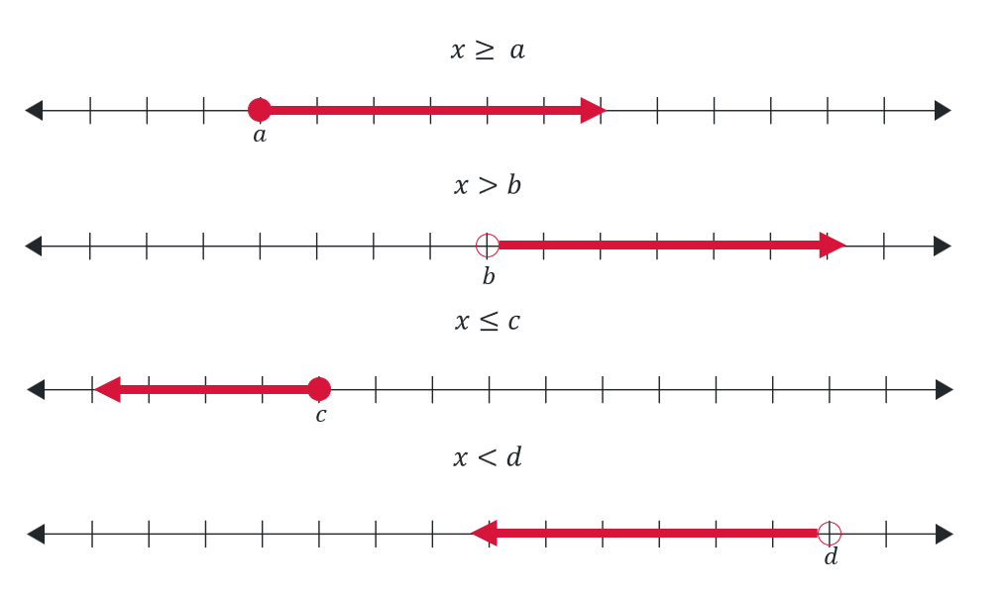
Linear inequalities on the number line
How to visually represent linear inequalities

Slide 5
Represent these scenarios on the number line
You need to be at least 18 years of age to attend the music festival.
Your average screen time needs to be less than 3 hours a day to win the digital detox challenge.
Your phone battery must be above 50% to install the latest update.
A person can bring up to 4 guests to their university graduation.
If you're under 25 and working towards your red Ps, you need to record at least 120 hours of driving experience, including 20 hours of night driving. (Communicate all three inequalities)

Slide 6

Approaching questions scaffold

Slide 7

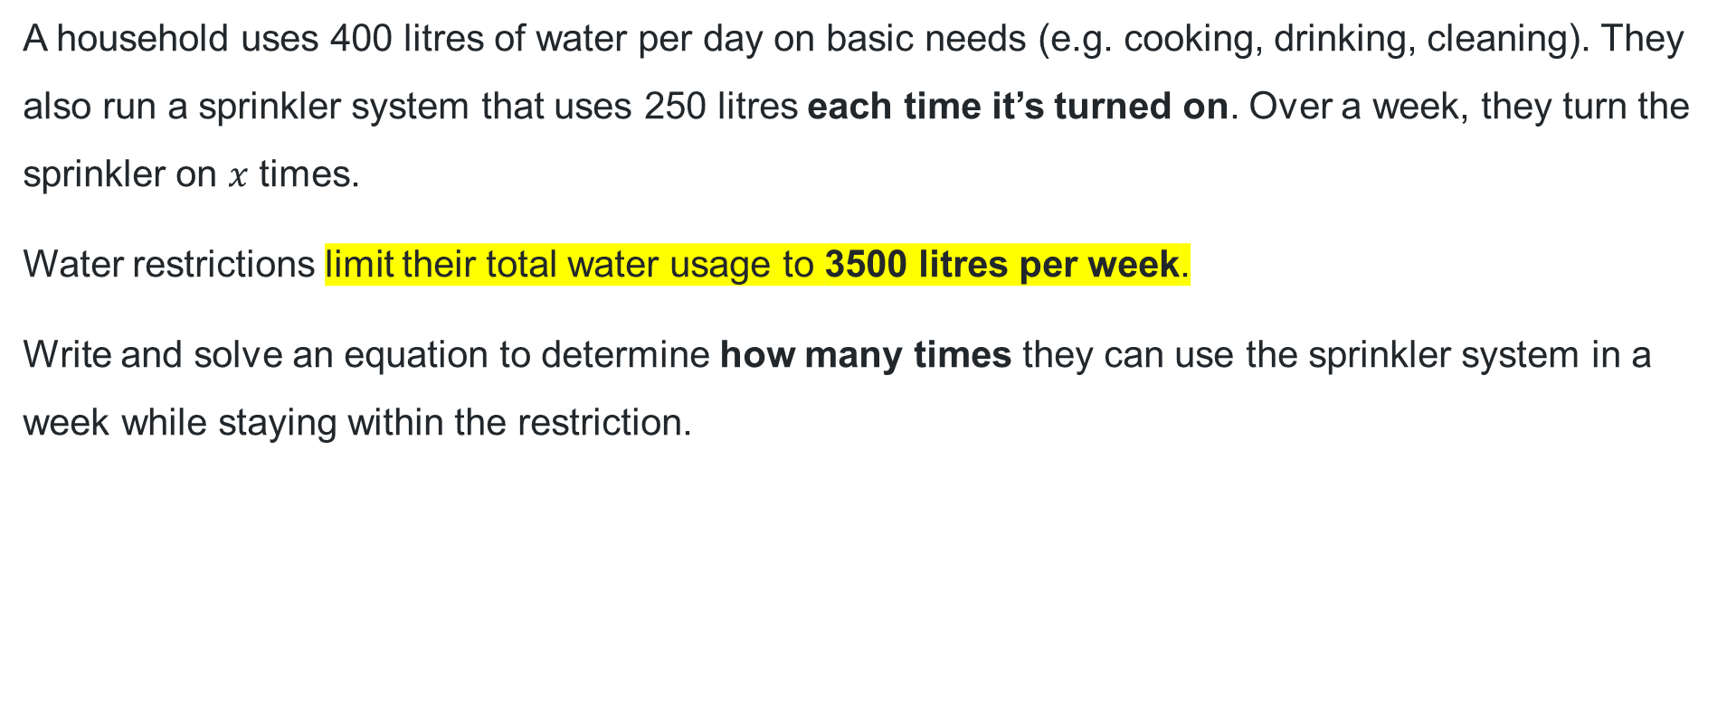
Water restrictions equation – question
A household uses 400 litres of water per day on basic needs (e.g. cooking, drinking, cleaning). They also run a sprinkler system that uses 250 litres each time it’s turned on. Over a week, they turn the sprinkler on $x$ times.
Water restrictions limit their total water usage to 3500 litres per week.
Write and solve an equation to determine how many times they can use the sprinkler system in a week while staying within the restriction.

Slide 8



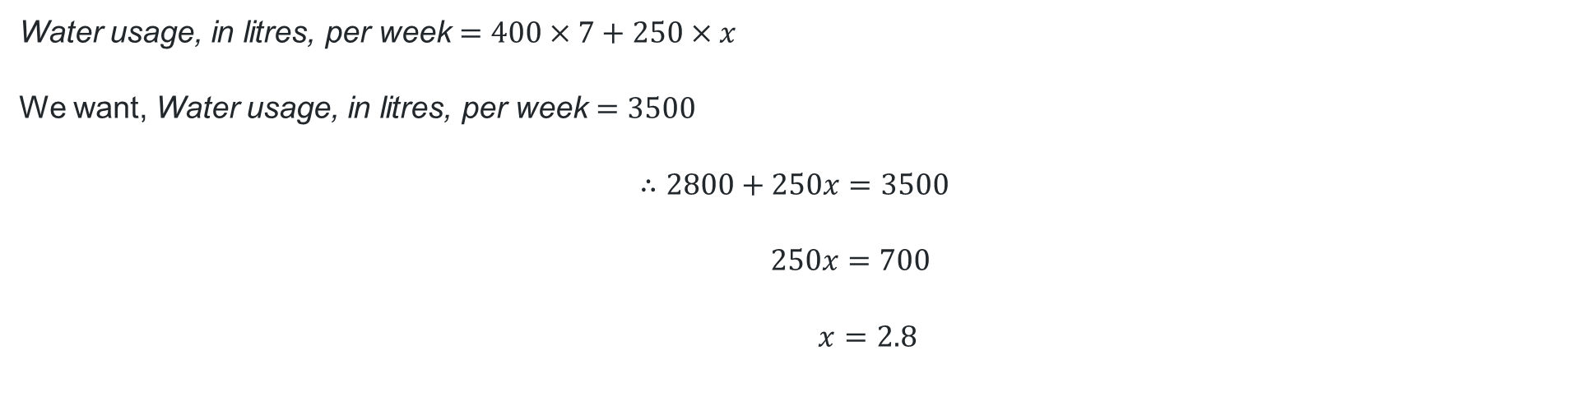
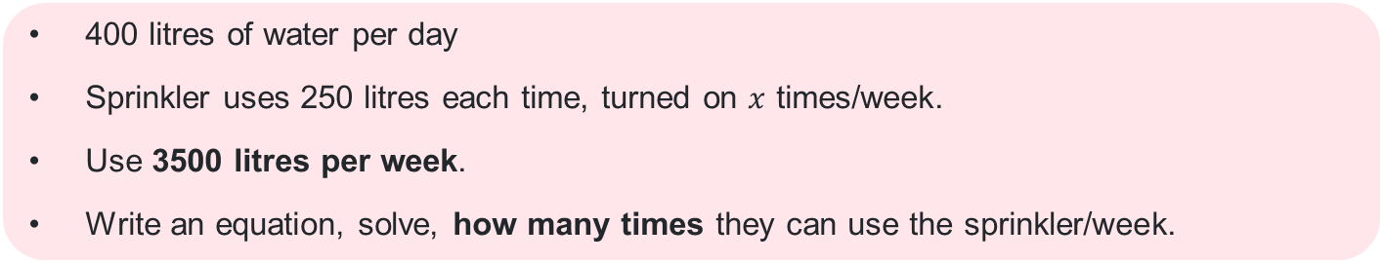
Water restrictions equation – solution
400 litres of water per day
Sprinkler uses 250 litres each time, turned on $x$ times/week.
Use 3500 litres per week.
Write an equation, solve, how many times they can use the sprinkler/week.
Does this answer make sense practically?
Water usage, in litres, per week $=400×7+250×x$
We want, Water usage, in litres, per week $=3500$
$$∴2800+250x=3500$$
$$250x=700$$
$$x=2.8$$

Slide 9
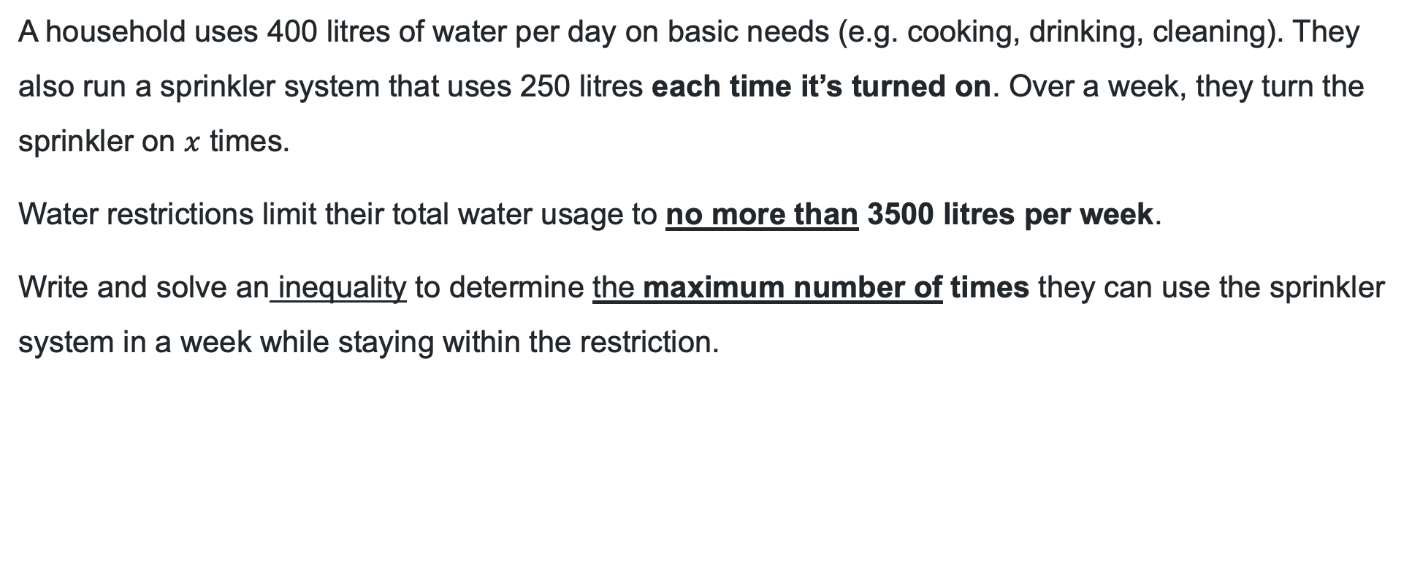
Water restrictions inequality – question
A household uses 400 litres of water per day on basic needs (e.g. cooking, drinking, cleaning). They also run a sprinkler system that uses 250 litres each time it’s turned on. Over a week, they turn the sprinkler on $x$ times.
Water restrictions limit their total water usage to no more than 3500 litres per week.
Write and solve an inequality to determine the maximum number of times they can use the sprinkler system in a week while staying within the restriction.

Slide 10
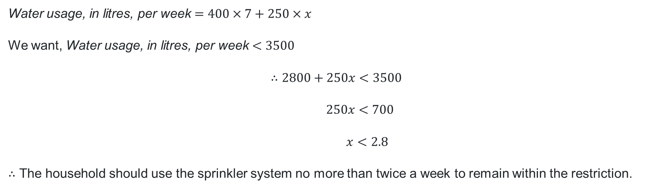
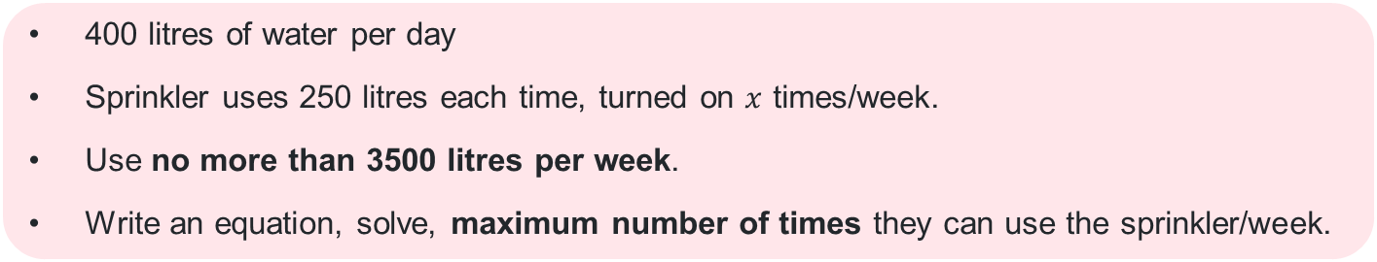
Water restrictions inequality – solution
400 litres of water per day
Sprinkler uses 250 litres each time, turned on $x$ times/week.
Use no more than 3500 litres per week.
Write an equation, solve, maximum number of times they can use the sprinkler/week.
Water usage, in litres, per week $=400×7+250×x$
We want, Water usage, in litres, per week $<3500$
$$∴2800+250x<3500$$
$$250x<700$$
$$x<2.8$$
$∴$ The household should use the sprinkler system no more than twice a week to remain within the restriction.

Slide 11
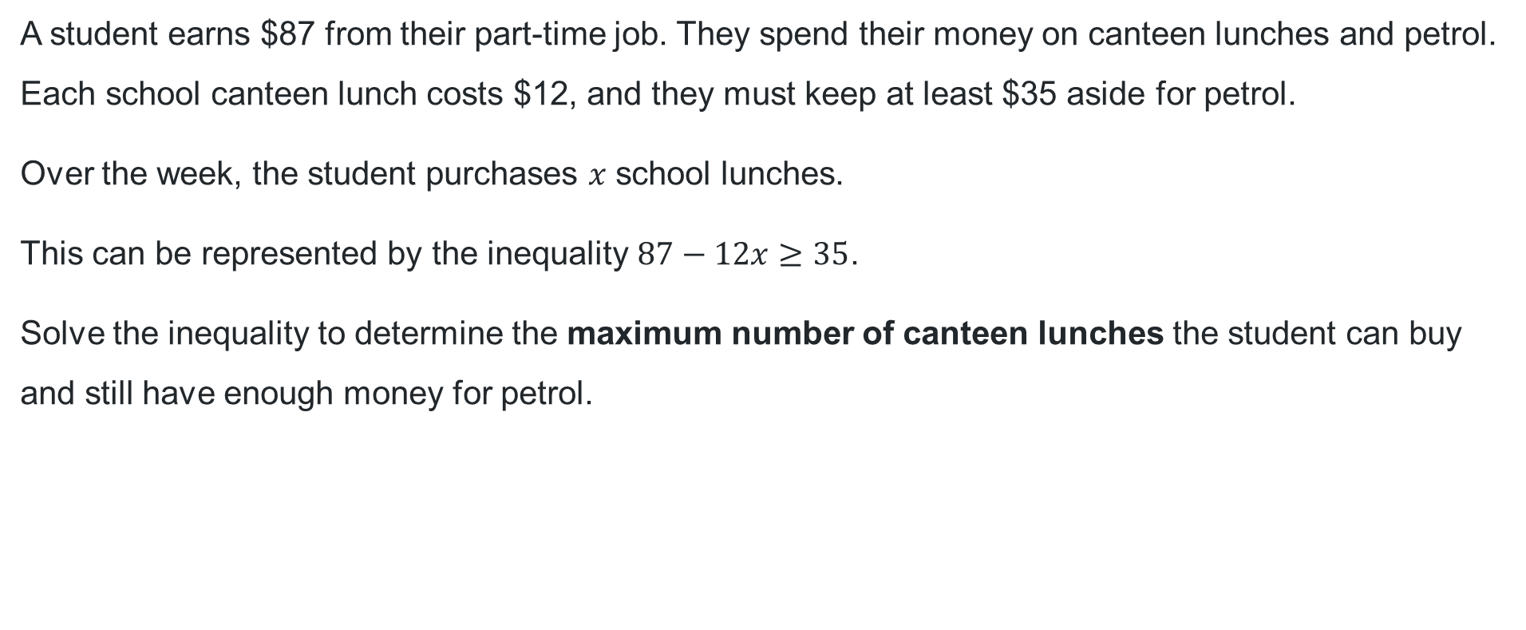
Canteen lunches inequality
A student earns $87 from their part-time job. They spend their money on canteen lunches and petrol. Each school canteen lunch costs $12, and they must keep at least $35 aside for petrol.
Over the week, the student purchases $x$ school lunches.
This can be represented by the inequality $87−12x≥35$.
Solve the inequality to determine the maximum number of canteen lunches the student can buy and still have enough money for petrol.

Slide 12
Releasing responsibility

Slide 13
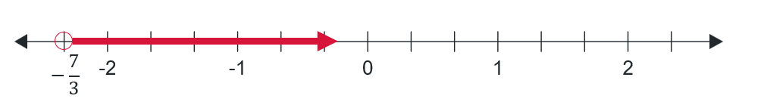

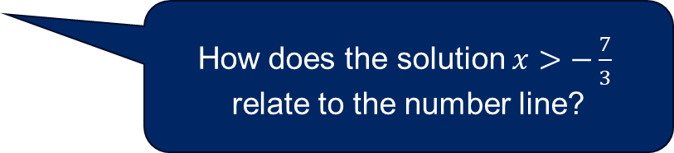
Solving inequalities with negative coefficients (1)
Worked example 1
Solve $10−3x<17$ and plot your solution on the number line.
$$10−3x<17 \\ −3x<7 \\ x>−\frac{7}{3}$$
How is solving this inequality similar to solving an equation? How is it different?
How does the solution $x>−\frac{7}{3}$ relate to the number line?

Slide 14
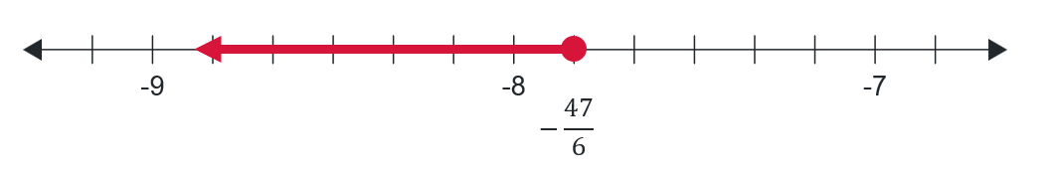

Solving inequalities with negative coefficients (2)
Your turn
Solve $5−6x≥52$ and plot your solution on the number line.
$$5−6x≥52 \\ −6x≥47 \\ x≤−\frac{47}{6}$$

Slide 15
Independent practice

Slide 16

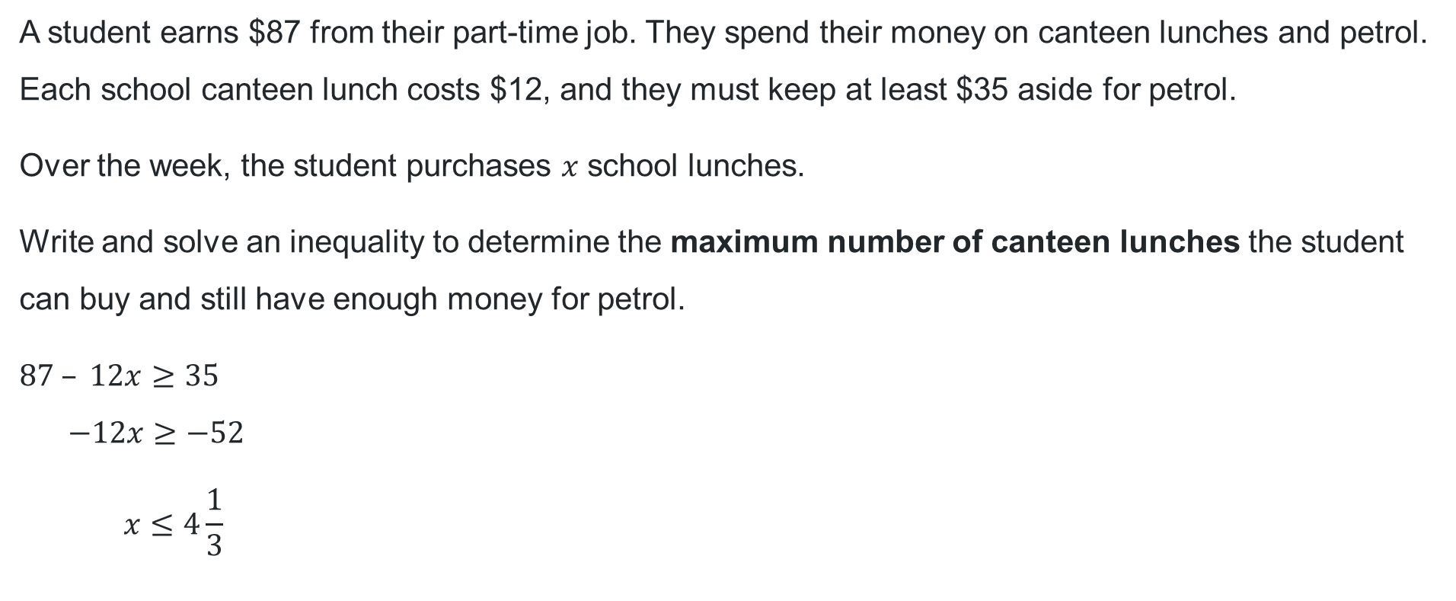
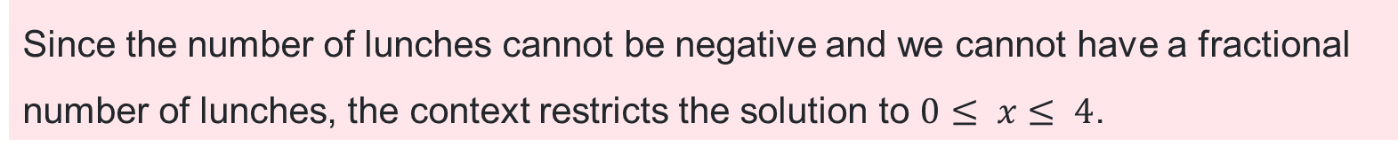
Revisiting the canteen lunches inequality
Your turn
A student earns $87 from their part-time job. They spend their money on canteen lunches and petrol. Each school canteen lunch costs $12, and they must keep at least $35 aside for petrol.
Over the week, the student purchases $x$ school lunches.
Write and solve an inequality to determine the maximum number of canteen lunches the student can buy and still have enough money for petrol.
$$87 – 12x≥35 \\ −12x≥−52 \\ x≤4\frac{1}{3}$$
Since the number of lunches cannot be negative and we cannot have a fractional number of lunches, the context restricts the solution to $0≤ x≤ 4$.

Slide 17
References
This presentation contains NSW Curriculum and syllabus content. The NSW Curriculum is developed by the NSW Education Standards Authority. This content is prepared by NESA for and on behalf of the Crown in the right of the State of New South Wales. The material is protected by Crown copyright.
Please refer to the NESA Copyright Disclaimer for more information https://educationstandards.nsw.edu.au/wps/portal/nesa/mini-footer/copyright.
NESA holds the only official and up-to-date versions of the NSW Curriculum and syllabus documents. Please visit the NSW Education Standards Authority (NESA) website https://educationstandards.nsw.edu.au/wps/portal/nesa/home and the NSW Curriculum website https://curriculum.nsw.edu.au.
Mathematics Advanced 11-12 Syllabus © NSW Education Standards Authority (NESA) for and on behalf of the Crown in right of the State of New South Wales, 2024.

Slide 18
Copyright
© State of New South Wales (Department of Education), 2025
The copyright material published in this resource is subject to the Copyright Act 1968 (Cth) and is owned by the NSW Department of Education or, where indicated, by a party other than the NSW Department of Education (third-party material).
Copyright material available in this resource and owned by the NSW Department of Education is licensed under a Creative Commons Attribution 4.0 International (CC BY 4.0) license.
This license allows you to share and adapt the material for any purpose, even commercially.
Attribution should be given to © State of New South Wales (Department of Education), 2025.
Material in this resource not available under a Creative Commons license:
the NSW Department of Education logo, other logos and trademark-protected material
Material owned by a third party that has been reproduced with permission. You will need to obtain permission from the third party to reuse its material.
Links to third-party material and websites
Please note that the provided (reading/viewing material/list/links/texts) are a suggestion only and implies no endorsement, by the New South Wales Department of Education, of any author, publisher, or book title. School principals and teachers are best placed to assess the suitability of resources that would complement the curriculum and reflect the needs and interests of their students.
If you use the links provided in this document to access a third-party’s website, you acknowledge that the terms of use, including licence terms set out on the third-party’s website apply to the use which may be made of the materials on that third-party website or where permitted by the Copyright Act 1968 (Cth). The department accepts no responsibility for content on third-party websites.

