Slide 1

Modelling linear functions
Mathematics Advanced – Year 11
Working with linear and quadratic functions

Slide 2
Activating prior knowledge

Slide 3
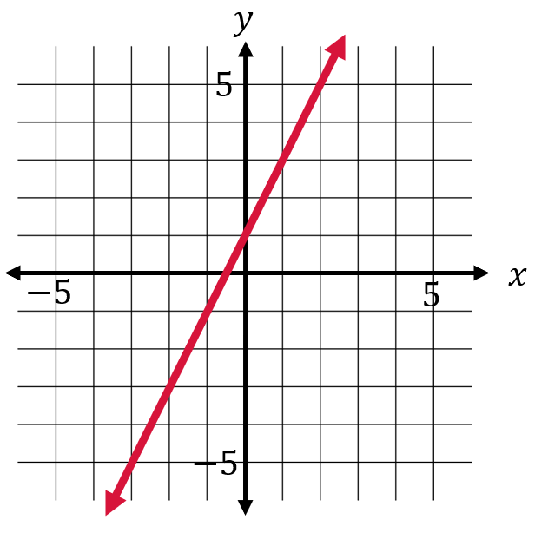
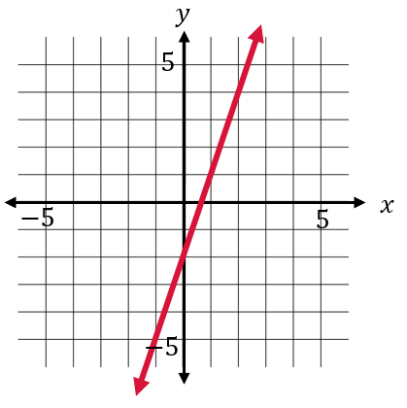
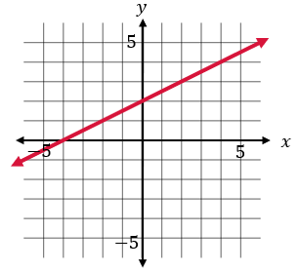
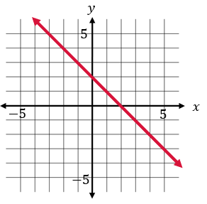
Which one doesn’t belong? (1)
Provide reasons

Slide 4
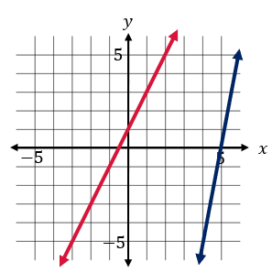
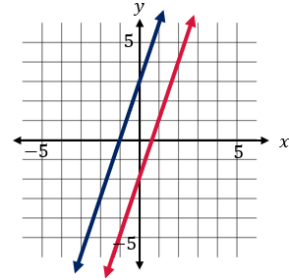
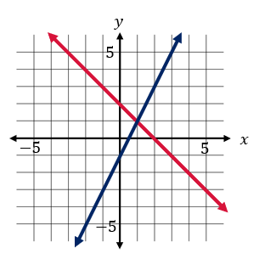
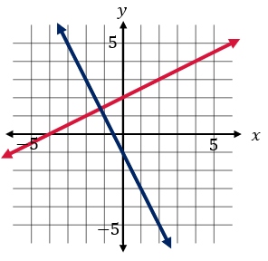
Which one doesn’t belong? (2)
Provide reasons

Slide 5
Connecting learning

Slide 6
Learning intentions and success criteria
Learning intentions
To be able to construct and model linear functions.
To be able to solve practical problems with simultaneous equations graphically.
Success criteria
I can identify the independent and dependent variables in a linear model.
I can describe what the point of intersection of a graph represents in context.
I can justify conclusions in the context of the problem.
I can model situations where cost and revenue are represented linearly.
I can model linear relationships digitally.
Notes:
Notes for teachers:
Learning intentions and success criteria are best co-constructed with students. Adapt the learning intention as required and add matching success criteria.
For more information See ⁠AITSL or the NSW Department of Education explicit teaching strategies, ⁠Sharing learning intentions and ⁠Sharing success criteria
LISC is not necessarily presented at the beginning of the lesson. Teacher needs to consider most effectual time to introduce
LISC should be revisited during the lesson to support students' evaluation of their learning

Slide 7
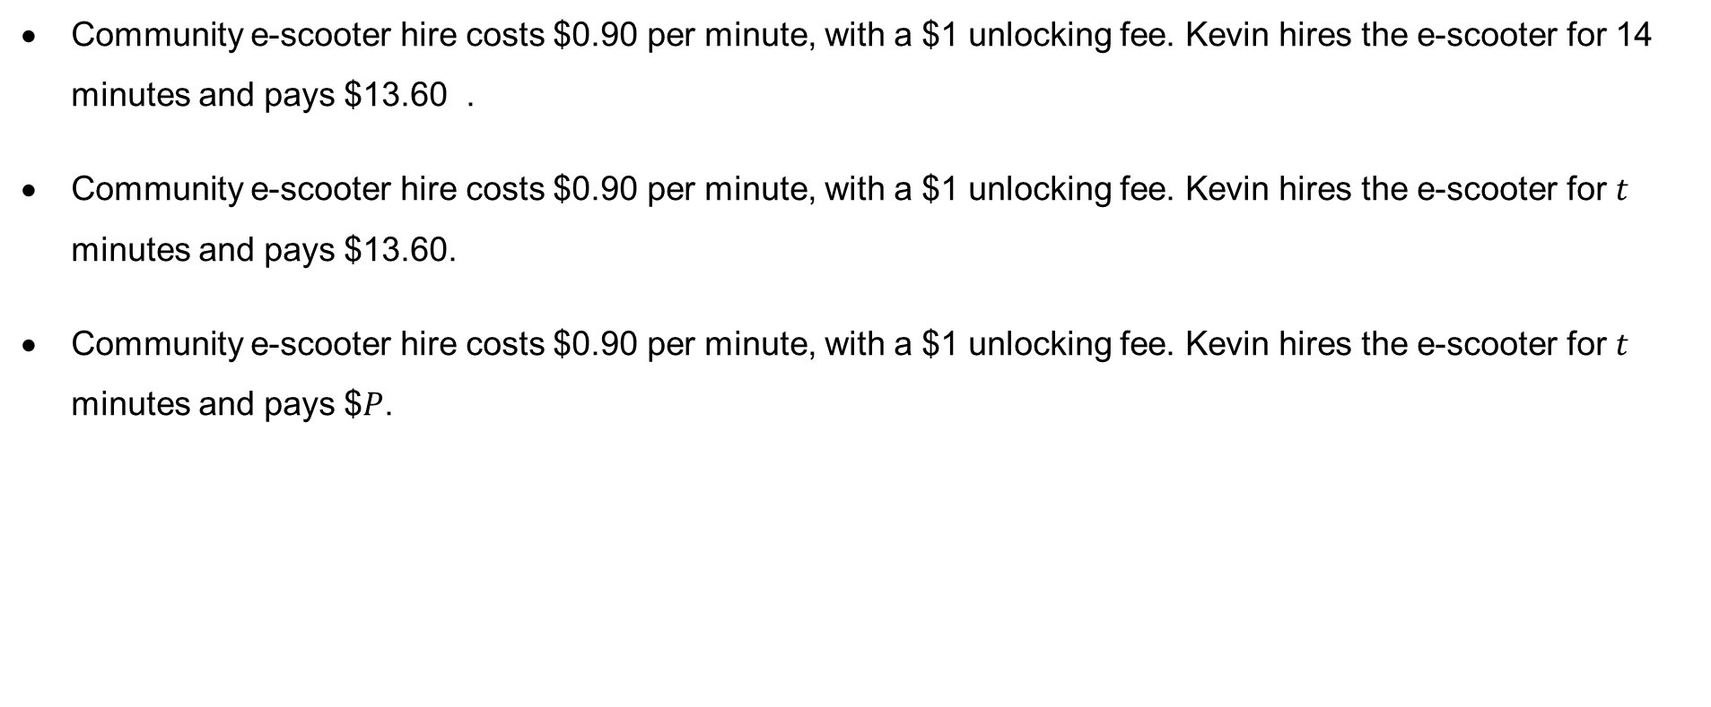
E-scooter equations
Reflect on your responses
Community e-scooter hire costs $0.90 per minute, with a $1 unlocking fee. Kevin hires the e-scooter for 14 minutes and pays $13.60 .
Community e-scooter hire costs $0.90 per minute, with a $1 unlocking fee. Kevin hires the e-scooter for $t$ minutes and pays $13.60.
Community e-scooter hire costs $0.90 per minute, with a $1 unlocking fee. Kevin hires the e-scooter for $t$ minutes and pays $$P$.

Slide 8
Releasing responsibility

Slide 9
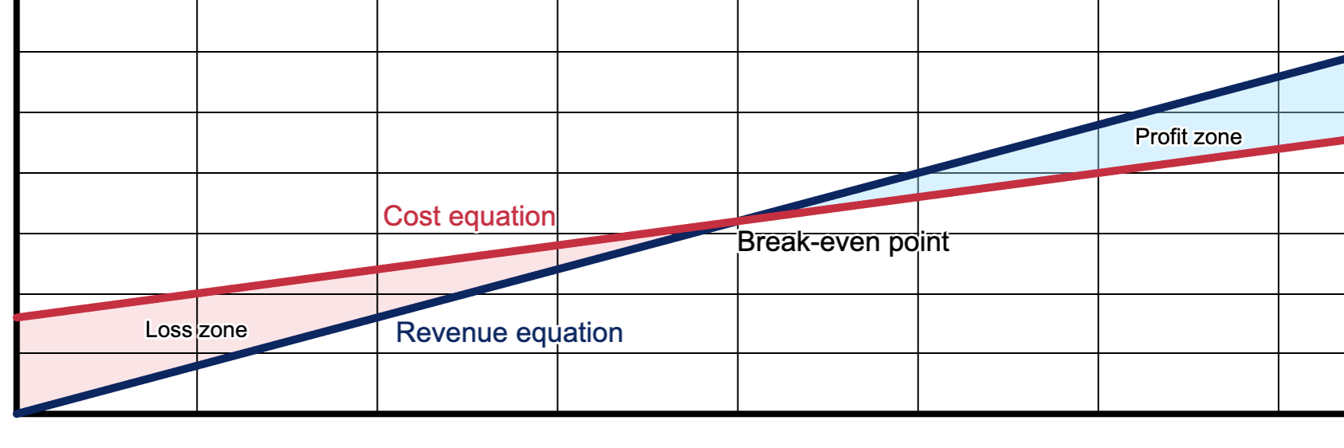
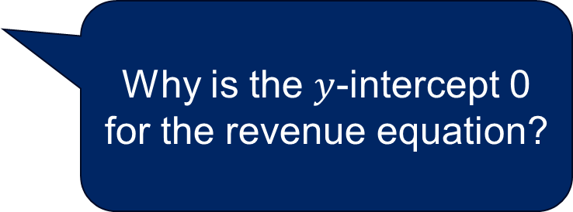
Revenue and cost
Self-explanation prompts
Why is the break even point at the intersection of the two lines?
What does the gradient represent in each equation?
600
500
Dollars ($)
400
300
200
Why is the $y$-intercept 0 for the revenue equation?
100
0
10
20
30
40
50
60
70
Amount

Slide 10
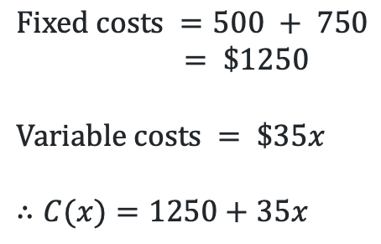

Worked example – 1(a)
Example 1 – part a
Phil and Dave are planning to hold a fundraising event. They can hire a function room for $500 and a musical act for $750. Food and beverages will cost them $35 per person.
a) Write a function for the cost, $C\left(x\right),$ of holding the charity event for $x$ people.
$$Fixed costs =500 + 750$$
$$= \$1250$$
$$Variable costs = \$35x$$
$$∴C(x)=1250+35x$$
How do we know which variable is independent and which is dependent?
What will the gradient of the equation be?

Slide 11

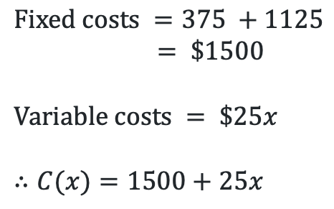
Worked example (your turn) (1)
Example 2 – part a
Margot, Edith and Agnes are planning a school formal. They can hire a function room for $375 and a musical act for $1125. Food and beverages will cost them $25 per person.
a) Write a function for the cost, $C\left(x\right),$ of holding the formal for $x$ people.
$$Fixed costs =375 +1125$$
$$= \$1500$$
$$Variable costs = \$25x$$
$$∴C(x)=1500+25x$$

Slide 12
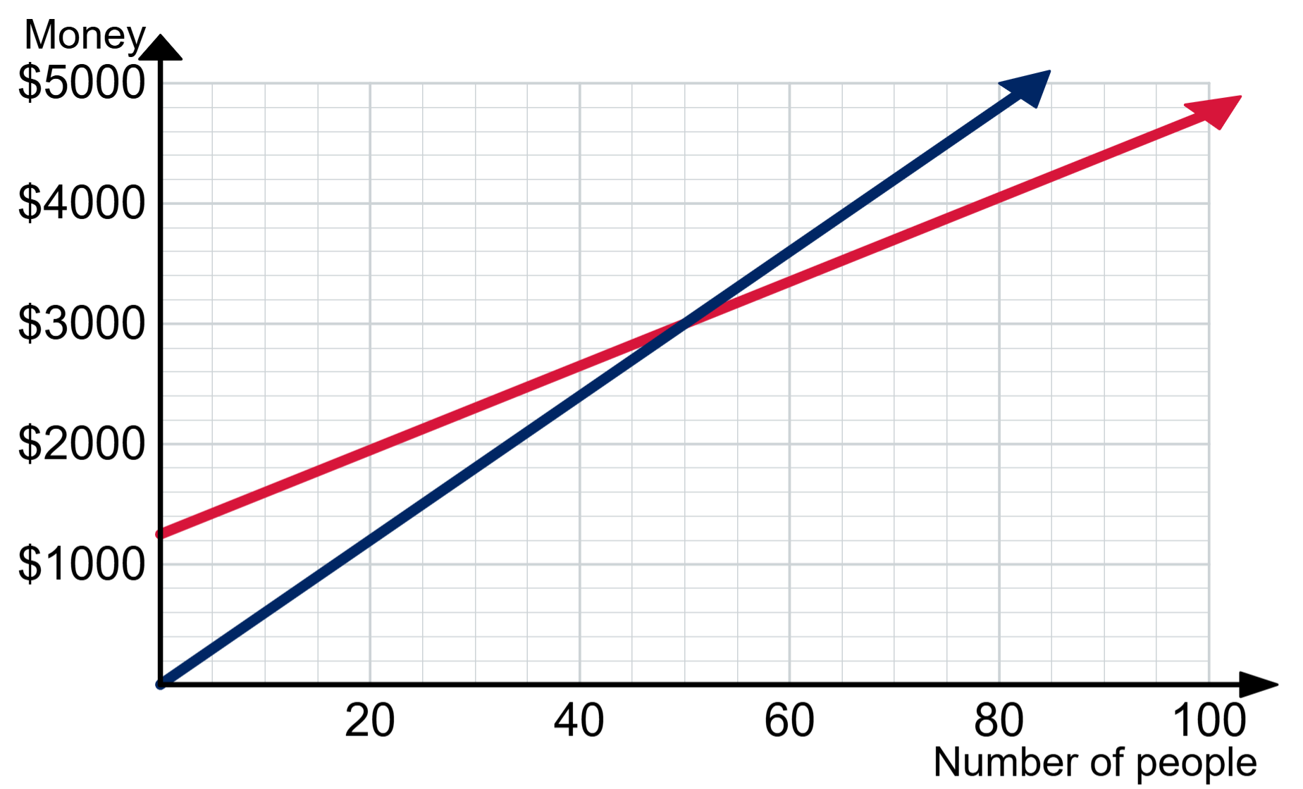
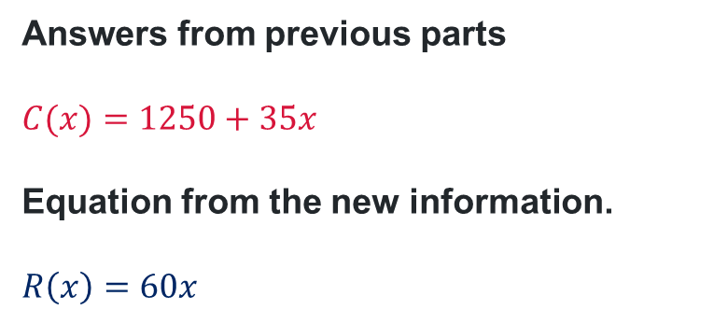
Worked example – 1(b)
Example 1 – part b
Phil and Dave are planning to hold a fundraising event. They can hire a function room for $500 and a musical act for $750. Food and beverages will cost them $35 per person.
b) They plan to charge $60 per ticket. Graph the income and costs of holding the event.
Answers from previous parts
$$C(x)=1250+35x$$
Equation from the new information.
$$R\left(x\right)=60x$$
What information can we interpret from the graph?
Where did this income function come from?

Slide 13
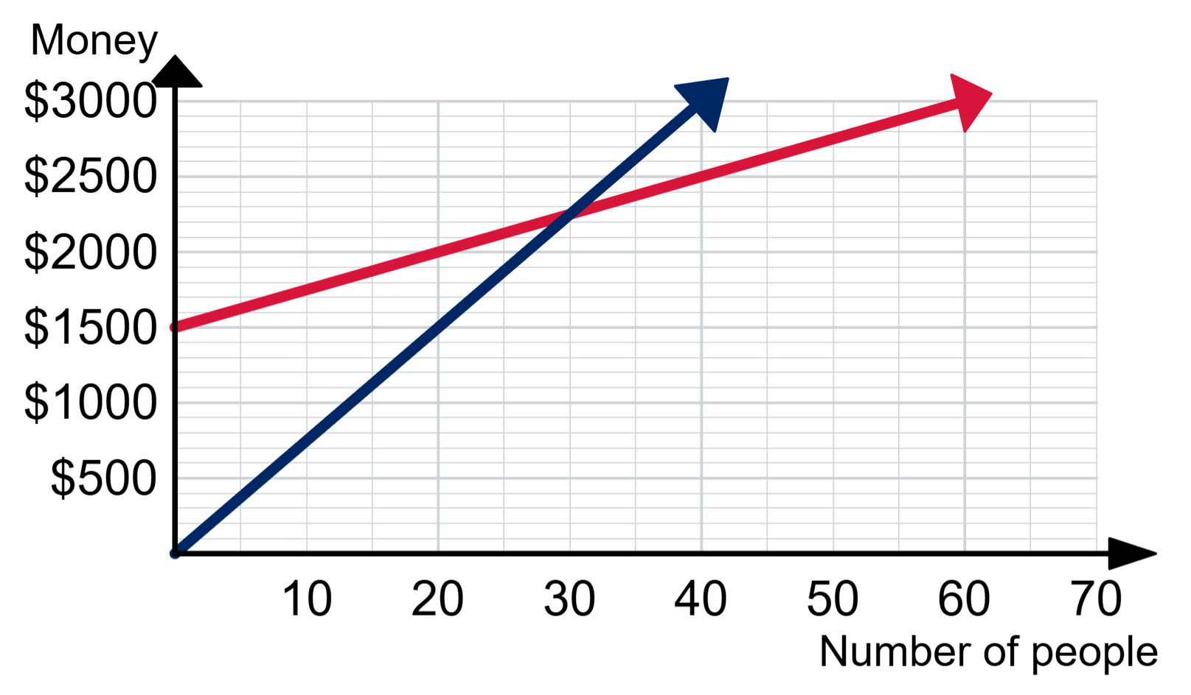
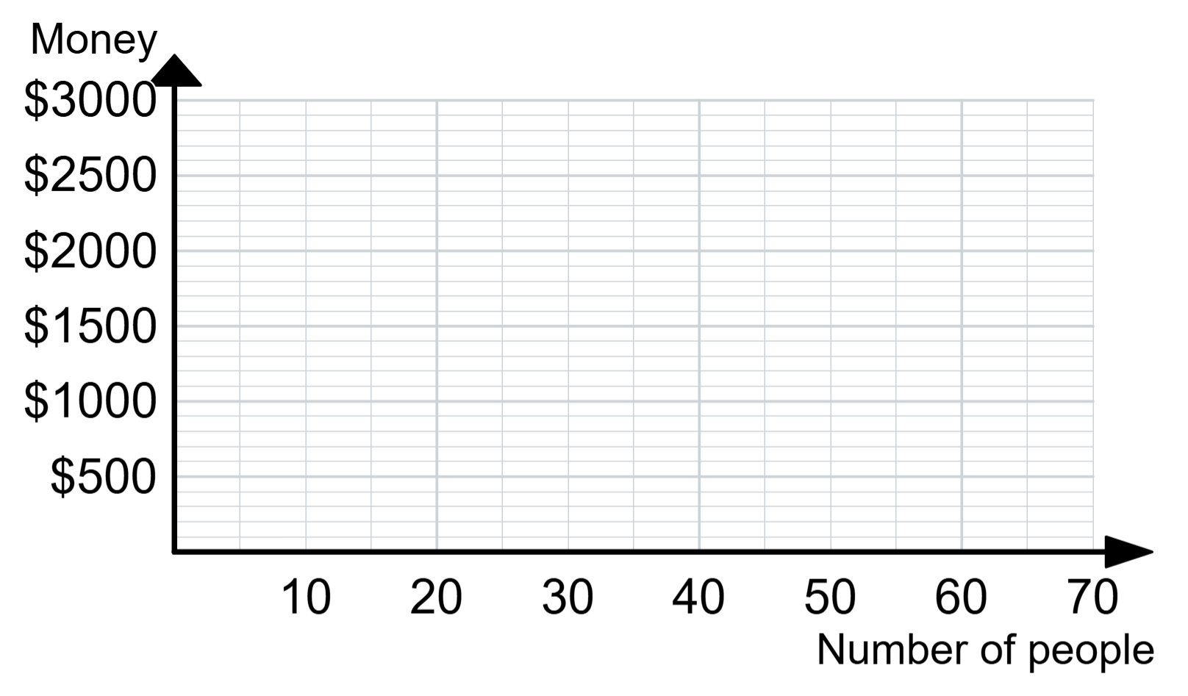
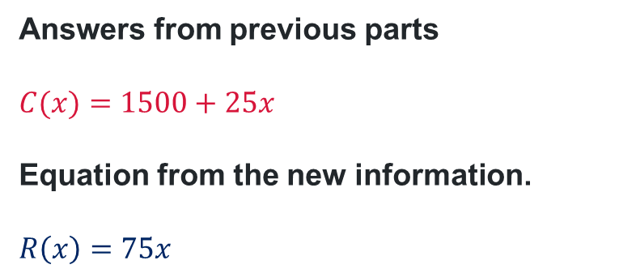
Worked example (your turn) (2)
Example 2 – part b
Margot, Edith and Agnes are planning a school formal. They can hire a function room for $375 and a musical act for $1125. Food and beverages will cost them $25 per person.
b) They plan to charge $75 per ticket. Graph the revenue and costs of holding the event.
Answers from previous parts
$$C(x)=1500+25x$$
Equation from the new information.
$$R\left(x\right)=75x$$

Slide 14
Worked example – 1(c)
Example 1 – part c
Phil and Dave are planning to hold a fundraising event. They can hire a function room for $500 and a musical act for $750. Food and beverages will cost them $35 per person.
c) Phil and Dave have currently sold 30 tickets. How many more do they need to sell to break-even?
How can they tell how many tickets they need to sell to break-even?
Answers from previous parts
The event will break-even once 50 tickets are sold.
Phil and Dave need to sell 20 more tickets.

Slide 15

Worked example (your turn) (3)
Example 2 – part c
Margot, Edith and Agnes are planning a school formal. They can hire a function room for $375 and a musical act for $1125. Food and beverages will cost them $25 per person.
c) How much money would they lose if only 20 tickets were sold?
Answers from previous parts
From the graph, Margot, Edith and Agnes would lose $500.
Substitute into the functions to confirm this.
$$C\left(20\right)=1500+25×20 \\ C\left(20\right)=\$2000 \\ R\left(20\right)=75×20 \\ R\left(20\right)=\$1500 \\ Loss=C\left(20\right)−R\left(20\right) \\ Loss=\$500$$

Slide 16
Independent practice

Slide 17

Approaching questions

Slide 18
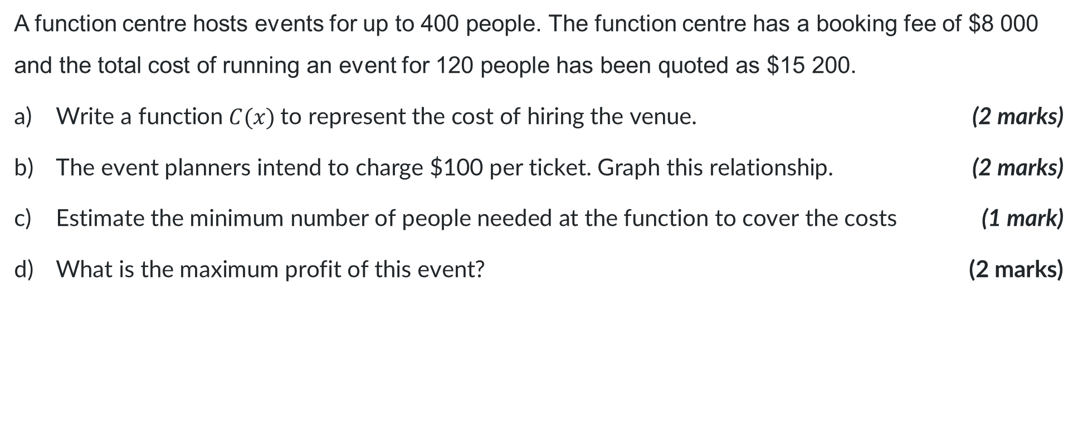
HSC style question (1)
Complete in pairs
A function centre hosts events for up to 400 people. The function centre has a booking fee of $8 000 and the total cost of running an event for 120 people has been quoted as $15 200.
Write a function $C(x)$to represent the cost of hiring the venue. (2 marks)
The event planners intend to charge $100 per ticket. Graph this relationship. (2 marks)
Estimate the minimum number of people needed at the function to cover the costs (1 mark)
What is the maximum profit of this event? (2 marks)

Slide 19
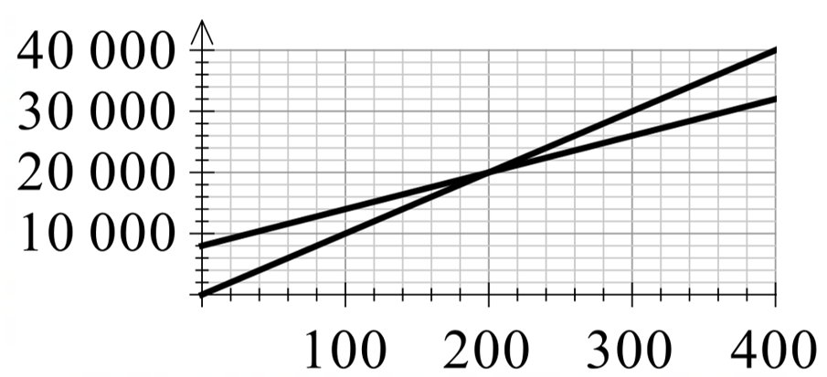

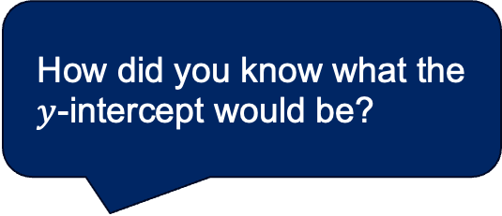

HSC style question (1) - solutions
How did you know what the $y$-intercept would be?
Where did 400 come from?
Compare and discuss
$15200=m\left(120\right)+8000$
$7200=120m$
$m=60$
$C\left(x\right)=60x+8000$
The break-even point is 200 patrons.
$C\left(400\right)= 8000 + 60× 400$
$C(400) = \$32 000$
$R\left(400\right)= 100×400$
$R(400) = \$40 000$
$Maximum Profit = \$8000$

Slide 20
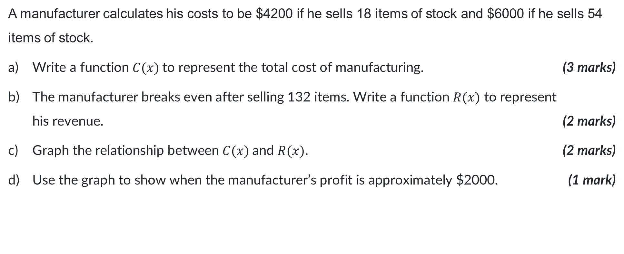
HSC style question (2)
Complete in pairs
A manufacturer calculates his costs to be $4200 if he sells 18 items of stock and $6000 if he sells 54 items of stock.
Write a function $C(x)$to represent the total cost of manufacturing. (3 marks)
The manufacturer breaks even after selling 132 items. Write a function $R(x)$ to represent
his revenue. (2 marks)
Graph the relationship between $C(x)$and $R(x)$. (2 marks)
Use the graph to show when the manufacturer’s profit is approximately $2000. (1 mark)

Slide 21
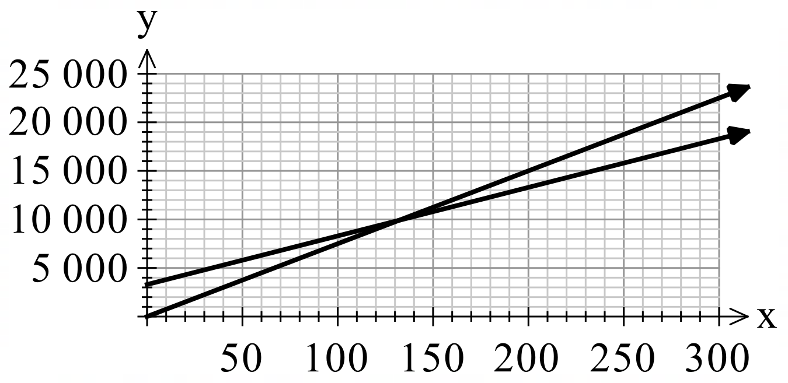
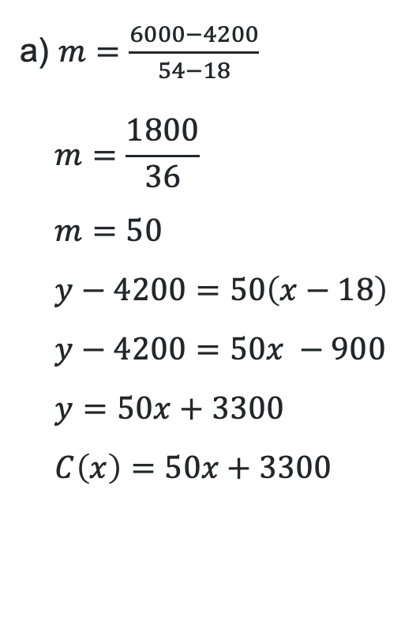
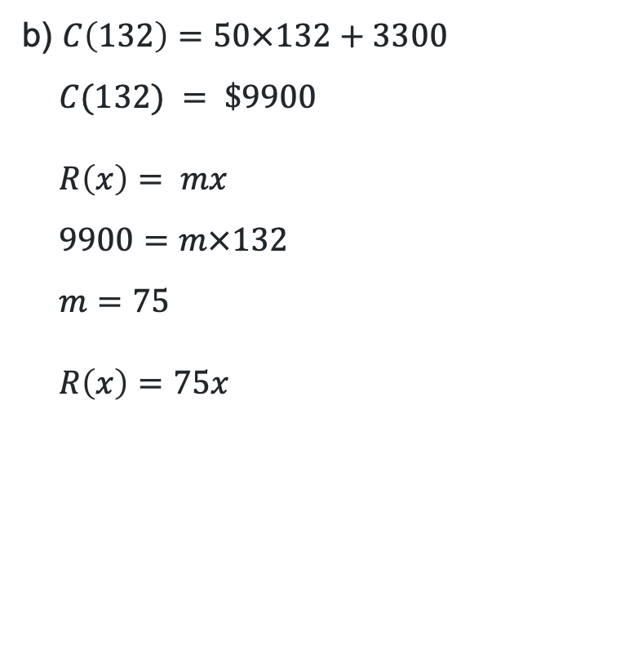
HSC style question (2)- solutions
Compare and discuss
a) $m=\frac{6000−4200}{54−18}$
$$m=\frac{1800}{36} \\ m=50 \\ y−4200=50\left(x−18\right) \\ y−4200=50x −900 \\ y=50x+3300 \\ C\left(x\right)=50x+3300$$
b) $C\left(132\right)=50×132+3300$
$$C(132) = \$9900$$
$$R\left(x\right)= mx \\ 9900=m×132 \\ m=75$$
$$R\left(x\right)=75x$$
c)
d) The manufacturer will make $2000 profit when they have sold approximately 230 items.

Slide 22
References
This presentation contains NSW Curriculum and syllabus content. The NSW Curriculum is developed by the NSW Education Standards Authority. This content is prepared by NESA for and on behalf of the Crown in the right of the State of New South Wales. The material is protected by Crown copyright.
Please refer to the NESA Copyright Disclaimer for more information https://educationstandards.nsw.edu.au/wps/portal/nesa/mini-footer/copyright.
NESA holds the only official and up-to-date versions of the NSW Curriculum and syllabus documents. Please visit the NSW Education Standards Authority (NESA) website https://educationstandards.nsw.edu.au/wps/portal/nesa/home and the NSW Curriculum website https://curriculum.nsw.edu.au.
Mathematics Advanced 11-12 Syllabus © NSW Education Standards Authority (NESA) for and on behalf of the Crown in right of the State of New South Wales, 2024..

Slide 23
Copyright
© State of New South Wales (Department of Education), 2025
The copyright material published in this resource is subject to the Copyright Act 1968 (Cth) and is owned by the NSW Department of Education or, where indicated, by a party other than the NSW Department of Education (third-party material).
Copyright material available in this resource and owned by the NSW Department of Education is licensed under a Creative Commons Attribution 4.0 International (CC BY 4.0) license.
This license allows you to share and adapt the material for any purpose, even commercially.
Attribution should be given to © State of New South Wales (Department of Education), 2025.
Material in this resource not available under a Creative Commons license:
the NSW Department of Education logo, other logos and trademark-protected material
Material owned by a third party that has been reproduced with permission. You will need to obtain permission from the third party to reuse its material.
Links to third-party material and websites
Please note that the provided (reading/viewing material/list/links/texts) are a suggestion only and implies no endorsement, by the New South Wales Department of Education, of any author, publisher, or book title. School principals and teachers are best placed to assess the suitability of resources that would complement the curriculum and reflect the needs and interests of their students.
If you use the links provided in this document to access a third-party’s website, you acknowledge that the terms of use, including licence terms set out on the third-party’s website apply to the use which may be made of the materials on that third-party website or where permitted by the Copyright Act 1968 (Cth). The department accepts no responsibility for content on third-party websites.

