Slide 1
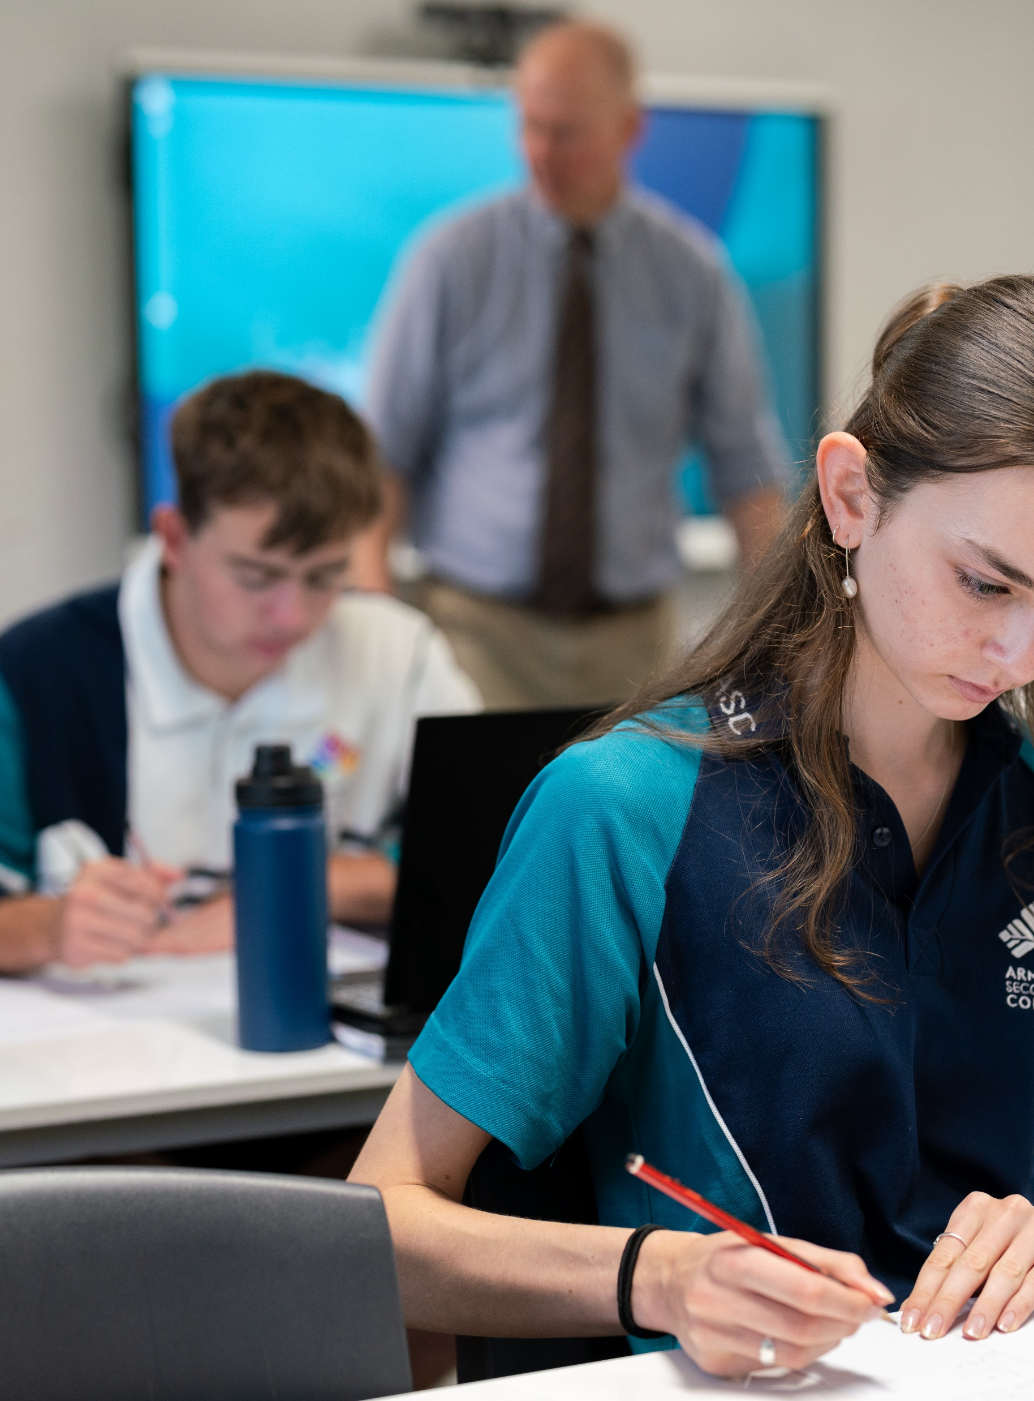
Linear functions
Mathematics Advanced – Stage 6 – Year 11
Working with linear and quadratic functions

Slide 2
Learning intentions and success criteria
Learning intentions
To be able to determine the equation of a straight line.
Success criteria
I can calculate the gradient from two points.
I can determine the equation of the line from two points in gradient-intercept form.
I can determine the equation of the line from two points in general form.
I can determine the intercepts of a straight line from its equation.
I can determine the equation of a line using the point-gradient formula.
Notes:
Notes for teachers:
Learning intentions and success criteria are best co-constructed with students. Adapt the learning intention as required and add matching success criteria.
For more information See ⁠AITSL or the NSW Department of Education explicit teaching strategies, ⁠Sharing learning intentions and ⁠Sharing success criteria
LISC is not necessarily presented at the beginning of the lesson. Teacher needs to consider most effectual time to introduce
LISC should be revisited during the lesson to support students' evaluation of their learning

Slide 3
Connecting learning

Slide 4
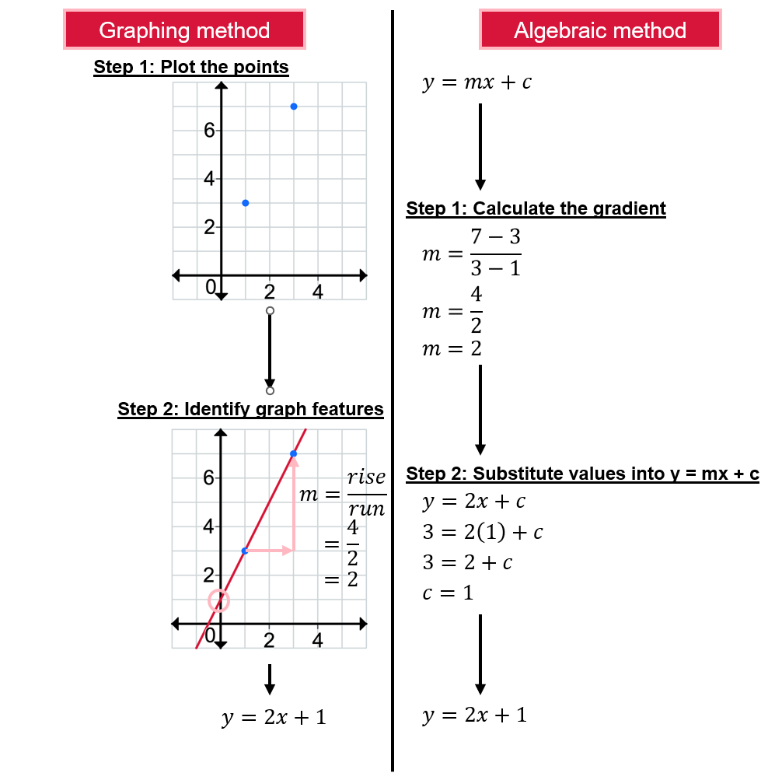

Working with linear functions (1)
Worked example (comparison)
Find the equation of the line passing through (1, 3) and (3, 7).
Why have these points been selected?
Where are these numbers coming from?
Why might it be challenging to confidently predict the $y$-intercept from other graphs?
Why might the student have substituted (3,1) into the equation?

Slide 5
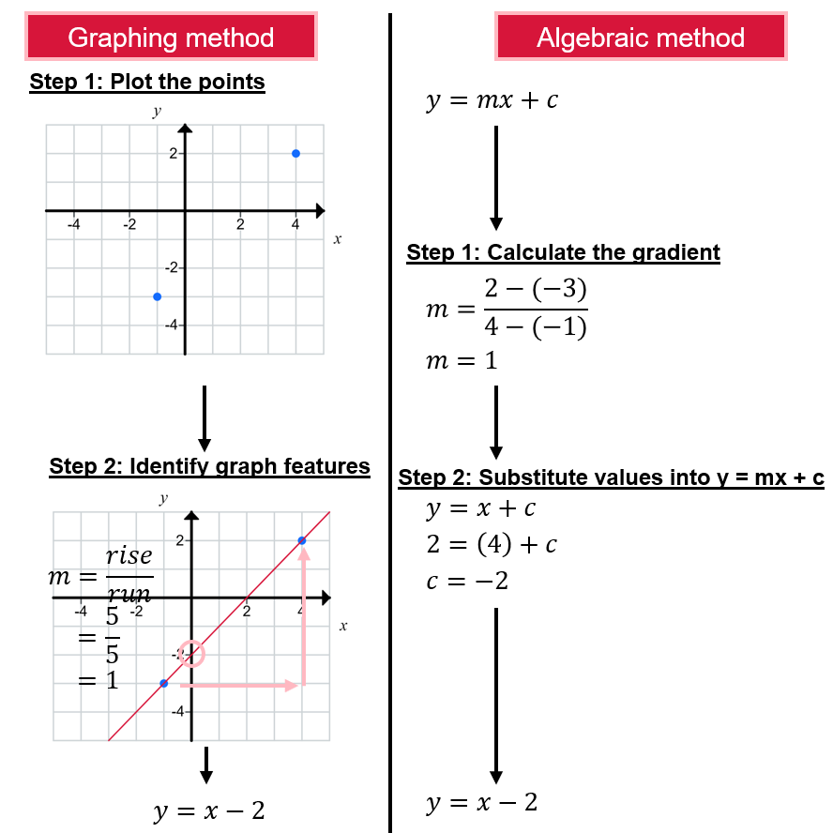

Working with linear functions (2)
Your turn
Find the equation of the line passing through $(−1, −3)$and $(4, 2)$.

Slide 6
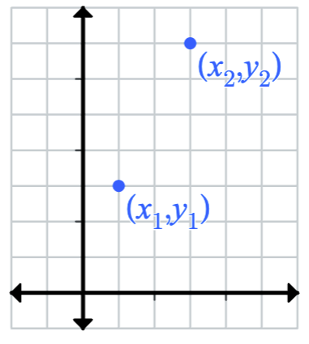
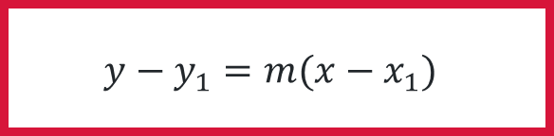


Point-gradient formula (1)
Generalising the process
The gradient ($m$) can be found using the gradient formula:
The equation of a line with a gradient ($m$) and passing through the point $(x_{1},y_{1})$ is:
$$m=\frac{rise}{run} \\ m=\frac{y_{2}−y_{1}}{x_{2}−x_{1}}$$
$$y−y_{1}=m(x−x_{1})$$

Slide 7

Point-gradient formula (2)
Worked example
Find the equation of the line with $m=2$ and passing through $(1, 3).$
$$y−y_{1}=m\left(x−x_{1}\right)$$
$$y−3=2(x−1)$$
$$y−3=2x−2$$
$$y=2x+1$$
What would you do differently if you were given a second point rather than the gradient?
How would the process change if the gradient or point was negative?
What name do we give this format of a linear equation?

Slide 8

Point-gradient formula (3)
Example – your turn
Find the equation of the line with $m= 3$ and passing through $\left(−1, 3\right)$.
$$y−y_{1}=m\left(x−x_{1}\right)$$
$$y−3=3(x+1)$$
$$y−3=3x+3$$
$$y=3x+6$$

Slide 9


Incorrect worked example (1)
Find the equation of the line passing through $(−1 −4)$ and $(5, −8).$
$$y=mx+c$$
$$m=\frac{y_{2}−y_{1}}{x−x}$$
$$m=\frac{−8−(−4)}{5−(−1)}$$
$$m=\frac{−4}{6}$$
$$m=−\frac{2}{3}$$
What error has the student made?
$$y−y_{1}=m(x−x_{1})$$
$$y−8=−\frac{2}{3}(x−5)$$
$$y−8=−\frac{2}{3}x+\frac{10}{3}$$
$$y=−2x+\frac{34}{3}$$
How can we learn from this error?

Slide 10



Incorrect worked example (2)
Find the equation of the line passing through $(4, 1)$and $(−7, 2).$
$$y−y_{1}=m(x−x_{1})$$
$$y−1=−5(x−4)$$
$$y−1=−5x−20$$
$$y=−5x−19$$
$$y=mx+c$$
$$m=\frac{y_{2}−y_{1}}{x−x}$$
$$m=\frac{−7−3}{4−2}$$
$$m=\frac{−10}{2}$$
$$m=−5$$
What error has the student made?
How can we learn from this error?

Slide 11
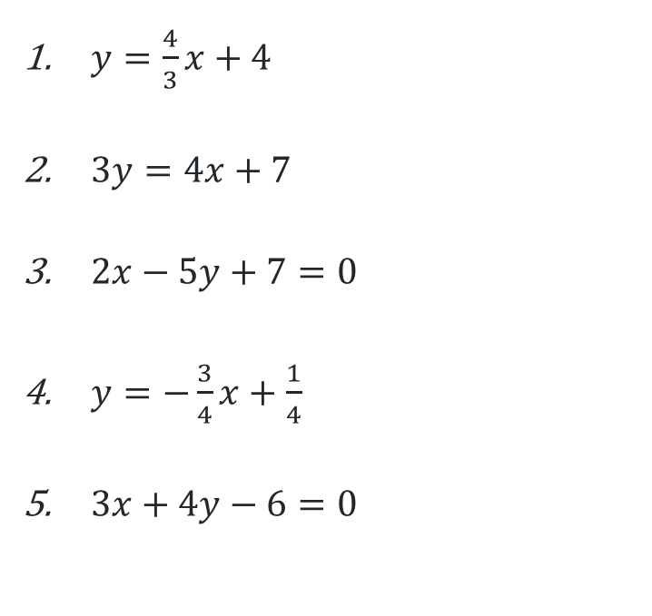

Examining intercepts
Graph each pair of points and join them to create a straight line.
$(−3, 0)$ and $(0, 4)$
$(−1, 1)$ and $(2, 5)$
$(−1, 1)$ and $(4, 3)$
$(−1, 1)$ and $(3, −2)$
$(2, 0)$ and $(6, −3)$
$y=\frac{4}{3}x+4$
$3y=4x+7$
$2x−5y+7=0$
$y=−\frac{3}{4}x+\frac{1}{4}$
$3x+4y−6=0$

Slide 12

General form of an equation
A straight line in general form is given as $ax+by+c=0$, where $a$, $b$ and $c$ are constants.
(NESA, 2024)
For example, $y=\frac{4}{3}x+\frac{1}{3}$
$$3y=4x+1$$
$$4x−3y+1=0$$

Slide 13
Independent practice

Slide 14

Open middle problem
Linear functions
Direction: Using the digits $−9$to $9$ at most one time each, place a digit in each box so that the linear equation, in general form, passes through the two points.
Point 1: Point 2:
Equation:
v
v
v
v
,
,
v
v
v
$x+$ $y+$ $=0$

Slide 15
References
This presentation contains NSW Curriculum and syllabus content. The NSW Curriculum is developed by the NSW Education Standards Authority. This content is prepared by NESA for and on behalf of the Crown in the right of the State of New South Wales. The material is protected by Crown copyright.
Please refer to the NESA Copyright Disclaimer for more information https://educationstandards.nsw.edu.au/wps/portal/nesa/mini-footer/copyright.
NESA holds the only official and up-to-date versions of the NSW Curriculum and syllabus documents. Please visit the NSW Education Standards Authority (NESA) website https://educationstandards.nsw.edu.au/wps/portal/nesa/home and the NSW Curriculum website https://curriculum.nsw.edu.au.
Mathematics Advanced 11-12 Syllabus © NSW Education Standards Authority (NESA) for and on behalf of the Crown in right of the State of New South Wales, 2024.
.

Slide 16
Copyright
© State of New South Wales (Department of Education), 2025
The copyright material published in this resource is subject to the Copyright Act 1968 (Cth) and is owned by the NSW Department of Education or, where indicated, by a party other than the NSW Department of Education (third-party material).
Copyright material available in this resource and owned by the NSW Department of Education is licensed under a Creative Commons Attribution 4.0 International (CC BY 4.0) license.
This license allows you to share and adapt the material for any purpose, even commercially.
Attribution should be given to © State of New South Wales (Department of Education), 2025.
Material in this resource not available under a Creative Commons license:
the NSW Department of Education logo, other logos and trademark-protected material
Material owned by a third party that has been reproduced with permission. You will need to obtain permission from the third party to reuse its material.
Links to third-party material and websites
Please note that the provided (reading/viewing material/list/links/texts) are a suggestion only and implies no endorsement, by the New South Wales Department of Education, of any author, publisher, or book title. School principals and teachers are best placed to assess the suitability of resources that would complement the curriculum and reflect the needs and interests of their students.
If you use the links provided in this document to access a third-party’s website, you acknowledge that the terms of use, including licence terms set out on the third-party’s website apply to the use which may be made of the materials on that third-party website or where permitted by the Copyright Act 1968 (Cth). The department accepts no responsibility for content on third-party websites.

