Slide 1
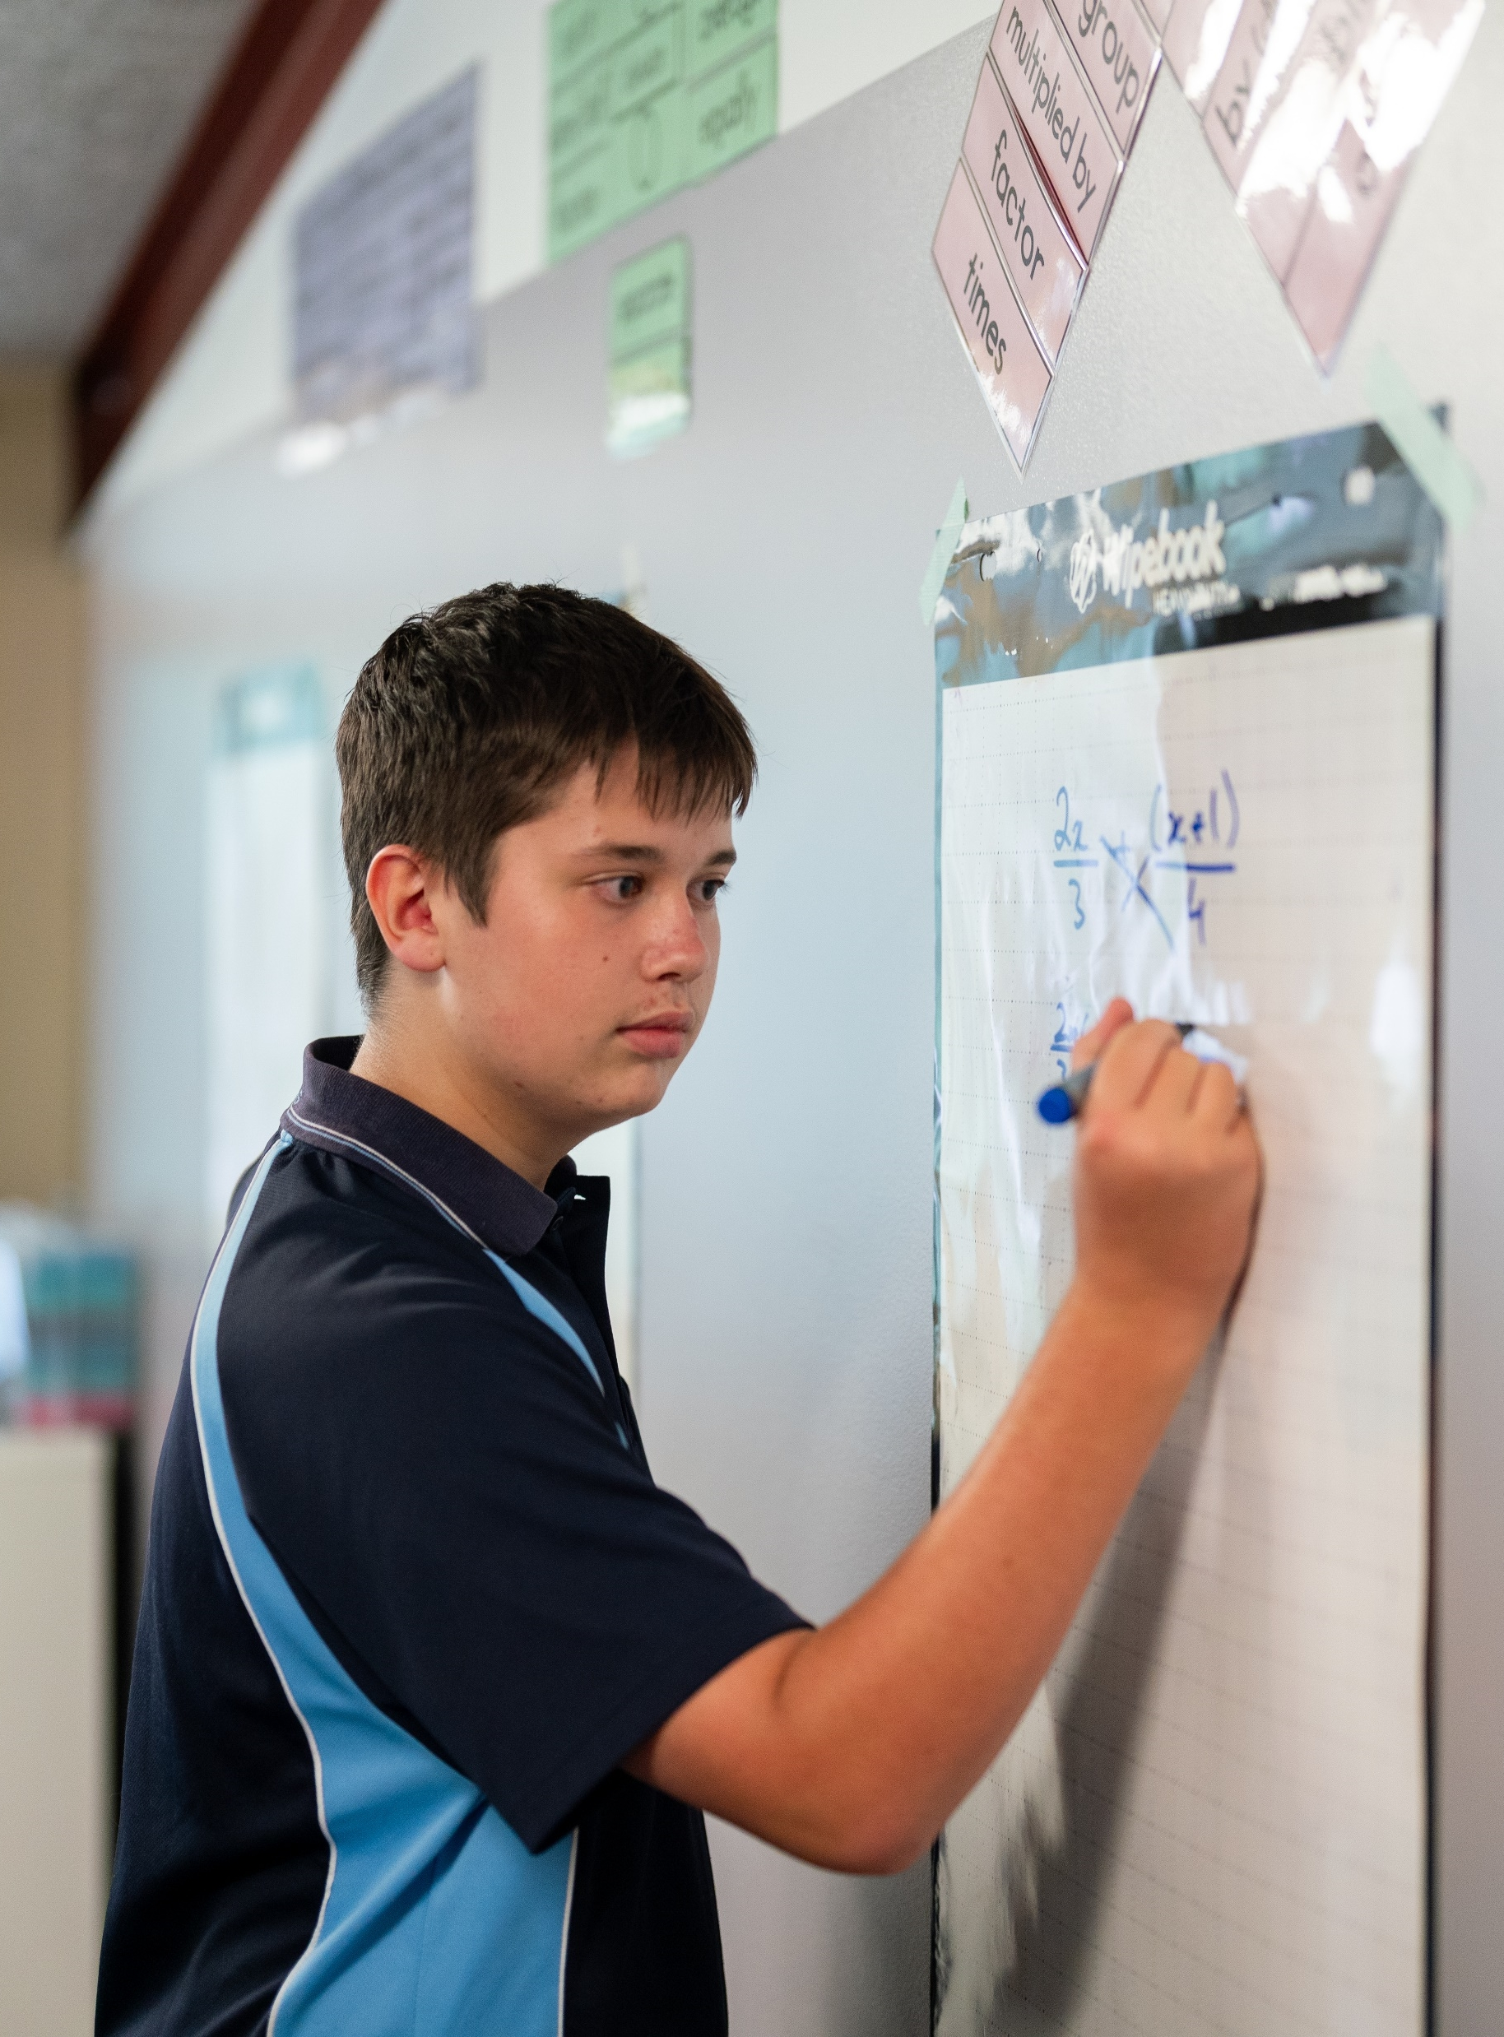
Odd and even functions
Mathematics Advanced – Stage 6 Year 11
Unit 2 – Introduction to functions

Slide 2
Learning intentions and success criteria
Learning Intentions
To be able to identify odd and even functions through algebraic and graphical methods
Success Criteria
I can justify why a graph represents an odd function
I can justify why a graph represents an even function
I can use algebraic tests to determine if a function is odd, even or neither
Notes:
Notes for teachers:
Learning intentions and success criteria are best co-constructed with students. Adapt the learning intention as required and add matching success criteria.
For more information See ⁠AITSL or the NSW Department of Education explicit teaching strategies, ⁠Sharing learning intentions and ⁠Sharing success criteria
LISC is not necessarily presented at the beginning of the lesson. Teacher needs to consider most effectual time to introduce
LISC should be revisited during the lesson to support students' evaluation of their learning

Slide 3
Activating prior knowledge

Slide 4
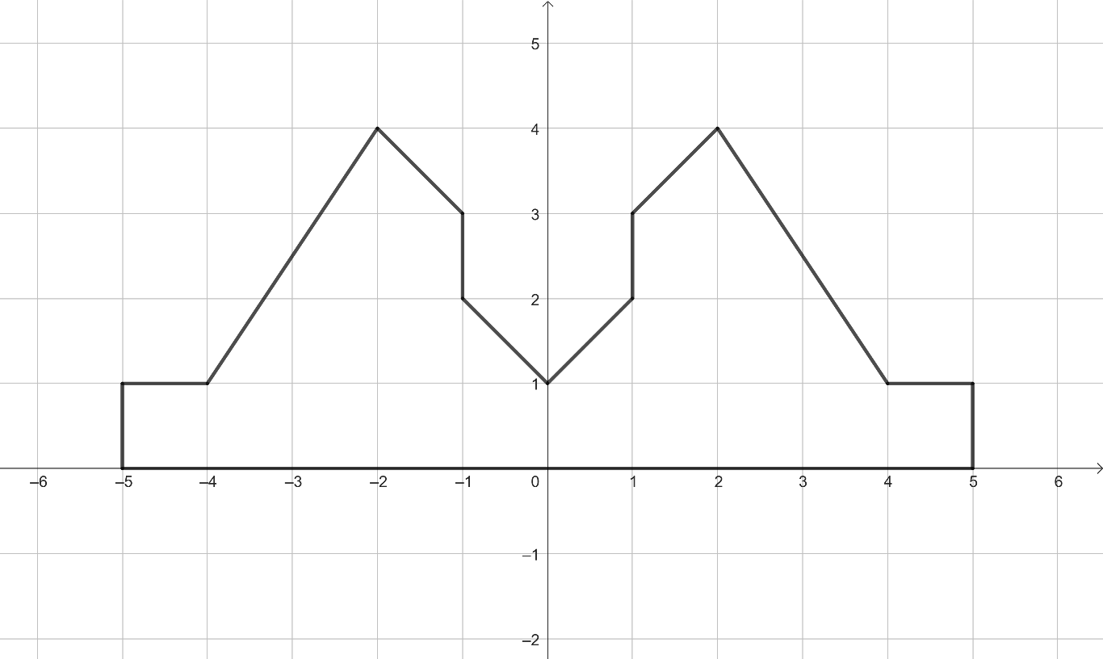


Area of composite shapes (1)
$$y$$
$$x$$

Slide 5
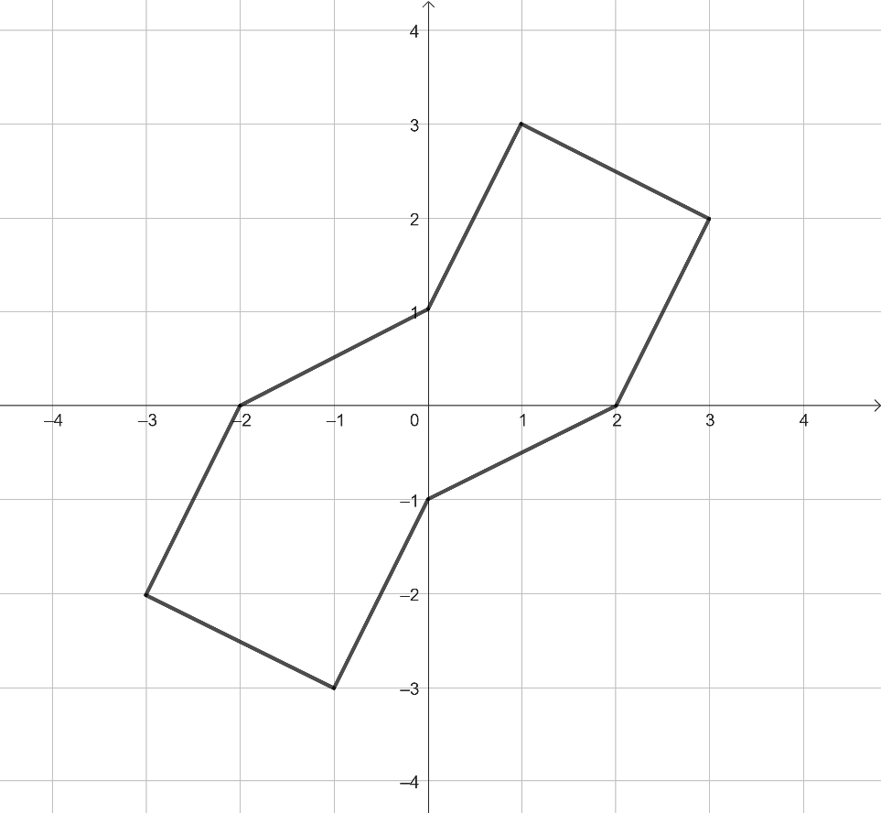


Area of composite shapes (2)
$$y$$
$$x$$

Slide 6
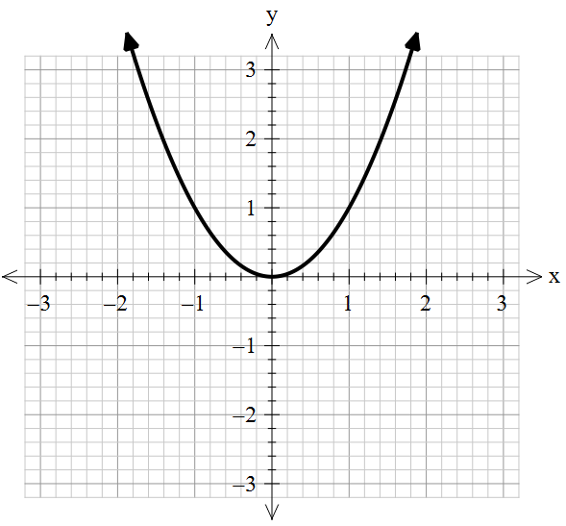
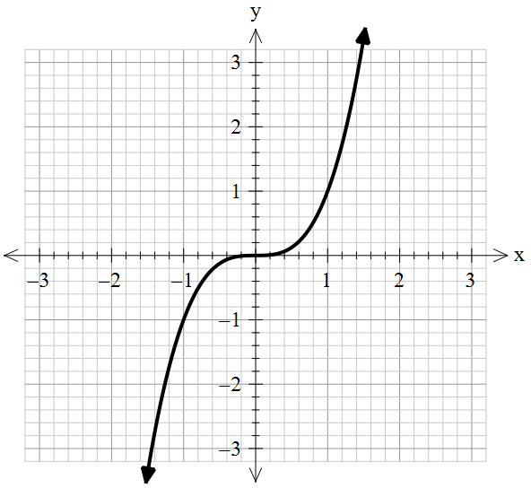


Considering symmetry for the graphs of functions
The graph of $y=x^{2}$ is shown.
The graph of $y=x^{3}$ is shown.

Slide 7
Connecting learning

Slide 8
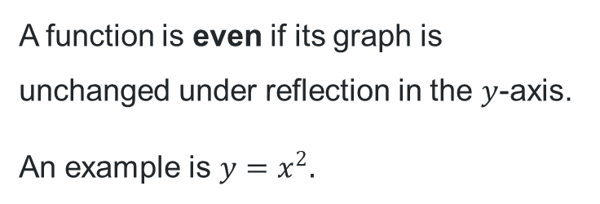
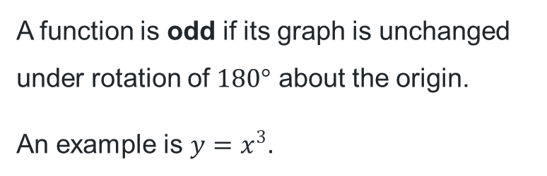
Graphs of odd and even functions (1)
A function is even if its graph is unchanged under reflection in the $y$-axis.
An example is $y=x^{2}.$
A function is odd if its graph is unchanged under rotation of $180°$ about the origin.
An example is $y=x^{3}.$

Slide 9
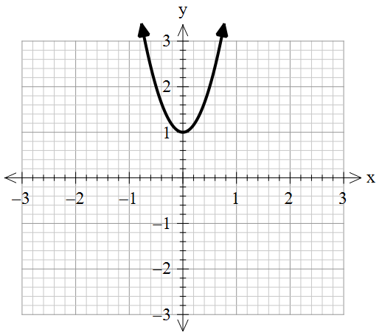
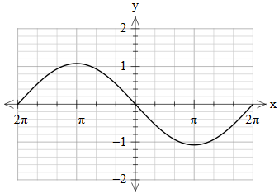
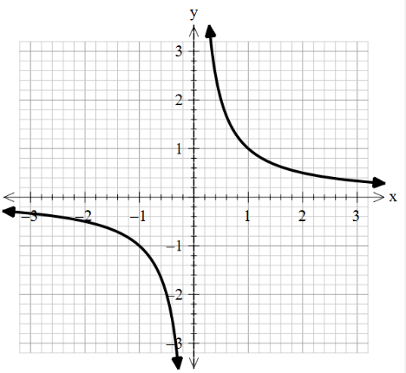
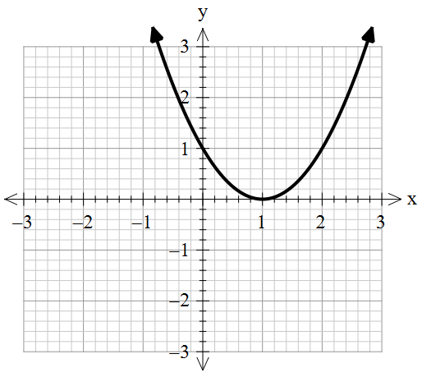
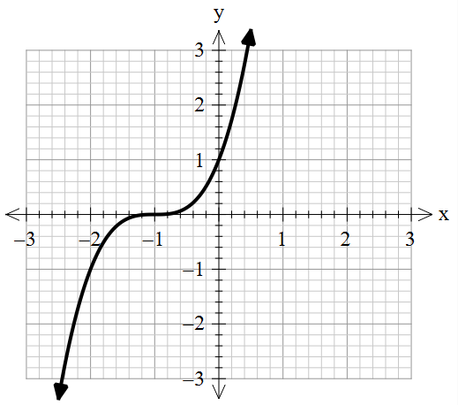
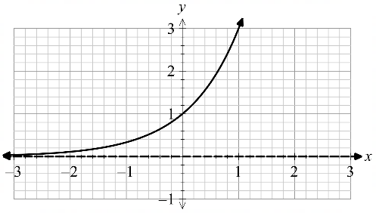
Graphs of odd and even functions (2)
1.
2.
3.
4.
5.
6.

Slide 10
Releasing responsibility

Slide 11
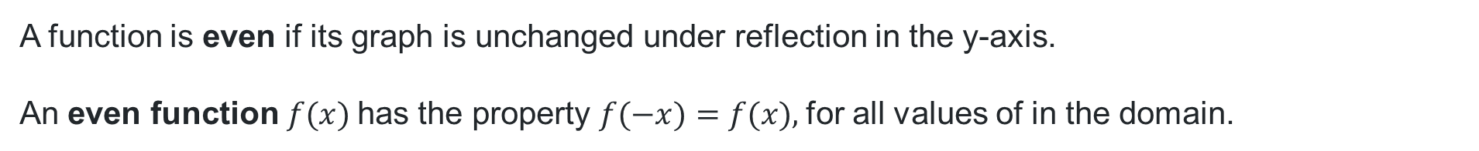
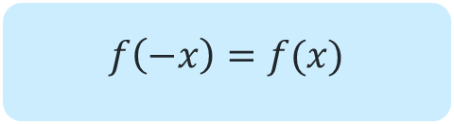

Even function (1)
A function is even if its graph is unchanged under reflection in the y-axis.
An even function $f(x)$has the property $f(−x)=f(x),$for all values of in the domain.
$$f\left(−x\right)=f(x)$$
$$y=x^{2}$$

Slide 12
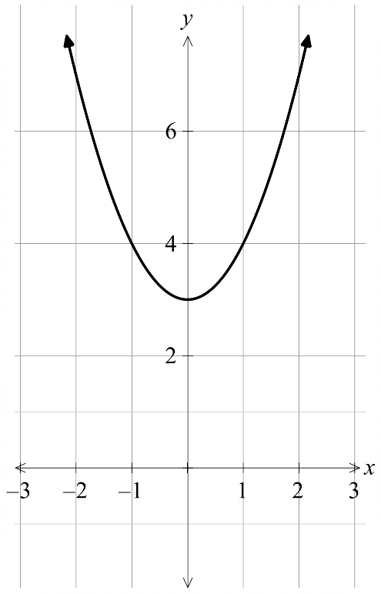
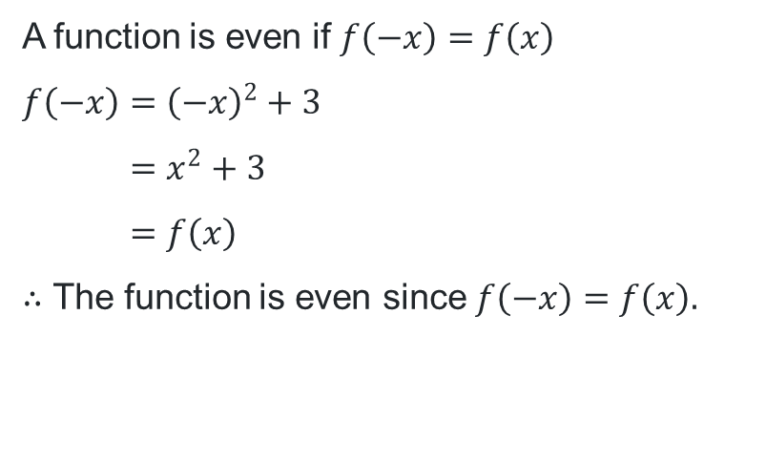

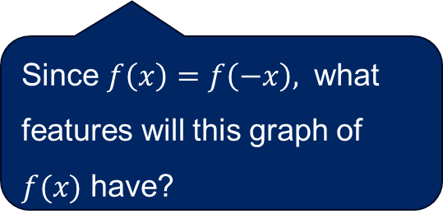
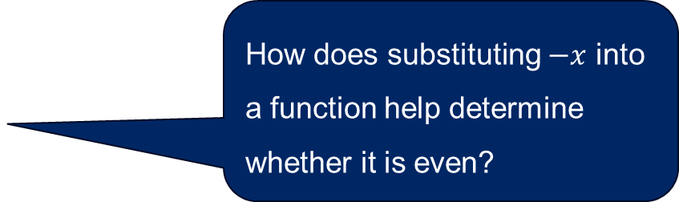
Even function (2)
Worked example 1
$$y=x^{2}+3$$
Test whether$f\left(x\right)=x^{2}+3$is an even function.
How does substituting $−x$ into a function help determine whether it is even?
A function is even if $f\left(−x\right)=f\left(x\right)$
$$f\left(−x\right)={\left(−x\right)}^{2}+3 \\ =x^{2}+3 \\ =f\left(x\right)$$
$∴$ The function is even since $f\left(−x\right)=f\left(x\right).$
Since $f\left(x\right)=f\left(−x\right),$ what features will this graph of $f(x)$ have?

Slide 13
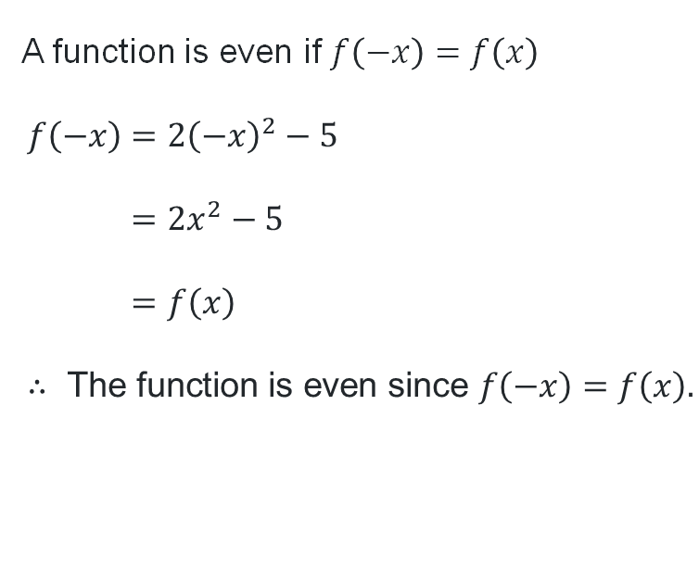
Even function (3)
Your turn 1
Test whether $f\left(x\right)=2x^{2}−5$ is an even function.
A function is even if $f\left(−x\right)=f\left(x\right)$
$$f\left(−x\right)=2{\left(−x\right)}^{2}−5 \\ =2x^{2}−5 \\ =f\left(x\right) \\ ∴ \text{The} \text{function} \text{is} \text{even} \text{since} f\left(−x\right)=f\left(x\right).$$

Slide 14
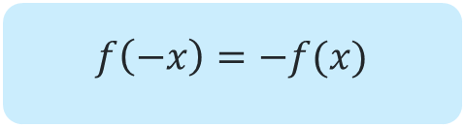

Odd function (1)
A function is odd if its graph is unchanged under rotation of $180°$ about the origin.
An odd function $f(x)$has the property $f(−x)=−f(x)$, for all values of in the domain.
$$f\left(−x\right)=−f(x)$$
$$y=x^{3}$$

Slide 15
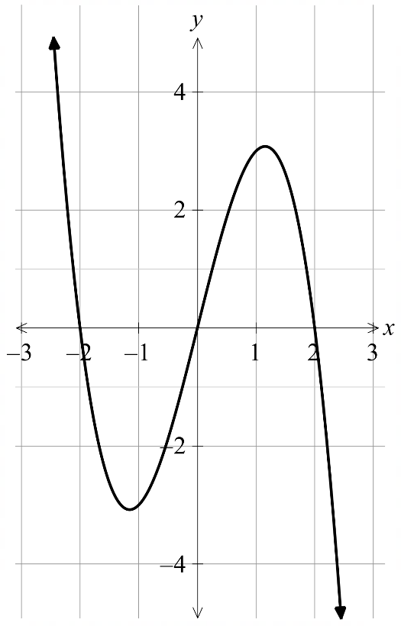
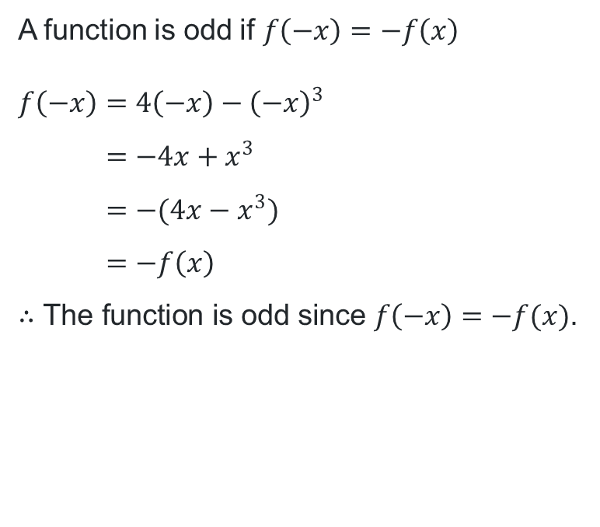

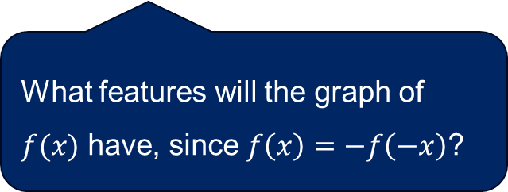
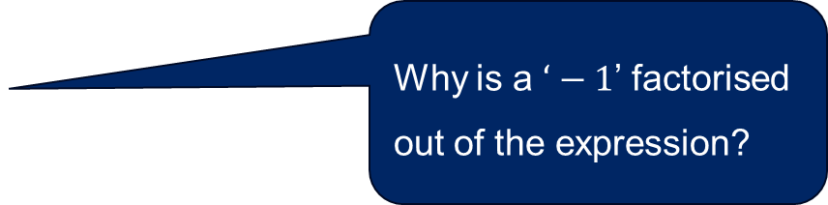
Odd function (2)
Worked example 2
$$y=4x−x^{3}$$
Test whether $f\left(x\right)=4x−x^{3}$ is an odd function.
A function is odd if $f\left(−x\right)=−f\left(x\right)$
$$f\left(−x\right)=4\left(−x\right)−{\left(−x\right)}^{3} \\ =−4x+x^{3} \\ =−(4x−x^{3}) \\ =−f\left(x\right)$$
$∴\text{The} \text{function} \text{is} \text{odd} \text{since} f\left(−x\right)=−f(x)$.
Why are brackets necessary?
Why is a $‘−1$’ factorised out of the expression?
What features will the graph of $f(x)$ have, since $f\left(x\right)=−f\left(−x\right)$?

Slide 16
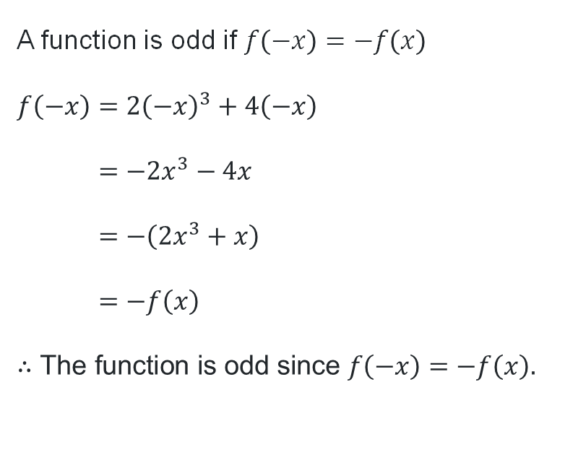
Odd function (3)
Your turn 2
Test whether $f\left(x\right)={2x}^{3}+4x$ is an odd function.
A function is odd if $f\left(−x\right)=−f\left(x\right)$
$$f\left(−x\right)=2{\left(−x\right)}^{3}+4\left(−x\right) \\ =−2x^{3}−4x \\ =−\left(2x^{3}+x\right) \\ =−f\left(x\right) \\ ∴\text{The} \text{function} \text{is} \text{odd} \text{since} f\left(−x\right)=−f\left(x\right).$$

Slide 17
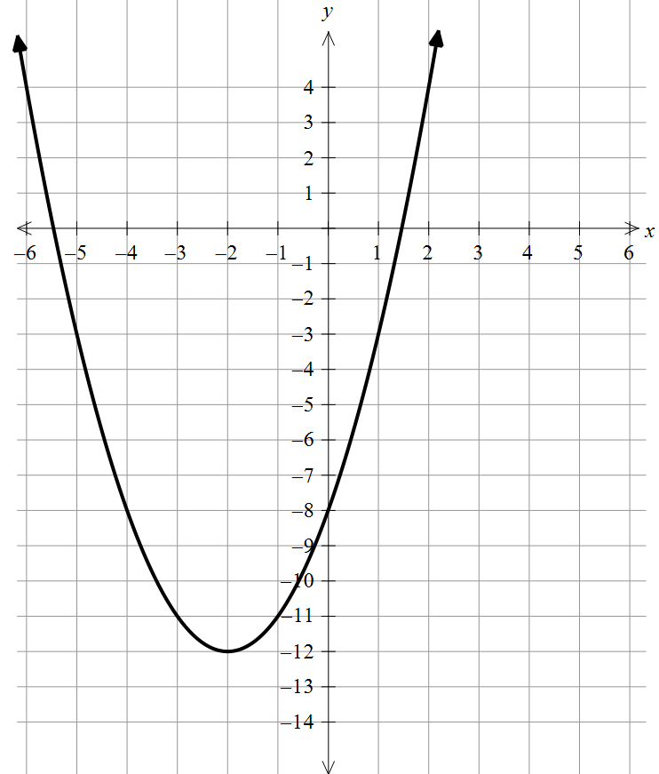
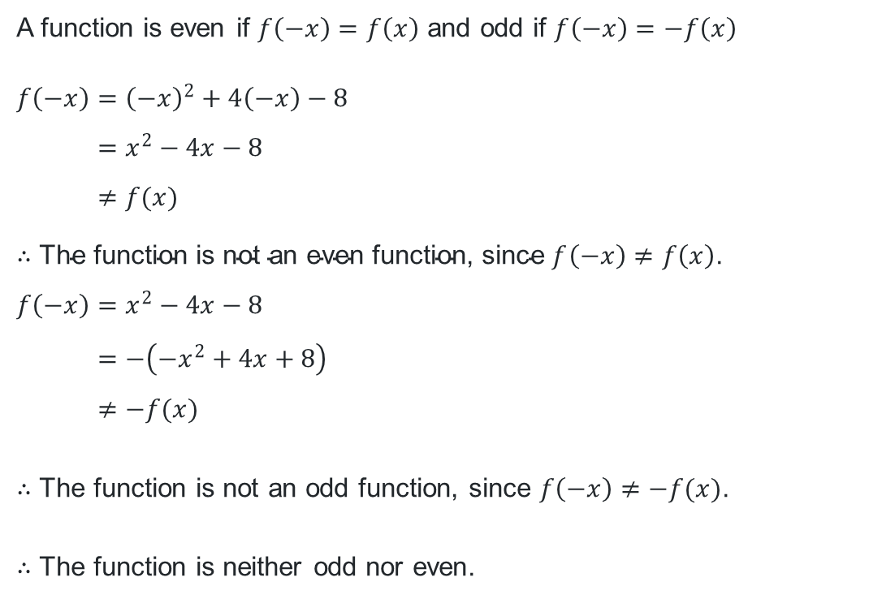

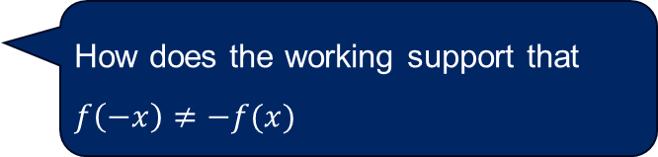
Odd and even functions (1)
Worked example 3
$$y=x^{2}+4x−8$$
Test whether the function$f\left(x\right)=x^{2}+4x−8$ is odd, even or neither.
A function is even if $f\left(−x\right)=f\left(x\right)$ and odd if $f\left(−x\right)=−f\left(x\right)$
$$f\left(−x\right)={\left(−x\right)}^{2}+4\left(−x\right)−8 \\ =x^{2}−4x−8 \\ ≠f(x)$$
$∴$ $\text{The} \text{function} \text{is} \text{not} \text{an} \text{even} \text{function}\text{, }\text{since} f\left(−x\right)≠f\left(x\right)\text{.}$
$$f\left(−x\right)=x^{2}−4x−8 \\ =−\left(−x^{2}+4x+8\right) \\ ≠−f(x)$$
$∴$ The function is not an odd function, since $f\left(−x\right)≠−f(x)\text{. }$
$∴$ The function is neither odd nor even.
What does this notation mean?
How does the working support that $f\left(−x\right)≠−f(x)$

Slide 18
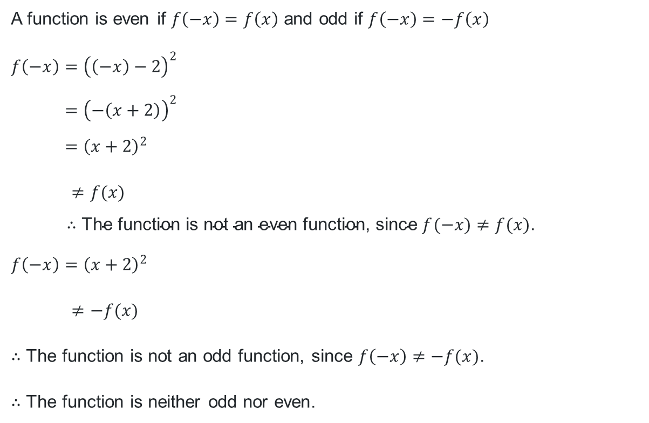
Odd and even functions (2)
Your turn 3
Test if the function $f\left(x\right)={\left(x−2\right)}^{2}$ is odd, even or neither.
A function is even if $f\left(−x\right)=f\left(x\right)$ and odd if $f\left(−x\right)=−f\left(x\right)$
$$f\left(−x\right)={\left(\left(−x\right)−2\right)}^{2} \\ ={\left(−\left(x+2\right)\right)}^{2} \\ ={\left(x+2\right)}^{2}$$
$≠f(x)$
$∴$ $\text{The} \text{function} \text{is} \text{not} \text{an} \text{even} \text{function}\text{, }\text{since} f(−x)≠f(x)\text{.}$
$$f\left(−x\right)={\left(x+2\right)}^{2}$$
$≠−f(x)$
$∴$ The function is not an odd function, since $f\left(−x\right)≠−f(x)\text{. }$
$∴$ The function is neither odd nor even.

Slide 19
References
This presentation contains NSW Curriculum and syllabus content. The NSW Curriculum is developed by the NSW Education Standards Authority. This content is prepared by NESA for and on behalf of the Crown in the right of the State of New South Wales. The material is protected by Crown copyright.
Please refer to the NESA Copyright Disclaimer for more information https://educationstandards.nsw.edu.au/wps/portal/nesa/mini-footer/copyright.
NESA holds the only official and up-to-date versions of the NSW Curriculum and syllabus documents. Please visit the NSW Education Standards Authority (NESA) website https://educationstandards.nsw.edu.au/wps/portal/nesa/home and the NSW Curriculum website https://curriculum.nsw.edu.au.
Mathematics Advanced 11-12 Syllabus © NSW Education Standards Authority (NESA) for and on behalf of the Crown in right of the State of New South Wales, 2024.

Slide 20
Copyright
© State of New South Wales (Department of Education), 2025
The copyright material published in this resource is subject to the Copyright Act 1968 (Cth) and is owned by the NSW Department of Education or, where indicated, by a party other than the NSW Department of Education (third-party material).
Copyright material available in this resource and owned by the NSW Department of Education is licensed under a Creative Commons Attribution 4.0 International (CC BY 4.0) license.
This license allows you to share and adapt the material for any purpose, even commercially.
Attribution should be given to © State of New South Wales (Department of Education), 2025.
Material in this resource not available under a Creative Commons license:
the NSW Department of Education logo, other logos and trademark-protected material
Material owned by a third party that has been reproduced with permission. You will need to obtain permission from the third party to reuse its material.
Links to third-party material and websites
Please note that the provided (reading/viewing material/list/links/texts) are a suggestion only and implies no endorsement, by the New South Wales Department of Education, of any author, publisher, or book title. School principals and teachers are best placed to assess the suitability of resources that would complement the curriculum and reflect the needs and interests of their students.
If you use the links provided in this document to access a third-party’s website, you acknowledge that the terms of use, including licence terms set out on the third-party’s website apply to the use which may be made of the materials on that third-party website or where permitted by the Copyright Act 1968 (Cth). The department accepts no responsibility for content on third-party websites.

