Slide 1

Composite functions
Mathematics Advanced – Stage 6 Year 11
Unit 2 – Introduction to functions

Slide 2
Learning intentions and success criteria
Learning intentions
To understand and use composite functions, where the output of one function becomes the input of another.
To determine the equation of a composite function.
Success criteria
I can accurately evaluate a composite function for a given input.
I can determine the equation of a composite function by substitution.
I can identify and correct common mistakes when forming or evaluating composite functions.
Notes:
Notes for teachers:
Learning intentions and success criteria are best co-constructed with students. Adapt the learning intention as required and add matching success criteria.
For more information See ⁠AITSL or the NSW Department of Education explicit teaching strategies, ⁠Sharing learning intentions and ⁠Sharing success criteria
LISC is not necessarily presented at the beginning of the lesson. Teacher needs to consider most effectual time to introduce
LISC should be revisited during the lesson to support students' evaluation of their learning

Slide 3
Activating prior knowledge

Slide 4


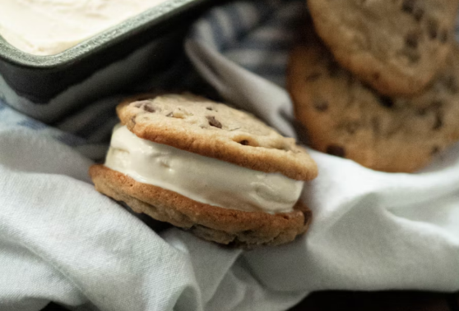

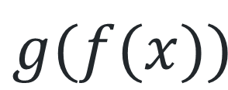
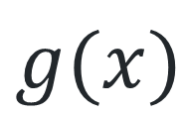
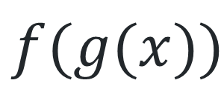
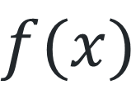
Visualising composite functions (1)
Notice and wonder
$$f(x)$$
$$g(x)$$
$$g(f(x))$$
$$f(g(x))$$
Images licensed under Unsplash License and Pixabay Content License

Slide 5


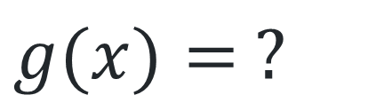
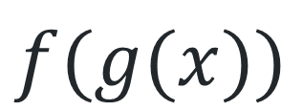

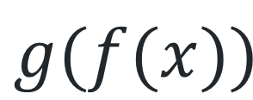
Visualising composite functions (2)
Salmon and rice
$$g(f(x))$$
$$f(g(x))$$
$$f(x)= ?$$
$$g(x)= ?$$
Images licensed under Unsplash License and Pixabay Content License

Slide 6
Connecting learning

Slide 7
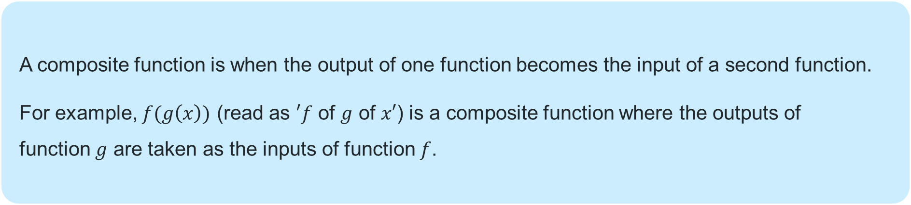
Definition
Composite functions
    A composite function is when the output of one function becomes the input of a second function.
    For example, $f(g\left(x\right))$ (read as $′f$ of $g$ of $x′$) is a composite function where the outputs of function $g$ are taken as the inputs of function $f$.

Slide 8
Releasing responsibility

Slide 9
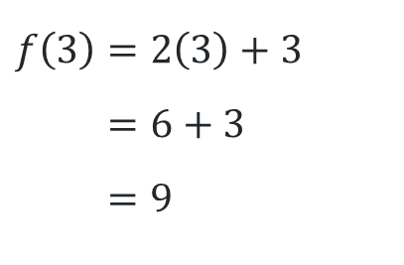
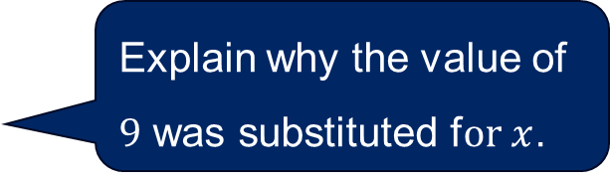
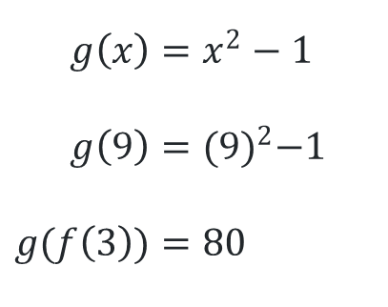
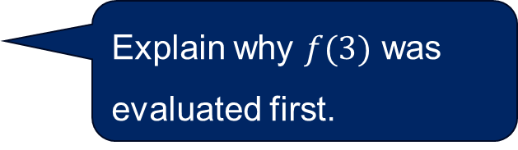
Composite functions (1)
Worked example 1
Given that $f\left(x\right)=2x+3$and $g\left(x\right)=x^{2}−1$, evaluate $g(f(3)).$
$$f\left(3\right)=2\left(3\right)+3 \\ =6+3 \\ =9$$
Explain why $f(3)$ was evaluated first.
$$g\left(x\right)=x^{2}−1$$
$$g\left(9\right)={(9)}^{2}−1$$
$$g(f\left(3\right))=80$$
Explain why the value of $9$ was substituted f$or x$.

Slide 10

Composite functions (2)
Your turn – question 1
Given that $f\left(x\right)=2x^{2}$and $g\left(x\right)=5x−1$, evaluate $g\left(f\left(2\right)\right).$
$$f(2)=2{\left(2\right)}^{2} \\ =2\left(4\right) \\ =8$$
$$g\left(x\right)=5x−1$$
$$g\left(f(2)\right)=5(8)−1 \\ =39$$

Slide 11
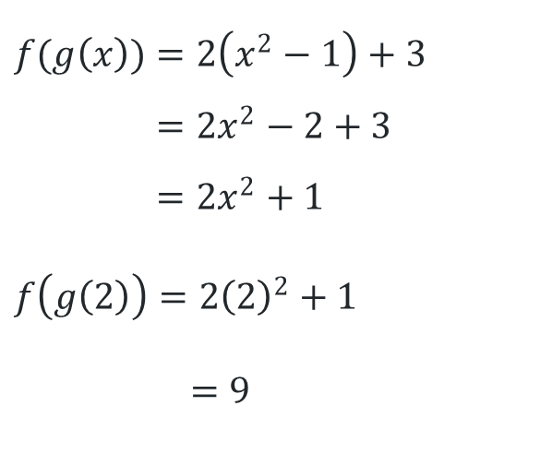
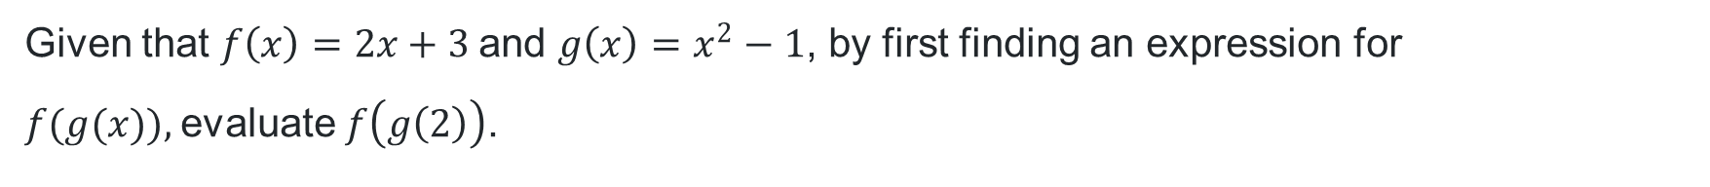
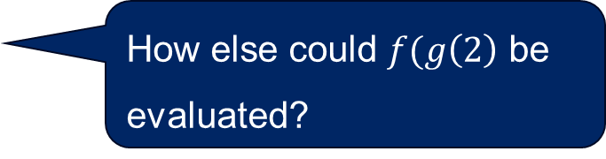

Composite functions (3)
Worked example 2
Given that $f\left(x\right)=2x+3$and $g\left(x\right)=x^{2}−1$, by first finding an expression for $f(g(x)),$evaluate $f\left(g\left(2\right)\right)$.
Why has $(x^{2}−1)$ appeared in this line of working?
$$f(g\left(x\right))=2\left(x^{2}−1\right)+3 \\ =2x^{2}−2+3 \\ =2x^{2}+1$$
$$f\left(g\left(2\right)\right)=2{\left(2\right)}^{2}+1$$
$$=9$$
How else could $f(g\left(2\right)$ be evaluated?

Slide 12

Composite functions (4)
Your turn – question 2
Given that $f\left(x\right)=2x^{2}$and $g\left(x\right)=5x−1$, by first finding an expression for $f(g(x))$, evaluate $f\left(g\left(2\right)\right).$
$$f\left(g\left(x\right)\right)=2{\left(5x−1\right)}^{2} \\ =2(5x−1)(5x−1)$$
$$=2(25x^{2}−10x+1) \\ =50x^{2}−20x+2$$
$$f\left(g\left(2\right)\right)=50{\left(2\right)}^{2}−20\left(2\right)+2 \\ =162$$

Slide 13
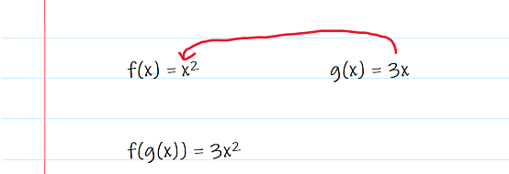

Non-example (1)
Incorrect example 1
Brooke attempted to write the composite function $f\left(g\left(x\right)\right)$ but made an error.
This is Brooke’s attempt.
Can you explain the error that was made?

Slide 14

Correction (1)
Your turn
Write the expression for the composite function, $f(g(x)),$given $f\left(x\right)={2x}^{2}+1$ and $g\left(x\right)=4x$.
$$f\left(x\right)={2x}^{2}+1$$
$$f\left(g\left(x\right)\right)={2\left(4x\right)}^{2}+1 \\ =2\left(16x^{2}\right)+1 \\ =32x^{2}+1$$

Slide 15
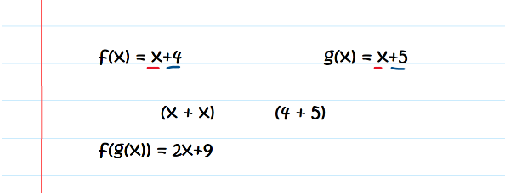
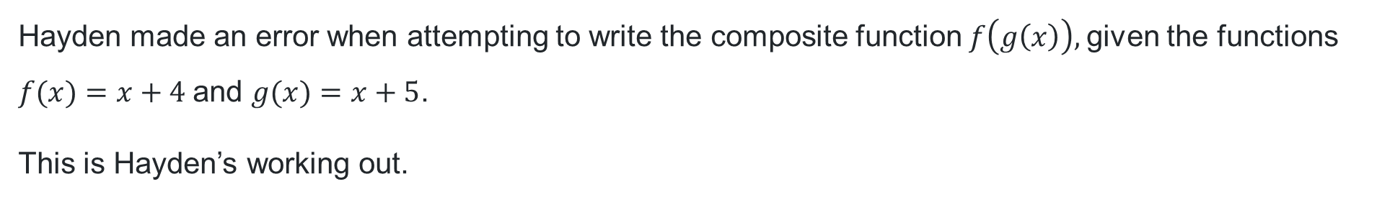
Non-example (2)
Incorrect example 2
Hayden made an error when attempting to write the composite function $f\left(g\left(x\right)\right),$given the functions $f(x)=x+4$and $g(x)=x+5$.
This is Hayden’s working out.
Can you explain the error made?

Slide 16

Correction (2)
Your turn
Write the expression for the composite function $g(f\left(x\right))$, given $f\left(x\right)=x+4$ and $g\left(x\right)=3x+1$.
$$g\left(f\left(x\right)\right)=3\left(x+4\right)+1 \\ =3x+12+1 \\ =3x+13$$

Slide 17
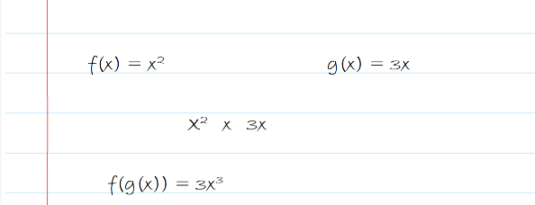
Non-example (3)
Incorrect example 3
Glenn attempted to write the composite function of two functions but made an error.
This is Glenn’s working out.
Can you explain the error made?

Slide 18

Correction (3)
Your turn
Write the expression for the composite function $f(g\left(x\right))$, given $f\left(x\right)=x^{2}−4$ and $g\left(x\right)=2x$.
$$f\left(g\left(x\right)\right)={\left(2x\right)}^{2}−4 \\ =4x^{2}−4$$

Slide 19
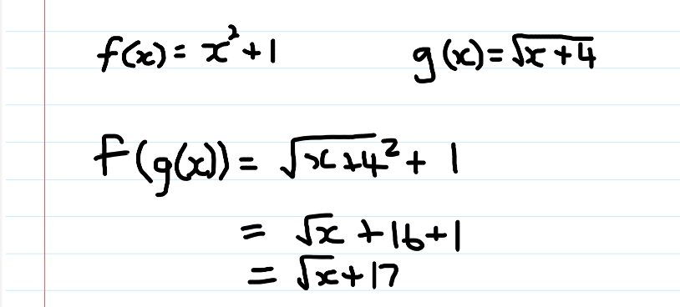
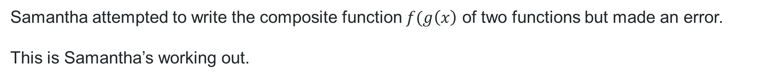
Non-example (4)
Incorrect example 4
Samantha attempted to write the composite function $f(g\left(x\right)$ of two functions but made an error.
This is Samantha’s working out.
Can you explain the error made?

Slide 20

Correction (4)
Your turn
Write the expression for the composite function $f(g\left(x\right))$, given $f\left(x\right)=x^{2}−2$ and $g\left(x\right)=\sqrt{x+1}$.
$$f\left(g\left(x\right)\right)={\left(\sqrt{x+1}\right)}^{2}−2 \\ =\left(x+1\right)−2 \\ =x−1$$

Slide 21
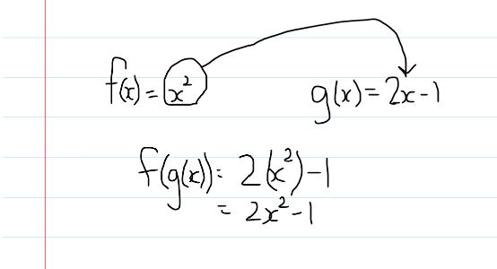

Non-example (5)
Incorrect example 5
Brian attempted to write the composite function $f(g\left(x\right)$) of two functions but made an error.
This is Brian’s working out.

Slide 22
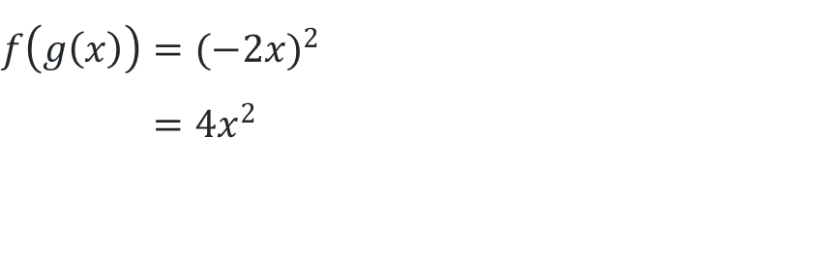
Correction (5)
Your turn
Write the expression for the composite function $f(g\left(x\right))$, given $f\left(x\right)=x^{2}$ and $g\left(x\right)=−2x$.
$$f\left(g\left(x\right)\right)={(−2x)}^{2} \\ =4x^{2}$$

Slide 23
Independent practice

Slide 24
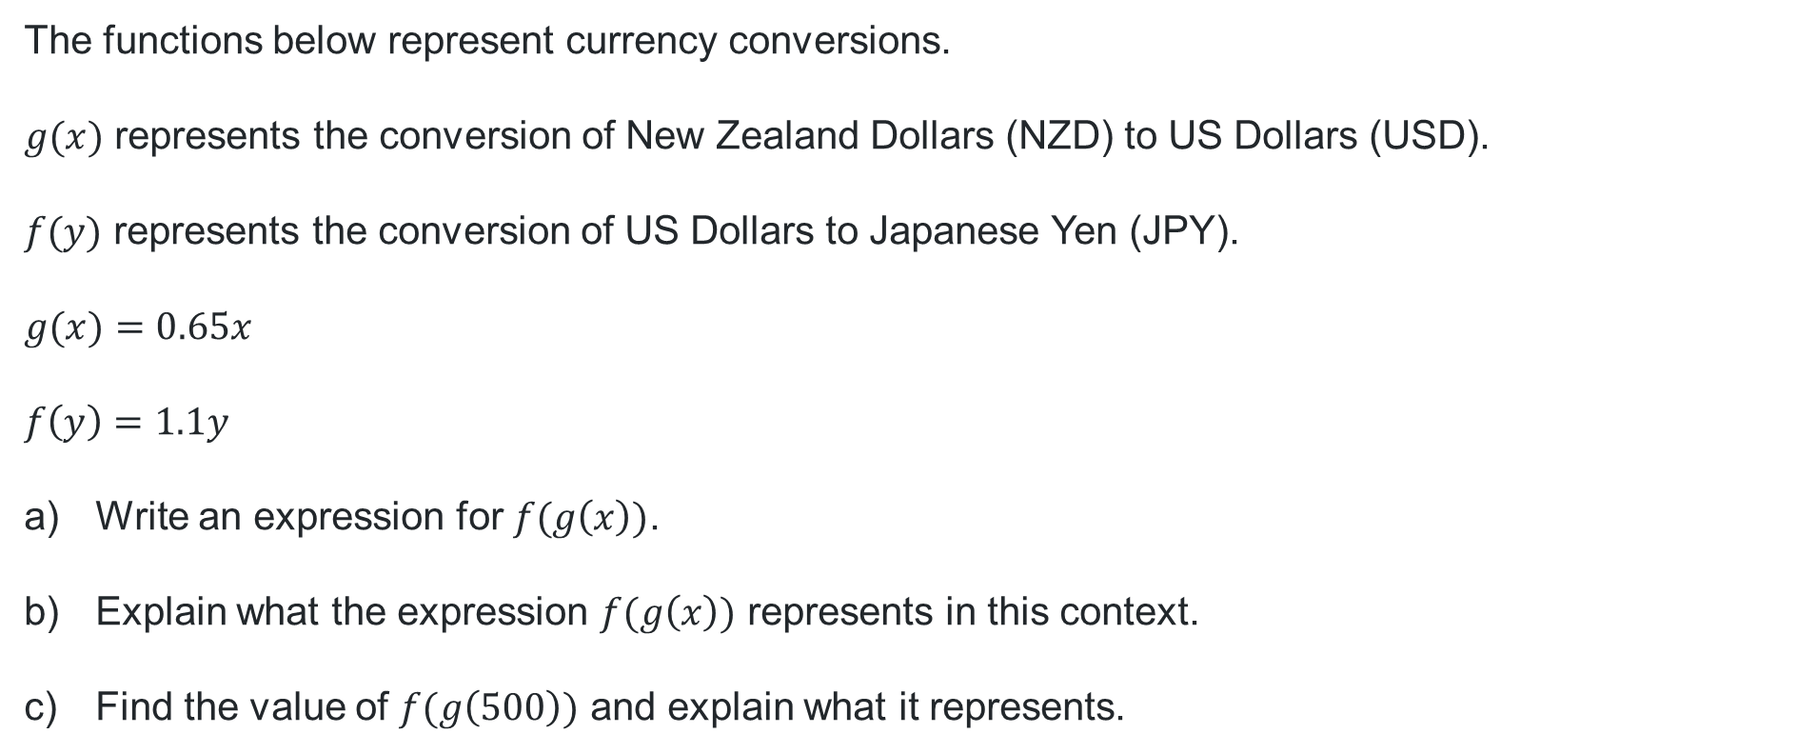
Real-world problem (1)
Composite functions
The functions below represent currency conversions.
$g(x)$ represents the conversion of New Zealand Dollars (NZD) to US Dollars (USD).
$f(y)$ represents the conversion of US Dollars to Japanese Yen (JPY).
$$g(x)=0.65x$$
$$f\left(y\right)=1.1y$$
Write an expression for $f(g\left(x\right))$.
Explain what the expression $f(g\left(x\right))$ represents in this context.
Find the value of $f(g\left(500\right))$ and explain what it represents.

Slide 25
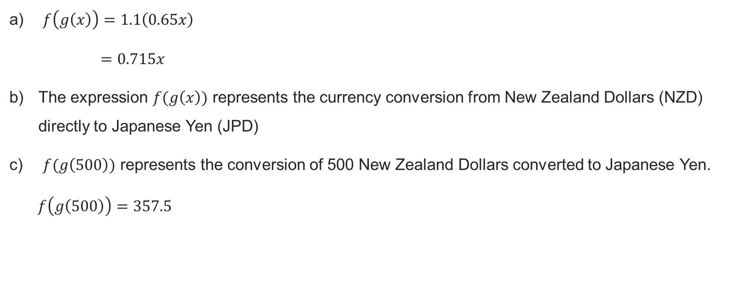
Real-world problem (2)
Solution
$f\left(g\left(x\right)\right)=1.1\left(0.65x\right)$
$$=0.715x$$
The expression $f(g\left(x\right))$ represents the currency conversion from New Zealand Dollars (NZD) directly to Japanese Yen (JPD)
$f(g\left(500\right))$ represents the conversion of 500 New Zealand Dollars converted to Japanese Yen.
$$f\left(g\left(500\right)\right)=357.5$$

Slide 26
References
This presentation contains NSW Curriculum and syllabus content. The NSW Curriculum is developed by the NSW Education Standards Authority. This content is prepared by NESA for and on behalf of the Crown in the right of the State of New South Wales. The material is protected by Crown copyright.
Please refer to the NESA Copyright Disclaimer for more information https://educationstandards.nsw.edu.au/wps/portal/nesa/mini-footer/copyright.
NESA holds the only official and up-to-date versions of the NSW Curriculum and syllabus documents. Please visit the NSW Education Standards Authority (NESA) website https://educationstandards.nsw.edu.au/wps/portal/nesa/home and the NSW Curriculum website https://curriculum.nsw.edu.au.
Mathematics Advanced 11-12 Syllabus © NSW Education Standards Authority (NESA) for and on behalf of the Crown in right of the State of New South Wales, 2024.

Slide 27
Copyright
© State of New South Wales (Department of Education), 2025
The copyright material published in this resource is subject to the Copyright Act 1968 (Cth) and is owned by the NSW Department of Education or, where indicated, by a party other than the NSW Department of Education (third-party material).
Copyright material available in this resource and owned by the NSW Department of Education is licensed under a Creative Commons Attribution 4.0 International (CC BY 4.0) license.
This license allows you to share and adapt the material for any purpose, even commercially.
Attribution should be given to © State of New South Wales (Department of Education), 2025.
Material in this resource not available under a Creative Commons license:
the NSW Department of Education logo, other logos and trademark-protected material
Material owned by a third party that has been reproduced with permission. You will need to obtain permission from the third party to reuse its material.
Links to third-party material and websites
Please note that the provided (reading/viewing material/list/links/texts) are a suggestion only and implies no endorsement, by the New South Wales Department of Education, of any author, publisher, or book title. School principals and teachers are best placed to assess the suitability of resources that would complement the curriculum and reflect the needs and interests of their students.
If you use the links provided in this document to access a third-party’s website, you acknowledge that the terms of use, including licence terms set out on the third-party’s website apply to the use which may be made of the materials on that third-party website or where permitted by the Copyright Act 1968 (Cth). The department accepts no responsibility for content on third-party websites.

