Slide 1

Domain and range
Mathematics Advanced – Stage 6 (Year 11)
Unit 2 – Introduction to functions

Slide 2
Learning intentions and success criteria
Learning intentions
To understand the concepts of domain and range and how they apply to functions and relations.
To be able to describe the domain and range of functions and relations.
Success criteria
I can define the domain and range of a function or relation.
I can describe the domain and range using worded descriptions or inequalities.
I can describe the domain and range using interval notation.
Notes:
Notes for teachers:
Learning intentions and success criteria are best co-constructed with students. Adapt the learning intention as required and add matching success criteria.
For more information See ⁠AITSL or the NSW Department of Education explicit teaching strategies, ⁠Sharing learning intentions and ⁠Sharing success criteria
LISC is not necessarily presented at the beginning of the lesson. Teacher needs to consider most effectual time to introduce
LISC should be revisited during the lesson to support students' evaluation of their learning

Slide 3
Connecting learning

Slide 4
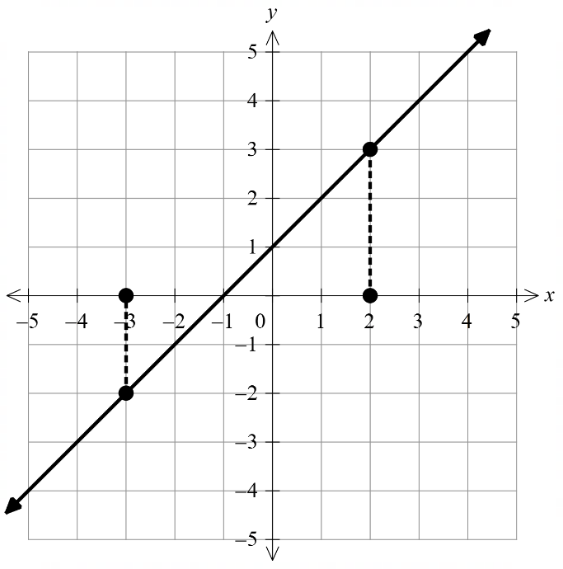

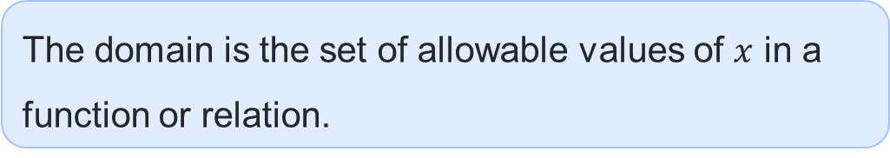
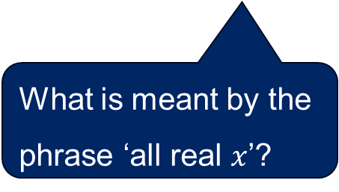
Domain
Definition
The domain is the set of allowable values of $x$ in a function or relation.
That is, the domain is the set of allowable inputs.
For the function $f\left(x\right)=x+1$, the domain is ‘all real $x$’.
What is meant by the phrase ‘all real $x$’?
What do the arrows at each end of the line mean?

Slide 5
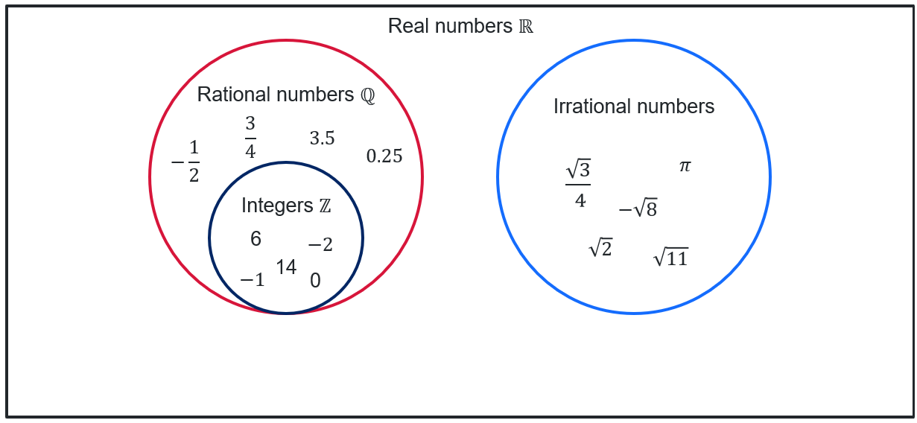
All real $x$
The real numbers are the set of all rational and irrational numbers.
‘All real 𝑥’ means that 𝑥 can be any real number on the 𝑥-axis.

Slide 6
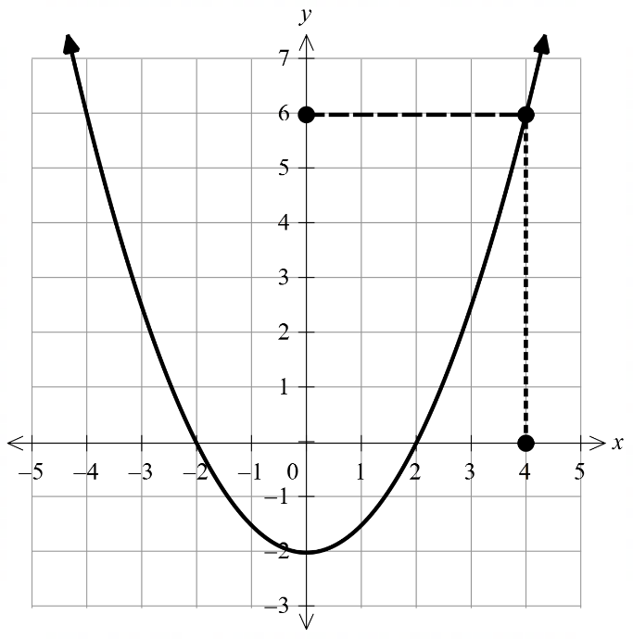
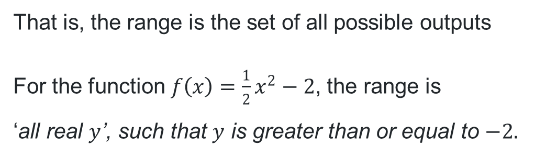


Range
Definition
The range is the set of values of the dependent variable for which a function is defined.
That is, the range is the set of all possible outputs
For the function $f\left(x\right)=\frac{1}{2}x^{2}−2$, the range is
‘all real $y$’, such that $y$ is greater than or equal to $−2.$
$$y=\frac{1}{2}x^{2}−2$$
Is it possible for the function to produce an output of $−3$? Why or why not?

Slide 7
Releasing responsibility

Slide 8


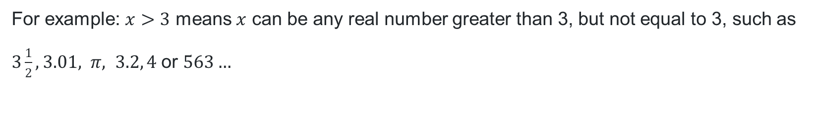
Inequalities
Definition
A statement that one number or algebraic expression is less than (or greater than) another.
There are 4 types of inequalities:
How do you read these?
How do you remember which way the symbol goes?
$$a<b$$
$a$ is less than $b$
$a≤b$
$a$ is less than or equal to $b$
$$a>b$$
$a$ is greater than $b$
$$a≥b$$
$a$ is greater than or equal to $b$
For example: $x>3$ means $x$ can be any real number greater than 3, but not equal to 3, such as $3\frac{1}{2}, 3.01, π, 3.2, 4$or $563…$

Slide 9
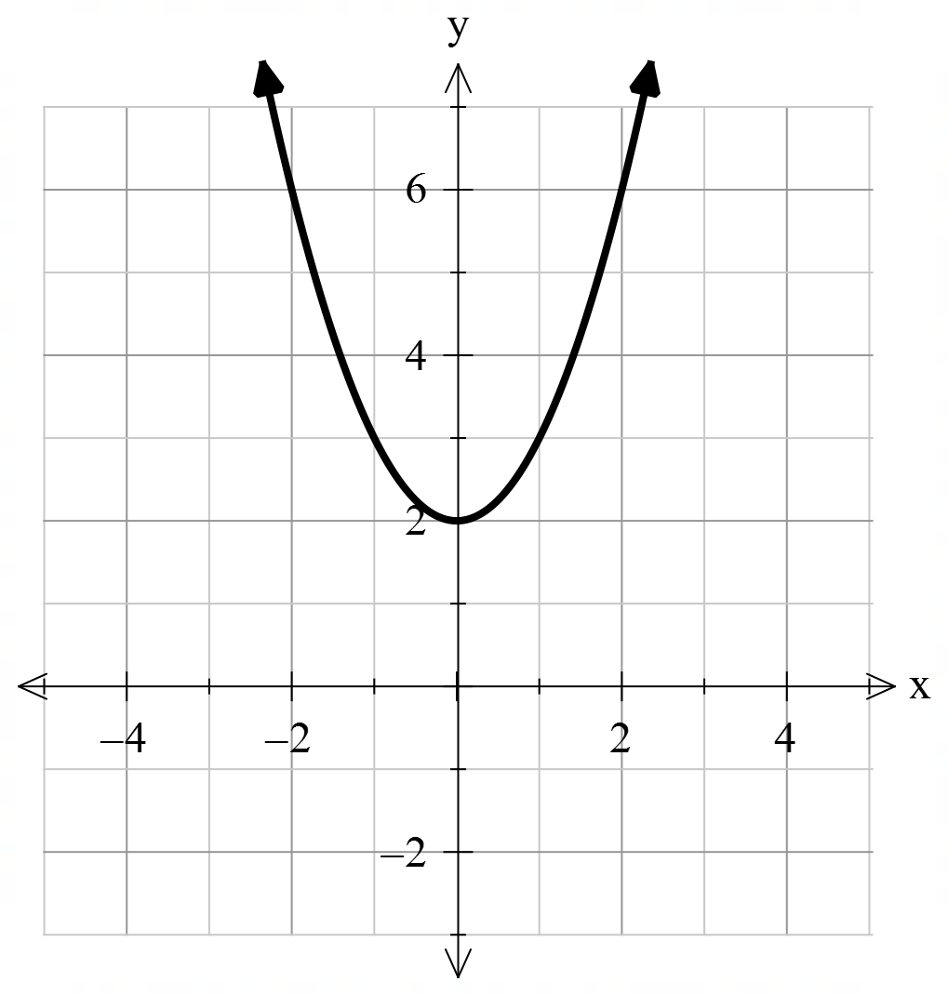

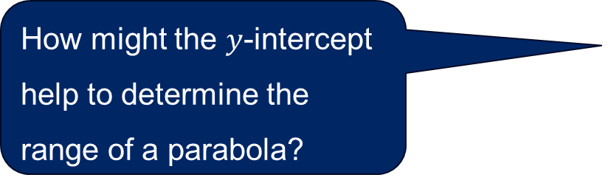
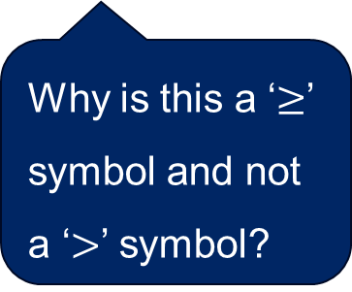
Domain and range (1)
Worked example 1
What is the domain and range of $f\left(x\right)=x^{2}+2$?
Write your answer as an inequality where possible.
Domain: all real $x$
Range: $y≥2$
How might the $y$-intercept help to determine the range of a parabola?
Why is this a ‘$≥$’ symbol and not a ‘$>$’ symbol?

Slide 10
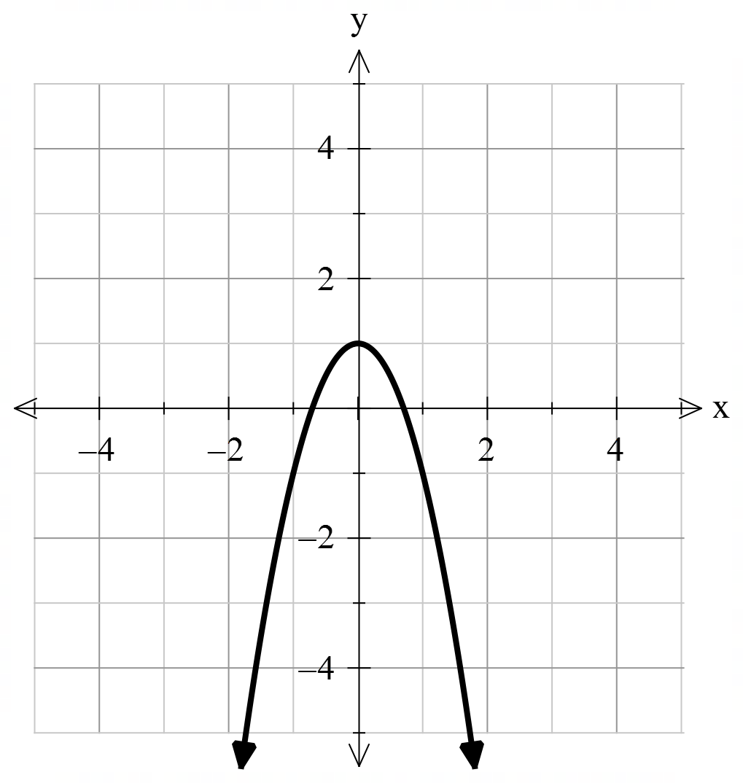

Domain and range (2)
Your turn – question 1
What is the domain and range of $f\left(x\right)=−x^{2}+1$?
Write your answer as an inequality where possible.
Domain: all real $x$
Range: $y≤1$

Slide 11
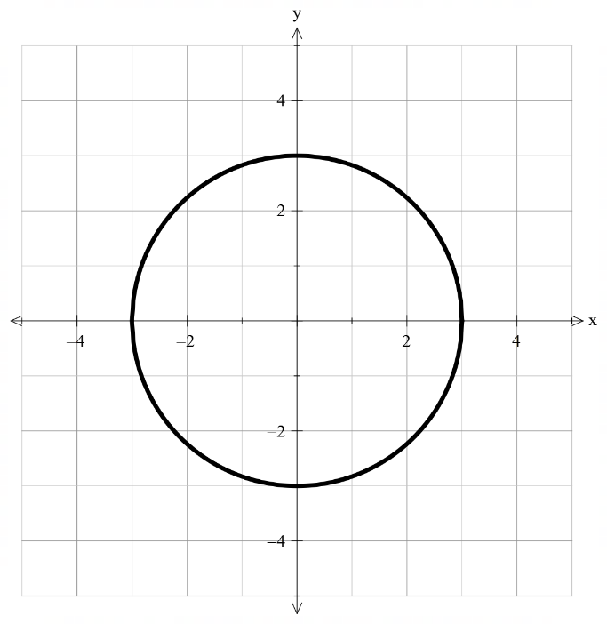

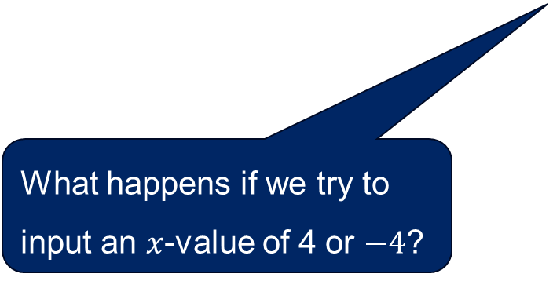
Domain and range (3)
Worked example 2
What is the domain and range of $x^{2}+y^{2}=9$?
Write your answers in the form of an inequality.
Domain: $−3≤x≤3$
Range: $−3≤y≤3$
What does this mean?
What happens if we try to input an $x$-value of 4 or $−4$?

Slide 12
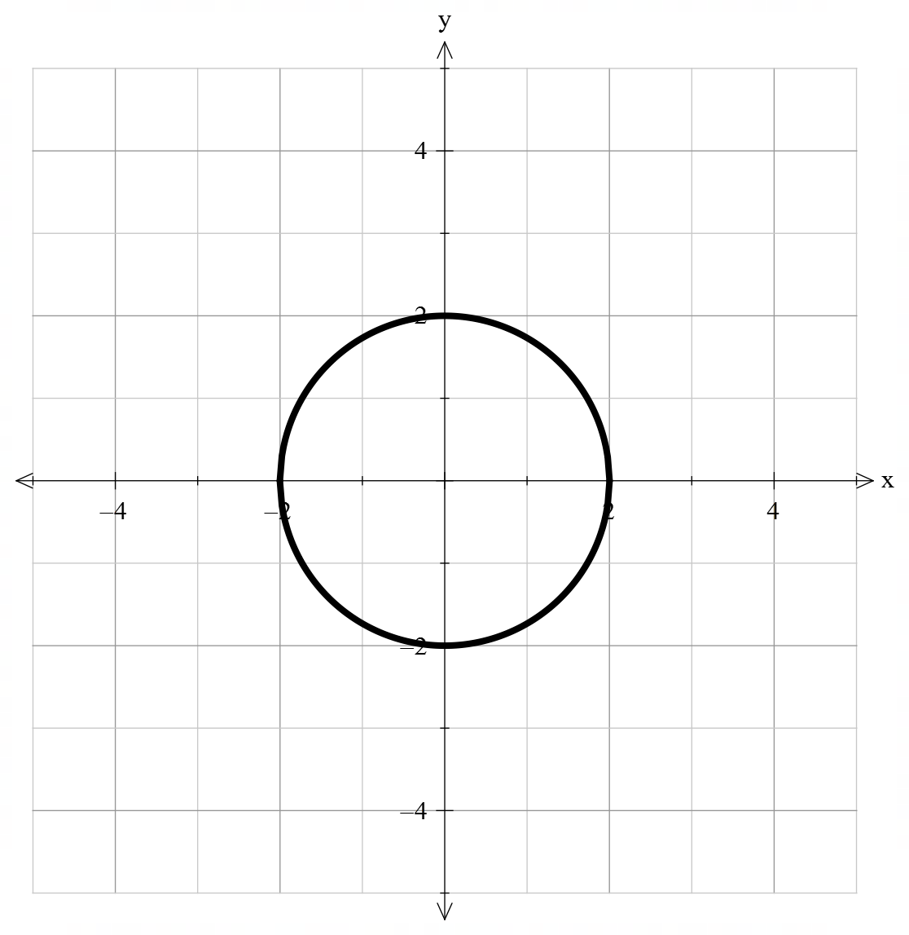

Domain and range (4)
Your turn – question 2
What is the domain and range of $x^{2}+y^{2}=4$?
Write your answers in the form of an inequality.
Domain: $−2≤x≤2$
Range: $−2≤y≤2$

Slide 13
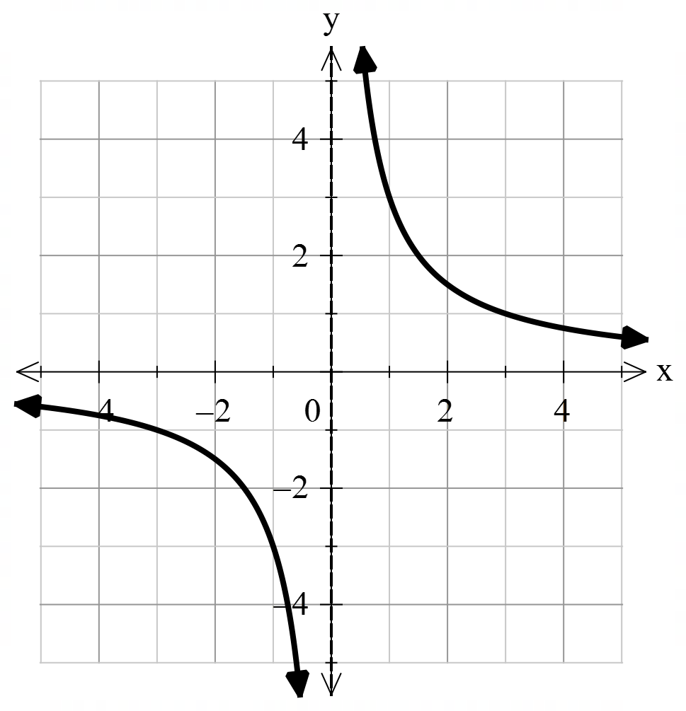

Domain and range (5)
Worked example 3
Determine the domain and range for $f\left(x\right)=\frac{3}{x}.$
Write your answer using mathematical notation.
Domain: All real $x$, $x≠0$
Range: All real $y$, $y≠0$
What does this symbol mean?
Why can’t we input zero?
How else could we express the domain and range of this function?

Slide 14
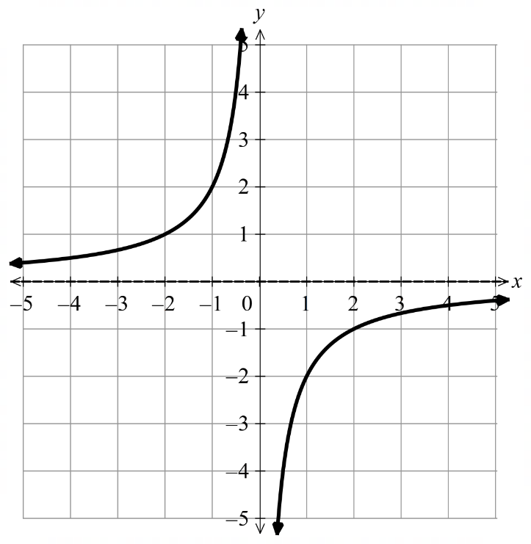

Domain and range (6)
Your turn – question 3
Determine the domain and range for $f\left(x\right)=−\frac{2}{x}.$
Write your answer using mathematical notation.
Domain: All real $x$, $x≠0$
Range: All real $y$, $y≠0$

Slide 15
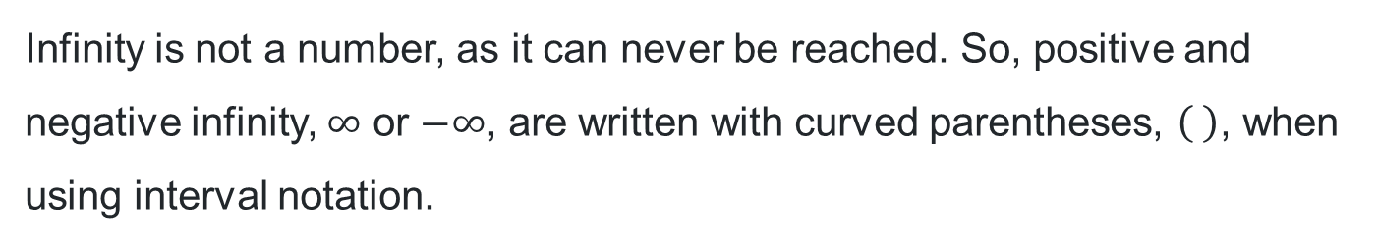
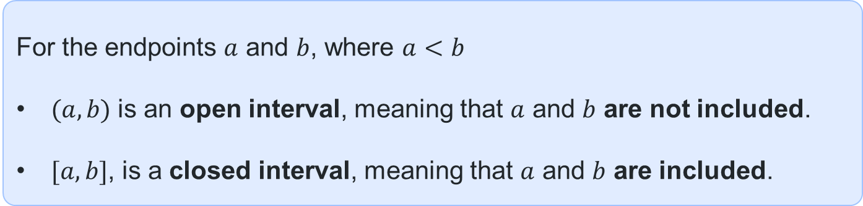
Interval notation (1)
Definition
Interval notation is a way of representing an interval on the real number line using its endpoints.
For the endpoints $a$ and $b$, where $a<b$
$(a, b)$ is an open interval, meaning that $a$ and $b$ are not included.
$[a, b]$, is a closed interval, meaning that $a$ and $b$ are included.
What is meant by the word ‘endpoints’?
Infinity is not a number, as it can never be reached. So, positive and negative infinity, $∞$ or $−∞$, are written with curved parentheses, , when using interval notation.

Slide 16
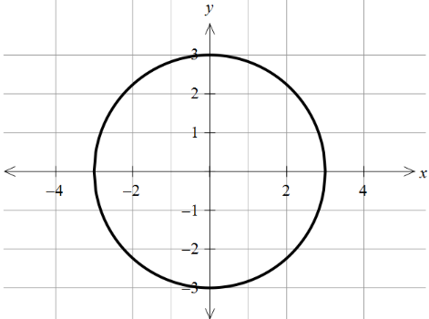
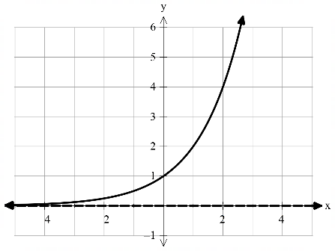
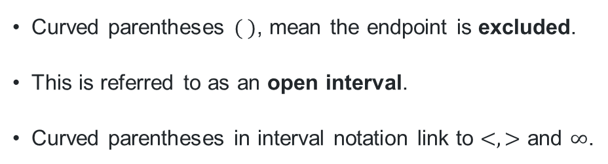
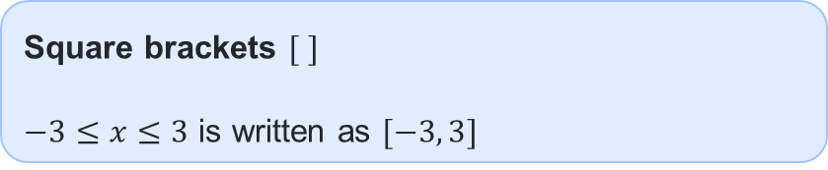

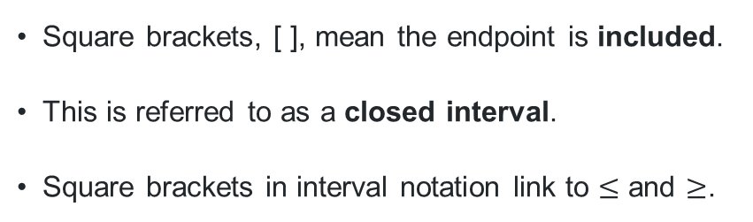
Interval notation (2)
Definitions
Square brackets $[ ]$
$−3≤x≤3$ is written as $[−3, 3]$
Curved parentheses $( )$
$y>0$ is written as $(0, ∞)$
What are the endpoints for the domain of the circle?
Square brackets, [ ], mean the endpoint is included.
This is referred to as a closed interval.
Square brackets in interval notation link to $≤$ and $≥$.
Curved parentheses $( )$, mean the endpoint is excluded.
This is referred to as an open interval.
Curved parentheses in interval notation link to $<, >$ and $∞$.

Slide 17
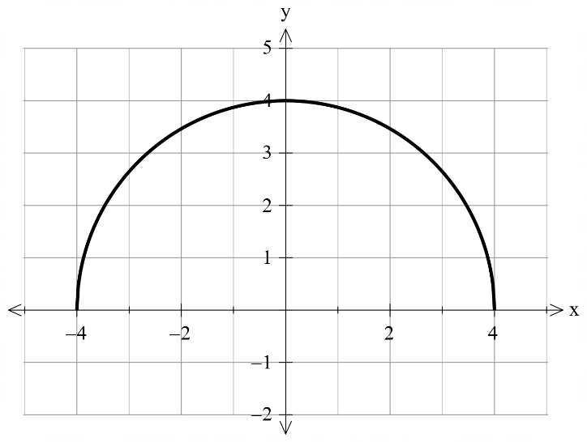
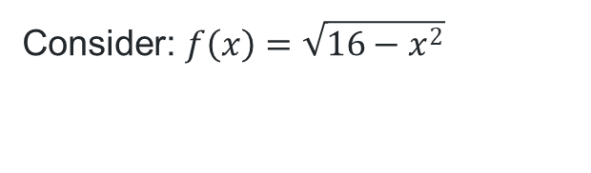
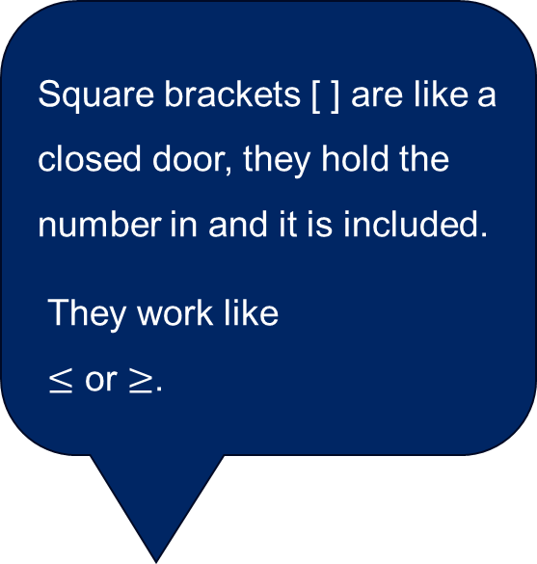
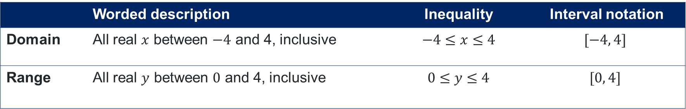
Interval notation (3)
Example 1
Square brackets [ ] are like a closed door, they hold the number in and it is included.
They work like
$≤$ or $≥$.
Consider: $f\left(x\right)=\sqrt{16−x^{2}}$
 | Worded description | Inequality | Interval notation
Domain | All real $x$ between $−4$ and 4, inclusive | $−4≤$ $x≤4$ | $$[−4, 4]$$
Range | All real $y$ between $0$ and 4, inclusive | $0≤$ $y≤4$ | $$[0, 4]$$

Slide 18
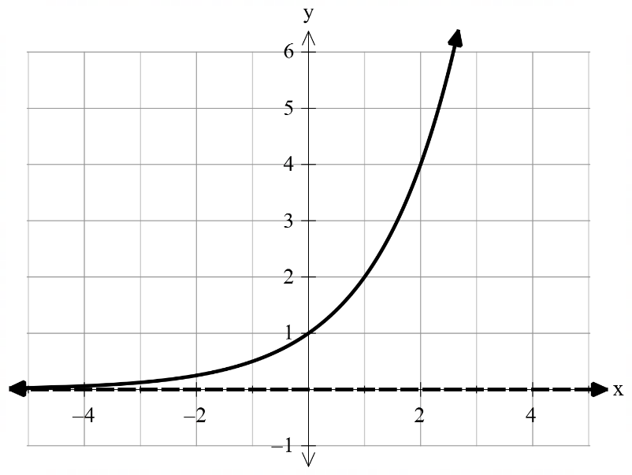

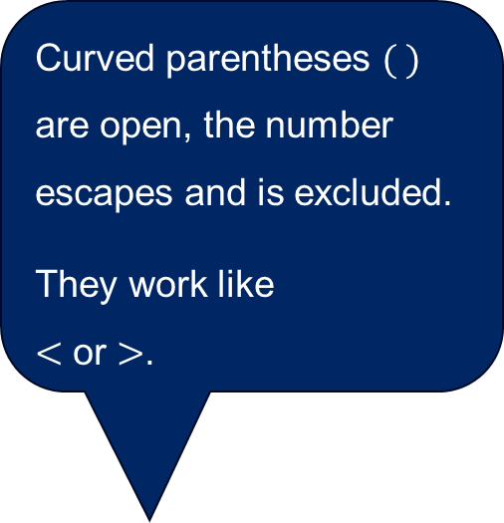
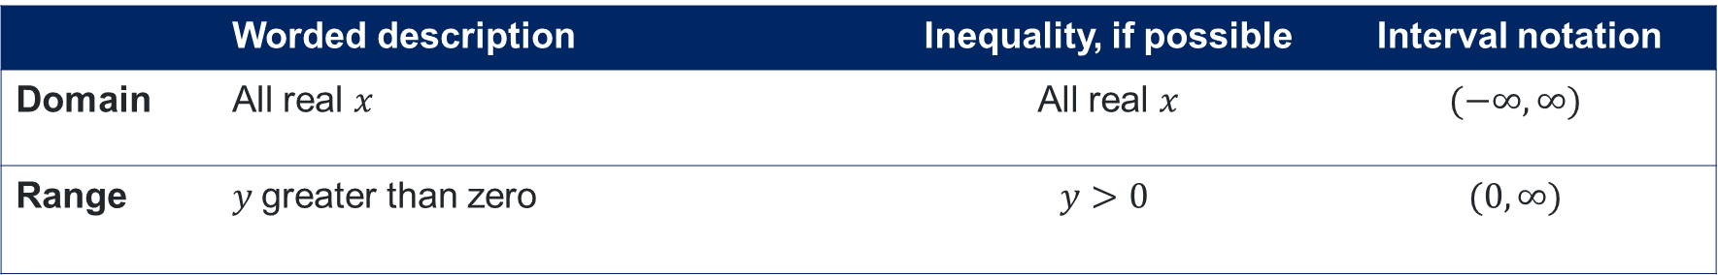
Interval notation (4)
Example 2
Curved parentheses $( )$ are open, the number escapes and is excluded.
They work like
$<$ or $>$.
Consider: $f\left(x\right)=2^{x}$
 | Worded description | Inequality, if possible | Interval notation
Domain | All real $x$ | All real $x$ | $$(−∞, ∞)$$
Range | $y$greater than zero | $$y>0$$ | $$(0, ∞)$$

Slide 19
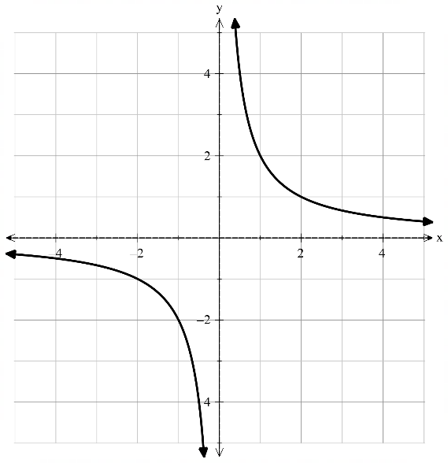

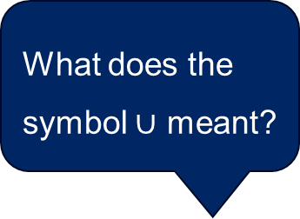
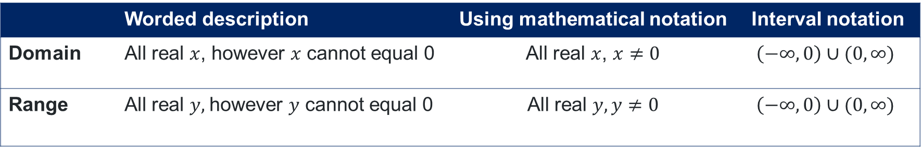
Interval notation (5)
Example 3
Consider: $f\left(x\right)=\frac{2}{x}$
What does the symbol $∪$ meant?
 | Worded description | Using mathematical notation | Interval notation
Domain | All real $x$, however $x$ cannot equal 0 | All real $x$, $x≠0$ | $$\left(−∞, 0\right)∪(0, ∞)$$
Range | All real $y,$however $y$ cannot equal 0 | All real $y, y≠0$ | $$\left(−∞, 0\right)∪(0, ∞)$$

Slide 20
References
This presentation contains NSW Curriculum and syllabus content. The NSW Curriculum is developed by the NSW Education Standards Authority. This content is prepared by NESA for and on behalf of the Crown in the right of the State of New South Wales. The material is protected by Crown copyright.
Please refer to the NESA Copyright Disclaimer for more information https://educationstandards.nsw.edu.au/wps/portal/nesa/mini-footer/copyright.
NESA holds the only official and up-to-date versions of the NSW Curriculum and syllabus documents. Please visit the NSW Education Standards Authority (NESA) website https://educationstandards.nsw.edu.au/wps/portal/nesa/home and the NSW Curriculum website https://curriculum.nsw.edu.au.
Mathematics Advanced 11-12 Syllabus © NSW Education Standards Authority (NESA) for and on behalf of the Crown in right of the State of New South Wales, 2024.

Slide 21
Copyright
© State of New South Wales (Department of Education), 2025
The copyright material published in this resource is subject to the Copyright Act 1968 (Cth) and is owned by the NSW Department of Education or, where indicated, by a party other than the NSW Department of Education (third-party material).
Copyright material available in this resource and owned by the NSW Department of Education is licensed under a Creative Commons Attribution 4.0 International (CC BY 4.0) license.
This license allows you to share and adapt the material for any purpose, even commercially.
Attribution should be given to © State of New South Wales (Department of Education), 2025.
Material in this resource not available under a Creative Commons license:
the NSW Department of Education logo, other logos and trademark-protected material
Material owned by a third party that has been reproduced with permission. You will need to obtain permission from the third party to reuse its material.
Links to third-party material and websites
Please note that the provided (reading/viewing material/list/links/texts) are a suggestion only and implies no endorsement, by the New South Wales Department of Education, of any author, publisher, or book title. School principals and teachers are best placed to assess the suitability of resources that would complement the curriculum and reflect the needs and interests of their students.
If you use the links provided in this document to access a third-party’s website, you acknowledge that the terms of use, including licence terms set out on the third-party’s website apply to the use which may be made of the materials on that third-party website or where permitted by the Copyright Act 1968 (Cth). The department accepts no responsibility for content on third-party websites.

