Slide 1
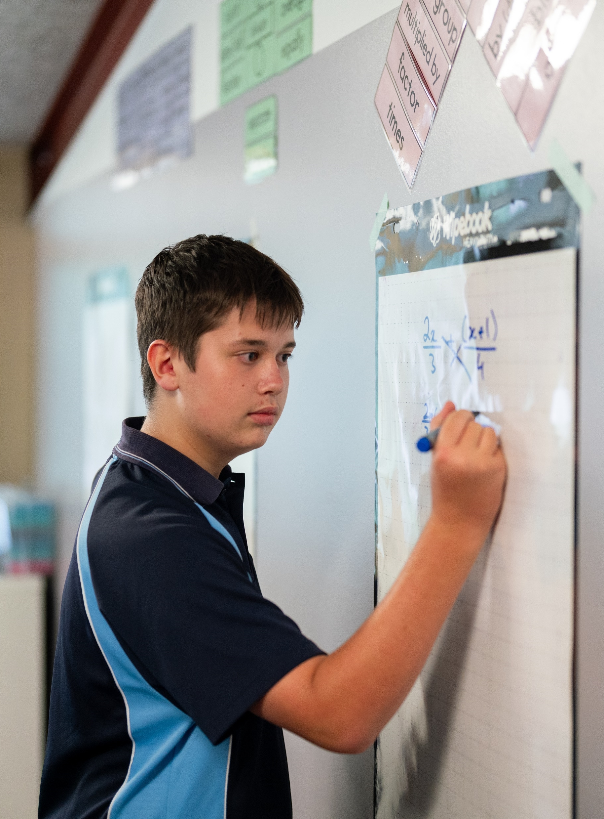
Circles and semicircles
Mathematics Advanced – Stage 6 (Year 11)
Introduction to functions

Slide 2
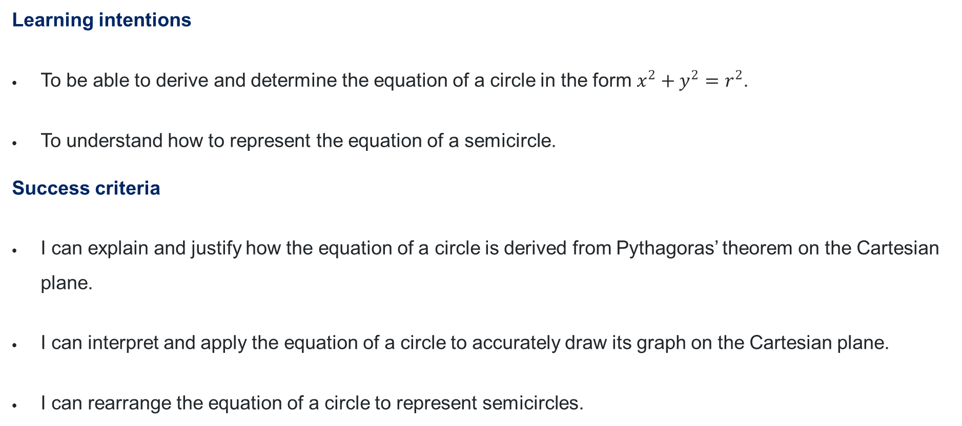
Learning intentions and success criteria
Learning intentions
To be able to derive and determine the equation of a circle in the form $x^{2}+y^{2}=r^{2}$.
To understand how to represent the equation of a semicircle.
Success criteria
I can explain and justify how the equation of a circle is derived from Pythagoras’ theorem on the Cartesian plane.
I can interpret and apply the equation of a circle to accurately draw its graph on the Cartesian plane.
I can rearrange the equation of a circle to represent semicircles.

Slide 3
Connecting learning

Slide 4
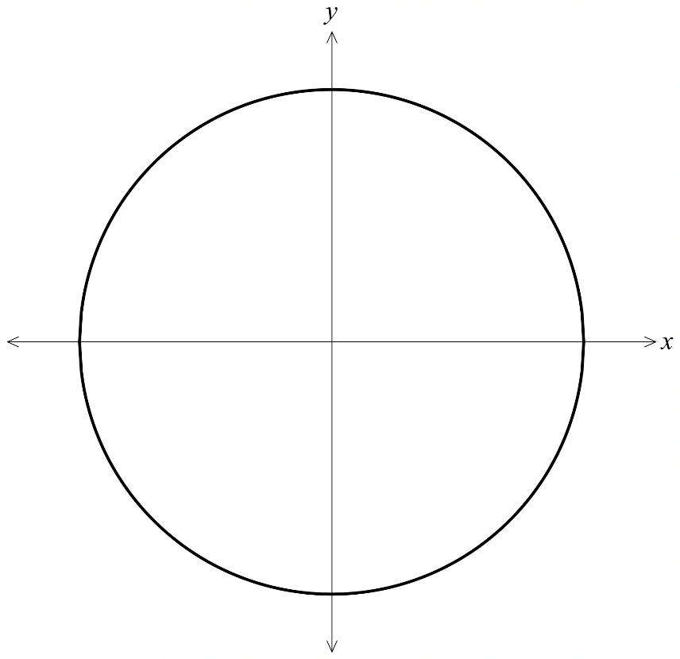





The equation of a circle
The graph of $x^{2}+y^{2}=r^{2}$
$$r$$
$$r$$
$$−r$$
$$r$$
$$−r$$

Slide 5
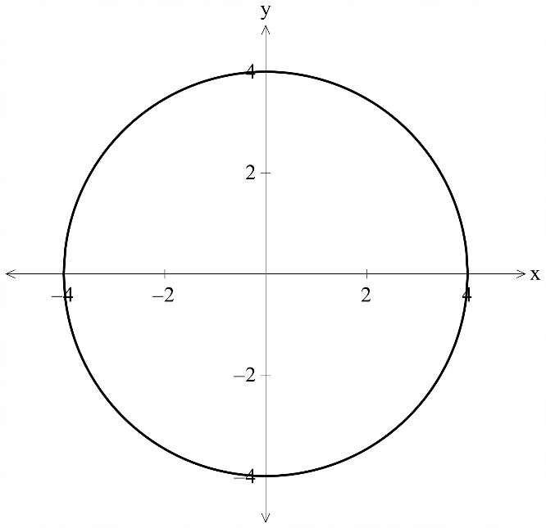

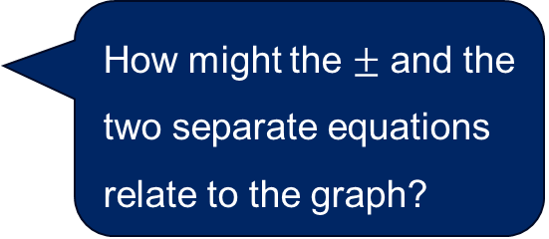
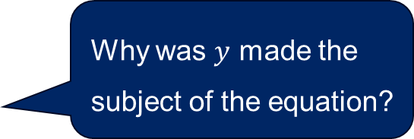
Rearranging the equation of a circle
How can the equation of a circle, with the centre at the origin and a radius of $4$ be rearranged?
$$x^{2}+y^{2}=4^{2}$$
$$y^{2}=\sqrt{16−x^{2}}$$
$$y=±\sqrt{16−x^{2}}$$
$$∴y=\sqrt{16−x^{2}} \text{or} y=−\sqrt{16−x^{2}}$$
Why was $y$ made the subject of the equation?
How might the $±$ and the two separate equations relate to the graph?

Slide 6
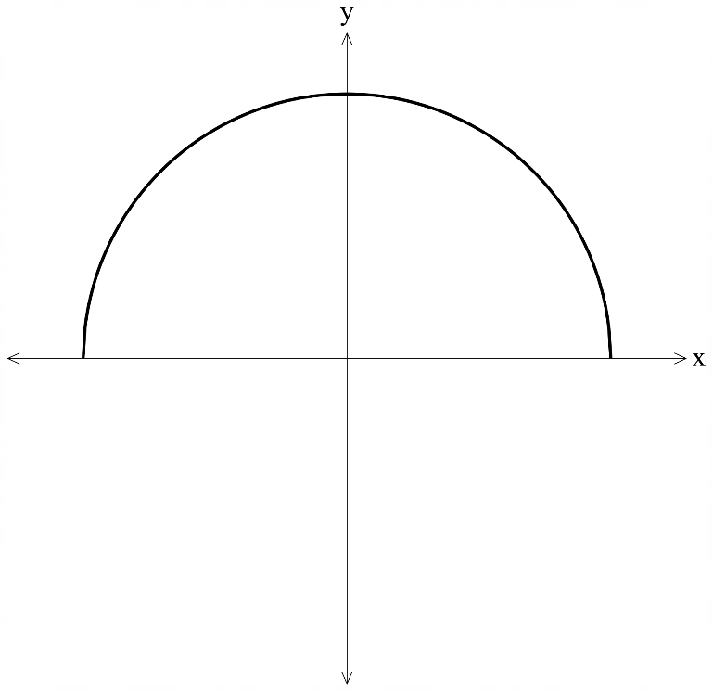
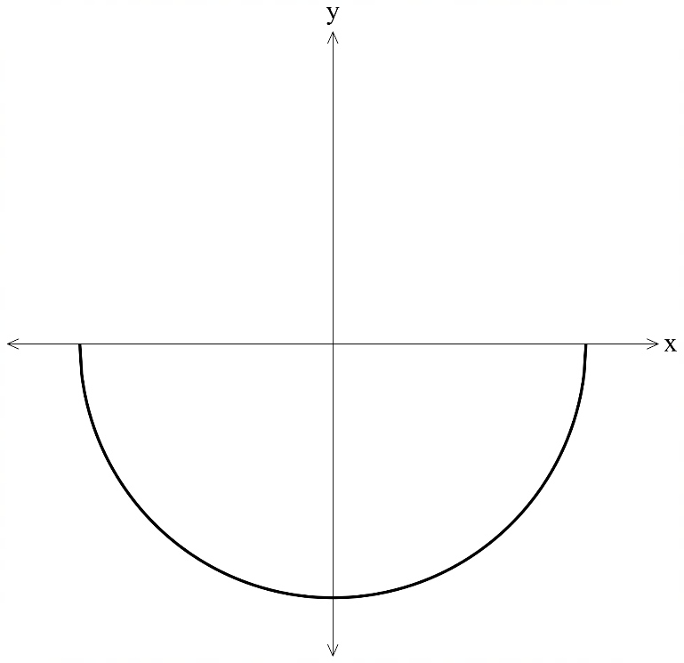

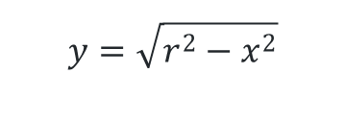
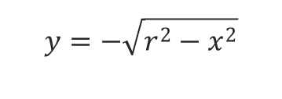





The equation of a semicircle (1)
Top and bottom half of a circle
$$y=\sqrt{r^{2}−x^{2}}$$
$$y=−\sqrt{r^{2}−x^{2}}$$
$$r$$
$$−r$$
$$r$$
$$−r$$
$$r$$
$$−r$$

Slide 7
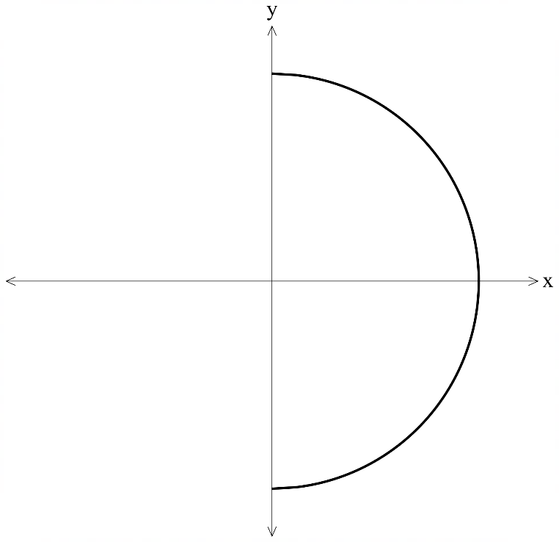
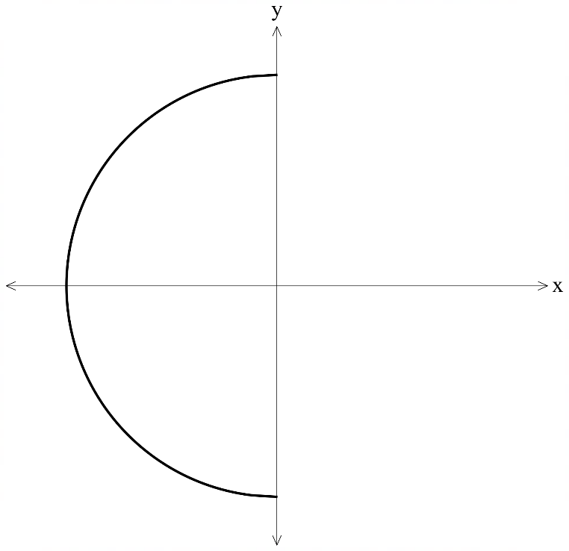
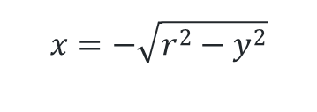
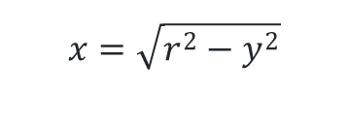






The equation of a semicircle (2)
Left and right sides
$$x=\sqrt{r^{2}−y^{2}}$$
$$x=−\sqrt{r^{2}−y^{2}}$$
$$r$$
$$r$$
$$r$$
$$−r$$
$$−r$$
$$−r$$

Slide 8
Releasing responsibility

Slide 9
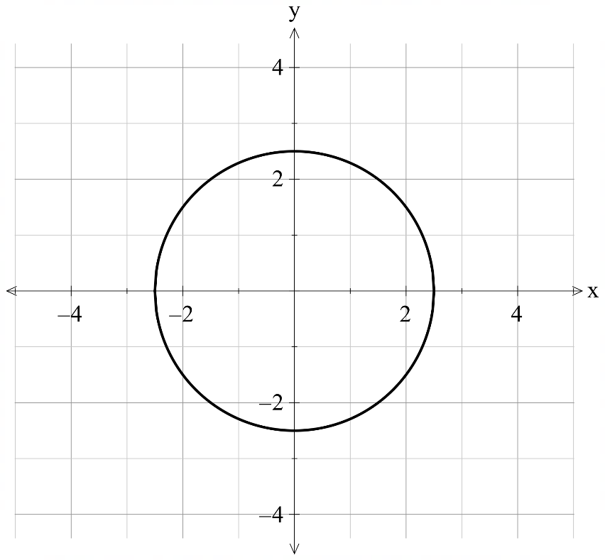
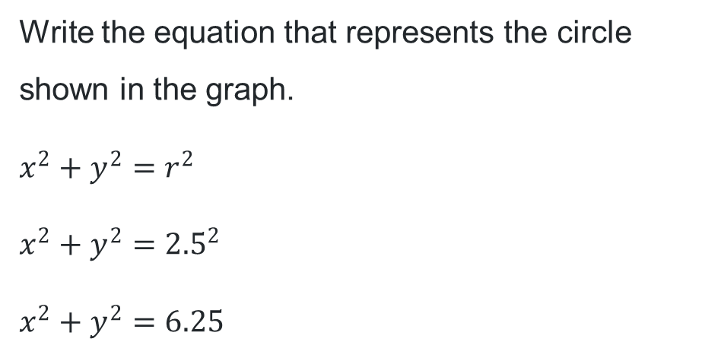
Circles and semicircles (1)
Worked example 1
Write the equation that represents the circle shown in the graph.
$$x^{2}+y^{2}=r^{2}$$
$$x^{2}+y^{2}={2.5}^{2}$$
$$x^{2}+y^{2}=6.25$$
Which version of the equation assists with graphing the circle?
What information from the graph is needed to write the equation of a circle?

Slide 10
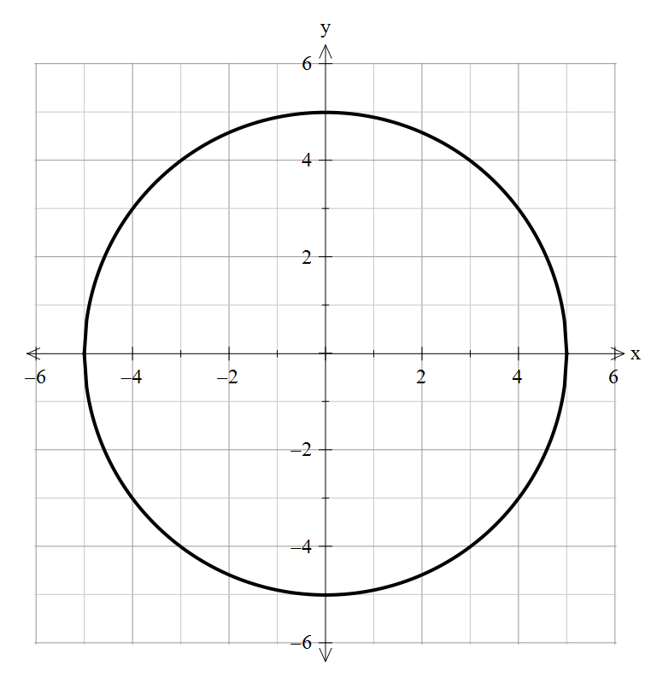
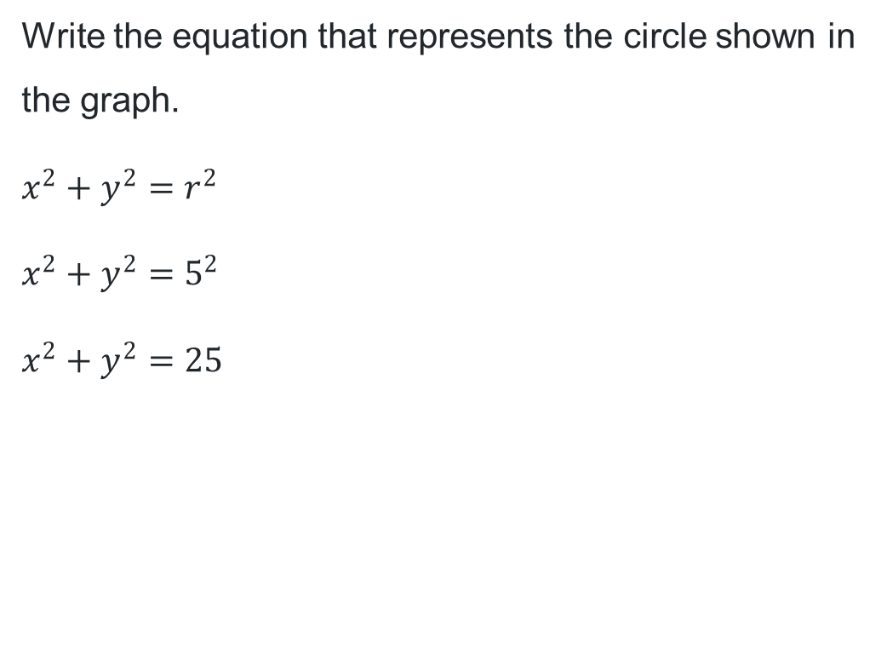
Circles and semicircles (2)
Your turn – question 1
Write the equation that represents the circle shown in the graph.
$$x^{2}+y^{2}=r^{2}$$
$$x^{2}+y^{2}=5^{2}$$
$$x^{2}+y^{2}=25$$

Slide 11
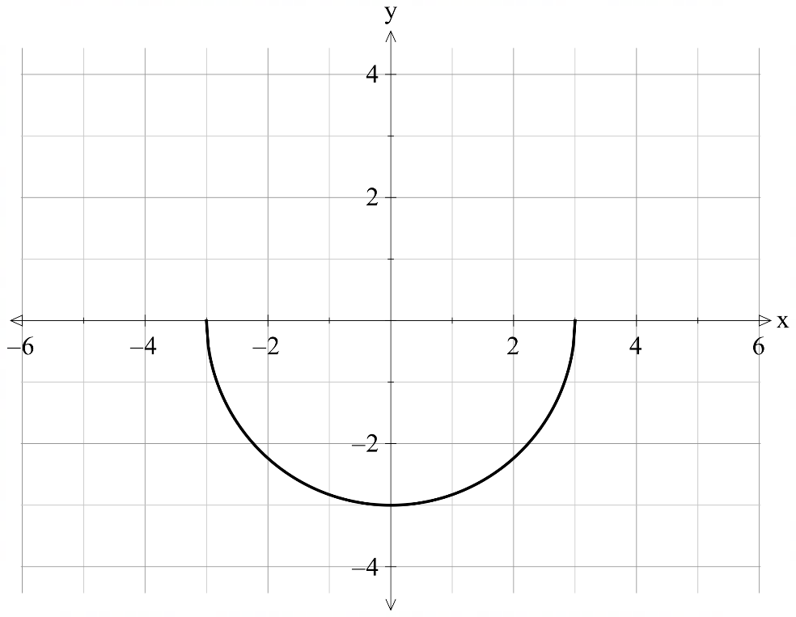
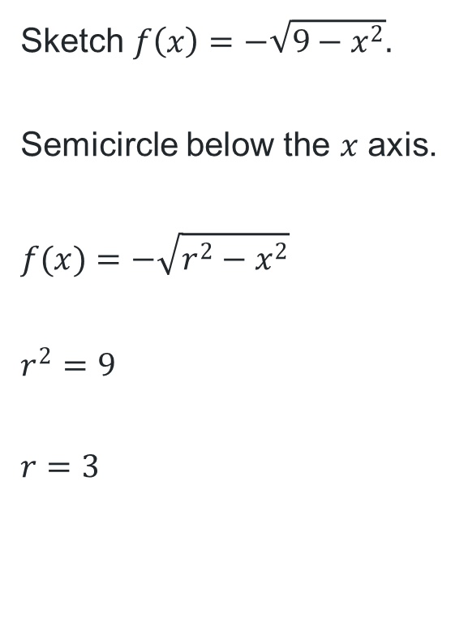
Circles and semicircles (3)
Worked example 2
What does the equation tell us about the graphical representation of this semicircle?
Sketch $f\left(x\right)=−\sqrt{9−x^{2}}.$
Semicircle below the $x$ axis.
$$f(x)=−\sqrt{r^{2}−x^{2}}$$
$$r^{2}=9$$
$$r=3$$
How was the radius of 3 determined from the equation?

Slide 12
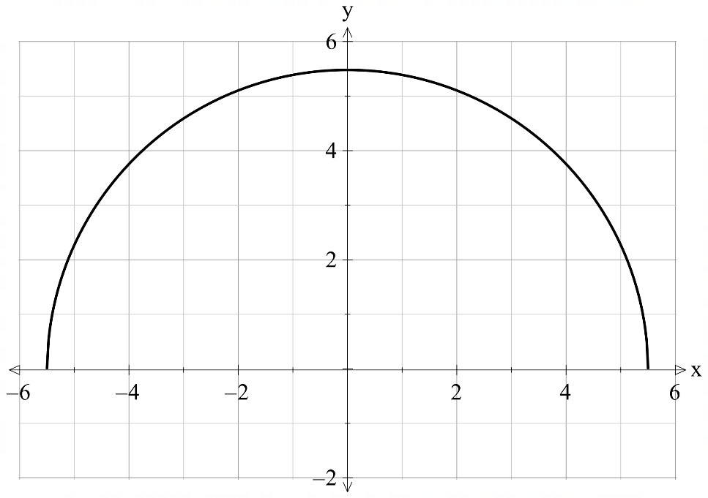

Circles and semicircles (4)
Your turn – question 2
Sketch $y=\sqrt{\frac{121}{4}−x^{2}}$
Semicircle above the $x$- axis.
$$y=−\sqrt{r^{2}−x^{2}}$$
$$y=−\sqrt{{\left(\frac{11}{2}\right)}^{2}−x^{2}}$$
$$∴r=5.5$$

Slide 13
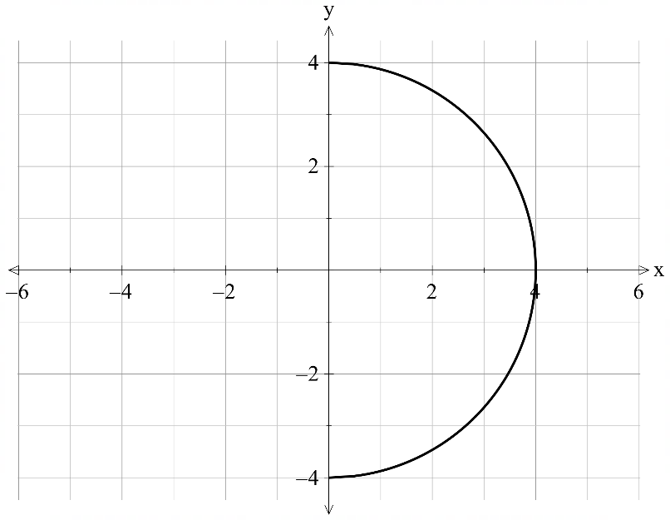
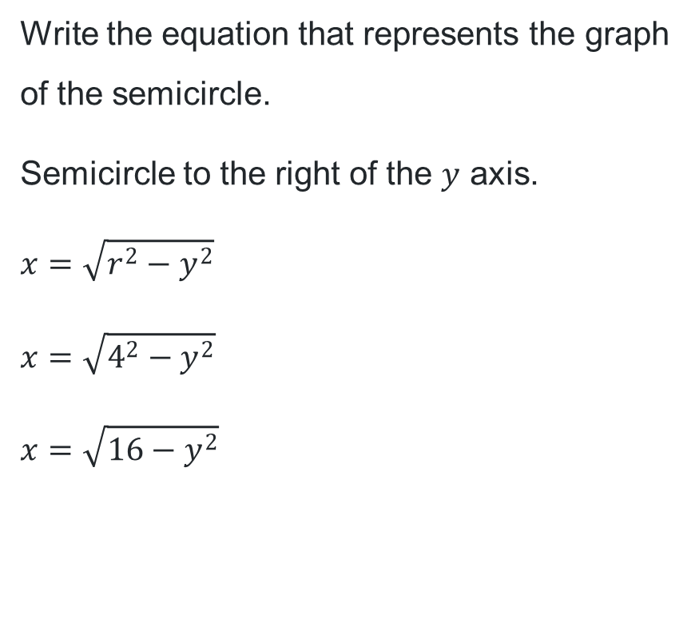
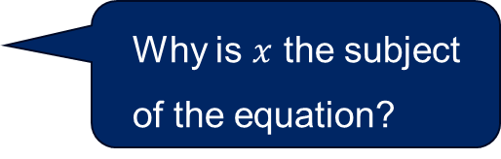
Circles and semicircles (5)
Worked example 3
What does the graph tell us about the structure of the equation?
Write the equation that represents the graph of the semicircle.
Semicircle to the right of the $y$ axis.
$$x=\sqrt{r^{2}−y^{2}}$$
$$x=\sqrt{4^{2}−y^{2}}$$
$$x=\sqrt{16−y^{2}}$$
Why is $x$ the subject of the equation?

Slide 14
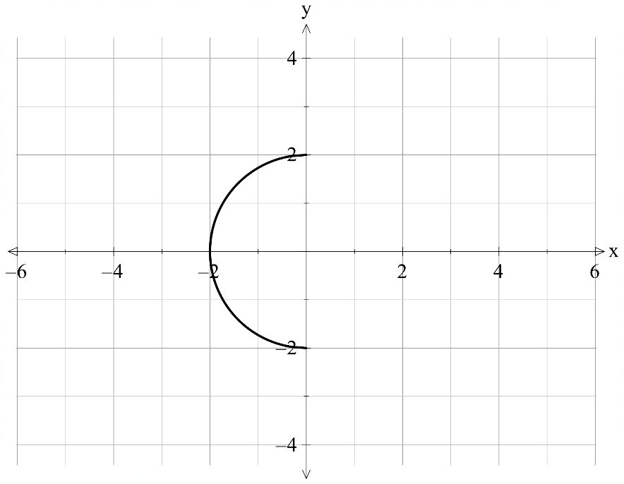
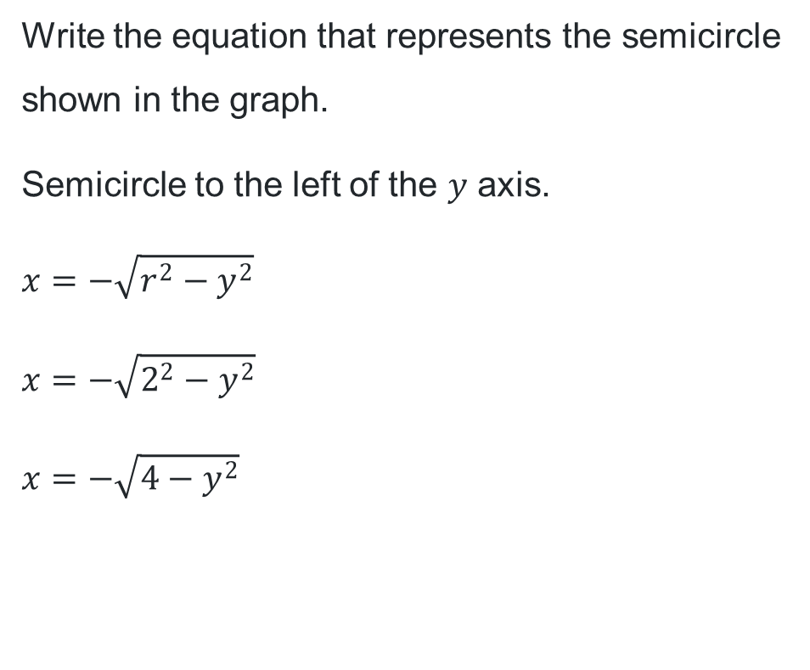
Circles and semicircles (6)
Your turn – question 3
Write the equation that represents the semicircle shown in the graph.
Semicircle to the left of the $y$ axis.
$$x=−\sqrt{r^{2}−y^{2}}$$
$$x=−\sqrt{2^{2}−y^{2}}$$
$x=−\sqrt{4−y^{2}}$

Slide 15
References
This presentation contains NSW Curriculum and syllabus content. The NSW Curriculum is developed by the NSW Education Standards Authority. This content is prepared by NESA for and on behalf of the Crown in the right of the State of New South Wales. The material is protected by Crown copyright.
Please refer to the NESA Copyright Disclaimer for more information https://educationstandards.nsw.edu.au/wps/portal/nesa/mini-footer/copyright.
NESA holds the only official and up-to-date versions of the NSW Curriculum and syllabus documents. Please visit the NSW Education Standards Authority (NESA) website https://educationstandards.nsw.edu.au/wps/portal/nesa/home and the NSW Curriculum website https://curriculum.nsw.edu.au.
Mathematics Advanced 11-12 Syllabus © NSW Education Standards Authority (NESA) for and on behalf of the Crown in right of the State of New South Wales, 2024.

Slide 16
Copyright
© State of New South Wales (Department of Education), 2025
The copyright material published in this resource is subject to the Copyright Act 1968 (Cth) and is owned by the NSW Department of Education or, where indicated, by a party other than the NSW Department of Education (third-party material).
Copyright material available in this resource and owned by the NSW Department of Education is licensed under a Creative Commons Attribution 4.0 International (CC BY 4.0) license.
This license allows you to share and adapt the material for any purpose, even commercially.
Attribution should be given to © State of New South Wales (Department of Education), 2025.
Material in this resource not available under a Creative Commons license:
the NSW Department of Education logo, other logos and trademark-protected material
Material owned by a third party that has been reproduced with permission. You will need to obtain permission from the third party to reuse its material.
Links to third-party material and websites
Please note that the provided (reading/viewing material/list/links/texts) are a suggestion only and implies no endorsement, by the New South Wales Department of Education, of any author, publisher, or book title. School principals and teachers are best placed to assess the suitability of resources that would complement the curriculum and reflect the needs and interests of their students.
If you use the links provided in this document to access a third-party’s website, you acknowledge that the terms of use, including licence terms set out on the third-party’s website apply to the use which may be made of the materials on that third-party website or where permitted by the Copyright Act 1968 (Cth). The department accepts no responsibility for content on third-party websites.

