Slide 1
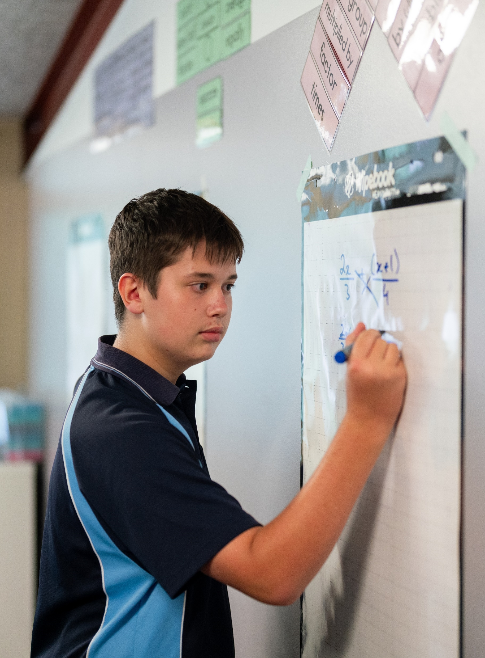
Function values and intercepts
Mathematics Advanced – Stage 6 – Year 11
Introduction to functions

Slide 2
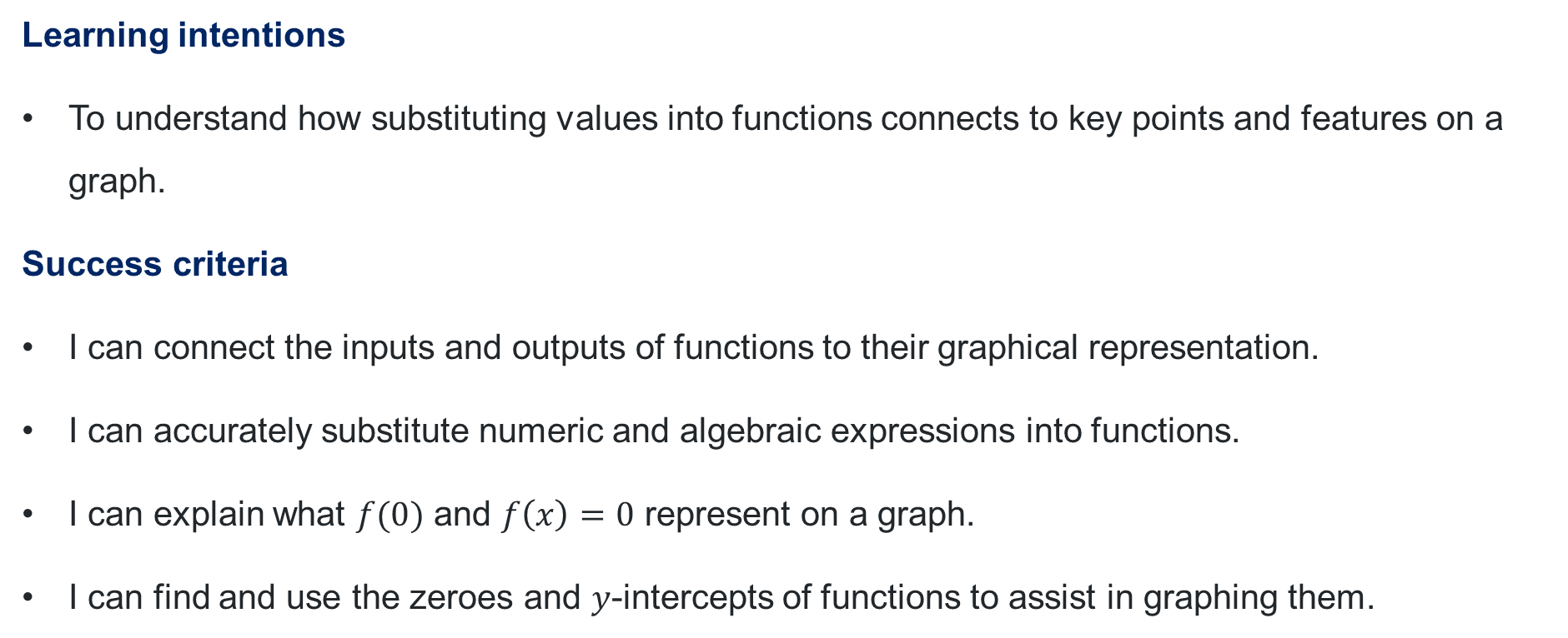
Learning intentions and success criteria
Learning intentions
To understand how substituting values into functions connects to key points and features on a graph.
Success criteria
I can connect the inputs and outputs of functions to their graphical representation.
I can accurately substitute numeric and algebraic expressions into functions.
I can explain what $f(0)$ and $f\left(x\right)=0$ represent on a graph.
I can find and use the zeroes and $y$-intercepts of functions to assist in graphing them.
Notes:
Notes for teachers:
Learning intentions and success criteria are best co-constructed with students. Adapt the learning intention as required and add matching success criteria.
For more information See ⁠AITSL or the NSW Department of Education explicit teaching strategies, ⁠Sharing learning intentions and ⁠Sharing success criteria
LISC is not necessarily presented at the beginning of the lesson. Teacher needs to consider most effectual time to introduce
LISC should be revisited during the lesson to support students' evaluation of their learning

Slide 3
Connecting learning

Slide 4
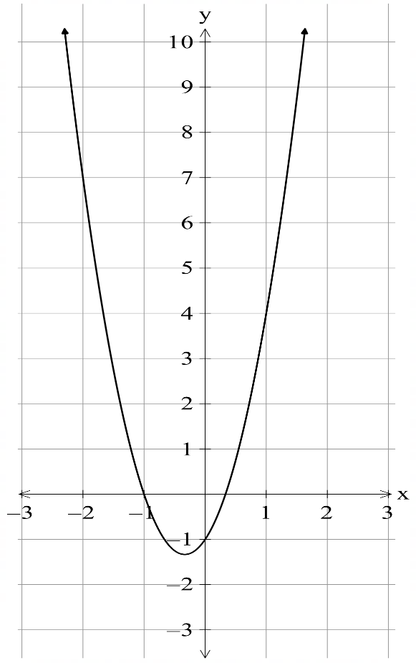
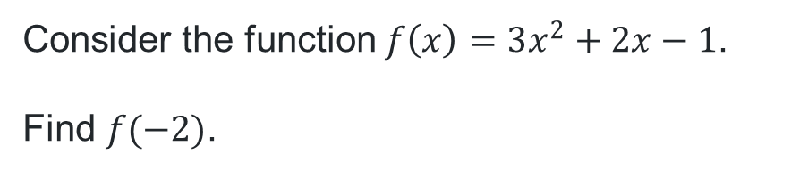
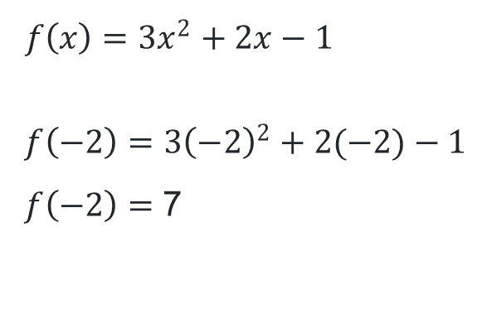
Substituting numerical values into functions (1)
Worked example 1
Consider the function $f\left(x\right)=3x^{2}+2x−1$.
Find $f(−2)$.
What are the independent and dependent variables in this equation?
$$f\left(x\right)={3x}^{2}+2x−1$$
$$f\left(−2\right)={3\left(−2\right)}^{2}+2(−2)−1$$
$f\left(−2\right)=$ 7
How might you explain what this means in connection to the graph?

Slide 5
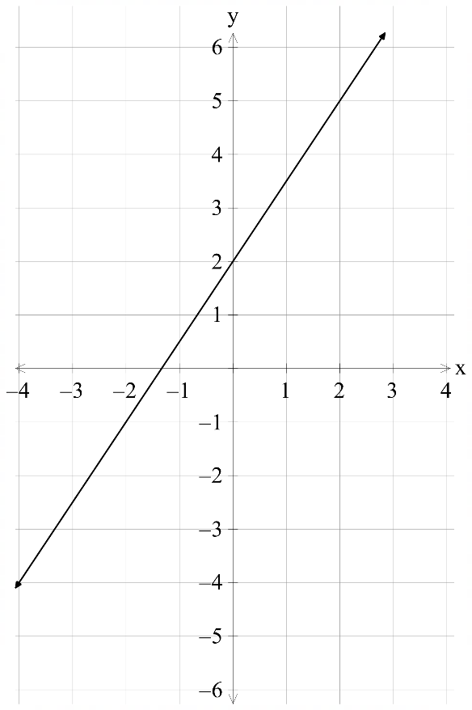
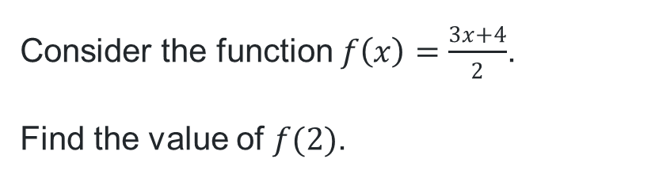

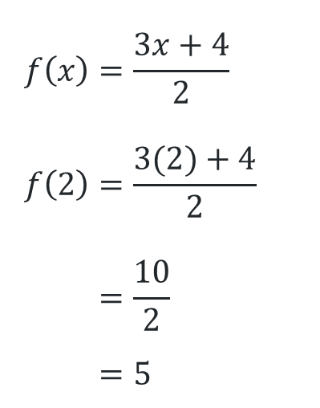
Substituting numerical values into functions (2)
Your turn 1
Consider the function $f\left(x\right)=\frac{3x+4}{2}$.
Find the value of $f(2)$.
$$(2, 5)$$
$$f\left(x\right)=\frac{3x+4}{2} \\ f\left(2\right)=\frac{3(2)+4}{2} \\ =\frac{10}{2} \\ =5$$

Slide 6
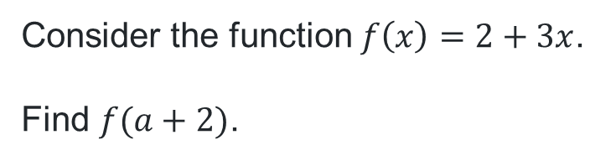
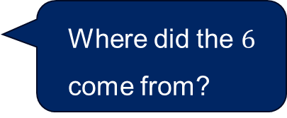
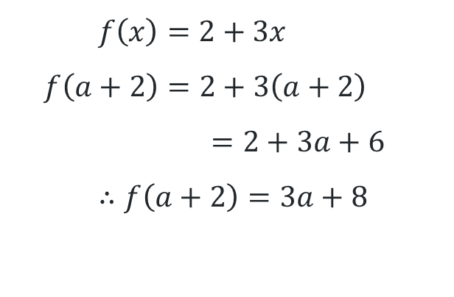
Substituting in algebraic expressions (1)
Worked example 2
What are the independent and dependent variables in this equation?
Consider the function $f\left(x\right)=2+3x$.
Find $f(a+2)$.
What does this notation mean?
$$f\left(x\right)=2+3x \\ f\left(a+2\right)=2+3\left(a+2\right) \\ =2+3a+6 \\ ∴f\left(a+2\right)=3a+8$$
Where did the $6$ come from?

Slide 7
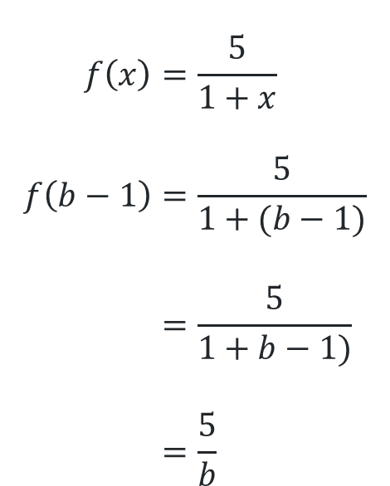
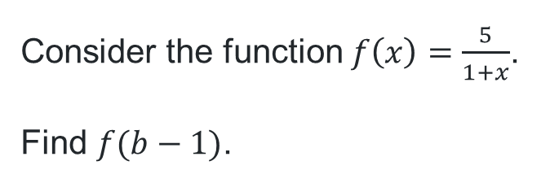
Substituting in algebraic expressions (2)
Your turn 1
Consider the function $f\left(x\right)=\frac{5}{1+x}$.
Find $f(b−1)$.
$$f\left(x\right)=\frac{5}{1+x} \\ f\left(b−1\right)=\frac{5}{1+(b−1)} \\ =\frac{5}{1+b−1)} \\ =\frac{5}{b}$$

Slide 8
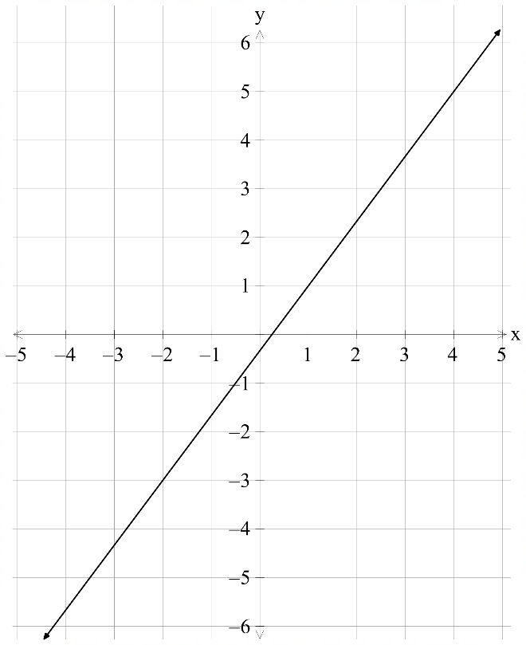
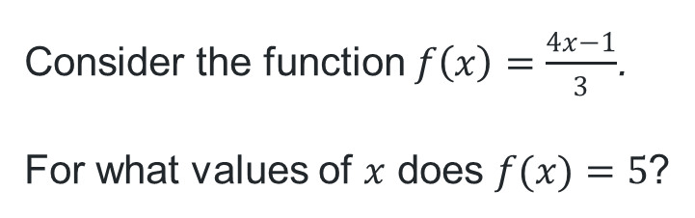

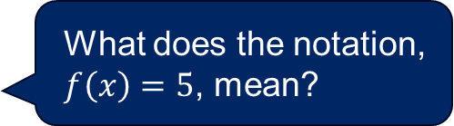
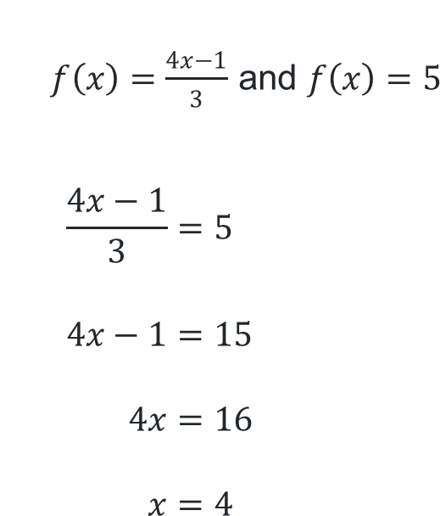
Solving an equation with function notation (1)
Worked example 3
Consider the function $f\left(x\right)=\frac{4x−1}{3}$.
For what values of $x$ does $f(x)=5$?
What does the notation, $f\left(x\right)=5$, mean?
$$(4, 5)$$
$f\left(x\right)=$ $\frac{4x−1}{3}$ and $f\left(x\right)=5$
$$\frac{4x−1}{3}=5 \\ 4x−1=15 \\ 4x=16 \\ x=4$$
What does this solution represent graphically?

Slide 9
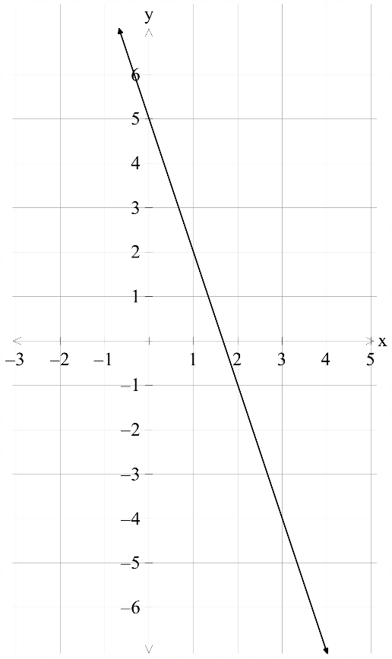
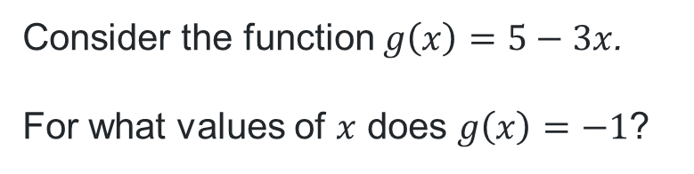
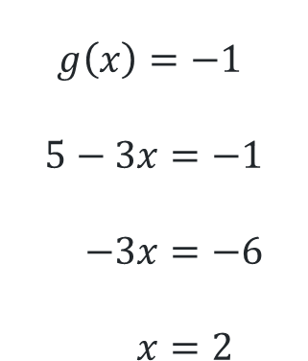
Solving an equation with function notation (2)
Your turn 3
Consider the function $g\left(x\right)=5−3x$.
For what values of $x$ does $g\left(x\right)=−1$?
$$g\left(x\right)=−1$$
$$5−3x=−1 \\ −3x=−6 \\ x=2$$

Slide 10
Releasing responsibility

Slide 11
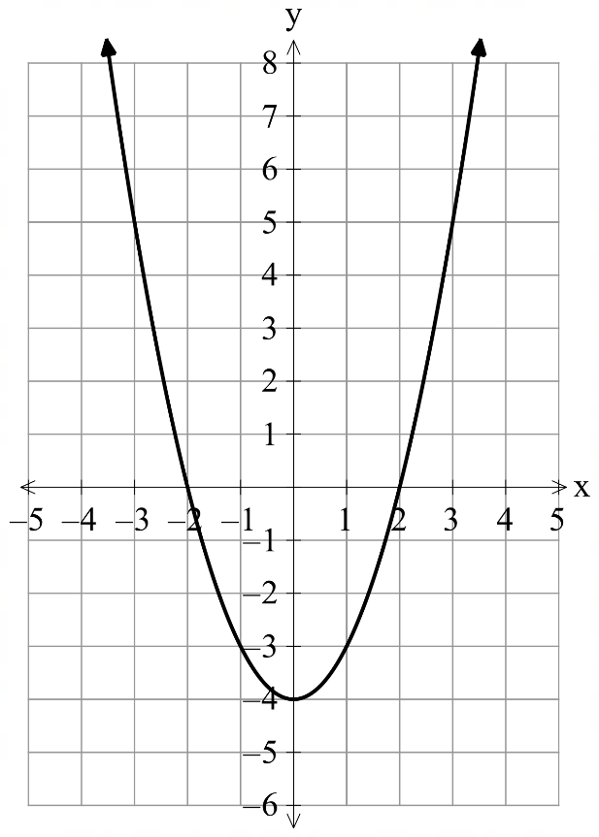
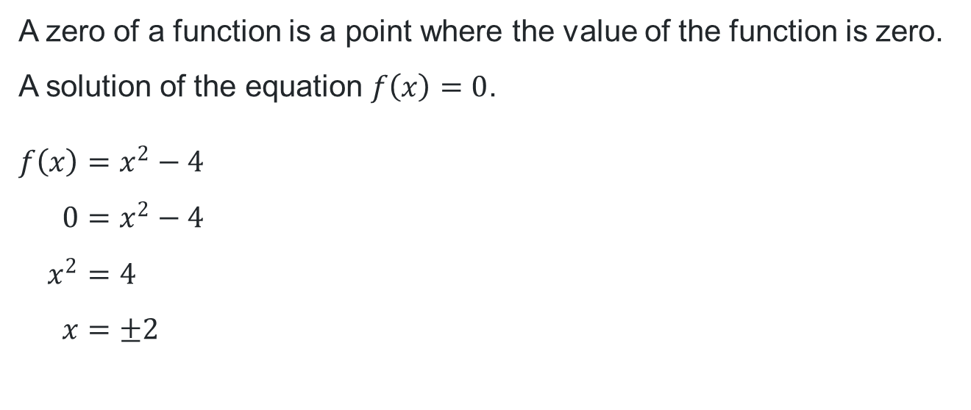

Zeroes of a function
$$f\left(x\right)=x^{2}−4$$
A zero of a function is a point where the value of the function is zero. A solution of the equation $f\left(x\right)=0$.
$$f\left(x\right)=x^{2}−4 \\ 0=x^{2}−4 \\ x^{2}=4 \\ x=±2$$

Slide 12
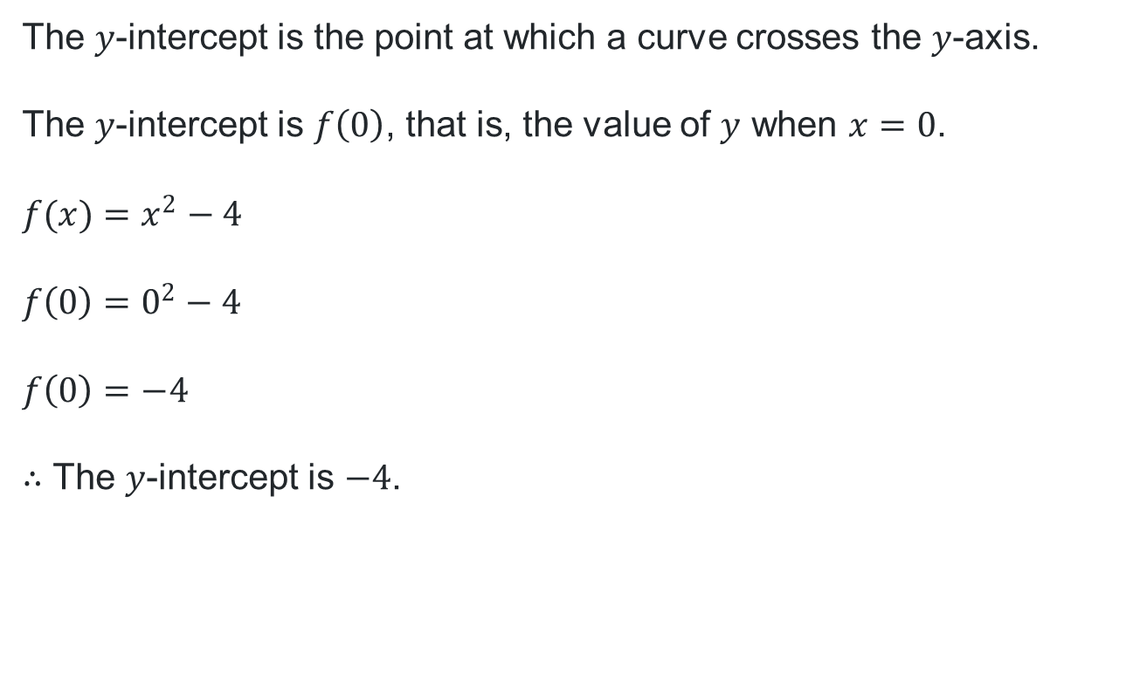
$y$-intercept
$$f\left(x\right)=x^{2}−4$$
The $y$-intercept is the point at which a curve crosses the $y$-axis.
The $y$-intercept is $f\left(0\right)$, that is, the value of $y$ when $x=0$.
$$f(x)=x^{2}−4$$
$$f\left(0\right)=0^{2}−4$$
$$f\left(0\right)=−4$$
$∴$ The $y$-intercept is $−4$.

Slide 13
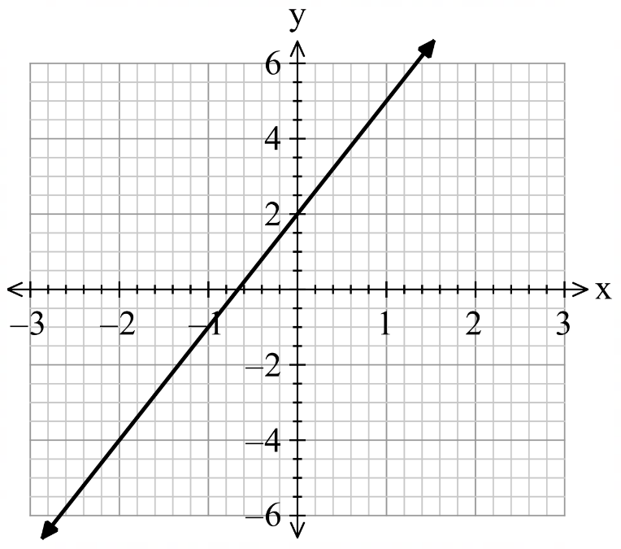
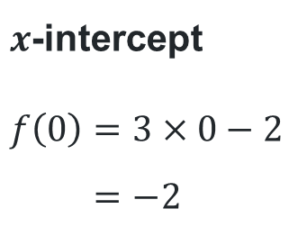
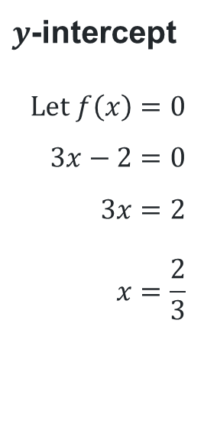
Graphing functions (1)
Worked example 1
For the function $f\left(x\right)=3x−2$, find $f(0)$ and the zero of the function, then use these to graph the function.
How do you know what type of graph this function will be?
$x$-intercept
$$f\left(0\right)=3×0−2 \\ =−2$$
$y$-intercept
$$Let f\left(x\right)=0 \\ 3x−2=0 \\ 3x=2 \\ x=\frac{2}{3}$$
What might this represent on the graph?
Where is the zero of the function on the graph?

Slide 14
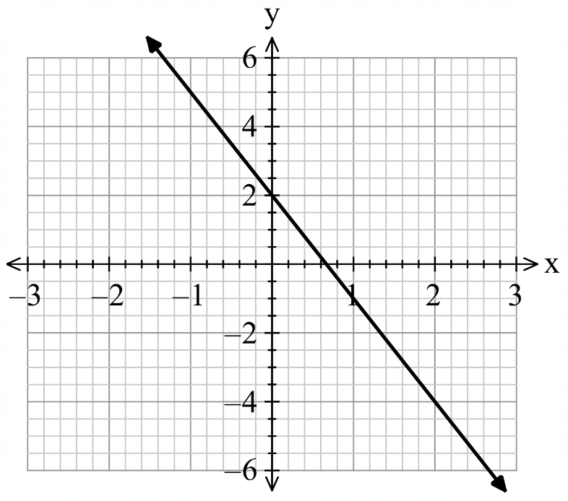
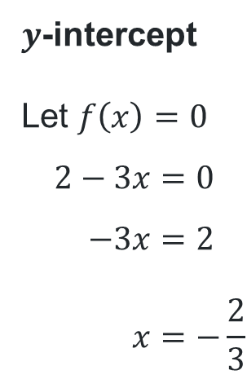
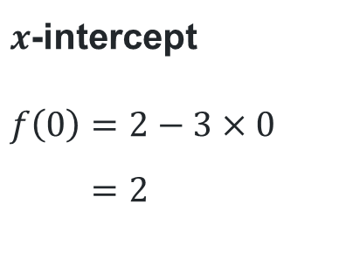
Graphing functions (2)
Your turn – question 1
For the function $f\left(x\right)=2−3x$, find $f(0)$ and the zero of the function, then use these to graph the function.
$x$-intercept
$$f\left(0\right)=2−3×0 \\ =2$$
$y$-intercept
Let $f\left(x\right)=0$
$$2−3x=0 \\ −3x=2 \\ x=−\frac{2}{3}$$

Slide 15
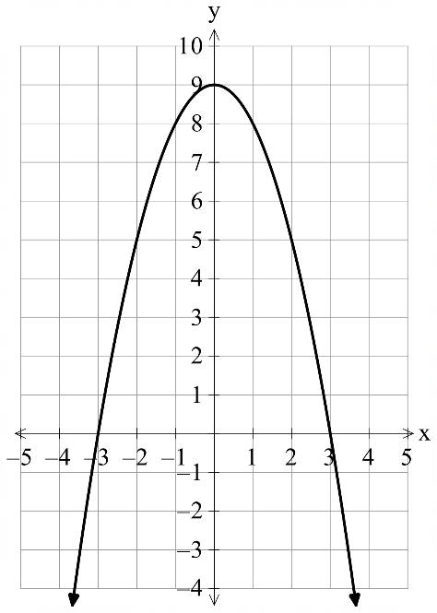
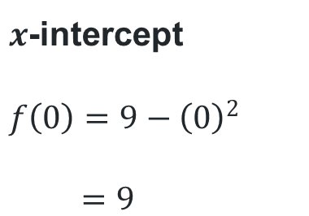
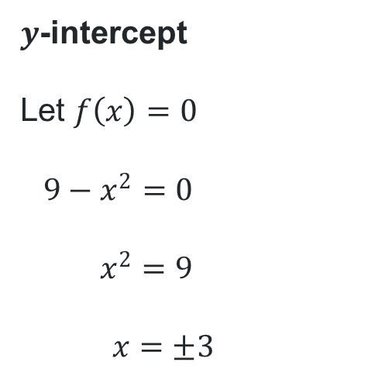
Graphing functions (3)
Worked example 2
For the function $f\left(x\right)=9−x^{2}$, find $f(0)$ and the zero(es) of the function, then use these to graph the function.
What type of graph will this function be? How do you know?
$x$-intercept
$$f\left(0\right)=9−{\left(0\right)}^{2}$$
$$=9$$
$y$-intercept
Let $f\left(x\right)=0$
$$9−x^{2}=0$$
$$x^{2}=9$$
$$x=±3$$
Where on the graph are the zeroes of the function?
What does this represent on the graph?

Slide 16
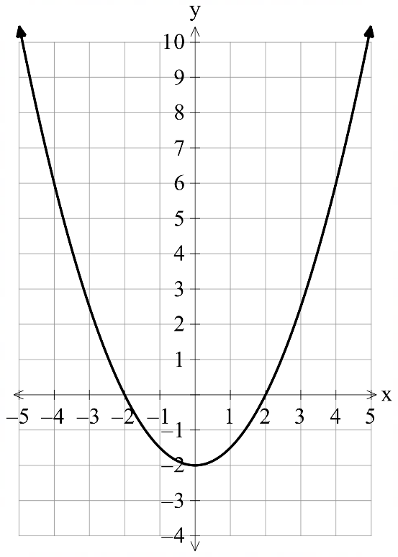
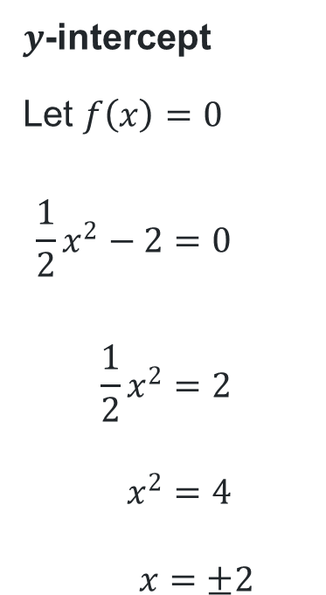
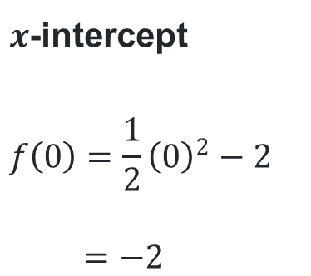
Graphing functions (4)
Your turn – question 2
For the function $f\left(x\right)=\frac{1}{2}x^{2}−2$, find $f(0)$ and the zero(es) of the function, then use these to graph the function.
$x$-intercept
$$f\left(0\right)=\frac{1}{2}{\left(0\right)}^{2}−2$$
$$=−2$$
$y$-intercept
Let $f\left(x\right)=0$
$$\frac{1}{2}x^{2}−2=0$$
$${\frac{1}{2}x}^{2}=2$$
$$x^{2}=4$$
$$x=±2$$

Slide 17
Independent practice

Slide 18





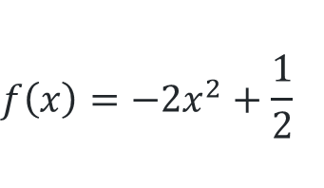

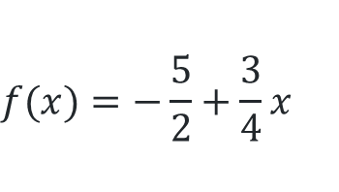
Working backwards from the graph
Bank of equations
$$f\left(x\right)=4−\frac{1}{2}$$
$$f(x)=3^{x}$$
$$f(x)=\frac{1}{4}x^{2}−1$$
$$f\left(x\right)=−2x^{2}+\frac{1}{2}$$
$$f\left(x\right)=3+2x$$
$$f(x)={−3}^{x}$$
$$f(x)=2x^{2}−8$$
$$f(x)=−\frac{5}{2}+\frac{3}{4}x$$

Slide 19
References
This presentation contains NSW Curriculum and syllabus content. The NSW Curriculum is developed by the NSW Education Standards Authority. This content is prepared by NESA for and on behalf of the Crown in the right of the State of New South Wales. The material is protected by Crown copyright.
Please refer to the NESA Copyright Disclaimer for more information https://educationstandards.nsw.edu.au/wps/portal/nesa/mini-footer/copyright.
NESA holds the only official and up-to-date versions of the NSW Curriculum and syllabus documents. Please visit the NSW Education Standards Authority (NESA) website https://educationstandards.nsw.edu.au/wps/portal/nesa/home and the NSW Curriculum website https://curriculum.nsw.edu.au.
Mathematics Advanced 11-12 Syllabus © NSW Education Standards Authority (NESA) for and on behalf of the Crown in right of the State of New South Wales, 2024.

Slide 20
Copyright
© State of New South Wales (Department of Education), 2025
The copyright material published in this resource is subject to the Copyright Act 1968 (Cth) and is owned by the NSW Department of Education or, where indicated, by a party other than the NSW Department of Education (third-party material).
Copyright material available in this resource and owned by the NSW Department of Education is licensed under a Creative Commons Attribution 4.0 International (CC BY 4.0) license.
This license allows you to share and adapt the material for any purpose, even commercially.
Attribution should be given to © State of New South Wales (Department of Education), 2025.
Material in this resource not available under a Creative Commons license:
the NSW Department of Education logo, other logos and trademark-protected material
Material owned by a third party that has been reproduced with permission. You will need to obtain permission from the third party to reuse its material.
Links to third-party material and websites
Please note that the provided (reading/viewing material/list/links/texts) are a suggestion only and implies no endorsement, by the New South Wales Department of Education, of any author, publisher, or book title. School principals and teachers are best placed to assess the suitability of resources that would complement the curriculum and reflect the needs and interests of their students.
If you use the links provided in this document to access a third-party’s website, you acknowledge that the terms of use, including licence terms set out on the third-party’s website apply to the use which may be made of the materials on that third-party website or where permitted by the Copyright Act 1968 (Cth). The department accepts no responsibility for content on third-party websites.

