Slide 1
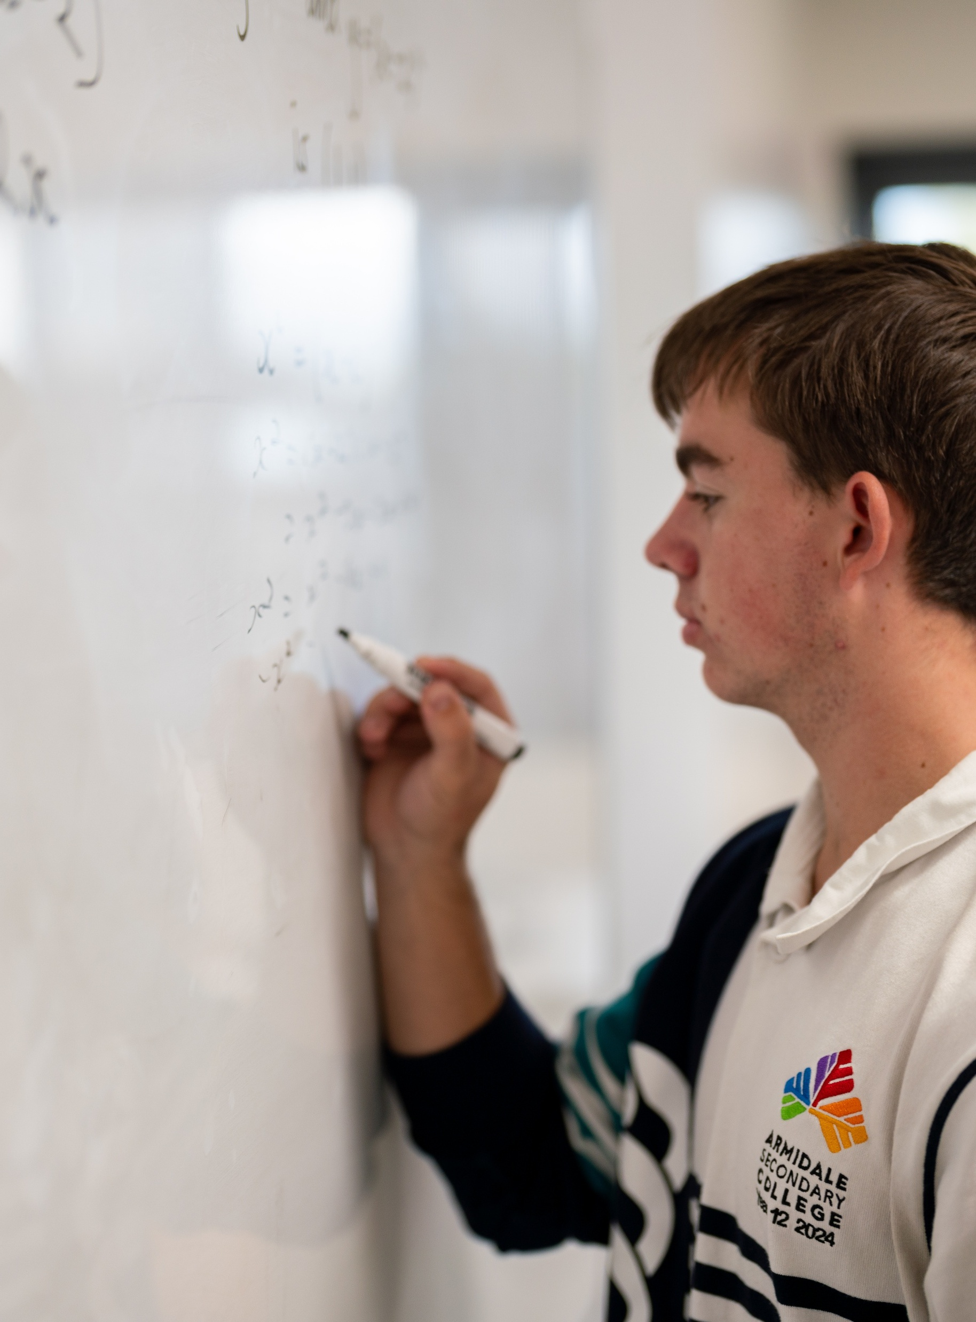
Differentiating cosecant, secant and cotangent functions
Mathematics Advanced – Stage 6 (Year 12)
Further differentiation, modelling and graphing

Slide 2
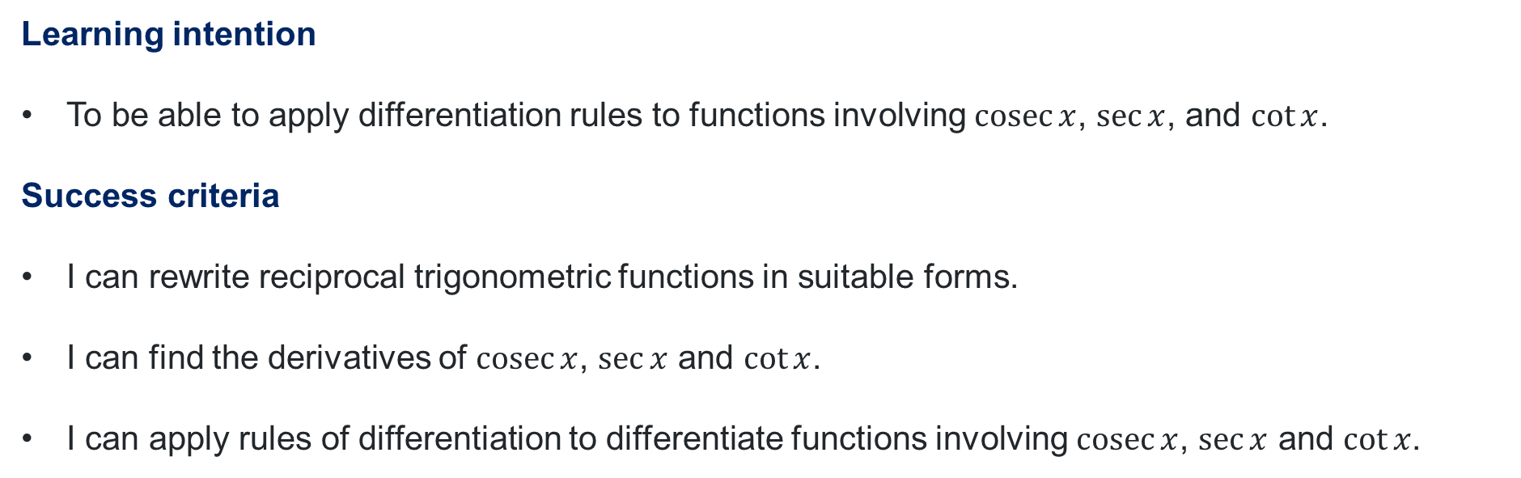
Learning intentions and success criteria
Learning intention
To be able to apply differentiation rules to functions involving $\operatorname{cosec}{x}$, $\sec{x}$, and $\cot{x}$.
Success criteria
I can rewrite reciprocal trigonometric functions in suitable forms.
I can find the derivatives of $\operatorname{cosec}{x}$, $\sec{x}$ and $\cot{x}$.
I can apply rules of differentiation to differentiate functions involving $\operatorname{cosec}{x}$, $\sec{x}$ and $\cot{x}$.

Slide 3
Activating prior knowledge

Slide 4
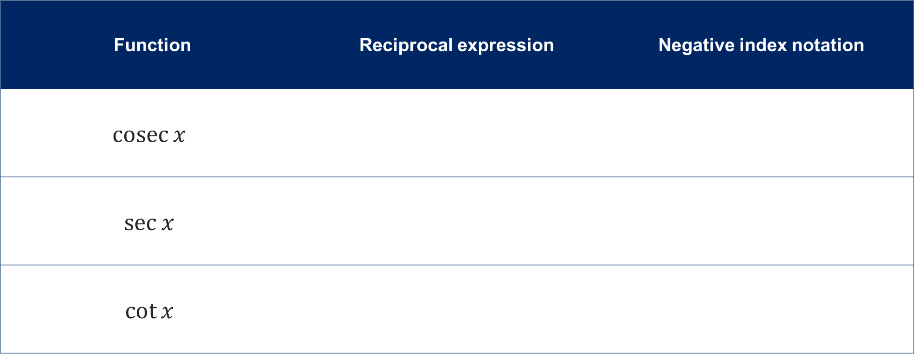
Reciprocal trigonometric functions (1)
Function | Reciprocal expression | Negative index notation
$$\operatorname{cosec}{x}$$
$$\sec{x}$$
$$\cot{x}$$

Slide 5
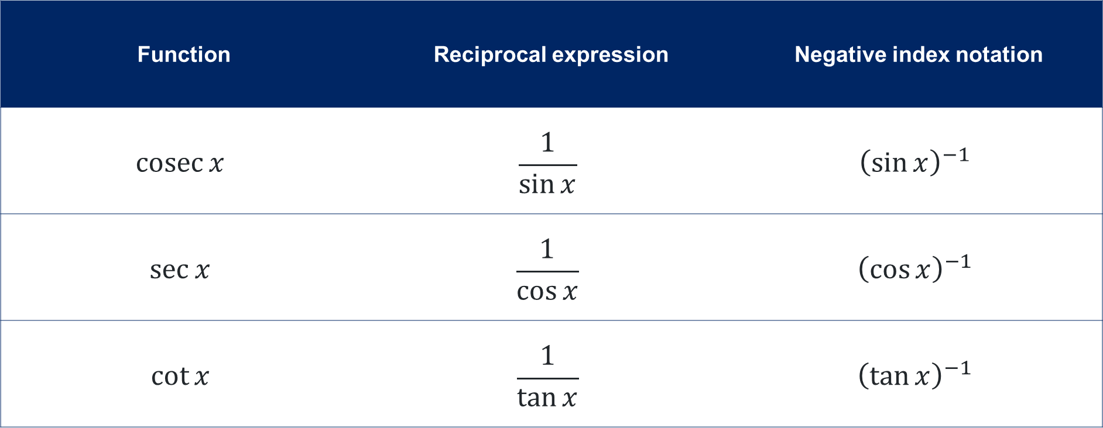
Reciprocal trigonometric functions (2)
Function | Reciprocal expression | Negative index notation
$$\operatorname{cosec}{x}$$ | $$\frac{1}{\sin{x}}$$ | $${\left(\sin{x}\right)}^{−1}$$
$$\sec{x}$$ | $$\frac{1}{\cos{x}}$$ | $${\left(\cos{x}\right)}^{−1}$$
$$\cot{x}$$ | $$\frac{1}{\tan{x}}$$ | $${\left(\tan{x}\right)}^{−1}$$

Slide 6
Releasing responsibility

Slide 7
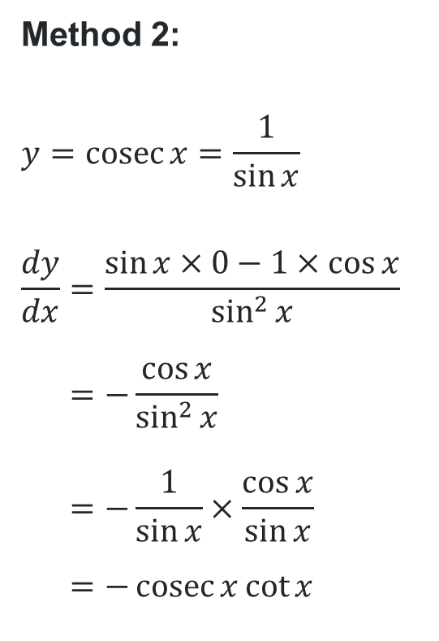
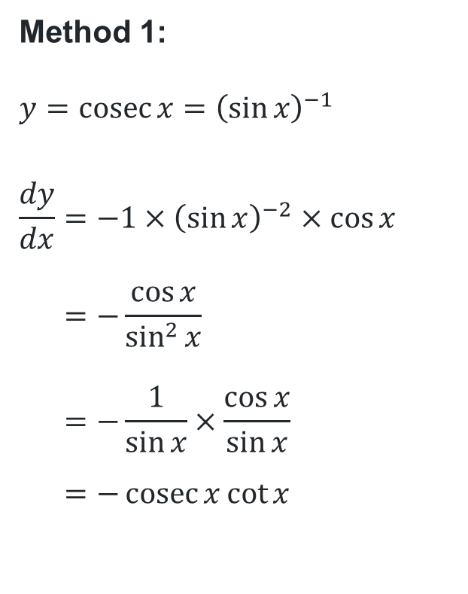
Differentiating cosecant
Worked example comparison
Method 1:
$$y=\operatorname{cosec}{x}={\left(\sin{x}\right)}^{−1}$$
$$\frac{dy}{dx}=−1×{\left(\sin{x}\right)}^{−2}×\cos{x} \\ =−\frac{\cos{x}}{\sin^{2}{x}} \\ =−\frac{1}{\sin{x}}×\frac{\cos{x}}{\sin{x}} \\ =−\operatorname{cosec}{x}\cot{x}$$
What is the main difference between the 2 methods in how we set up and apply rules for differentiation?
Method 2:
$$y=\operatorname{cosec}{x}=\frac{1}{\sin{x}}$$
$$\frac{dy}{dx}=\frac{\sin{x}×0−1×\cos{x}}{\sin^{2}{x}} \\ =−\frac{\cos{x}}{\sin^{2}{x}} \\ =−\frac{1}{\sin{x}}×\frac{\cos{x}}{\sin{x}} \\ =−\operatorname{cosec}{x}\cot{x}$$
What similarities do you notice in the steps?
Do both methods give the same final answer?

Slide 8

Derivatives of the reciprocal trigonometric functions
$$y=\operatorname{cosec}{x}, \frac{dy}{dx}=−\operatorname{cosec}{x}\cot{x}$$
$$y=\sec{x}, \frac{dy}{dx}=\sec{x}\tan{x}$$
$$y=\cot{x}, \frac{dy}{dx}=−{cosec}^{2}{x}$$

Slide 9
References
This presentation contains NSW Curriculum and syllabus content. The NSW Curriculum is developed by the NSW Education Standards Authority. This content is prepared by NESA for and on behalf of the Crown in the right of the State of New South Wales. The material is protected by Crown copyright.
Please refer to the NESA Copyright Disclaimer for more information https://www.nsw.gov.au/education-and-training/nesa/copyright.
NESA holds the only official and up-to-date versions of the NSW Curriculum and syllabus documents. Please visit NESA https://www.nsw.gov.au/education-and-training/nesa and NSW Curriculum https://curriculum.nsw.edu.au.
Mathematics Advanced 11-12 Syllabus © NSW Education Standards Authority (NESA) for and on behalf of the Crown in right of the State of New South Wales, 2024.

Slide 10
Copyright
© State of New South Wales (Department of Education), 2026
The copyright material published in this resource is subject to the Copyright Act 1968 (Cth) and is owned by the NSW Department of Education or, where indicated, by a party other than the NSW Department of Education (third-party material).
Copyright material available in this resource and owned by the NSW Department of Education is licensed under a Creative Commons Attribution 4.0 International (CC BY 4.0) license.
This license allows you to share and adapt the material for any purpose, even commercially.
Attribution should be given to © State of New South Wales (Department of Education), 2026.
Material in this resource not available under a Creative Commons license:
the NSW Department of Education logo, other logos and trademark-protected material
Material owned by a third party that has been reproduced with permission. You will need to obtain permission from the third party to reuse its material.
Links to third-party material and websites
Please note that the provided (reading/viewing material/list/links/texts) are a suggestion only and implies no endorsement, by the New South Wales Department of Education, of any author, publisher, or book title. School principals and teachers are best placed to assess the suitability of resources that would complement the curriculum and reflect the needs and interests of their students.
If you use the links provided in this document to access a third-party’s website, you acknowledge that the terms of use, including licence terms set out on the third-party’s website apply to the use which may be made of the materials on that third-party website or where permitted by the Copyright Act 1968 (Cth). The department accepts no responsibility for content on third-party websites.

